Slide 1
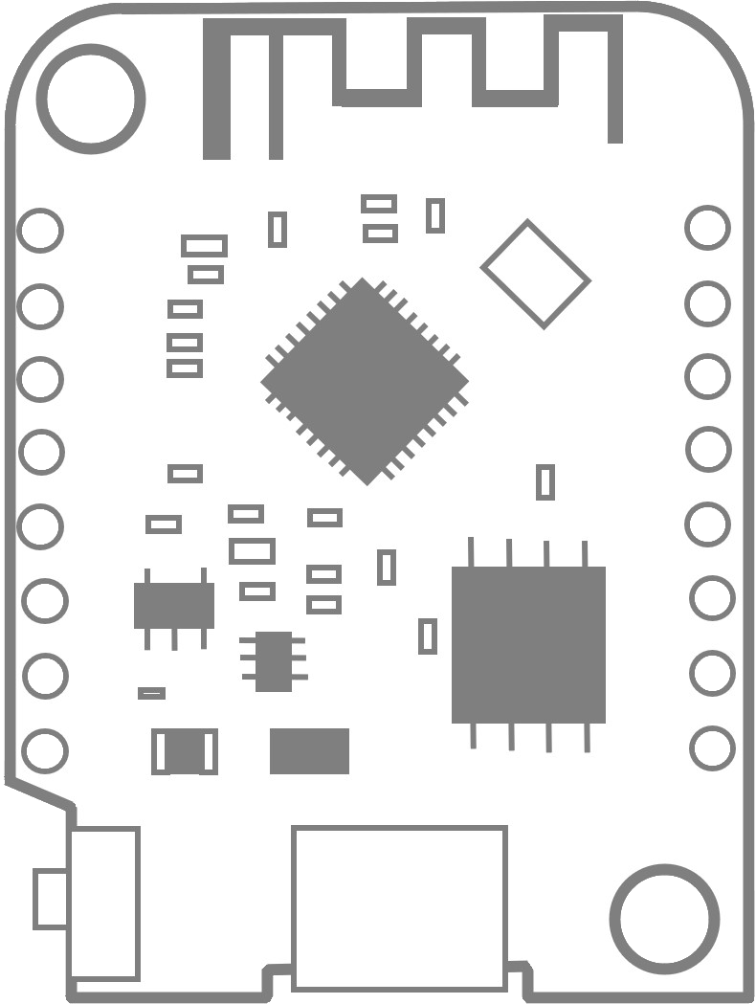
RST
TX
3V3 Max
A0
RX
16/D0
5/D1
SCL
SCK
14/D5
4/D2
SDA
MISO
12/D6
0/D3
10K Pull Up
MOSI
13/D7
2/D4
LED
10K Pull Up
10K Pull Down
SS
15/D8
GND
3V3
5V

