Slide 1
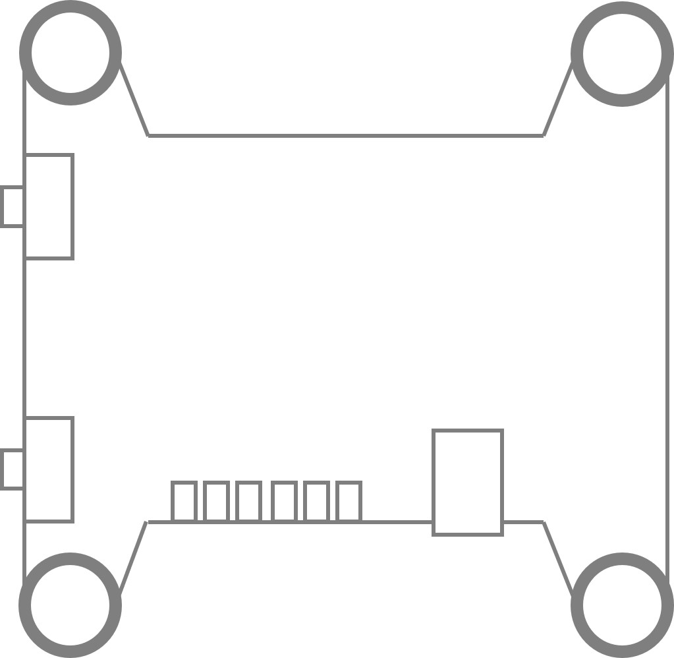
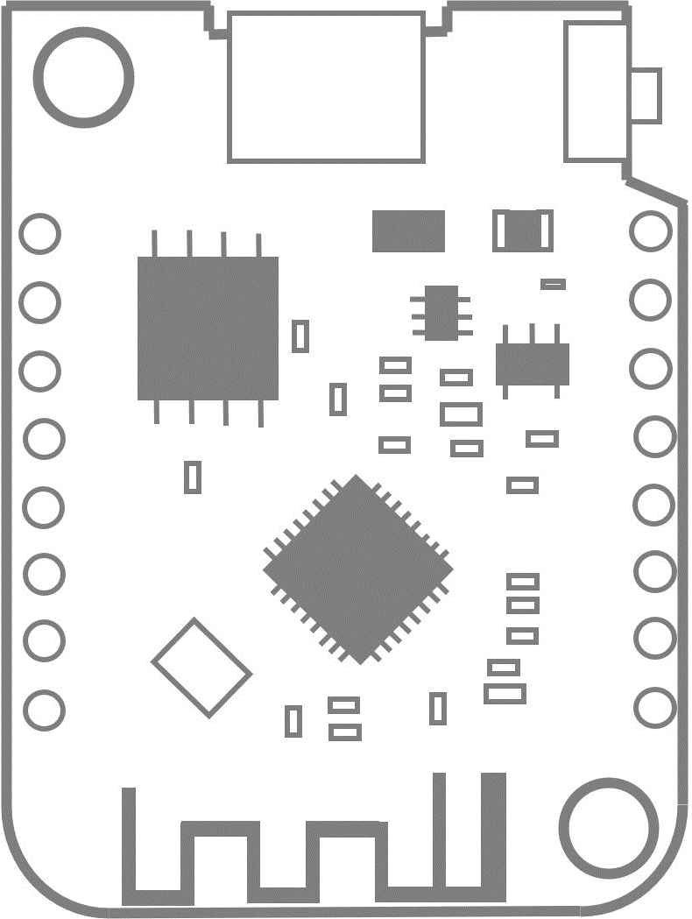
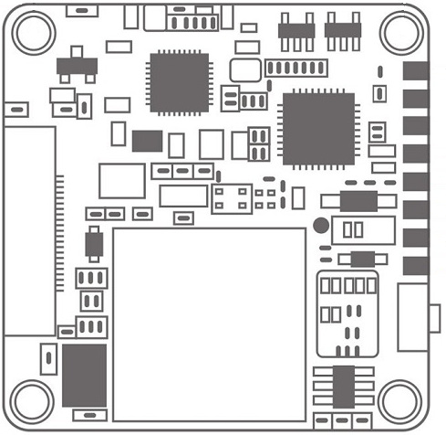
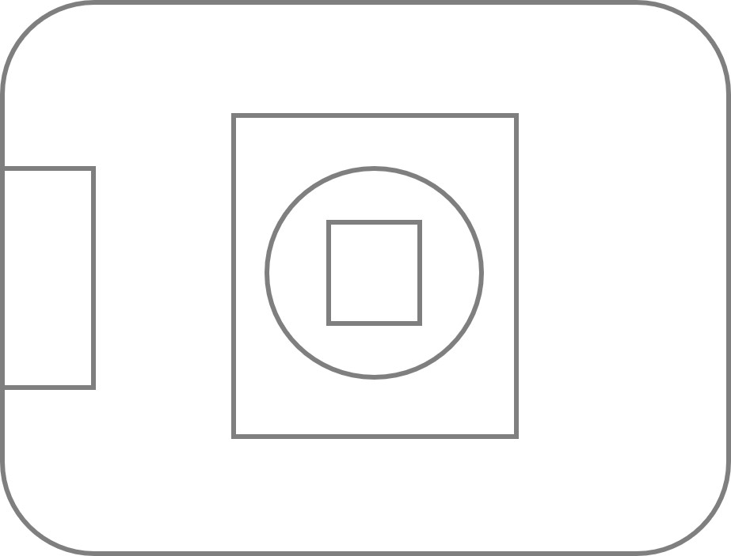
GND
WEMOS D1 mini
5V
Video transmitter
5V
GND
Drone
D2
GND
D1
12V
VIDEO
Wifi Link
TX
RX
5Keys pad
Menu
Caddx Loris
GND

Slide 2
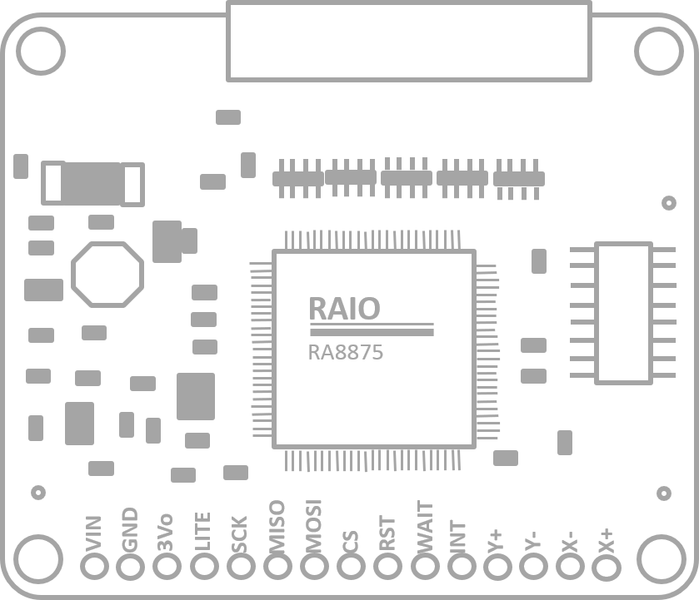
Touch Screen
5V
GND
Wifi Link

Slide 3
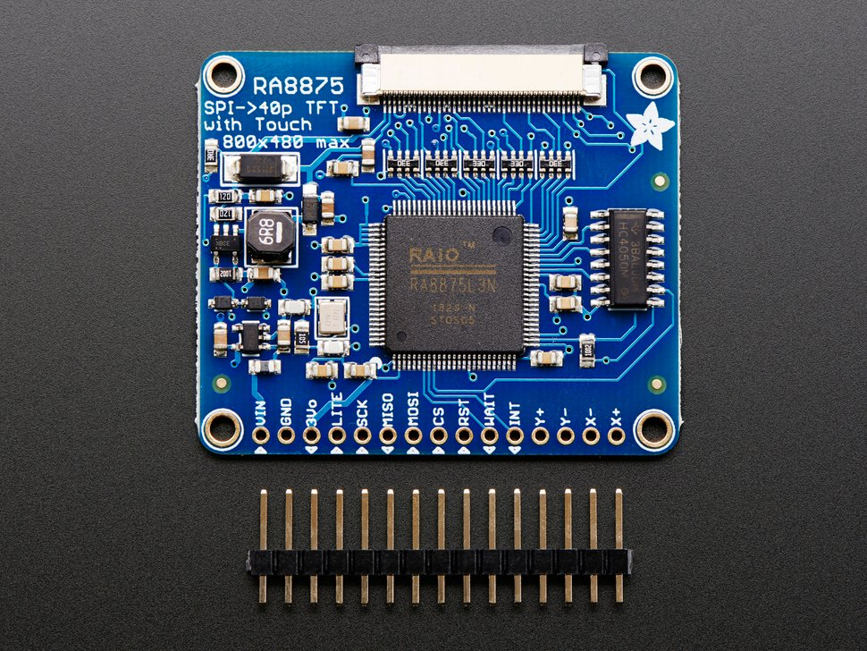
RAIO
RA8875
MOSI
GND
LITE
MISO
WAIT
VIN
3Vo
SCK
CS
RST
INT
Y+
Y-
X-
X+

Slide 4
MANUAL
DISCONNECTED
READY
RECORDING
MENU

Slide 5
[0123456789ABCDEFGHIJKLMNOPQRSTUVWXYZ]
Voltage
Time
Reset
Exit
Save and Exit
Resolution
Loop video
Auto recording
Save and Exit
Exposure
Metering mode
FOV
Screen Flip
Light Frequency
Save and Exit
OSD Setting
Video
Camera Settings
Image Effect
TV System
System Setting
TV ratio
Save and Exit
Saturation
Sharpness
Contrast
Bright
Reset
Save and Exit
Auto boot
Language
SD Card Info
Format SD Cards
System info
Factory Reset
Save and Exit
Yes
No

