Slide 1

MAHARAJA’S TECHNOLOGICAL INSTITUTE, GOVERNMENT POLYTECHNIC COLLEGE THRISSUR - 680 020
ZERO TRUST SECURITY
Submitted By:
MELWIN JOSHY
Register No: 2201133041
Department of Computer Engineering 2024-2025
Department of Computer Engineering

Slide 2
MAHARAJA’S TECHNOLOGICAL INSTITUTE, GOVERNMENT POLYTECHNIC COLLEGE THRISSUR - 680 020
COMPUTER ENGINEERING
CERTIFICATE
This is to certify that the seminar entitled “ZERO TRUST SECURITY” is submitted by MELWIN JOSHY bearing Reg_No. 2201133041 in partial fulfilment of the requirement for the award of the Diploma in Computer Engineering of State Board of Technical Examinations, Kerala for the academic year 2024-2025.
LECT. IN CHARGE
HEAD OF THE DEPARTMENT
EXTERNAL EXAMINER
INTERNAL EXAMINER
Department of Computer Engineering

Slide 3
ACKNOWLEDGEMENT
First of all, I am indebted to the GOD ALMIGHTY for giving me an opportunity to excel in my efforts to complete this seminar on time.
I am extremely grateful to Mrs. THAJBI P M, Head of Department, Department of Computer Engineering, for providing all the required resources for the successful completion of my seminar.
My heartfelt gratitude to my seminar guide Mrs.THAJBI P.M, Head Of Department & Mrs. Maya U.C Lecturer, Department of Computer Engineering, for these valuable suggestions and guidance in the preparation of the seminar report.
I will be failing in duty if I do not acknowledge with grateful thanks the authors of the references and other literature referred to in this seminar. Last but not the least,
I am very much thankful to my parents who guides me in every steps that I took
Department of Computer Engineering

Slide 4
ABSTRACT
Zero Trust Architecture (ZTA) has emerged as a transformative approach to cybersecurity, fundamentally changing how organizations protect their digital assets. Unlike traditional security models that rely on perimeter defenses, ZTA operates on the principle that no entity, whether inside or outside the network, should be implicitly trusted. This paradigm shift is crucial in today's landscape, where cloud computing, mobile devices, and the Internet of Things (IoT) have eroded traditional network boundaries. ZTA enforces strict access controls, continuous monitoring, and verification of all users and devices attempting to access network resources, thus minimizing potential security risks.
The implementation of Zero Trust principles involves several key strategies. Central to these is the concept of "never trust, always verify," which requires continuous authentication and authorization for every access request. Additionally, micro-segmentation is used to break down security perimeters into smaller, isolated zones to prevent lateral movement of threats within the network. Advanced encryption techniques are employed to protect data both in transit and at rest. Real-time monitoring and analytics play a crucial role in detecting and responding to anomalies, ensuring that any potential breaches are quickly identified and mitigated.
Moreover, the Zero Trust by Design extends these principles beyond network security to encompass the entire software development lifecycle. By integrating Zero Trust tenets into software engineering and protocol design, organizations can create inherently secure systems from the ground up. This holistic approach ensures that security is not an afterthought but a foundational element of system architecture. Zero trust architecture provides a set of best practices and reusable patterns that address common security challenges, promoting a more resilient and robust security posture.
In light of increasing cybersecurity threats, such as sophisticated supply chain attacks and the widespread shift to remote work, the adoption of Zero Trust strategies has become more critical than ever. This seminar will dive into the core principles of Zero Trust Architecture, exploring practical implementation strategies and real-world case studies. By fostering a deeper understanding of Zero Trust Security and it's Architecture.
Department of Computer Engineering

Slide 5
SERIAL NO. |  | TOPIC | PAGE NO.
 |  |  | 12-14
1.
2.
INTRODUCTION
Cyber security
Cyber security models
6-11
7
8-11
1.
1.
2.
ZERO TRUST SECURITY
2.
WHAT IS ZERO TRUST SECURITY?
PRINCIPLES OF ZERO TRUST SECURITY
12
13-14
3.
ZERO TRUST SECURITY ARCHITECTURE
15-17
4.
APPLICATION OF ZERO TRUST SECURITY MODEL
18
5.
ADVANTAGES OF ZERO TRUST SECURITY
19-20
6.
DISADVANTAGES OF ZERO TRUST SECURITY
21
7.
FUTURE SCOPE
22
8.
CONCLUSION
23
REFERENCES
24
Department of Computer Engineering

Slide 6
1.INTRODUCTION
In the modern era of distributed computing, there have been many advances in the adoption and implementation of networked security systems for cloud servers. Since 2010, the global cloud services industry has had a year-on-year increase which sums up-to a USD 370 billion valuation in 2020, posting a 380 percent growth in a decade. As a consequence of such breakneck adoption in 2022, over 60 percent of all corporate data is stored in the cloud. This complex enterprise has led to the development of a new model for cybersecurity known as “zero trust” (ZT). A Zero Trust approach is primarily focused on data and service protection but can and should be expanded to include all enterprise assets (devices, infrastructure components, applications, virtual and cloud components) and subjects (end users, applications and other nonhuman entities that request information from resources).
Zero trust security models assume that an attacker is present in the environment and that an enterprise-owned environment is no different—or no more trustworthy—than any nonenterprise-owned environment. In this new paradigm, an enterprise must assume no implicit trust and continually analyze and evaluate the risks to its assets and business functions and then enact protections to mitigate these risks. In zero trust, these protections usually involve minimizing access to resources (such as data and compute resources and applications/services) to only those subjects and assets identified as needing access as well as continually authenticating and authorizing the identity and security posture of each access request..
A zero trust architecture (ZTA) is an enterprise cybersecurity architecture that is based on zero trust principles and designed to prevent data breaches and limit internal lateral movement. ZT is not a single architecture but a set of guiding principles for workflow, system design and operations that can be used to improve the security posture of any classification or sensitivity level [FIPS199]. Transitioning to ZTA is a journey concerning how an organization evaluates risk in its mission and cannot simply be accomplished with a wholesale replacement of technology. That said, many organizations already have elements of a ZTA in their enterprise infrastructure today. Organizations should seek to incrementally implement zero trust principles, process changes, and technology solutions that protect their data assets and business functions by use case. Most enterprise infrastructures will operate in a hybrid zero trust/perimeter-based mode while continuing to invest in IT modernization initiatives and improve organization business processes.
Department of Computer Engineering

Slide 7

1.1 CYBER SECURITY
Cybersecurity is the practice of protecting systems, networks, and programs from digital attacks. These attacks usually aim to access, change, or destroy sensitive information, extort money from users, or interrupt normal business processes. Implementing effective cybersecurity measures is challenging because there are more devices than people, and attackers are becoming more innovative. The importance of cybersecurity grows as we increasingly rely on digital infrastructure for everything from personal communications to critical infrastructure.
Cyber security covers a variety of vulnerabilities that occurs when a user is scouring through the network. Some of the key components are:
Network Security : Protects the integrity, confidentiality, and availability of data as it is transmitted across or accessed through networks. Measures include firewalls, intrusion detection systems (IDS), and virtual private networks (VPNs).
Application Security : Ensures that software and applications are secure from threats during the development and deployment stages. This includes rigorous testing, coding best practices, and regular updates.
Information Security : Protects the data itself, both in transit and at rest, through encryption, access controls, and data masking.
Operational Security : Involves processes and decisions for handling and protecting data assets. This includes user permissions and the procedures that determine how and where data may be stored or shared.
Department of Computer Engineering

Slide 8
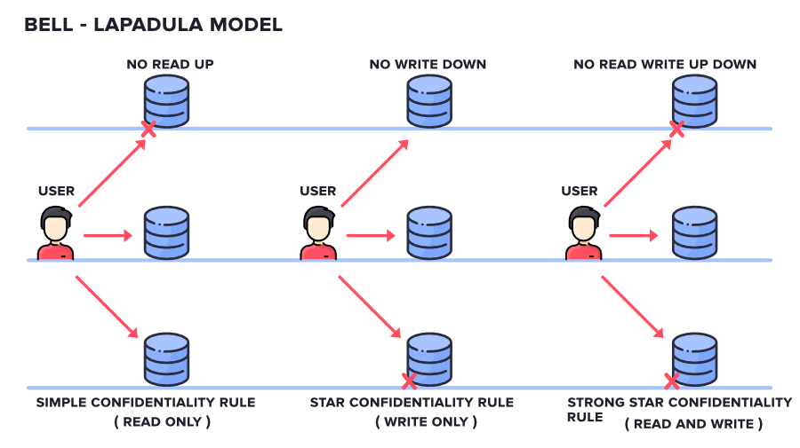
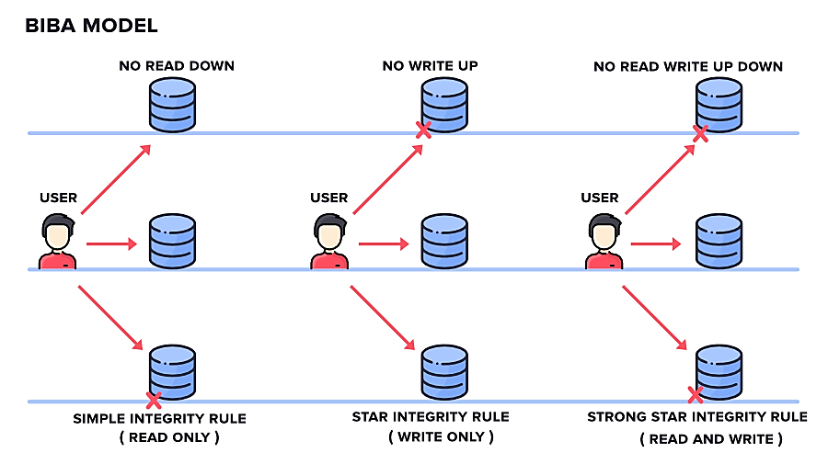
1.2 CYBER SECURITY MODELS
There are several security models used in cybersecurity to protect data and systems.
These include:
Bell-LaPadula Model : This model is used to enforce access control in government and military applications. It focuses on data confidentiality and controlled access to classified information. The model uses security labels on data and rules to ensure that information can only flow in ways that preserve confidentiality. Users can read data at or below their security level (no read up) and write data at or above their security level (no write down).
Biba Model : This model is designed to maintain data integrity. It prevents data from being modified by unauthorized users and ensures that data flows correctly from one level to another. The Biba Model uses a set of rules opposite to Bell-LaPadula, focusing on preventing unauthorized modification of data. Users can write data only at or below their integrity level (no write up) and read data at or above their integrity level (no read down).
Department of Computer Engineering

Slide 9
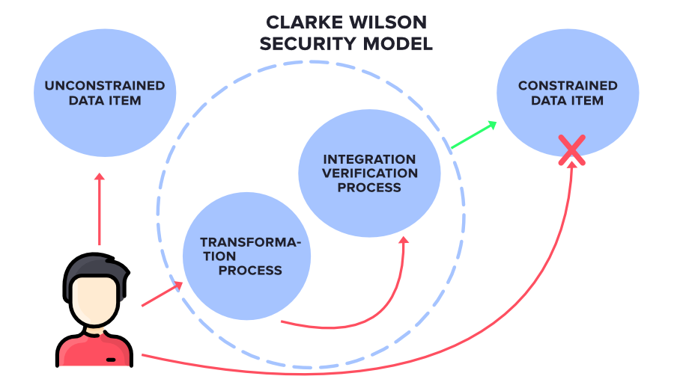
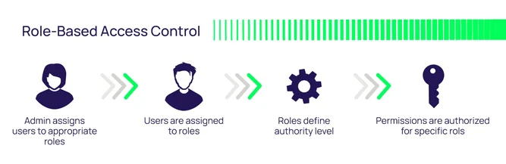
Clark-Wilson Model : This model ensures that data is modified only in authorized ways and by authorized users. It focuses on enforcing well-formed transactions and separation of duties. The model uses constrained data items (CDIs) that can only be manipulated by a set of well-defined programs, ensuring that all changes are legitimate and authorized. This prevents both accidental and malicious changes to data.
Role-Based Access Control (RBAC) : This model assigns access permissions based on roles within an organization, rather than individuals. It simplifies the management of permissions and enhances security by ensuring that users have only the access necessary to perform their duties. Roles are created for various job functions, and permissions to perform certain operations are assigned to these roles. Users are then assigned roles, gaining the associated permissions.
Department of Computer Engineering

Slide 10
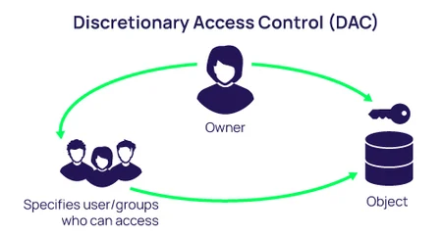
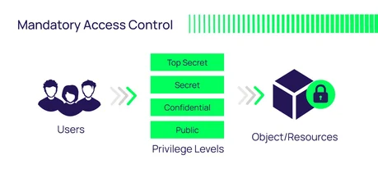
Discretionary Access Control (DAC) : This model allows data owners to decide who can access their data. It is flexible but can be less secure if owners are not careful. In DAC, access rights are granted based on the identity of the user and at the discretion of the data owner. This model is commonly used in operating systems and applications but requires careful management to prevent unauthorized access.
Mandatory Access Control (MAC) : This model uses a central authority to manage access rights based on multiple levels of security. It is often used in environments that require high security. MAC policies classify all users and resources, and access decisions are made based on these classifications. Users cannot change access controls, which ensures a high level of security but can be less flexible than DAC.
Department of Computer Engineering

Slide 11
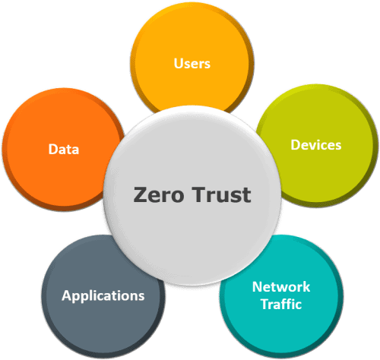
Zero Trust Model : The Zero Trust Model is based on the principle of never trusting and always verifying. It assumes that threats could be both external and internal, and it requires strict identity verification for every person and device trying to access resources on a private network. This model emphasizes continuous monitoring and validation of user and device identity, as well as strict access controls and micro-segmentation to limit lateral movement within the network.
Department of Computer Engineering

Slide 12

2.1. What is ”zero trust security”?
Zero Trust Security is a cybersecurity model that fundamentally changes the traditional approach to network security. Instead of assuming that everything inside an organization's network is trustworthy, Zero Trust operates on the principle of "never trust, always verify." Unlike traditional security models that assume everything inside an organization's network is trustworthy, Zero Trust requires continuous verification of every user, device, and application attempting to access resources. This approach minimizes the risk of unauthorized access and lateral movement within the network by enforcing strict access controls and assuming that threats could be both external and internal.
The architecture of Zero Trust Security involves several key components, including Identity and Access Management (IAM), micro-segmentation, continuous monitoring, and robust data encryption. IAM ensures that only authenticated and authorized users and devices can access specific resources, while micro-segmentation divides the network into smaller, isolated zones to contain potential breaches. Continuous monitoring and advanced analytics enable real-time detection of anomalies and threats, allowing for proactive responses. Data encryption protects sensitive information both at rest and in transit, further safeguarding against data breaches.
Implementing Zero Trust Security in cloud environments presents unique challenges and opportunities. Cloud-native security tools, such as Cloud Access Security Brokers (CASBs) and identity-centric controls, are essential for enforcing Zero Trust principles in the cloud. By integrating security into the DevOps pipeline and ensuring consistent policies across hybrid and multi-cloud environments, organizations can achieve enhanced security, scalability, and visibility. Despite the complexity and resource requirements, the Zero Trust model offers a robust framework for mitigating modern cybersecurity threats and protecting critical assets.
2. ZERO TRUST SECURITY
Department of Computer Engineering

Slide 13
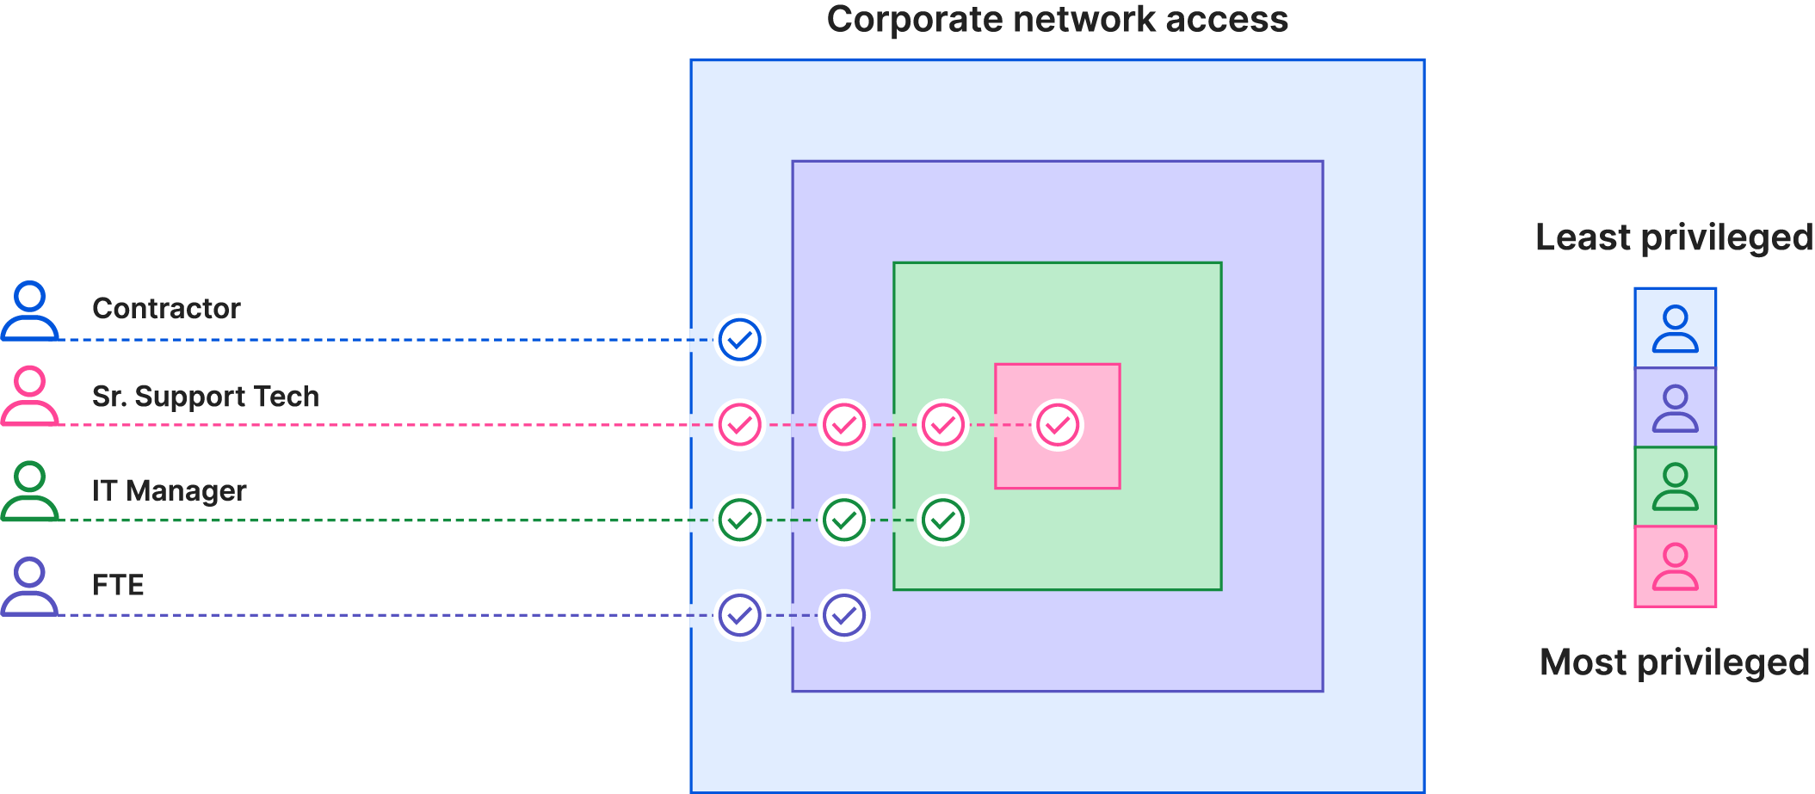
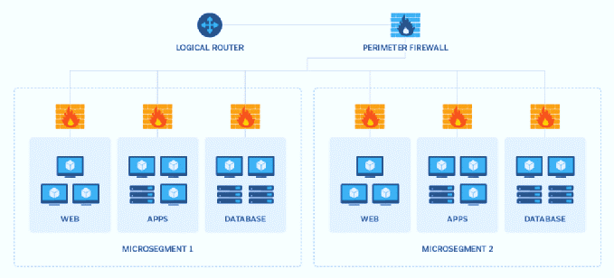
2.2 . PRINCIPLES OF ZERO TRUST SECURITY
Least Privilege Access : In a Zero Trust Security model, the principle of least privilege ensures that users and devices are granted only the minimum level of access necessary to perform their specific tasks. This approach significantly reduces the attack surface by limiting the number of resources any given user or device can access. By minimizing unnecessary access privileges, organizations can prevent the spread of malicious activities within their network, thereby reducing the potential impact of breaches. This principle is enforced through meticulous access control policies and regular audits to ensure that permissions are always aligned with current roles and responsibilities
Micro-Segmentation : Micro-segmentation is a core component of Zero Trust Security that involves dividing a network into smaller, isolated zones. Each zone is secured with its own set of access controls and policies, allowing for more granular control over traffic. This segmentation restricts lateral movement within the network, meaning that if a breach occurs, the attacker’s ability to move laterally and access other parts of the network is significantly hindered. Micro-segmentation can be implemented using various technologies, including virtual local area networks (VLANs), software-defined networking (SDN), and next-generation firewalls, all of which help to contain threats and protect sensitive data..
Department of Computer Engineering

Slide 14
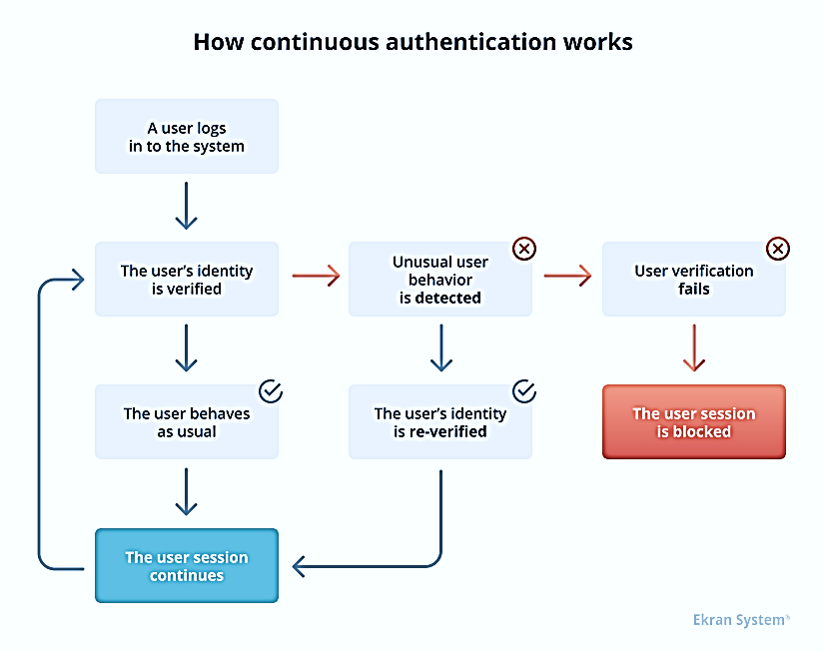
Continuous Authentication : Zero Trust Security requires continuous authentication and authorization, rather than one-time validation at the point of entry. This continuous process evaluates contextual factors such as user behavior, device posture, location, and network conditions to dynamically adjust access privileges in real-time. For instance, if a user’s behavior deviates from their typical patterns, or if a device shows signs of compromise, their access can be restricted or revoked immediately. Continuous authentication ensures that access decisions are always based on the most current risk assessments, enhancing the overall security posture of the organization..
Strict Policy Enforcement : Security policies are rigorously enforced across all network segments and endpoints, with no tolerance for deviations from established norms or suspicious behavior. This involves deploying advanced security tools and technologies to monitor and enforce policies consistently. Any suspicious behavior or policy violations are immediately flagged for investigation and response. By maintaining strict adherence to security policies, organizations can ensure that their defense mechanisms are robust and effective against potential threats.
Department of Computer Engineering

Slide 15
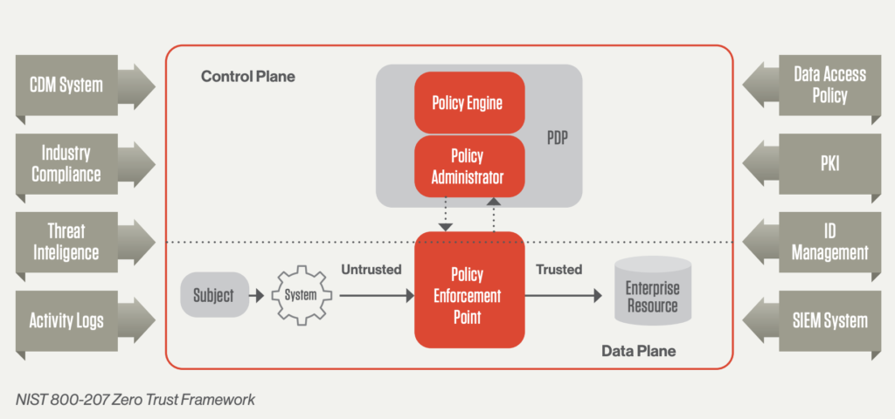
3. ZERO TRUST SECURITY ARCHITECTURE
The Zero trust architecture has several logical components they are :
Policy engine (PE) : This component is responsible for the ultimate decision to grant access to a resource for a given subject. The PE uses enterprise policy as well as input from external sources as input to a trust algorithm to grant, deny, or revoke access to the resource. The PE is paired with the policy administrator component. The policy engine makes and logs the decision (as approved, or denied), and the policy administrator executes the decision.
Policy administrator (PA) : This component is responsible for establishing and/or shutting down the communication path between a subject and a resource (via commands to relevant PEPs). It would generate any session-specific authentication and authentication token or credential used by a client to access an enterprise resource. It is closely tied to the PE and relies on its decision to ultimately allow or deny a session. If the session is authorized and the request authenticated, the PA configures the PEP to allow the session to start.
Policy enforcement point (PEP) : This system is responsible for enabling, monitoring, and eventually terminating connections between a subject and an enterprise resource. The PEP communicates with the PA to forward requests and/or receive policy updates from the PA. This is a single logical component in ZTA but may be broken into two different components: the client and resource side or a single portal component that acts as a gatekeeper for communication paths.
Department of Computer Engineering

Slide 16
Continuous diagnostics and mitigation (CDM) system : This gathers information about the enterprise asset’s current state and applies updates to configuration and software components. An enterprise CDM system provides the policy engine with the information about the asset making an access request, such as whether it is running the appropriate patched operating system (OS), the integrity of enterprise-approved software components or presence of non-approved components and whether the asset has any known vulnerabilities. CDM systems are also responsible for identifying and potentially enforcing a subset of polices on non-enterprise devices active on enterprise infrastructure..
Industry compliance system : This ensures that the enterprise remains compliant with any regulatory regime that it may fall under. This includes all the policy rules that an enterprise develops to ensure compliance.
Threat intelligence feed(s) : This provides information from internal or external sources that help the policy engine make access decisions. These could be multiple services that take data from internal and/or multiple external sources and provide information about newly discovered attacks or vulnerabilities. This also includes newly discovered flaws in software, newly identified malware, and reported attacks to other assets that the policy engine will want to deny access to from enterprise assets.
Network and system activity logs : This enterprise system aggregates asset logs, network traffic, resource access actions, and other events that provide real-time feedback on the security posture of enterprise information systems.
Data access policies : These are the attributes, rules, and policies about access to enterprise resources. This set of rules could be encoded in (via management interface) or dynamically generated by the policy engine. These policies are the starting point for authorizing access to a resource as they provide the basic access privileges for accounts and applications/services in the enterprise. These policies should be based on the defined mission roles and needs of the organization.
Enterprise public key infrastructure (PKI) : This system is responsible for generating and logging certificates issued by the enterprise to resources, subjects, services and applications. This also includes the global certificate authority ecosystem and the Federal PKI,4 which may or may not be integrated with the enterprise PKI.
Department of Computer Engineering

Slide 17
ID management system : This is responsible for creating, storing, and managing enterprise user accounts and identity records. This system contains the necessary subject information (e.g., name, email address, certificates) and other enterprise characteristics such as role, access attributes, and assigned assets. This system often utilizes other systems (such as a PKI) for artifacts associated with user accounts. This system may be part of a larger federated community and may include non-enterprise employees or links to non-enterprise assets for collaboration.
Security information and event management (SIEM) system : This collects security centric information for later analysis. This data is then used to refine policies and warn of possible attacks against enterprise assets.
Department of Computer Engineering

Slide 18
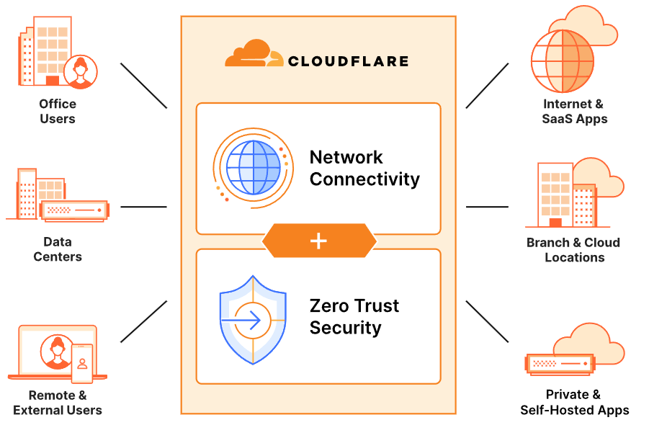
4 . APPLICATIONS OF ZERO TRUST SECURITY MODEL
Enterprise Networks : Zero Trust Security is widely applied in enterprise networks to protect sensitive data and critical business operations. By continuously verifying user identities, monitoring device compliance, and enforcing strict access controls, organizations can prevent unauthorized access and reduce the risk of data breaches. This model is particularly effective in protecting against insider threats, as it does not inherently trust any user or device, regardless of their location within the network.
Cloud Computing : Zero Trust is especially relevant in cloud environments, where traditional network perimeters are blurred. Cloud service providers and organizations leveraging cloud infrastructure can implement Zero Trust to ensure that access to cloud resources is tightly controlled and continuously monitored. This includes using identity and access management (IAM) solutions, multi-factor authentication (MFA), and micro-segmentation to protect data and applications hosted in the cloud.
Remote Workforces : With the rise of remote work, Zero Trust Security has become essential for securing access to corporate resources from various locations and devices. By enforcing continuous authentication and authorization, organizations can ensure that remote employees access resources securely, without relying on traditional VPNs that may have vulnerabilities. This model helps in maintaining secure and seamless access while mitigating risks associated with remote work.
Healthcare : In the healthcare sector, Zero Trust is applied to protect patient data and ensure compliance with regulations like HIPAA. Healthcare organizations use Zero Trust to safeguard electronic health records (EHRs) by enforcing strict access controls, continuous monitoring, and encryption of data at rest and in transit. This approach helps in preventing unauthorized access to sensitive patient information and mitigating the risk of data breaches.
Department of Computer Engineering

Slide 19
5. ADVANTAGES OF ZERO TRUST SECURITY
Enhanced Security Posture : Zero Trust Security significantly improves an organization's security posture by eliminating implicit trust. By continuously verifying and validating every access request, Zero Trust ensures that only authenticated and authorized users and devices can access resources. This rigorous approach reduces the risk of data breaches and unauthorized access, as even internal users are not automatically trusted.
Reduced Attack Surface: Zero Trust minimizes the attack surface by implementing the principle of least privilege. Users and devices are granted only the minimum access necessary to perform their tasks, reducing the opportunities for attackers to exploit vulnerabilities. Micro-segmentation further isolates network segments, ensuring that even if an attacker gains access to one part of the network, they cannot easily move laterally to other segments. This containment strategy limits the spread of malware and reduces the potential impact of a breach​.
Improved Visibility and Monitoring: Zero Trust architecture provides comprehensive visibility into all network activities, allowing security teams to monitor user behavior and detect anomalies in real-time. Advanced analytics and continuous monitoring enable the detection of suspicious activities, such as unusual login patterns or unauthorized access attempts. This proactive approach allows for immediate responses to potential threats, enhancing the overall security of the organization. The ability to track and analyze all access requests and activities also helps in compliance reporting and forensic investigations.
Better Compliance and Regulatory Alignment: Many industries are subject to stringent regulatory requirements that mandate strict data protection and access controls. Zero Trust Security aligns well with these regulations by ensuring that access to sensitive data is tightly controlled and continuously monitored. By implementing robust authentication, authorization, and auditing mechanisms, organizations can demonstrate compliance with regulations such as GDPR, HIPAA, and CCPA. The detailed logs and reports generated by Zero Trust systems also facilitate easier audits and regulatory reporting​ .
Scalability and Flexibility: Zero Trust architecture is highly adaptable and can be implemented in various IT environments, including on-premises, cloud, and hybrid setups. This flexibility allows organizations to scale their security measures in line with their growth and changing technological landscapes. Zero Trust provides a scalable framework that can evolve to meet emerging security challenges​.
Department of Computer Engineering

Slide 20
Protection Against Insider Threats : One of the unique advantages of Zero Trust Security is its ability to mitigate insider threats. Traditional security models often overlook the risks posed by internal users with malicious intent or those who have had their credentials compromised. Zero Trust assumes that threats can come from within the organization and, therefore, requires continuous verification and monitoring of all users and devices. By limiting access and continuously monitoring activities, Zero Trust can detect and respond to insider threats more effectively than traditional security models.
Enhanced User Experience : While Zero Trust emphasizes stringent security controls, it can also enhance the user experience through seamless and adaptive access controls. By using contextual information, such as the user’s behavior, device health, and location, Zero Trust can provide a smoother and more efficient authentication process. For example, a user accessing resources from a known and secure location may have fewer authentication steps, while access from an unfamiliar location may trigger additional verification. This adaptive approach balances security with user convenience, ensuring that security measures do not become overly intrusive​.
Cost Efficiency: Implementing Zero Trust Security can lead to long-term cost savings by reducing the incidence and impact of security breaches. The costs associated with data breaches, including remediation, legal fees, and reputational damage, can be substantial. By proactively preventing breaches through continuous verification and strict access controls, Zero Trust helps organizations avoid these costs. Additionally, Zero Trust can streamline security operations by automating policy enforcement and incident response, reducing the need for manual intervention and lowering operational costs​ .
Department of Computer Engineering

Slide 21
6. DISADVANTAGES OF ZERO TRUST SECURITY
Complexity of Implementation : One of the primary disadvantages of Zero Trust Security is its complexity. Implementing a Zero Trust architecture requires significant changes to an organization's existing network infrastructure, which can be both time-consuming and resource-intensive. This includes deploying new security technologies, reconfiguring network segments, and integrating various security tools and systems.
High Initial Costs : The transition to a Zero Trust model can involve substantial upfront costs. This includes investments in advanced security tools, such as identity and access management (IAM) systems, multi-factor authentication (MFA), micro-segmentation solutions, and continuous monitoring and analytics platforms. Organizations may also need to allocate budget for training staff and possibly hiring additional personnel with expertise in Zero Trust principles and technologies.
User Experience Challenges : While Zero Trust aims to enhance security, it can also lead to a more cumbersome user experience. The requirement for continuous authentication and strict access controls means users may face frequent verification prompts, especially if they are accessing resources from different locations or devices. This can lead to frustration and reduced productivity if not managed properly.
Ongoing Maintenance and Management : Maintaining a Zero Trust architecture requires continuous effort. Security policies and access controls need to be regularly updated to reflect changes in the organization, such as new employees, new devices, and evolving threats. Continuous monitoring and real-time analytics demand constant oversight to identify and respond to potential security incidents. This ongoing maintenance can strain IT and security resources, requiring a dedicated team to manage and optimize the Zero Trust environment effectively​.
Resistance to Change : Implementing Zero Trust Security often requires a significant cultural shift within an organization. Employees and stakeholders may resist changes to established workflows and practices, especially if they perceive the new security measures as overly restrictive or intrusive.
Department of Computer Engineering

Slide 22
7. FUTURE SCOPE
Zero trust security opens path for various application in the upcoming internet society:
Integration with Advanced Technologies: The future of Zero Trust Security is poised to be significantly enhanced by integrating with advanced technologies such as artificial intelligence (AI) and machine learning (ML). These technologies can automate threat detection and response, continuously analyzing vast amounts of data to identify patterns and anomalies that could indicate a security threat. AI-driven analytics can improve the accuracy of risk assessments, enabling more precise and dynamic access controls. As organizations increasingly adopt AI and ML, Zero Trust frameworks will become more efficient and effective, providing real-time protection against sophisticated cyber threats.
Expansion in IoT and Edge Computing: As the Internet of Things (IoT) and edge computing continue to grow, the application of Zero Trust principles in these areas will become increasingly critical. IoT devices often lack robust security features, making them vulnerable entry points for cyber attacks. Implementing Zero Trust Security can ensure that each device is continuously verified and monitored, preventing unauthorized access and securing data at the edge of the network. This will be essential as more industries adopt IoT solutions for critical operations, from healthcare and manufacturing to smart cities and autonomous vehicles.
Cloud-Native Zero Trust Architectures: With the rapid adoption of cloud computing, the future of Zero Trust Security will see a more profound integration with cloud-native architectures. Organizations will need to implement Zero Trust models that are specifically designed for cloud environments, ensuring consistent security policies across multi-cloud and hybrid cloud deployments. Cloud-native Zero Trust architectures will leverage the scalability and flexibility of cloud services to provide continuous monitoring, granular access controls, and automated threat response, addressing the unique challenges posed by distributed and dynamic cloud infrastructures.
Enhanced User Experience and Adaptability: As Zero Trust Security matures, there will be a greater focus on balancing security with user experience. Future advancements will aim to minimize friction for users while maintaining rigorous security standards. Adaptive authentication mechanisms that consider contextual factors such as user behavior, location, and device health will become more sophisticated, allowing for seamless access in low-risk scenarios and additional verification steps in higher-risk situations. This adaptability will help organizations maintain robust security without compromising productivity or user satisfaction.
Department of Computer Engineering

Slide 23
8. CONCLUSION
Zero Trust Security represents a paradigm shift in how organizations approach cybersecurity, moving away from traditional perimeter-based defenses to a model that assumes threats can come from both inside and outside the network. By adhering to principles such as continuous authentication, least privilege access, micro-segmentation, and strict policy enforcement, Zero Trust provides a robust framework for protecting sensitive data and critical systems in a rapidly evolving threat landscape.
The implementation of Zero Trust can significantly enhance an organization’s security posture, reduce the attack surface, and improve visibility and monitoring of network activities. These benefits, however, come with challenges such as the complexity of integration, high initial costs, and potential impacts on user experience and network performance. Organizations must carefully plan and allocate resources to address these challenges and ensure the successful adoption of Zero Trust principles.
In conclusion, while the transition to Zero Trust Security requires significant effort and investment, the long-term benefits of enhanced security, better compliance with regulations, and reduced risk of data breaches make it a valuable approach for modern enterprises. As cyber threats continue to evolve, the Zero Trust model provides a flexible and scalable solution that can adapt to new challenges, ensuring the ongoing protection of organizational assets and information.
Department of Computer Engineering

Slide 24
REFERENCES
REFERENCES
Sarkar, S.; Choudhary, G.; Shandilya, S.K.; Hussain, A.; Kim, H. Security of Zero Trust Networks in Cloud Computing: A Comparative Review. Sustainability 2022, 14, 11213. https://doi.org/10.3390/su141811213​ (MDPI)​​ (MDPI)
Rajesh Patela*, Klaus Müllerb , Giorgi Kvirkveliac , John Smithd , Emily Wilsone aEngineering Faculty, Aryabhatta Knowledge University, India . Zero Trust Security Architecture Raises the https://firstcierapublisher.com/index.php/Informatica/article/view/77
Zero Trust Architecture: Trend and Impact on Information Security https://scholarworks.sjsu.edu/faculty_rsca/3382/
Zero Trust Architecture (ZTA): A Comprehensive Survey https://ieeexplore.ieee.org/abstract/document/9773102/
Introducing zero trust by design principles and practices beyond the zero trust hype https://www.researchgate.net/publication/354054404_Introducing_Zero_Trust_by_Design_Principles_and_Practice_Beyond_the_Zero_Trust_Hype
Department of Computer Engineering

