Slide 1

Follow along using http://tra.li/go-do

Slide 2
Who am I?
Luis Rodriguez
Software Engineer at The Buffalo News
Working with Go for less than a year

Slide 3
Why are you here?
Who has used Go?
What do you want to accomplish with Go?
Feel free to ask questions anytime
Who else uses Go?

Slide 4

Companies Using Go

Slide 5
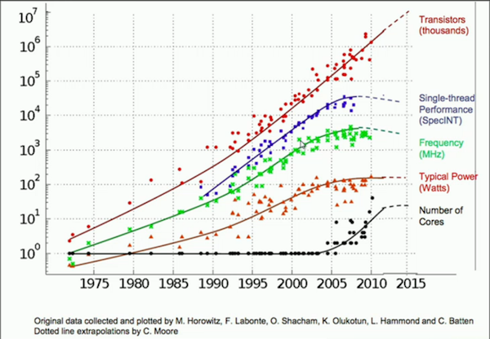
Hardware Limitations

Slide 6
Go runs Direct
No Operating system specific configurations
Compile on any, run on any
No added software
Starting a Go app is as simple as “./myprogram” or a double click on windows

Slide 7
Routines
Take advantage of multi-threading
Simple to use “go functionName()”
Cheaper to use
Faster startup time
Easy to communicate between routines

Slide 8
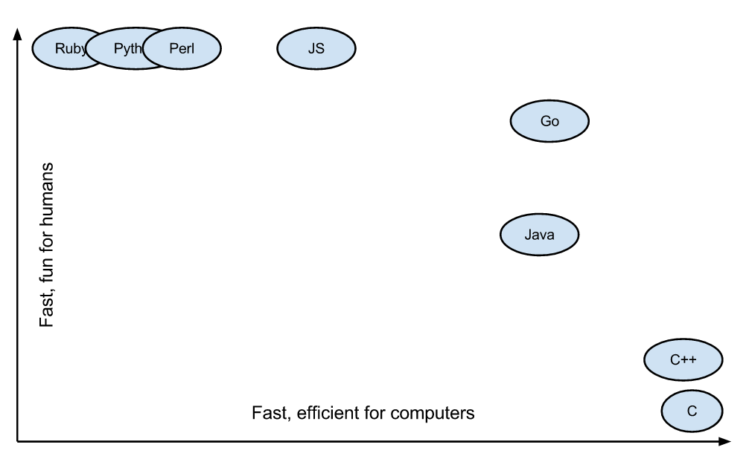
Easy to maintain

Slide 9
Where have I used Go?
Bash Scripts
Cloud Backups
Server monitoring
Web API’s
IOT
Server Management
PHP/NodeJS Replacements
Big Data

Slide 10
Summary
Great script replacements like Bash and PHP
Tutorials followed by meetup sessions to discuss each tutorial.
Want to give a talk?

Slide 11
Q & A
Get all of the slides and content at http://tra.li/go-do
My email l@tra.li
Blog.silocitylabs.com

