Slide 1

CS6220 Data Mining Techniques
2024 EURO Predictions
Shuhao Liu
Heshun Wang
Chenyu Song
Jianpeng Chen

Slide 2
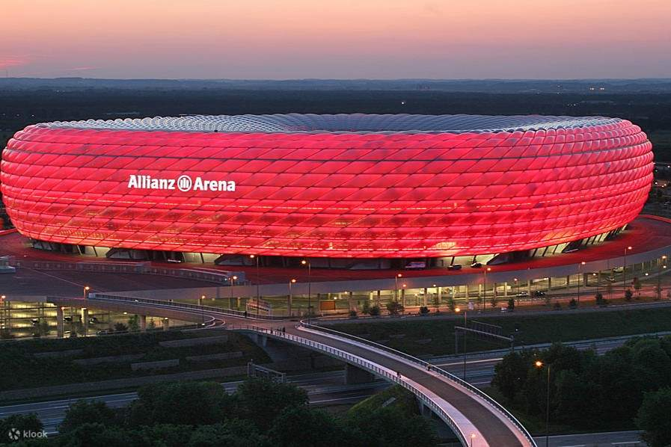
Introduction to 2024 EURO
Host Nation: Germany
Dates: June 14 to July 14, 2024
Cities and Venues: Matches will be held in 11 venues across 10 cities including Berlin, Munich, Dortmund, and Hamburg.
Teams: 24 national teams competing.
Group Stage: Teams divided into 6 groups of four.
Knockout Phases: Top two from each group plus the four best third-placed teams progress to the round of 16.
Group of Death(Group B): Spain, Italy, Croatia, Albania

Slide 3
Data preprocessing
To predict the outcomes of the 2024 European Championship, our analysis leverages extensive historical data encompassing national teams' performances.
DATASET
NAME | FIFA Rankings | EURO Cup 2024 Group Stages | Goal Scorers | Match Results | Penalty Shootouts
FIFA Rankings: fifa_ranking-2023-07-20.csv
Description: This dataset includes the FIFA world rankings of national teams up to July 20, 2023, providing a snapshot of team strengths globally.
EURO Cup 2024 Group Stages: Eurocup_2024_Groups.csv
Description: Contains details of the group stage matches for the 2024 EURO Cup.

Slide 4
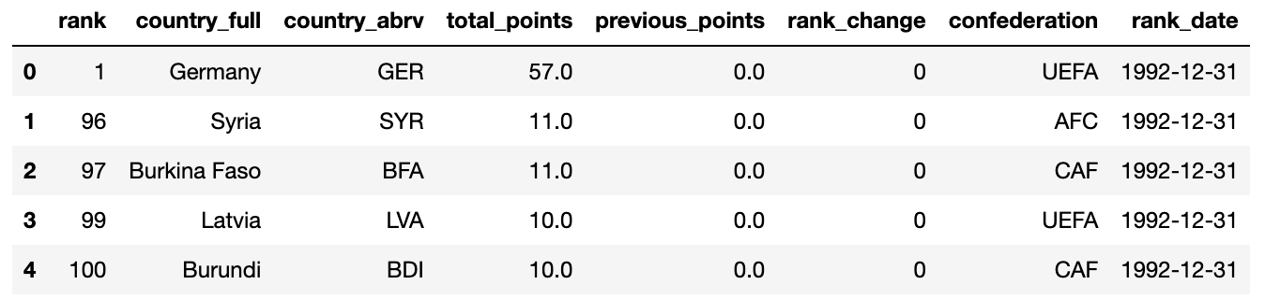
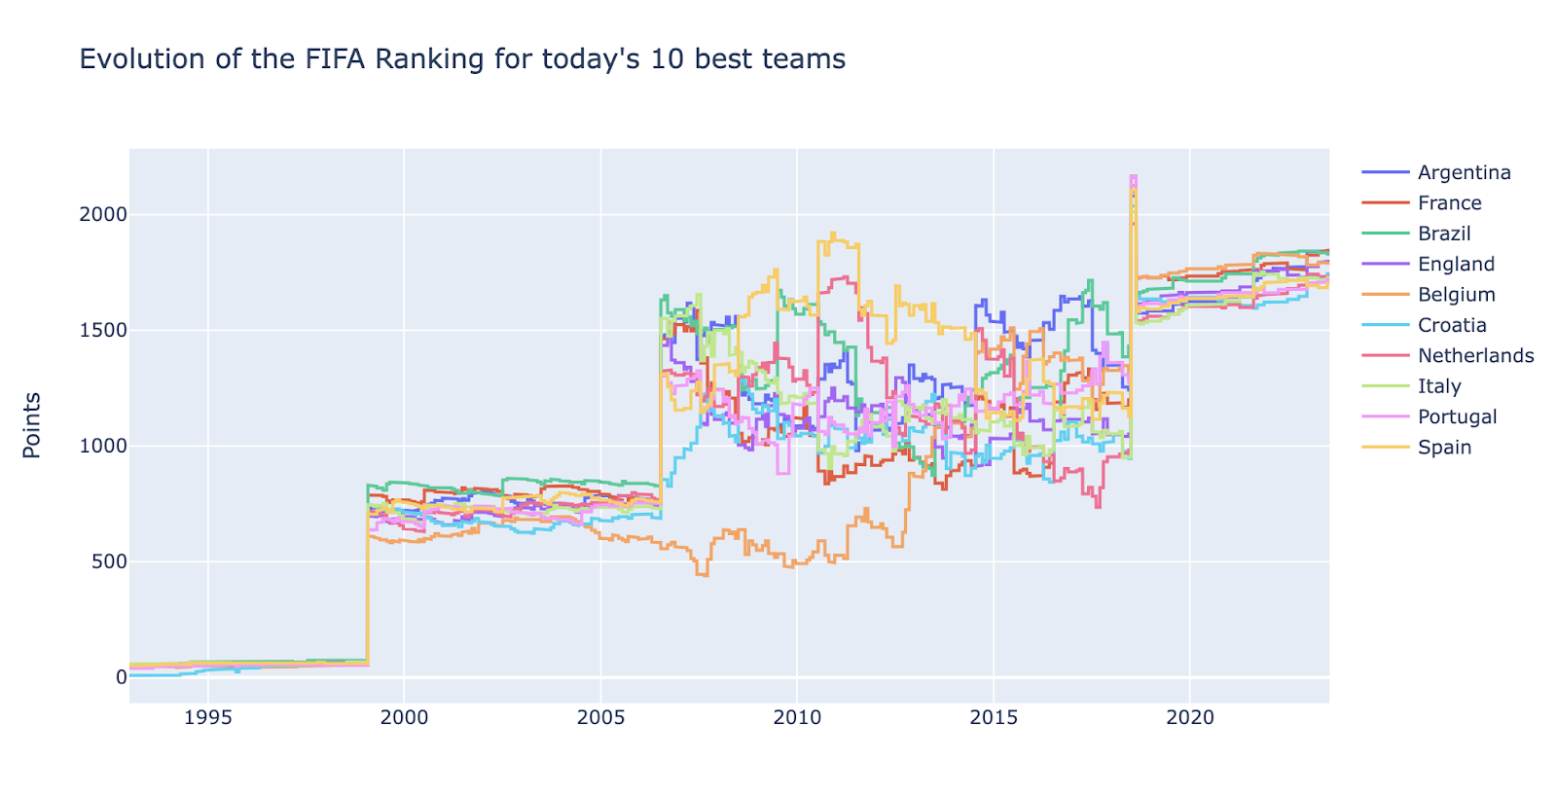
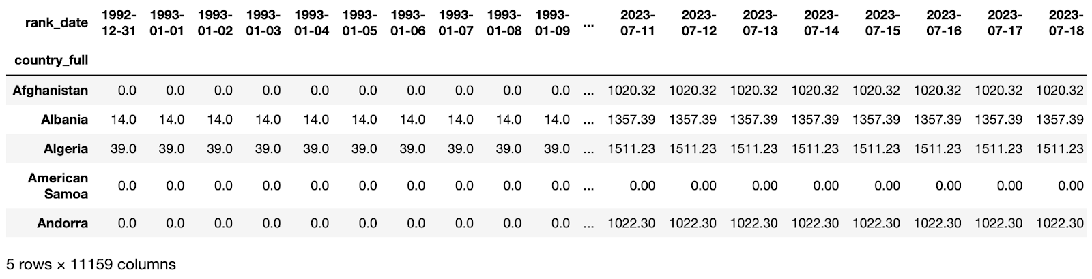

Slide 5
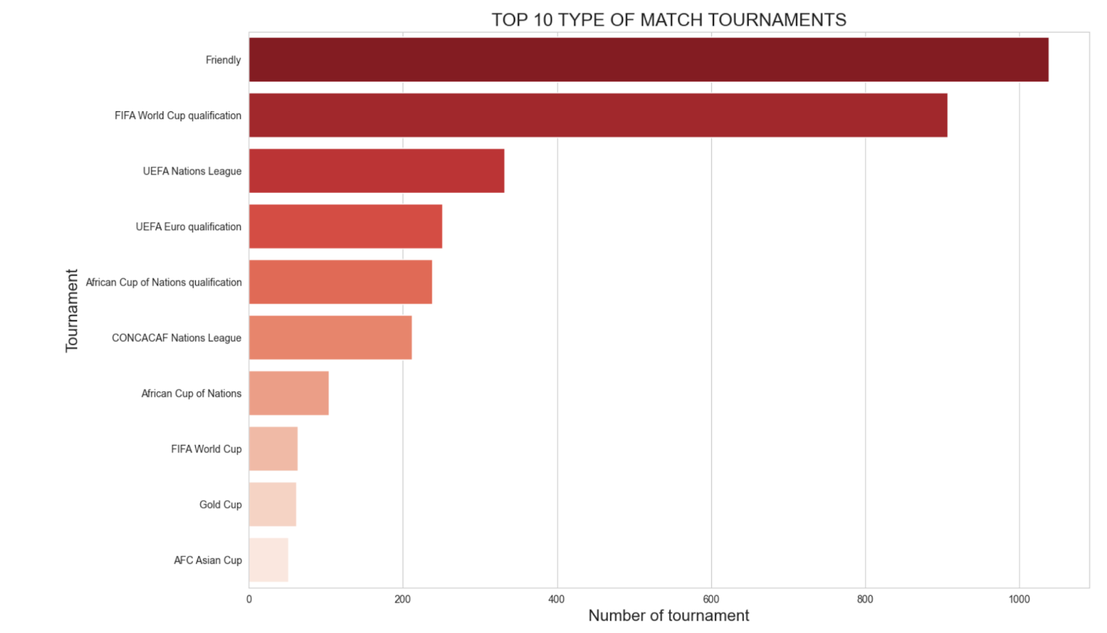

Slide 6
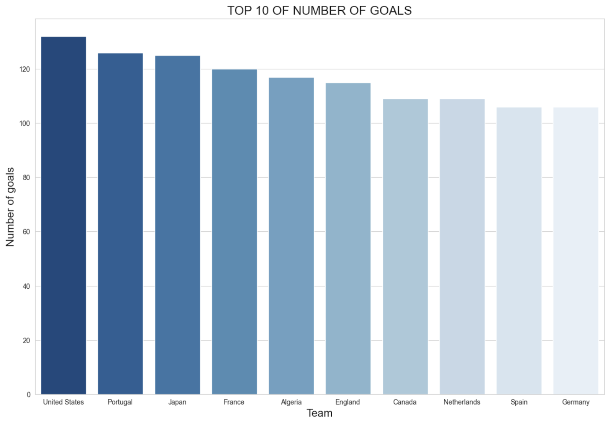

Slide 7
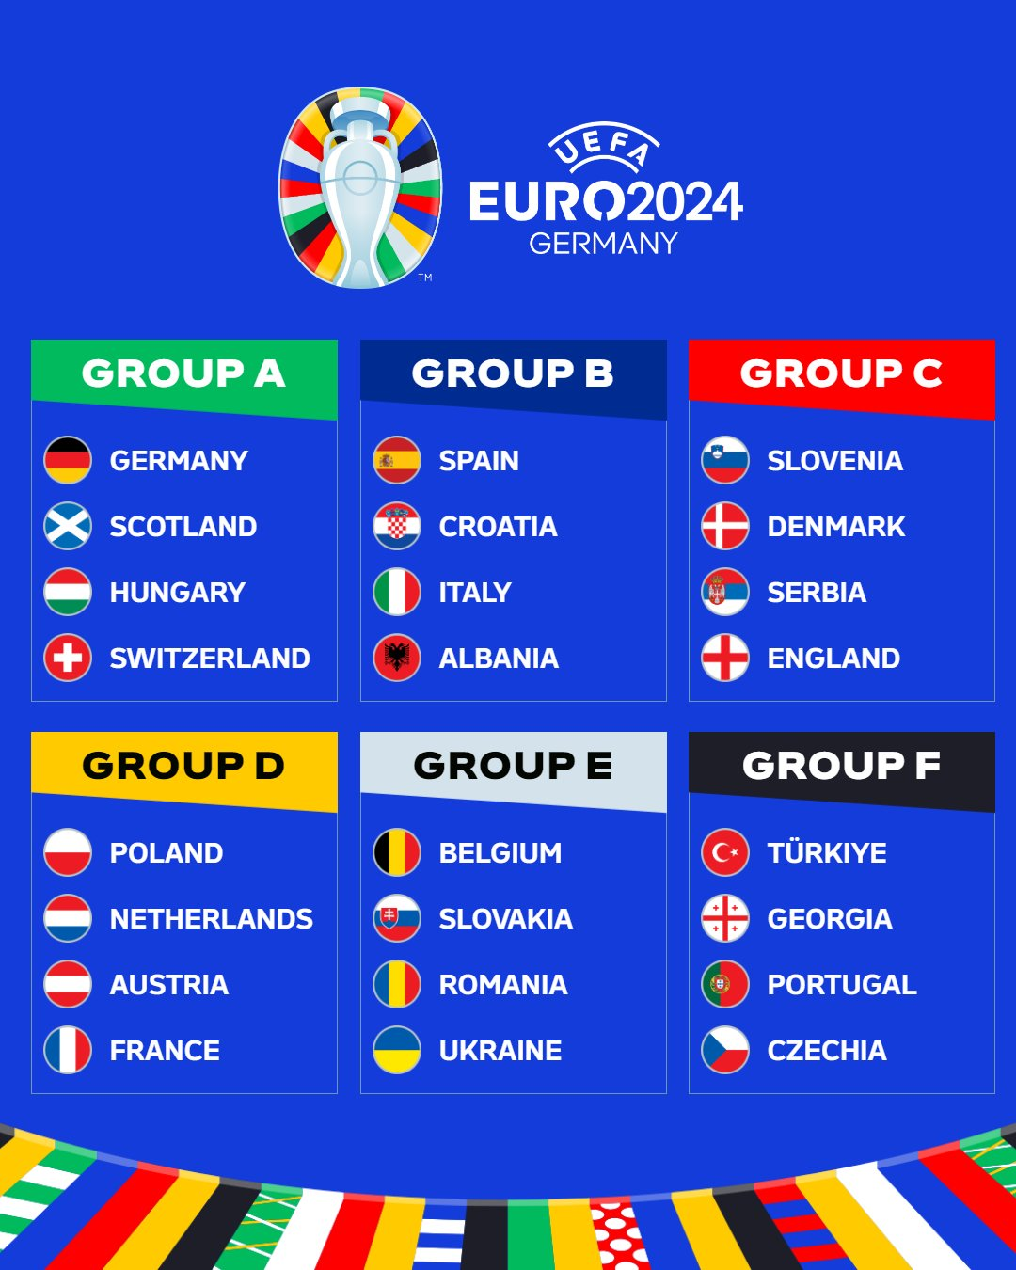
Group Stage Teams for UEFA Euro 2024

Slide 8
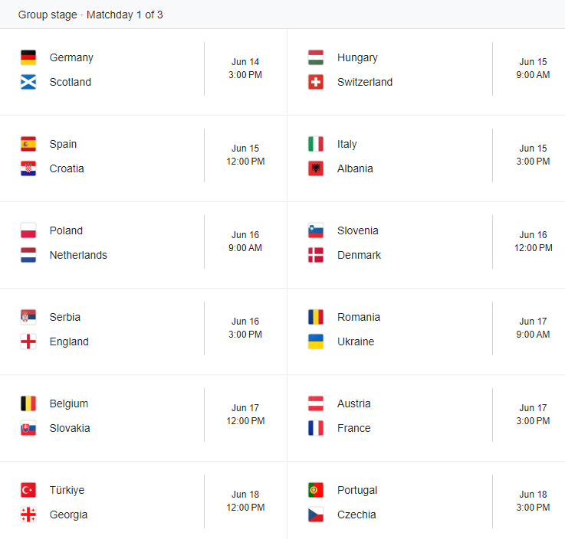
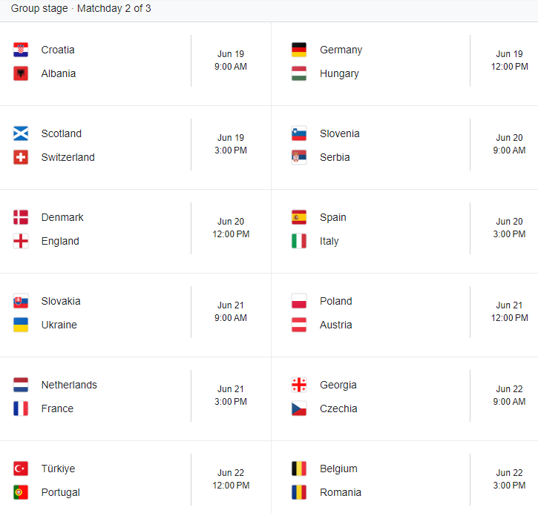
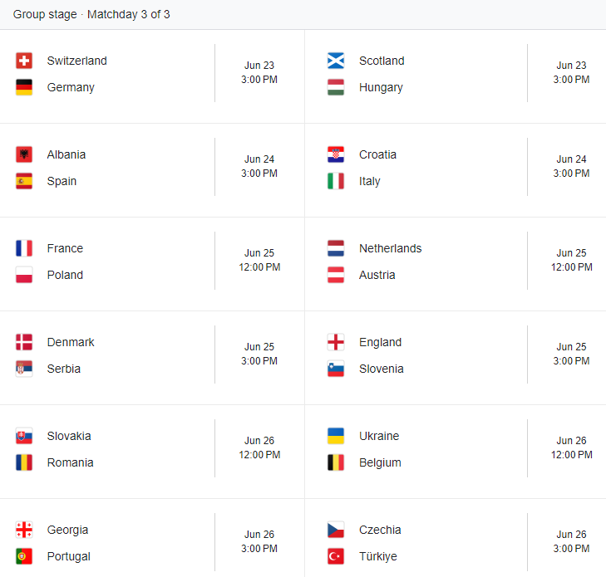
Detailed Group Stage Schedule for UEFA Euro 2024

Slide 9
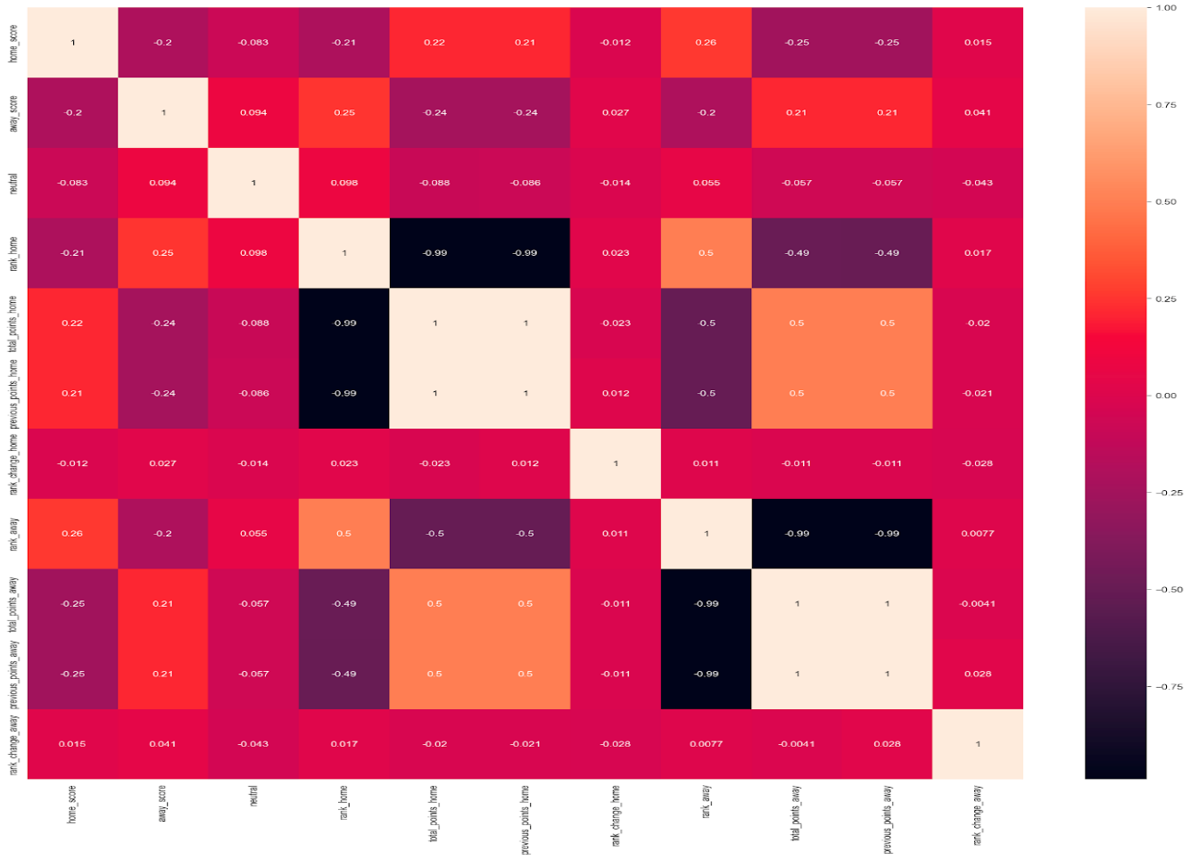
Methodology - Predictive Models for UEFA Euro 2024

Slide 10
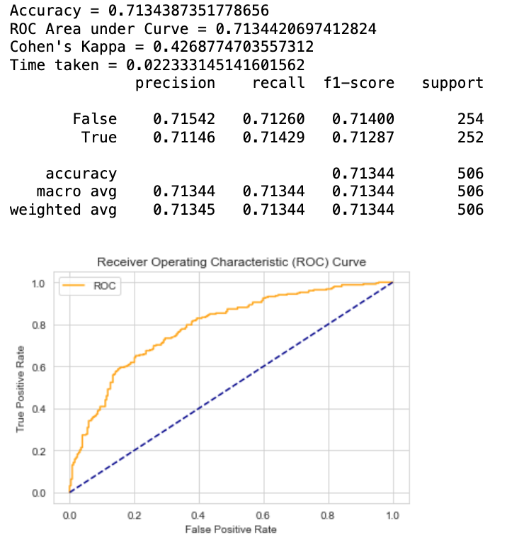
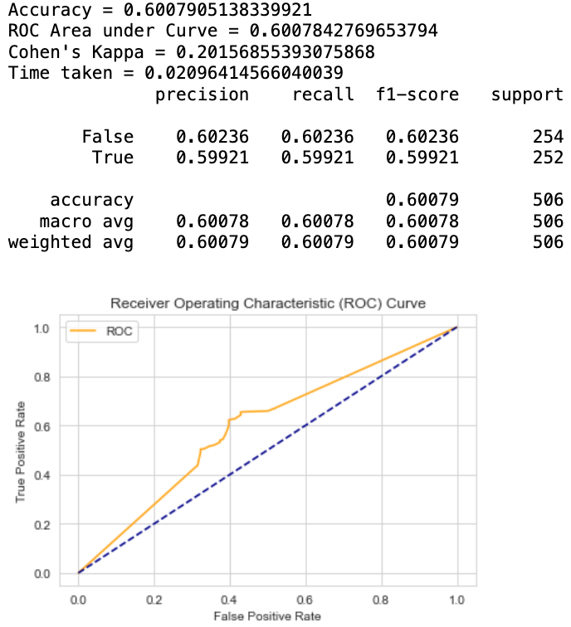
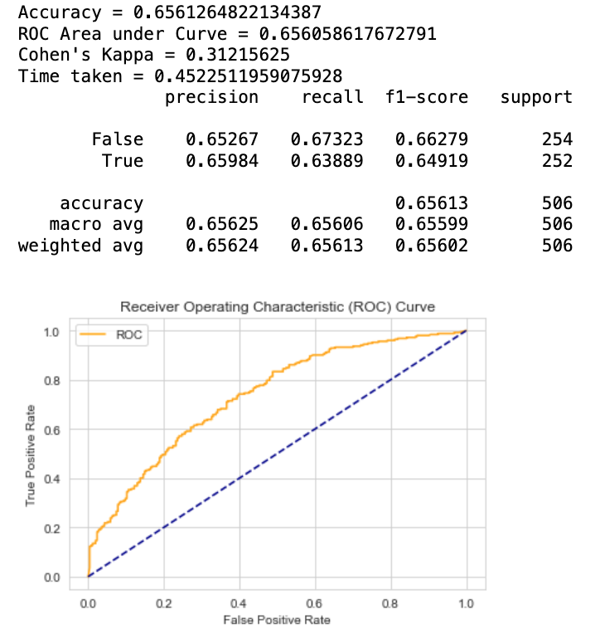
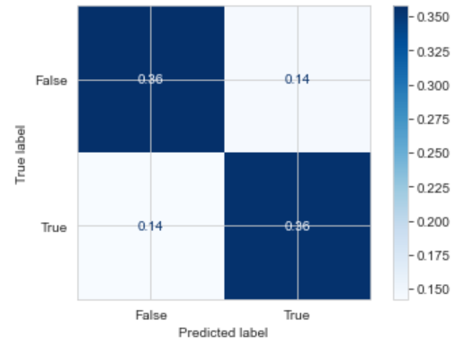
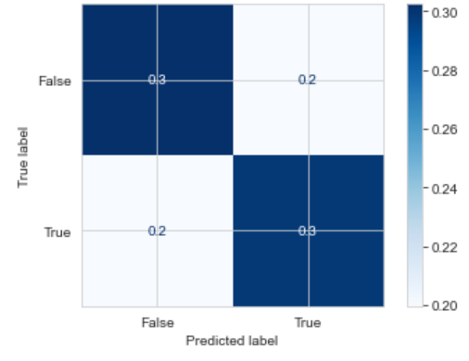
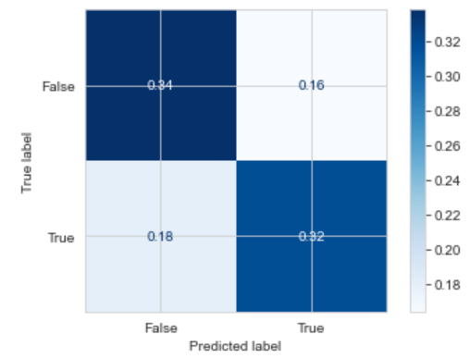
Logistic regression Decision Trees Random Forests

Slide 11
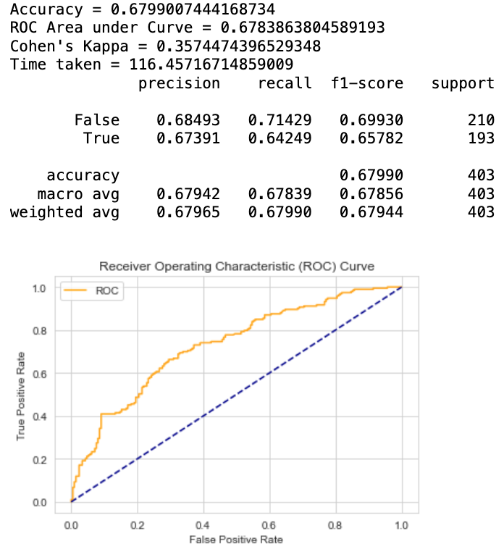
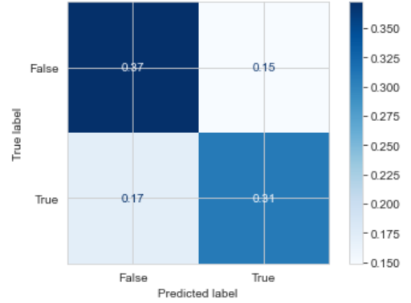
MLP:

Slide 12
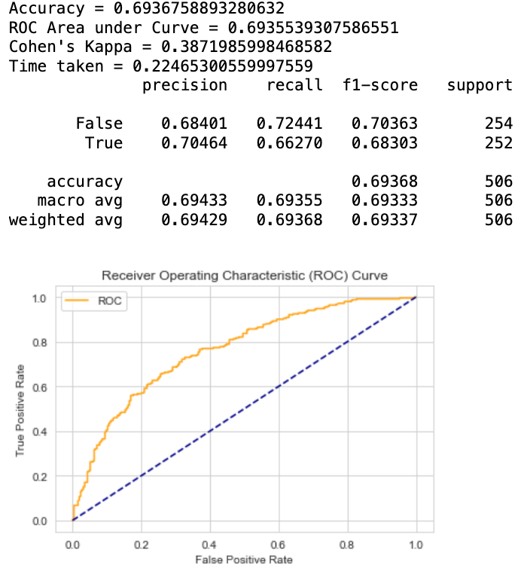
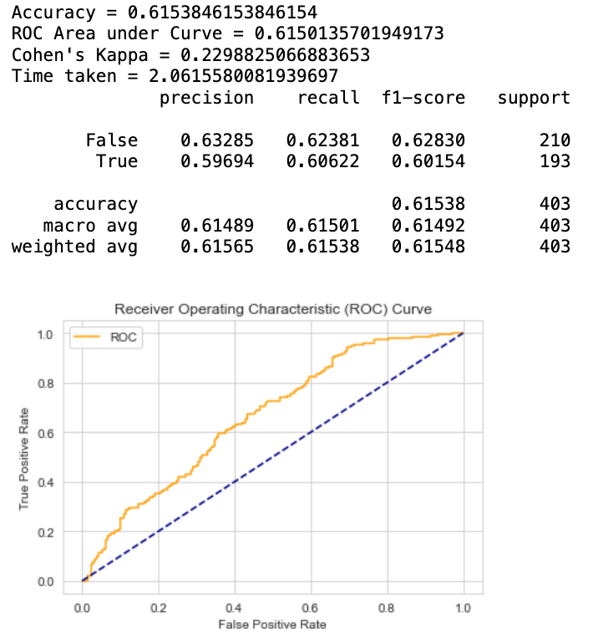
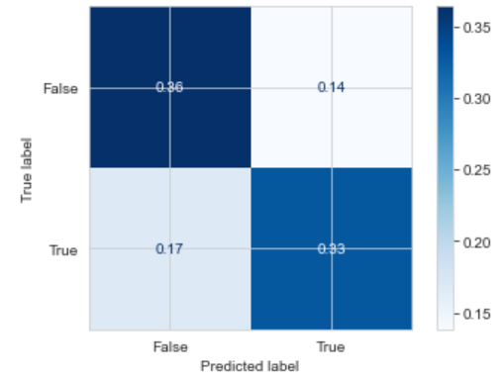

LGB XGB

Slide 13
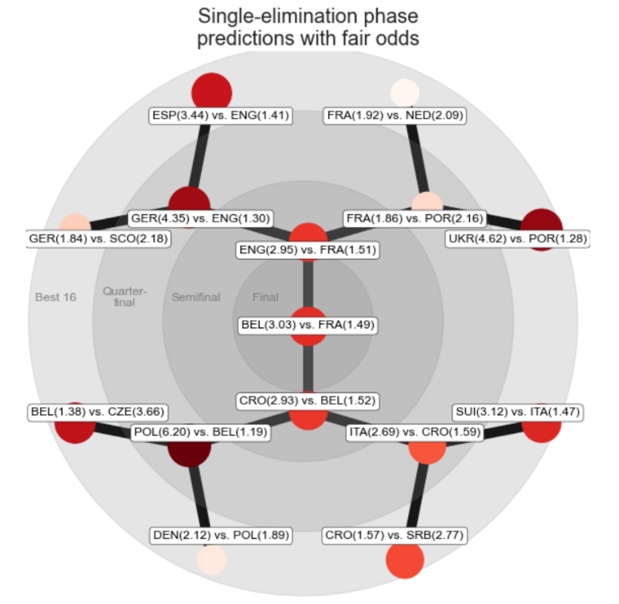
Predicting the UEFA Euro 2024 Champion
Predictive Factors:
Team Strength: Based on FIFA rankings and recent performance in international competitions.
Player Performance: Individual statistics such as goals scored, assists, and defensive records.
Historical Data: Outcomes from previous tournaments and head-to-head matchups.
Tactical Adaptability: Teams’ ability to adapt strategies against different opponents.
The final four teams:
Croatia
Belgium
England
France
The champion: France

Slide 14
Predicting the 2022 FIFA World Cup Knockout Stage
Leveraging our predictive model, we also applied our methodologies to forecast the outcomes of the 2022 FIFA World Cup knockout stages. This retrospective analysis helps validate our model's accuracy and reliability.
Model Application:
Model Framework: Utilizing a combination of Logistic Regression, Neural Networks, and Ensemble Methods.
Data Input: Included team performance during the group stage, player fitness and form, and historical matchup outcomes.
Predictive Accuracy:
Matches Predicted: Detailed every match from the Round of 16 through to the Final.
Accuracy Rate: Achieved a prediction accuracy of over 80% for the knockout stages.
Key Predictions: Successfully predicted major upsets and closely contested matches, showcasing the model's nuanced understanding of team dynamics.

Slide 15
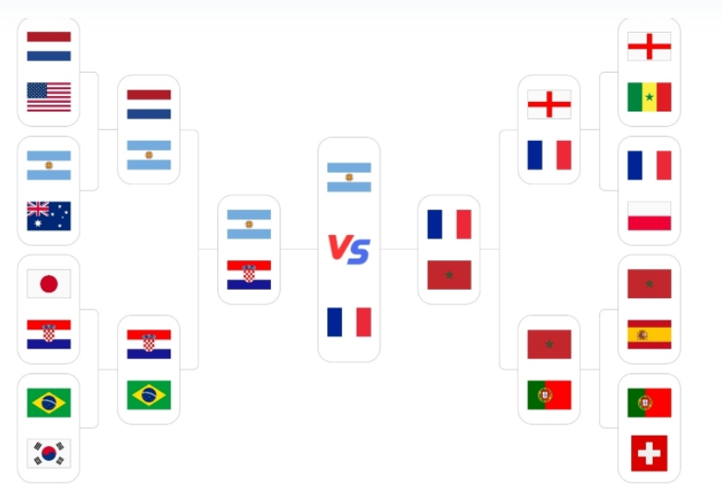
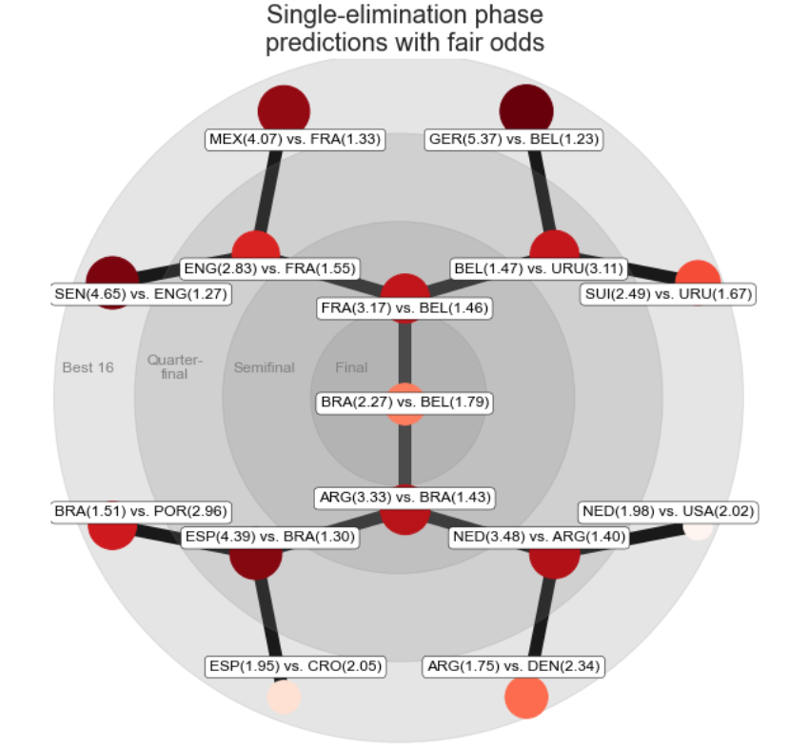
2022 FIFA World Cup Final Match Result vs Prediction

Slide 16
 | LogisticRegression | DecisionTree | MLP | RandomForest | LGBM | XGB
Champion | Belgium | brazil | Belgium | Belgium | Belgium | Belgium
Champion(in fact) | Argentina | Argentina | Argentina | Argentina | Argentina | Argentina
Runner-up | brazil | Spain | brazil | brazil | brazil | brazil
Runner-up(in fact) | France | France | France | France | France | France
Correct for semi-final | 50% | 50% | 25% | 50% | 50% | 50%
Correct for quarter-final | 62.5% | 50% | 50% | 62.5% | 62.5% | 62.5%
Correct for Last 16 | 68.75% | 62.5% | 68.75% | 56.25% | 62.5% | 56.25%

Slide 17
Challenges and Opportunities
Challenges:
Data Limitations: The availability and quality of data can significantly affect the accuracy of our predictions. Incomplete historical data or lack of access to certain datasets may limit our analysis capabilities.
Predictive Uncertainty: No model can predict the outcome of a football match with 100% accuracy due to the unpredictable nature of the sport, where unforeseen circumstances like injuries, weather, or referee decisions can impact results.
Overfitting: There's always a risk that our models may perform well on historical data but fail to generalize to new, unseen matches.
Opportunities:
Model Improvement: By integrating more diverse data sources, such as real-time player analytics and advanced team metrics, we can enhance our model's predictive power.
Collaborative Research: Partnering with other research institutions or leveraging crowdsourced data could help overcome data limitations and improve model accuracy.
Expanding Applications: Beyond predicting match outcomes, these models can be adapted for player performance analysis, injury prediction, or even dynamic ticket pricing strategies.

Slide 18
Conclusion
Key Insights:
Analysis highlighted specific factors such as team formation adaptability, player physical fitness, and historical performance under pressure as critical predictors of success.
Application Recommendations:
Betting Markets: Our analysis can guide bettors on probable outcomes, enhancing betting strategies with a higher probability of success based on historical data and predictive analytics.
Tactical Analysis for Teams: Coaches and analysts can use our predictions to better understand opponent strengths and weaknesses, potentially informing game strategies and training focus areas.

