Slide 1












$${\overline{y}}_{j+1}$$
N
$${\overline{y}}_{j}$$
n
W
w
P
e
E
$$∆\overline{y}$$
$${\overline{y}}_{j−1}$$
s
S
$$\overline{y}$$
$$∆x$$
$$j$$
$$i$$
$$x$$
$$x_{i−1}$$
$$x_{i}$$
$$x_{i+1}$$

Slide 2






$$z_{j+1}$$
NW
N
NE
$$z_{j}$$
n
W
w
P
e
E
$$∆z$$
$$z_{j−1}$$
s
SW
S
SE
$$z$$
$$∆x$$
$$k$$
$$i$$
$$x$$
$$x_{i−1}$$
$$x_{i}$$
$$x_{i+1}$$

Slide 3






$$y$$
$$h_{1}$$
$$h_{2}$$
$$x$$
$$L$$
$$U$$

Slide 16
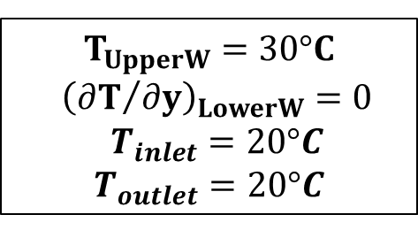
$$T_{UpperW}=30°C$$
$${\left({∂T}/{∂y}\right)}_{LowerW}=0$$
$$T_{inlet}=20°C$$
$$T_{outlet}=20°C$$

Slide 17
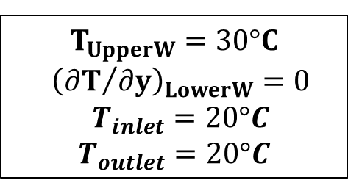
$$T_{UpperW}=30°C$$
$${\left({∂T}/{∂y}\right)}_{LowerW}=0$$
$$T_{inlet}=20°C$$
$$T_{outlet}=20°C$$

Slide 18

$$T_{UpperW}=30°C$$
$$T_{LowerW}=20°C$$
$$T_{inlet}=20°C$$
$$T_{outlet}=20°C$$

Slide 19

$$T_{UpperW}=30°C$$
$$T_{LowerW}=20°C$$
$$T_{inlet}=20°C$$
$$T_{outlet}=20°C$$

Slide 24
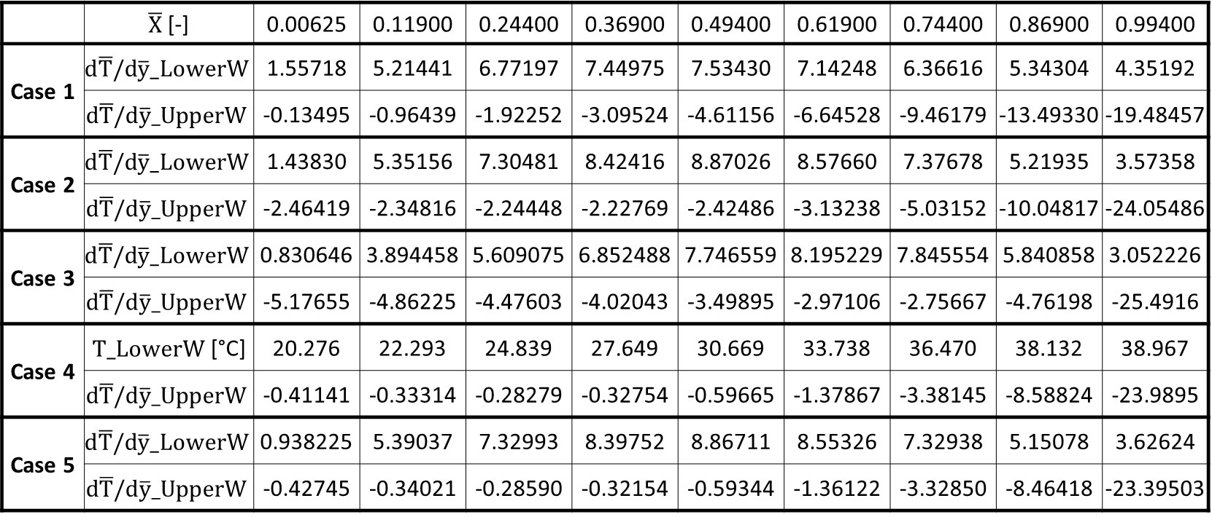
 | $\overline{X}$[-] | 0.00625 | 0.11900 | 0.24400 | 0.36900 | 0.49400 | 0.61900 | 0.74400 | 0.86900 | 0.99400
Case 1 | $$d\overline{T}/d\overline{y}_LowerW$$ | 1.55718 | 5.21441 | 6.77197 | 7.44975 | 7.53430 | 7.14248 | 6.36616 | 5.34304 | 4.35192
 | $$d\overline{T}/d\overline{y}_UpperW$$ | -0.13495 | -0.96439 | -1.92252 | -3.09524 | -4.61156 | -6.64528 | -9.46179 | -13.49330 | -19.48457
Case 2 | $$d\overline{T}/d\overline{y}_LowerW$$ | 1.43830 | 5.35156 | 7.30481 | 8.42416 | 8.87026 | 8.57660 | 7.37678 | 5.21935 | 3.57358
 | $$d\overline{T}/d\overline{y}_UpperW$$ | -2.46419 | -2.34816 | -2.24448 | -2.22769 | -2.42486 | -3.13238 | -5.03152 | -10.04817 | -24.05486
Case 3 | $$d\overline{T}/d\overline{y}_LowerW$$ | 0.830646 | 3.894458 | 5.609075 | 6.852488 | 7.746559 | 8.195229 | 7.845554 | 5.840858 | 3.052226
 | $$d\overline{T}/d\overline{y}_UpperW$$ | -5.17655 | -4.86225 | -4.47603 | -4.02043 | -3.49895 | -2.97106 | -2.75667 | -4.76198 | -25.4916
Case 4 | $T_LowerW$ [°C] | 20.276 | 22.293 | 24.839 | 27.649 | 30.669 | 33.738 | 36.470 | 38.132 | 38.967
 | $$d\overline{T}/d\overline{y}_UpperW$$ | -0.41141 | -0.33314 | -0.28279 | -0.32754 | -0.59665 | -1.37867 | -3.38145 | -8.58824 | -23.9895
Case 5 | $$d\overline{T}/d\overline{y}_LowerW$$ | 0.938225 | 5.39037 | 7.32993 | 8.39752 | 8.86711 | 8.55326 | 7.32938 | 5.15078 | 3.62624
 | $$d\overline{T}/d\overline{y}_UpperW$$ | -0.42745 | -0.34021 | -0.28590 | -0.32154 | -0.59344 | -1.36122 | -3.32850 | -8.46418 | -23.39503

Slide 25
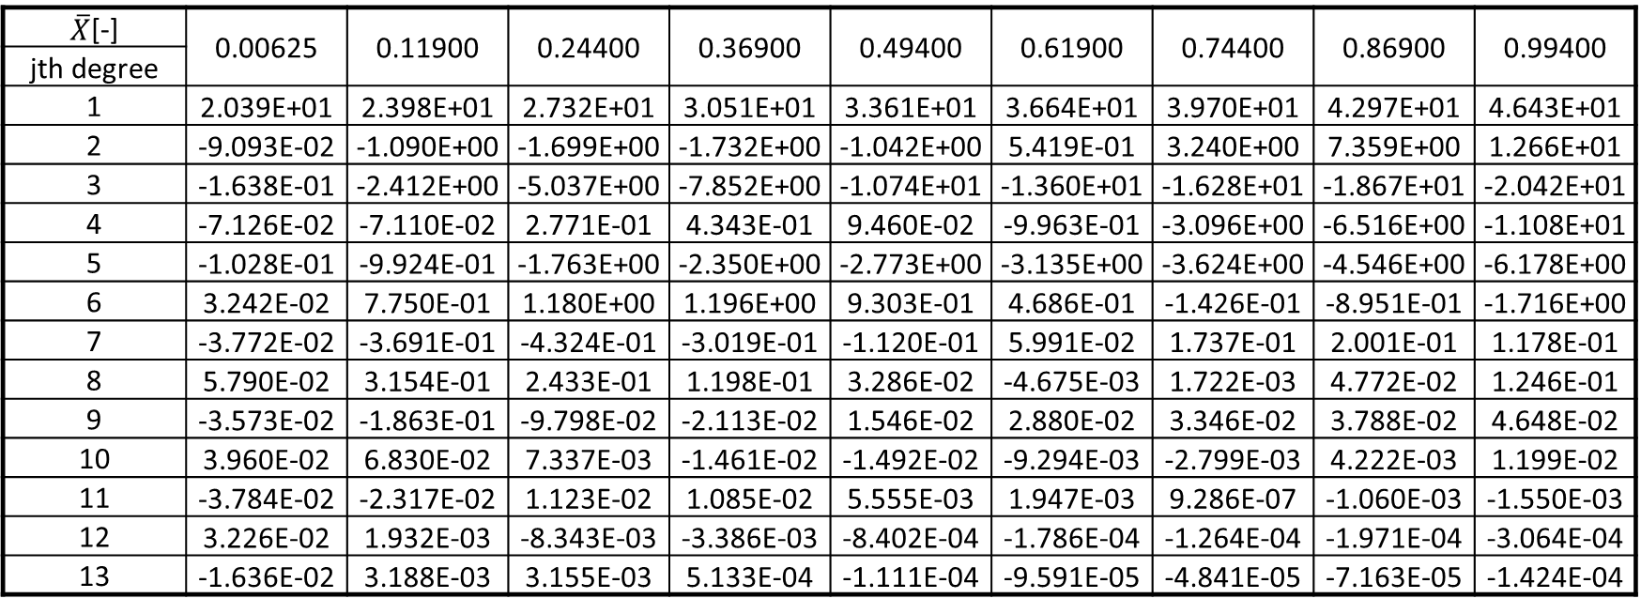
$\overline{X}$[-] | 0.00625 | 0.11900 | 0.24400 | 0.36900 | 0.49400 | 0.61900 | 0.74400 | 0.86900 | 0.99400
jth degree
1 | 2.039E+01 | 2.398E+01 | 2.732E+01 | 3.051E+01 | 3.361E+01 | 3.664E+01 | 3.970E+01 | 4.297E+01 | 4.643E+01
2 | -9.093E-02 | -1.090E+00 | -1.699E+00 | -1.732E+00 | -1.042E+00 | 5.419E-01 | 3.240E+00 | 7.359E+00 | 1.266E+01
3 | -1.638E-01 | -2.412E+00 | -5.037E+00 | -7.852E+00 | -1.074E+01 | -1.360E+01 | -1.628E+01 | -1.867E+01 | -2.042E+01
4 | -7.126E-02 | -7.110E-02 | 2.771E-01 | 4.343E-01 | 9.460E-02 | -9.963E-01 | -3.096E+00 | -6.516E+00 | -1.108E+01
5 | -1.028E-01 | -9.924E-01 | -1.763E+00 | -2.350E+00 | -2.773E+00 | -3.135E+00 | -3.624E+00 | -4.546E+00 | -6.178E+00
6 | 3.242E-02 | 7.750E-01 | 1.180E+00 | 1.196E+00 | 9.303E-01 | 4.686E-01 | -1.426E-01 | -8.951E-01 | -1.716E+00
7 | -3.772E-02 | -3.691E-01 | -4.324E-01 | -3.019E-01 | -1.120E-01 | 5.991E-02 | 1.737E-01 | 2.001E-01 | 1.178E-01
8 | 5.790E-02 | 3.154E-01 | 2.433E-01 | 1.198E-01 | 3.286E-02 | -4.675E-03 | 1.722E-03 | 4.772E-02 | 1.246E-01
9 | -3.573E-02 | -1.863E-01 | -9.798E-02 | -2.113E-02 | 1.546E-02 | 2.880E-02 | 3.346E-02 | 3.788E-02 | 4.648E-02
10 | 3.960E-02 | 6.830E-02 | 7.337E-03 | -1.461E-02 | -1.492E-02 | -9.294E-03 | -2.799E-03 | 4.222E-03 | 1.199E-02
11 | -3.784E-02 | -2.317E-02 | 1.123E-02 | 1.085E-02 | 5.555E-03 | 1.947E-03 | 9.286E-07 | -1.060E-03 | -1.550E-03
12 | 3.226E-02 | 1.932E-03 | -8.343E-03 | -3.386E-03 | -8.402E-04 | -1.786E-04 | -1.264E-04 | -1.971E-04 | -3.064E-04
13 | -1.636E-02 | 3.188E-03 | 3.155E-03 | 5.133E-04 | -1.111E-04 | -9.591E-05 | -4.841E-05 | -7.163E-05 | -1.424E-04

