Slide 1
Day 1
☞
Section 1 - The General Purpose Language
  Introduction to SIMSCRIPT II.5
  Variables & Syntax
  Assignment & Control
  Input/Output
  Arrays
  Program Structure, Routines & Functions
  Exercise 1
Section 2 - Simulation Constructs
  Entities & Attributes
  Sets
  SIMLAB Programming Environment
  Exercise 2

Slide 2
Section 1 - The General Purpose Language
Part 1 - Introduction to SIMSCRIPT II.5

Slide 3
Modeling & Simulation
Modeling
  State goals and define the system
  List system services and expected outcomes
  Select "Measures of Effectiveness" and
  "Measures of Performance"
  List parameters that affect MOEs and MOPs
  Select factors and appropriate levels to study
Select evaluation technique
  Analytical Modeling
  Simulation
  Measurement
Simulation
  Implement Model
  Verification & Validation
  Design experiments
  Perform experiments, analyze and interpret data
  Present results

Slide 4
Overview of SIMSCRIPT II.5
A complete general-purpose programming language
  English like syntax
  Data structures make programming easier and faster
  Highly portable language
A powerful discrete-event simulation language
  Models a system as it evolves over time
  Timing routine and event set handled automatically
  Provides random number generation & statistics collection
Animated graphics language SIMGRAPHICS
  User-Interface forms
  Presentation graphics
  Animation

Slide 5
Overview of SIMSCRIPT II.5 (continued)
Data Structures
  Arrays
  Entities & Attributes
  Sets
Commands and Syntax
  Assignment
  Control structures
"Behind the Scenes"
  Timing
  Event Handling
  List Processing
  Measurement

Slide 6
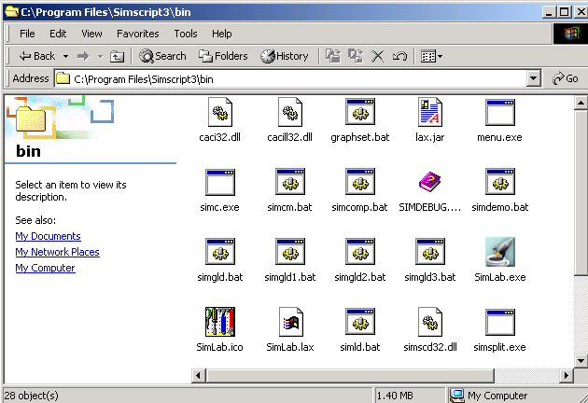
SIMSCRIPT Demonstration
PC environment
Editor
Compiler
Linker
Debugger

Slide 7
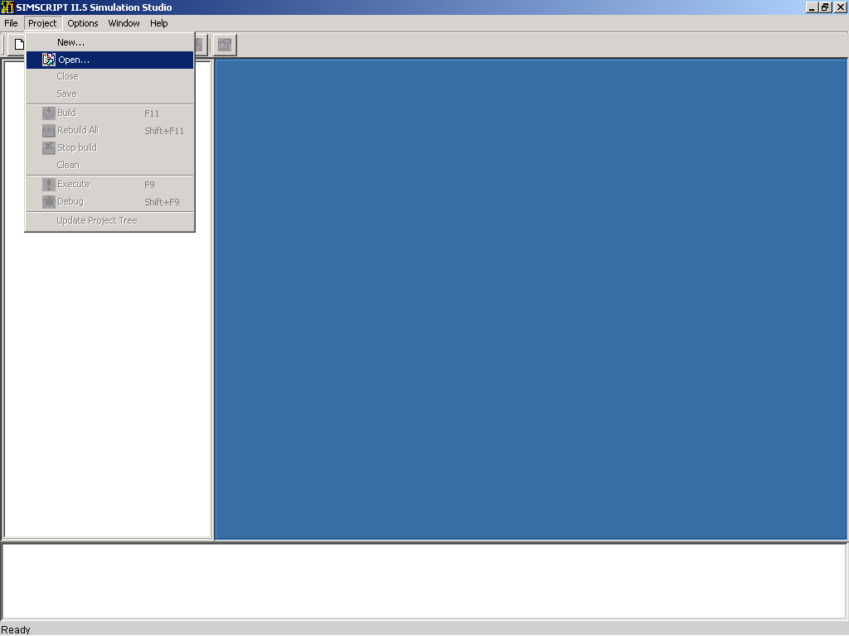
Existing Project

Slide 8
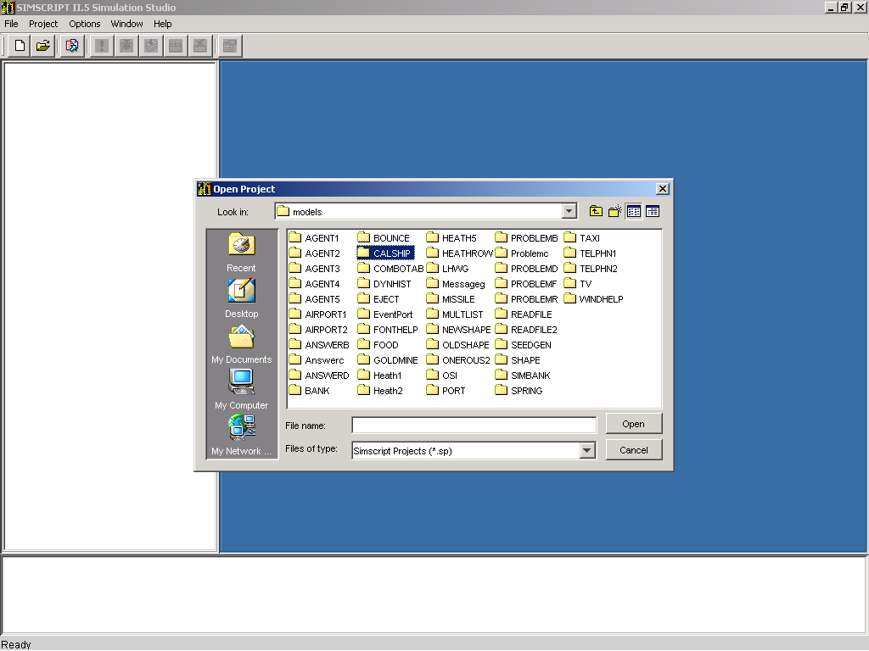
Open "Calship" Directory

Slide 9
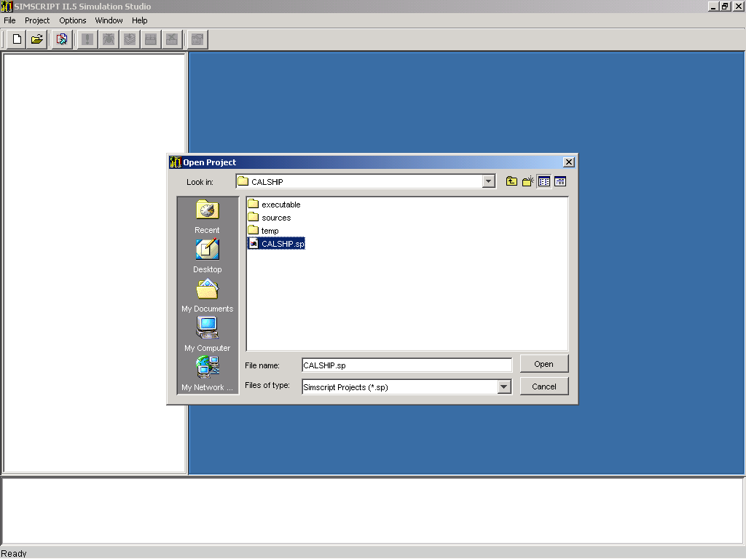
Open "Calship.sp"

Slide 10
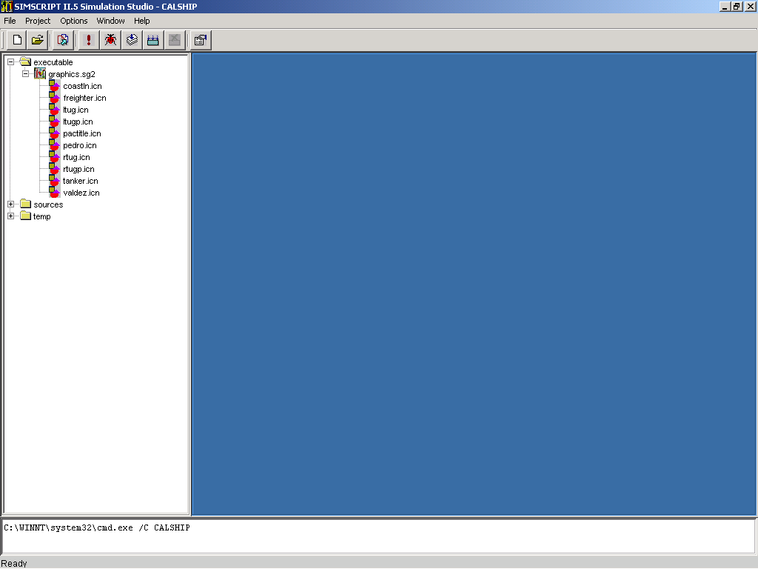
Graphics File

Slide 11
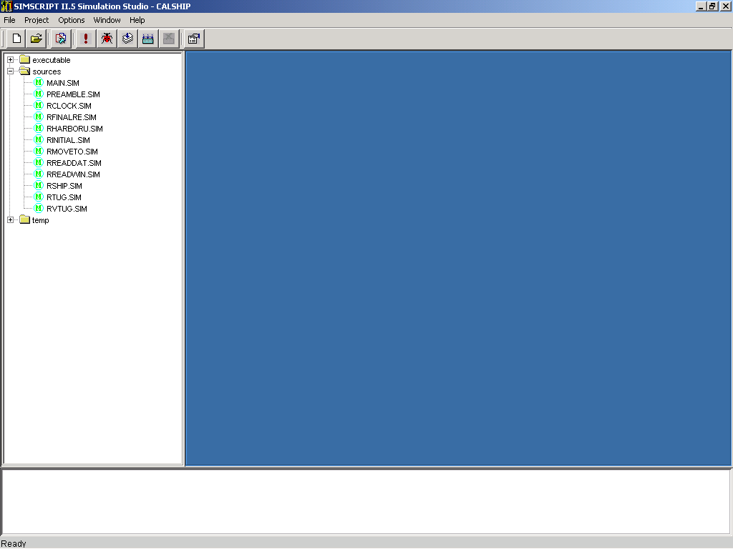
Preamble, Main, & Routines

Slide 12
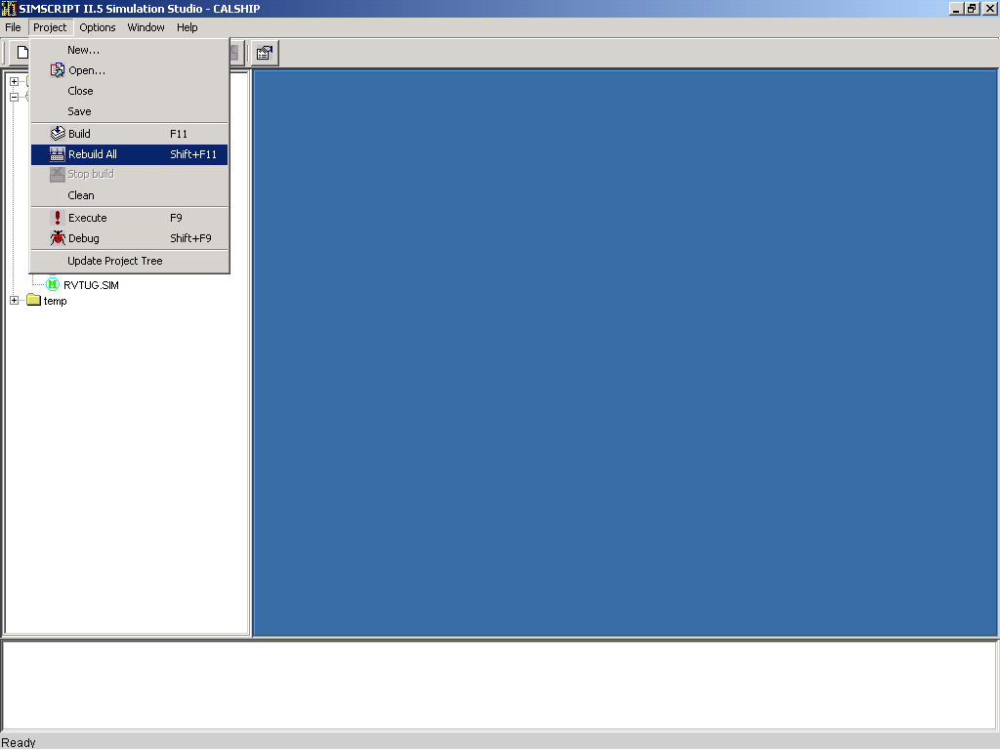
Rebuild All

Slide 13

Compile, Link => Project Built!

Slide 14
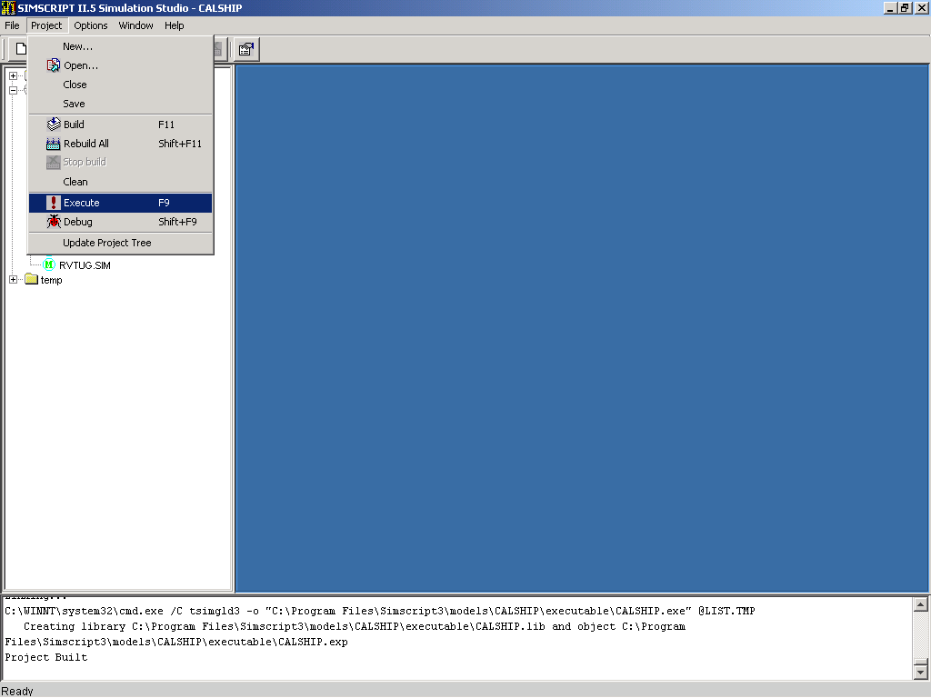
Execute

Slide 15
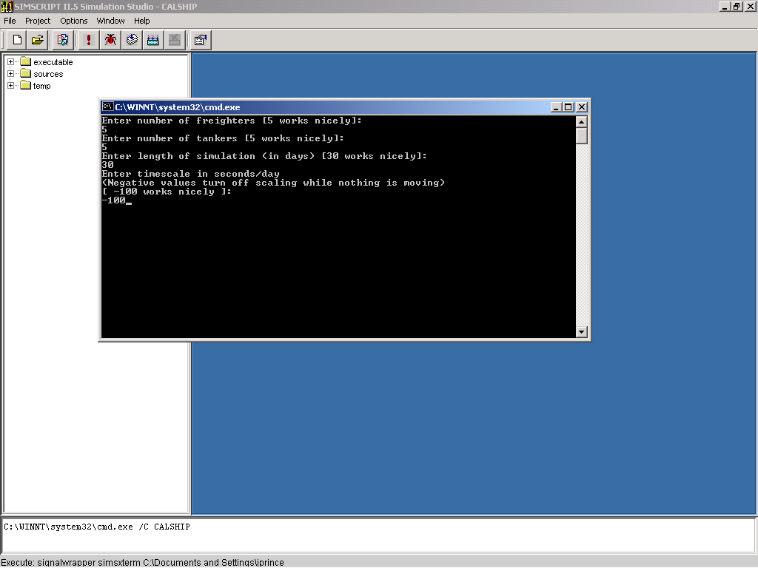
Standard Input

Slide 16
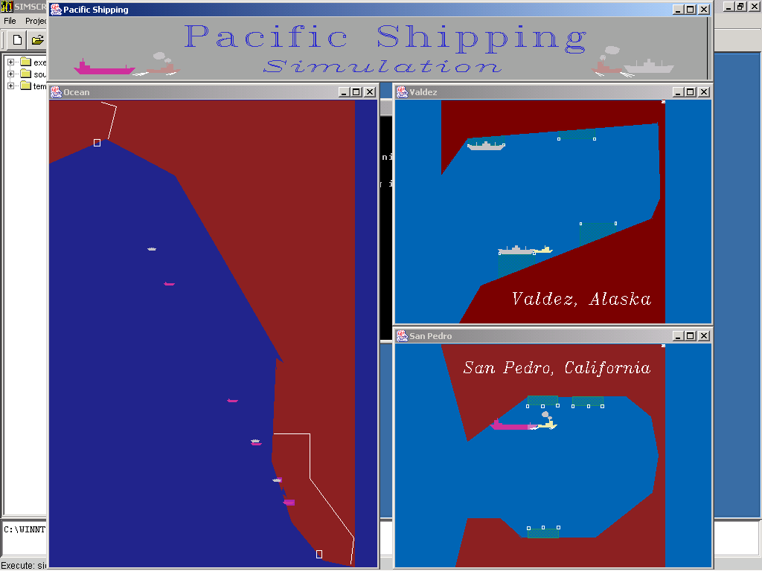
Pacific Port Problem

Slide 17
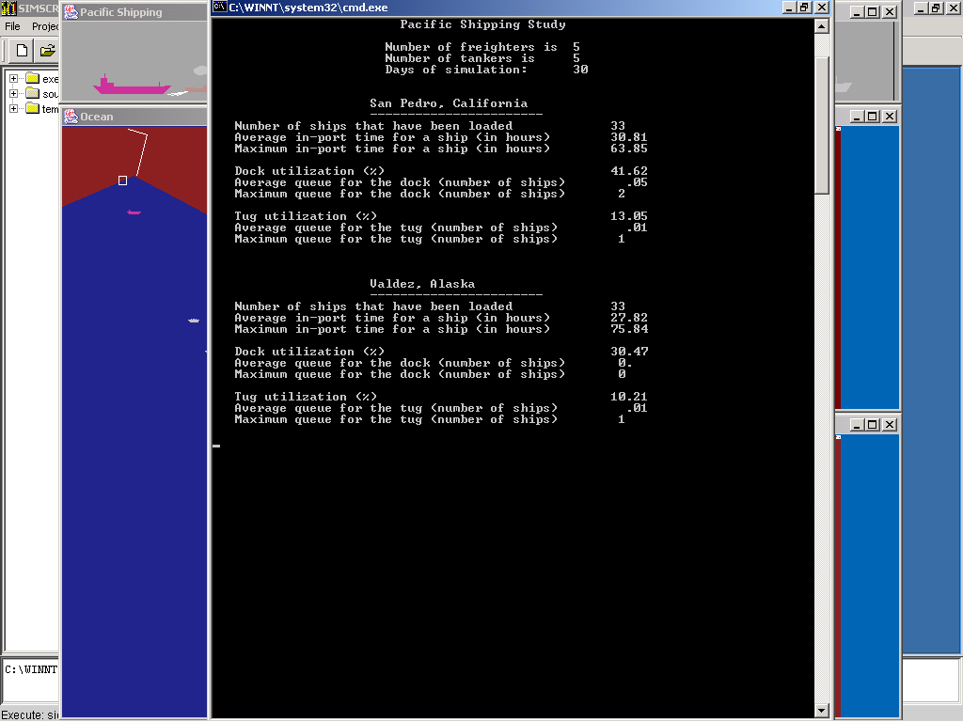
Standard Output

Slide 18
Section 1 - The General Purpose Language
Part 2 - Variables & Syntax

Slide 19
Variable Names
    Any combination of letters, digits, periods and underscores that is not a number
        X
        NATIONAL.STOCK.NUMBER
        1.3.6
    Leading periods make a difference; trailing periods don't
        ..YES is not the same as YES
        but
        YES.. = YES

Slide 20
Variable Names (continued)
SIMSCRIPT II.5 variables begin or end with a single letter
pi.c (constant) Q.RESOURCE (RESOURCE queue)
hours.v (variable) F.Q.RESOURCE (first in queue)
sqrt.f (function) N.Q.RESOURCE (number in queue)
time.r (routine) L.Q.RESOURCE (last in queue)
User variables and functions should not begin or end in a single letter
        Function LOADING.TIME.FN

Slide 21
Variables
Variables have a mode
    Integer Let NUMBER = 1
    Real, double Let MONEY = 5.50
    Alpha Let GRADE = "A"
    Text Let TITLE = "Gone with the Wind"
    Pointer Create an ENTITY
    Subprogram Let ROUTINE.NAME = 'TITLE’
All variables must be typed by SIMSCRIPT II.5

Slide 22
Variables (continued)
Specific definitions
    Define GROSS.TAKE.OFF.WEIGHT as a real variable
    Define I, J, and K as integer variables
Default definitions
    Normally mode is integer
    Define GROSS.TAKE.OFF.WEIGHT as a real variable
    For I = 1 to 10 do
    Normally mode is undefined

Slide 23
Some Style Conventions
    All SIMSCRIPT II.5 words are capitals and lower case
    All user-defined words are upper case
    All global variables begin with a word or acronym (defined in the Preamble)
        AIRCRAFT
        AC.TAIL.NUMBER
    All local variables begin with a single period (Defined in routines and functions)
        .AIRCRAFT

Slide 24
Syntax
Each statement begins with key word
    Let NUMBER.OF.GATES = 20
    Subtract 1 from NUMBER.OF.GATES
Key words are not reserved words
No statement delimiters
Comments begin with 2 apostrophes ('') and end either:
    1. At the end of the record or
    2. At the next pair of apostrophes (on the same line)
    Let PAYLOAD = 30000 ''pounds

Slide 25
Syntax (continued)
SIMSCRIPT II.5 is field oriented (not record oriented)
Words are fields--anything between:
    1. two blanks or
    2. a blank and carriage return
Can't break word at end of line
Statements can begin anywhere, end anywhere
Words must be in proper order

Slide 26
Section 1 - The General Purpose Language
Part 3 - Assignment & Control

Slide 27
Assignments
    Let X = X + 1
    Add 1 to X
    Subtract 2 from NUMBER.OF.AVAILABLE.PILOTS
    Let .ANSWER = (5/3 + 2 * (A*C)**2) - 6
    Let AIRLINE = "DELTA"

Slide 28
If..Else..Endif
        If <logical expression>
        <statements>
        Else
        <statements>
        Endif
        If A > B
        Add 1 to B
        Else
        Add 1 to A
        Endif ''A > B

Slide 29
Logical Expressions
Logical expressions may be simple or compound
A simple logical expression is a single comparison such as:
    A > B
    B**2 - 4*A*C < > 0
Compound logical expressions are just simple logical expressions connected by and, or and parentheses
    If AIRLINE = "DELTA" and FLIGHT = "DL145"
    If X < = B and (C = D or E = F)

Slide 30
Case Statements
Select case TODAY
Case 1
Let DAY = "Sunday"
Case 7
Let DAY = "Saturday"
Case 2 to 6
Let DAY = "Weekday"
Default
Let DAY = "TODAY can only range from 1 to 7"
Endselect ''TODAY
Select case .LETTER
Case "A","E","I","O","U"
Let .RESULT = ..VOWEL
Default
Let .RESULT = ..CONSONANT
Endselect

Slide 31
Case Statements (continued)
Select case .PROBABILITY
Case 0.0 to .25
Let .UNLOADING.TIME = 18
Case .25 to .80
Let .UNLOADING.TIME = 24
Case .80 to 1.00
Let .UNLOADING.TIME = 36
Default
Endselect ''.PROBABILITY

Slide 32
FOR Loop
        For I = 1 to 10 by 2
        Do
        <statements>
        Loop ''I = 1 to 10 by 2
        For J back from 20 to 1 by 5
        Do
        <statements>
        Loop ''J back from 20 to 1 by 5

Slide 33
While & Until Loops
While M < 10000
Do
Let M = M * X
Add 1 to X
Loop ''M < 10000
Until M >= 10000
Do
Let M = M * X
Add 1 to X
Loop ''M >= 10000

Slide 34
Termination Phrases
  For I = 1 to N
  while SUM <= MAX
  Do
  <statements>
  Loop ''I = 1 to N
(This loop will continue until either I exceeds N or SUM exceeds MAX, whichever occurs first.)

Slide 35
Selection Phrases
  For I = 1 to 13
  with VALUE(I) > 9
  Do
  Add VALUE(I) - 9 to .POINT.COUNT
  Loop ''I = 1 to 13
(This loop will iterate 13 times, executing the Add statement only when Value(I) > 9

Slide 36
Section 1 - The General Purpose Language
Part 4 - Input & Output

Slide 37
Free Form Input
Read SQUADRON.NUMBER,
AUTHORIZED.STRENGTH and
SQUADRON.NAME
Possible data:
1002 174 522.TFS
or
1002 174
522.TFS

Slide 38
Formatted Input
  Read SQUADRON.NUMBER,
  AUTHORIZED.STRENGTH and
  SQUADRON.NAME
  as /,i 5,s 1,d(10,0),s 1,t 20
  Read SQUADRON.NAME as t *
  '522nd Tactical Fighter Squadron'

Slide 39
Input Control Statements
System Variables can test characteristics of input data before the data are read
  sfield.f, efield.f Starting/ending column of next data field
  mode Mode of next data field
  data Presence/absence of data
  While data is not ended
  Do
    Read SQUADRON.NUMBER,
    AUTHORIZED.STRENGTH and
    SQUADRON.NAME
    Loop ''data is not ended

Slide 40
Free Form Output
List SQUADRON.NUMBER,
AUTHORIZED.STRENGTH and
SQUADRON.NAME
Output Looks Like This:
SQUADRON.NUMBER = 1002
AUTHORIZED.STRENGTH = 174
SQUADRON.NAME = 522.TFS

Slide 41
Formatted Output
  Print 4 lines with SQUADRON.NUMBER,
  AUTHORIZED.STRENGTH and
  SQUADRON.NAME thus
  SQUADRON NUMBER: ****
  AUTHORIZED STRENGTH: ****
  SQUADRON NAME: *************************

Slide 42
Formatted Output (continued)
    Open unit 10 for output, name = "RESULTS"
    Use unit 10 for output
    Write SQUADRON.NUMBER,
    AUTHORIZED.STRENGTH,
    SQUADRON.NAME
    as /,s 4,"SQUADRON.NUMBER:",s 1,i 4,/,
    "AUTHORIZED.STRENGTH:",s 1,i 4,/,
    s 6,"SQUADRON.NAME:",s 1,t 25
    using unit 10

Slide 43
Formatted Output (continued)
To start a new line:
Start new line
To introduce blank lines:
Skip n lines
To go to a new output page:
Start new page

Slide 44
Titles on Every Page
    Let heading.v = 'TITLE'
    Call date.r
    Yielding
    DATE,
    TIME
    Routine TITLE
    Print 2 lines with DATE,
    TIME thus
    ****** ******
    Final Report
    End ''TITLE

Slide 45
Titles on Every Page (continued)
Lines.v Number of lines per page
(default = 55, 0 implies no page breaks)
Line.v Current line number
Pagecol.v means number pages with PAGE beginning in column n
        Use unit 20 for output
        Let pagecol.v = 0
        Let lines.v = 30
        Use unit 21 for output
        Let pagecol.v = 60
        Let lines.v = 50

Slide 46
Section 1 - The General Purpose Language
Part 5 - Arrays

Slide 47
Defining Arrays
Arrays have mode and dimensionality
All elements have same mode
Mode and dimensionality determined at compile time
The size of the array may be determined at run time
  Define AIRPORT as a 1-dimensional, text array
  Define TABLE as a 3-dim, real array

Slide 48
Initializing Arrays
The space for an array is allocated during execution as follows:
    Reserve AIRPORT as 5
    Reserve TABLE as 10 by 32 by 8
The space for an array is released during execution as follows:
    Release AIRPORT, TABLE

Slide 49
Manipulating Arrays
Array elements are referenced by subscribing the array name
      Let AIRPORT(5) = "Dallas-Ft.Worth"
      Let TABLE(5,3,7) = 16.5
Subscript values range from 1 to the specified maximum

Slide 50
Storing Arrays
Define AIRPORT as a 1-dimensional, text array
Reserve AIRPORT as 5
Behind the Scenes
AIRPORT(*)
address
base pointer
AIRPORT(1)
AIRPORT(2)
AIRPORT(3)
AIRPORT(4)
AIRPORT(5)

Slide 51
This page is intentionally blank

Slide 52
Section 1 - The General Purpose Language
Part 6 - Program Structure, Routines & Functions

Slide 53
Program Structure
  Preamble
  Definitions only--no executable statements
  All global variables must be defined explicitly in the preamble
  End
  Main
  Execution starts here
  End
  Routines
  Local variables are local to routine where defined
  Simscript II.5 routines are recursive
  Separate local memory for each call
  Must have an End

Slide 54
Functions
Preamble
Define FIND.NAME as a text function
End ''Preamble
Main
Define .SOCIAL.SECURITY.NUMBER as an integer variable
Define .NAME as a text variable
Let .SOCIAL.SECURITY.NUMBER = 500551212
Let .NAME = FIND.NAME(.SOCIAL.SECURITY.NUMBER)
End ''Main

Slide 55
Functions (continued)
  Function FIND.NAME
  Given
  .NUMBER ''Social security number
    Define .NUMBER as an integer variable
    Define .LAST.NAME as a text variable
  ... <statements> ...
  Return with .LAST.NAME
  End ''FIND.NAME

Slide 56
System Functions
There are a large number of system functions. For example:
  abs.f Absolute value
  arcsin.f Trig functions
  atot.f ALPHA to TEXT conversion
  beta.f statistical distributions
  date.f converts a calendar date to simulation time
  frac.f mathematical functions
  shr.f bit shift right
  substr.f returns a substring of a text variable
  upper.f converts letters to upper case
  (See Reference Manual, Section 1.8, Table 6, p. 21ff. - "Go to page 39" in Acrobat Reader - In the online help, pick SIMSCRIPT II.5 - System functions.)

Slide 57
Routines
Main
Define .SOCIAL.SECURITY.NUMBER as an integer variable
Define .NAME as a text variable
Let .SOCIAL.SECURITY.NUMBER = 500551212
Call FIND.NAME
Given
.SOCIAL.SECURITY.NUMBER
Yielding
.NAME
End ''Main

Slide 58
Routines (continued)
  Routine FIND.NAME
  Given
  .NUMBER ''Social security number
  Yielding
  .LAST.NAME ''Name of the person with that SSN
  Define .NUMBER as an integer variable
  Define .LAST.NAME as a text variable
  <statements>
  Return
  End ''FIND.NAME

Slide 59
This page is intentionally blank

Slide 60
Exercise 1
A Data File with Comments
C:\SIMSCRIPT\MODELS\ReadFile

Slide 61
Example Using Routines & I/O:
A Data File with Comments
A program uses a separate routine to read each file.
  The file begins with a record listing the name of the routine and the date of the file.
  This is followed by one or more comments. The comment section ends when a numerical field is found at the beginning of a record.
  The read routine compares the name in the first record with the name of the routine. If they are not the same, the routine prints an error message and stops.
  Otherwise it reads the data and prints it.
Try writing to an output file instead of a window

Slide 62
Data File
INP.220.READ.AIRCRAFT.DATA 2-12-1988
'' Aircraft location file
'' Given authorized number and location of each aircraft type
'' a. Type of aircraft (text)
'' b. Authorized number of aircraft (integer)
'' c. Location of aircraft (text) - location must be
'' enclosed by apostrophes
9 End of comments; data starts
F-15 72 'Langley AFB VA'
F-16 24 'Hill AFB UT'

Slide 63
1 Preamble
2
3 '' Program to Read and Print a Commented Data File
4 '' files: READFILE.SIM, ACFT.DAT
5
6 Normally mode is undefined
7
8 End ''Preamble
1 Main
2
3 Call INP.220.READ.AIRCRAFT.DATA
4
5 Print 2 lines thus
Press <CR> to end program…
8 Read as / using unit 5
9
10 End ''Main

Slide 64
1 Routine INP.220.READ.AIRCRAFT.DATA
2
3 Define .AUTHORIZED.NUMBER as an integer variable
4
5 Define .ROUTINE.NAME,
6 .SHORT.NAME,
7 .DATE,
8 .AIRCRAFT.NAME and
9 .LOCATION
10 as text variables
11
12 '' Open the input unit
13
14 Open unit 10 for input, name = "ACFT.DAT"
15 Use unit 10 for input
16
17 '' Read the file name and date; if not correct, print error message
18 '' and stop
19
20 Read .ROUTINE.NAME,
21 .DATE
22
23 Let .SHORT.NAME = substr.f(.ROUTINE.NAME, 1, 7)
24
25 If .SHORT.NAME is not equal to "INP.220"
26
27 Print 2 lines with .SHORT.NAME thus
File name does not agree with routine name
******* INP.220
30
31 Trace
32 Stop
33

Slide 65
34 Endif ''.SHORT.NAME is not equal to "INP.220"
35
36 '' Print the name and date to the standard output; skip 2 lines
37
38 Print 1 line with .ROUTINE.NAME,
39 .DATE thus
****************************** **********
41
42 Skip 2 output lines
43
44 '' Jump over the comments in the data file
45
46 While mode is alpha
47 Do
48 Start new record
49 Loop ''mode is alpha do
50
51 Start new input record
52
53 '' As long as there is data in the file, read 3 fields and print them
54
55 While data is not ended
56 Do
57
58 Read .AIRCRAFT.NAME,
59 .AUTHORIZED.NUMBER
60 Read .LOCATION as t *
61
62 Print 1 line with .AIRCRAFT.NAME,
63 .AUTHORIZED.NUMBER and
64 .LOCATION thus
***** ** *********************************
66
67 Loop ''data is not ended

Slide 66
68
69 '' Close the input unit and return
70
71 Close unit 10
72
73 End ''INP.220

Slide 67
Output
INP.220.READ.AIRCRAFT.DATA 2-12-1988
F-15 72 Langley AFB VA
F-16 24 Hill AFB UT

Slide 68
This page is intentionally blank

