Slide 1
Day 1
Section 1 - The General Purpose Language
  Overview of SIMSCRIPT II.5
  Variables & Syntax
  Assignment & Control
  Input/Output
  Arrays
  Program Structure, Routines & Functions
  Exercise 1
Section 2 - Simulation Constructs
  Entities & Attributes
  Sets
  SIMLAB Programming Environment
  Exercise 2
☞

Slide 2
Section 2 - Simulation Constructs
Part 1 - Entities & Attributes

Slide 3
Entities, Attributes & Sets
Suppose you are modeling the departure of aircraft from an airport.
  Several airlines use the airport. Each airline has characteristics of importance to our model - a "Name" and an "Annual Revenue"
  Each airline owns a fleet of airplanes.
  Each airplane in the fleet has some characteristics of interest - a "Tail Number" and a "Takeoff Weight"
We say that:
  Each airline is an entity & has two attributes. Each airplane is an entity & has two attributes.
  The fleet is a set owned by the airline. Airplanes are members of the fleet and are said to belong to the set.
  There are 3 attributes per set automatically added to the owner of the set and another 3 attributes added automatically to each member of the set.

Slide 4
Entities, Attributes & Sets (continued)
AIRLINE
AIRPLANE
AL.NAME
AP.TAIL.NUMBER
AL.ANNUAL.REVENUE
AP.TAKEOFF.WEIGHT
F.FLEET
P.FLEET
L.FLEET
S.FLEET
N.FLEET
M.FLEET
The set FLEET is
owned by AIRLINE
AIRPLANE
AIRPLANE
AIRPLANE
AIRPLANE
AIRPLANES
"belong to" the
FLEET
FLEET

Slide 5
SIMSCRIPT has two Entity Types
Permanent entity is used when all of the entities of that type will exist throughout the simulation run
  Airline in an airport model
  Teller in a bank model
  Circuit in a communications model
  Tug in a port model
Temporary entity is used when the entities may be created or destroyed during the simulation run
  Airplane in an airport model
  Customer in a bank model
  Call or message in a communications model
  Ship in a port model

Slide 6
Defining Permanent Entities & Their Attributes
  Preamble
  Permanent entities
  Every AIRLINE has
  an AL.NAME and
  an AL.ANNUAL.REVENUE
  Define AL.NAME as a text variable
  Define AL.ANNUAL.REVENUE as a real variable

Slide 7
Create Each Permanent Entity
All copies of permanent entities are created or destroyed at the same time (must be outside of Preamble)
Create each AIRLINE(10)
OR
Create every AIRLINE(10)
OR
Let N.AIRLINE = 10
Create each AIRLINE

Slide 8
Destroy Each Permanent Entity
All copies of permanent entities are created or destroyed at the same time
For both the Create Each and Destroy Each statements associated with permanent entities, the "each" part of the phrase is mandatory. However, the synonyms "every" and "all" can be substituted for "each."
Destroy each AIRLINE
OR
Destroy every AIRLINE

Slide 9
Storing Permanent Entities
N.AIRLINE
Permanent entities are stored as arrays
10
The "rows" are the attributes
The "columns" are the entities
Each attribute is a separate vector
AIRLINE
1
2
3
4
5
6
7
8
9
10
AL.NAME
AL.ANNUAL.REVENUE

Slide 10
Defining Temporary Entities & Their Attributes
  Preamble
  Temporary entities
  Every AIRPLANE has
  an AP.TAIL.NUMBER and
  an AP.TAKEOFF.WEIGHT
  Define AP.TAIL.NUMBER as a text variable
  Define AP.TAKEOFF.WEIGHT as a real variable

Slide 11
Create [a] Temporary Entity
Create temporary entities one at a time (Must be outside of Preamble)
    Create AIRPLANE
    OR
    Create an AIRPLANE
    OR
    Create an AIRPLANE called .AP
When an AIRPLANE is created:
  SIMSCRIPT II.5 allocates enough memory to hold the attributes of one copy of AIRPLANE
  It puts the address of the first word of memory in the global variable, AIRPLANE or the variable .AP
  AIRPLANE (or .AP) is a pointer, not an index like AIRLINE!

Slide 12
Destroy [a] Temporary Entity
Destroy temporary entities one at a time
    Destroy AIRPLANE
    OR
    Destroy an AIRPLANE
    OR
    Destroy an AIRPLANE called .AP
For both the Create and Destroy statements associated with temporary entities, the keyword "a" is optional and can be omitted or replaced by the synonyms "an", "the" or "this."

Slide 13
Storing Temporary Entities
Behind the Scenes
Every AIRPLANE has ...
Local Variables
Global Variable
.AP.1
AIRPLANE
.AP.2
Create an AIRPLANE
Create an AIRPLANE called .AP.1
Create an AIRPLANE called .AP.2
Let AP.TAKEOFF.WEIGHT(AIRPLANE) = 190000
Let AP.TAKEOFF.WEIGHT(.AP.1) = 44700

Slide 14
This page is intentionally blank

Slide 15
Section 2 - Simulation Constructs
Part 2 - Sets

Slide 16
Defining Sets - Ownership & Membership
Preamble
Permanent entities
Every AIRLINE has
an AL.NAME,
an AL.ANNUAL.REVENUE and
owns a FLEET
Temporary entities
Every AIRPLANE has
an AP.TAIL.NUMBERS,
an AP.TAKEOFF.WEIGHT and
belongs to a FLEET

Slide 17
Sets Have Disciplines
First-in, first-out (FIFO): (Default)
Last-in, first-out (LIFO):
      Define FLEET as a LIFO set
Ranked by an attribute
      Define FLEET as a set
      ranked by low AP.TAKEOFF.WEIGHT
  In case of ties: FIFO
  All ranking done on filing only

Slide 18
Three Things We Can Do with Sets
    File entities in a set
    Search the set for a particular entity
    Remove entities from a set
    Done anywhere outside of the Preamble

Slide 19
Filing Temporary Entities in Sets
Let .AIRLINE = 7
For .I = 1 to 50 do
Create an AIRPLANE
Read AP.TAIL.NUMBER(AIRPLANE),
AP.TAKEOFF.WEIGHT(AIRPLANE)
File AIRPLANE in the FLEET(.AIRLINE)
Loop ''.I = 1 to 50

Slide 20
Filing Temporary Entities in a Set (Continued)
Define .AP as a pointer variable
Let .AIRLINE = 7
For .I = 1 to 50 do
Create an AIRPLANE called .AP
Read AP.TAIL.NUMBER(.AP),
AP.TAKEOFF.WEIGHT(.AP)
File .AP in the FLEET(.AIRLINE)
Loop '‘.I = 1 to 50

Slide 21
How Entities are Stored in Sets
Behind the Scenes
AIRLINE
FLEET
AL.NAME
AL.ANNUAL.REVENUE
F.FLEET
address 1
L.FLEET
AP.TAIL.NUMBER
N.FLEET
3
AP.TAKEOFF.WEIGHT
P.FLEET
0
S.FLEET
address 2
M.FLEET
7
AP.TAIL.NUMBER
AP.TAKEOFF.WEIGHT
P.FLEET
S.FLEET
address 3
M.FLEET
7
AP.TAIL.NUMBER
AP.TAKEOFF.WEIGHT
P.FLEET
S.FLEET
0
M.FLEET
7

Slide 22
Set Attributes
Permanent entities
  F.FLEET = Pointer to first airplane in fleet.
  L.FLEET = pointer to last airplane in fleet.
  N.FLEET = number of airplanes in fleet.
Temporary entities
  P.FLEET = Pointer to previous airplane in fleet (if this is plane #2, P.FLEET = 1).
  S.FLEET = pointer to next airplane in fleet.
  M.FLEET = Pointer to fleet this entity belongs to.

Slide 23
Multiple Sets
Preamble
Permanent entities
Every AIRLINE has
an AL.NAME,
an AL.ANNUAL.REVENUE and
owns a FLEET and
a MAINTENANCE.FACILITY
Temporary entities
Every AIRPLANE has
an AP.TAIL.NUMBERS,
an AP.TAKEOFF.WEIGHT and
belongs to a FLEET and
a MAINTENANCE.FACILITY

Slide 24
Multiple Sets (continued)
Behind the Scenes
AIRLINE
AIRPLANE
AL.NAME
AP.TAIL.NUMBER
AL.ANNUAL.REVENUE
AP.TAKEOFF.WEIGHT
F.FLEET
P.FLEET
L.FLEET
S.FLEET
N.FLEET
M.FLEET
F.MAINTENANCE.FACILITY
P.MAINTENANCE.FACILITY
L.
MAINTENANCE.FACILITY
S.MAINTENANCE.FACILITY
N.
MAINTENANCE.FACILITY
M.MAINTENANCE.FACILITY

Slide 25
Searching Sets
For each .AIRPLANE in the FLEET(.AIRLINE)
Do
<statements>
Loop ''each .AIRPLANE in the FLEET(.AIRLINE)
Go through the FLEET from beginning to end
Put the address of each entity encountered in the local variable, .AIRPLANE
Execute <statements> before going to next entity

Slide 26
Counting While Searching a Set
    For each .AIRPLANE in the FLEET(.AIRLINE)
    while .I <= 10
    Do
    Add 1 to .I
    <statements>
    Loop ''each .AIRPLANE in the FLEET(.AIRLINE)

Slide 27
Removing From Sets
For each .AIRPLANE in the FLEET(.AIRLINE)
with AP.TAIL.NUMBER(.AIRPLANE) = "N637D"
Find the first case
If found
Remove .AIRPLANE from the FLEET(.AIRLINE)
Destroy the AIRPLANE called .AIRPLANE
Endif ''found

Slide 28
Removing from Sets (continued)
Remove the first AIRPLANE from the FLEET(AIRLINE)
  Take the first entity out of the FLEET
  Put its address in the global variable, AIRPLANE
For each AIRPLANE in the FLEET(AIRLINE)
with AP.TAIL.NUMBER(AIRPLANE) = "N637D"
Do
Remove this AIRPLANE from the FLEET(AIRLINE)
Destroy this AIRPLANE
Loop ''each AIRPLANE in the FLEET(AIRLINE)

Slide 29
This page is intentionally blank

Slide 30
Section 2 - Simulation Constructs
Part 3 - SIMLAB Programming Environment

Slide 31
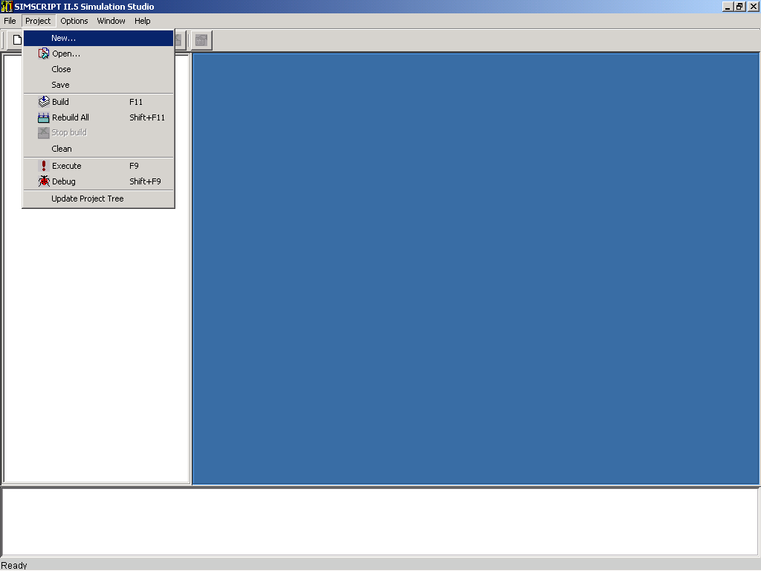
New Project

Slide 32
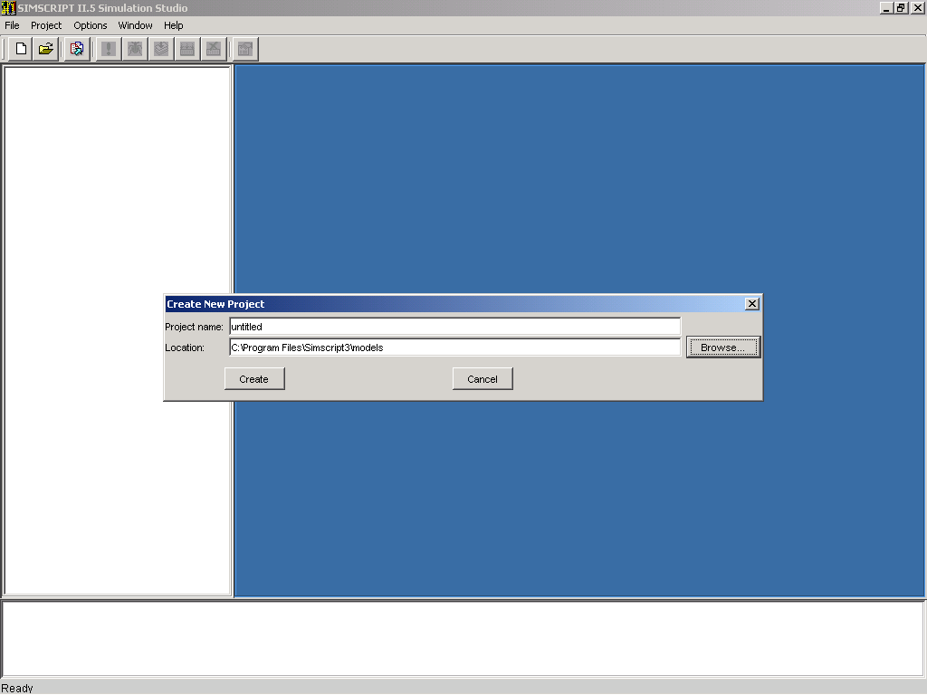
Select Directory for Project

Slide 33
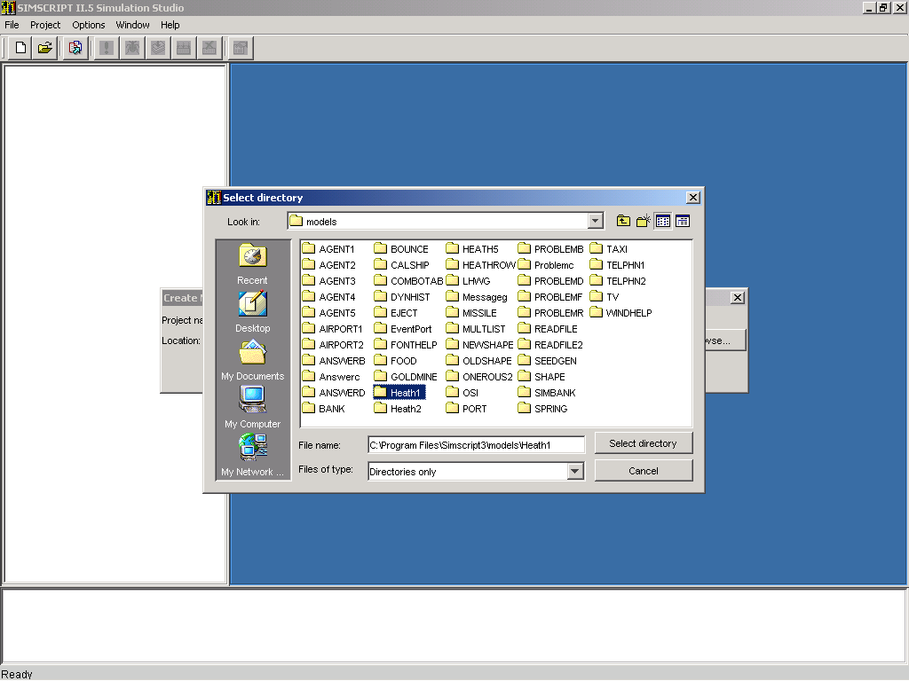
Open Directory

Slide 34
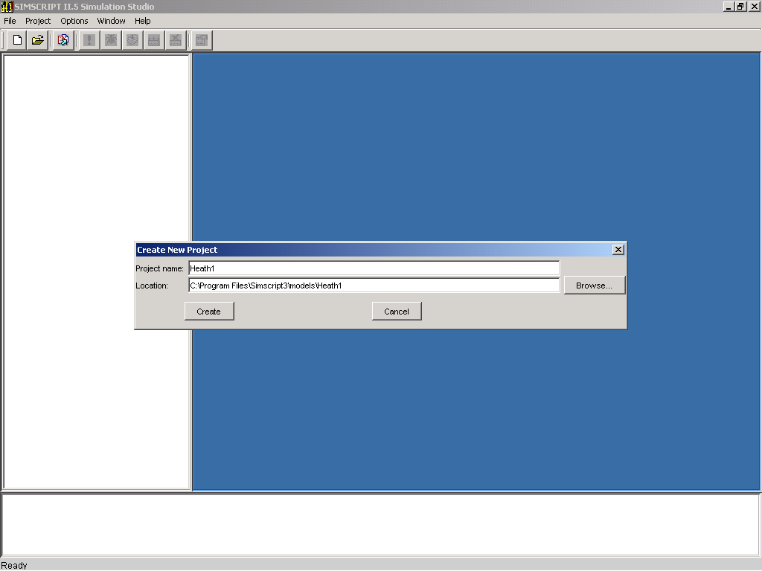
Enter Project Name and Create

Slide 35
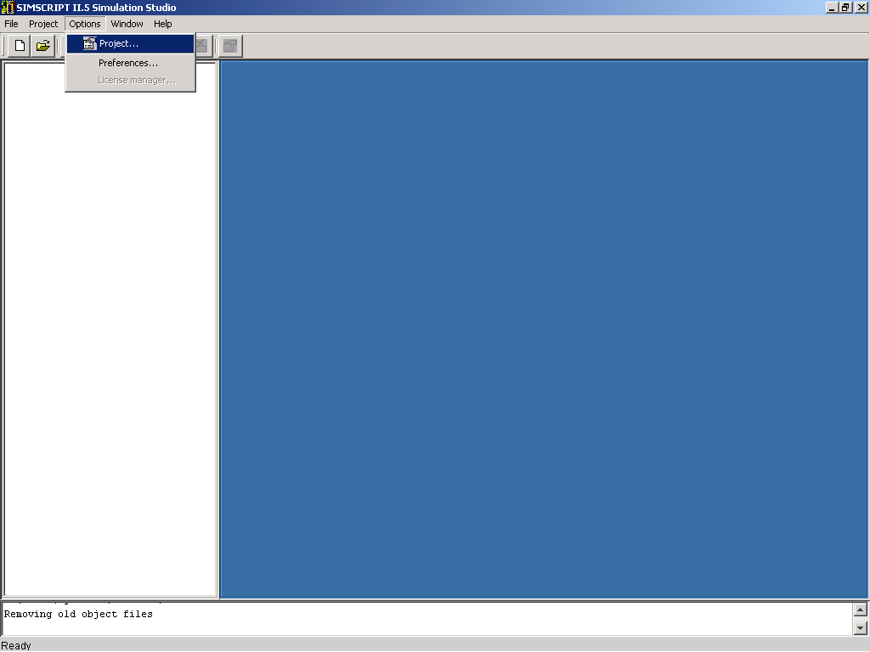
Select Project Options

Slide 36
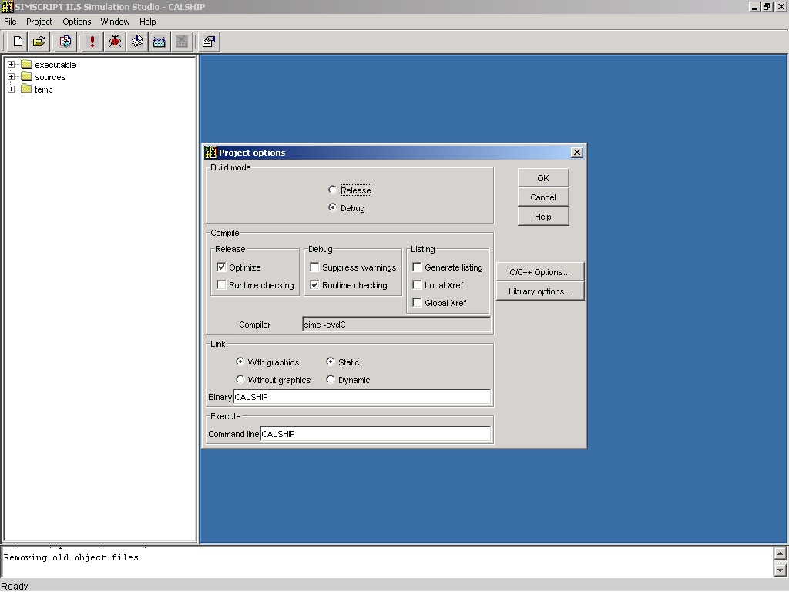
Set Project Options

Slide 37
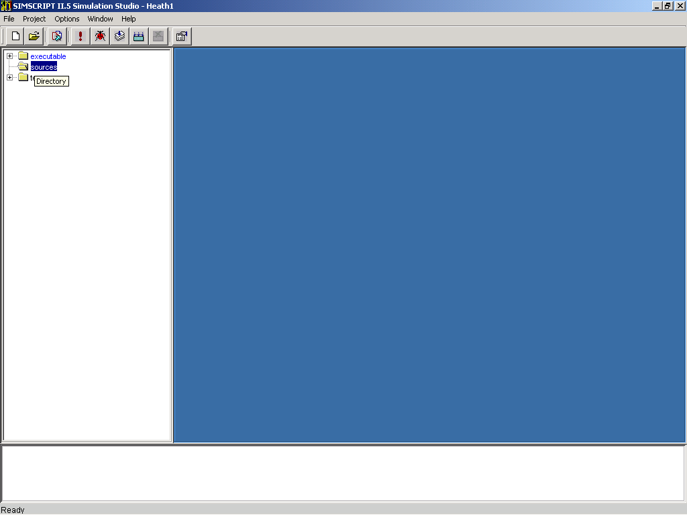
Select “sources”

Slide 38
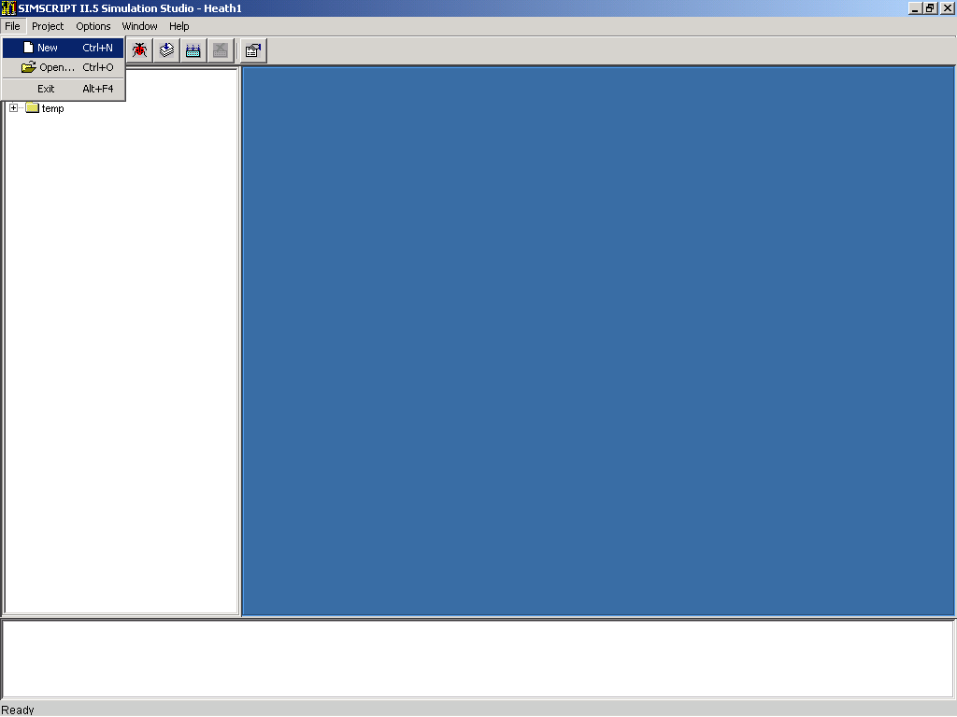
Create new file

Slide 39
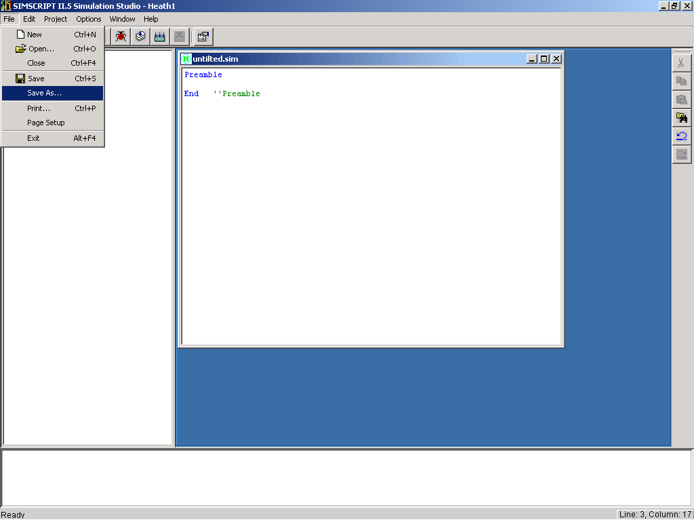
Create Preamble

Slide 40
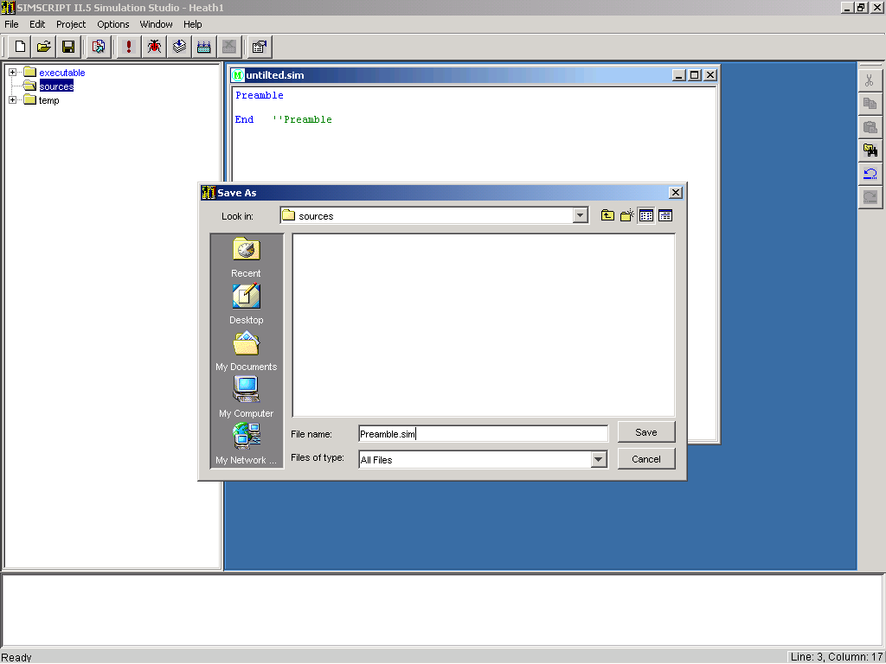
Save Preamble

Slide 41
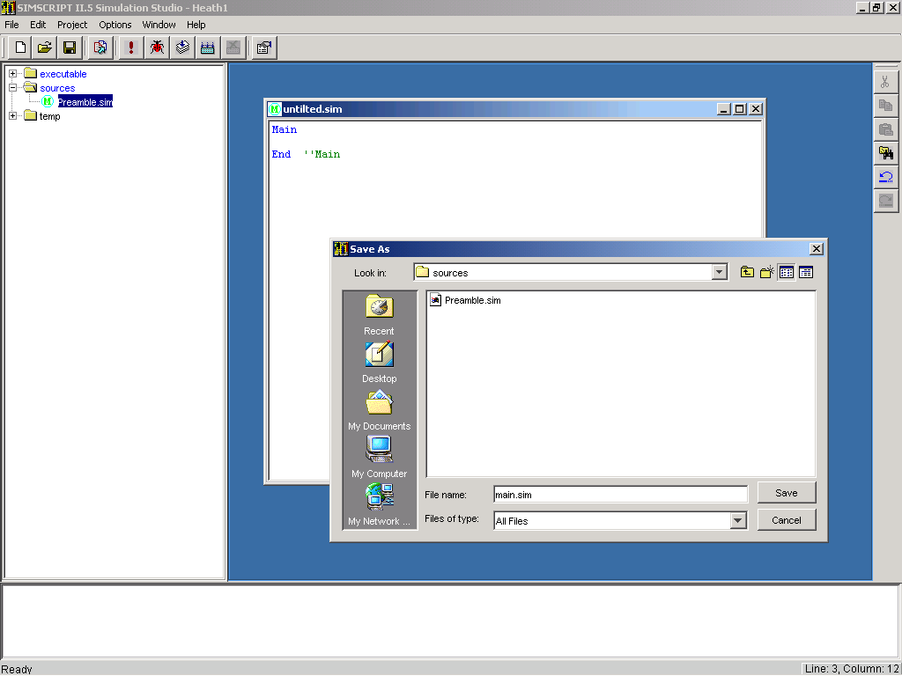
Repeat for Main

Slide 42
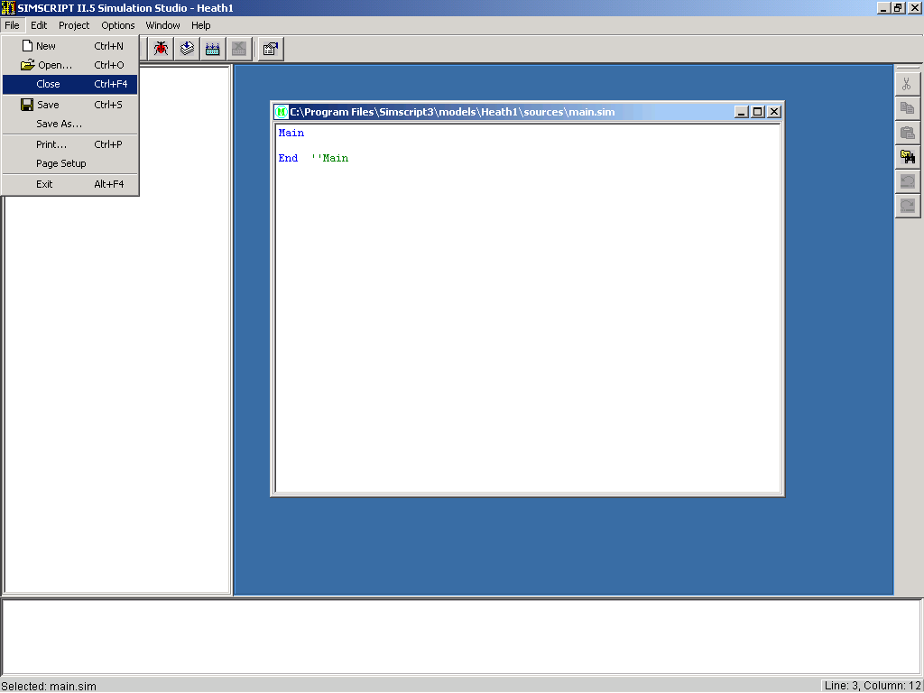
Close the files

Slide 43

Change Indicator

Slide 44
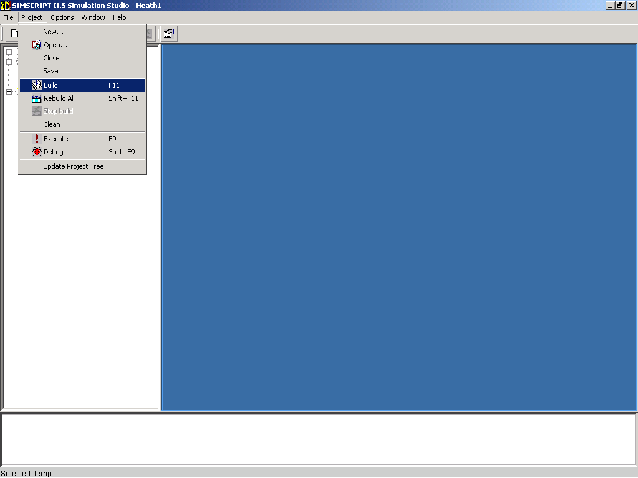
Build Project

Slide 45
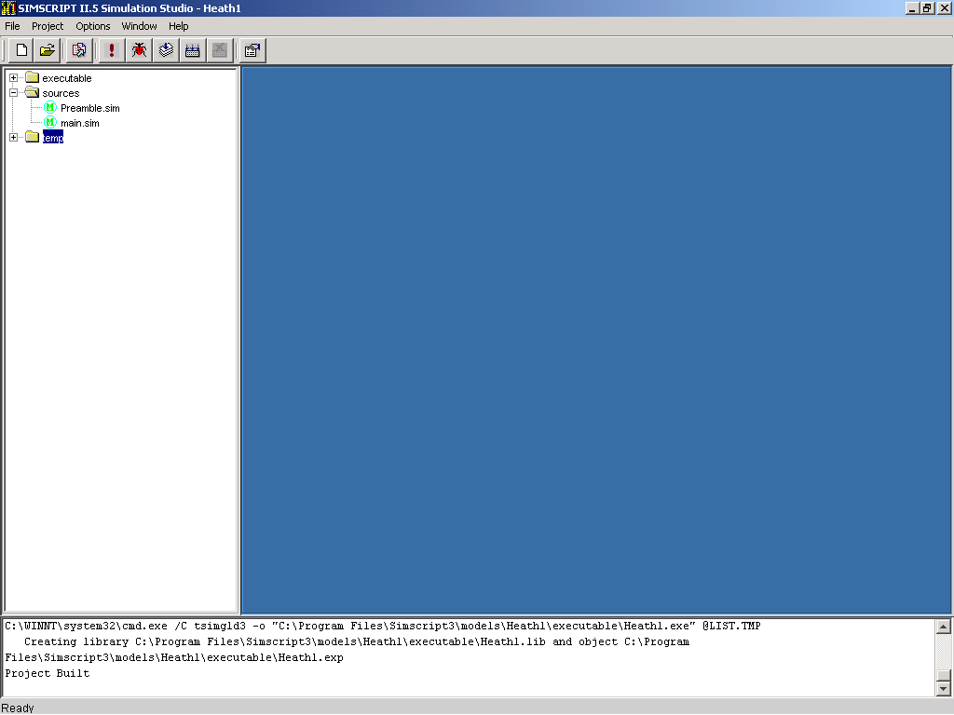
Build Results Indicator

Slide 46
Status Messages

Slide 47

Edit Main

Slide 48
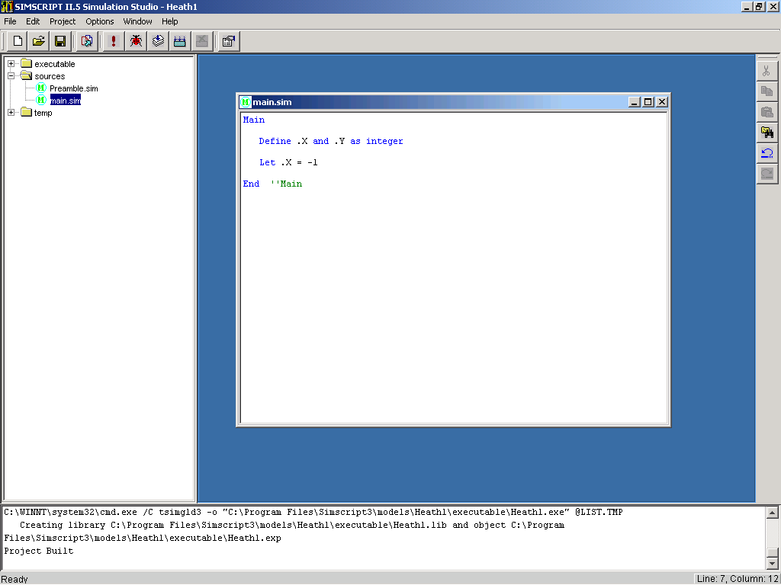
Example Incorrect Code

Slide 49
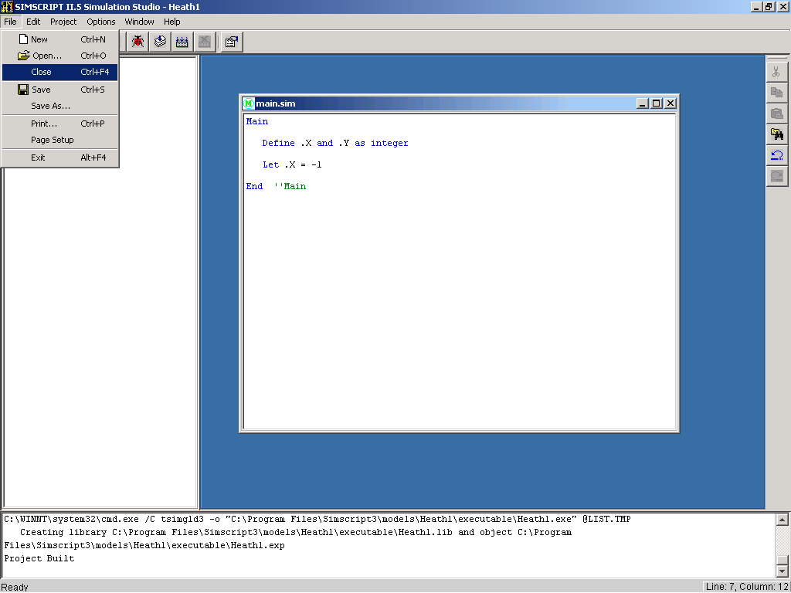
Close Main without Saving

Slide 50
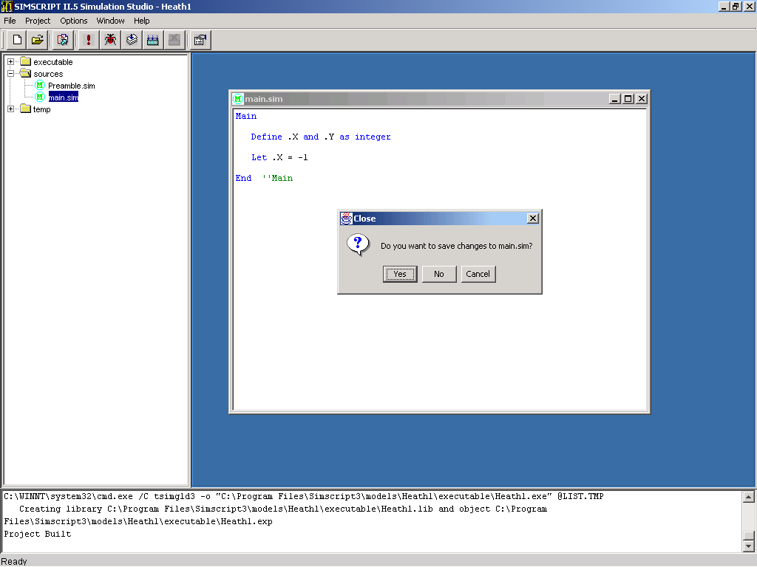
Save Main

Slide 51
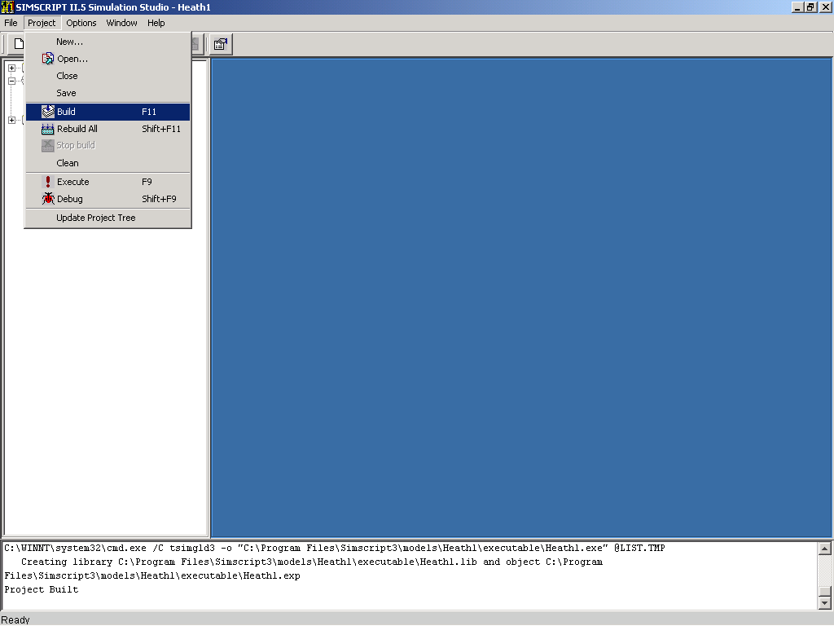
Build Project

Slide 52
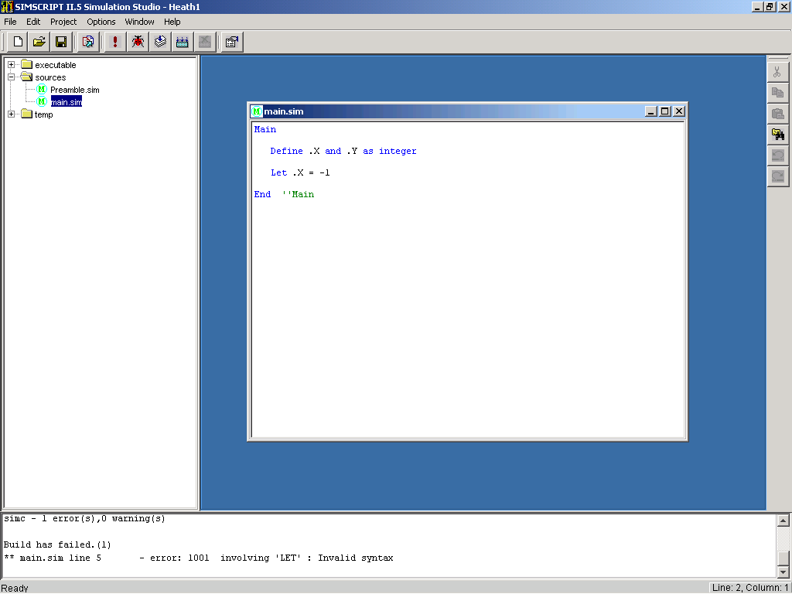
Error Indicator

Slide 53
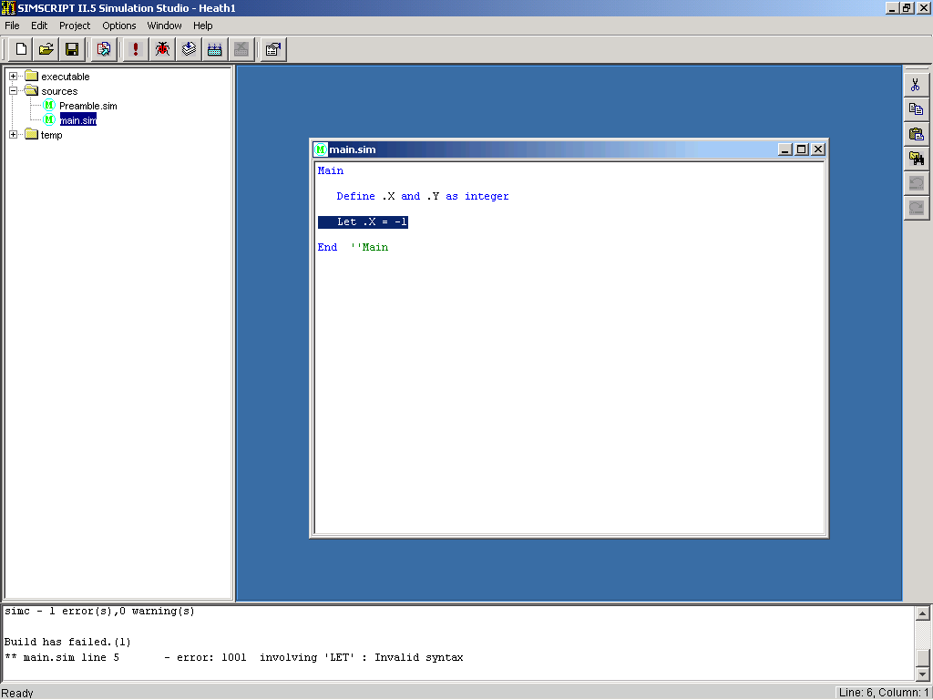
Double Click on Error Statement

Slide 54
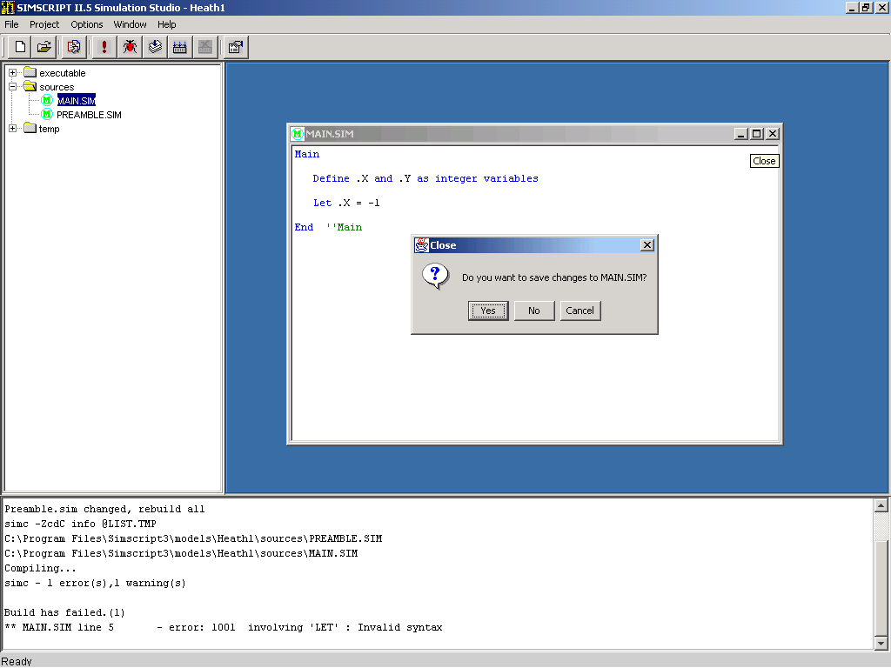
Edit Main and save when closing

Slide 55
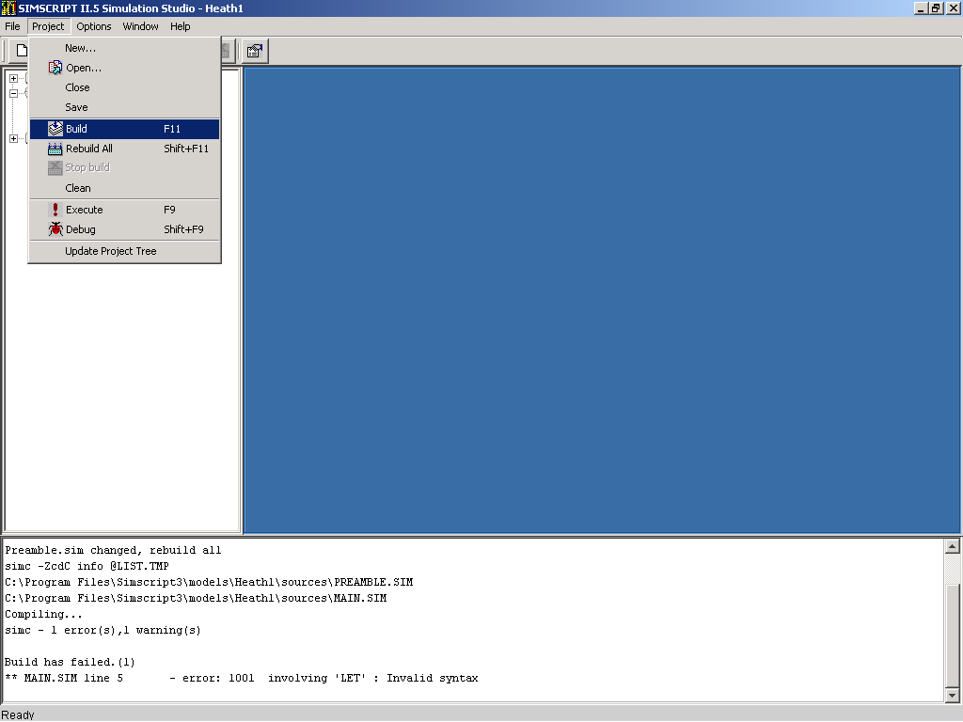
Build

Slide 56
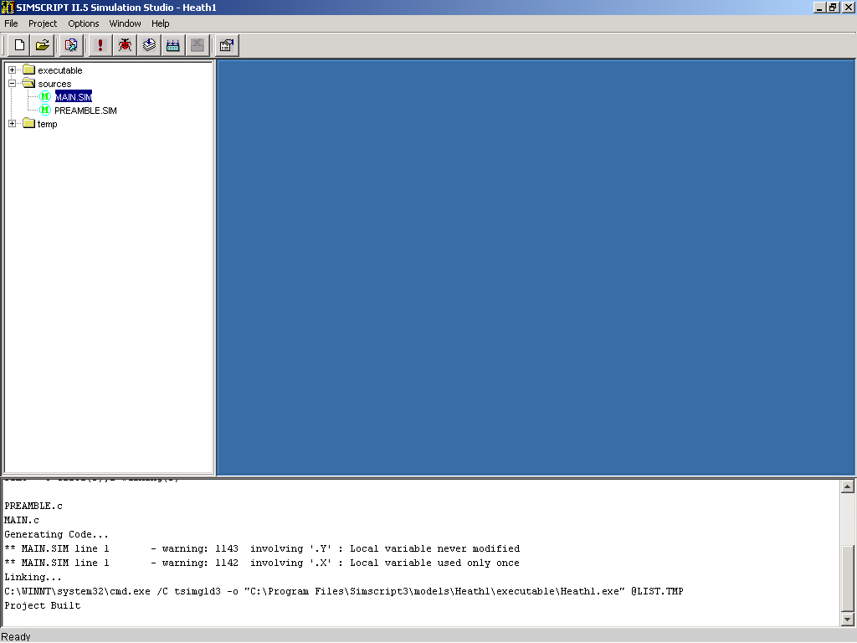
Warning Messages

Slide 57
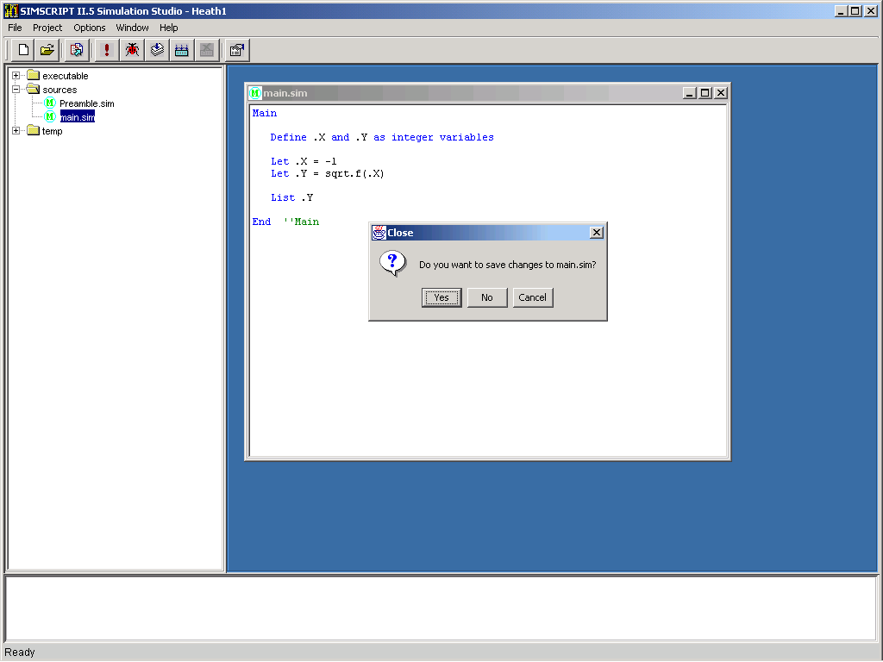
Edit Main and Save when Closing

Slide 58
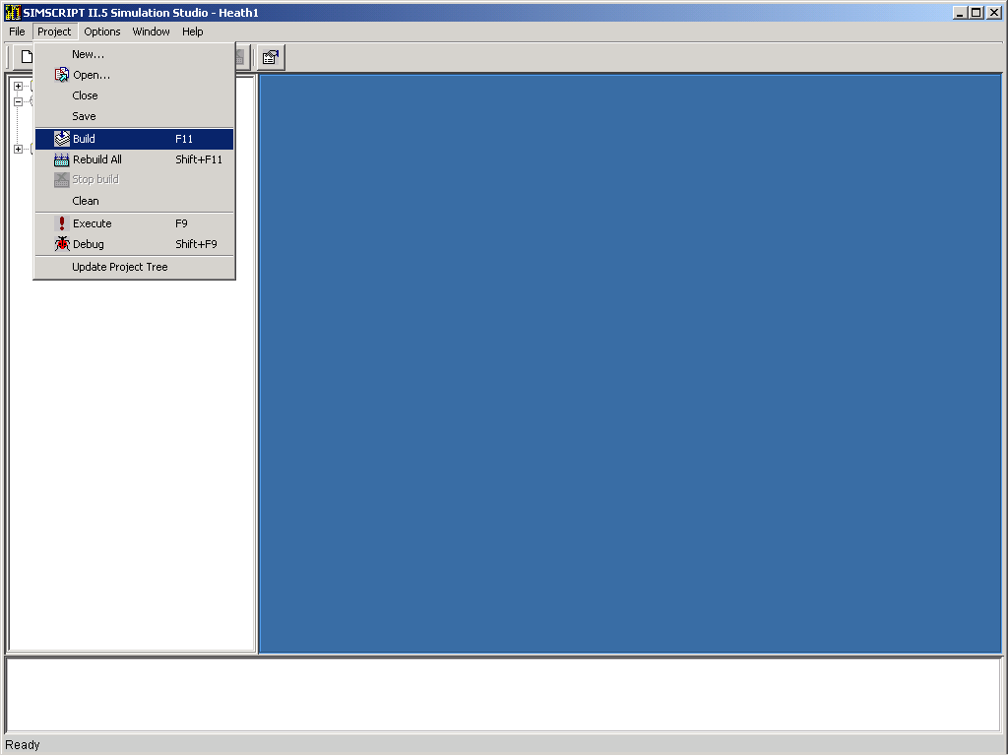
Build Project

Slide 59
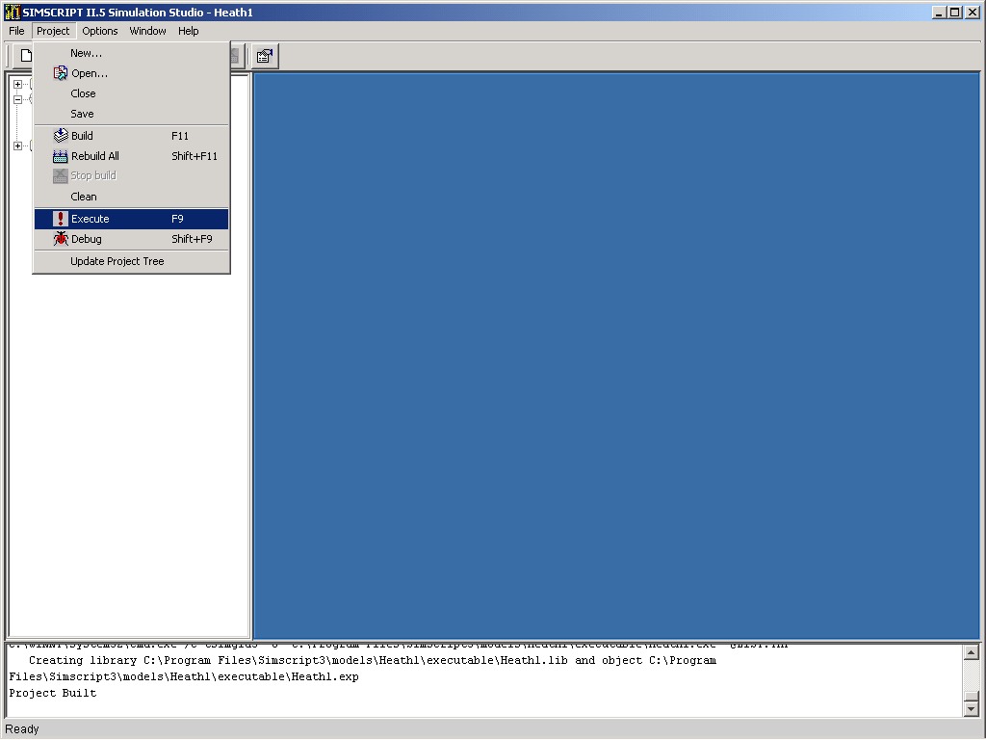
Execute Project

Slide 60
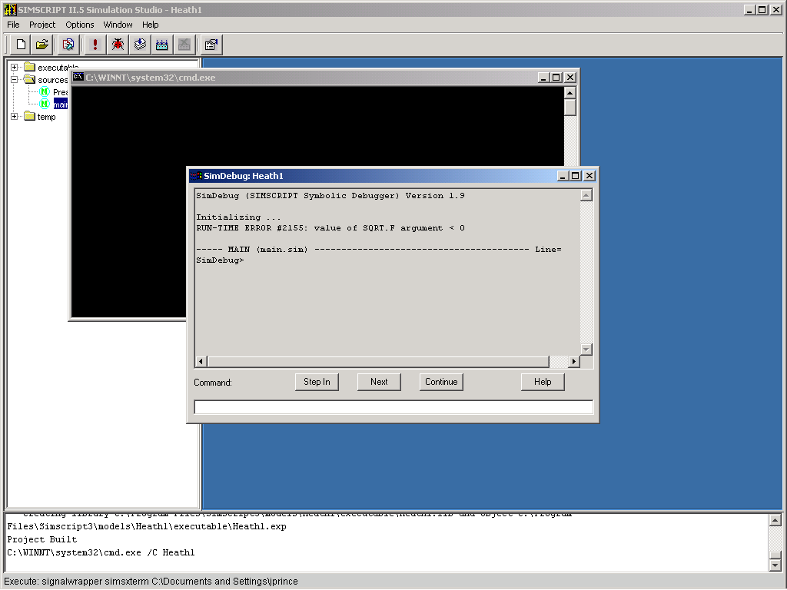
Runtime Debugger

Slide 61
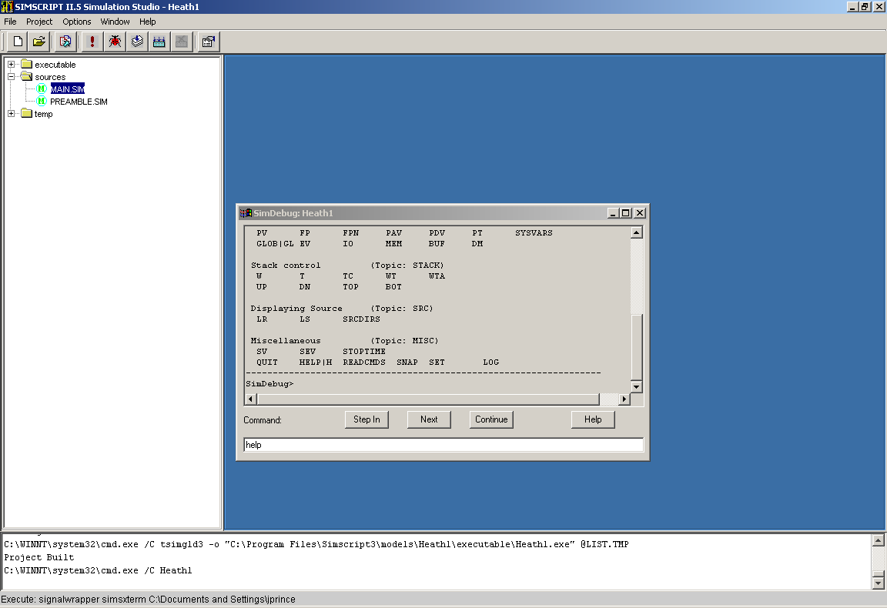
Debugger Commands

Slide 62
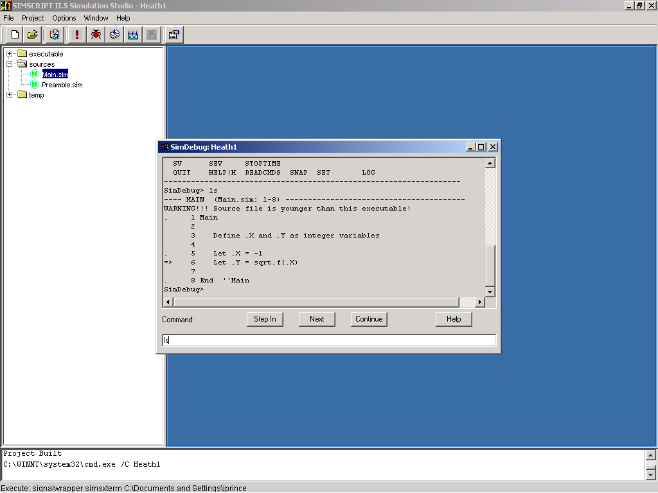
List Command (i.e. "ls")

Slide 63
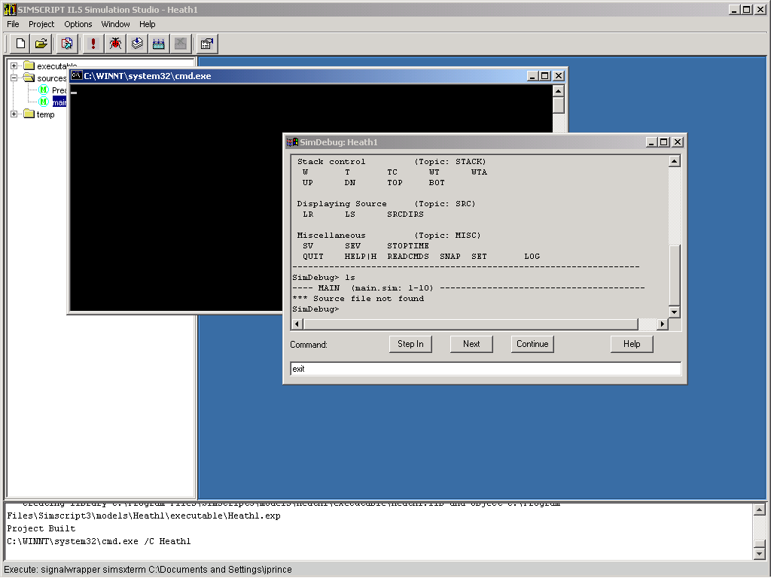
Exit Debugger

Slide 64
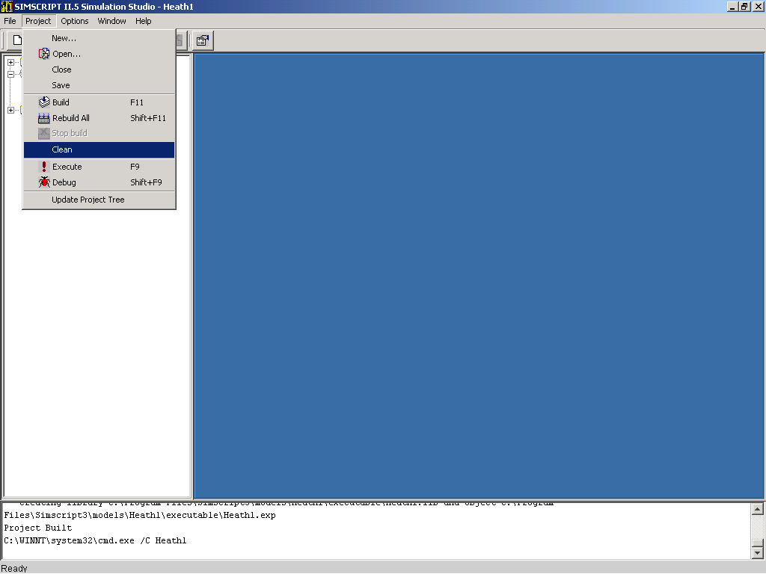
Cleanup Project

Slide 65
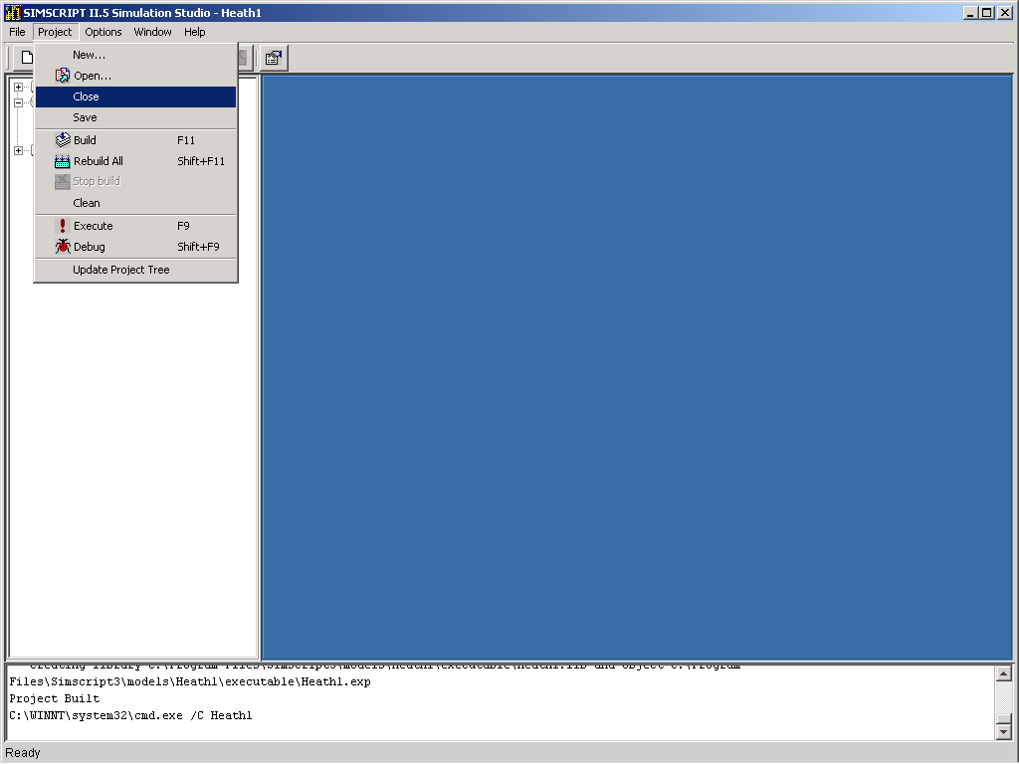
Close Project

Slide 66
This page is intentionally blank

Slide 67
Exercise 2
Heathrow Airport
C:\Program Files\Simscript3\models\ProblemF

Slide 68
Heathrow Airport
Heathrow Airport, near London, has a fixed number of landing approaches. Each approach has a set of check points.
Given an approach, an aircraft starts at the first check point, flies to each check point in turn until it lands at the last one.
The data is in a file called WESTAPR.DAT
Write a program to create the appropriate entities, read the data and print it. List the attributes of all check points in each approach.

Slide 69
WESTAPR.DAT
'' This file lists the western approaches to Heathrow Airport,
'' London England
'' The first number is the number of approaches
'' This is followed by the name of the approach
'' Each approach is followed by a check point consisting
'' of the check point number and the X,Y coordinates
'' in miles from the origin
4 Western approaches to Heathrow Airport, London
Polar
6 0 20
5 10 15
4 10 10
3 13 10
2 16 14
1 20 14
Western
7 0 9
5 10 15
4 10 10
3 13 10
2 16 14
1 20 14

Slide 70
Southern
8 10 0
5 10 15
4 10 10
3 13 10
2 16 14
1 20 14
Continental
10 15 5
9 20 2
5 10 15
4 10 10
3 13 10
2 16 14
1 20 14

