Slide 1
Day 2
☞
Section 3 - Introduction to Process Simulation
  Modeling the Passage of Time
  Processes
  Randomness
  Exercise 3
Section 4 - Process Simulation II
  Time
  Resources
  Implementation of the Process Approach
  Exercise 4

Slide 2
Section 3 - Introduction to Process Simulation
Part 1 - Modeling the Passage of Time

Slide 3
Modeling the Passage of Time
Suppose we have a telephone system consisting of two incoming lines. Calls arrive at a certain rate. If a line is free, the call is answered and the line is tied up for a certain amount of time, then released.
If both lines are busy, the caller hangs up, and the call is lost. We want to simulate the operation of the system and keep track of the number of lost calls.
  How do you model this?
  How do you write a SIMSCRIPT II.5 program to simulate it?
  How does SIMSCRIPT II.5 take care of the details?

Slide 4
Modeling the Passage of Time (continued)
Process
Events
Start
End
Start
End
Call
Call
Call
Call
Line 1
Activity
Start
End
Call
Call
Line 2
Another
Call

Slide 5
Modeling the Passage of Time (continued)
An event is instantaneous
  Something of importance happens at an event (change of state)
    Global variable changes
    Entity is changed, created, filed, removed or destroyed
    Another process or event is scheduled
Time passes by doing nothing until another event occurs. This passage of time is a called an activity
A process is a sequence of events and activities that affect an entity as it travels through our simulated system.

Slide 6
Next-event Time Advance
You don't move the clock ahead a certain amount then ask what has happened (fixed-increment time advance).
You ask when the next process is to occur, set the clock to that time, then execute the process.
The variable, time.v, is the clock

Slide 7
Section 3 - Introduction to Process Simulation
Part 2 - Processes

Slide 8
How do we Model a Process?
For a single instance of the process write down the steps in order of occurrence
  Instantaneous events
  Activities that take time
Activate it every time we want a process to occur
SIMSCRIPT II.5 will take care of the rest

Slide 9
How Does SIMSCRIPT II.5 Handle the Details?
    There are four key elements:
      The process notice
      The event set
      The timing routine
      The process routine

Slide 10
The Process Notice
A special type of temporary entity containing data needed to execute one copy or instance of the process; nine SIMSCRIPT II.5 attributes
    Preamble
    Processes include INCOMING.CALL
    End ''Preamble
Outside the preamble
    Activate an INCOMING.CALL at 8
Creates the process notice
Sets time.a to 8
Files the process notice in the event set

Slide 11
The Event Set
    A set ranked by low time.a
    Contains all process notices in order of occurrence
    It is called ev.s
    Processes begun by Start Simulation statement
      In main routine
      Must be one process in the event set before simulation starts

Slide 12
The Timing Routine
Start Simulation
Any
Process or Event
NO
Notices in the
Event Set
Return
YES
Select Process or Event Notice
with Earliest Execution Time
Update Simulation Clock to
Time of Process or Event
Determine type of
Process or Event
Remove Process or Event Notice
from the Event Set
Execute the Process or
Event Routine

Slide 13
Process Routine
    Process INCOMING.CALL
    If NUMBER.BUSY < 2
    Add 1 to NUMBER.BUSY
    Wait uniform.f (6.0,10.0,2) minutes
    Subtract 1 from NUMBER.BUSY
    Else
    Add 1 to LOST.CALLS
    Endif ''NUMBER.BUSY < 2
    End ''INCOMING.CALL

Slide 14
The Timing Routine (continued)
Wait statement transfers control back to time.r
Time.r
  Changes time.a to the current time plus waiting time.
  Records the number of the line last executed.
  Files the process notice back in the event set.
  Gets the next process notice.
When the waiting period is up, that is, this process notice is first in ev.s, time.r passes control back to the process routine at the line after the Wait statement.

Slide 15
Section 3 - Introduction to Process Simulation
Part 3 - Randomness

Slide 16
Probability Distributions
Simscript II.5 provides a number of built-in probability distributions:
      random.f erlang.f
      randi.f normal.f
      uniform.f log.normal.f
      poisson.f Weibull.f
      exponential.f binomial.f
      gamma.f triangular.f
      beta.f
Let .PROB = distrib(parameters, random number stream)
Let .PROB = uniform.f(1.0,5.0,2)
(Check the Reference Manual - Section 1.8, Table 6, System Functions, page 30 – In the online help, pick SIMSCRIPT II.5 - System functions.)
.

Slide 17
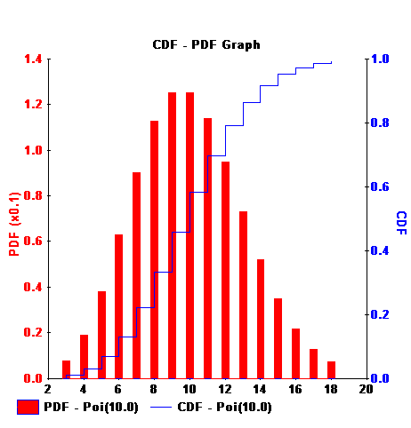
Poisson
Poisson process
  Customers arrive one at a time (no batches)
  The number of customers arriving in the time interval from T to T+S is independent of the number that arrived in the earlier time interval 0 to T. (This property would be violated if the number arriving from 0 to T caused some of the arrivals arriving from T to T+S to balk.)
  The distribution of the number of arrivals between T & T+S is independent of T. (If we restrict our analysis to a short period - e.g., 1-hour peak traffic - assumption okay.)
Possible applications
  Message generation - number of message arrivals in a given interval of time

Slide 18
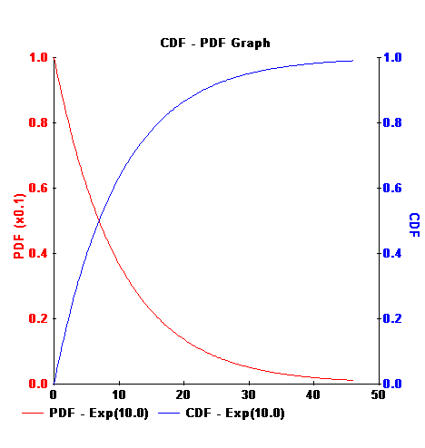
Exponential
Extensively used in queuing models
Memoryless property
  Remembering the time since the last event does not help in predicting the time until the next event
Possible applications
  Interarrival times for a Poisson process are exponentially distributed.
  Message length
  Reliability models (time between failure)
  Service time of devices

Slide 19
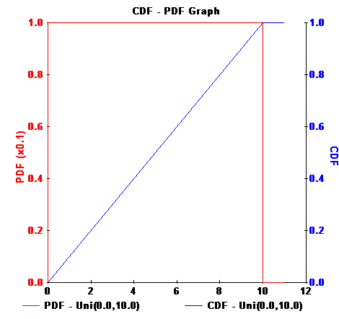
Uniform
Commonly used if a random variable has bounds and no other information is available
  Distance between source and destinations of messages on a network
  Seek time on a disk

Slide 20
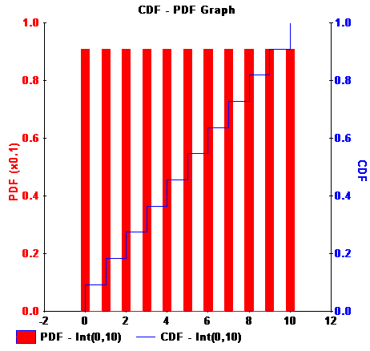
Uniform (Integer)
Discrete version of uniform
Possible applications
  I/O device number for next I/O
  Source & destination node for next packet on network
  Track numbers for seeks on a disk

Slide 21
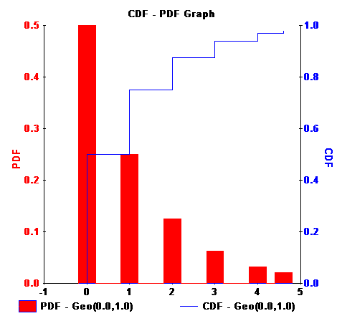
Geometric
The distribution of the number of trials up to and including the first success in a sequence of Bernoulli trials
  Bernoulli variate takes on values of failure or success, such as 0 or 1.
Discrete equivalent of exponential
Possible applications
  Number of local queries to database between successive accesses to remote database
  Number of packets successfully transmitted between retransmissions
  Number of successive error-free bits between in-error bits in a packet on a noisy links
  Batch sizes where batches arrive according to a Poisson distribution

Slide 22
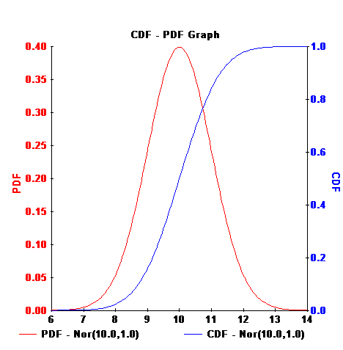
Normal
Used whenever randomness caused by several independent sources acting additively
  Errors in measurement
  Errors in modeling to account for a number of factors omitted from the model
  Sample means of a large number of independent observations from a distribution

Slide 23
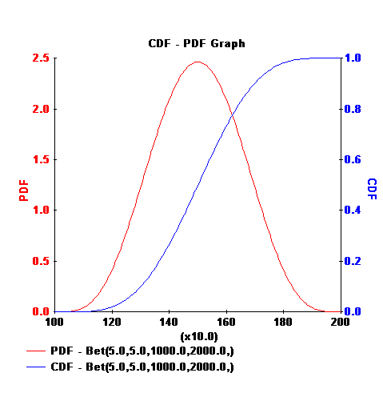
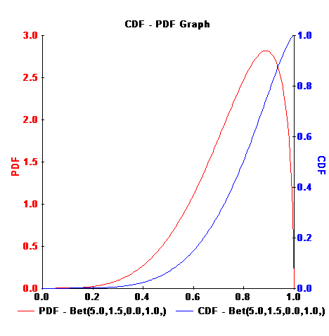
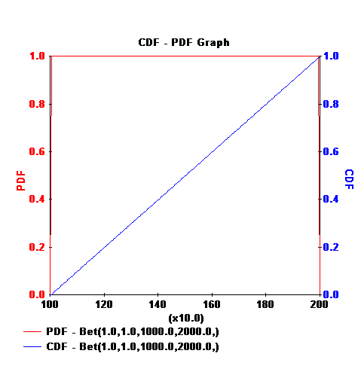
Beta Distribution
Very flexible distribution
  Shape parameter A = B = 1 => uniform
  If shape parameters are equal and greater than 1, the Beta approaches a normal distribution without infinite tails
Possible applications
  Often used where a normal distribution expected because it lacks infinite tails
  Time to complete a task

Slide 24
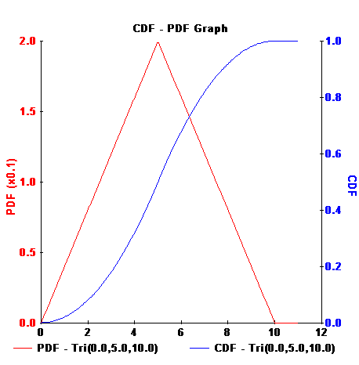
Triangular Distribution
Interview “those in the know”
  minimum
  maximum
  “typical value”
Possible applications
  Often used as a first approximation in the absence of data

Slide 25
Exercise 3
The Telephone Model
C:\Program Files\Simscript3\models\Telphn1

Slide 26
The Telephone Model
Introduction to Process Simulation
  Process generator
  What happens to entities when process is activated
  How are entities disposed?
Try adding code to
  Run the simulation as long as the user wants
    [Hint - time.v is the simulation clock]
  Calculate the average processing time for each telephone call

Slide 27
1 Preamble
2
3 '' A simple telephone system model - CACI Products Company
4 '' files: TELPHN1.SRC
5
6 Normally mode is undefined
7
8 Processes include
9 GENERATOR
10
11 Every INCOMING.CALL has
12 a CALL.ID
13
14 Define CALL.ID as an integer variable
15
16 Define NUMBER.BUSY and
17 LOST.CALLS
18 as integer variables
19
20 End ''Preamble
1 Main
2 Activate a GENERATOR now
3
4 Start simulation
5
6 Print 1 line with LOST.CALLS thus
15 phone calls were made and ** were lost due to busy lines

Slide 28
8
9 Read as / using unit 5
10
11 End ''Main
1 Process GENERATOR
2
3 Define .I as an integer variable
4
5 For .I = 1 to 15
6 Do
7
8 Activate a INCOMING.CALL now
9 Let CALL.ID(INCOMING.CALL) = .I
10
11 Wait uniform.f (2.0, 6.0, 1) minutes
12
13 Loop ''I = 1 to 15
14
15 End ''GENERATOR
1 Process INCOMING.CALL
2
3 If NUMBER.BUSY < 2
4
5 Add 1 to NUMBER.BUSY
6 Wait uniform.f(6.0, 10.0, 2) minutes

Slide 29
7 Subtract 1 from NUMBER.BUSY
8
9 Else
10
11 Add 1 to LOST.CALLS
12
13 Endif ''NUMBER.BUSY < 2
14
15 End ''INCOMING.CALL

Slide 30
At 0. minutes, the GENERATOR is at line -1 prior to execution.
At 0. minutes, call 1 is at line -1. Number busy = 0 and Lost calls = 0.
At 5.7 minutes, the GENERATOR completes line 8.
At 5.7 minutes, call 2 is at line -1. Number busy = 1 and Lost calls = 0.
At 6.7 minutes, call 1 completes line 6. Number busy = 2 and Lost calls = 0
At 8.4 minutes, the GENERATOR completes line 8.
At 8.4 minutes, call 3 is at line -1. Number busy = 1 and Lost calls = 0.
At 11.4 minutes, the GENERATOR completes line 8.
At 11.4 minutes, call 4 is at line -1. Number busy = 2 and Lost calls = 0.
At 12.4 minutes, call 2 completes line 6. Number busy = 2 and Lost calls = 1
At 17.3 minutes, the GENERATOR completes line 8.
At 17.3 minutes, call 5 is at line -1. Number busy = 1 and Lost calls = 1.
At 17.9 minutes, call 3 completes line 6. Number busy = 2 and Lost calls = 1
At 20.3 minutes, the GENERATOR completes line 8.
At 20.3 minutes, call 6 is at line -1. Number busy = 1 and Lost calls = 1.
At 23.6 minutes, call 5 completes line 6. Number busy = 2 and Lost calls = 1
At 25.7 minutes, the GENERATOR completes line 8.
At 25.7 minutes, call 7 is at line -1. Number busy = 1 and Lost calls = 1.
At 27.4 minutes, call 6 completes line 6. Number busy = 2 and Lost calls = 1
At 30.3 minutes, the GENERATOR completes line 8.
At 30.3 minutes, call 8 is at line -1. Number busy = 1 and Lost calls = 1.
At 33.4 minutes, call 7 completes line 6. Number busy = 2 and Lost calls = 1

Slide 31
At 35.6 minutes, the GENERATOR completes line 8.
At 35.6 minutes, call 9 is at line -1. Number busy = 1 and Lost calls = 1.
At 39.3 minutes, the GENERATOR completes line 8.
At 39.3 minutes, call 10 is at line -1. Number busy = 2 and Lost calls = 1.
At 39.6 minutes, call 8 completes line 6. Number busy = 2 and Lost calls = 2
At 42.2 minutes, the GENERATOR completes line 8.
At 42.2 minutes, call 11 is at line -1. Number busy = 1 and Lost calls = 2.
At 45.3 minutes, call 9 completes line 6. Number busy = 2 and Lost calls = 2
At 46.0 minutes, the GENERATOR completes line 8.
At 46.0 minutes, call 12 is at line -1. Number busy = 1 and Lost calls = 2.
At 49.0 minutes, the GENERATOR completes line 8.
At 49.0 minutes, call 13 is at line -1. Number busy = 2 and Lost calls = 2.
At 50.6 minutes, call 11 completes line 6. Number busy = 2 and Lost calls = 3
At 53.9 minutes, call 12 completes line 6. Number busy = 1 and Lost calls = 3
At 54.3 minutes, the GENERATOR completes line 8.
At 54.3 minutes, call 14 is at line -1. Number busy = 0 and Lost calls = 3.
At 59.5 minutes, the GENERATOR completes line 8.
At 59.5 minutes, call 15 is at line -1. Number busy = 1 and Lost calls = 3.
At 62.4 minutes, call 14 completes line 6. Number busy = 2 and Lost calls = 3
At 65.0 minutes, the GENERATOR completes line 8.
At 68.0 minutes, call 15 completes line 6. Number busy = 1 and Lost calls = 3
15 phone calls were made and 3 were lost due to busy lines

