Slide 1
Day 2
Section 3 - Introduction to Process Simulation
  Modeling the Passage of Time
  Processes
  Randomness
  Exercise 3
Section 4 - Process Simulation II
  Time
  Resources
  Implementation of the Process Approach
  Exercise 4
☞

Slide 2
Section 4 - Process Simulation II
Part 1 - Time

Slide 3
Time
Activate must have a time phrase (Outside the Preamble)
    Activate a DEPARTURE at 8
    Activate a DEPARTURE in 20 minutes
    Activate a DEPARTURE now
Wait (and its synonym, Work) must have a time phrase
    Wait 10 minutes
Nothing else has a time phrase: you have to carry that in your head
    Let .UNLOADING.TIME = 21 ''hours

Slide 4
Time (continued)
Time.v is a double precision variable which represents the simulation clock. The simulation clock, time.v, advances in time by units. Units default to days. SIMSCRIPT II.5 recognizes days, hours, minutes.
    Wait 2 days
    Wait 48 hours
    Wait 2880 minutes
    hours.v = 24
    minutes.v = 60
All calculations done in days (i.e. units)
    Wait 48 hours
    Let time.a(process notice) = 48/hours.v + time.v

Slide 5
Time (continued)
You can change units
In Preamble
  Define MILLISECONDS to mean days
  Define MICROSECONDS to mean hours
  Define NANOSECONDS to mean minutes
Outside of Preamble
  Let hours.v = 1000
  Let minutes.v = 1000
  Wait 32 nanoseconds
You can add units
  Define PICOSECONDS to mean /1000 NANOSECONDS
  Wait 32000 picoseconds

Slide 6
Time (continued)
Define MILLISECONDS to mean units
Define MICROSECONDS to mean /1000 MILLISECONDS
Define NANOSECONDS to mean /1000000 MILLISECONDS
      Wait 100 MICROSECONDS
      Wait 100 /1000 MILLISECONDS
      Wait 0.1 Units

Slide 7
Time (continued)
  Define minutes to mean units
  Define minute to mean units
Be careful about redefining hours or minutes as units
hours.v and minutes.v still apply and may have to be adjusted

Slide 8
This page is intentionally blank

Slide 9
Section 4 - Process Simulation II
Part 2 - Resources

Slide 10
Resources
Resources are variants of permanent entities
  Preamble
    Resources include RUNWAY.GROUP
  End ''Preamble
  Routine INITIALIZE.RESOURCES
    Create every RUNWAY.GROUP(2)
    Let U.RUNWAY.GROUP (1) = 2
    Let U.RUNWAY.GROUP (2) = 3
  End ''INITIALIZE.RESOURCES

Slide 11
Using Resources
Process AIRPLANE
  ...
  Request 1 RUNWAY.GROUP(2)
  Wait 2 minutes
  Relinquish 1 RUNWAY.GROUP(2)
  ...
End ''AIRPLANE

Slide 12
More Details on Resources
Each type of resource has a total number of units (servers) of that type available and two sets
    U.RUNWAY.GROUP(type)
    Q.RUNWAY.GROUP(type) N.Q.RUNWAY.GROUP(type)
    X.RUNWAY.GROUP(type) N.X.RUNWAY.GROUP(type)

Slide 13
More Details on Resources (continued)
Multi-Queue, Multi-Server
Single-Queue, Multi-Server
Let N.RUNWAY.GROUP = 3
Create every RUNWAY.GROUP
Let U.RUNWAY.GROUP(1) = 2
Let U.RUNWAY.GROUP(2) = 1
Let U.RUNWAY.GROUP(3) = 2
Let N.RUNWAY.GROUP = 1
Create every RUNWAY.GROUP
Let U.RUNWAY.GROUP(1) = 5

Slide 14
More Details on Resources (continued)
8 Airplanes in processing
Single-Queue, Multi-Server
Multi-Queue, Multi-Server
(1) (2) (3)
(1)
0
0
0
U.RUNWAY.GROUP
N.X.RUNWAY.GROUP
N.Q.RUNWAY.GROUP
0
U.RUNWAY.GROUP
N.X.RUNWAY.GROUP
N.Q.RUNWAY.GROUP
2
1
2
5
1
0
2
3

Slide 15
Resource Modeling
Once you request a resource of a certain type,
you stay there until you get it
You can't take a resource away from someone else,
but you can go ahead of others in line
  Request 1 RUNWAY.GROUP(2) with priority 5

Slide 16
Section 4 - Process Simulation II
Part 3 - Implementation of the Process Approach

Slide 17
The Airport Model
Consider an airport with two groups of runways.
An airplane will be assigned to one group of runways or the other depending on which has the shortest line relative to the total number of runways.
The user will be asked to enter the number of runways of each type.
Calculate the maximum waiting time and maximum number of aircraft waiting at any one time.

Slide 18
The Airport Model (continued)
We will model the departure as a process, called DEPARTURE.
Departures will be activated by a DEPARTURE.GENERATOR.
RUNWAY.GROUP will be a resource and there will be two types of runways.
A FINAL.REPORT will be a process. Not necessary but a useful technique.

Slide 19
The Airport Model (continued)
Takeoff Method
Depart
Arrive
Start
End
Events
Gate
Runway
Takeoff
Takeoff
Taxi
Wait
Takeoff
Time

Slide 20
1 Preamble
2
3 '' The Airport Model using processes - CACI Products Company
4 '' files: AIRPORT2.SRC
5
6 Normally mode is undefined
7
8 Processes include
9 DEPARTURE.GENERATOR,
10 DEPARTURE and
11 FINAL.REPORT
12
13 Resources
14 Every RUNWAY has
15 a RWY.TOTAL.RUNWAYS and
16 a RWY.MAX.NO.OF.WAITING.AIRPLANES
17
18 Define RWY.TOTAL.RUNWAYS and
19 RWY.MAX.NO.OF.WAITING.AIRPLANES
20 as integer variables
21
22 '' Global variables
23
24 Define MINIMUM.INTER.DEPARTURE.TIME,
25 MAXIMUM.INTER.DEPARTURE.TIME,
26 MINIMUM.TAKE.OFF.TIME,
27 MAXIMUM.TAKE.OFF.TIME,
28 MAX.WAITING.TIME and
29 RUN.LENGTH
30 as real variables
31
32 End ''Preamble

Slide 21
1 Main
2
3 Call READ.DATA
4
5 Activate a FINAL.REPORT in RUN.LENGTH hours
6 Activate an DEPARTURE.GENERATOR now
7
8 Start simulation
9
10 End ''Main

Slide 22
1 Routine READ.DATA
2
3 Print 3 lines thus
Enter the shortest and longest times between airplane departures
(in minutes)
Shortest time:
7 Read MINIMUM.INTER.DEPARTURE.TIME
8
9 Print 1 line thus
Longest time:
11 Read MAXIMUM.INTER.DEPARTURE.TIME
12
13 Print 2 lines thus
Enter the shortest and longest takeoff times (in minutes)
Shortest time:
16 Read MINIMUM.TAKE.OFF.TIME
17
18 Print 1 line thus
Longest time:
20 Read MAXIMUM.TAKE.OFF.TIME
21
22 Create every RUNWAY(2)
23 For each RUNWAY
24 Do
25 Print 1 line with RUNWAY thus
Enter the number of runways in group *:
27 Read RWY.TOTAL.RUNWAYS(RUNWAY)
28 Let U.RUNWAY(RUNWAY) = RWY.TOTAL.RUNWAYS(RUNWAY)
29 Loop ''each RUNWAY
30
31 Print 1 line thus
Enter the run length (in hours):
33 Read RUN.LENGTH
34
35 End ''READ.DATA

Slide 23
1 Process DEPARTURE.GENERATOR
2
3 Define .TIME.TO.QUIT as a real variable
4
5 Let .TIME.TO.QUIT = RUN.LENGTH / hours.v
6 Until time.v >= .TIME.TO.QUIT
7 Do
8 Activate an DEPARTURE now
9 Wait uniform.f(MINIMUM.INTER.DEPARTURE.TIME,
10 MAXIMUM.INTER.DEPARTURE.TIME,
11 1) minutes
12 Loop ''time.v >= .TIME.TO.QUIT
13
14 End ''DEPARTURE.GENERATOR

Slide 24
1 Process DEPARTURE
2
3 Define .BEGIN.WAIT.TIME and
4 .WAITING.TIME
5 as real variables
6 Define .MY.CHOICE as an integer variable
7
8 Let .BEGIN.WAIT.TIME = time.v
9 If (N.X.RUNWAY(1) + N.Q.RUNWAY(1)) / RWY.TOTAL.RUNWAYS(1) <=
10 (N.X.RUNWAY(2) + N.Q.RUNWAY(2)) / RWY.TOTAL.RUNWAYS(2)
11 Let .MY.CHOICE = 1
12 Else
13 Let .MY.CHOICE = 2
14 Endif ''(N.X.RUNWAY(1) + N.Q.RUNWAY(1)) / RWY.TOTAL.RUNWAYS(1) <=
15
16 Request 1 unit of RUNWAY(.MY.CHOICE)
17 Let .WAITING.TIME = time.v - .BEGIN.WAIT.TIME
18 Let MAX.WAITING.TIME = max.f(.WAITING.TIME, MAX.WAITING.TIME)
19 Work uniform.f(MINIMUM.TAKE.OFF.TIME,
20 MAXIMUM.TAKE.OFF.TIME,
21 2) minutes
22 Let RWY.MAX.NO.OF.WAITING.AIRPLANES(.MY.CHOICE)
23 = max.f(N.Q.RUNWAY(.MY.CHOICE),
24 RWY.MAX.NO.OF.WAITING.AIRPLANES(.MY.CHOICE))
25 Relinquish 1 unit of RUNWAY(.MY.CHOICE)
26
27 End ''DEPARTURE

Slide 25
1 Process FINAL.REPORT
2 Print 5 lines with time.v * hours.v,
3 MAX.WAITING.TIME * hours.v * minutes.v,
4 RWY.MAX.NO.OF.WAITING.AIRPLANES(1),
5 RWY.MAX.NO.OF.WAITING.AIRPLANES(2) thus
The simulation ended at **.* hours
The maximum waiting time for a runway was **.** minutes
The maximum number of aircraft waiting at any one time was:
Runway 1: **
Runway 2: **
11
12 Read as / using unit 5
13
14 Stop
15
16 End ''FINAL.REPORT

Slide 26
Enter the shortest and longest times between airplane departures
(in minutes)
Shortest time: 1
Longest time: 3
Enter the shortest and longest takeoff times (in minutes)
Shortest time: 3
Longest time: 5
Enter the number of runways in group 1: 1
Enter the number of runways in group 2: 1
Enter the run length (in hours): 10
The simulation ended at 10.0 hours
The maximum waiting time for a runway was 11.05 minutes
The maximum number of aircraft waiting at any one time was:
Runway 1: 3
Runway 2: 3

Slide 27
Memory for Processes
Memory for the process notices
  Each instance has a unique process notice with
  9 or more attributes
  In addition, memory to store local variables
Released when the process routine is finished

Slide 28
This page is intentionally blank

Slide 29
Exercise 4
The Pacific Port Problem
C:\Program Files\Simscript3\models\ProblemB

Slide 30
The Pacific Port Problem
Tankers unload crude oil in San Pedro, California from overseas. Interarrival times are uniformly distributed with a minimum of 4 hours and a maximum of 18 hours.
Three classes of ships are served. They have different unloading times and probabilities of arrival as follows:
  Type Relative Frequency Unloading Time (hours)
  1 .25 18 +/- 2
  2 .55 24 +/- 3
  3 .20 36 +/- 4

Slide 31
The Pacific Port Problem (cont'd)
The port can unload as many as three ships simultaneously but only one tug serves the port. All tankers need the tug to move them into and out of the berths. When the tug is available, the movement times are one hour (each way).
Formulate a model and write a SIMSCRIPT II.5 program in order to determine the average and the maximum delays experienced by any ship and the total number of ships unloaded.
In a subsequent lab session, we shall be expanding on this model.
SELECT PROBLEMB

Slide 32
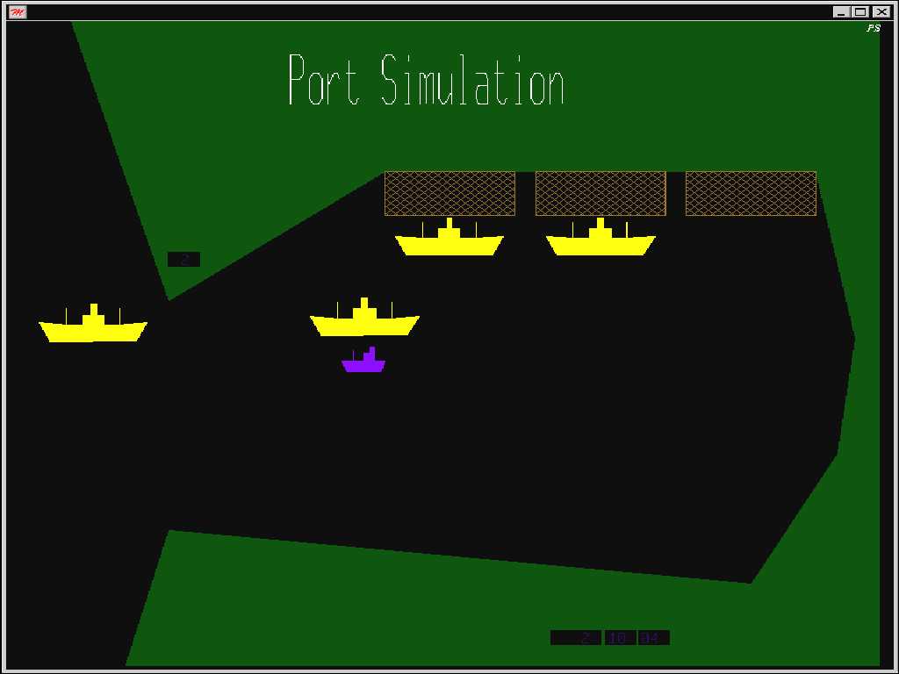
A Graphical View
(C:\Program Files\Simscript3\models\Port)

Slide 33
Preamble
'' Pacific Port Problem - CACI Products Company
'' Preliminary Code for Student Problem B
'' files: PROBLEMB.SRC
Normally mode is undefined
Resources include
DOCK,
TUG
'' Output global variables
Define WAITING.TIME as a real variable
Define TOTAL.WAITING.TIME and MAX.WAITING.TIME as real variables
Define NO.OF.SHIPS.SERVED as an integer variable
End ''Preamble

Slide 34
This page is intentionally blank

