Slide 1
EURO
The Association
of European Operational Research Societies within
IFORS
the International Federation of Operational Research Societies.
Silvano Martello
VP3 of EURO
University of Bologna, Italy

Slide 2
Contents
EURO and IFORS – Brief History
Some Facts
Member Societies
Instruments

Slide 3
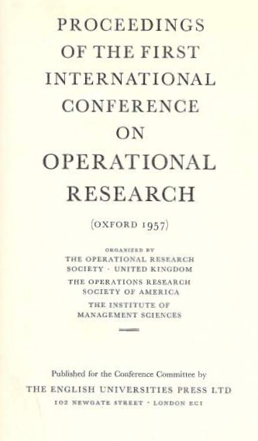
1. EURO and IFORS – Brief History
1957 – First International Conference (Oxford, UK)
1959 – IFORS
1975 – EURO - the first regional grouping of IFORS
.

Slide 4
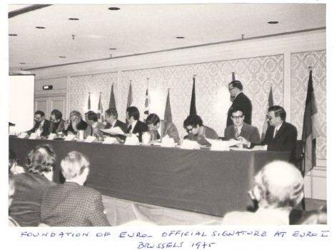
1. EURO and IFORS – Brief History
The EURO draft agreement was signed by 10 representatives from Belgium, Denmark, Finland, Germany, Great Britain, Greece, Ireland, Netherlands, Sweden, and Switzerland.

Slide 5
Contents
EURO – History
Some Facts
Member Societies
Instruments

Slide 6
2. EURO and IFORS – Some Facts
Regional Groups
ALIO Asociacion Latino-Ibero-Americana de Investigacion Operativa Latin American Ibero Association on Operations Research Website: www.dc.uba.ar/alio/index-en.htm
APORS The Association of Asian-Pacific Operational Research Societies Website: www.apors.asia
EURO The Association of European Operational Research Societies Website: www.euro-online.org
NORAM The Association of North American Operations Research Societies
The International Federation of Operational Research Societies (IFORS) is currently composed of 52 national societies.
Objectives:
- Sponsoring of international conferences and meetings;
- Encouraging the establishment of national operational research societies;
- Encouraging the teaching of operational research
BRINGING THE WORLD OF OPERATIONAL RESEARCH TOGETHER

Slide 7

2. EURO and IFORS – Some Facts
31 EURO Member societies: Austria, Belarus, Belgium, Croatia, Czech Republic, Denmark, Estonia, Finland, France, Germany, Greece, Hungary, Iceland, Ireland, Israel, Italy, Lithuania, The Netherlands, Norway, Poland, Portugal, Serbia, Slovakia, Slovenia, South Africa, Spain, Sweden, Switzerland, Tunisia, Turkey, United Kingdom

Slide 8
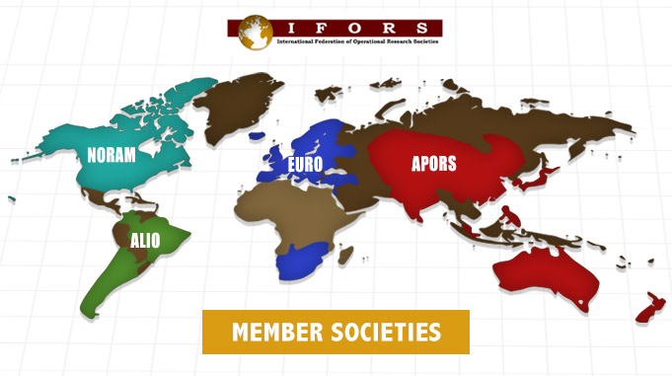
2. EURO and IFORS – Some Facts
31 EURO Member societies: Austria, Belarus, Belgium, Croatia, Czech Republic, Denmark, Estonia, Finland, France, Germany, Greece, Hungary, Iceland, Ireland, Israel, Italy, Lithuania, The Netherlands, Norway, Poland, Portugal, Serbia, Slovakia, Slovenia, South Africa, Spain, Sweden, Switzerland, Tunisia, Turkey, United Kingdom

Slide 9
2. EURO and IFORS – Some Facts
The aim of EURO is to promote Operational Research throughout Europe.
EURO is a "non profit" association domiciled in Switzerland. Its affairs are regulated by a Council consisting of representatives/alternates of all its members and an Executive Committee which constitutes its board of directors.
Council meetings are typically held annually, Executive Committee Meetings twice per year.

Slide 10
Contents
EURO – History
Some Facts
Member Societies
Instruments

Slide 11
3. Member Societies
The members of EURO are full members of IFORS and comprise the national OR societies of countries, most of whom are located within or nearby (in a broad sense) Europe.
EURO currently represents about 10,000 members of 31 national OR societies.

Slide 12
3. Member Societies
Membership of IFORS
http://ifors.org/web/application-for-membership/
A society applying for membership in the Federation shall provide the Secretary with a copy of its Constitution or Charter and its By Laws (in English) and a statement giving:
i. objectives of the society;
ii. confirmation that membership in the society is based on such scientific and professional qualifications as it has laid down, and that membership and its privileges are in no way restricted by race, religion, colour, national origin, sex, or political preference;
iii. names and addresses of the officers and the persons composing the governing body;
iv. procedures for the election of officers and members of the governing body;
v. qualifications for membership, dues, entrance fees;
vi. provisions for meetings and publications.

Slide 13
3. Member Societies
Membership of IFORS - benefits
Influencing IFORS activities by proposing new initiatives and through representation on Board of Representatives
Attending and organizing joint activities with other societies
Participating in the global and regional activities set up by IFORS
Eligibility for support for summer/winter schools and other activities
Fee for membership is USD$1.25/full member/year (min. $50)

Slide 14
3. Member Societies
Membership of EURO
National OR Societies who are already members of IFORS can apply to be members of a Regional Grouping.
An IFORS Vice-President is in the EURO EC. Currently:
Prof. Jacek Błazewicz
Poznań University of Technology, Poland
For EURO we would require the Statutes and a letter of application. If approved by the Executive Committee they would be passed to Council who would vote at the next meeting.
Fees for EURO membership are currently €100 per calendar year.

Slide 15
3. Member Societies
Membership of EURO - benefits
National OR Society members have access to various instruments funded by EURO, such as Summer/Winter Institutes, PhD Schools, Mini Conferences.
Encouraged to apply to host events such as EURO-k and other smaller events.
Eligible to be on the coordination boards of EURO Working Groups
Eligible to nominate candidates for EURO Gold Medal and EURO Distinguished Service Medal Award.
Eligible to apply for funds to support various activities.

Slide 16
Contents
EURO – History
Some Facts
Member Societies
Instruments

Slide 17
4. IFORS Instruments
IFORS Meetings: Coming Together to Share Ideas
The Triennial Conference, a tradition since 1957.
The 21st Triennial Conference will be held in Quebec City, Canada in July, 2017. It will attract over 1,500 participants from 45 countries http://ifors2017.ca/
The 22nd Triennial Conference will be held in Seoul, South Korea in 2020.
Distinguished Lectures and Tutorial Lectures funded by IFORS:
The IFORS Distinguished Lecture, typically a plenary session, recognizes worldwide contributions to O.R.
The IFORS Tutorial Lecture recognizes new research in emerging areas of O.R.

Slide 18
4. IFORS Instruments
IFORS Publications and Communications
The International Abstracts in Operations Research (IAOR) has a long tradition in collecting information on what is published worldwide in the area of operations research
The International Transactions in Operational Research (ITOR) carries methodological and applied articles with an important international outlook, with articles from very diverse countries, which reflect the IFORS membership.
Information a Click Away
IFORS News, an online quarterly magazine that carries information on iFORS, its members and OR related activites and initatives worldwide.
IFORS Website – a key tool in the promotion of OR internaitonally and a valuable resource for any practitioner or academic. www.ifors.org

Slide 19
4. IFORS Instruments
IFORS – Fostering the use of OR for Development
The International Conference on O.R. in Development (ICORD) provides a forum for researchers to interact and discuss issues of O.R. for development, and applications for developing countries.
The IFORS prize, awarded at the close of the triennial conference, recognizes exemplary work. It carries a grand prize of US $4,000 and a runner up prize of US $2000.
The Developing Country On-Line Resources page offers publicly-available materials on the topic of O.R. for Development.
IFORS – Education and Scholarships
IFORS sponsors scholarships for students to attend the EURO and ALIO Summer Schools.
Education Resources http://educationresources.ifors.org/

Slide 20
4. EURO Instruments
Conferences & Meetings funded by EURO
EURO-k Conferences
Attract ~2500 participants. Hosted by a national society.
The EURO-k conferences take place yearly, except the years when there is an IFORS triennial conference.
In the future, EURO will host a joint EWG meeting in the years of the IFORS conferences.
EURO Mini Conferences
To assemble a limited number of specialists around a specific theme.
Joint International Conferences
EURO (co-) organizes and supports joint conferences with national OR Societies outside Europe and other regional bodies within IFORS.

Slide 21

4. EURO Instruments
Student-focused Activities funded by EURO
Summer/Winter Institutes
Aimed at early stage researchers, they are an important instrument in motivating and educating future generations of Operational Researchers.
PhD Schools
To encourage the organisation of post-graduate education initiatives for PhD students under a school format. Also EURO supports a number of students each year who wish to attend NATCOR courses
http://www.natcor.ac.uk/

Slide 22
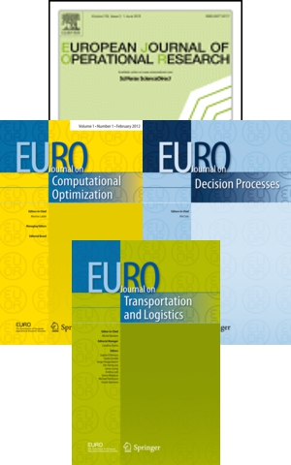

4. EURO Instruments
Publications
European Journal of Operational Research (EJOR) First volume published in 1977. WoS IF = 2.68
New EURO Journals:
  EURO Journal on Computational Optimization
  EURO Journal on Decision Processes
  EURO Journal on Transportation and Logistics
  These journals were launched in 2011.
Advanced Tutorials in Oper. Research(books)
Established in 2012 and in progress.

Slide 23
4. EURO Instruments
Working Groups
EURO working groups are a very successful dynamic instrument for collaborative work in established and new topics within Operational Research. Financial and administrative support of EURO.
Currently 32 active working groups. Largest EWGs:
EUROPT, Continuous Optimization
ECCO, Combinatorial Optimization
EWG-MCDA, Multiple Criteria Decision Aiding
EU/ME, Metaheuristics
VeRoLog, Vehicle Routing & Logistics
EWGLA, Locational Analysis

Slide 24
4. EURO Instruments
Prizes and Awards
EURO Gold Medal
The highest distinction within OR in Europe is conferred for an outstanding contribution to the Operational Research science.
Distinguished Service Medal Award
A recognition of distinguished service to the association and to the profession of OR.
Excellence in Practice Award
Outstanding accomplishments in the practice of Operational Research.
Doctoral Dissertation Award
A recognition of OR contributions of PhD students
EURO Award for the Best EJOR Papers
A recognition of the best articles published in the European J. of Oper. Research.

Slide 25
4. EURO Instruments
Additional Support
Conference Sponsorship: The EURO Plenary
Supports international meetings on relevant OR topics held in one of its member countries by sponsoring a plenary presentation
Cooperation with Other National Societies & Regional Organizations
EURO provides financial support for joint conferences
General Support Fund
Bids for financial support for any activity related to EURO that cannot be covered by other instruments of EURO

Slide 26
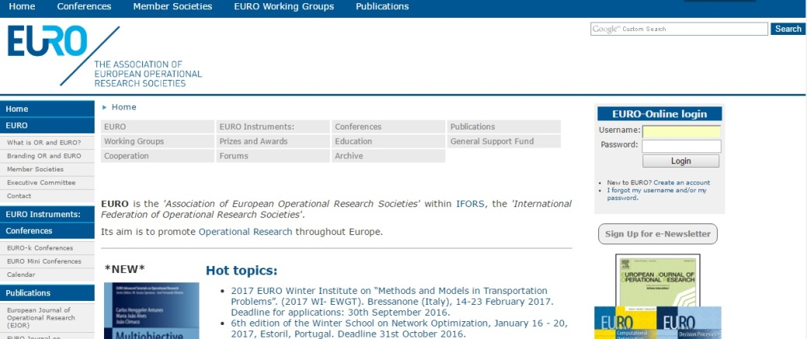
4. EURO Instruments
Website, Newsletter and Social Media
EURO Website
http://www.euro-online.org/
Website contains information on current activities and also includes a forum on which announcements such as job opportunities and publications can be posted.

Slide 27
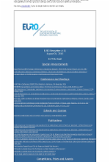
4. EURO Instruments
Website, Newsletter and Social Media
Electronic Newsletter
  - available since March 2013
  - distributed monthly (approx.)
  - over 22,000 subscribers worldwide

Slide 28


4. EURO Instruments
Website, Newsletter and Social Media
Twitter Account (EUROonline_News)
LinkedIn Interest Group
Wikipedia page
https://en.wikipedia.org/wiki/Association_of_European_Operational_Research_Societies

Slide 29

Dates for your diary:
EURO 2018, Valencia, Spain, Jul 8-11 2018
EURO 2019, Dublin, Ireland, Jun 23-26 2019

Slide 30
Thank you for your attention!

