Slide 1
Publications Silvano Martello

Slide 2
EURO Journals
EURO Journal on Transportation and Logistics (EJTL)
Editor-in-Chief: Michel Bierlaire
2012 Vol 1: 4 issues, 14 articles, 326 pages
2013 Vol 2: 4 issues, 13 articles, 335 pages
2014: Vol 3: 4 issues, 15 articles, 331 pages
2015: Vol 4: 4 issues, 21 articles, 473 pages
2016: Vol 5: 4 issues, 17 articles, 431 pages
2017: Vol 6: the 2 first issues are complete.
Submissions: increased from 23 in 2015 to 53 in 2016.
----------------------------------------------------------------------------------------------------------
EJTL is indexed by Scopus
EJTL is indexed by Emerging Sources Citation Index (ESCI, WoS)
EJTL was submitted to Thomson Reuters for IF in July 2015. No news yet.

Slide 3
EURO Journals (cont’d)
EURO Journal on Decision Processes (EJDP)
New Editor-in-Chief: Vincent Mousseau
2013 Vol 1: 4 issues, 14 articles, 324 pages
2014: Vol 2: 4 issues, 13 articles, 363 pages
2015: Vol 3: 4 issues, 16 articles, 424 pages
2016: Vol 4: 2 double special issues published, 12 articles, 267 pages 2017: Vol 5: no article published online.
The situation is worrying: hope that Vincent works well.
In July 2016 Silvano submitted EJDP to Scopus as "suggestion for inclusion“.
In July 2016 Sonal submitted EJDP to WoS ESCI. No news yet (for both)
European Journal of Operational Research (EJOR)
From Roman: “EJOR is doing well and there is no critical issue to report“;
“I am glad to note that in America, EJOR enjoys a growing popularity.”

Slide 4
EURO Journals (cont’d)
EURO Journal on Computational Optimization (EJCO)
Editor-in-Chief: Martine Labbé
2013 Vol 1: 4 issues, 12 articles, 312 pages
2014 Vol 2: 4 issues, 12 articles, 296 pages
2015: Vol 3: 4 issues, 14 articles, 370 pages
2016: Vol 4: 2 issues:18 papers, 481 pages
2017: Vol 5: Online first 15 articles . Good flow of good quality submissions.
The journal will be able to publish 20+ articles in 2017
In July 2016 Silvano submitted EJDP to Scopus as "suggestion for inclusion“.
In July 2016 Sonal submitted EJDP to WoS ESCI. No news yet.
Martine: It could be the right moment for submitting to WoS.
Sonal: citation count insufficient: better to wait one more year.

Slide 5
EURO Advanced Tutorials on Operations Research
Aims and scope of the series
Didactical purposes: Master and PhD courses
Authors: experienced scholars in the area
Uniform style and vision (not a collection of chapters)
Technical aspects
Published by Springer, 80-150 pages (400-500 words per page)
Editors: M.G. Speranza, J.F. Oliveira
Status:
1 book published (2015):
Linear and Mixed Integer Programming for Portfolio
Optimization by R. Mansini, W. Ogryczak, M.G. Speranza
2 books published (2016):
Dual-feasible functions for integer programming and combinatorial optimization
by C. Alves, F. Clautiaux, J. Valério de Carvalho, and J. Rietz
Multi-objective linear and integer programming
by C. Henggeler Antunes, M. J. Alves, and J. Clímaco
8 proposals accepted, 1 rejected, 1 to be re-submitted
9 expressions of interest

Slide 6
EURO Advanced Tutorials on Operations Research Books in preparation
Jesper Larsen, Richard Lusby, Troels Martin Range |  | Column Generation for Linear and Integer Programming - Theory and Practice
Abraham Duarte, Manuel Laguna, and Rafael Martí |  | Metaheuristics for Business Analytics
Lima Zhao, Arnd Huchzermeier |  | Operations-finance interface: Integrated risk management
Francesco Menoncin |  | Risk Management for Pension Funds
Paolo Serafini, Giuseppe Lancia |  | Exponential-size Integer Linear Programs
Femke van Wageningen |  | Traffic Flow Modelling: Introduction to Traffic Flow Theory Through a Genealogy of Models
Giancarlo Bigi, Marco Castellani, Massimo Pappalardo, Mauro Passacantando |  | Nonlinear programming techniques for equilibria
Constantin Zopounidis, Chistos Lemonakis, Michael Doumpos, Dimitrios Niklis |  | Operations Research Techniques in the Assessment of Credit Risk

Slide 7
Communications Silvano Martello

Slide 8
Visibility
Wikipedia Project: Wikipedia pages on
EURO
national OR societies
EWGs
EURO journals
Wikipedia’s heavy restrictions (watchdogs)
The EURO Wikipedia page is alive and kicking:
Google search for: Operations Research Societies Wiki →→→

Slide 9
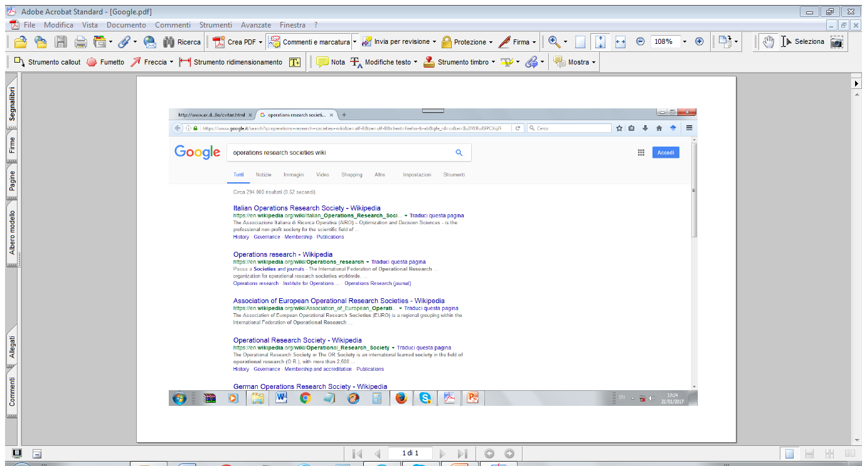

Slide 10
Visibility
European OR Societies:
Accepted society pages (new societies in red):
Belgium
Croatia
Finland
France
Germany
Hungary
Italy
United Kingdom
The Netherlands
South Africa
Spain
Sweden
Austria
Accepted society entries with redirect to the EURO Wiki page:
Denmark Greece
Practically all main societies are now on Wikipedia.
Serious troubles when I tried to contact the Serbian OR society: several unanswered emails
to President, Secretary, Treasurer, Representative. The web site is offline.

Slide 11
Visibility
EURO working groups
EWGs with Wikipedia page (new groups in red ):
European Working Group on Multiple Criteria Decision Aiding (EWG-MCDA)
European Chapter on Combinatorial Optimization (ECCO)
Vehicle Routing and Logistics Optimization (VeRoLog)
Continuous Optimization Working Group of EURO (EUROPT)
EURO Working Group on Metaheuristics (EU/ME)
EURO Working Group on Locational Analysis (EWGLA), CANCELED ☹,
(Bernard an I are working on it.)
Practically all main EWGs are now on Wikipedia.

Slide 12
Visibility
Wiki pages for EURO journals
Unsuccessful so far (no reaction from the EiCs)
Probably difficult without IF; delayed.
Will re-try if EJTL gets an IF

Slide 13
Joint EURO/ORSC/ECCO International Conference 2017 in Combinatorial Optimization (ECCO XXX)
Silvano Martello

Slide 14
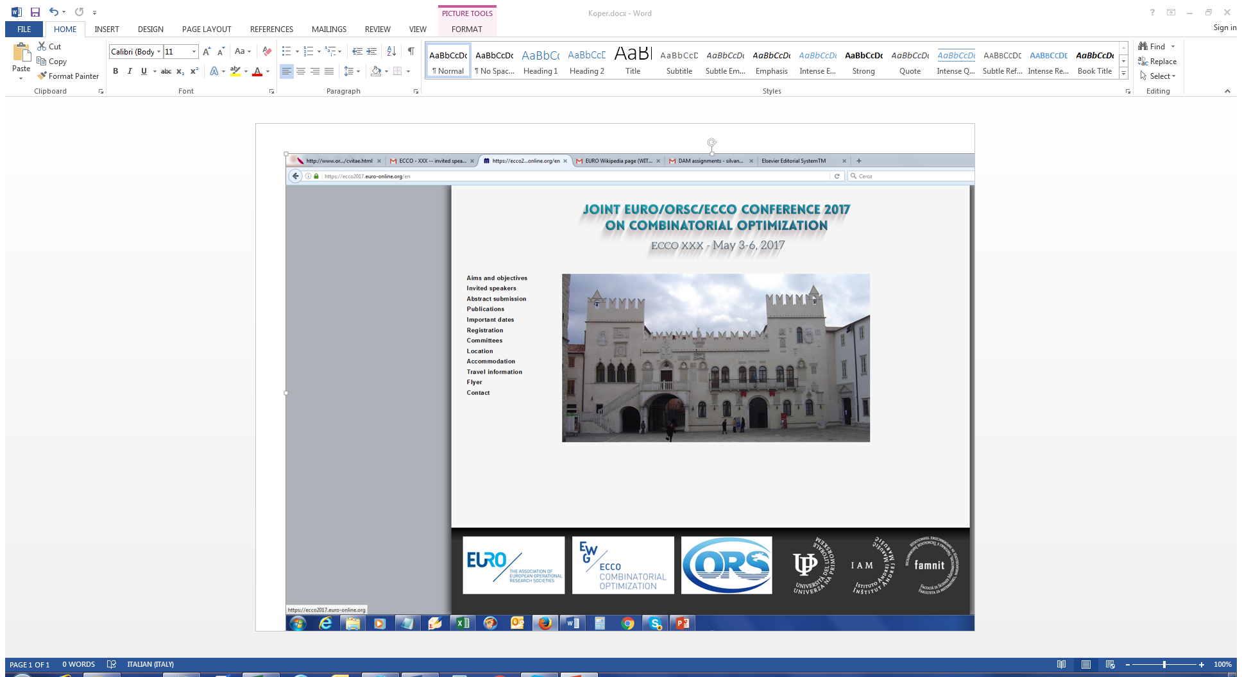

Slide 15
EURO/ORSC/ECCO
General Conference Committee
Xiaodong Hu, Chinese Academy of Sciences Silvano Martello, University of Bologna Gerhard Wäscher, Otto von Guericke University Magdeburg
Program Committee
Andrej Brodnik, University of Primorska and University of Ljubljana - co-chair Guochuan Zhang, Zhejiang University - co-chair Jacek Blazewicz, Poznan University of Technology Xujin Chen, Chinese Academy of Sciences Van-Dat Cung, Institut Polytechnique de Grenoble Alain Hertz, Ecole Polytechnique de Montréal Liying Kang, Shanghai University Minming Li, The City University of Hong Kong Xiwen Lu, East China University of Science and Technology Silvano Martello, University of Bologna Paolo Toth, University of Bologna Dachuan Xu, Beijing University of Technology Gerhard Wäscher, Otto von Guericke University Magdeburg Zhao Zhang, Zhejiang Normal University
Organizing Committee
Andrej Brodnik, University of Primorska and University of Ljubljana - co-chair Degang Liu, Chinese Academy of Sciences - co-chair Guangting Chen, Taizhou University Rok Požar, University of Primorska Xin Liu, Chinese Academy of Sciences Yindong Shen, Huazhong Univeristy of Science and Technology

Slide 16
EURO/ORSC/ECCO
Plenary Speakers
Robert Bixby
Xiaotie Deng
Bernard Ries,
Gerhard Woeginger
Abstract submission closes: March 1, 2017
Two special issues:
Discrete Applied Mathematics;
Journal of the Operations Research Society of China
Expected ~40 participants from China (invitation letters sent),
~100 participants from Europe.
Optional pre-congress tour to Venice on May 2, 2017 (including transfer to Koper on May 3).

Slide 17
EURO/ORSC/ECCO
Financial issues:
Source: usual ECCO funding +
special EURO funds for cooperation with other national societies
Payments to invited speakers (lump sums) directly handled by Marino (to avoid having to pay VAT to Slovenia): in total 4800 Euros.
Fees waived to invited speakers, co-chairs, Chinese General chair:
~< 2000 Euros (VAT is included; Marino will transfer to the organizers).
Dinner for invited speakers and co-chairs: ~800 Euros.
Fee waiving to students and young researchers from low currency countries.
https://ecco2017.euro-online.org/en/

Slide 18
The Russian Affair
Silvano Martello

Slide 19
July
Poznan, EC Meeting also attended by Mike Trick.
Decision: try and contact the Russian Scientific Operation Research Society (RSORS) to explore the possibility that they join IFORS and EURO
Information gathered from Russian friends (Kovalyov, Eremeev, …):
RSORS was created in 1996 under the sponsorship of the Russian Academy of Sciences (RAS). Apparently, IFORS and EURO were never approached.
The President of RSORS has died, the Vice-President is above 80 and seriously ill;
the RAS is in the process of reorganization and many people are not satisfied with this reorganization;
the web site is outdated;
the only activity of RSORS seems to be the organization of the triennial Moscow International Conference on Operations Research (ORM), that is however organized by a group of (younger) mathematicians.

Slide 20
August
The next ORM Conference will be in October 2016.
After some attempts, succeeded in contacting Alexander Vasin (Co-chair of ORM), Lomonosov Moscow State University, co-chair of ORM 2016.
Interested in our proposals.
Invited to give a plenary talk at the ORM 2016 Conference on IFORS and EURO.
Official invitation letter for the Russian embassy .
Continuous consultation with Elena.
September
Russian bureaucracy (Soviet Union!)
Nice Slides prepared with the help of Sarah and Mary Magrogan (IFORS).

Slide 21
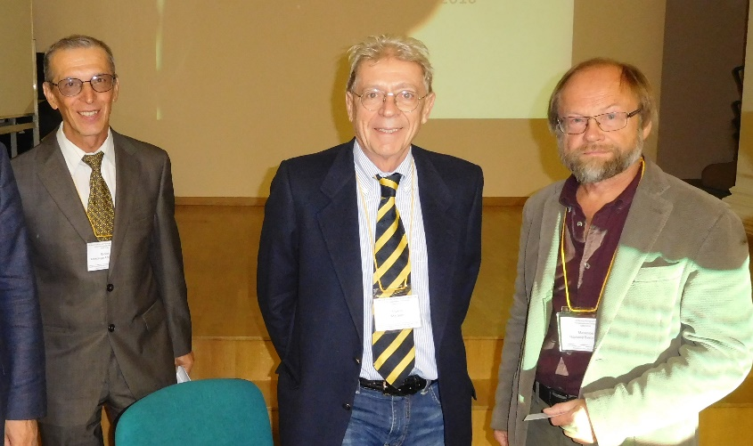
October
Traveled to Moscow: plenary speech, assembly, meetings, …
Most active: Vasin and Vladimir Mazalov (Director of the Institute of Applied Mathematical Research, Karelia).
Decision: re-found the society with the explicit purpose of joining IFORS and EURO. New society: RuORS (Russian Operational Research Society).
Approved list of 12 members as the governing body
(different regions, institutions,
and scientific areas).
Bylaws in English.
New web site.
(Vasin, Silvano, Mazalov)

Slide 22
November
RuORS sends a call-to-join to prospective mathematicians.
Bylaws finalized and submitted to IFORS.
Our target: open the six-month ballot in January; if positive, submit to EURO for approval in Quebec.
So far, Mike Trick was very positive and enthusiastic. But now
hesitancy about recognizing RuORS as the Russian OR Society;
doubts on the relationships RSORS-RuORS;
criticisms about the voting rules;
lack of history;
the initial answer of the Administrative Committee is NO;
suggested to delay by one-two years to see meetings, conferences, …
Very disappointing!
Determined official mail sent by Elena (Silvano, Willi consulted).
Work with the Russian colleagues to improve bylaws, presentation, and web page according to the IFORS criticisms.

Slide 23

December
New bylaws and documents, including list of members, interim President (Mazalov) and Directive Board, submitted to IFORS:
Clarified that RuORS is the international springoff of RSORS;
New, less restrictive voting rules (1/2 majority instead of 2/3);
Clarified that all key persons from RSORS have joined RuORS;
December 2013 IFORS Bulletin, article From Russia, With Love for OR: “Among the matters discussed was the establishment of a new Russian Operational Research Society (RuORS)”. [Thanks, ]
Mike Trick: “The new bylaws seem much better but there are still some who want to see the first meeting and the election of non-Moscow officers. But others are comfortable as is.”
We have information that the past IFORS Presidents are in favor.
New criticisms from Mike → answers → new criticisms → answers …

Slide 24
January
“Harsh” email exchanges (Elena, Mike, Silvano):
EURO positively replied when IFORS asked to facilitate the integration of Norway and Tunisia; now is EURO who is knocking on IFORS doors;
for Norway and Tunisia, IFORS was much less demanding; is there anything “special” related to this specific country?
Reaction: This seems to be an underlying question so let me be clear: I (and the rest of the AC) have nothing against Russia. To the contrary…
Pessimistic expectations, but
January 13, Mike “Dear Professor Mazalov, The Administrative Committee has voted to submit your application for consideration
by the membership of IFORS.”
6-month ballot; majority requested 2/3.
Richard and Elena email the Presidents of the EURO societies asking for their positive vote. Should the IFORS representatives be reminded?
Elena emails her contacts in ALIO (which will ask support for Colombia).
What about APORS? Elise del Rosario?
(to be continued)

Slide 25
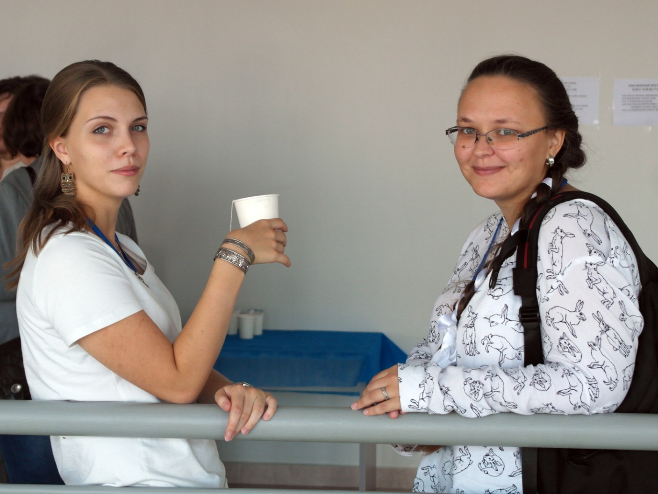
From the RuORS web site. Random picture from a recent conference.

