Slide 1

Notes:
[Sources] - User-uploaded HTML converted to image: aktivar-linkedin-carousel-v7 (1).html

Slide 2
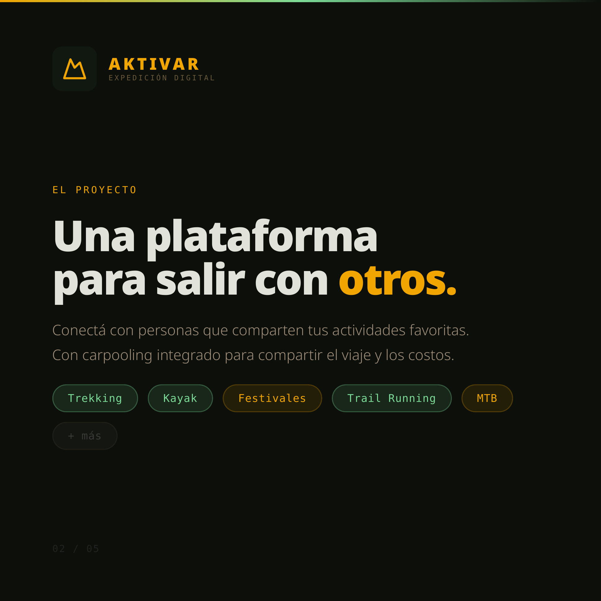
Notes:
[Sources] - User-uploaded HTML converted to image: aktivar-linkedin-carousel-v7 (1).html

Slide 3
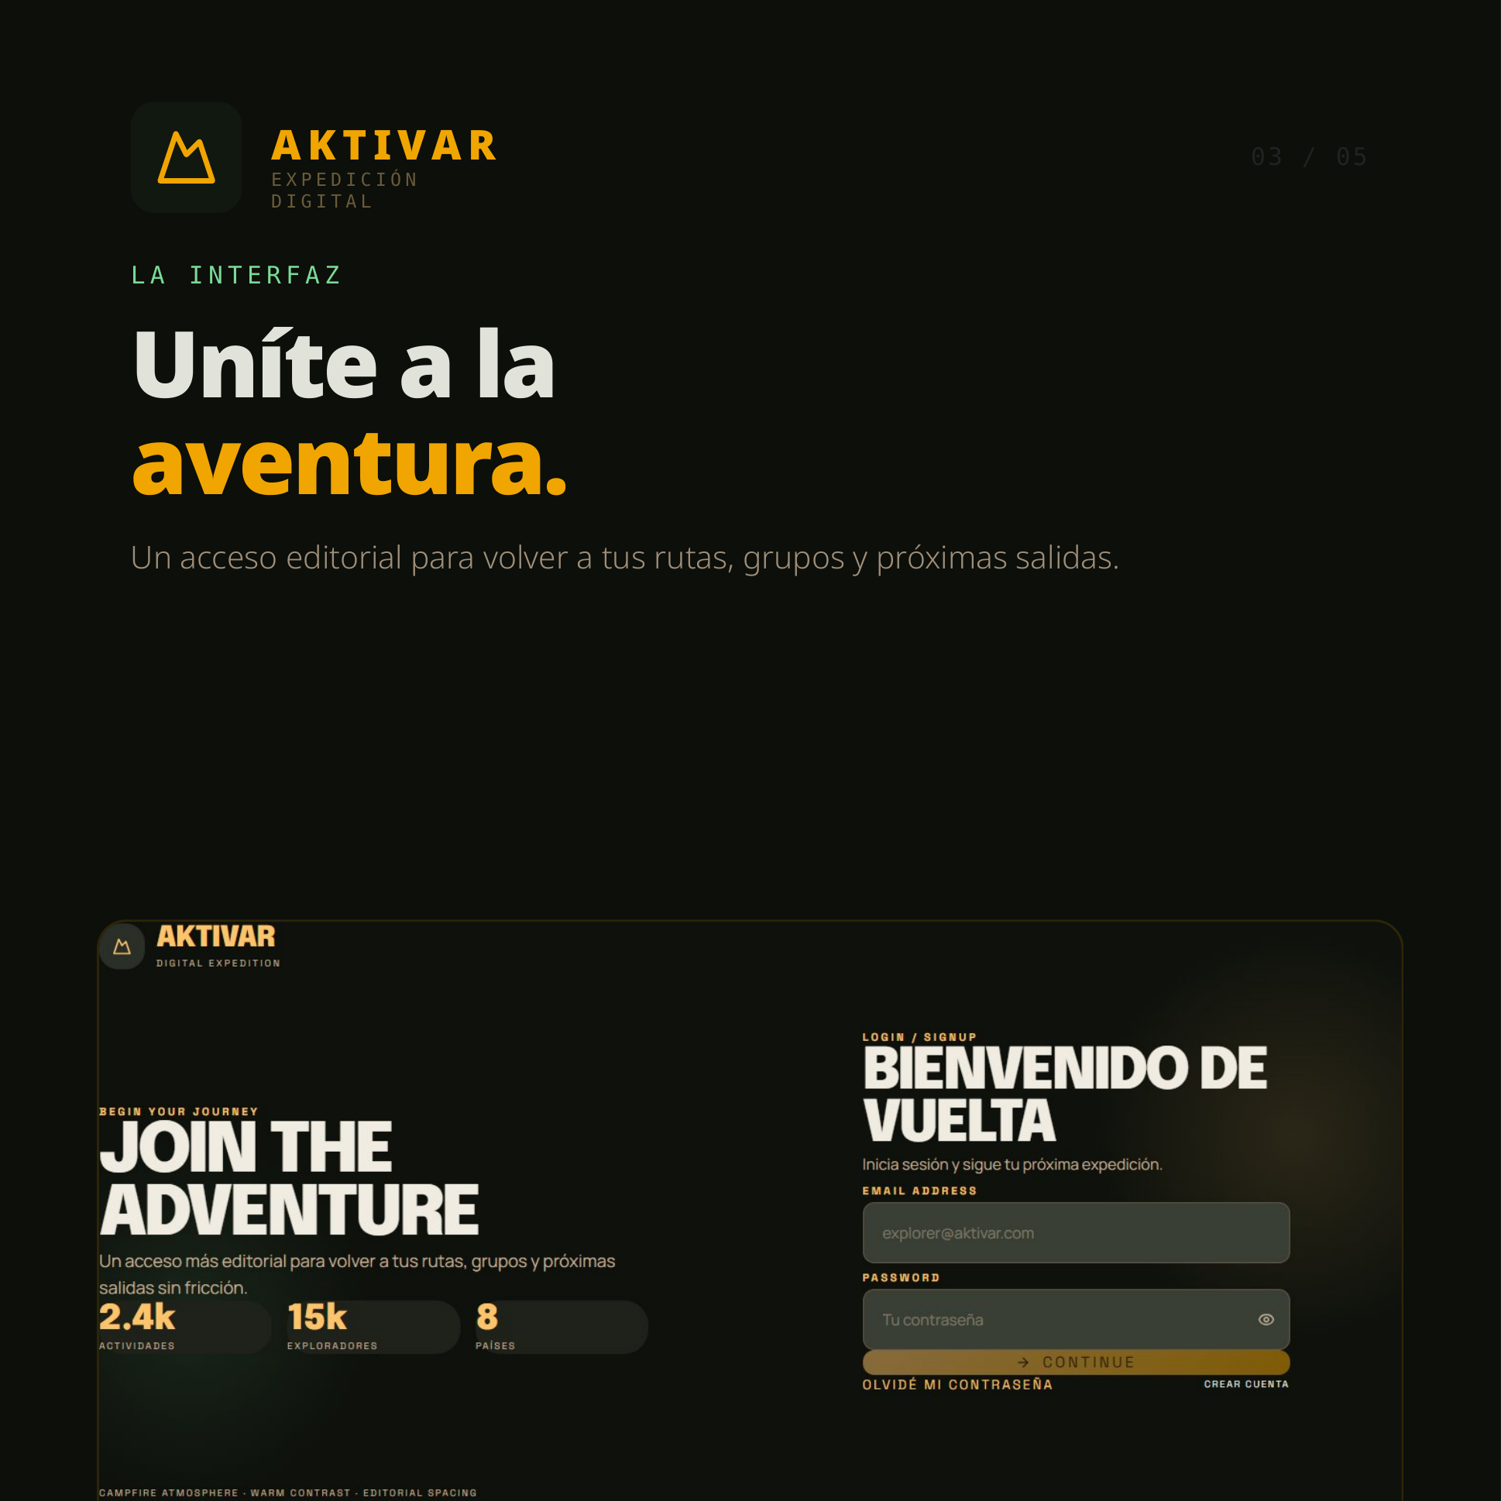
Notes:
[Sources] - User-uploaded HTML converted to image: aktivar-linkedin-carousel-v7 (1).html

Slide 4
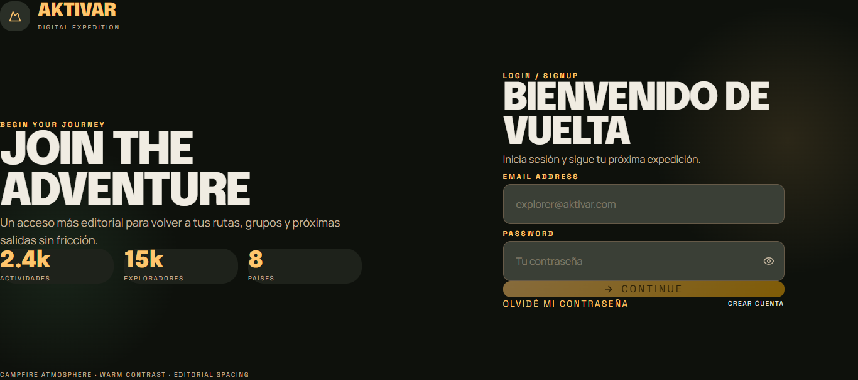

Slide 5
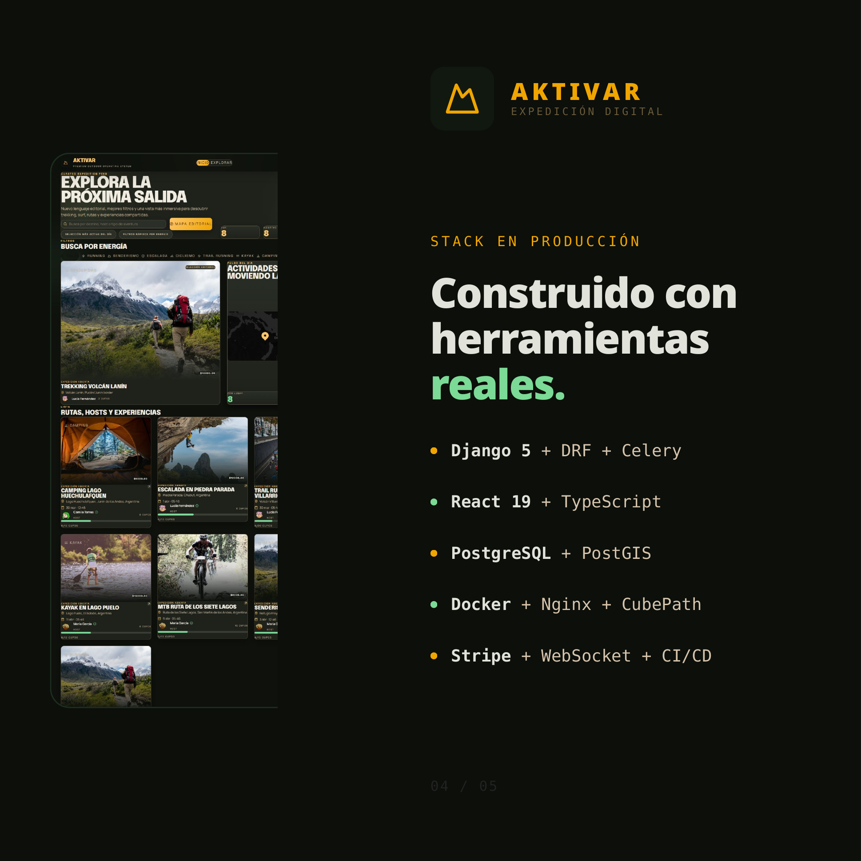
Notes:
[Sources] - User-uploaded HTML converted to image: aktivar-linkedin-carousel-v7 (1).html

Slide 6

Notes:
[Sources] - User-uploaded HTML converted to image: aktivar-linkedin-carousel-v7 (1).html

