Slide 1
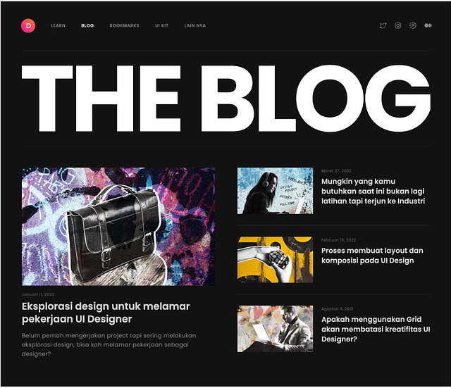
MENU-BAR
MENU-TITLE
SMALL-CARD
BIG-CARD

