Slide 1


College of Technology (01)
Silver Oak College of Engineering and Technology
Bachelor of Technology
Department of Computer Engineering(04)
Group Member
Parag Bhangale(Group Admin)-210133072005
Smit Chawla-200103071003
Swati Chawla-200103071004
Shail Shah-200103078062
Faculty Member
Rashmi Hirani

Slide 2

Objectives…..
Define Key logger
Captures keystrokes
Sends mail to the admin
Monitors the system Activities by others

Slide 3
CONTENTS…..
What is keylogging ?
Importance of keylogger
Features of keylogger
Pro- Features of keylogger
Program files
Modules used
Keylogger Architecture
Programming
Block diagram
System Requirement
Conclusion
Reference

Slide 4

A program or Hardware device that capture every key impression on the system.
Used to monitor user’s activities .
Used to retrieve data and forgotten URLs .
What is keylogging ?

Slide 5

Importance of Key logger …
IT organizations can indicate their concerns by going after the culprit whose performance is deteriorating that of the whole organization .
Keylogger s/w is also available for use on smart phones, such as iPhones and Android .

Slide 6
FEATURES OF KEYLOGGER
Key stroke monitoring
Web site visited
Screen shot capturing
Windows startup
Program captured
Startup Alert

Slide 7
Pro- Features of Key logger
Remote viewing email delivery
Log exporting
Optimal stealth
mode
Log Filtering
Customizable
Setting mode
Auto log clearing

Slide 8
Program files :
keylogger.py

Slide 9
1 -SMTPlib :
It is a client session object that can be used to send mail to any internet machine with SMTP domain
ModuleUsed :
2 -Pynput :
This library allow you to control and monitor input devices .

Slide 10
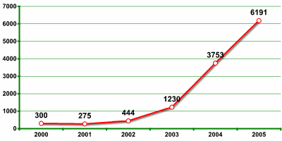
Key logging functionality of one company in Verisign’s recent report as rapid growth in malicious program

Slide 11
Ke
Key Logger Architecture
Internet Explorer
Application
FTP module
Application
HHook procedure
Hook procedure
Hook procedure
Main Module

Slide 12
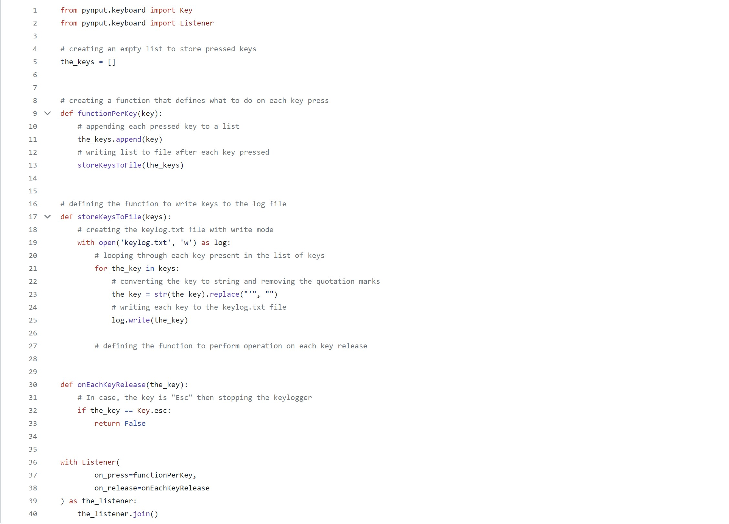
INPUT
Git hub link:- https://github.com/Er-Parag-Cyber/text-keylogger/

Slide 13

OUTPUT

Slide 14
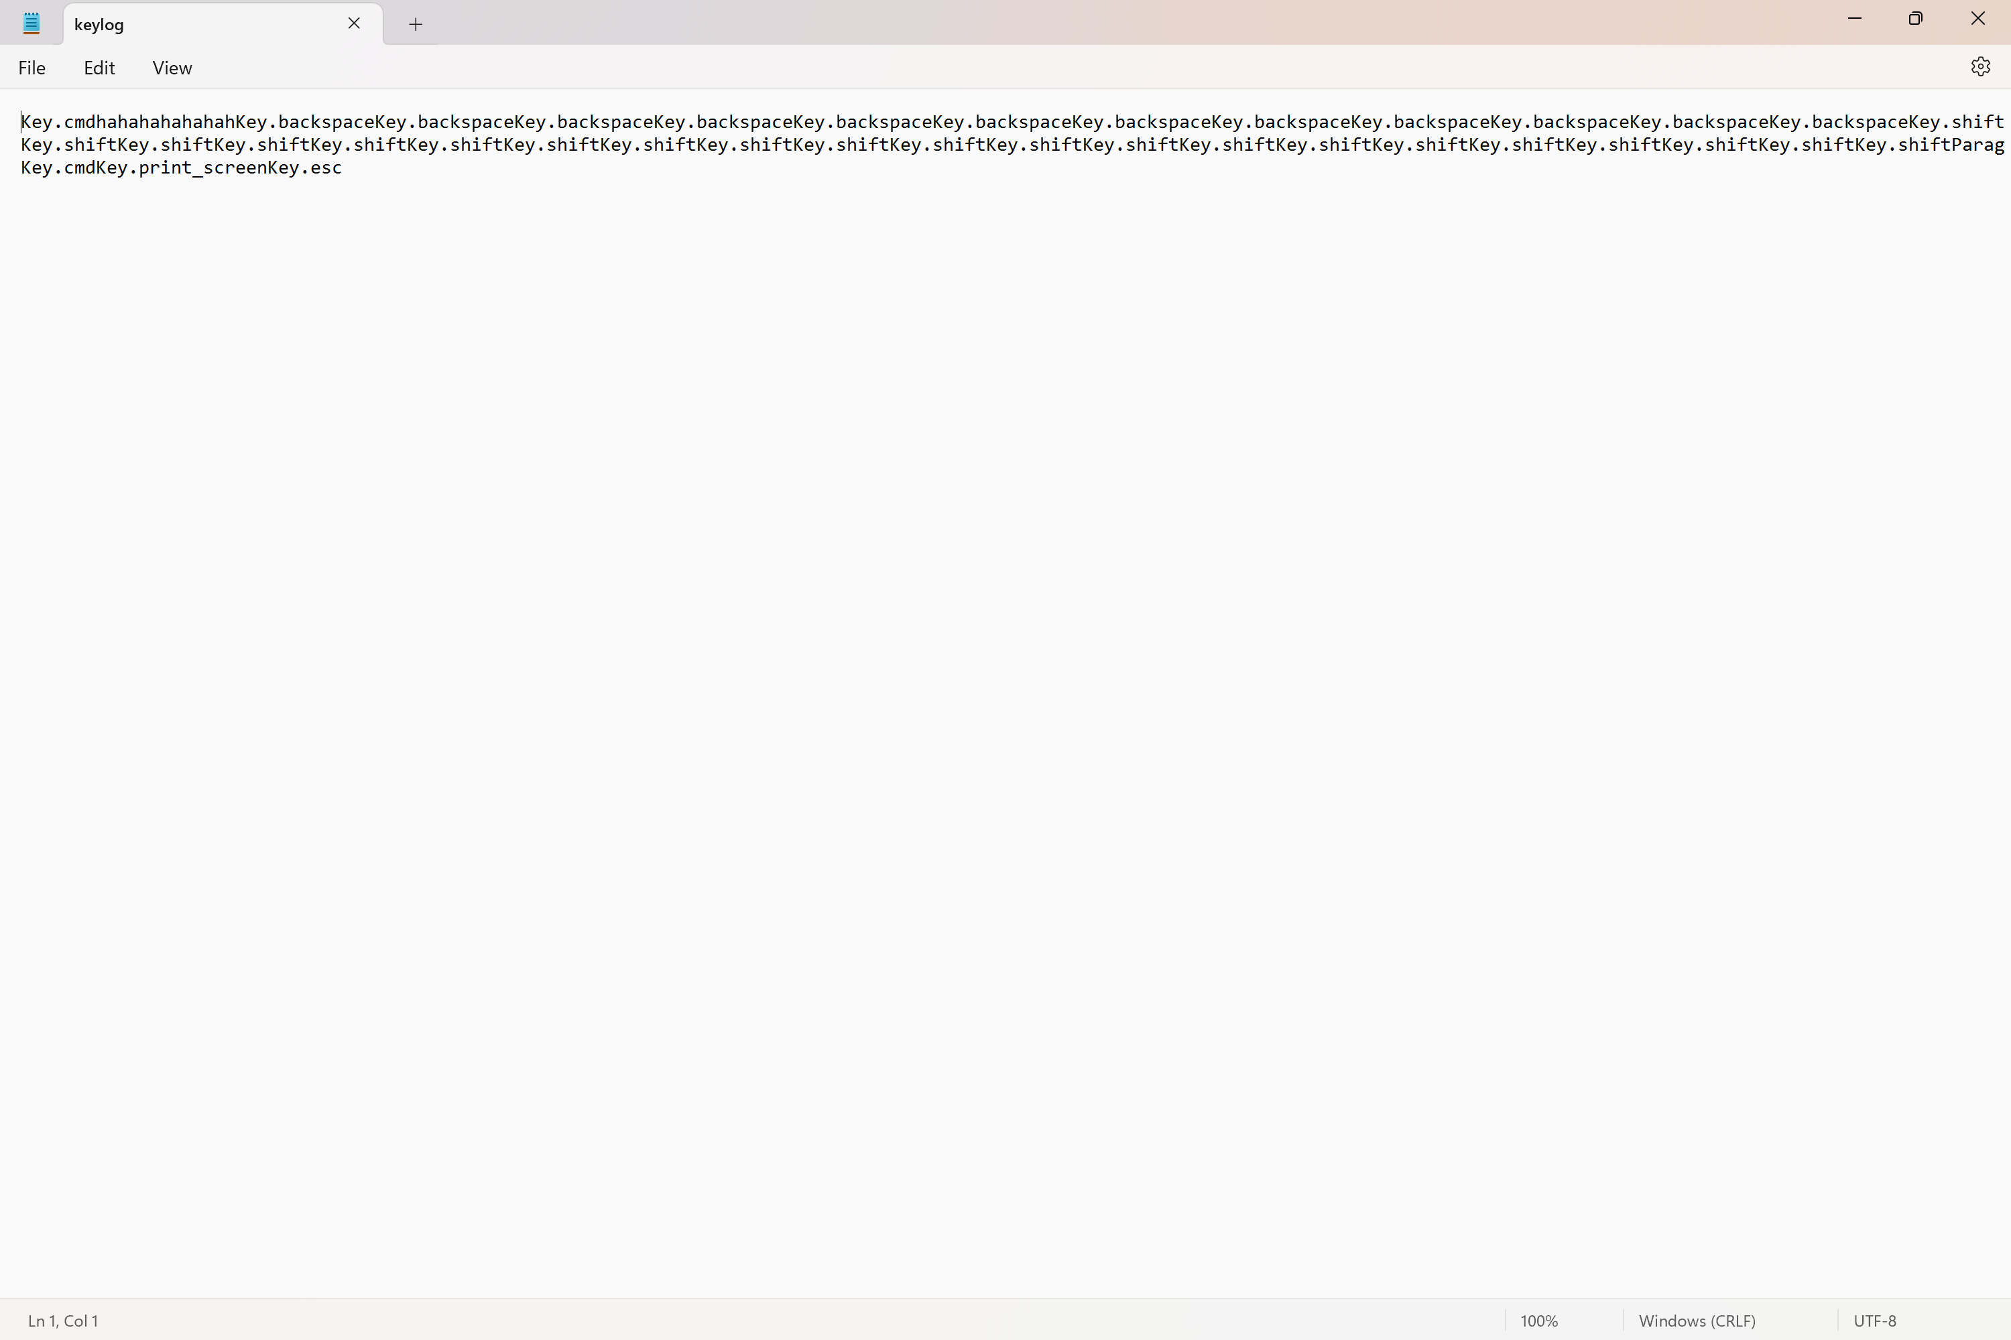
OUTPUT

Slide 15
Spyrix Keylogger
Actual Keylogger
Examples of Keylogger
Revealer Keylogger
REFOG Keylogger

Slide 16
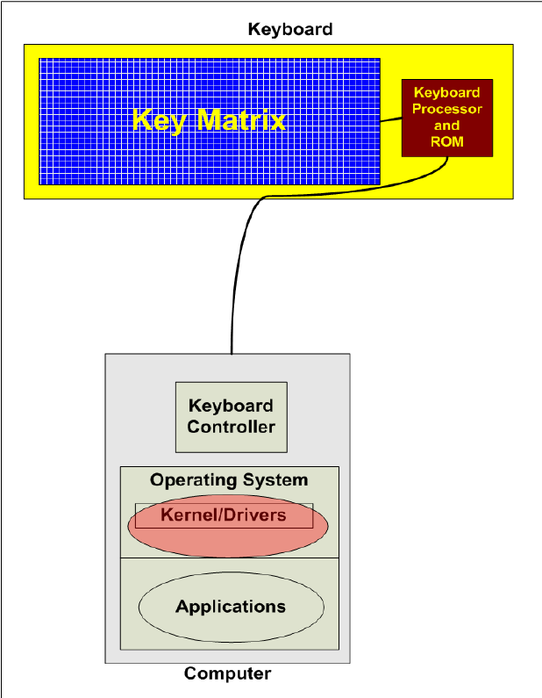
Block diagram

Slide 17
System Requirements
Windows 2000,
Windows XP (32-bit and x64),,
Windows Server 2003/2008,
Windows Vista (32-bit and x64),
Windows 7 (32-bit and x64),
Windows 8 (32-bit and x64),
Windows 10 (32-bit and x64),
Windows 11 (32-bit and x64),
Windows 2000 or later ,
Internet Explorer 5.0 or later ,monitor : 15” color ,HDD 40GB
Basic input devices required: keyboard
Basic output devices required: mobile devices
S/W requirement: PyCharm, Python 3.8.0
Technologies used: Advanced programming using Python

Slide 18
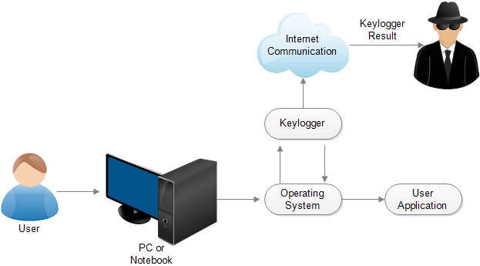
Keylogger process in user activity

Slide 19
CONCLUSION
Key logger record keystrokes
Legitimate use : monitor employee activity
legal uses : steal password , user name and other personal / corporate data . Reports show that there is an increased tendency to use rootkit technologies in keylogging software, to help the keylogger evade manual detection and detection by antivirus solutions.
Only dedicated protection can detect that a keylogger is being used for spy purposes.
Be conscious what installed in the computer.
Use caution when snuffing the internet.
Keep your computer software update.

Slide 20
REFERENCE :
https://medium.com/
https://www.slideshare.net/
https://en.m.wikipedia.org/wiki/
https://security.stackexchange.com/
https://www.ionos.com/digitalguide/

Slide 21


Slide 22


