Slide 1
PROJECT ON WORDLE
Tribhuvan University
Institute of Engineering
Thapathali Campus, Thapathali
TEAM MEMBERS
Kushal Saud
Yujen Shrestha
Yangdi Bhote Shalaka
Suhan Man Pradhan
Presented To:
Department of Electronics and Computer Engineering
Presented on:
March 14, 2025

Slide 2
Table of Contents
Introduction
Objective
How to Play Wordle
Project Architecture
Challenges & Solutions
Live Demo
Conclusion
Q&A

Slide 3
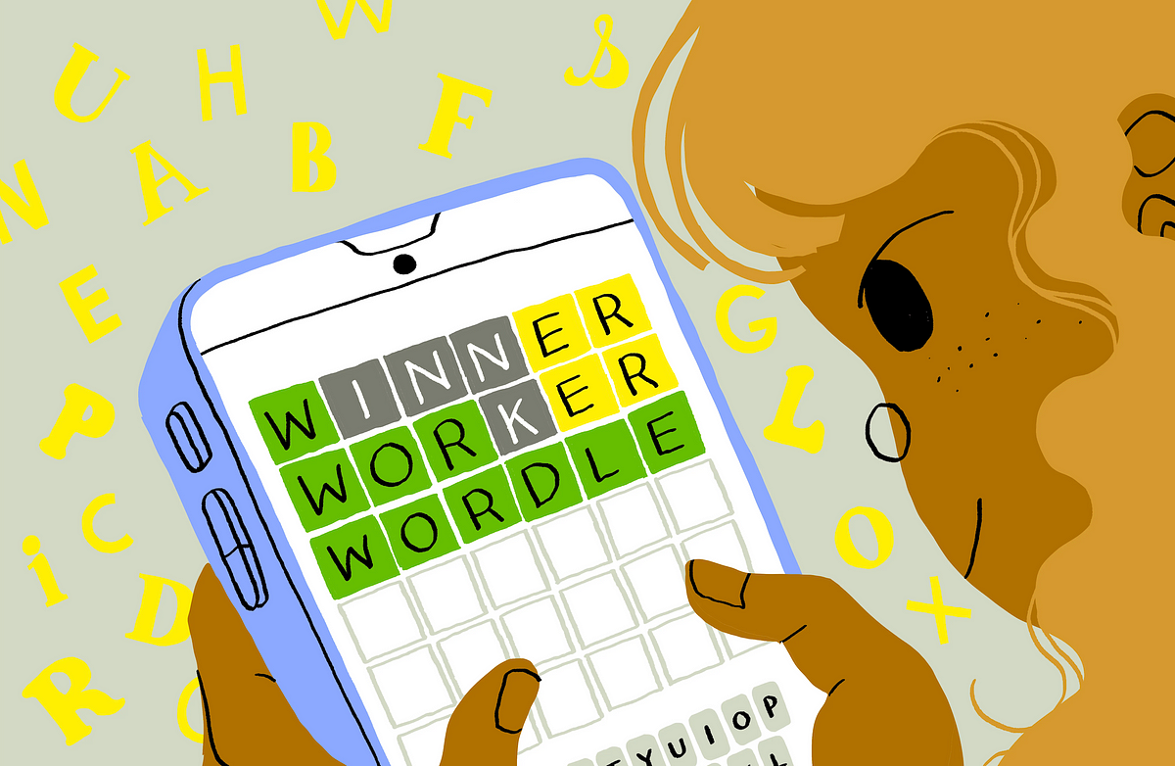
Introduction
Wordle is a word puzzle game where players have six attempts to guess a five-letter word.
Originally created by Josh Wardle in 2021 as a fun project for his partner
The game quickly gained immense popularity due to social media trends

Slide 4
Objective
Recreate the core gameplay of Wordle
Develop a dynamic word list, containing all words in the Wordle glossary
Include a stats section to track player progress
To improve logical thinking capabilities

Slide 5
How to Play Wordle
Guess a 5-letter Word: You have six attempts to find the correct word
Get Feedback on your Guess:
Green – Letter is in the word and in the right spot.
Yellow – Letter is in the word but in the wrong spot.
Gray – Letter is not in the word at all.
Use the Hints – Based on the colors, adjust your next guess.
Win or Lose – You win if you guess the correct word within six tries! If not, the word is revealed at the end.

Slide 6
Project Architecture
The system consists of a main page, where you can switch between four options. We can access these options by selecting them and pressing ‘Enter’.
Start Game – To start a new game
How to Play – Gives info on how the game is played
Stats – Shows the records and data of the games played
Exit Game – Exits the game

Slide 7
Start Game
startgame() – Contains the main body. Takes in input, and prints the necessary output
wordpicker() – Generates random word from “wordleanswers.txt” for user to guess using srand() and rand()
validword() – Checks whether the word exists in the Wordle glossary stored in “totalwords.txt” using binary search
wordchecker() – Checks the status of each letter of the inputted word to the word to guess, and assigns certain value to each letter (2 for correct, 1 for incorrect placement, 0 for incorrect letter)
statswin() and statslose() – Edits the stats.txt file after each game based on the win/lose

Slide 8
Stats
Keeps track of helpful statistics for players to keep track of their performance by storing the data in a text file “stats.txt”.
Displays the required statistics along with a convenient bar graph to show guess distribution.
Allows users to reset the stats data.

Slide 9
How to Play and Exit Game
How to Play gives the user information on how the game is played.
Exit Game exits the game.

Slide 10
Libraries Used
stdio.h
conio.h
stdlib.h
windows.h
string.h
time.h
unistd.h

Slide 11
Challenges & Solution
Challenge – Difficult to check validity of word among >11,000 words. Solution – Used Binary Search
Challenge – Handling Case Sensitivity Solution – All inputted lowercase characters are saved immediately as uppercase characters
Challenge – Providing letter feedback Solution – Used ‘windows.h’ to change text and background color for intuitive understanding

Slide 12
Live Demo
Here, we will showcase a live demonstration of our Wordle game in action
We will walk through how a player guesses words and receives feedback based on letter positions

Slide 13
Conclusion
Our Wordle project successfully recreates the fun and challenge of the original game while enhancing our programming and problem-solving skills
Through this project, we learned about logic building
Wordle’s popularity comes from its simplicity and engaging mechanics, and our version reflects those core elements
This project has been a great learning experience, and we look forward to applying these skills to future developments

Slide 14
ANY QUERIES

Slide 15
Thank you!!!

