Slide 1
Cluster Computing: Spark
Mike Cafarella
6.830/6.814 May 10, 2021 Thanks to Mosharaf Chowdhury for original slides (now modified)

Slide 2
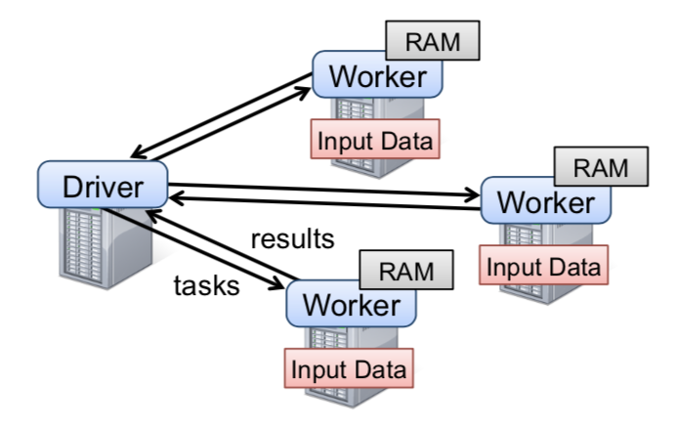
Motivation & Background
Frameworks back in 2012: MapReduce, a bit of Microsoft’s Dryad
Pros:
Allowed parallel computation without worrying low level details (e.g., work distribution, fault tolerance)
Provided a set of high-level operations (map, reduce)
You didn’t have to think about schemas
Cons:
Little to no support for leveraging cluster memory
Large overhead for reusing data in iterative or interactive tasks (I/O, replication, serialization)
You didn’t have to think about schemas
Implementations had bad latency

Slide 3
Resilient Distributed Datasets (RDDs)
Utilize Distributed Memory while providing efficient fault tolerance
Avoid storing data updates explicitly
Instead, obtain fault tolerance by logging transformations (lineage)
Limit operations to coarse-grained transformations (e.g., map, filter)
Allow user control of data persistence and partitioning
How did MapReduce obtain fault tolerance? Take 60 seconds and put answers in the chat!

Slide 4
RDDs
Read-only, partitioned collection of records
Created from either data in stable storage or other RDDs
A sequence of transformations defines an RDD:
Map, filter, flatmap, sample, groupbykey, reducebykey, join, union
Actions return value or export data to storage system
count, collect, save, reduce, lookup
No need to actually run code until there’s an action
Read-only means we can exploit speculative execution, just like MapReduce

Slide 5
Example: Console Log Mining
lines = spark.textFile("hdfs://...")
errors = lines.filter(_.startsWith("ERROR"))
errors.count()
HDFS File
definition
Base RDD: lines
Transformation: filter
Transformed RDD: errors
Action: count
Number of lines with ERROR
Notes:
Note: the “underscore” syntax here in Scala is something called “placeholder syntax”
It’s way of creating an anonymous function --- akin to lambda in Python --- without even being explicit about the incoming parameter.
You can read the “_.startsWith(“ERROR”)” text as a way to write a small boolean function. It takes a line of input and returns true or false

Slide 6
RDDs: Fault Tolerance
Limit operations to coarse-grained transformations and only log the transformations instead of replicating data for recovering
Lineage: transformations used to build a dataset
Recover lost partition by applying lineage from corresponding data partition in stable storage

Slide 7
Example: Console Log Mining
lines = spark.textFile("hdfs://...")
errors = lines.filter(_.startsWith("ERROR"))
errors.count()
HDFS File
definition
Base RDD: lines
Transformation: filter
Transformed RDD: errors
Action: count
Number of lines with ERROR
“Base RDD” and “Transformed RDD” may never be actually materialized
Notes:
Note: the “underscore” syntax here in Scala is something called “placeholder syntax”
It’s way of creating an anonymous function --- akin to lambda in Python --- without even being explicit about the incoming parameter.
You can read the “_.startsWith(“ERROR”)” text as a way to write a small boolean function. It takes a line of input and returns true or false

Slide 8


Example
RDD 0
p1
p2
p3
Worker 3
Coordinator
RDD 1a
RDD 1b
p1
p2
p3
p1
p2
p3
Worker 1
Worker 2
RDD 2
p1
p2
p3
4 RDDs
3 partitions. (e.g., all p1s are on worker 1)
What’s a possible program that leads to this dataflow? Take a minute.
RDD 3
p1
p2
p3
Notes:
RDD 0: initialization (reading from an input file)
RDD 1a/b: some mapping or filtering
RDD 2: some joining
RDD 3: some filtering
What happens when Worker 3 goes down?
All partitions on worker 3 disappear.So we have to rebuild Worker 3’s partitions.
So we have to go back up the lineage and rebuild each partition from each ancestor.

Slide 9
Example
RDD 0
p1
p2
p3
Worker 3
Coordinator
RDD 1a
RDD 1b
p1
p2
p3
p1
p2
p3
Worker 1
Worker 2
RDD 2
p1
p2
p3
employeeIds = spark.textFile("hdfs://...")
names = map( # map from ID to name)
salaries = map( # map from ID to salary) fullEmps = join( # names, salaries on empId)
execs = fullEmps.filter( # filter on salary)
RDD 3
p1
p2
p3
Notes:
RDD 0: initialization (reading from an input file)
RDD 1a/b: some mapping or filtering
RDD 2: some joining
RDD 3: some filtering
What happens when Worker 3 goes down?
All partitions on worker 3 disappear.So we have to rebuild Worker 3’s partitions.
So we have to go back up the lineage and rebuild each partition from each ancestor.

Slide 10

Example
RDD 0
p1
p2
p3
Worker 3
Coordinator
RDD 1a
RDD 1b
p1
p2
p3
p1
p2
p3
Worker 1
Worker 2
RDD 2
p1
p2
p3
RDD 3
p1
p2
p3
Notes:
RDD 0: initialization (reading from an input file)
RDD 1a/b: some mapping or filtering
RDD 2: some joining
RDD 3: some filtering
What happens when Worker 3 goes down?
All partitions on worker 3 disappear.So we have to rebuild Worker 3’s partitions.
So we have to go back up the lineage and rebuild each partition from each ancestor.

Slide 11
Example
RDD 0
p1
p2
p3
Worker 3
Coordinator
RDD 1a
RDD 1b
p1
p2
p3
p1
p2
p3
Worker 1
Worker 2
RDD 2
p1
p2
p3
RDD 3
p1
p2
p3
Notes:
RDD 0: initialization (reading from an input file)
RDD 1a/b: some mapping or filtering
RDD 2: some joining
RDD 3: some filtering
What happens when Worker 3 goes down?
All partitions on worker 3 disappear.So we have to rebuild Worker 3’s partitions.
So we have to go back up the lineage and rebuild each partition from each ancestor.

Slide 12
Example
RDD 0
p1
p2
p3
Worker 3
Coordinator
RDD 1a
RDD 1b
p1
p2
p3
p1
p2
p3
Worker 1
Worker 2
RDD 2
p1
p2
p3
RDD 3
p1
p2
p3
Notes:
RDD 0: initialization (reading from an input file)
RDD 1a/b: some mapping or filtering
RDD 2: some joining
RDD 3: some filtering
What happens when Worker 3 goes down?
All partitions on worker 3 disappear.So we have to rebuild Worker 3’s partitions.
So we have to go back up the lineage and rebuild each partition from each ancestor.

Slide 13
Example
RDD 0
p1
p2
p3
Worker 3
Coordinator
RDD 1a
RDD 1b
p1
p2
p3
p1
p2
p3
Worker 1
Worker 2
RDD 2
p1
p2
p3
RDD 3
p1
p2
p3
Notes:
RDD 0: initialization (reading from an input file)
RDD 1a/b: some mapping or filtering
RDD 2: some joining
RDD 3: some filtering
What happens when Worker 3 goes down?
All partitions on worker 3 disappear.So we have to rebuild Worker 3’s partitions.
So we have to go back up the lineage and rebuild each partition from each ancestor.

Slide 14
Example
RDD 0
p1
p2
p3
Worker 3
Coordinator
RDD 1a
RDD 1b
p1
p2
p3
p1
p2
p3
Worker 1
Worker 2
RDD 2
p1
p2
p3
RDD 3
p1
p2
p3
Notes:
RDD 0: initialization (reading from an input file)
RDD 1a/b: some mapping or filtering
RDD 2: some joining
RDD 3: some filtering
What happens when Worker 3 goes down?
All partitions on worker 3 disappear.So we have to rebuild Worker 3’s partitions.
So we have to go back up the lineage and rebuild each partition from each ancestor.

Slide 15
Example
RDD 0
p1
p2
p3
Worker 3
Coordinator
RDD 1a
RDD 1b
p1
p2
p3
p1
p2
p3
Worker 1
Worker 2
RDD 2
p1
p2
p3
RDD 3
p1
p2
p3
Notes:
RDD 0: initialization (reading from an input file)
RDD 1a/b: some mapping or filtering
RDD 2: some joining
RDD 3: some filtering
What happens when Worker 3 goes down?
All partitions on worker 3 disappear.So we have to rebuild Worker 3’s partitions.
So we have to go back up the lineage and rebuild each partition from each ancestor.

Slide 16
RDDs
User can control
Persistence: indicate storage strategy (e.g. in-memory)
Partitioning: placement optimization (e.g. hash partitioning)

Slide 17
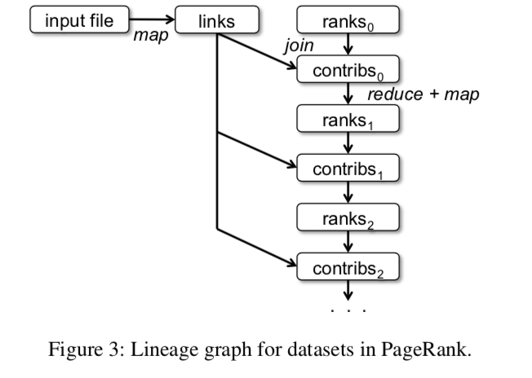
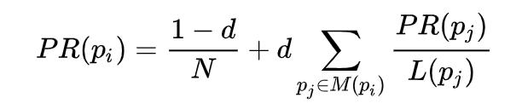
Example : PageRank
Don’t look at the next slide!
Try to write down code for implementing PageRank
See you in 10 minutes.
PageRank is an iterative algorithm for computing rank of web graph nodes
The PageRank paper shows that if you keep recomputing this value then the quantities will converge
The size of the lineage graph depends on how many iterations you perform
Notes:
p_j \in M(p_i) means “the set of pages that link to p_i”
AND
“PR(p_j)” means “the page rank of p_j”
AND
L(p_j) means “the number of outbound links from page p_j

Slide 18
val links = spark.textFile(...).map(...).persist() var ranks = // RDD of (URL, rank) pairs for (i <- 1 to ITERATIONS) {
// Build an RDD of (targetURL, float) pairs
// with the contributions sent by each page
val contribs = links.join(ranks).flatMap {
(url, (links, rank)) =>
links.map(dest => (dest, rank/links.size))
}
// Sum contributions by URL and get new ranks
ranks = contribs.reduceByKey((x,y) => x+y)
.mapValues(sum => a/N + (1-a)*sum)
}
They use ”1-a” instead of “d” in the example code!
Notes:
p_j \in M(p_i) means “the set of pages that link to p_i”
AND
“PR(p_j)” means “the page rank of p_j”
AND
L(p_j) means “the number of outbound links from page p_j

Slide 19
PageRank Challenges
What problems might we face, failure-wise, that we wouldn’t face if we wrote similar code with MapReduce?
Take 60 seconds and put answers in the Zoom chat
What problems might we face, runtime-wise, if we implement this naïvely?
Take 60 seconds and put some answers in the Zoom chat

Slide 20
PageRank Challenges
What problems might we face, failure-wise, that we wouldn’t face if we wrote similar code with MapReduce?
Use explicit persistence to avoid having to regenerate ranks from lineage (not necessary for links)
What problems might we face, runtime-wise, if we implement this naïvely?
Partition both links and ranks in the same way, so joins always happen on a single machine.

Slide 21
Example : PageRank
Use Spark support for controlling partitioning!
Partition rank and corresponding links on the same machine to eliminate cross-machine communication
facebook.com
google.com
mit.edu
facebook.com
google.com
mit.edu
facebook.com
google.com
mit.edu
facebook.com
google.com
mit.edu
facebook.com
google.com
mit.edu
PageRank with hash partitioning
PageRank without partitioning

Slide 22
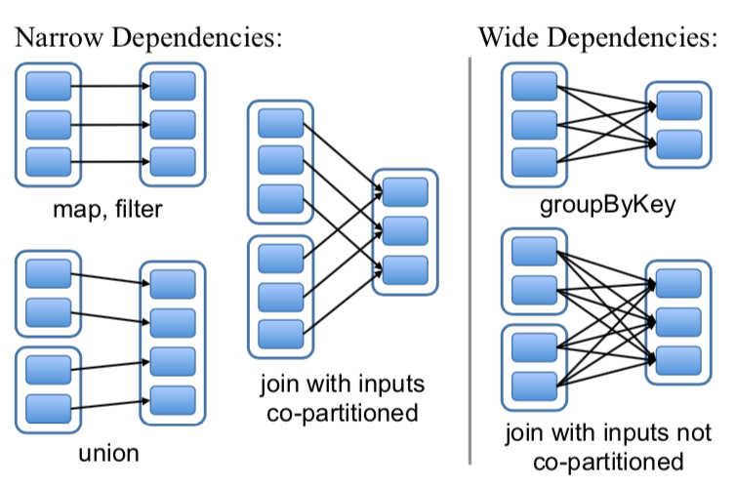
RDD Representation
Partitions: atomic pieces of the RDD
Dependencies: relations with parent RDDs
Narrow Dependencies: A parent RDD partition is used by at most one child partition (e.g. map, filter). Can be pipelined
Wide Dependencies: A parent RDD partition is used by multiple child partitions (e.g. join, groupByKey). Need internode communication
Notes:
narrow dependencies: each partition of the parent RDD is used by at most one partition of the child RDD,
wide dependencies: multiple child partitions may depend on one parent RDD.
Narrow: pipelined execution on one node, efficient, as only the lost parent partitions need to be recomputed in parallel on different nodes.
Wide: need internode communication

Slide 23
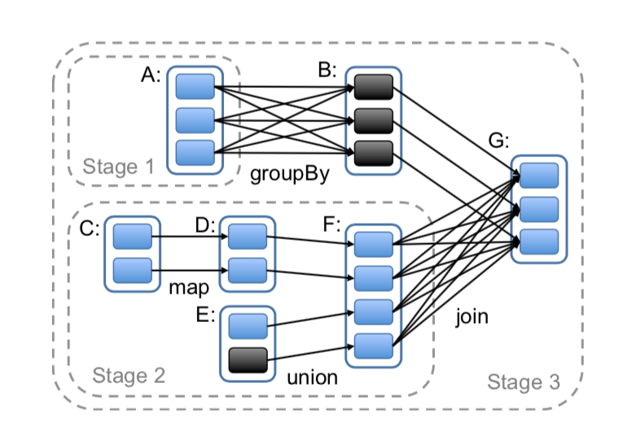
Job Scheduling
Build DAG of stages to execute
Each stage contains as much as possible pipelined transformations with narrow dependencies
Stages are linked by wide dependencies
Assign tasks based on data locality
Notes:
2 co-locate data and computation
Group narrow dependencies into a stage, which can be pipelined on 1 node.

Slide 24
A Moment About Data Storage
This paper doesn’t talk about data storage much
Spark usually operates on HDFS (Hadoop Distributed File System), which is roughly equivalent to the Google File System
Core elements:
UNIX-style bytestream files (not relations)
A single hierarchical file namespace
Files are potentially huge, stored in chunks scattered across a cluster
Reading a file usually means connecting to multiple machines
Designed for streaming reads and writes. Ill-suited for single-byte reads or writes
Chunk locations can be exposed to clients
Notes:
2 co-locate data and computation
Group narrow dependencies into a stage, which can be pipelined on 1 node.

Slide 25
Fault Tolerance
Task failures
Stage’s parents available: rerun on another node
Some stages unavailable: resubmit tasks to compute missing partitions in parallel
Does not tolerate scheduler failures
Solution: Lineage graph replication
25

Slide 26
Memory Management
Three storage strategies:
In-memory storage as deserialized Java objects, (fastest performance, since JVM can access each RDD element natively)
In-memory storage as serialized data, (more memory-efficient than Java object graphs, useful when space is limited)
On-disk storage (useful when RDDs are larger than RAM, but expensive to recompute from lineage)
LRU policy for eviction at RDD level when there is not enough RAM
Or, use user-specified “persistence priority” for eviction

Slide 27
Checkpointing and Failures with Spark
Short lineage chain?
Just recompute from lineage
Long lineage chain with narrow dependencies?
Fast to recompute from lineage using pipelined execution
Long lineage chain with wide dependencies?
This can be time-consuming. A node failure might require recomputing everything!
Use persistence as a checkpoint to prevent long recoveries
A lot more is left to the user than with MapReduce or RDBMS

Slide 28
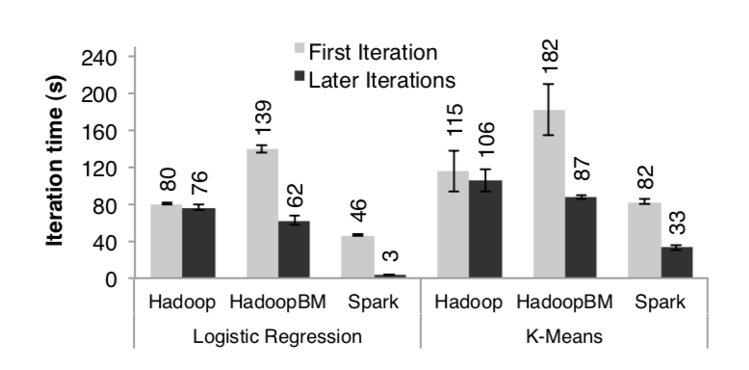
Performance: Iterative Machine Learning
K-Means and Logistic Regression
Experiment Setup:
10 iterations
10GB datasets
25-100 machines
Note: HadoopBM in its first iteration converts text input data to a more efficient binary format

Slide 29
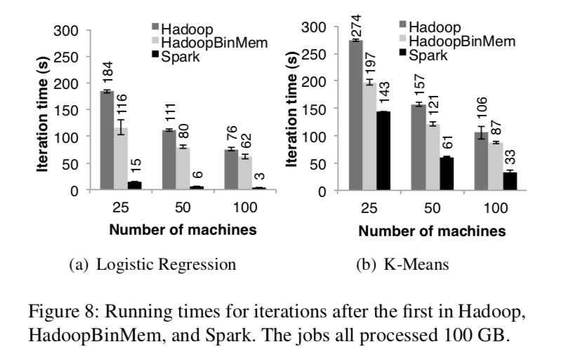
Performance: Iterative Machine Learning
Notes:
Outperforms HadoopBinMemory
1. Minimum overhead of the Hadoop software stack
2. Overhead of HDFS while serving data
3. Deserialization cost to convert binary records to us- able in-memory Java objects.

Slide 30
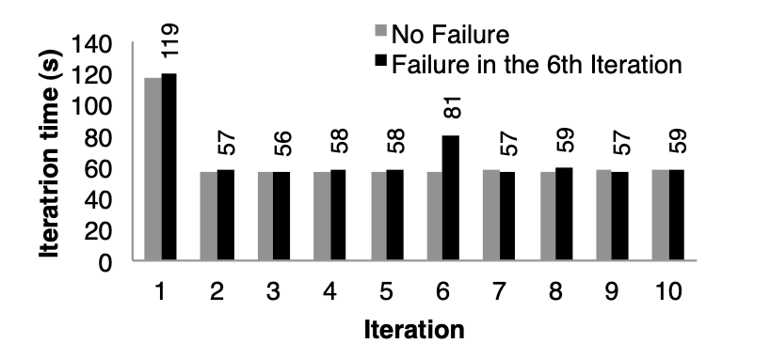
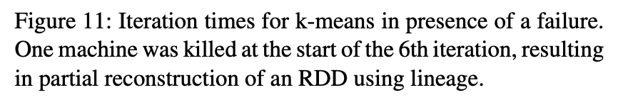
Failure and Recovery

Slide 31
Spark and MapReduce
Spark has pretty much taken over “large-scale arbitrary compute jobs” from MapReduce
Are there any advantages to MapReduce? Not really; you can express a MapReduce program almost exactly using Spark

Slide 32
Spark and RDBMS
Spark doesn’t have anything to say about transactions
Spark has more optimization opportunities than MapReduce, but they’re still mostly manual. Nothing like RDBMS optimizer (is it even possible with Spark?)
Some room for exploiting RDBMS techniques, like joins
(Certainly, more room than with MapReduce)
Scala programs or SQL queries?
Spark SQL exists as SQL layer, much like Hive for Mapreduce

