Slide 1
Learning Data System Components
6.830 Lecture 11
Sivaprasad Sudhir, Kapil Vaidya
Slides Courtesy: Prof. Tim Kraska

Slide 2
Building Blocks of Data Systems
Indexes
Joins
Sorting
Caching
Hash Tables

Slide 3
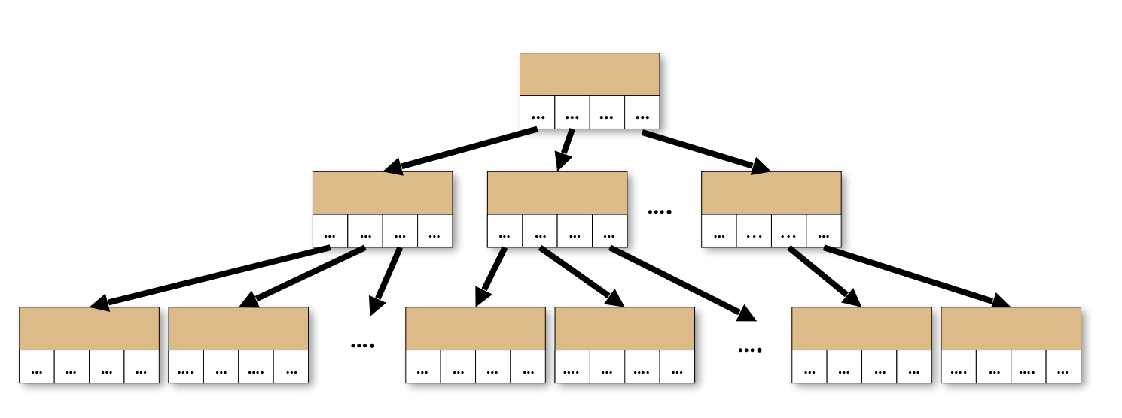
An example
Index all Integers from 100 to 1M
Data =
100 | 101 | 102 | 103 | 104 | 105 | ... | 1M
B-Tree?

Slide 4
An example
Index all Integers from 100 to 1M
Data =
100 | 101 | 102 | 103 | 104 | 105 | ... | 1M
Data[key – 100]

Slide 5
An example
What about even integers?
Data =
100 | 101 | 102 | 103 | 104 | 105 | ... | 1M
Data =
100 | 102 | 104 | 106 | 108 | 110 | ... | 1M
Data[(key – 100) / 2]

Slide 6
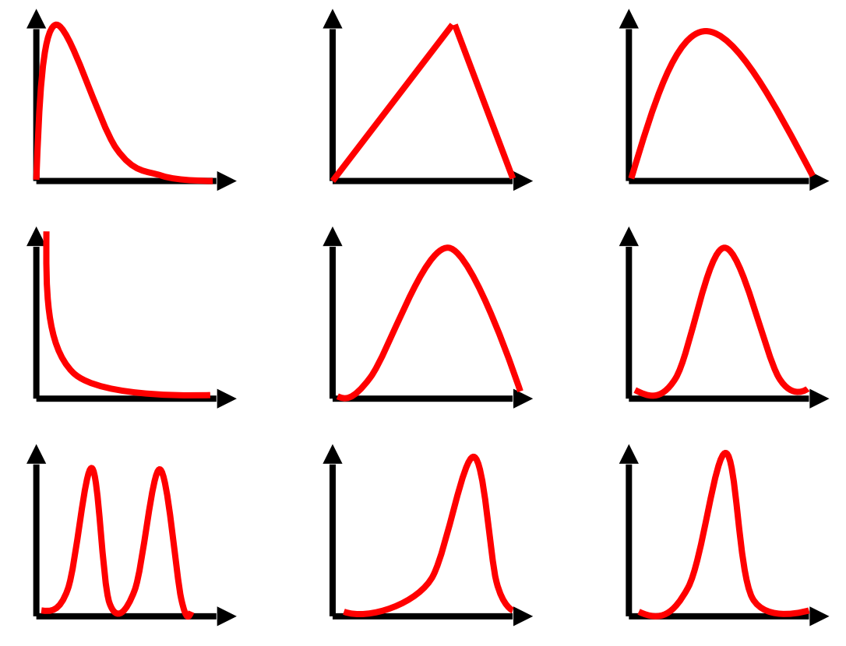
Other distributions?

Slide 7
Key Insight
Traditional data structures make no assumption about data
Optimized for worst case
Notes:
Nice worst case guarantees
But not optimal for the specific case

Slide 8
Building a system from scratch for every use case is not scalable
What if we could learn the data distribution?
Notes:
Data structure is a black box that has no knowledge about data distribution and make it a white box
Advantage of ML – can automatically discover the patterns

Slide 9
Setup
In-memory
Read only
Notes:
Data is continuous pages in memory

Slide 10
B-Tree as a model
Maps key to page
B-Tree
Pages

Slide 11
B-Tree as a model
Maps key to pos
Search between pos and pos + page size
B-Tree
Sorted Array
pos
pos + page size

Slide 12
B-Tree as a model
Model that predicts the position of a key within some error bounds
Model
Sorted Array
pos
pos + page size

Slide 13
Index as a model
Model maps key to pos
Search in [pos – err_{min}, pos + err_{max}]
err_{min} and err_{max} are known from training
Model
Sorted Array
pos - err_{min}
pos + err_{max}

Slide 14
What is the model estimating?
Predicting the position of a key
Modeling the CDF of the keys
pos = P(X <= key) * #keys
Model
Sorted Array
pos - err_{min}
pos + err_{max}
Notes:
You only need to know about the error of the data the is stored in your database

Slide 15
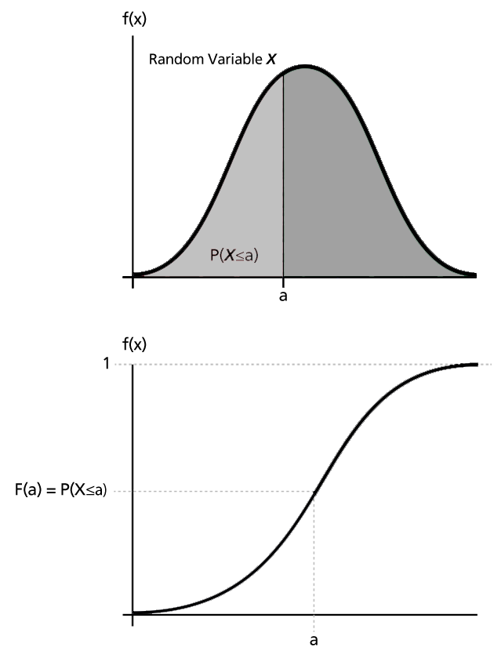
What is the model estimating?
Predicting the position of a key
Modeling the CDF of the keys
pos = P(X <= key) * #keys
= F(key) * #keys
Notes:
If the CDF model over the empirical data distribution were perfect, then every data would mapped correctly

Slide 16
LookUp(key)
Use the CDF model to predict the position of the key
pos = F(key) * #keys
Scan from [pos – errmin, pos + errmax]

Slide 17
Key Idea
When CPU cycles are cheap relative to memory accesses, compute-intensive function approximations can be beneficial for lookups
ML models may be better at approximating some functions than existing data structures
Power of continuous functions
Notes:
B+ Tree does a search within each page

Slide 18
Potential Advantages of Learned Models
Smaller indexes
Faster lookups

Slide 19
What Models?
200M web-server log records by timestamp-sorted
2-layer NN, 32 width, ReLU activated
Prediction task: timestamp -> position within sorted array
Notes:
Inference of the model on the critical path of look up

Slide 20

Naïve Approach
250 ns
???

Slide 21
Naïve Approach
250 ns
80,000 ns

Slide 22
Problems
Tensorflow is designed for large models
B-Trees are very good at overfitting
B-Trees are cache-efficient
Search does not take advantage of the prediction
Notes:
Overfitting is a good thing

Slide 23
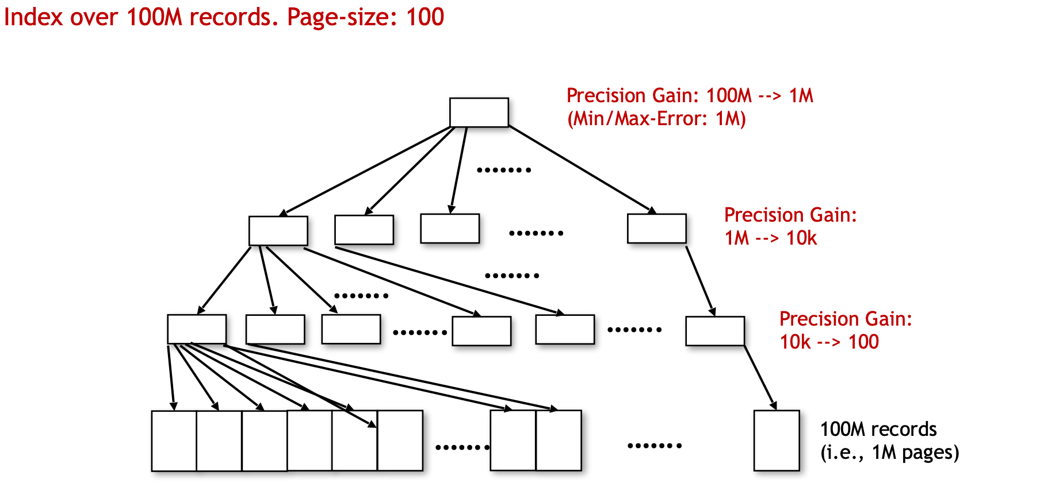
Precision gain per node

Slide 24
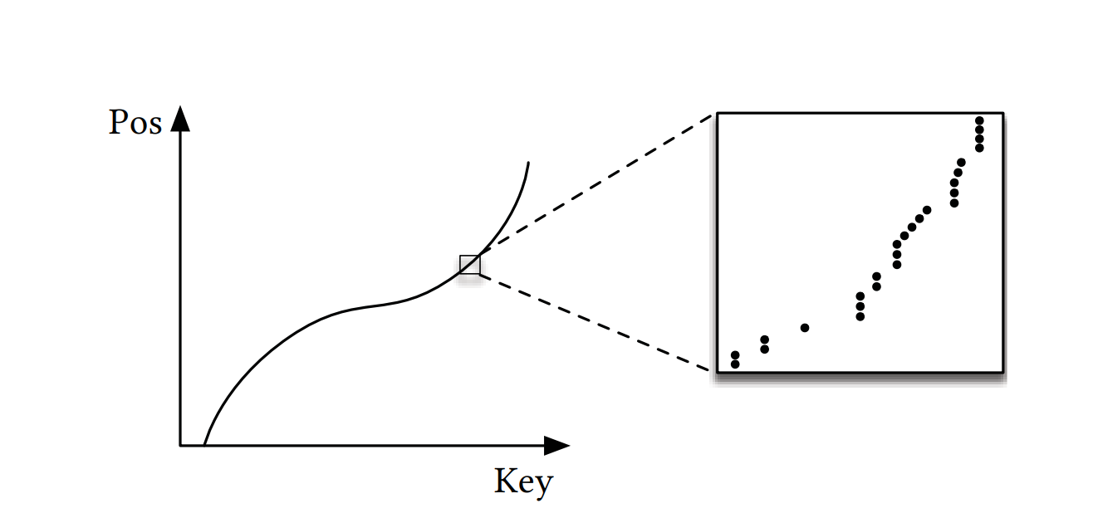
Last Mile Problem

Slide 25
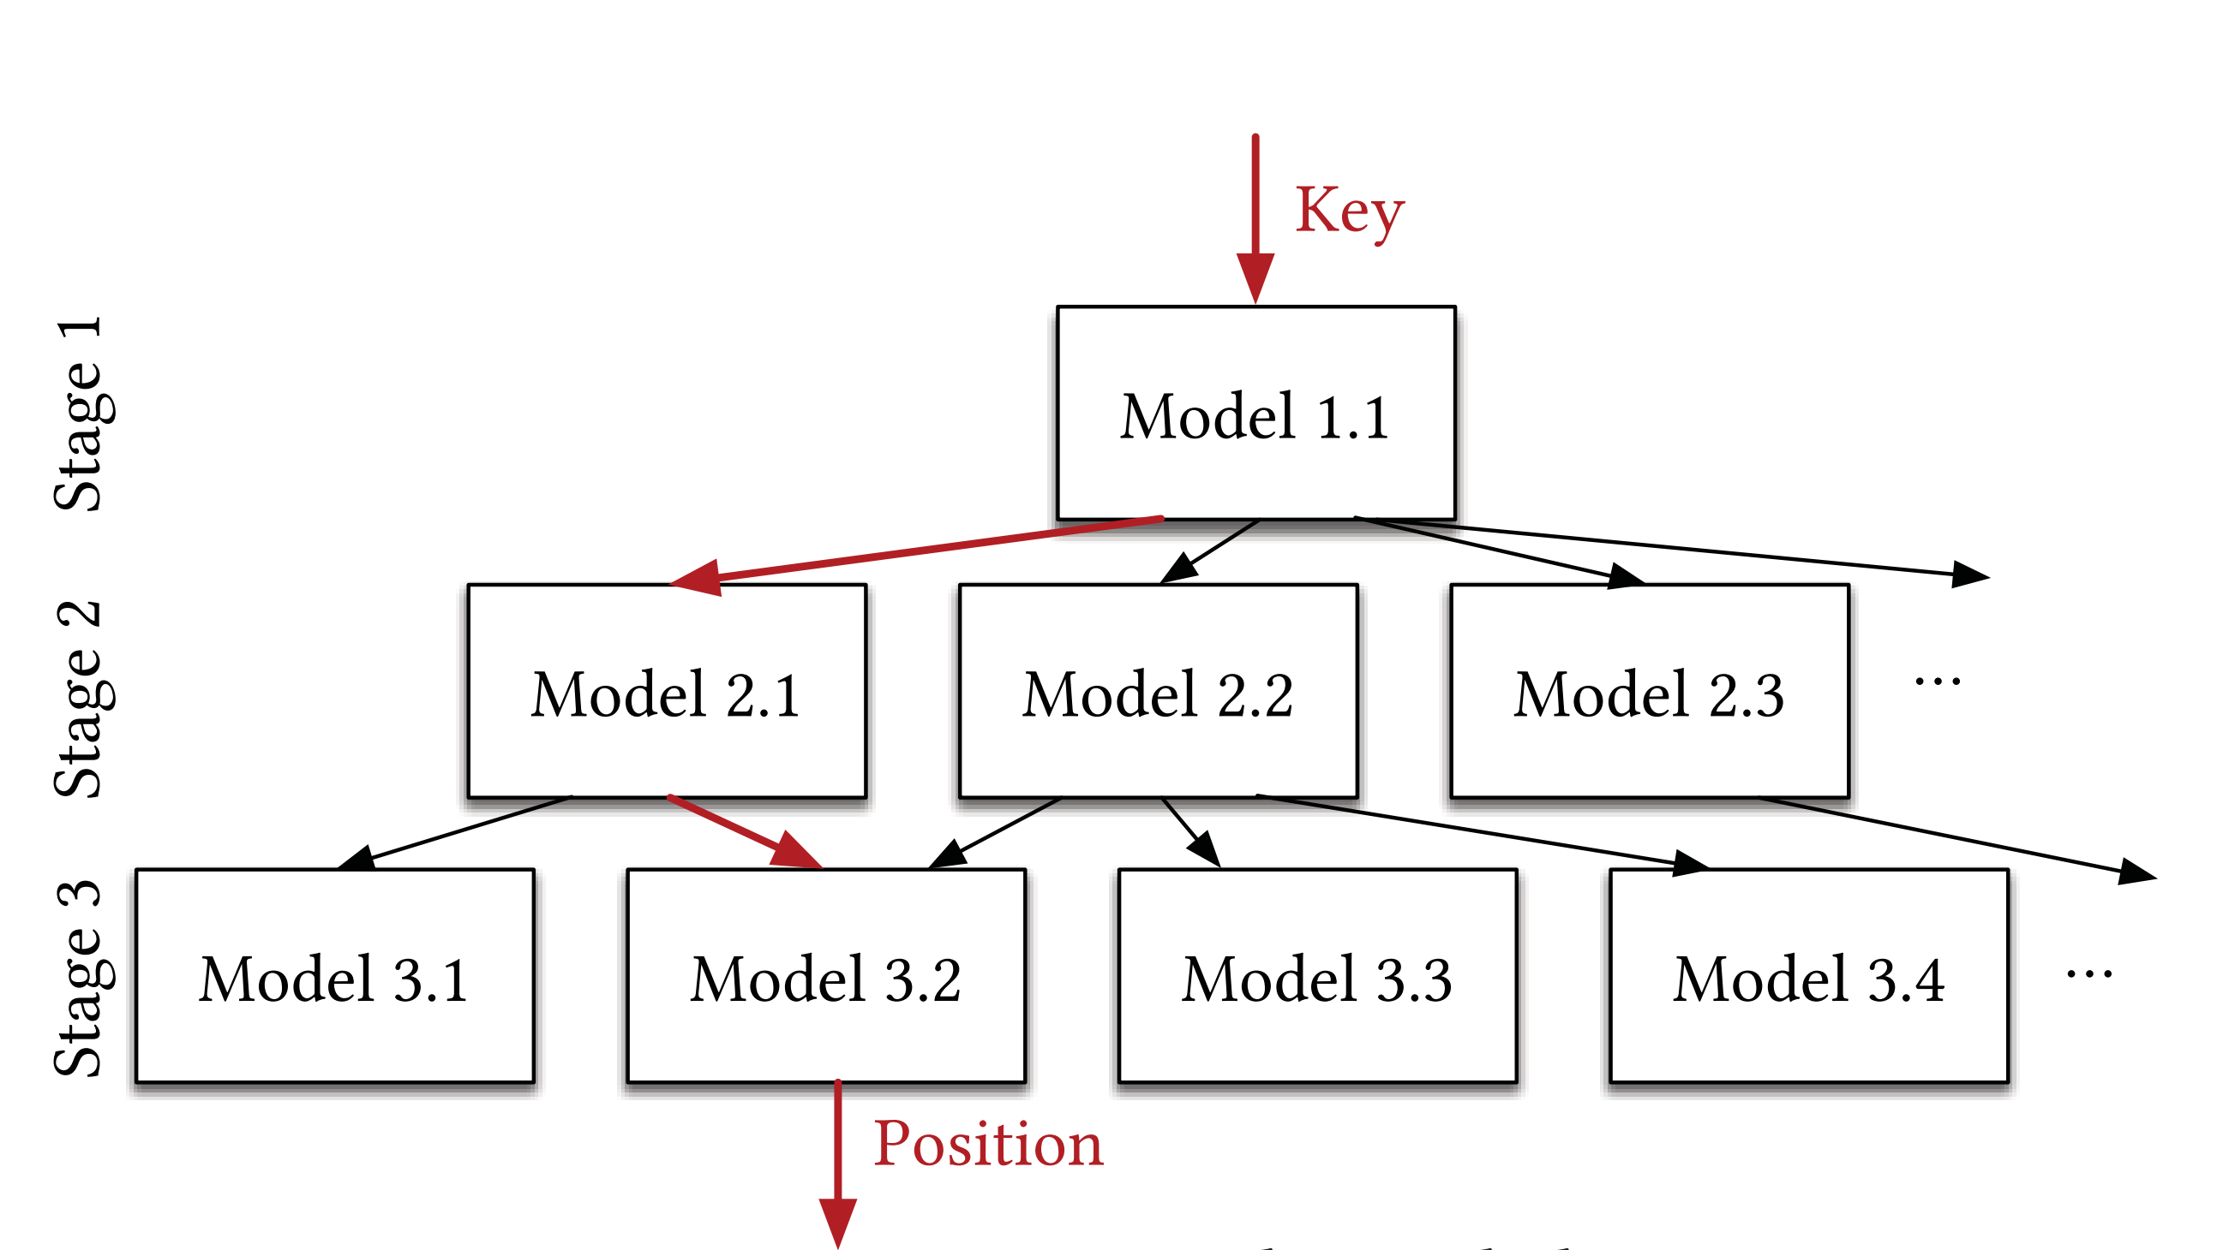
Recursive Model Index (RMI)
Fl.k - CDF of Ml.k
Ml – Number of models in level l
N – Number of keys
floor(F1.1(key) * M2) = 0
floor(F2.1(key) * M3) = 1
floor(F3.2(key) * N) = pos
Notes:
Take away from
Simple
Good position estimation
Be aware of system

Slide 26
Recursive Model Index (RMI)
Notes:
Get to a good position estimate in as few operations as possible
Mixtures of experts

Slide 27
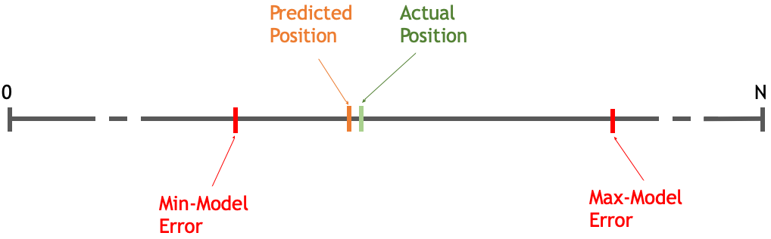
Min-/Max-Error vs Average Error

Slide 28
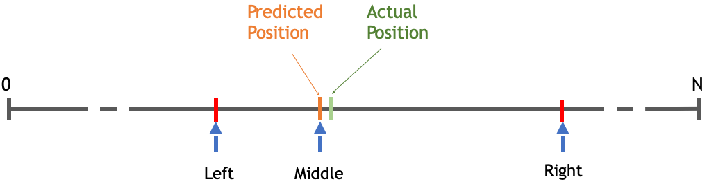
Binary Search

Slide 29
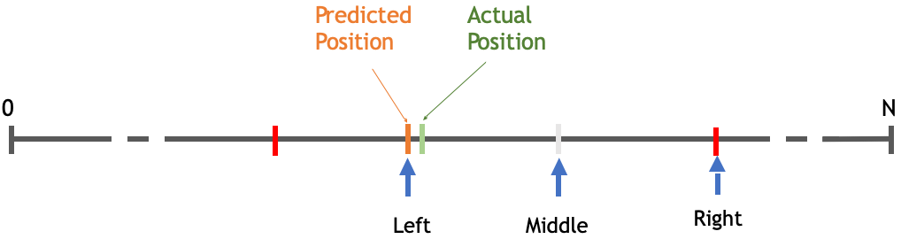
Binary Search

Slide 30
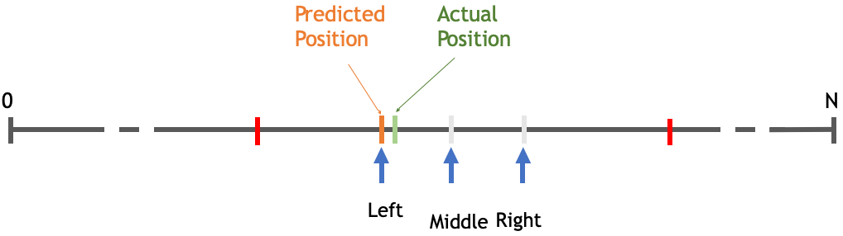
Binary Search

Slide 31
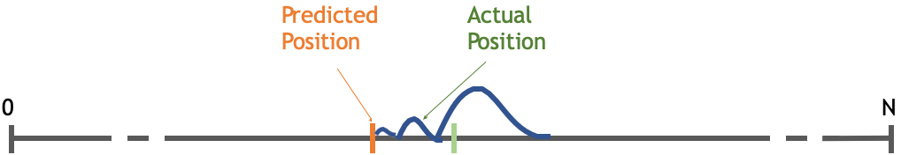
Exponential Search

Slide 32
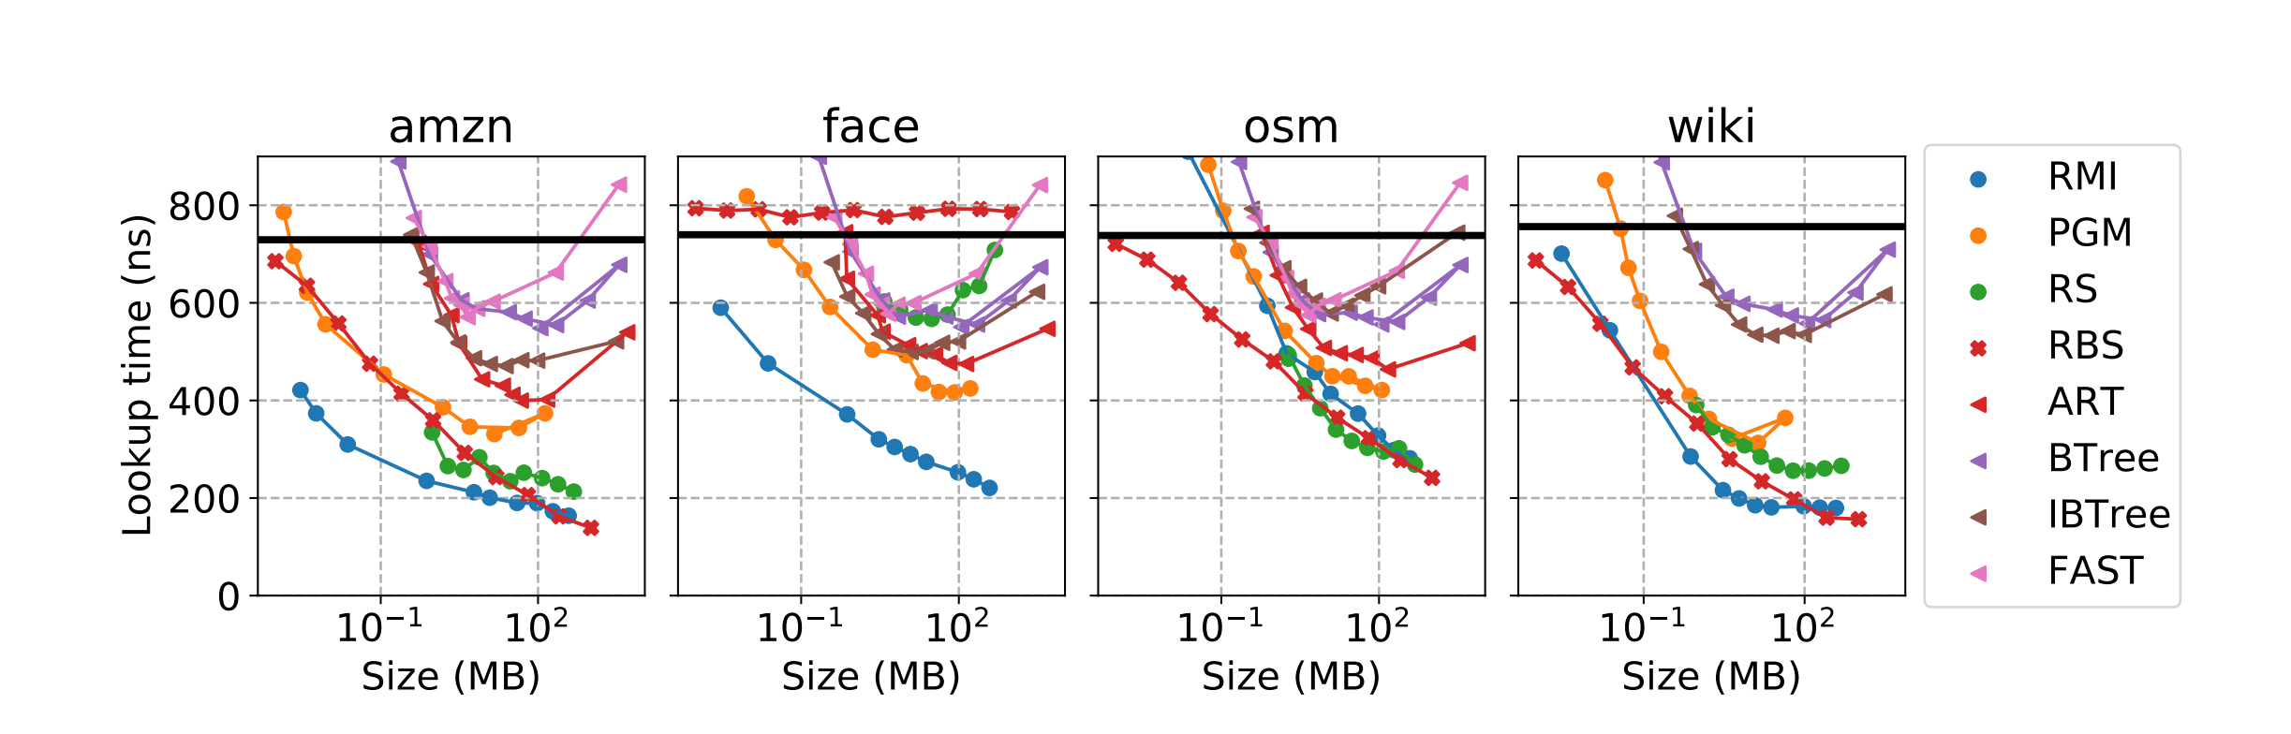
Results
Ryan Marcus, Andreas Kipf, Alexander van Renen, Mihail Stoian, Sanchit Misra, Alfons Kemper, Thomas Neumann, and Tim Kraska. 2020. Benchmarking learned indexes. Proc. VLDB Endow. 14, 1 (September 2020), 1–13. DOI:https://doi.org/10.14778/3421424.3421425

Slide 33
Updates?
Ding, Jialin, et al. "ALEX: an updatable adaptive learned index." Proceedings of the 2020 ACM SIGMOD International Conference on Management of Data. 2020.
Slides Courtesy: Jialin Ding

Slide 34
Why are inserts hard?
How do B-Trees handle inserts?

Slide 35
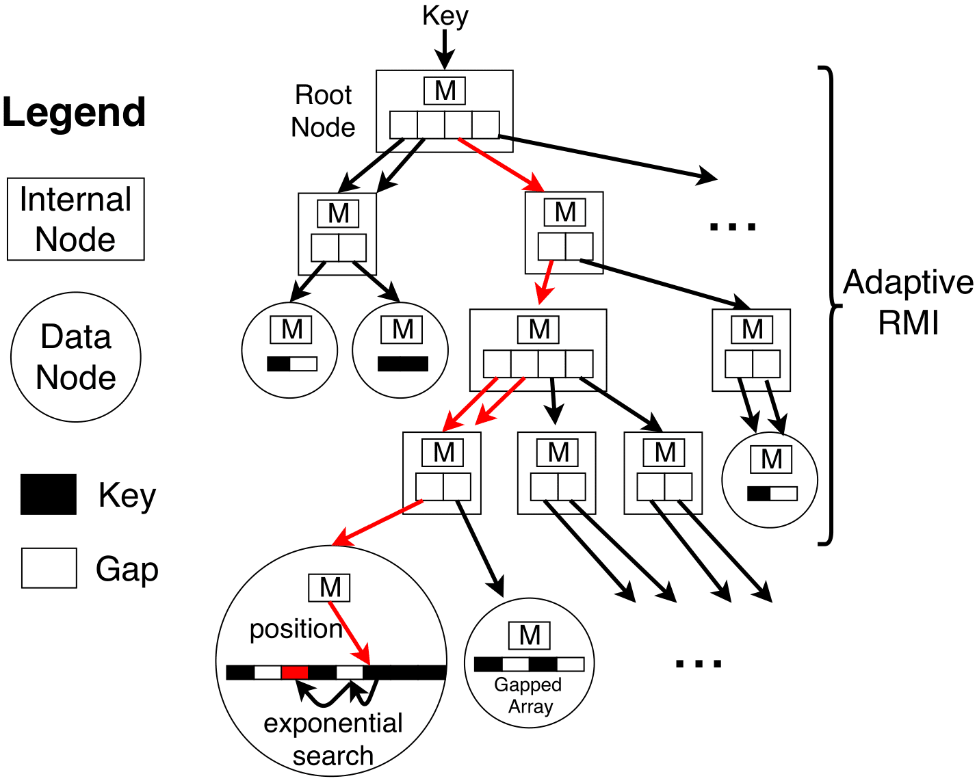
ALEX
Goals
Writes competitive with B+ Tree
Reads faster than B+ Tree and Learned Index
Index size smaller than B+ Tree and Learned Index
Core structure
Dynamic tree structure
Models

Slide 36
ALEX Core Ideas
 | Faster Reads | Faster Writes | Adaptiveness
1. Gapped Array |  | ✔
2. Model-based Inserts | ✔
3. Adaptive Tree Structure | ✔ | ✔ | ✔

Slide 37
1. Gapped Array
Dense Array
1 | 2 | 3 | 4 | 5 | 6 | 7 | 8

Slide 38
1. Gapped Array
Dense Array
1 | 2 | 3 | 4 | 5 | 6 | 7 | 8

Slide 39
1. Gapped Array
Dense Array
1 | 2 | 3 | 4 | 5 | 6 | 7 | 8
 | 1 | 2 | 3 | 4 | 5 | 6 | 7 | 8

Slide 40
1. Gapped Array
Dense Array
1 | 2 | 3 | 4 | 5 | 6 | 7 | 8
0 | 1 | 2 | 3 | 4 | 5 | 6 | 7 | 8

Slide 41
1. Gapped Array
Dense Array
0 | 1 | 2 | 3 | 4 | 5 | 6 | 7 | 8

Slide 42

1. Gapped Array
Insertion Time
Dense Array
0 | 1 | 2 | 3 | 4 | 5 | 6 | 7 | 8
$$O(n)$$

Slide 43
1. Gapped Array
Insertion Time
Dense Array
0 | 1 | 2 | 3 | 4 | 5 | 6 | 7 | 8
$$O(n)$$
B+ Tree Node
1 | 2 | 3 | 4 | 5 | 6 | 7 | 8

Slide 44
1. Gapped Array
Insertion Time
Dense Array
0 | 1 | 2 | 3 | 4 | 5 | 6 | 7 | 8
$$O(n)$$
B+ Tree Node
 | 1 | 2 | 3 | 4 | 5 | 6 | 7 | 8

Slide 45
1. Gapped Array
Insertion Time
Dense Array
0 | 1 | 2 | 3 | 4 | 5 | 6 | 7 | 8
$$O(n)$$
B+ Tree Node
0 | 1 | 2 | 3 | 4 | 5 | 6 | 7 | 8

Slide 46

1. Gapped Array
Insertion Time
Dense Array
0 | 1 | 2 | 3 | 4 | 5 | 6 | 7 | 8
$$O(n)$$
B+ Tree Node
0 | 1 | 2 | 3 | 4 | 5 | 6 | 7 | 8
$$O(n)$$

Slide 47
1. Gapped Array
Insertion Time
Dense Array
0 | 1 | 2 | 3 | 4 | 5 | 6 | 7 | 8
$$O(n)$$
B+ Tree Node
0 | 1 | 2 | 3 | 4 | 5 | 6 | 7 | 8
$$O(n)$$
Gapped Array
1 | 2 |  | 3 | 4 |  | 5 | 6 |  | 7 | 8

Slide 48
1. Gapped Array
Insertion Time
Dense Array
0 | 1 | 2 | 3 | 4 | 5 | 6 | 7 | 8
$$O(n)$$
B+ Tree Node
0 | 1 | 2 | 3 | 4 | 5 | 6 | 7 | 8
$$O(n)$$
Gapped Array
 | 1 | 2 | 3 | 4 |  | 5 | 6 |  | 7 | 8

Slide 49
1. Gapped Array
Insertion Time
Dense Array
0 | 1 | 2 | 3 | 4 | 5 | 6 | 7 | 8
$$O(n)$$
B+ Tree Node
0 | 1 | 2 | 3 | 4 | 5 | 6 | 7 | 8
$$O(n)$$
Gapped Array
0 | 1 | 2 | 3 | 4 |  | 5 | 6 |  | 7 | 8

Slide 50

1. Gapped Array
Insertion Time
Dense Array
0 | 1 | 2 | 3 | 4 | 5 | 6 | 7 | 8
$$O(n)$$
B+ Tree Node
0 | 1 | 2 | 3 | 4 | 5 | 6 | 7 | 8
$$O(n)$$
Gapped Array
0 | 1 | 2 | 3 | 4 |  | 5 | 6 |  | 7 | 8
$$O(\log{n})$$

Slide 51
1. Gapped Array
Insertion Time
Dense Array
0 | 1 | 2 | 3 | 4 | 5 | 6 | 7 | 8
$$O(n)$$
B+ Tree Node
0 | 1 | 2 | 3 | 4 | 5 | 6 | 7 | 8
$$O(n)$$
Gapped Array
0 | 1 | 2 | 3 | 4 |  | 5 | 6 |  | 7 | 8
$$O(\log{n})$$
Gapped Array achieves inserts using fewer shifts, leading to faster writes

Slide 52
2. Model-based Inserts
Gapped Array
1 | 2 |  | 3 | 4 |  | 5 | 6 |  | 7 | 8

Slide 53
2. Model-based Inserts
Model
Key | 1 | 2 | 3 | 4 | 5 | 6 | 7 | 8
Gapped Array
1 | 2 |  | 3 | 4 |  | 5 | 6 |  | 7 | 8

Slide 54
2. Model-based Inserts
Model
Key | 1 | 2 | 3 | 4 | 5 | 6 | 7 | 8
Gapped Array

Slide 55
2. Model-based Inserts
Model
Key | 1 | 2 | 3 | 4 | 5 | 6 | 7 | 8
Gapped Array
 | 1

Slide 56
2. Model-based Inserts
Model
Key | 1 | 2 | 3 | 4 | 5 | 6 | 7 | 8
Gapped Array
 | 1 | 2

Slide 57
2. Model-based Inserts
Model
Key | 1 | 2 | 3 | 4 | 5 | 6 | 7 | 8
Gapped Array
 | 1 | 2 |  | 3

Slide 58
2. Model-based Inserts
Model
Key | 1 | 2 | 3 | 4 | 5 | 6 | 7 | 8
Gapped Array
 | 1 | 2 |  | 3 | 4

Slide 59
2. Model-based Inserts
Model
Key | 1 | 2 | 3 | 4 | 5 | 6 | 7 | 8
Gapped Array
 | 1 | 2 |  | 3 | 4 | 5

Slide 60
2. Model-based Inserts
Model
Key | 1 | 2 | 3 | 4 | 5 | 6 | 7 | 8
Gapped Array
 | 1 | 2 |  | 3 | 4 | 5 |  | 6 | 7 | 8

Slide 61
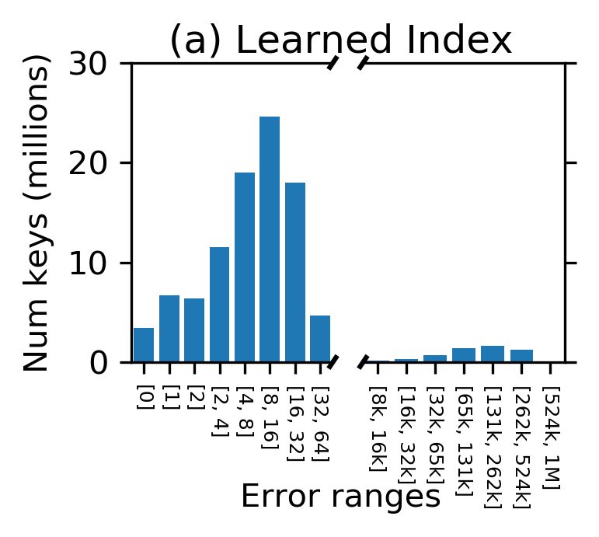
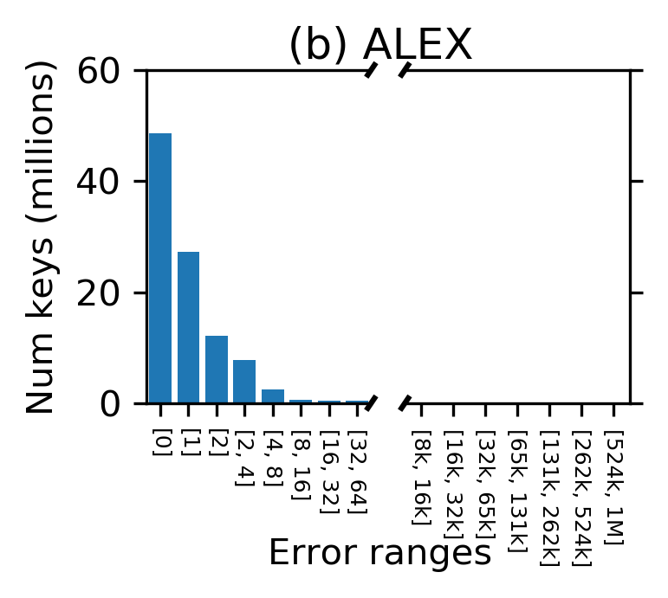
2. Model-based Inserts
Model-based inserts achieve lower error, leading to faster reads

Slide 62
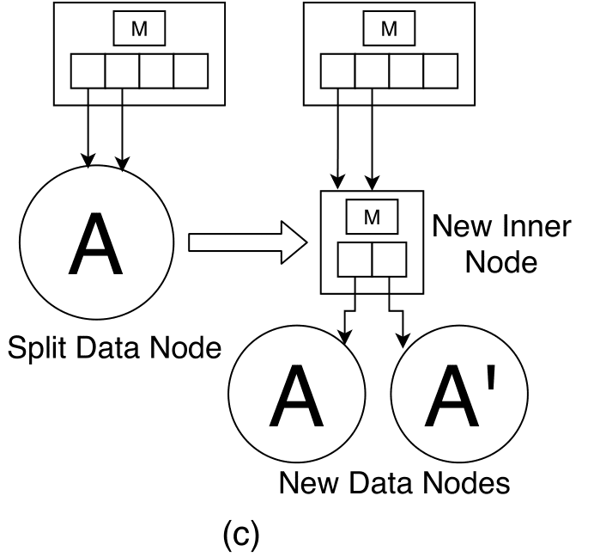
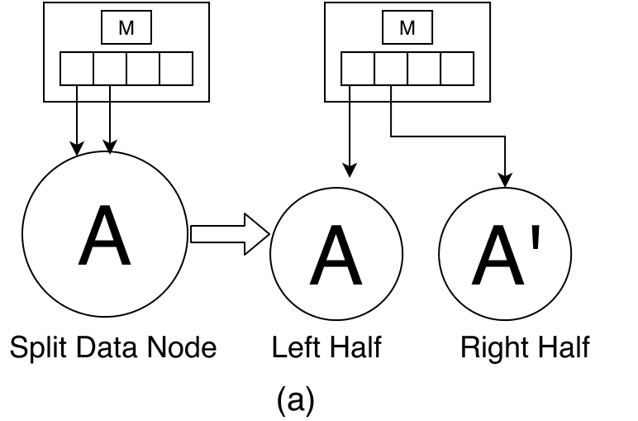
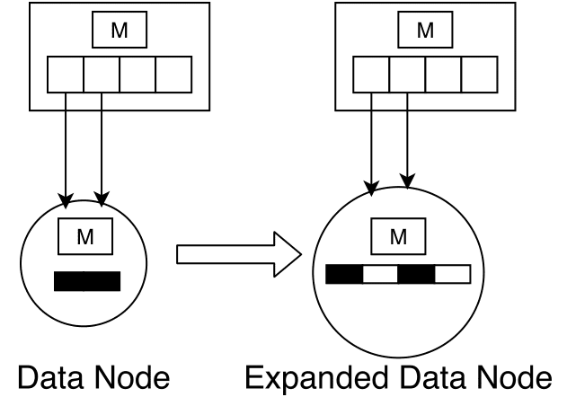
3. Adaptive Structure
Flexible tree structure
Split nodes sideways
Split nodes downwards
Expand nodes
Merge nodes, contract node
All decisions are made to maximize performance
Uses a cost model of query runtime

Slide 63
Learned Data Structures
A lot more work on different data structures
Multi-dimensional indexes
Hash Tables
Bloom Filters
Suffix Trees
Different models to learn CDFs

Slide 64
Study Break
How to extend the CDF idea to algorithms like sorting?
Can you frame sorting as a prediction task?

Slide 65
Sorting
Notes:
Next we will have a look at how learning can be applied to sorting.

Slide 66
Sorting
Puts elements of a list in a certain order.
Notes:
First we will quickly go over some sorting basics from algorithms 101 to refresh your memory.
Sorting is a very popular and fundamental algorithm. It is present as a sub routine in almost all computational systems.
So what does sorting do?
Sorting basically just puts elements of a list in a certain order.

Slide 67
Sorting
Puts elements of a list in a certain order.
Numerical order
A =
9 | 1 | 17 | 18 | 3 | 0 | 1 | 4
Sort(A) =
0 | 1 | 1 | 3 | 4 | 9 | 17 | 18
Notes:
One of the popular orders is to just put things in numerical order.

Slide 68
Sorting
Puts elements of a list in a certain order.
Numerical order
Lexicographic order
A =
9 | 1 | 17 | 18 | 3 | 0 | 1 | 4
Sort(A) =
0 | 1 | 1 | 3 | 4 | 9 | 17 | 18
A =
uvw | aaa | bbc | efg | gjl | abc | cba | ghe
Sort(A) =
aaa | abc | bbc | cba | efg | ghe | gjl | uvw
Notes:
If the data is of string type one would lexicographically sort the data.

Slide 69
Sorting
Puts elements of a list in a certain order.
Numerical order
Lexicographic order
Complex data types such as multi-dimensional, categorical etc have their own specific sort order.
A =
9 | 1 | 17 | 18 | 3 | 0 | 1 | 4
Sort(A) =
0 | 1 | 1 | 3 | 4 | 9 | 17 | 18
A =
uvw | aaa | bbc | efg | gjl | abc | cba | ghe
Sort(A) =
aaa | abc | bbc | cba | efg | ghe | gjl | uvw
Notes:
Complex data types such as multi-dimensional and categorical data can have their own specific sort order.
The problem of sorting multi dimensional data arises when compressing a table. Given a table with multiple columns, people use heuristics to define a sort order that minimizes the compressed data size. After defining a sort order, they use a sorting algorithm to put the rows in order and then compress the data.

Slide 70
Comparison based sorting algorithms
Notes:
We will just do an overview of comparison based sorting algorthms.

Slide 71
Comparison based Sorting
Use a comparison function that determines which of two elements should occur first in the final sorted list.
Compare two elements and then swap if needed.
Some popular sorting functions: Quick Sort, Heap Sort, Insertion Sort, Tim Sort, Bubble Sort, Selection Sort
Notes:
Comparison based sorting algortihms make use of a comparison function. This comparison function take in two elements and returns a boolean indicating which one of them is bigger. Using this function the sorting algorithm decides whether to swap the data or not.
Some popular comparison sorting algorihtm are mentioned here. You must have seen Quick, insertion sort in your algorithms class. Tim sort is the algorihtm that Python uses. It works well on real world data.

Slide 72
Bubble Sort
Compare each pair of adjacent elements
Swap the two of necessary
Repeat Until array is sorted

Slide 73
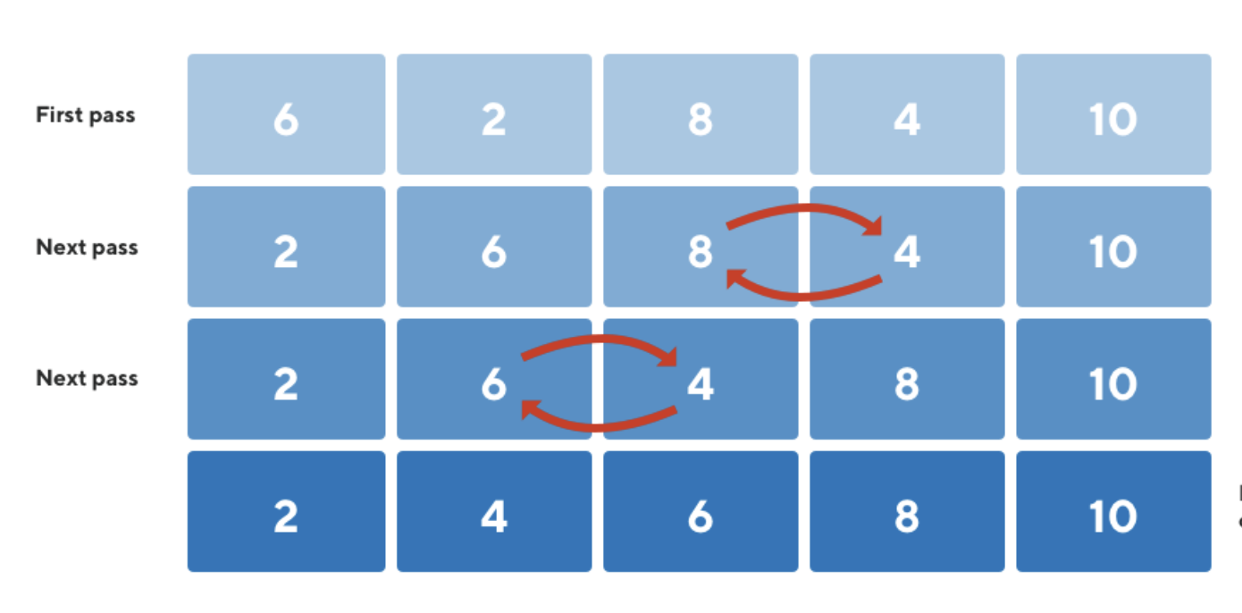
Bubble Sort Example

Slide 74
Insertion Sort
Just like sorting a deck of cards.
Maintain a sorted deck of cards seen until now.
For a new card, find the position in the sorted deck
Place the card in the position by shifting the following cards
Repeat Until no new incoming card
Notes:
As an example of comparison based sorting algorithm, we will quickly look at insertion sort. Insertion sort is just like sorting a deck of cards.
You maintain a sorted deck of cards of the cards seen unitl now. For each new card, you find the position in the sorted deck. You do this by repeatedly calling the comparison function. Once you know the position, you just place the card in that position by shifting the following cards. Repeat this until no new card is left.

Slide 75
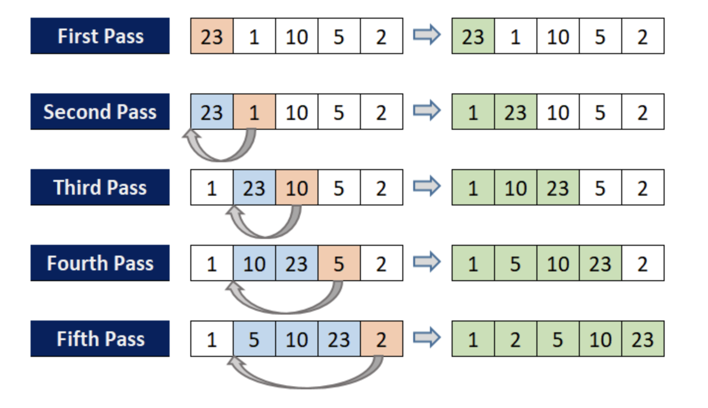
Insertion Sort Example
Quite fast if numbers are close to actual positions (nearly sorted array )!!
Notes:
In the first pass, since we have only one element, its already sorted.

Slide 76
Complexity of comparison-based algorithms
Number of comparisons required is atleast O(N log(N)).
Proof:
Let's say sorting algorithm makes atmost D comparison function calls every run.
There are N! different arrays that we can feed to this algorithm.
Every different order feed should result in new set of D decisions.
N! <= 2^{D}

Slide 77
Complexity of comparison-based algorithms
The number of comparisons required is proportional to O(N log(N)).
Proof:
Lets say sorting algorithm makes atmost D comparison function calls every run.
There are N! different arrays that we can feed to this algorithm.
Every different order feed should result in new set of D decisions.
N! <= 2^{D}
Is Nlog(N) the best we can do?

Slide 78
Question
Given a 1 million sized integer array, if you knew the integers are between 1-100, how would you sort the array?

Slide 79
Question
Given a 1 million sized integer array, if you knew the integers are between 1-100, how would you sort the array?
Use a 100 sized array to count occurences of each value

Slide 80
Distribution based sorting algorithms

Slide 81
Distribution based algorithms
General idea of distribution-based sorting algorithms:
"Build a histogram of the data and place the data using it"
Easy to build a histogram if range of the data is limited

Slide 82
Counting Sort
Useful when the data range is small.
Initialize an empty count array for the data range
Parse the array and increment count of value seen
This generates a histogram of the data
Calculate the CDF of each value using the histogram
Parse the array and place elements based on their CDF
Decrement the CDF count

Slide 83
Counting Sort:
Data Range is from [0,7]
Input Array
5 | 7 | 5 | 2 | 1 | 1
Count array
0 | 1 | 2 | 3 | 4 | 5 | 6 | 7
0 | 0 | 0 | 0 | 0 | 0 | 0 | 0

Slide 84
Counting Sort:
Data Range is from [0,7]
Input Array
5 | 7 | 5 | 2 | 1 | 1
Count array
0 | 1 | 2 | 3 | 4 | 5 | 6 | 7
0 | 2 | 1 | 0 | 0 | 2 | 0 | 1

Slide 85
Counting Sort:
Data Range is from [0,7]
0 | 1 | 2 | 3 | 4 | 5
Input Array
5 | 7 | 5 | 2 | 1 | 1
Count array
(Histogram)
0 | 1 | 2 | 3 | 4 | 5 | 6 | 7
0 | 2 | 1 | 0 | 0 | 2 | 0 | 1
0 | 1 | 2 | 3 | 4 | 5 | 6 | 7
CDF
-1 | 1 | 2 | 2 | 2 | 4 | 4 | 5

Slide 86
Counting Sort:
Data Range is from [0,7]
0 | 1 | 2 | 3 | 4 | 5
Input Array
5 | 7 | 5 | 2 | 1 | 1
Count array
(Histogram)
0 | 1 | 2 | 3 | 4 | 5 | 6 | 7
0 | 2 | 1 | 0 | 0 | 2 | 0 | 1
0 | 1 | 2 | 3 | 4 | 5 | 6 | 7
CDF
-1 | 1 | 2 | 2 | 2 | 4 | 4 | 5
Output Array
1 | 1 | 2 | 5 | 5 | 7

Slide 87
Counting Sort
Only works if data range small

Slide 88
Counting Sort
Only works if data range small
How to generalize counting sort?

Slide 89
Counting Sort
Only works if data range small
How to generalize counting sort?
Operate on small segments of data

Slide 90
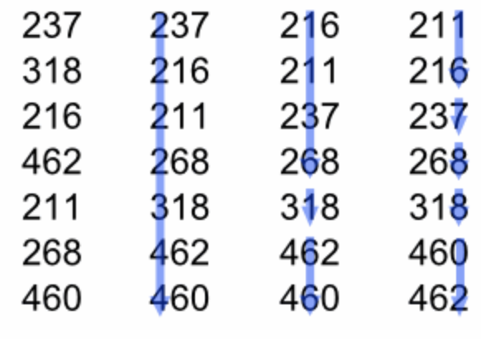
Radix Sort: Generalized Count Sort
Divide element into segments
Does count sort one segment at a time.
Repeats this procedure on following segments until finished
Segments can be anything 10 bits, 2 digits, one character, etc

Slide 91
Radix Sort: Generalized Count Sort
Divide element into segments
Does count sort one segment at a time.
Repeats this procedure on following segments until finished
Segments can be anything 10 bits, 2 digits, one character, etc

Slide 92
Radix Sort: Generalized Count Sort
Divide element into segments
Does count sort one segment at a time.
Repeats this procedure on following segments until finished
Segments can be anything 10 bits, 2 digits, one character, etc

Slide 93
Radix Sort: Generalized Count Sort
Divide element into segments
Does count sort one segment at a time.
Repeats this procedure on following segments until finished
Segments can be anything 10 bits, 2 digits, one character, etc

Slide 94
Distribution based algorithms complexity
Assuming the data elements have atmost W digits, the complexity of radix sort is atmost O(NW).
This might be better than NLogN based on W
Generally, for numerical data 32, 64, 128 bit integers radix sort is much faster than comparison-based sorts.

Slide 95
Distribution based algorithms
Essentially generate CDF of the data by counting
Can we use ML models to model CDF?

Slide 96
A Learned Sorting Algorithm

Slide 97

Sorting as a prediction task
Sorting is essentially a prediction task
Sorting involves predicting the correct final position of the element based on its value
The algorithms indirectly calculate the position of the element using some operations and place it there
We can potentially use models for doing this instead of algorithms.

Slide 98
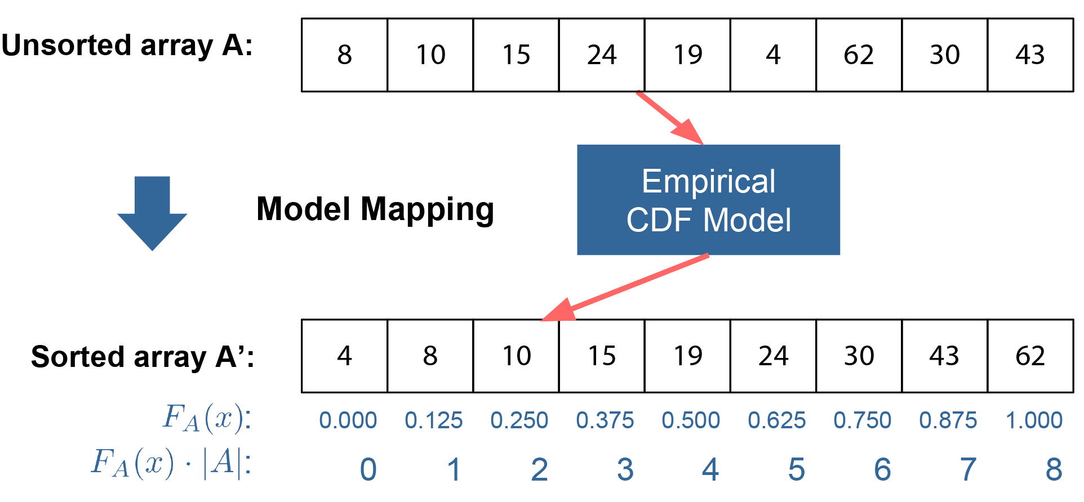
Sorting as a prediction task

Slide 99
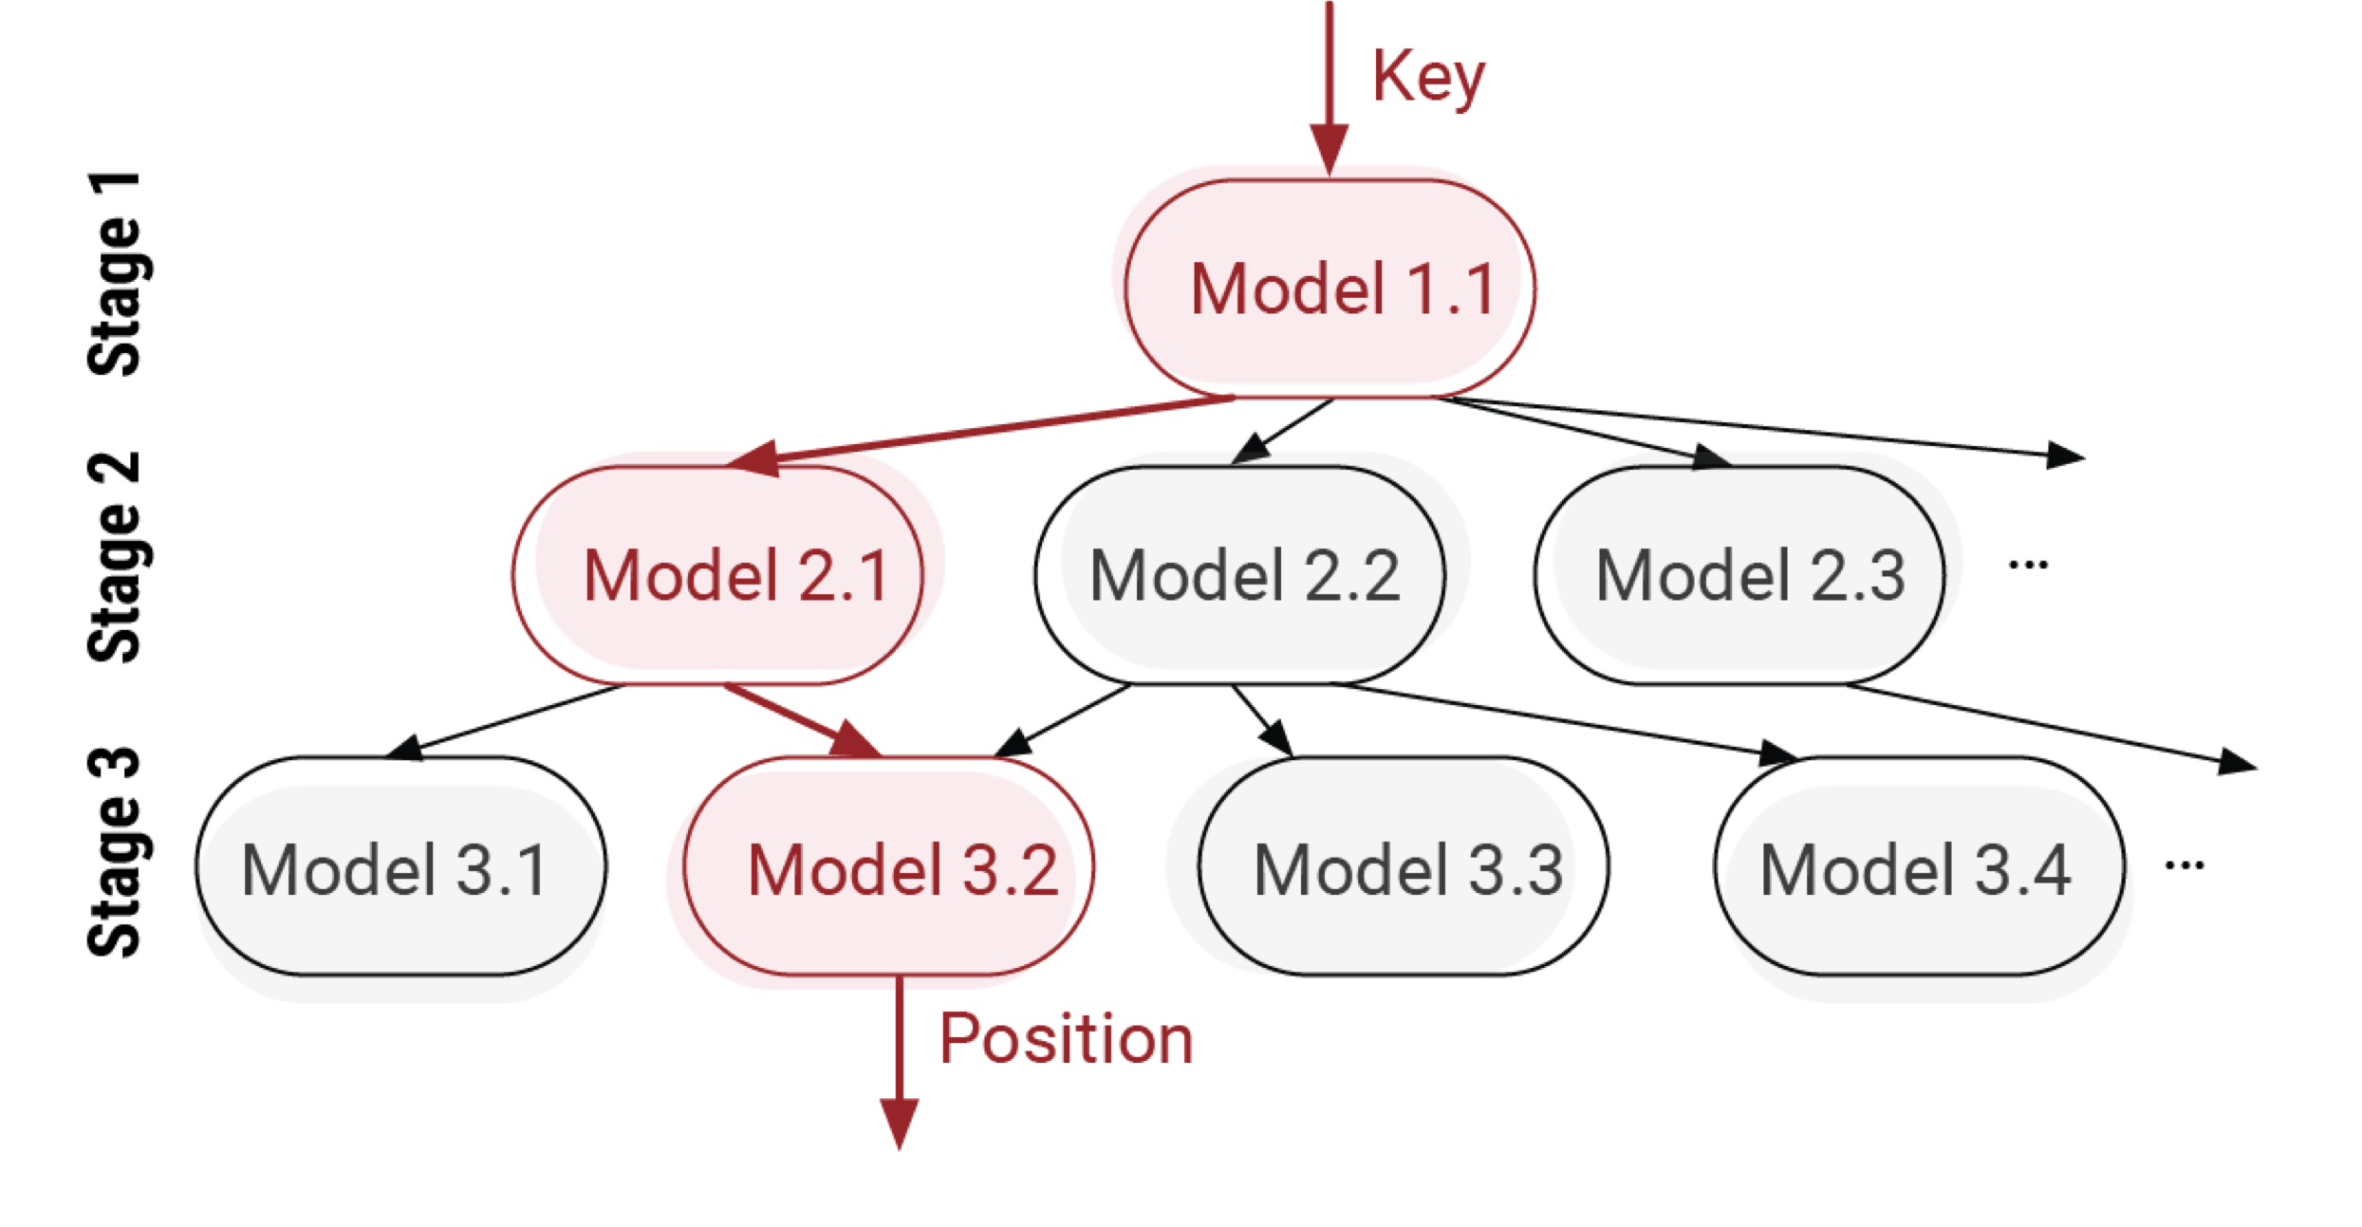
Model
Fast in training and inference
Can't use Neural networks and other expensive models
Use RMI from indexing
They are fast to train and infer

Slide 100
What are the potential issues with suing RMI's?
RMI
Sorted Array:
15
10
In
15

Slide 101
Sorting with RMIs
RMI
Nearly Sorted Array:
15
10
In
15
19
43
24

Slide 102
Issues with directly using model
Collisions: two elements get mapped to the same place
Imperfect mapping: array may not be monotonic

Slide 103
Fixing the collisions
Standard Problem in Hash Maps
Solution use bucketing. Sort within buckets later.
8 | 10 | 15 | 24 | 19 | 4 | 62 | 30 | 43
RMI
 |  |  | 8

Slide 104
Fixing the collisions
Standard Problem in Hash Maps
Solution use bucketing. Sort within buckets later.
8 | 10 | 15 | 24 | 19 | 4 | 62 | 30 | 43
RMI
10 |  |  | 8

Slide 105
Fixing the collisions
Standard Problem in Hash Maps
Solution use bucketing. Sort within buckets later.
8 | 10 | 15 | 24 | 19 | 4 | 62 | 30 | 43
RMI
10 |  |  | 8 | 15

Slide 106
Fixing the collisions
Standard Problem in Hash Maps
Solution use bucketing. Sort within buckets later.
8 | 10 | 15 | 24 | 19 | 4 | 62 | 30 | 43
RMI
10 |  |  | 8 | 15 |  | 24

Slide 107
Fixing the collisions
Standard Problem in Hash Maps
Solution use bucketing. Sort within buckets later.
8 | 10 | 15 | 24 | 19 | 4 | 62 | 30 | 43
RMI
10 |  |  | 8 | 15 | 19 | 24

Slide 108
Fixing the collisions
Standard Problem in Hash Maps
Solution use bucketing. Below bucket Size=3
8 | 10 | 15 | 24 | 19 | 4 | 62 | 30 | 43
RMI
10 | 4 |  | 8 | 15 | 19 | 24

Slide 109
Fixing the collisions
Standard Problem in Hash Maps
Solution use bucketing. Sort within buckets later.
8 | 10 | 15 | 24 | 19 | 4 | 62 | 30 | 43
RMI
10 | 4 |  | 8 | 15 | 19 | 24

Slide 110
Fixing the collisions
Standard Problem in Hash Maps
Solution use bucketing. Sort within buckets later.
8 | 10 | 15 | 24 | 19 | 4 | 62 | 30 | 43
RMI
10 | 4 |  | 8 | 15 | 19 | 24 | 62

Slide 111
Fixing the collisions
Standard Problem in Hash Maps
Solution use bucketing. Sort within buckets later.
8 | 10 | 15 | 24 | 19 | 4 | 62 | 30 | 43
RMI
10 | 4 |  | 8 | 15 | 19 | 24 | 62 | 30

Slide 112
Fixing the collisions
Standard Problem in Hash Maps
Solution use bucketing. Sort within buckets later.
8 | 10 | 15 | 24 | 19 | 4 | 62 | 30 | 43
Bucketing Reduces Collisions!! But does not eliminate them!!
RMI
10 | 4 |  | 8 | 15 | 19 | 24 | 62 | 30
43

Slide 113

Fixing the collisions: monotonicity not garantued
Standard Problem in Hash Maps
Solution use bucketing. Sort within buckets later.
When bucket full, throw the extra bucketin a separate array.
8 | 10 | 15 | 24 | 19 | 4 | 62 | 30 | 43
Bucketing Reduces Collisions!! But does not eliminate them!!
RMI
10 | 4 |  | 8 | 15 | 19 | 24 | 62 | 30
43

Slide 114
Imperfect Array
Since the array is nearly sorted.
We use a fast-sorting algorithm for nearly sorted array.
Insertion Sort is good for such cases.

Slide 115
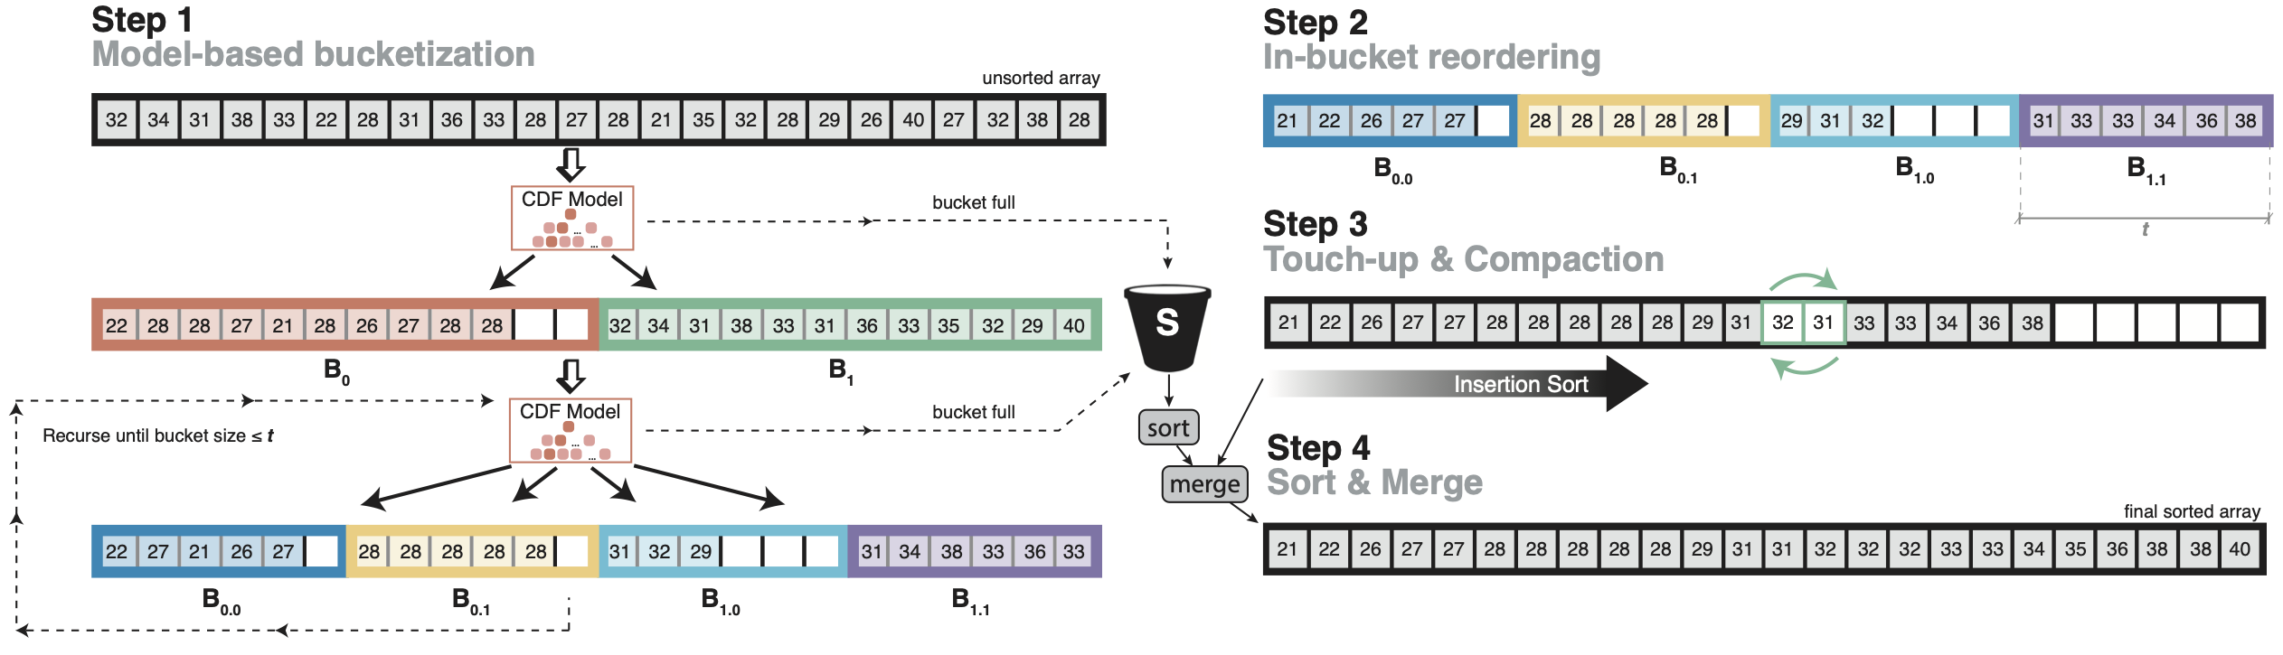
Learned Sort: After Fixing All Issues
RMI
Bucket Full

Slide 116
Learned Sort: After Fixing All Issues
RMI
Bucket Full

Slide 117
Learned Sort: After Fixing All Issues
RMI
Bucket Full

Slide 118
Learned Sort: After Fixing All Issues
RMI
Bucket Full

Slide 119
Performance of Learned Sort
How do you expect it to perform w.r.t Radix Sort

Slide 120
Performance of Learned Sort
How do you expect it to perform w.r.t Radix Sort
It is much Slower than Radix Sort!!
But why is it slow?

Slide 121
Random access by the model

Slide 122
Performance of Learned Sort
How do you expect it to perform w.r.t Radix Sort
It is much Slower than Radix Sort!!
Model does a lot of random accesses while mapping elements in buckets
Solution: Use small number buckets(~1000) so they fit in cache. Then recursively divide bucket into smaller buckets.

Slide 123
Recursive Partition: fanout=2
8 keys
8 | 10 | 15 | 24 | 19 | 4 | 62 | 30 | 43

Slide 124
Recursive Partition: fanout=2
8 keys
8 | 10 | 15 | 24 | 19 | 4 | 62 | 30 | 43
2 buckets x 4
8 | 10 | 15 | 4
24 | 19 | 62 | 30

Slide 125
Recursive Partition: fanout=2
8 keys
8 | 10 | 15 | 24 | 19 | 4 | 62 | 30 | 43
2 buckets x 4
8 | 10 | 15 | 4
24 | 19 | 62 | 30
4 buckets x 2
8 | 4
10 | 15
24 | 19
62 | 30
Learn Sort Fanout depends on L2 cache size!! (Around 1k-5k)

Slide 126
Multi layered Learned Sort algorithm

Slide 127
Cache Efficeint Learned Sort
How would this perform compared to Radix Sort?

Slide 128
Radix Sort vs Learned Sort:
Learned Sort is 1.5x faster than Radix Sort on 64 bit integers
Reason: Learned Sort does fewer number of passes over the data

Slide 129
Summary
Performance of data structures and algorithms can be enhanced by learned models of data and query distribution
ML models cannot be simply plugged in
ML enhanced data structures and algorithms require careful design
Need to consider Models + Systems + Algortihms

