Slide 1
Eventual Consistency & Amazon Dynamo
Lecture 19
5/3/2021
Lab 6 out
Lab 5 due
Project meetings today!
Quiz 2 Next Wednesday (5/12)

Slide 2
Amazon Operational DB Desiderata
”Always Available” shopping cart
Should not go down even if a datacenter fails
No centralized point of failure
Very low latency
Lots of orders being processed
Many lookups required to render a page
No need for complex analytics
Incrementally scalable

Slide 3
Enter Dynamo
“Always Available” shopping cart
Data replicated across multiple nodes
Favor availability over consistency
Very low latency
No need for complex analytics
Incrementally scalable
Key value store
CRUD semantics
Keys partitioned across workers using consistent hashing

Slide 4
Versus RDBMS
“Always Available” shopping cart
Data replicated across multiple nodes
Favor availability over consistency
Very low latency
No need for complex analytics
Incrementally scalable
Key value store
CRUD semantics
Keys partitioned across workers using consistent hashing
Favor consistency above all else
Complex SQL queries can be slow
Can add new nodes in shared nothing but shuffle joins may not scale incrementally

Slide 5
Replication Primer
Replicating data helps with fault tolerance and performance
Reads:
On a fault, reads can be directed to replica
Also, reads can be handled by local replica
What about writes?
Slower? (More nodes to write)
Less available? (Have to write all nodes, what if some nodes crash?)

Slide 6
Availability
Availability: can the system process requests?
In large systems, even w/ very reliable nodes, failures happen!
Replication clearly provides read availability
What about writes?

Slide 7
Write Availability Tradeoff
If we write to all replicas, availability is worse!
If we only write some replicas, availability is better, but replicas can be stale
Availability and consistency are a spectrum:
Many models of consistency
Monotonicity (always see a view of data moving forward in time)
1 copy serializability (“ACID”)
Replicas will eventually converge if updates stop
Eventual Consistency
HIGHLY AVAILABLE
Read your writes
Strong Consistency
NOT HIGHLY AVAILABLE

Slide 8
No Free Lunch
Pick one of availability or consistency
CAP Theorem
Eric Brewer at PODC 02; system can have 2 of 3 properties
Consistency Availability Partition Tolerance
CAP proof on systems with async communication

Slide 9
CAP Example
n1
n2
n3
x=4
x=4
x=4
Rx?
Wx=5
Partition
Options:
Wait for partition to heal (Consistent)
Forge ahead: n1 and n2 process write, somehow make n3 aware later? (Available)
If data is partitioned must choose either consistent or available!

Slide 10
NoSQL
Class of systems like Dynamo that generally offer:
Key/value storage (not SQL!)
Partitioned and replicated by key
Favoring availability over consistency

Slide 11
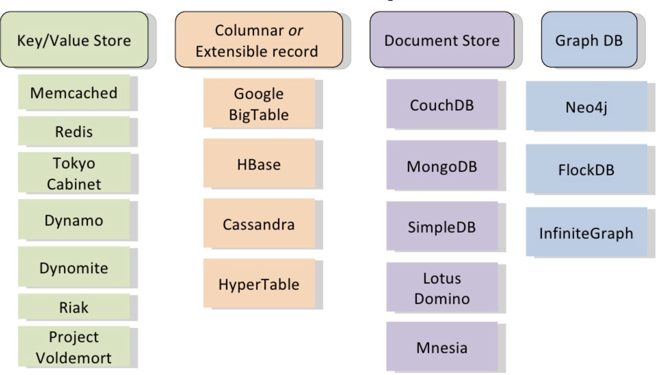
Early 2010’s saw MANY such systems, with slightly different data models and semantics
Source: https://www.slideshare.net/danglbl/schemaless-databases/7

Slide 12
Dynamo Query Interface
Key / Value store
All keys and values are arbitrary byte arrays
md5 on key to generate ID
get(key)
put(key, context, value)
Context is an sequence number done by coordinator of write
More later
single-key atomicity
I.e., each read/write is atomic, but only with respect to key

Slide 13
Dynamo Data Partitioning and Replication
All data replicated on N nodes
Each node has an address on a “ring” representing space of hash values from say, 0→2¹²⁸
Data stored on ring as well
“Overlay network”: Nodes are not actually in a physical ring, but are just machines on the Internet
Each node occupies one (or multiple) random locations on ring
N=3
k
A key hashed to location k is stored on N successors in ring

Slide 14
Consistent Hashing
Data and nodes mapped to ring
Data assigned to nearest successor(s)
When a node joins, it takes over only keys in range it joins
No need to rehash all values!
F takes over
F

Slide 15
Joining the Ring
Administrators explicitly add / remove nodes
When a node joins, it contacts a list of “seed nodes”
Other nodes periodically “gossip” to learn about ring structure
When a node i learns about new node j, i sends j any keys j is responsible for
Each node has mapping of all other nodes.
This is small, even for thousands of nodes
External discovery service
Seed nodes are nodes clients and other nodes can ask for current mapping
Node | Loc
A | 0
B | X
C | Y
…
Node | Loc
A | 0
B | X
C | Y
F | W
Node | Loc
A | 0
B | X
C | Y
…
Node | Loc
A | 0
B | X
C | Y
F | W
Seed node list
F
B Table
C Table
Keys in range [X,W]

Slide 16
Handling Reads
Each item is replicated on N nodes
To read: hash key, send request to one replica
Client either uses Amazon front end or reads mapping table from seeds
Client selects one node to be coordinator
N=3
k

Slide 17
Handling Writes
Route as in reads
Back to our availability conundrum
Do we write all replicas? What if one has failed / isn’t available?
Do we write just one replica? How do we ensure that our read will be visible to other nodes?
Client selects one node to be coordinator
N=3
k

Slide 18
Dynamo Consistency
“Quorum Writes”
R+W > N
N = number of replicas of each data item
R = number of replicas each read must be heard from
W = number of replicas each write must be sent to
E.g., R = 2, W = 2, N = 3
R1 R2 R3
v1 v1 v1
v2 v1 v2 ← write to 2 out of 3
Any read of 2 will see v2!

Slide 19
Dynamo Consistency
“Quorum Writes”
R+W > N
N = number of replicas of each data item
R = number of replicas each read must be heard from
W = number of replicas each write must be sent to
Need some way to ensure that if fewer than N nodes written to, write eventually propagates
If a reader sees that a replica has a stale version, it writes back

Slide 20
Sloppy Quorum
Quorums still favor consistency too heavily, because:
Decreased durability (want to write all data at least N times)
Decreased availability in the case of partitioning.
Solution: Sloppy Quorum

Slide 21
Sloppy Quorum & Hinted Handoff
If fewer than N writes succeed, continue around ring, past successors
K=x
Hint: Owner=E
❌
N=3
”Hinted Handoff”: B will keep trying to read E to let it know about the value of K
k
2 our of 3 writes succeed
Continue around ring, write to B

Slide 22
Sloppy Quorum ➔ Divergence
If network is partitioned, hinted handoff can lead to divergent replicas
E.g., suppose N=3, W=2, R=2, Partitioned
✔(sloppy)
✔(sloppy)
k
Client 1
✔

Slide 23
Sloppy Quorum ➔ Divergence
If network is partitioned, hinted handoff can lead to divergent replicas
E.g., suppose N=3, W=2, R=2, Partitioned
(sloppy) ✔
Two different versions of key k, k1 and k2 now exist
✔
k
Client 2
✔

Slide 24
Vector Clocks
k
Each node keeps a monotonic version counter that increments for every write it coordinates
Each data item has a clock, consisting of a list of the most recent version it includes from each coordinator
A | B | C | D | E | F

Slide 25
Vector Clocks
k
✔
✔
✔
Each node keeps a monotonic version counter that increments for every write it coordinates
Each data item has a clock, consisting of a list of the most recent version it includes from each coordinator
Client 1
Create k → C
C writes [C,1] to C, D, E
A | B | C | D | E | F
 |  | 1 [C,1] | 1 [C,1] | 1 [C,1]
[C,1]: Contains first version from C as coordinater

Slide 26
Vector Clocks
✔
✔
k
✔
C1
Each node keeps a monotonic version counter that increments for every write it coordinates
Each data item has a clock, consisting of a list of the most recent version it includes from each coordinator
Client 1
Create k → C
C writes [C,1] to C, D, E
A | B | C | D | E | F
 |  | 1 [C,1] | 1 [C,1] | 1 [C,1]
2 [C,2] | 2 [C,2] | 2 [C,2]
Client 1
Read k → C
C reads C, D, E
C returns [C,1]
Write k [C, 1] → C
C writes [C,2] → C, A, B

Slide 27
Vector Clocks
✔
✔
k
C2
✔
Each node keeps a monotonic version counter that increments for every write it coordinates
Each data item has a clock, consisting of a list of the most recent version it includes from each coordinator
Client 2
Read k → D
D reads D,E,F
D returns [C,1]
Write k [C, 1] → D
D writes [C,1][D,1]
to D, E, F
A | B | C | D | E | F
 |  | 1 [C,1] | 1 [C,1] | 1 [C,1]
2 [C,2] | 2 [C,2] | 2 [C,2]
 |  |  | 3 [C,1][D,1] | 3 [C,1][D,1] | 3 [C,1][D,1]
Incomparable (can’t totally order)

Slide 28
Read Repair
Possible for a client to read 2 incomparable versions
Need reconciliation; options:
Latest writer wins
Application specific reconciliation (e.g., shopping cart union)
After reconciliation, perform write back, so replicas know about new state

Slide 29
Study Break
Suppose there are three replicas, R1, R2, and R3. Three writes are performed to key K,resulting in three version clocks
V1 =<R1:0,R2:3,R3:2>
V2 =<R1:1,R2:3,R3:2>
V3 =<R1:0,R2:0,R3:3>
Which of the following are true statements?

Slide 30
Study Break
V1 =<R1:0,R2:3,R3:2>
V2 =<R1:1,R2:3,R3:2>
V3 =<R1:0,R2:0,R3:3>
V2 was coordinated by R1, saw same versions as V1
V3 was coordinated by R3, did not see R2 1, 2, or 3, and happened concurrently with V2
The writer that produced V1 observed V2.
The writer that produced V2 observed V1.
The writer that produced V3 observed V1.
❌
✓
❌

Slide 31
Anti-entropy
Once a partition heals, or a node recovers, need a way to patch up
Could rely on gossip & hinted handoff
Dynamo also compares nodes responsible for each key range
Comparison done via hashing, using a technique called Merkle trees
Here, for EA range, B and C are also responsible

Slide 32
Merkle Trees
Here, for EA range, B and C are also responsible
Suppose EA range has keys u,v,w,x,y,z, A and B are comparing

Slide 33
Merkle Trees
Here, for EA range, B and C are also responsible
Suppose EA range has keys u,v,w,x,y,z, A and B are comparing

Slide 34
Merkle Trees
Here, for EA range, B and C are also responsible
Suppose EA range has keys u,v,w,x,y,z, A and B are comparing

Slide 35
Merkle Trees
Here, for EA range, B and C are also responsible
Suppose EA range has keys u,v,w,x,y,z, A and B are comparing

Slide 36
Merkle Trees
Here, for EA range, B and C are also responsible
Suppose EA range has keys u,v,w,x,y,z, A and B are comparing
This whole tree is as big as data, but only need to exchange parts of it that are different, i.e., no need to send light gray nodes in diagram, since parent hashes are all equal

Slide 37
Summary
Problem | Technique | Purpose
Partitioning | Consistent hashing | Incremental scalability

Slide 38
Summary
Problem | Technique | Purpose
Partitioning | Consistent hashing | Incremental scalability
Highly available for writes | Vector clocks with read repair | Version size decoupled from update rate

Slide 39
Summary
Problem | Technique | Purpose
Partitioning | Consistent hashing | Incremental scalability
Highly available for writes | Vector clocks with read repair | Version size decoupled from update rate
Handle temporary failures | Sloppy quorum and hinted handoff | HA with some durability

Slide 40
Summary
Problem | Technique | Purpose
Partitioning | Consistent hashing | Incremental scalability
Highly available for writes | Vector clocks with read repair | Version size decoupled from update rate
Handle temporary failures | Sloppy quorum and hinted handoff | HA with some durability
Recovery from permanent failures | Anti-entropy | Sync replicas w/ Merkle Trees

Slide 41
Summary
Problem | Technique | Purpose
Partitioning | Consistent hashing | Incremental scalability
Highly available for writes | Vector clocks with read repair | Version size decoupled from update rate
Handle temporary failures | Sloppy quorum and hinted handoff | HA with some durability
Recovery from permanent failures | Anti-entropy | Sync replicas w/ Merkle Trees
Membership / failure detection | Gossip based membership | Symmetry and no centralized coordination

