Slide 1

MapReduce 6.830, May 5 Mike Cafarella
Notes:
Happy Web guys

Slide 2
Processing Large Data
Let’s distribute load over many machines
1000s, not 2-16 as in traditional distributed databases
Programmer cannot know how many machines at program-time or runtime
Even so, job is very long-lasting compared to most db queries
Machines die, machines depart; job must survive

Slide 3
MapReduce
MapReduce system provides:
Automatic parallelization & distribution
Fault-tolerance
Status and monitoring tools
Clean abstraction for programmers

Slide 4
Data-Centric Programming
MapReduce has become very popular, for lots of good reasons
Easy to write distributed programs
Built-in reliability on large clusters
Bytestreams, not relations
“Schema-later”, or “schema-never”
Your choice of programming languages
Hadoop relatively easy to administer
Should you use MapReduce instead of a database? This was very popular in late-2000s. Today, less so

Slide 5
A Story About MapReduce
Imagine some fictional comedy sorority or fraternity has instituted a new “entrance” ritual. A student must compute:
How common are 1-character words? (‘a’, ‘I’, etc.)
How common are 2-character words? (‘an’, ‘be’, ‘is’, etc.)
… up to 10-character words
... IN THE ENTIRE MIT LIBRARY
Notes:
Based on: http://ksat.me/map-reduce-a-really-simple-introduction-kloudo/

Slide 6
A Story About MapReduce
A few (real) statistics
~6M volumes in the MIT library
You have one semester
You can recruit ~1,000 students to help
In the end, we’ll have 10 numbers:
Count of one-character words
Count of two-character words
… etc. until 10

Slide 7
A Story About MapReduce
The next day near Stata:
Divide the students into groups
The Mappers
Thousands of people
The Grouper
Just one person for now (in the real MapReduce system, the story is more complicated)
The Reducers
Around 10
The Controller
You

Slide 8
A Story About MapReduce
Each mapper student gets a “reading list” of 6,000 books (welcome to college!)
That’s 6M books / ~1k first-year students
And a notepad
Instructions: write one line for each word you see in your reading list, along with the number of characters
2, It
3, was
3, the
… etc. many many many times

Slide 9
A Story About MapReduce
After the mappers are done, they hand their notebooks to the grouper
The grouper has a 10 page notebook
The grouper takes the mappers’ notebooks and writes every 1-letter word on page 1, 2-letter word on page 2, etc.
Sheet 1: a, a, a, I, a, … many more
Sheet 2: if, if, an, if, at ... many more
...
Sheet 10: schnozzles, mozzarella, etc.

Slide 10
A Story About MapReduce
Now, each of the 10 sheets goes to a reducer
Each reducer counts the number of words on one sheet, and writes the number in bold letters on the back
Remember, Sheet 2 has: if, of, it, of, of, if, at, im, is, is, of, of …
The reducer writes 2453838307534 on the back

Slide 11
A Story About MapReduce
Now, the controller collects the 10 sheets and reads the back of each sheet, which is the number of 1-character words, 2-character words, etc.
And you’re done!

Slide 12
A Story About MapReduce
A few observations
The Mappers can work independently
The Reducers can work independently
The Grouper has a lot of work (collating and writing down each individual word on a sheet!) but didn’t have to do any counting (“real work”)
All Grouper had to do was to look at the Mappers’ outputs and put that word on the appropriate sheet

Slide 13
A Story About MapReduce
Ideas for optimizations?
How could you reduce the amount paper used by the mappers?

Slide 14
A Story About MapReduce
Ideas for optimizations?
TAKE 60 SECONDS TO PUT THEM IN THE CHAT!
What steps CAN’T be optimized easily?
TAKE ANOTHER 60 SECONDS
Notes:
Idea 1: the mappers don’t need write the words down, just "1" for each word of a certain length
Idea 2: mappers do part of the reducer work: number of 1-letter words, 2-letter words, etc

Slide 15
From Story to MapReduce Library
The work of the Controller (dividing the work) and the Grouper (Grouping the values by key), remains the same
MapReduce library provides these
Grouping is sometimes called ”sort” or “shuffle”
The work of the mappers and reducers differs with problem
This is what you write

Slide 16
Programming Model
The computation:
Input key/value pairs
e.g., (book_title, book_content)
Output different key/value pairs
e.g., (word_length, occurrences)
The user of the MapReduce library expresses the computation as two functions….
CAN YOU GUESS THEIR NAMES???????
Map and Reduce

Slide 17
Map function
User's map function takes an input pair and produces a set of intermediate key/value pairs
map(book_title, book_content): words = book_content.split() for word in words: word_length = len(word) EmitIntermediate(word_length, 1)
The MapReduce library groups together all intermediate values associated with the same intermediate key and passes them to the Reduce function

Slide 18
Reduce function
User's reduce function accepts an intermediate key and a list of values for that key. It merges together these values to form a possibly smaller set of values.
reduce(word_length, list_of_occurrences): sum = 0 for i in list_of_occurrences: sum += i Emit(sum)

Slide 19
Example
input01.txt Hello World Bye World
input02.txt Hello Hadoop Goodbye Hadoop
Task: count the number of words with 1 character, 2 characters, etc. (same as before)
Spend 2 minutes and think about:
What are the inputs to the map steps?
What are the outputs of the map steps?
What are the inputs to the reduce steps?
What are the outputs of the reduce steps?

Slide 20
Example
What are the inputs to the map steps?
Segments of the inputs
For example,
First call to map:
"input01.txt", "Hello World Bye World"
Second call to map:
"input02.txt", "Hello Hadoop Goodbye Hadoop"

Slide 21
Example
input01.txt Hello World Bye World
input02.txt Hello Hadoop Goodbye Hadoop
What are the outputs of the map steps?
NOTE: order doesn't matter
5 1
5 1
3 1
5 1
5 1
6 1
7 1
6 1

Slide 22
Example
input01.txt Hello World Bye World
input02.txt Hello Hadoop Goodbye Hadoop
What are the inputs to the reduce steps?
Prior to reduce(), MapReduce groups together the map() outputs like keys
3 1
------
5 1
5 1
5 1
5 1
------
6 1
6 1
------
7 1

Slide 23
Example
input01.txt Hello World Bye World
input02.txt Hello Hadoop Goodbye Hadoop
What are the outputs of the reduce steps?
<word_length, occurrences>
3 1
5 4
6 2
7 1

Slide 24
Types
Map and reduce have related types
map (k1, v1) → list(k2, v2)
reduce (k2, list(v2)) → list(v2)
Final output list can be:
Smaller than input list (in the case of computing summary statistics, like word count)
Larger than input list (in the case of computing some kind of data structure for downstream use)
Typically, just zero or one output value is produced per reduce invocation

Slide 25
Exercise: Word Count
Count the number of occurrences of each word in a collection of web documents, identified by URL
Exercise: write a map function and a reduce function

Slide 26
Exercise: Word Count
Count the number of occurrences of each word in a collection of web documents, identified by URL
map(url, content): for word in content: EmitIntermediate(word, 1);
reduce(word, occurrences): Emit(sum(occurrences))

Slide 27
Exercise: Word Count
map(url, content): for word in content: EmitIntermediate(word, 1);
Inputs to map
Outputs of map
input01.txt Hello World Bye World
input02.txt Hello Hadoop Goodbye Hadoop
Hello 1
World 1
Bye 1
World 1
Hello 1
Hadoop 1
Goodbye 1
Hadoop 1

Slide 28
Exercise: Word Count
reduce(word, occurrences): Emit(sum(occurrences))
Inputs to reduce (grouped by MR)
Outputs of reduce
Bye 1
----------
Goodbye 1
----------
Hadoop 1
Hadoop 1
----------
Hello 1
Hello 1
----------
World 1
World 1
Bye 1
Goodbye 1
Hadoop 2
Hello 2
World 2
What if the number of unique words is small compared to the number of documents? Can you optimize this?

Slide 29
Exercise: Word Count
Another solution: sum the words within each doc
map(url, content): for word in content: if word in counts_hash: counts_hash[word] += 1 else: counts_hash[word] = 1 occurrences = counts_hash.items() #to list EmitIntermediate(occurrences); #list of (k,v)
reduce(word, occurrences): Emit(sum(occurrences))

Slide 30
Exercise: Word Count
input01.txt Hello World Bye World
input02.txt Hello Hadoop Goodbye Hadoop
Output of map
Output of reduce
Hello 1
World 2
Bye 1
Hello 1
Hadoop 2
Goodbye 1
Bye 1
Goodbye 1
Hadoop 2
Hello 2
World 2
(same answer as before)
We’re summing at doc-level (in map()) and corpus-level (in reduce()).
What if we want to find the average # of occurrences for each word?
What about median?

Slide 31
At-Home Exercises (take 10 mins)
Write mapper and reducer functions for computing the dot product of two large vectors
Assume we have prepared A and B for you: (1,(Ai,Bi))
Write mapper and reducer functions for distributed search (AKA grep)
Print any line of a big input file that contains an input pattern as a substring
See you in 10 minutes!

Slide 32
Dot product
Write mapper and reducer functions for computing the dot product of two large vectors
map(1, (ai, bi)): product = ai * bi EmitIntermediate(1, product)
reduce(1, product_list): Emit(1, sum(product_list))
Notes:
Note: don't need to keep track of "i" because addition order doesn't matter

Slide 33
Linear search (grep)
Write mapper and reducer functions for distributed search (AKA grep)
Print any line of a big input file that contains an input pattern as a substring
map(filename, content): for line in content: if pattern in line: EmitIntermediate(1, line)
reduce(1, lines): for line in lines: Emit(1, line)

Slide 34
MapReduce vs the RDBMS
Schemas: MR doesn’t have them, for better and worse
Functions: MR doesn’t have a query language, but permits flexible UDFs
Execution and optimization: MR has optimizations, but limited schemas mean limited options
Failure recovery: MR can lose machines and keep going. Distributed RDBMS traditionally restarts queries
Transactions: MR always yields new data. It never modifies data in place. Unclear semantics if the input data changes during processing.
Notes:
34

Slide 35
Executing MapReduce
MapReduce execution consists of 3 main stages:
Map
Shuffle/Sort (aka Group)
Reduce
In stage 1, partition input data and run map() on many machines
Then group intermediate data by intermediate key
In stage 2, partition intermediate data by key and run reduce() on many machines
Output is whatever reduce() emits
Notes:
35

Slide 36
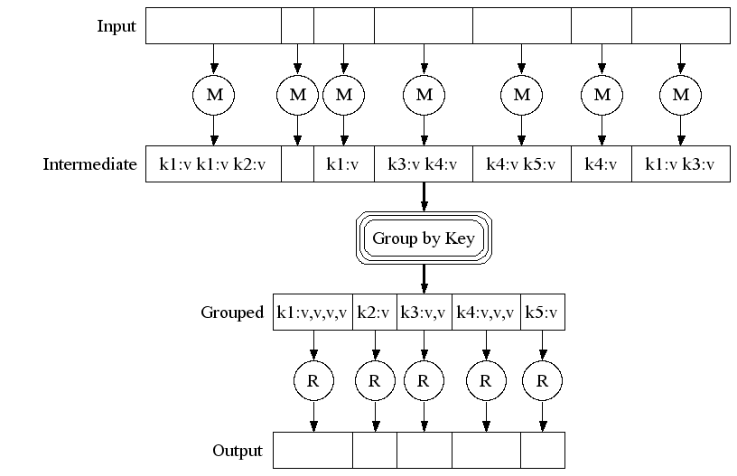

Slide 37
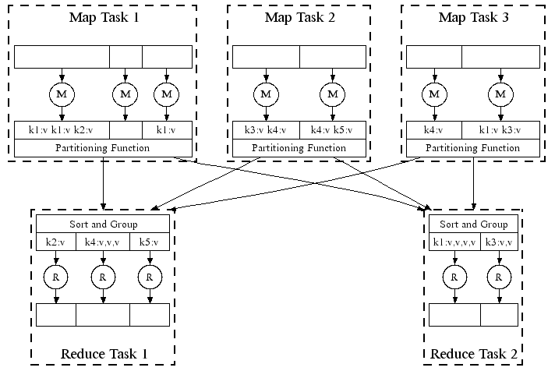

Slide 38
Shuffle/Sort
What happens between map & reduce?
Data collated and grouped for map
Default: hash(key)%R
This step is similar to the RDBMS shuffle join
What’s the join key? The intermediate mapper output key
Execution goes as follows:
Break input into M chunks
Process each chunk w/ map process
Group-by map output keys
Place key-groups into R chunks
Process each chunk w/ reduce process
reduce fn’s outputs go to disk

Slide 39
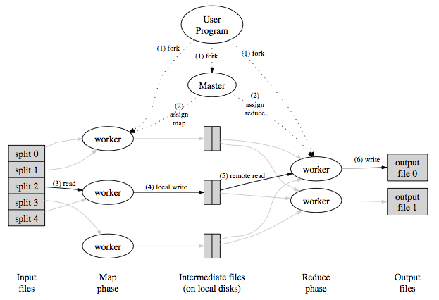
Architecture

Slide 40
Job Processing
Worker 0
Worker 1
Worker 2
Controller
Worker 3
Worker 4
Worker 5
“grep”
Client submits “grep” job, indicating code and input files

Slide 41
Job Processing
Worker 0
Worker 1
Worker 2
Controller
Worker 3
Worker 4
Worker 5
Client submits “grep” job, indicating code and input files
Controller breaks input file into k chunks, (in this case 6). Assigns work to workers.

Slide 42
Job Processing
Worker 0
Worker 1
Worker 2
Controller
Worker 3
Worker 4
Worker 5
Client submits “grep” job, indicating code and input files
Controller breaks input file into k chunks, (in this case 6). Assigns work to workers.
After map(), workers exchange map-output to build reduce() keyspace

Slide 43
Job Processing
Worker 0
Worker 1
Worker 2
Controller
Worker 3
Worker 4
Worker 5
Client submits “grep” job, indicating code and input files
Controller breaks input file into k chunks, (in this case 6). Assigns work to workers.
After map(), workers exchange map-output to build reduce() keyspace
Controller breaks reduce() keyspace into m chunks (in this case 6). Assigns work.

Slide 44
Job Processing
Worker 0
Worker 1
Worker 2
Controller
Worker 3
Worker 4
Worker 5
Client submits “grep” job, indicating code and input files
Controller breaks input file into k chunks, (in this case 6). Assigns work to workers.
After map(), workers exchange map-output to build reduce() keyspace
Controller breaks reduce() keyspace into m chunks (in this case 6). Assigns work.
reduce() output may go to shared fs

Slide 45
Applications
What else can be a MapReduce program?
URL counting in logs
Inverted index construction for search engines, Sorting
Massive image conversion, others

Slide 46
Robustness
How do we know if a machine goes down?
Heartbeat messages tell master which machines are online
What happens to the job with MapReduce?
What happens without MapReduce? (say, in an RDBMS)

Slide 47
Robustness
What happens when a machine dies?
With MapReduce
If a map() worker dies
Just restart that task on a different box
You lose the map() work, but no big deal
If a reduce() worker ides
Restart the reducer, using output from source mappers
Notes:
47

Slide 48
Robustness
What happens when a machine dies?
Without MapReduce, in a traditional RDBMS
Query is restarted
Not so hot if your job is in hour 23
Recovery in the face of partial failure is maybe MapReduce’s most important contribution

Slide 49
A few nice features
What about slow, not dead, machines?
Speculative execution for stragglers
Kill the 2nd-place finisher
What about data placement?
Spread input files across cluster disks; start tasks where the target data already lies
Isn’t the intermediate data size large?
Use a “local reducer” called a Combiner at each map
Compress data between map and reduce
Notes:
49

Slide 50
Key observations
Scalability and fault-tolerance achieved by optimizing the execution engine once
Use it many times by writing different map and reduce functions for different applications
Stateless mapper
Stateless reducer

Slide 51
Key observations
Map and reduce functions inspired by functions of the same name in Lisp programming language
Functional programming
Computation as the evaluation of mathematical functions
Functions have no side effects
AKA "pure" functions
AKA stateless
Does not change state outside itself
Easy to parallelize!

Slide 52
Further Reading
Some researchers disagree with MapReduce's popularity: “MapReduce: A Major Step Backwards”
https://homes.cs.washington.edu/~billhowe/mapreduce_a_major_step_backwards.html
Paper on Google's MapReduce framework "MapReduce: Simplified Data Processing on Large Clusters" by Jeffrey Dean and Sanjay Ghemawat
https://static.googleusercontent.com/media/research.google.com/en//archive/mapreduce-osdi04.pdf

Slide 53
BEGIN CUT SLIDES

Slide 54
Distributed Indexing
Document sizes huge; must divide work over many machines in cluster
Phase 1: Parsing
Break input pages into n splits
Machines in cluster process a split at a time (A split consists of documents)
Each breaks into (termID,docID) pairs
Write to local segment files: a-f, g-p, q-z

Slide 55
Distributed Indexing
Phase 2: Inverting
Break keyspace into partitions; assign a machine to each partition, E.g., a-f, or g-p
Each inverter machine collects the segment files that are useful for its partition
Each inverter then combines the segment files for each termID within its keyspace, and outputs a new segment file
How many segment files do you get?
How do you choose the number of inverters? Or parsers?

Slide 56
Distributed Indexing
Recap:
A Parser is assigned a region of input
Parsers break docs into (termID, docID)
Parsers write pairs into segment files
An Inverter is assigned region of keyspace
Inverters collect segment files appropriate for its keyspace
Inverters combine segment info for each termID, then write out index for that termID

Slide 57
Exercise: Filter
Filter the integers, returning only the primes
is_prime(x) is provided
This function is very expensive for large numbers
Assume that the MapReduce framework divides the input set of integers for you
Why do this? Perhaps we are searching for large primes, which take a long time to test

Slide 58
Exercise: Filter
Filter the integers, returning only the primes
map(1, i): if is_prime(i): EmitIntermediate(1, i)
reduce(1, list): Emit(1, list)

Slide 59
Exercise: Reverse Web-Link Graph
Reverse web-link graph
Input (URL, content)
Output: (target_URL, list(source_URL))
Assume you have a extract_urls() function

Slide 60
Exercise: Reverse Web-Link Graph
Reverse web-link graph
Input (url, content)
Output: (target_url, list(source_url))
Assume you have a extract_urls() function
map(url, content): source = url for target in extract_urls(content): EmitIntermediate(target, source)
reduce(target, list): Emit(target, list)

