Slide 1
6.830 Lecture 3
Relational Algebra and Normalization
2.24.21

Slide 2
Today
Recap relational algebra
Discuss logical data independence
Schema normalization and normal forms

Slide 3
Relational Algebra
Projection
π(R,c1, …, cn) = π_{c1…c2n}R
select a subset c1 … cn of columns of R
Selection
σ(R, pred) = σ_{pred}R
select a subset of rows that satisfy pred
Cross Product (||R|| = #attrs in R, |R| = #rows in row)
R1 X R2 (aka Cartesian product)
combine R1 and R2, producing a new relation with ||R1|| + ||R2|| attrs, |R1| * |R2| rows
Join
⨝(R1, R2, pred) = R1 ⨝_{pred} R2 = σ_{pred} (R1 X R2)

Slide 4
Relational Algebra ➔ SQL
SELECT List ➔ Projection
FROM List ➔ all tables referenced
WHERE ➔ SELECT and JOIN
Many equivalent relational algebra expressions for any one SQL query (due to relational identities)
Join reordering
Select reordering
Select pushdown

Slide 5
IMS v CODASYL v Relational
 | IMS | CODASYL | Relational
Many to many relationships without redundancy | ❌ | ✓ | ✓
Declarative, non “navigational” programming | ❌ | ❌ | ✓
Physical data independence | ❌ | ❌ | ✓
Logical data independence | ❌ | ❌ | ✓

Slide 6
Logical Data Independence
What if I want to change the schema without changing the code?
Views allow us to map old schema to new schema, so old programs work

Slide 7
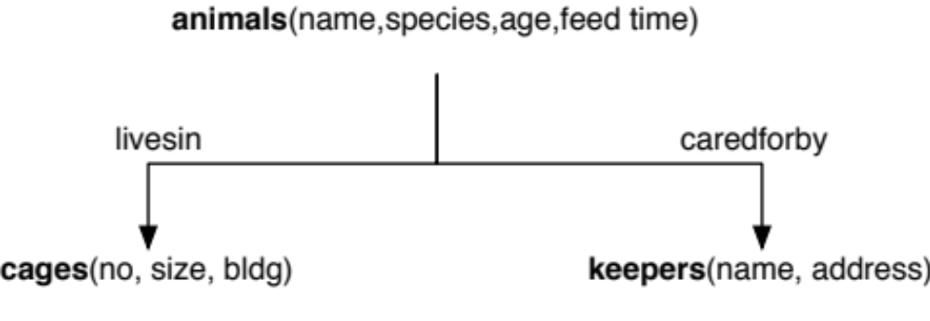
Multiple Feedtimes
feedtimes(time, animal)

Slide 8
Views Example
Suppose I want to add multiple feedtimes?
How to support old programs?
  Rename existing animals table to animals2
  Create feedtimes table
  Copy feedtime data from animals2
  Remove feedtime column from animals2
  Create a view called animals that is a query over animals2 and feedtimes
CREATE VIEW animals as (
SELECT name, age, species, cageno,
(SELECT feedtime FROM feedtimes WHERE animalid = id LIMIT 1)
FROM animals2
)

Slide 9
Multiple Feedtimes in SQL
animals:(name STRING,cageno INT,keptby INT,age INT,feedtime TIME)
CREATE TABLE feedtimes(aname STRING, feedtime TIME);
ALTER TABLE animals RENAME TO animals2;
ALTER TABLE animals2 DROP COLUMN feedtime;
CREATE VIEW animals AS
SELECT name, cageno, keptby, age,
(SELECT feedtime
FROM feedtimes
WHERE aname=name
LIMIT 1) AS feedtime
FROM animals
Views enable logical data independence by emulating old schema in new schema

Slide 10
Study Break
Given animals table:
animals:(name STRING,cageno INT,keptby INT,age INT,feedtime TIME)
Find a view rewrite that will allow the following schema changes (while maintaining backwards compatibility)?
Key of table is animalId instead of name
Animals can be in multiple cages
Age → Birthday

Slide 11
Study Break
Key of table is animalId instead of name
newAnimals:(animalId int, name STRING,cageno INT,keptby INT,age INT,feedtime TIME)
CREATE VIEW animals AS (SELECT name, cageno, keptby, age, feedtime FROM newAnimals)
Animals can be in multiple cages
newAnimals:(name STRING, keptby INT,age INT,feedtime TIME)
animalCages:(aName STRING, cageId INT)
CREATE VIEW animals AS (SELECT name, (SELECT cageId FROM animalCages WHERE aName = name LIMIT 1) AS cageno, keptby, age, feedtime FROM newAnimals)

Slide 12
Study Break
Age → Birthday
newAnimals:(name STRING,cageno INT,keptby INT,bday DATE,feedtime TIME)
CREATE VIEW animals AS (SELECT name, cageno, keptby, ((now() – bday)/(365 * 24 * 60 * 60))::INT AS age, feedtime)

Slide 13
Hobbies Example
Consider a database about people & their hobbies
People have names and addresses, hobbies have costs
People can have multiple hobbies, and hobbies can be practiced by multiple people
SSN
Entity Relationship Diagram
Name
Address
Person
n:n
Hobby
Cost
Name

Slide 14
Hobby DB, Attempt 1
SSN | Name | Address | Hobby | Cost
123 | john | main st | dolls | $
123 | john | main st | bugs | $
345 | mary | lake st | tennis | $$
456 | joe | first st | dolls | $
Table key is Hobby, SSN
“Wide” schema
– has redundancy (wasted space)
– anomalies in the presence of updates, inserts, and deletes
+ avoids joins

Slide 15
Types of Anomalies
Update anomaly
  E.g., address needs to change in several places
  Creates possibility for inconsistency
Insertion anomaly - what if we want to add someone with no hobby?
  Can we use NULLs?
  Problem: hobby is a part of the key!
Solution: “Normalize”!

Slide 16
Normalization
Normalized: a schema that is redundancy free
  As much as possible
Several methods:
  ER Diagrams
  Use functional dependencies and normal forms

Slide 17
Schema From ER Diagram
SSN | Name | Address
123 | john | main st
345 | mary | lake st
456 | joe | first st
Hobby | Cost
dolls | $
bugs | $
tennis | $$
SSN | Name | Address | Hobby | Cost
123 | john | main st | dolls | $
123 | john | main st | bugs | $
345 | mary | lake st | tennis | $$
456 | joe | first st | dolls | $
SSN→Name, Address
Hobby→Cost
Hobby | SSN
dolls | 123
bugs | 123
tennis | 345
dolls | 456
Schema is free of anomalies and redundancy
SSN
Entity Relationship Diagram
Name
Hobby, SSN → Hobby, SSN
Address
Person
n:n
Hobby
Cost
Name

Slide 18
Why Does Redundancy Arise
When a subset of attributes are uniquely determine by a subkey
  E.g., SSN determines name, address
  Key is SSN, Hobby
  Each row with same SSN will duplicate data!
SSN | Name | Address | Hobby | Cost
123 | john | main st | dolls | $
123 | john | main st | bugs | $
345 | mary | lake st | tennis | $$
456 | joe | first st | dolls | $

Slide 19
Functional Dependencies
X → Y
Attributes X uniquely determine Y
  I.e., for every pair of instances x1, x2 in X, with y1, y2 in Y, if x1=x2, y1=y2
For Hobbies, we have:
  SSN, Hobby → Name, Addr, Cost
  SSN → Name, Addr
  Hobby → Cost
  2 & 3 imply 1, by union under
  Armstrong’s Axioms
FDs are a property of the application, not the data!

Slide 20
Boyce-Codd Normal Form (BCNF)
For a relation R, with FDs of the form X→Y, every FD is either:
  1) Trivial (e.g., Y contains X), or
  2) X is a key of the table
If an FD violates 2), multiple rows with same X value may occur
  Indicates redundancy, as rows with given X value all have same Y value
  E.g., SSN → Name, Addr in non-decomposed hobbies schema
    Name, Addr repeated for each appearance of a given SSN
To put a schema into BCNF, create subtables of form XY
  E.g., tables where key is left side (X) of one or more FDs
  Repeat until all tables in BCNF

Slide 21
BCNFify
BCNFify(schema R, functional dependency set F):
D = {(R,F)} // D is set of output relations
while there is a (schema ,FD set) pair (S,F') in D not in BCNF, do:
given X→Y as a BCNF-violating dependency in F’
replace (S,F’) in D with
S1 = (XY,F1) and
S2 = ((S-Y) U X, F2)
where F1 and F2 are the FDs in F’ over XY or (S-Y) U X, respectively
End
return D

Slide 22
BCNFify Example for Hobbies
Did we lose S,H → N,A,C? No!
S,H → N, A, C is implied by H→C and S→N,A
No, using union rule from Armstrong’s Axioms,
S+H -> N,A + C
Iter 1
S = SSN, H = Hobby, N = Name, A = Addr, C = Cost
Schema | FDs
(S,H,N,A,C) | S,H → N,A,C S → N, A H → C
Iter 2
Schema | FDs
(S, N,A) | S → N, A
violates bcnf
Schema | FDs
(S,H, C) | S,H → C H → C
key
violates bcnf
S,H → N, A, C implies
S,H → C
Schema | FDs
(H, C) | H → C
3 remaining tables are same as in ER decomposition
Schema | FDs
(S,H)

Slide 23
Accounts, Client, Office
FD’s
  Client, Office → Account
  Account → Office
Account | Client | Office
a | joe | 1
b | mary | 1
a | john | 1
c | joe | 2

Slide 24
Accounts, Client, Office
FD’s
  Client, Office → Account
  Account → Office
Account | Client | Office
a | joe | 1
b | mary | 1
a | john | 1
c | joe | 2
Redundancy!

Slide 25
A Dilemma
FD’s
  Client, Office → Account
  Account → Office
This is not in BCNF
Put account, office in separate tables?
ao_id | Account | Office
1 | a | 1
2 | b | 1
3 | c | 2
ao_id | Client
1 | joe
2 | mary
1 | john
3 | joe
BCNF, but can’t check CO → A without a join

Slide 26
BCNF vs 3NF
BCNF decomposition is not “dependency preserving”
3rd Normal Form (3NF) eliminates as much redundancy as possible while preserving all dependencies
  We will skip the details
Neither form is “better”
  You can choose either dependency preservation (3NF) or redundancy-free (BCNF)

Slide 27
Study Break
Patient database
Want to represent patients at hospitals with doctors
Patients have names, birthdates
Doctors have names, specialties
Hospitals have names, addresses
One doctor can treat multiple patients, each patient has one doctor
Each patient in one hospital, hospitals have many patients
1) Draw an ER diagram
2) What are the functional dependencies
3) What is the normalized schema? Is it redundancy free?

Slide 28
Recap
Properly normalized schemas avoid redundancy and preserve dependencies
Functional dependencies and normal forms (e.g., BCNF) give us a formal way to reason about these concepts
In practice, people use ER modeling to derive a schema in BCNF rather than the BCNFify algorithm

