Slide 1
Code Smell Localization
Pratik Tripathy – 22075062
Mellacheruvu Rama Rakesh - 22075047

Slide 2
Overview
Definition - A code smell is a symptom in the code that indicates a deeper problem, usually related to poor design, maintainability, or readability.
Difference with Bugs - While code smells don't necessarily cause immediate bugs, they often make the code harder to understand, modify, or extend.
Common Types –
Long Method - A method that is too lengthy and tries to do too much.
Large Class - A class with too many responsibilities.
Duplicate Code - Identical or very similar code appears in multiple places.
Data Class – A class that primarily contains fields (data).
Why - Improved Maintainability, Team Productivity, Easier Debugging, etc

Slide 3
Problem Statement
Statement – Localizing code smell and Providing suggestions and tools to mitigate it using modern technology.
Previous Works and Literature Review -
Title of Paper | Link | Year | Journal | Method used | Limitation
Enhancing structural knowledge in code smell identification: A fusion learning framework combining AST-based metrics with semantic embeddings | https://www.sciencedirect.com/science/article/pii/S0957417424025922#b32 | 2025 | Expert Systems with Applications | The study used two artificial neural networks (ANNs) optimized with a genetic algorithm to predict microemulsion structures based on composition and DSC curves. | The approach depends on data quality, may have limited generalization, requires significant computational resources, and lacks interpretability due to the black-box nature of ANNs.
CoRT: Transformer-based code representations with self-supervision by predicting reserved words for code smell detection | https://link.springer.com/article/10.1007/s10664-024-10445-9 | 2024 | Empirical Software Engineering | CoRT employs a transformer-based model trained through self-supervised learning, where the model predicts masked reserved words in source code, enabling it to learn semantic and structural code features without labeled data. | Despite its effectiveness, CoRT may face challenges in generalizing to diverse programming languages and codebases due to potential overfitting to specific patterns in the training data.

Slide 4
Previous Work
Title of Paper | Link | Year | Journal | Method used | Limitation
Automatic detection of Feature Envy and Data Class code smells using machine learning | https://www.sciencedirect.com/science/article/pii/S0957417423033572 | 2024 | Expert Systems with Applications | The study compares machine learning models using software metrics (CK, RepositoryMiner) and pre-trained code embeddings (CuBERT, CodeT5), trained on a manually labeled dataset to detect Feature Envy and Data Class code smells. | The research focuses on specific code smells and may not generalize to other types; additionally, the performance of code embedding models can be influenced by the quality and representativeness of the pre-training data.
Improving Code Smell Detection by Reducing Dimensionality Using Ensemble Feature Selection and Machine Learning | https://link.springer.com/article/10.1007/s42979-024-03013-x | 2024 | SN Computer Science | The study proposes an ensemble feature selection approach to reduce features for training six classifiers, improving detection of six code smells. | The research focuses on six specific code smells, which may limit the generalizability of the findings to other types of code smells or software systems.
Python code smells detection using conventional machine learning models | https://pmc.ncbi.nlm.nih.gov/articles/PMC10280480/ | 2023 | PeerJ Computer Science | The study constructs a dataset of 2,000 Python code samples labeled for Large Class and Long Method code smells, extracts 18 features per sample, and assesses six machine learning models using Accuracy and Matthews Correlation Coefficient (MCC) metrics. | The dataset focuses solely on Large Class and Long Method code smells, potentially limiting the models' applicability to other code smells; additionally, the performance of the machine learning models is contingent upon the quality and representativeness of the dataset.
DeleSmell: Code smell detection based on deep learning and latent semantic analysis | https://www.sciencedirect.com/science/article/pii/S0950705122008796 | 2022 | Knowledge-Based Systems | DeleSmell leverages deep learning models alongside latent semantic analysis to identify code smells by capturing the semantic relationships within code snippets. ​ | The study focuses on specific code smells and may not generalize to other types; additionally, the effectiveness of the approach depends on the quality and representativeness of the training data used. ​

Slide 5
Analysis
Lack of Dataset –
There is a lack of dataset in this subject.
Most of the dataset is available in Java. We only found 1 Dataset in Python.
Even if the dataset is present there is very much unbalanced dataset, as number of 1 (with code smell) is ~ 20% of total. This results in high accuracy on training data but low on testing data.
Also, even if the codes are available, they have to be manually labeled, which is not only, time taken but also, subject to bias as certain code in one project may be called smelly but the same would be called not smelly in some other project.
Inaccurate Semantic Embeddings –
Code semantic meanings on context, depends in training data
Embeddings miss deeper architectural issues.
Slow Training and Inference on Real time data
Semantic embeddings don’t explain why something is smelly and difficult to change settings and fine tune based on user preference.

Slide 6
Analysis
Lack of tools to extract metrics –
There are no sufficient number of tools to evaluate metrics in several programming languages. Most of the available tools are related to Java slowing the development of code smell detection in languages other than Java.
Modern popular languages lack such specialized metrics tools.
ML over DL -
DL models are computationally expensive over ML models. We intend the work to be real time so that a developer can get output in few seconds and not wait for minutes.
ML models are giving comparable results as DL models with lower computational cost and resource consumption.
More Interpretability as we can determine which are relevant metrics and suggest changes.

Slide 7
Analysis
Lack of working detectors in IDEs –
Today most of development happens in IDEs and so there is a lack of specialized code smell detectors as an extensions to IDEs like VS Code.
People rarely want to go out of IDEs to get code improvement solutions.
Report generation capabilities –
In general, automatic report generation and suggestion generation mechanism was not available. You have to manually create report based on metrics in MS Word, Google Docs and Mail it to maintainers of the codebase, for any suggestions to code.
However, due to growth of advanced NLP with LLMs, we can create insightful reports with useful suggestions which can be sent to the maintainers with one click.

Slide 8
Base Paper Description
Name - Improving Code Smell Detection by Reducing Dimensionality Using Ensemble Feature Selection and Machine Learning
Link - https://link.springer.com/article/10.1007/s42979-024-03013-x
Journal - SN Computer Science
Year – 2024
Abstract - It proposes a new ensemble feature selection technique that performs dimensionality reduction and selects optimal features for the machine learning classifiers.
Dataset - This paper dataset ‘Qualitas Corpus’ (http://qualitascorpus.com/download/).
State-of-the-art Fisher’s Score and Sequential Forward feature selection techniques are sequentially ensemble in order to perform optimal dimensionality reduction.
Detect a total of six code smells from the dataset namely God Class (GC), Refused Bequest (RB), Shotgun Surgery (SS), Feature Envy (FE), Long Method (LM) and Long Parameter List (LPL).
The 6 considered ML classifiers are J48, Random forest, Naive Bayes, kNN, SVM, and Decision Tree.
The performance of various classifiers is evaluated using five performance measures namely Precision, Recall, F-Measure, Accuracy, and Area Under the ROC-AUC curve.

Slide 9
Base Paper Description
Name - Improving Code Smell Detection by Reducing Dimensionality Using Ensemble Feature Selection and Machine Learning
Link - https://link.springer.com/article/10.1007/s42979-024-03013-x
Journal - SN Computer Science
Year – 2024
Abstract - It proposes a new ensemble feature selection technique that performs dimensionality reduction and selects optimal features for the machine learning classifiers.
Dataset - This paper dataset ‘Qualitas Corpus’ (http://qualitascorpus.com/download/).
State-of-the-art Fisher’s Score and Sequential Forward feature selection techniques are sequentially ensemble in order to perform optimal dimensionality reduction.
Detect a total of six code smells from the dataset namely God Class (GC), Refused Bequest (RB), Shotgun Surgery (SS), Feature Envy (FE), Long Method (LM) and Long Parameter List (LPL).
The 6 considered ML classifiers are J48, Random forest, Naive Bayes, kNN, SVM, and Decision Tree.
The performance of various classifiers is evaluated using five performance measures namely Precision, Recall, F-Measure, Accuracy, and Area Under the ROC-AUC curve.

Slide 10
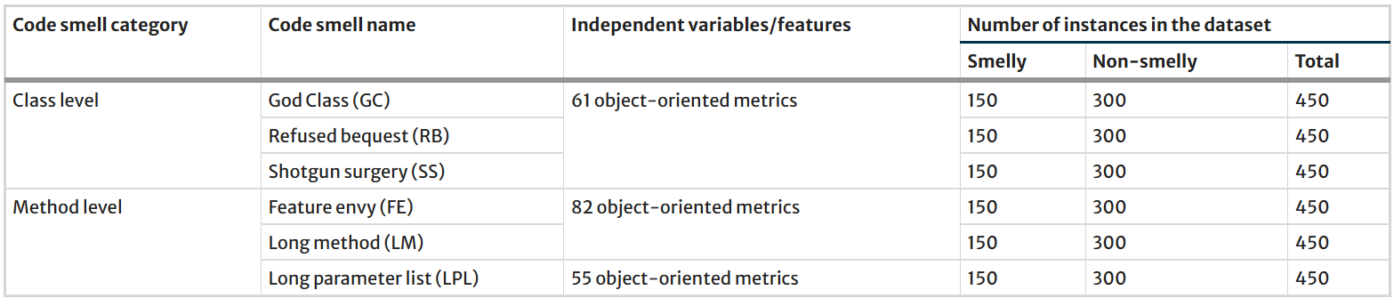
Base Paper Dataset
The ‘Qualitas Corpus’ is just a collection of Java files.
This dataset consists of 112 Java systems with a total of 754 versions of these systems, 61 source code metrics that are calculated at the class level and 82 source code metrics that are calculated at the method level.

Slide 11
Base Paper Preprocessing
Mean Imputation - Missing values in dataset are handled by simple mean imputation.
Min-Max Normalization - Feature scaling is necessary on the dataset as different features may have different ranges of values. In this technique, the new target normalized value (x′) is obtained from the original value (x) using the following formula: x′=(x−min(x))/(max(x)−min(x))
Balancing the Dataset: As the dataset is unbalanced, paper considers applying SMOTE (Synthetic Minority Oversampling TEchnique) for minority categories in the dataset. SMOTE helps in scaling minority values in the dataset by reducing the distance between different features (independent variables).

Slide 12
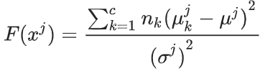
Base Paper Ensemble Feature Selection
Fisher Score – They use it to select a fraction of Relevant Features. As SFS is computationally intensive, we first remove the easily removable features.
The Fisher score (F) of the jth feature is computed as shown below, were μkj and σkj are the corresponding mean and standard deviation values for the kth class in the jth feature vector. Similarly, μj and σj are the corresponding mean and standard deviation values for the jth feature vector.
Sequential Forward Selection – It is basically an iterative method where all possible subsets of features are evaluated.
It is basically a bottom-up search method in which we iteratively add features to an initial empty feature subset based on evaluation criteria

Slide 13
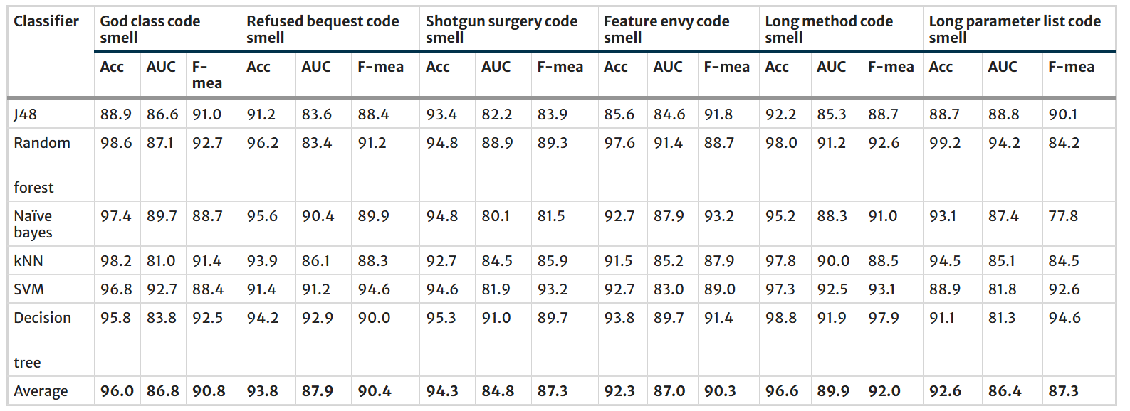
Base Paper Classification & Evaluation
The paper trains six machine learning classifiers in reference to code smell detection namely J48, Random forest, Naive Bayes, kNN, SVM, and Decision Tree.
The result is as below -

Slide 14
Base Paper Limitations
The ‘Qualitas Corpus’ is just a large collection of java files. The authors have not given how and which metrics they calculated and they manually labeled it too. This dataset is not available to us to recreate the exact results.
Mean Imputation is more affected by outliers
Min Max Scaler is more susceptible to the influence of extreme values
When we tried with SMOTE/ROSE, it was giving worse results on testing data due to high level of synthetic data resulting in overfitting.
The SFS algorithm is taking longer time (They mentioned in paper itself).
Biggest issue is that the dataset is highly unbalanced and Over sampling increases overfitting and synthetic data points. Hence, it is unreliable in real world scenario, even if accuracy and f1-score is high.

Slide 15
Our Work (as of now)
As we have seen ‘Qualitas Corpus’ is not available to us, we had to use another dataset. We initially tried with MLCQ Dataset (around 2000 samples) for Data Class (https://github.com/milica-skipina/ML-code-smell-detection) which contains pre labelled data.
However, as this MLCQ is unbalanced (only 200 True) we were getting bad results on training and testing it on unseen data. This is because the SMOTE/ROS (any variant) generated large amount of synthetic data which did not match with real world code metrics.
We proceeded to generate our own data set by scraping Java codes (with more than 100 stars from GitHub) and manually labelling them. This results in about 500 True out of 1200. (which is balanced)
We used Median imputation instead of Mean as it is less sensitive to extreme values(outliers) when compared to Mean.
We also used Robust Scaler as it is better than Min Max Scaler. The formula is: x′=(x−median(x))/IQR(x)
As our Dataset is sufficiently balanced, we removed SMOTE/ROSE oversampling technique as it would only lead to useless synthetic data and overfitting.

Slide 16
Our Work (as of now)
As we have seen ‘Qualitas Corpus’ is not available to us, we had to use another dataset. We initially tried with MLCQ Dataset (around 2000 samples) for Data Class (https://github.com/milica-skipina/ML-code-smell-detection) which contains pre labelled data.
However, as this MLCQ is unbalanced (only 200 True) we were getting bad results on training and testing it on unseen data. This is because the SMOTE/ROSE (any variant) generated large amount of synthetic data which did not match with real world code metrics.
We proceeded to generate our own data set by scraping Java codes (with more than 100 stars from GitHub) and manually labelling them. This results in about 500 True out of 1200. (which is balanced)
We used Median imputation instead of Mean as it is less sensitive to extreme values(outliers) when compared to Mean.
We also used Robust Scaler as it is better than Min Max Scaler. The formula is: x′=(x−median(x))/IQR(x)
As our Dataset is sufficiently balanced, we removed SMOTE/ROSE oversampling technique as it would only lead to useless synthetic data and overfitting.

Slide 17
Our Work (as of now)
We used the idea of ensembled features selection in our work too. After Fisher selection we are getting 29/49 features (['cbo', 'cboModified', 'fanin', 'fanout', 'wmc', 'rfc', 'lcom*', 'totalMethodsQty', 'publicMethodsQty', 'privateMethodsQty', 'protectedMethodsQty', 'visibleMethodsQty', 'totalFieldsQty', 'protectedFieldsQty', 'nosi', 'loc', 'returnQty', 'loopQty', 'comparisonsQty', 'tryCatchQty', 'stringLiteralsQty', 'numbersQty', 'assignmentsQty', 'mathOperationsQty', 'variablesQty', 'maxNestedBlocksQty', 'innerClassesQty', 'uniqueWordsQty', 'modifiers’]) and after SFS we are getting 10/49 features (['cboModified', 'rfc', 'protectedMethodsQty', 'protectedFieldsQty', 'loc', 'loopQty', 'tryCatchQty', 'assignmentsQty', 'maxNestedBlocksQty', 'innerClassesQty’])
We are getting metrics the metrics from CK tool (https://github.com/mauricioaniche/ck) as in MLCQ dataset.
Due to Ensemble Approach SFS is working fast (~ 7 sec)
We are training a Random Forest (n_estimators=300) for classifier.
As the base paper does not use Data Class Code Smell, direct comparision may not be very useful, but still, we are getting similar results for a new type of Code Smell
Here are the results –
Accuracy: 0.9822 (almost equal to base paper and our is balanced dataset)
F1-Score: 0.9629 (better than base paper)
Precision: 0.9792
Recall: 0.9471

Slide 18
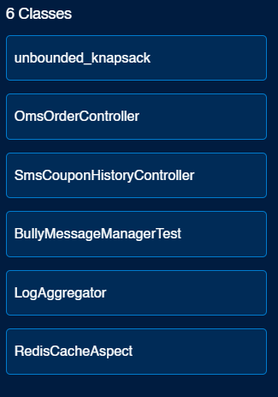
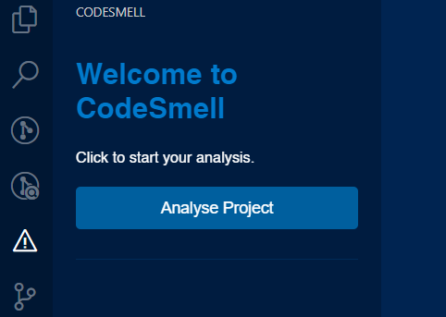
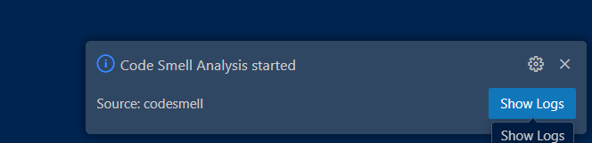
Our Work (as of now)
After getting good results, we have also started development on the VS Code Extension. As mentioned in Analysis, there is a lack of tools available for specifically code smell.
Currently, the extension can perform functions such as (Screenshots also attached below)–
Adds a new button in Activity bar of VS Code. On clicking it opens sidebar with ‘Analyze project’ button. After clicking that. All the project currently opened will be analyzed.
First, we will run CK to find metrics. Then we load the saved models, this CK metrics and saved selected features. After running classification, we get all those classes which suffer from code smell. We display as a List view.
Various UX features have been added like async, loading bar, notifications on errors, show logs , automatic clean up code

Slide 19
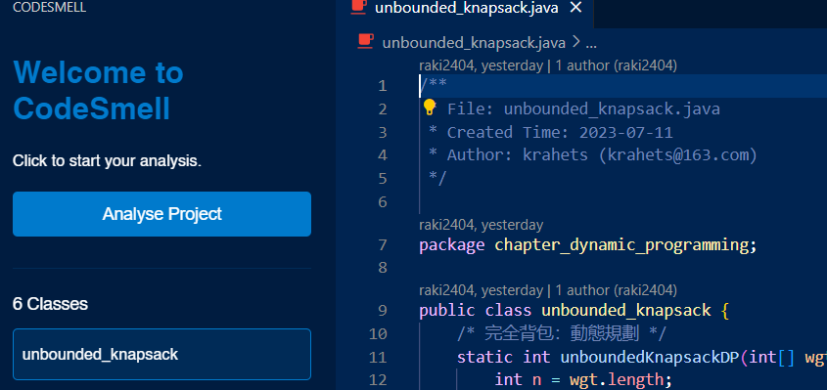
Our Work (as of now)
Currently, the extension can perform functions such as (Screenshots also attached below)–
On clicking, we are focused to the particular line of the class, in the file. (localisation)
It can also detect code smells in interfaces also.
All code is found in GitHub (https://github.com/SilverDragonOfR/CodeSmell-3)

Slide 20
Future Work (few ideas)
We will improve the extension by using PMD tool. In PMD tool, we can set our rules in an xml file. When the extension analyses the project and categorizes the class with code smells, the PMD tool verifies these classes with respect to the rules set by us to assess the severity of code smell as red(critical), medium red, orange etc.
We are also planning on including the ‘create report’ feature in our extension using LLM which analyses the project and generates a report in natural language.
We also want to add a button that sends the report generated through email or discord to the users maintaining the project.
Integrating it GitHub actions so that when the user pushes the code it immediately prepares the report of the new version of project.
We will also train the model on other programming languages like Go, Python, etc.
Historical Analysis – Track code quality over time, identifying patterns in how smells appear and evolve.

Slide 21
Thank You

