Slide 1
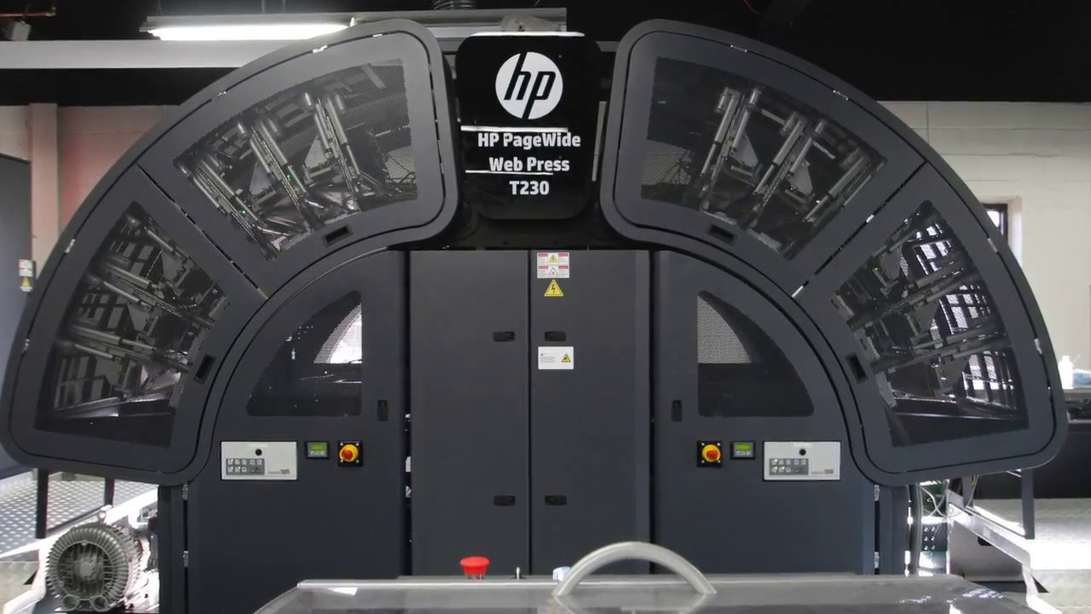

CS73
Press vr
HP BELIEVES VIRTUAL REALITY IS THE FUTURE, AND SO DO WE
HP needs a better way to train customers on how to use their industrial "WebPress" printer technology.
The team
The HP “WebPress” printer is a product designed for high-volume, industrial print jobs such as printing books for an Amazon warehouse, or printing the vibrant colors on cardboard boxes.
These multi-million dollar printers are warehouse sized and difficult to operate. In order to train its customers, HP holds training seminars at HP WebPress locations around the world.
However, they need less-expensive ways to train people.
HP thinks VR could potentially replace or augment some or all of the in-person training with a computer simulation.
Our project is a feasibility prototype to see if a VR program can work to supplement or replace the current training methods.
(From left to right)
Symon Ramos ramossy@oregonstate.edu
Stephen Hoffmann hoffmast@oregonThey believe virtual reality (VR) is the future, and so do we.state.edu
Stewart Rodger stewartrodger24@gmail.com
Nicholas Pugliese nicholas.d.pugliese@gmail.com
Kyle Tyler kyletyler17@gmail.com
Client (not pictured):
Tim Holt, HP Inc. timothy.holt@hp.com
Project description
The project is made up of multiple component parts:
A training room to teach new virtual reality users how to navigate a VR experience.
A training scenario that teaches a user how to solve a problem with the WebPress.
A sandbox mode that allows users to experience the Web Press in a free form environment.
Figure 1: A WebPress printer.
INNOVATING TRAINING WITH VR
Developing for vr
When developing this application, we had to consider the differences between traditional teaching methods and teaching with VR:
Traditional in depth instruction requires reading the manual and attending seminars.
Hands on training requires that equipment and supervisors be available.
To reduce costs, hands on training is done in groups, so solo experience might not be available.
Some advantages VR has over these limitations are:
Trainee can experience near-hands on training experience without supervisors, and at a reduced cost
While the modern iteration of virtual reality is relatively new, there are a number of development tools that help greatly when making VR experiences. We used the following tools:
Unreal Engine 4
Datasmith
3DS Max
These tools are primarily used for game development, but they have great support for general VR development. There are other technologies we could have used, such as the Unity game engine, but we chose Unreal Engine because HP has a business relationship with Unreal.
Notes:
Would be funny to have a picture of all of us with VR headsets on lol

