Slide 1
ELEC5620 · GROUP 16
A multi-agent audit
support system
One registered company auditor can complete a statutory audit. Agents run procedures and read evidence. The opinion and the signature stay with the auditor.
Member C
Member A
Member B
Positioning and functions
Agents and design models
Use cases and one full line
about 2 min 20 s
about 3 min 45 s
about 3 min
ELEC5620 · Group 16
1 / 39
Notes:
Hello, we are Group 16. This system helps one Australian registered company auditor complete a statutory audit. I will cover positioning and functions. The next speaker covers the agents and the design models. The last speaker walks one full case, from a cutoff error to the opinion.

Slide 2
MEMBER C
Positioning
Audit support: the opinion stays with the auditor
USER
SETTING
WHAT IT HOLDS
A sole-practitioner registered company auditor
Australian statutory audit
Three things the system does not take over
One person covers acceptance, planning, execution, completion, and reporting. The system takes the procedures it can run. The decisions that must be personal stay with the auditor.
Auditing standards ASA.
Accounting standards AASB.
Corporations Act 2001.
ASIC, ASQM, and APES 110.
The auditor issues the opinion.
A statutory decision is confirmed before the flow moves on.
Every judgment traces back to the original evidence.
The person keeps the judgment. The system runs the work, presents it, blocks it when it must, and keeps the record.
ELEC5620 · Group 16
2 / 39
Notes:
The user is a sole-practitioner registered company auditor. The setting is Australia: the auditing standards ASA, the accounting standards AASB, and the Corporations Act. This is audit support. The opinion and the signature have to be the auditor's own. Agents check registrations, run procedures, read evidence, and produce a preliminary judgment. Four statutory decisions stop and wait. Every judgment has to trace back to the original evidence.

Slide 3
MEMBER C
Functions
Five phases, four gates
P0
P1
P2
P3
P4
Acceptance
Planning
Execution
Completion
Reporting
Check the ABN and the ASIC register. Prepare the acceptance file.
Extract contracts, run a first analysis, and propose materiality and risks.
Run procedures in dependency layers. The prototype follows revenue and bank confirmation.
Add up uncorrected misstatements and propose an opinion type.
Draft the report. Comments send it back. A signature locks it.
Gate · acceptance
Gate · planning
Gate · opinion
Gate · signature
Whether to take the engagement
Confirm materiality and the risk list
Confirm the opinion type
Send it back, or sign and archive
Resumes from a checkpoint
161 procedures, assembled by risk
This prototype runs 17
Rule, hybrid, model, manual
ELEC5620 · Group 16
3 / 39
Notes:
The work runs in five phases. Acceptance checks the ABN and ASIC, and the auditor decides whether to take the engagement. Planning sets materiality, confirms the risk list, and assembles the procedure pack. Execution runs substantive procedures in parallel. In this prototype the two main lines are revenue cutoff and bank confirmation. Completion adds up uncorrected misstatements, and the auditor confirms the opinion type. Reporting drafts the report. The auditor can send it back with comments, or sign and archive it. A state machine drives the flow, and it can resume from a checkpoint. The specification has 161 procedures. This prototype runs 17. That is my part.

Slide 4
MEMBER A
Agents
Ten agents, split by what they produce
Control
A1 Orchestrator
State machine, gates, pack assembly, parallel schedule, and the trail. No language model.
Accept
& plan
A2 ClientIntel
A3 IngestAgent
A4 RiskAssessor
Background, independence, acceptance score
Contract and reply extraction
Risk, materiality, audit plan
Execute
A5 EvidenceAgent
A6 FieldworkAgent
A7 ReviewAgent
Outward evidence, such as a confirmation
Substantive judgments, many instances
Different model. Evidence only. Spec only.
Output
& talk
A8 WorkpaperAgent
A9 QCAgent
A10 ConciergeAgent
Workpapers and misstatement state. Spec only.
Rule checks and the misstatement roll-up
Present, pass the decision, draft the report
Agents do not call each other. Results go into the engagement state and A1 merges them. Dashed cards are specification only, and this prototype has not wired them in.
ELEC5620 · Group 16
4 / 39
Notes:
The ten agents are split by what they produce, not by account area, so the procedure library can grow without adding roles. A1 is the orchestrator: the state machine, the gates, and the schedule. It does not call a language model. Acceptance and planning are A2, A3, and A4. Execution is A5 and A6, and A6 can run as several instances. The dashed cards, A7 and A8, are in the specification and are not wired into this prototype. A9 does the rule-based roll-up. A10 is the only door. The next slide says what each one produces.

Slide 5
MEMBER A
Agents
What each agent produces
A1 Orchestrator
Advances the state machine, holds the gates, assembles the pack, writes the trail. No language model, and no procedures of its own.
AGENT
WHAT IT PRODUCES
ENGINE
OF 161
A2 ClientIntel
Background, independence, the engagement letter
Language model
11
A3 IngestAgent
Ledgers, contracts, replies, missing documents
Rules + model
12
A4 RiskAssessor
Risk ratings, materiality, the audit plan
Language model
20
A5 EvidenceAgent
Confirmations and other outward evidence
Rules, no model
9
A6 FieldworkAgent
Substantive judgments, many instances in parallel
Rules + model
80
A7 ReviewAgent
A second conclusion from the evidence alone
A different model
1 · spec
A8 WorkpaperAgent
Workpapers and misstatement classification
Language model
6 · spec
A9 QCAgent
Misstatement roll-up, completeness, tie-out
Rules, no model
7
A10 Concierge
Presents the item, records the decision, drafts
Language model
15
Counts are the specification. This prototype runs 17 procedures. Dashed rows are not wired in. A10 writes the auditor's decision as given.
ELEC5620 · Group 16
5 / 39
Notes:
The map named the ten roles. This is what each one produces. A1 does not run procedures. It only advances the state machine. The other nine share the 161 procedures in the specification. A2, A3, and A4 cover acceptance and planning. A5 sends confirmations and does not call a model. A6 does the substantive work. Most of the procedures sit there, and it can run as several instances. A7 reads the evidence again on a different model, so a model does not review itself. A8 writes the workpapers. Both are specification only. A9 is rules: the roll-up and the completeness checks. A10 is the only door. It presents the item and drafts the report. It records the auditor's decision as given. It does not decide.

Slide 6
MEMBER A
One agent
A6, one procedure: judge the cutoff
FieldworkAgent · REV-02 · hybrid · level 2. A rule selects the invoices. The model judges each one. The auditor reviews each one.
01
02
03
04
05
Released
Select
Judge
Record
Review
A1 starts REV-02 only after the three-way match and the contract judgment are in.
A rule takes invoices in the cutoff window, at or above performance materiality, plus any cutoff exception.
One model call per invoice. It sees that invoice, the delivery note, the contract, and two paragraphs of AASB 15.
A judgment: conclusion, reasoning chain, a counter-argument, and pointers back to the page.
The item waits. The auditor confirms it, overrides it, or records the misstatement. A6 does not decide.
THE ITEM THIS PROTOTYPE RUNS
Invoice SI-2026-0612. Posted 28 June. Signed 3 July. The contract transfers control on signing.
Proposed action: misstatement. Revenue overstated by AUD 142,000. The auditor still has to confirm it.
ELEC5620 · Group 16
6 / 39
Notes:
Take one agent, and one procedure it actually owns. A6 is Fieldwork. REV-02 is the revenue cutoff judgment. A1 does not start it until the three-way match and the contract judgment are already in the state. A rule then selects the invoices: inside the cutoff window, and large enough, or already flagged as a cutoff exception. The model judges one invoice at a time. It sees that invoice, the delivery note, the contract, and two paragraphs of AASB 15. It does not see the whole ledger. What comes back is a judgment: a conclusion, a reasoning chain, a counter-argument, and pointers to the page. Because this procedure is level 2, the item waits. The auditor confirms it, overrides it, or records the misstatement. On the synthetic file, invoice SI-2026-0612 was posted on 28 June and signed on 3 July. A6 proposes a misstatement of 142,000. It does not record that misstatement itself.

Slide 7
MEMBER A
Figure 1b
Full source class_agents.puml
class_agents.png
Agents meet only at the orchestrator
A2
A6
Background and independence
Substantive judgments
A1 ORCHESTRATOR
A3
A7
Engagement state
Contracts and replies
each agent
each agent
Second reading, before the merge
Passes the state out.
Merges the patch after four checks:
rights, type, unique id, references.
A4
A8
Risk and materiality
Workpapers
A5
A9
Outward evidence
Rule-based quality control
A10 CONCIERGE
Auditor
One exception
The only door. Shows the item. Writes the decision as given.
A6 calls A7 before the merge. Spec only.
ELEC5620 · Group 16
7 / 39
Notes:
This is the collaboration model, simplified from Figure 1b. Agents do not call each other. A1 hands each one the engagement state and merges the patch that comes back, after four checks. The dashed cards are specification only. The one exception is A7: A6 calls it before the merge, on a different model, and only with the evidence. The auditor comes in through A10.
https://github.sydney.edu.au/ELEC5620-Wed-14-16-Group-16/ELEC5620-demo/blob/main/docs/diagrams/class_agents.puml

Slide 8
MEMBER A
Design models
Three constraints on autonomy
MODEL 1
MODEL 2
MODEL 3
Bounded autonomy
Four autonomy levels
A traceable judgment
The macro flow is a state machine. A gate does not move until the auditor makes an explicit decision.
P0 → acceptance → P1 → planning → P2 → P3 → opinion → P4 → signature.
In execution, procedures run in dependency layers, in parallel within a layer. After the merge the flow continues, waits for a person, or enters completion.
L1 Advice only. The person decides each item.
L2 A judgment. The person reviews each item.
L3 The system proceeds. The person sees exceptions.
L4 The system runs. The person samples afterwards.
A significant risk, an amount above performance materiality, or low confidence moves the level down. Thirty-two statutory procedures stay at L1.
Conclusion and proposed action.
Reasoning chain: fact, standard, inference.
Counter-argument and confidence.
Evidence pointers, back to the page.
Four checks: syntax, structure, references, semantics. A fact needs a pointer. A standard must point at a fragment in the knowledge base.
ELEC5620 · Group 16
8 / 39
Notes:
There are three constraints. First, bounded autonomy. The macro flow is a state machine. A gate does not move until the auditor makes an explicit decision. In execution, procedures run in dependency layers, in parallel within a layer. After the merge the flow continues, waits for a person, or enters completion. Second, four autonomy levels: the person decides, the person reviews each item, the person sees only exceptions, or the person samples afterwards. A significant risk, an amount above performance materiality, or low confidence moves the level down. Thirty-two statutory procedures stay at level one and never move up. Third, a judgment is a conclusion, a reasoning chain, a counter-argument, a confidence score, and evidence pointers. Four checks: syntax, structure, references, and semantics. A fact has to point at a document. A standard has to point at a fragment in the knowledge base. That is my part.

Slide 9
MEMBER A
Figure 3a
Full source state_main.puml
state_main.png
Five phases. Gold is a human gate.
P0
P1
P2
P3
P4
Acceptance
Planning
Execution
Completion
Reporting
Check the ABN and ASIC. Prepare the acceptance file.
Materiality, the risk list, then assemble the pack.
Substantive work in parallel layers, then merge.
Add up uncorrected misstatements.
Draft the report. Comments, or sign and archive.
GATE
GATE
No gate.
The pack settles, then completion starts.
GATE
GATE
Accept or decline
Approve the plan
Confirm the opinion
Sign or send back
RETURN TO PLANNING
TWO EXITS
A risk flag in execution pauses the dispatch and sends the work back to planning. It does not ingest the file again.
Decline at acceptance. Or withdraw from any phase and seal the file.
The flow resumes from a checkpoint. A gate does not move until the auditor decides.
ELEC5620 · Group 16
9 / 39
Notes:
This is the engagement state machine, simplified from Figure 3a. Five phases run in order. The gold bars are the human gates: accept or decline, approve the plan, confirm the opinion, and sign or send the report back. Execution has no gate of its own. When the pack settles, completion starts. A risk flag can send execution back to planning. Decline and withdrawal are the two ways out. Hand over to the next speaker.
https://github.sydney.edu.au/ELEC5620-Wed-14-16-Group-16/ELEC5620-demo/blob/main/docs/diagrams/state_main.puml

Slide 10
MEMBER B
Use cases
Nine use cases cover the whole engagement
UC-01 · P0
UC-02 · P1
UC-03 · P2
Acceptance
Planning and risk
Procedure execution
After the register check, the auditor accepts or declines.
Materiality and the risk list. The pack is assembled only after approval.
Full-population checks and substantive procedures, including confirmations.
UC-04 · P2
UC-05 · P2→P1
UC-06 · P3→P4
Exception review
Risk re-assessment
Completion and report
Confirm, override, record a misstatement, or rerun.
New evidence that changes the risk pulls the work back to planning.
Evaluate misstatements, draft the report, review before signature.
UC-07 · P4
UC-08 · any
UC-09 · any
Archiving
Progress and source
Notice and withdrawal
After signature the file is locked and read-only.
Ask which step this is, and open the evidence.
Statutory clocks, or withdraw and seal the file.
ELEC5620 · Group 16
10 / 39
Notes:
There are nine use cases, and they sit on those five phases. The first seven follow the phases: acceptance, planning, execution, exception review, risk re-assessment, completion and the report, then archiving. The last two can cut in at any phase: asking where the work is and where a figure came from, and statutory notification or withdrawal. Besides the auditor, the actors are the client, external data sources, and the engagement quality reviewer before signature. Risk re-assessment can pull an engagement that has already started execution back into planning.

Slide 11
MEMBER B
Figure 6
Full source usecase.puml
usecase.png
Nine use cases, and who takes part
RCA
Client
External data
EQR reviewer
All nine. Also runs the manual procedures inside execution.
The letter, the file, replies on misstatements, fraud and NOCLAR talks.
ASIC and the ABN, the accounting system, confirmations, lodgement.
A pre-signature review, then read-only access to the archive.
AUDIT SUPPORT SYSTEM
UC-01 P0
UC-02 P1
UC-03 P2
Acceptance
Planning and risk
Execution
UC-04 P2
UC-05 P2 → P1
UC-06 P3 → P4
Exception review
Risk re-assessment
Completion and report
UC-07 P4
UC-08 Any phase
UC-09 Any phase
Archive
Progress and source
Notice and withdrawal
ELEC5620 · Group 16
11 / 39
Notes:
This is Figure 6, redrawn so the room can read it. The registered company auditor joins every use case. The client supplies the letter, the file, and the replies. External data covers the registers, the accounting system, and confirmations. The engagement quality reviewer comes in before signature, and afterwards can only read the archive. Risk re-assessment can pull execution back to planning. Statutory notice or withdrawal can cut in at any phase.
https://github.sydney.edu.au/ELEC5620-Wed-14-16-Group-16/ELEC5620-demo/blob/main/docs/diagrams/usecase.puml

Slide 12
MEMBER B
Prototype
How this prototype runs one engagement
Execution only. A1 schedules three layers. A patch comes back, A1 merges it, then the next layer starts.
LAYER 0
A6 REV-08
A6 REV-03
A5 CSH-04
A6 CSH-05
In parallel
Three-way match. Invoice posted 28 June, signed 3 July.
Reads the contract. Control transfers on signing.
Sends the bank confirmation. The mock reply comes back.
Compares the book with the statement. Gap of AUD 50,000.
A1 merges the patch, then opens the next layer
LAYER 1
A6 REV-02
A3 DOC-06
After the merge
Cutoff judgment. Uses the exception and the contract. Proposes a misstatement of AUD 142,000.
Reads the bank reply. The confirmed balance is AUD 50,000 below the book.
A1 merges again
LAYER 2
A6 CSH-02
REVIEW QUEUE
Last procedure
The gap is a deposit in transit, received on 2 July. Not a misstatement.
The auditor confirms both items. The agents do not decide.
A9 FIN-04
A10 RPT-03
AUD 142,000 is above materiality. The candidate opinion is qualified.
Drafts the report. The auditor sends it back once, then signs.
ELEC5620 · Group 16
12 / 39
Notes:
This is the path this prototype actually runs, not the full specification. A1 schedules execution in three layers. In the first layer, A6 matches the invoice to the delivery note and reads the contract, while A5 sends the bank confirmation and A6 compares the balances. A1 merges those results. In the next layer, A6 makes the cutoff judgment: the invoice was recorded on 28 June and signed for on 3 July, so it proposes a misstatement of 142,000. A3 reads the bank reply. In the last layer, A6 explains the 50,000 gap as a deposit in transit. The auditor confirms both items on the review queue. A9 rolls the cutoff above materiality, and A10 drafts the report. The next page is the same case, told as three scenes.

Slide 13
MEMBER B
One line
One line: a cutoff error, then a qualified opinion
A fictional company. Year-end 30 June 2026. Revenue about AUD 12 million.
SCENE 1 · REVENUE
SCENE 2 · CASH
SCENE 3 · OPINION
Cutoff misstatement
A timing difference
Qualified opinion
An invoice for AUD 142,000 is recorded on 28 June. The delivery note is signed on 3 July. The contract transfers control on signing.
The bank reply is AUD 50,000 below the book. The difference is a deposit in transit, recorded on 30 June and received on 2 July.
The overall-materiality range is 60 to 120 thousand. The cutoff misstatement is above the top of that range.
Propose a misstatement. The auditor confirms it.
Propose that this is not a misstatement. The auditor confirms it.
The proposed opinion is qualified. Signature waits for confirmation.
Three-way match
Cutoff judgment
Confirmation
Difference
Roll-up
Opinion
Signature
ELEC5620 · Group 16
13 / 39
Notes:
One line through the synthetic data. The company is fictional. Year-end 30 June 2026, revenue about 12 million Australian dollars. An invoice for 142,000 is recorded on 28 June, and the goods are signed for on 3 July. Control transfers on signing, so three-way matching flags the cutoff. The judgment proposes a misstatement, and the auditor confirms it. The bank reply is 50,000 below the book. That difference is a deposit in transit, recorded on 30 June and received on 2 July, so the system proposes that it is not a misstatement. The auditor confirms that too. The cutoff amount sits above the top of the overall-materiality range, 60 to 120 thousand, so completion proposes a qualified opinion. The signature waits until the auditor confirms the opinion type. The invoice, the delivery note, and the reply open from the judgment.

Slide 14
MEMBER B · CLOSE
Three sentences to take away
01
02
03
The judgment stays with the person. Execution, traceability, and the block stay with the system.
Ten agents collaborate by what they produce. The orchestrator is the only scheduler.
The higher the risk, the lower the autonomy. Statutory procedures never move up.
Thank you！
ELEC5620 · Group 16
14 / 39
Notes:
Three sentences. The judgment stays with the person. Execution, traceability, and the block stay with the system. Ten agents collaborate by what they produce, and the orchestrator is the only scheduler. The higher the risk, the lower the autonomy. Thank you. Questions welcome. Do not present the appendix unless someone asks for a figure.

Slide 15
APPENDIX
Design figures
One slide per figure in docs/diagrams. Open the linked .puml to read labels that are small on the slide.
ELEC5620 · Group 16
15 / 39
Notes:
Not spoken. Stop the talk on the previous slide unless a question asks for a figure.

Slide 16
FIGURE 1A
Class diagram — domain model
Source (group access) docs/diagrams/class_domain.puml
ELEC5620 · Group 16
16 / 39
Notes:
Not spoken. Class diagram — domain model
https://github.sydney.edu.au/ELEC5620-Wed-14-16-Group-16/ELEC5620-demo/blob/main/docs/diagrams/class_domain.puml

Slide 17
FIGURE 1B
Class diagram — agents, services, and contracts
Source (group access) docs/diagrams/class_agents.puml
ELEC5620 · Group 16
17 / 39
Notes:
Not spoken. Class diagram — agents, services, and contracts
https://github.sydney.edu.au/ELEC5620-Wed-14-16-Group-16/ELEC5620-demo/blob/main/docs/diagrams/class_agents.puml

Slide 18
FIGURE 2
Package diagram — modules and contracts
Source (group access) docs/diagrams/package.puml
ELEC5620 · Group 16
18 / 39
Notes:
Not spoken. Package diagram — modules and contracts
https://github.sydney.edu.au/ELEC5620-Wed-14-16-Group-16/ELEC5620-demo/blob/main/docs/diagrams/package.puml

Slide 19
FIGURE 3A
State machine — engagement lifecycle
Source (group access) docs/diagrams/state_main.puml
ELEC5620 · Group 16
19 / 39
Notes:
Not spoken. State machine — engagement lifecycle
https://github.sydney.edu.au/ELEC5620-Wed-14-16-Group-16/ELEC5620-demo/blob/main/docs/diagrams/state_main.puml

Slide 20
FIGURE 3B
Object state machines
Source (group access) docs/diagrams/state_objects.puml
ELEC5620 · Group 16
20 / 39
Notes:
Not spoken. Object state machines
https://github.sydney.edu.au/ELEC5620-Wed-14-16-Group-16/ELEC5620-demo/blob/main/docs/diagrams/state_objects.puml

Slide 21
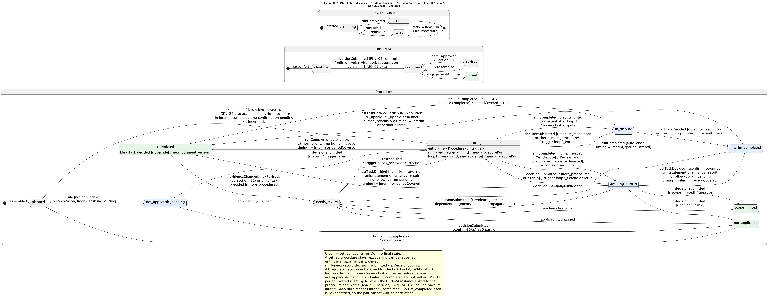
FIGURE 3B-1
Object states — risk, procedure, run
Source (group access) docs/diagrams/state_objects_member_b.puml
ELEC5620 · Group 16
21 / 39
Notes:
Not spoken. Object states — risk, procedure, run
https://github.sydney.edu.au/ELEC5620-Wed-14-16-Group-16/ELEC5620-demo/blob/main/docs/diagrams/state_objects_member_b.puml

Slide 22
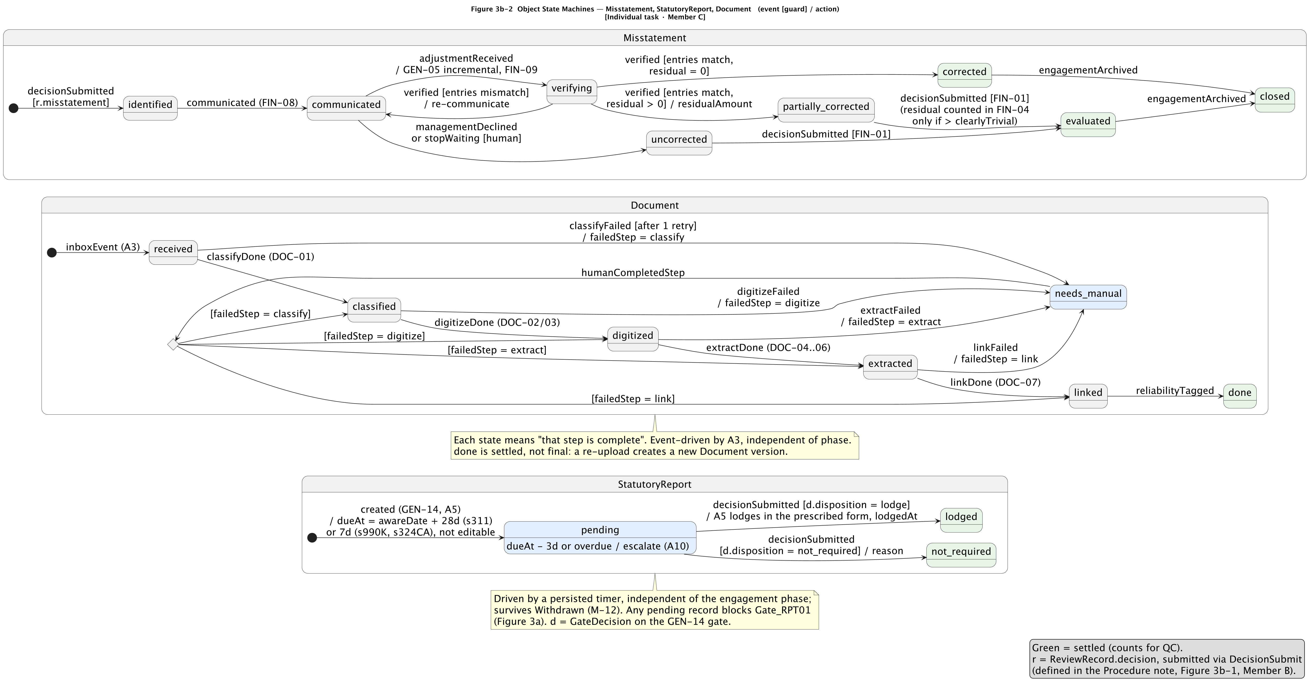
FIGURE 3B-2
Object states — misstatement, statutory report, document
Source (group access) docs/diagrams/state_objects_member_c.puml
ELEC5620 · Group 16
22 / 39
Notes:
Not spoken. Object states — misstatement, statutory report, document
https://github.sydney.edu.au/ELEC5620-Wed-14-16-Group-16/ELEC5620-demo/blob/main/docs/diagrams/state_objects_member_c.puml

Slide 23
FIGURE 4A
Activity — pack assembly and fieldwork
Source (group access) docs/diagrams/activity_fieldwork.puml
ELEC5620 · Group 16
23 / 39
Notes:
Not spoken. Activity — pack assembly and fieldwork
https://github.sydney.edu.au/ELEC5620-Wed-14-16-Group-16/ELEC5620-demo/blob/main/docs/diagrams/activity_fieldwork.puml

Slide 24
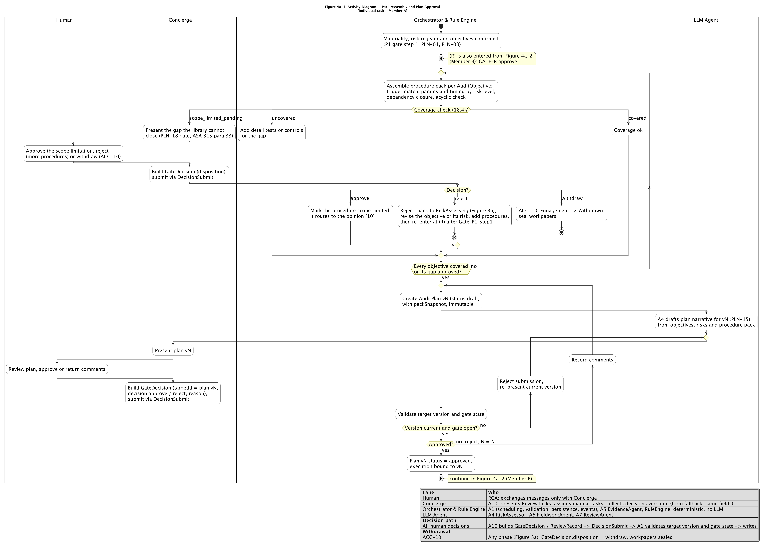
FIGURE 4A-1
Activity — pack assembly and plan approval
Source (group access) docs/diagrams/activity_planning.puml
ELEC5620 · Group 16
24 / 39
Notes:
Not spoken. Activity — pack assembly and plan approval
https://github.sydney.edu.au/ELEC5620-Wed-14-16-Group-16/ELEC5620-demo/blob/main/docs/diagrams/activity_planning.puml

Slide 25
FIGURE 4A-2
Activity — fieldwork execution and feedback loops
Source (group access) docs/diagrams/activity_execution.puml
ELEC5620 · Group 16
25 / 39
Notes:
Not spoken. Activity — fieldwork execution and feedback loops
https://github.sydney.edu.au/ELEC5620-Wed-14-16-Group-16/ELEC5620-demo/blob/main/docs/diagrams/activity_execution.puml

Slide 26
FIGURE 4B
Activity — one procedure inside an A6 instance
Source (group access) docs/diagrams/activity_procedure.puml
ELEC5620 · Group 16
26 / 39
Notes:
Not spoken. Activity — one procedure inside an A6 instance
https://github.sydney.edu.au/ELEC5620-Wed-14-16-Group-16/ELEC5620-demo/blob/main/docs/diagrams/activity_procedure.puml

Slide 27
FIGURE 5A
Sequence — assertion-level risk reasoning
Source (group access) docs/diagrams/sequence_risk_assessment.puml
ELEC5620 · Group 16
27 / 39
Notes:
Not spoken. Sequence — assertion-level risk reasoning
https://github.sydney.edu.au/ELEC5620-Wed-14-16-Group-16/ELEC5620-demo/blob/main/docs/diagrams/sequence_risk_assessment.puml

Slide 28
FIGURE 5B
Sequence — failure paths of a journal-exception attribution
Source (group access) docs/diagrams/sequence_failure_paths.puml
ELEC5620 · Group 16
28 / 39
Notes:
Not spoken. Sequence — failure paths of a journal-exception attribution
https://github.sydney.edu.au/ELEC5620-Wed-14-16-Group-16/ELEC5620-demo/blob/main/docs/diagrams/sequence_failure_paths.puml

Slide 29
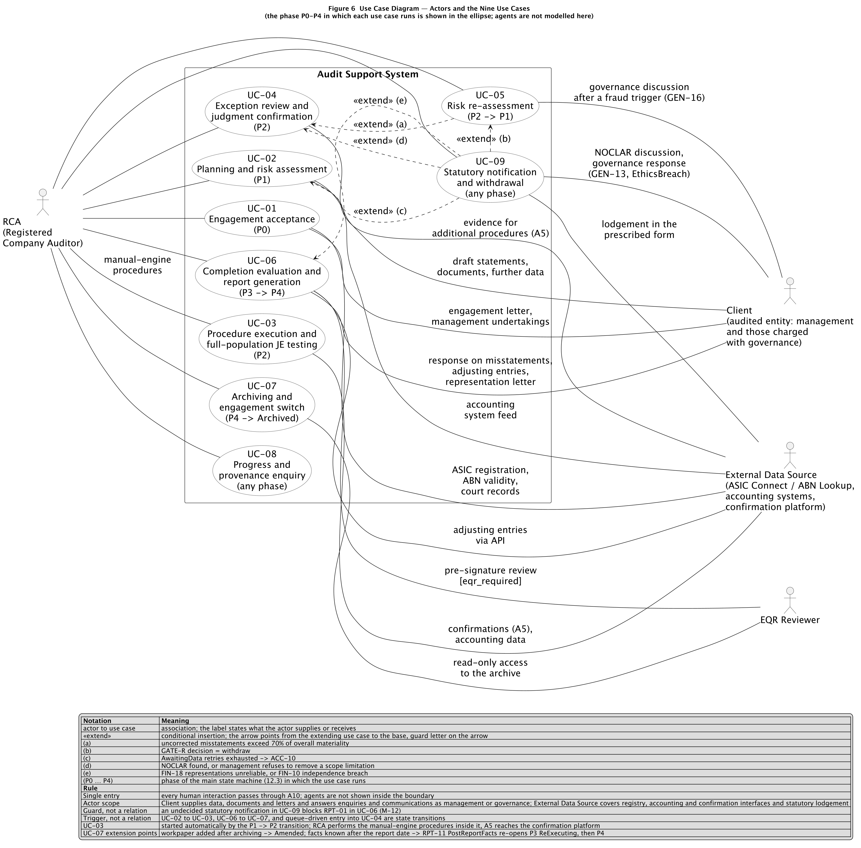
FIGURE 6
Use cases — actors and the nine use cases
Source (group access) docs/diagrams/usecase.puml
ELEC5620 · Group 16
29 / 39
Notes:
Not spoken. Use cases — actors and the nine use cases
https://github.sydney.edu.au/ELEC5620-Wed-14-16-Group-16/ELEC5620-demo/blob/main/docs/diagrams/usecase.puml

Slide 30
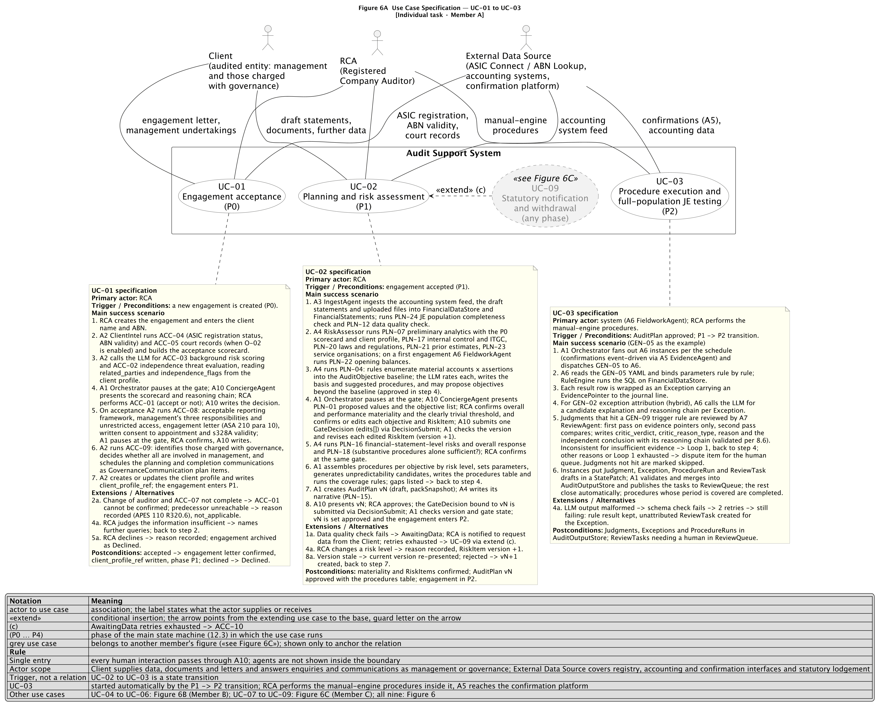
FIGURE 6A
Use case specification — UC-01 to UC-03
Source (group access) docs/diagrams/usecase_spec_member_a.puml
ELEC5620 · Group 16
30 / 39
Notes:
Not spoken. Use case specification — UC-01 to UC-03
https://github.sydney.edu.au/ELEC5620-Wed-14-16-Group-16/ELEC5620-demo/blob/main/docs/diagrams/usecase_spec_member_a.puml

Slide 31
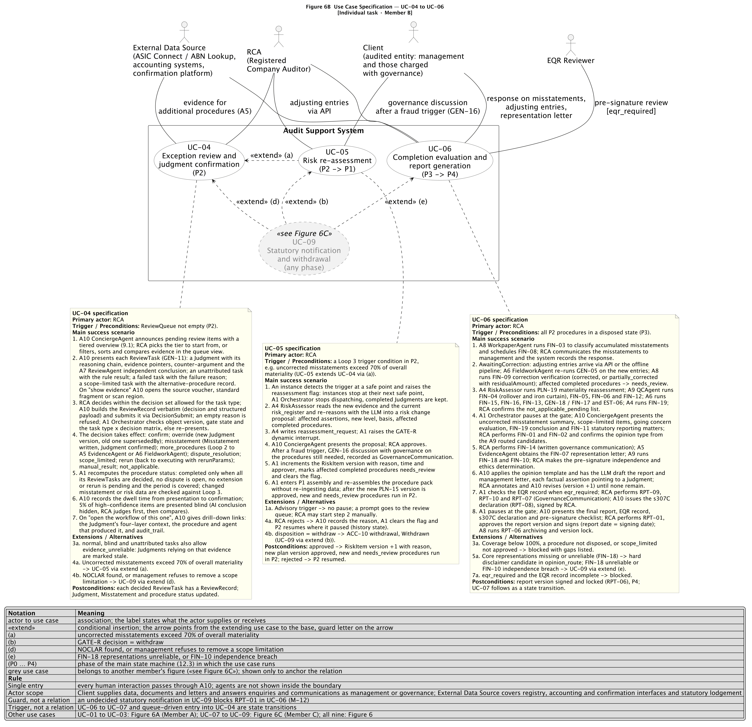
FIGURE 6B
Use case specification — UC-04 to UC-06
Source (group access) docs/diagrams/usecase_spec_member_b.puml
ELEC5620 · Group 16
31 / 39
Notes:
Not spoken. Use case specification — UC-04 to UC-06
https://github.sydney.edu.au/ELEC5620-Wed-14-16-Group-16/ELEC5620-demo/blob/main/docs/diagrams/usecase_spec_member_b.puml

Slide 32
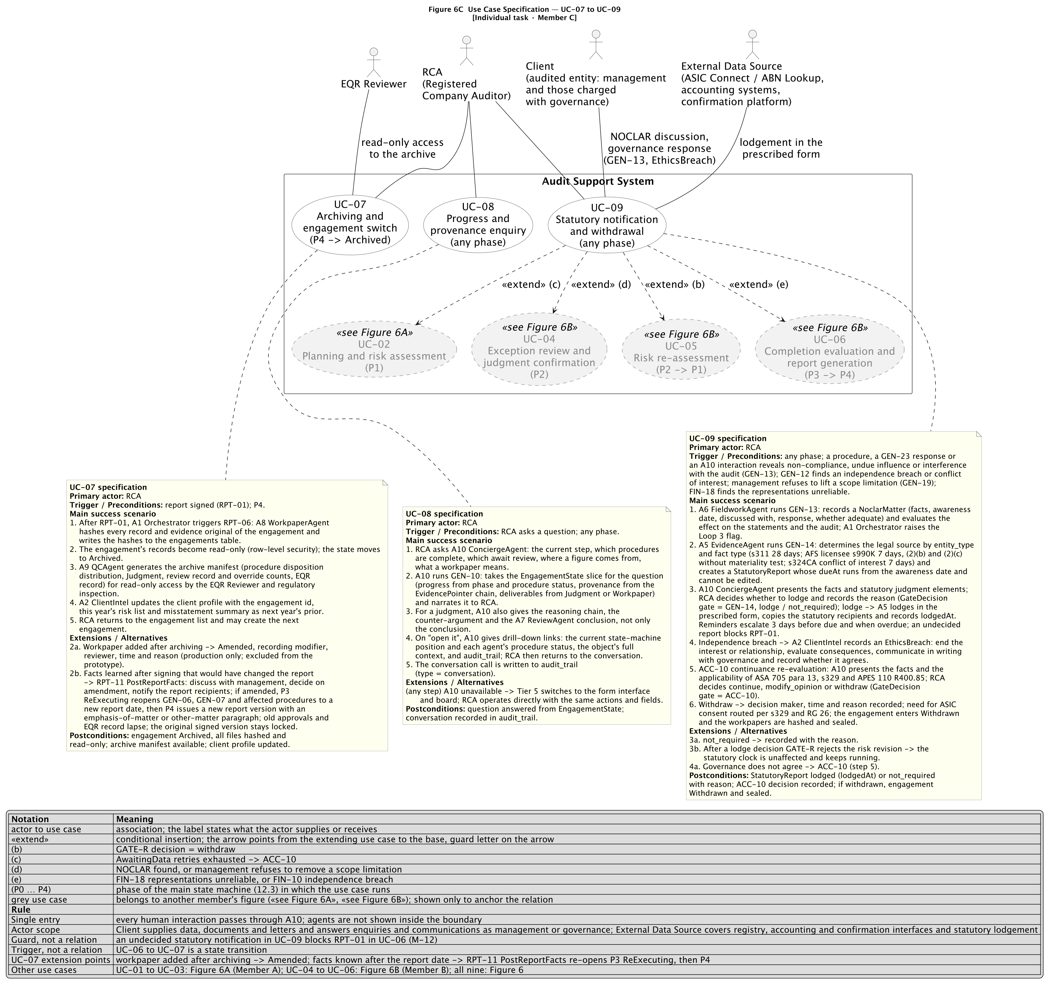
FIGURE 6C
Use case specification — UC-07 to UC-09
Source (group access) docs/diagrams/usecase_spec_member_c.puml
ELEC5620 · Group 16
32 / 39
Notes:
Not spoken. Use case specification — UC-07 to UC-09
https://github.sydney.edu.au/ELEC5620-Wed-14-16-Group-16/ELEC5620-demo/blob/main/docs/diagrams/usecase_spec_member_c.puml

Slide 33
FIGURE 7
Requirements — mandatory and optional
Source (group access) docs/diagrams/requirements.puml
ELEC5620 · Group 16
33 / 39
Notes:
Not spoken. Requirements — mandatory and optional
https://github.sydney.edu.au/ELEC5620-Wed-14-16-Group-16/ELEC5620-demo/blob/main/docs/diagrams/requirements.puml

Slide 34
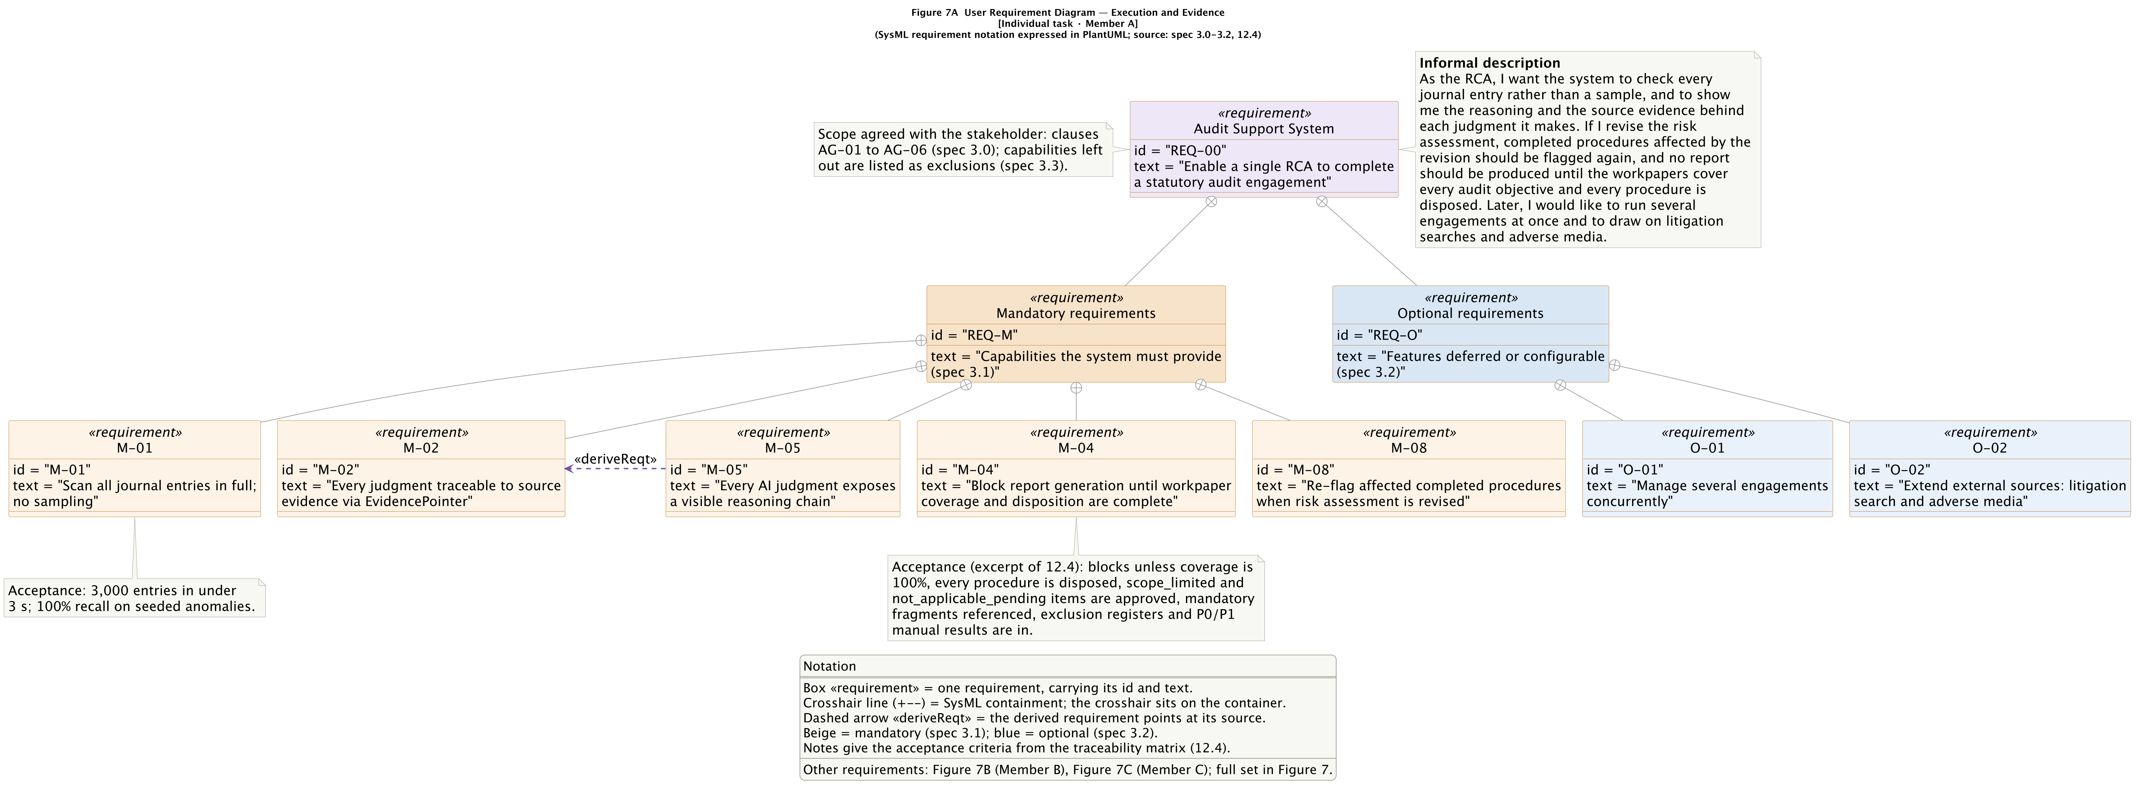
FIGURE 7A
Requirements — execution and evidence
Source (group access) docs/diagrams/requirements_member_a.puml
ELEC5620 · Group 16
34 / 39
Notes:
Not spoken. Requirements — execution and evidence
https://github.sydney.edu.au/ELEC5620-Wed-14-16-Group-16/ELEC5620-demo/blob/main/docs/diagrams/requirements_member_a.puml

Slide 35
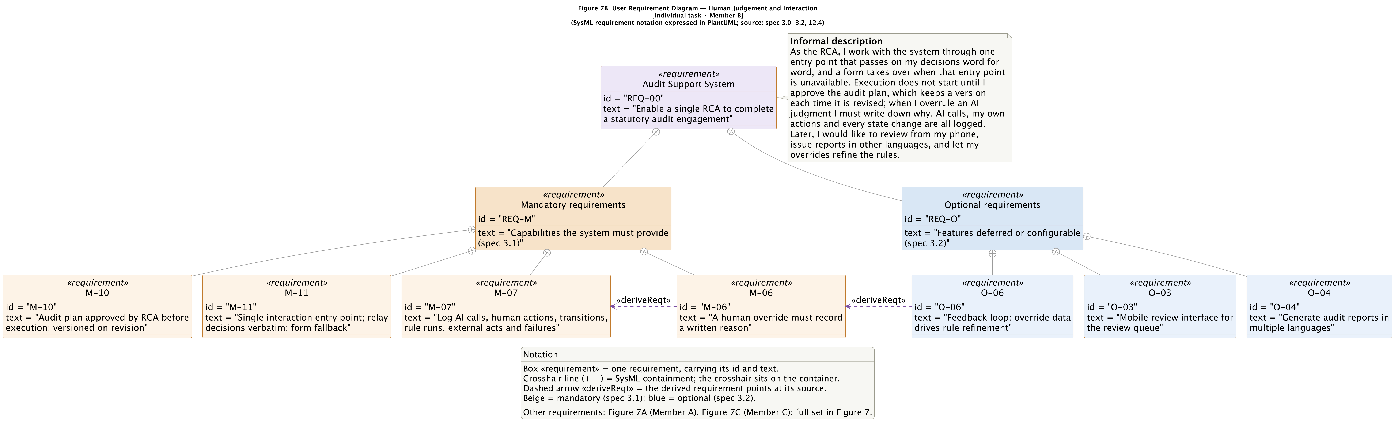
FIGURE 7B
Requirements — human judgement and interaction
Source (group access) docs/diagrams/requirements_member_b.puml
ELEC5620 · Group 16
35 / 39
Notes:
Not spoken. Requirements — human judgement and interaction
https://github.sydney.edu.au/ELEC5620-Wed-14-16-Group-16/ELEC5620-demo/blob/main/docs/diagrams/requirements_member_b.puml

Slide 36
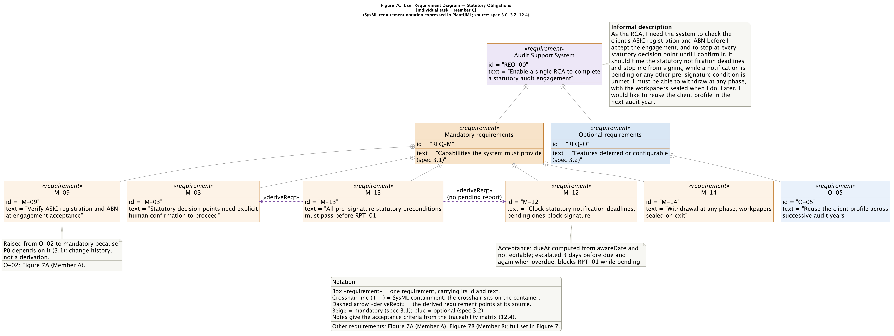
FIGURE 7C
Requirements — statutory obligations
Source (group access) docs/diagrams/requirements_member_c.puml
ELEC5620 · Group 16
36 / 39
Notes:
Not spoken. Requirements — statutory obligations
https://github.sydney.edu.au/ELEC5620-Wed-14-16-Group-16/ELEC5620-demo/blob/main/docs/diagrams/requirements_member_c.puml

Slide 37
FIGURE 8
Feature diagram — audit support system
Source (group access) docs/diagrams/feature.puml
ELEC5620 · Group 16
37 / 39
Notes:
Not spoken. Feature diagram — audit support system
https://github.sydney.edu.au/ELEC5620-Wed-14-16-Group-16/ELEC5620-demo/blob/main/docs/diagrams/feature.puml

Slide 38
FIGURE 9
Structured class — A1 Orchestrator
Source (group access) docs/diagrams/structured_class_a1.puml
ELEC5620 · Group 16
38 / 39
Notes:
Not spoken. Structured class — A1 Orchestrator
https://github.sydney.edu.au/ELEC5620-Wed-14-16-Group-16/ELEC5620-demo/blob/main/docs/diagrams/structured_class_a1.puml

Slide 39
FIGURE 10
Collaboration — one exception review
Source (group access) docs/diagrams/collaboration_review.puml
ELEC5620 · Group 16
39 / 39
Notes:
Not spoken. Collaboration — one exception review
https://github.sydney.edu.au/ELEC5620-Wed-14-16-Group-16/ELEC5620-demo/blob/main/docs/diagrams/collaboration_review.puml

