Slide 1
REST API for Countries and Capitals
Submission By :-
Hrishikesh Hendique
risikeshndq96@gmail.com (all small letters)
VIT university
p.No :- 9790728924

Slide 2
Steps I Executed
First Understood the definition of REST API (Pretty confusing it was took about 20 mins to understand ha-ha)
I started with Flask Documentation since I never used Flask till today.
Had ample experience with web-tech and json so three-tier wasn’t a new thing and didn’t cause any problem.
I had to choose between creating a database for the countries and capitals and reading from a text file. In both cases there is a dependency so I chose textfile as my data input because its just copy-pasting given data.

Slide 3
My learnings
Learnt how this whole flask apps work. I really like them they are amazing. Very easy way to write an API (Duh that’s what libraries are for right?).
Also leartn How to use some new configs with ngnix. That’s amazing too. I hosted my app used gunicorn and ngnix on a GCP server
Particularly how unicodes work on a web platform and utf-8 uses and manythings.

Slide 4
Likes and Improvs
I really loved the challenge the making of the app only took me around 2 hrs but making it non - case sensitive and non-accent sensitive took a lot of time around an hour.
The Unicode conversion using json.dumps was cool. I love it. It was not really fun it was a frustrating task but I loved it because I was able to achieve it. Now my app works even if the user uses normal letters instead of accents.
I don’t think there needs to be any improvs to the challenge. Its pretty decent

Slide 5
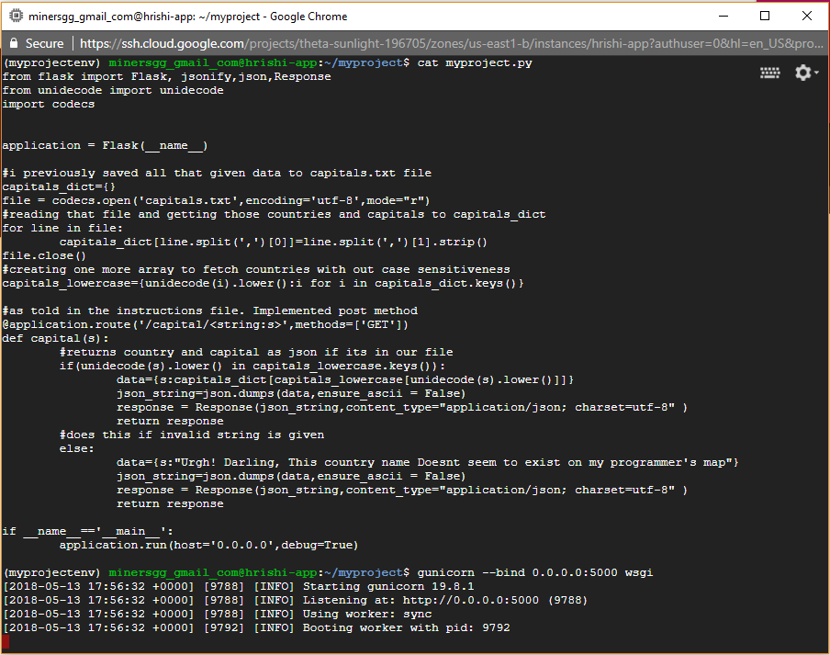



Works pretty well with out accent at ‘o’
Works with accent at ‘o’ too
And with a small ‘c’ (told u this is not case sensitive haha)

Slide 6
Thank You
Server IP
http://35.231.64.193:5000/capital/ < capital you want to test for >
Use %20 for space
The Code is in the attachments of this email
Most references from Flask and Unicode Documentation and Stackoverflow
Its been a pleasure. Hope to meet you and work at your company

