Slide 1
Cloud of Things in Smart Agriculture: Intelligent Irrigation Monitoring by Image processing
Group Members: Hrishikesh Handique
(15BCE1104)
Revathy Suresh
(15BCE1183)

Slide 2
INTRODUCTION
In India, where 60-70% economy depends on agriculture, Indian agriculture is developing day by day; despite its decline in country's GDP share, the advancement and development in agriculture sector could not be ignored. But with this improvement, Indian agriculture is also facing varieties of problems, some of which are natural while others are manmade. Indian soils have been used for growing crops over thousands of years without caring much for replenishing. This has led to depletion and exhaustion of soils resulting in their low productivity. The average yields of almost all the crops are among the lowest in the world. This is a serious problem which can be solved by using more manures and fertilizers.

Slide 3
OBJECTIVE
Tomorrow's challenges of doubling food supply put the sustainability of agriculture at one level with ensuring food security. The global food system needs to be resource efficient and at the same time sustainable. Efficient use of water, reduction of soil erosion and degradation to the minimum, minimization of energy input and maximization of yields under uncertain natural conditions are the goal.

Slide 4
MOTIVATION
The farming industry will become arguably more important than ever before in the next few decades. The world will need to produce 70% more food in 2050 than it did in 2006 in order to feed the growing population of the Earth, according to the UN Food and Agriculture Organization. To meet this demand, farmers and agricultural companies are turning to the Internet of Things for analytics and greater production capabilitiesTechnological innovation in farming is nothing new.

Slide 5
ABSTRACT
There has been much research and various attempts to apply new IOT technology to agricultural areas. This paper presents the IOT-based agricultural production system for stabilizing supply and demand of agricultural products while developing the environment sensors and prediction system for the growth and production amount of crops by gathering its environmental information. Currently, the demand by consumption of agricultural products could be predicted quantitatively, however, the variation of harvest and production by the change of farm's cultivated area, weather change, disease and insect damage etc. could not be predicted, so that the supply and demand of agricultural products has not been controlled properly. To overcome it, this paper designed the IOT-based monitoring system to analyze crop environment, and the method to improve the efficiency of decision making by analyzing harvest statistics.

Slide 6
Existing System | Proposed System
In the existing system humans need to monitor manually. So it is difficult to perform in automatic operations where it doesn’t require humans Drawbacks of existing system: It cannot be operated automatically Less operations can be performed in the field | In the proposed system we can monitor the plants using image processing method and that data’s store in IOT. And external sensors are used to monitor the plants exact status. Advantages of proposed system: It can be operated automatically. More operations can be performed using Automation Has intelligence to avoid flooding of field By using IOT we can the monitor

Slide 7
Working principle
To attain our proposed system need to use Arduino MEGA, controller to monitor the field. In this temperature sensor, moisture sensor, water level sensor and rain sensor is connected externally so we can monitor the exact view of plants. And the main part of the system is image processing so we can monitor the plant is good condition or not. Then the image processing data’s and sensor’s data’s move to the IoT hardware module so we can monitor the all data’s in unique URL address. Motor will automatically on and off based on sensor value.

Slide 8
GOALS
The goals of our project include:
➢ Automatic operation of motors ➢ Flooding can be prevented ➢ Diseases can be monitored and necessary preventions can be done ➢ Time-saving ➢ More operations can be performed in a cycle of time unlike manual farming ➢ All the necessary data can be stored in the IoT

Slide 9
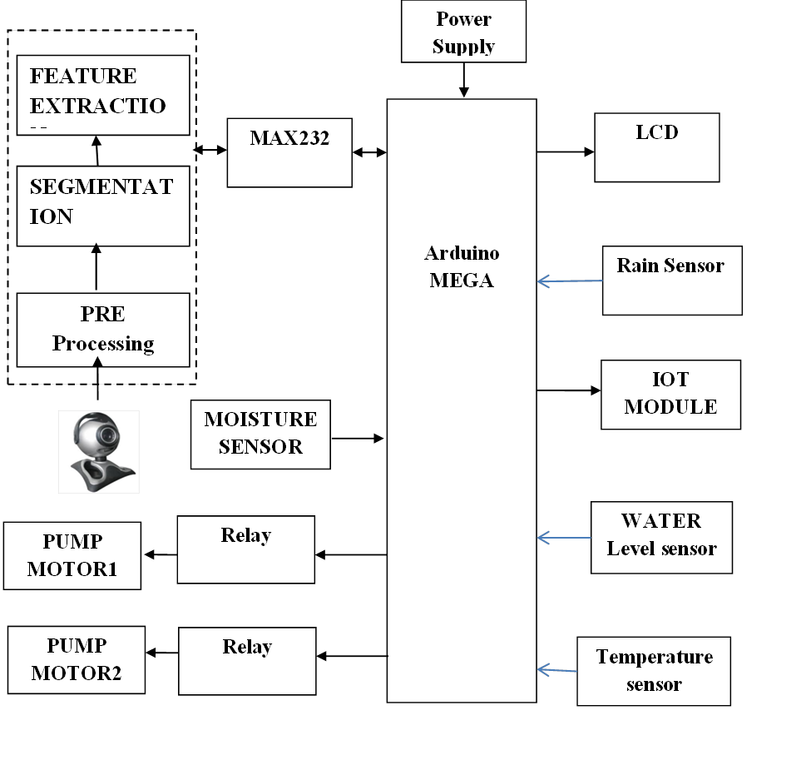
Block diagram

Slide 10

Hardware requirements
Arduino MEGA
Moisture Sensor
Temperature sensor
Water level sensor
Camera
Rain Sensor
LCD
IOT
Pump Motor

Slide 11
ARDUINO MEGA
The Mega 2560 is a microcontroller board based on the ATmega2560. It has 54 digital input/output pins (of which 15 can be used as PWM outputs), 16 analog inputs, 4 UARTs (hardware serial ports), a 16 MHz crystal oscillator, a USB connection, a power jack, an ICSP header, and a reset button. It contains everything needed to support the microcontroller; simply connect it to a computer with a USB cable or power it with a AC-to-DC adapter or battery to get started. The Mega 2560 board is compatible with most shields designed for the Uno and the former boards Duemilanove or Diecimila.

Slide 12
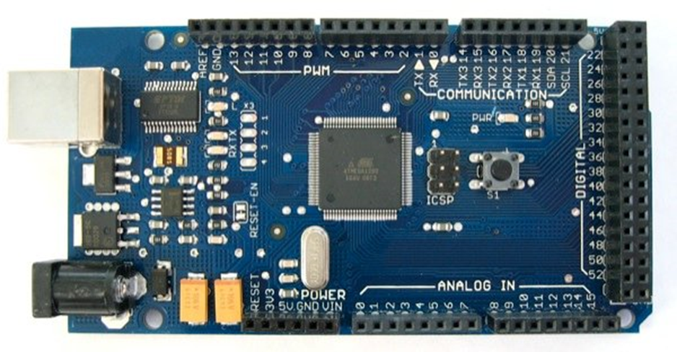
ARDUINO MEGA IMAGE

Slide 13
LIQUID CRYSTAL DISPLAYS:
The LCD standard requires 3 control lines and 8 I/O lines for the data bus.
8 data pins D7:D0
Bi-directional data/command pins. Alphanumeric characters are sent in ASCII format.
RS: Register Select
RS = 0 -> Command Register is selected RS = 1 -> Data Register is selected
R/W: Read or Write
0 -> Write, 1 -> Read
E: Enable (Latch data)
The 8 data lines are connected to PORT 1 of 8051 microcontroller. The three control lines ( RS, RW and EN ) are connected to PORT 3.5,3.6 and 3.7 respectively.

Slide 14
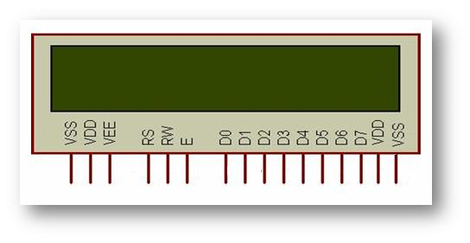
LCD IMAGE

Slide 15
Pin Description:
Pin No | Function | Name
1 | Ground (0V) | Ground
2 | Supply voltage; 5V (4.7V – 5.3V) | Vcc
3 | Contrast adjustment; through a variable resistor | V_{EE}
4 | Selects command register when low; and data register when high | Register Select
5 | Low to write to the register; High to read from the register | Read/write
6 | Sends data to data pins when a high to low pulse is given | Enable
7 | 8-bit data pins | DB0
8 |  | DB1
9 |  | DB2
10 |  | DB3
11 |  | DB4
12 |  | DB5
13 |  | DB6
14 |  | DB7
15 | Backlight V_{CC} (5V) | Led+
16 | Backlight Ground (0V) | Led-

Slide 16
Temperature Sensor - The LM35
The LM35 is an integrated circuit sensor that can be used to measure temperature with an electrical output proportional to the temperature (in ºC)
The LM35 - An Integrated Circuit Temperature Sensor
Why Use LM35s To Measure Temperature?
You can measure temperature more accurately than a using a thermistor.
The sensor circuitry is sealed and not subject to oxidation, etc.
The LM35 generates a higher output voltage than thermocouples and may not require that the output voltage be amplified.

Slide 17
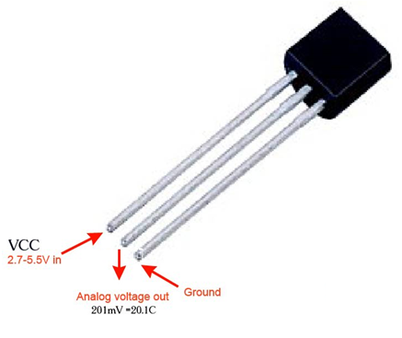
LM35 IMAGE

Slide 18
Soil Moisture Sensor
This sensor can be used to test the moisture of soil, when the soil is having water shortage, the module output is at high level, else the output is at low level. By using this sensor one can automatically water the flower plant, or any other plants requiring automatic watering technique. Module triple output mode, digital output is simple, analog output more accurate, serial output with exact readings.

Slide 19
Features:
Sensitivity adjustable.
Has fixed bolt hole, convenient installation.
Threshold level can be configured.
Module triple output mode, digital output is simple, analog output more accurate, serial output with exact readings.
Applications:
Agriculture
Landscape irrigation
Specifications :
Operating Voltage : +5v dc regulated
Soil moisture : Digital value is indicated by out pin

Slide 20
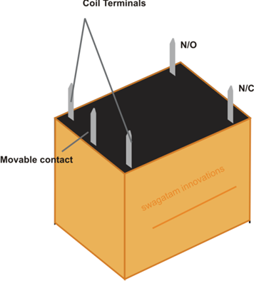
RELAY
A relay is an electro-mechanical switch capable of being remotely actuated/controlled. The schematics involving relays could be very simple, or incredibly complex since they may employ the well-known "relay-logic". The first computer was builtoutof only electro- Now, we can differentiate relays as being:

Slide 21
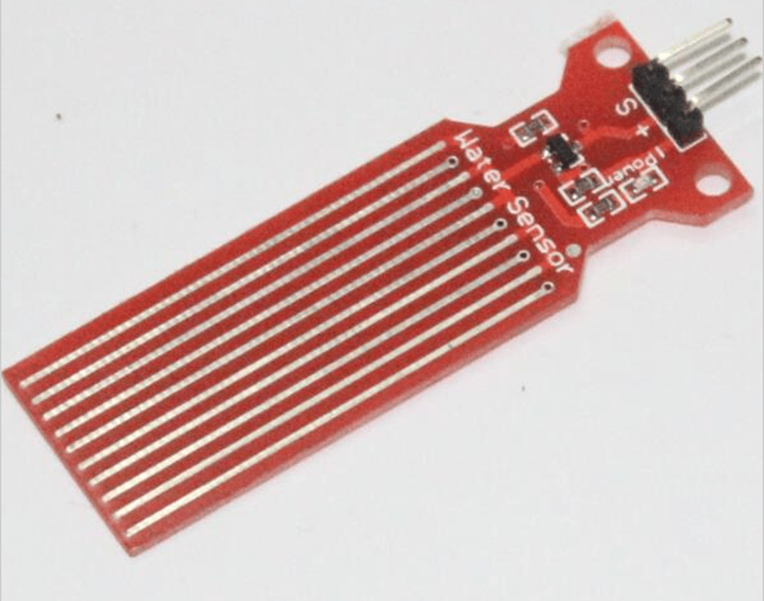
WATER LEVEL SENSOR

Slide 22
Internet of Things
Internet of Things (IoT) is an environment in which objects, animals or people are provided with unique identifiers and the ability to transfer data over a network without requiring human-to-human or human-to-computer interaction. IoT board featured with SIM900 GPRS modem to activate internet connection also equipped with a controller to process all input UART data to GPRS based online data. Data may be updated to a specific site or a social network by which the user can able to access the data.

Slide 23
Data Management
Data Collection and Analysis
Big Data
Semantic Sensor Networking
Virtual Sensors
Complex Event Processing.

Slide 24
APPLICATION AREAS:
Smart Parking: Monitoring of parking spaces availability in the city.
Structural health: Monitoring of vibrations and material conditions in buildings, bridges and historical monuments.
Noise Urban Maps: Sound monitoring in bar areas and centric zones in real
time.
Traffic Congestion: Monitoring of vehicles and pedestrian levels to optimize
driving and walking routes.
Smart Lightning: Intelligent and weather adaptive lighting in street lights.
Waste Management: Detection of rubbish levels in containers to optimize
the trash collection routes.
Intelligent Transportation Systems: Smart Roads and Intelligent Highways
with warning messages and diversions according to climate conditions and unexpected events like accidents or traffic jams.

Slide 25
Features
802.11 b/g/n
Integrated low power 32-bit MCU
Integrated 10-bit ADC
Integrated TCP/IP protocol stack
Integrated TR switch, balun, LNA, power amplifier and matching network
Integrated PLL, regulators, and power management units
Supports antenna diversity
Wi-Fi 2.4 GHz, support WPA/WPA2
Support STA/AP/STA+AP operation modes
Support Smart Link Function for both Android and iOS devices
Support Smart Link Function for both Android and iOS devices
SDIO 2.0, (H) SPI, UART, I2C, I2S, IRDA, PWM, GPIO
STBC, 1x1 MIMO, 2x1 MIMO
A-MPDU & A-MSDU aggregation and 0.4s guard interval
Deep sleep power < 5uA
Wake up and transmit packets in < 2ms
Standby power consumption of < 1.0mW (DTIM3)
+20dBm output power in 802.11b mode
Operating temperature range -40C ~ 125C

Slide 26
SOFTWARE REQUIREMENTS:
Arduino IDE
Embedded C

Slide 27
Arduino IDE:
The Arduino/Genuino Uno can be programmed with the (Arduino Software (IDE)). Select "Arduino/Genuino Uno from the Tools > Board menu (according to the microcontroller on your board). For details, see the reference and tutorials.
The ATmega328 on the Arduino/Genuino Uno comes preprogrammed with a bootloader that allows you to upload new code to it without the use of an external hardware programmer. It communicates using the original STK500 protocol (reference, C header files).
You can also bypass the bootloader and program the microcontroller through the ICSP (In-Circuit Serial Programming) header using Arduino ISP or similar; see these instructions for details.
The ATmega16U2 (or 8U2 in the rev1 and rev2 boards) firmware source code is available in the Arduino repository. The ATmega16U2/8U2 is loaded with a DFU bootloader, which can be activated by:
On Rev1 boards: connecting the solder jumper on the back of the board (near the map of Italy) and then rese ing the 8U2.
On Rev2 or later boards: there is a resistor that pulling the 8U2/16U2 HWB line to ground, making it easier to put into DFU mode.
You can then use Atmel's FLIP software (Windows) or the DFU programmer (Mac OS X and Linux) to load a new firmware. Or you can use the ISP header with an external programmer (overwriting the DFU bootloader). See this user-contributed tutorial for more information.

Slide 28
Warnings
The Arduino/Genuino Uno has a resettable polyfuse that protects your computer's USB ports from shorts and overcurrent. Although most computers provide their own internal protection, the fuse provides an extra layer of protection. If more than 500 mA is applied to the USB port, the fuse will automatically break the connection until the short or overload is removed.
Differences with other boards
The Uno differs from all preceding boards in that it does not use the FTDI USB-to-serial driver chip. Instead, it features the Atmega16U2 (Atmega8U2 up to version R2) programmed as a USB-to-serial converter.

Slide 29
Embedded C:
Embedded C is a set of language extensions for the C Programming language by the C Standards committee to address commonality issues that exist between C extensions for different embedded systems. Historically, embedded C programming requires nonstandard extensions to the C language in order to support exotic features such as fixed-point arithmetic, multiple distinct memory banks, and basic I/O operations.
In 2008, the C Standards Committee extended the C language to address these issues by providing a common standard for all implementations to adhere to. It includes a number of features not available in normal C, such as, fixed-point arithmetic, named address spaces, and basic I/O hardware addressing.
Embedded C uses most of the syntax and semantics of standard C, e.g., main() function, variable definition, datatype declaration, conditional statements (if, switch case), loops (while, for), functions, arrays and strings, structures and union, bit operations, macros, etc.

Slide 30
Advantages
It is small and simpler to learn, understand, program and debug.
Compared to assembly language, C code written is more reliable and scalable, more portable between different platforms.
C compilers are available for almost all embedded devices in use today, and there is a large pool of experienced C programmers.
Unlike assembly, C has advantage of processor-independence and is not specific to any particular microprocessor/microcontroller or any system. This makes it convenient for a user to develop programs that can run on most of the systems.
As C combines functionality of assembly language and features of high level languages, C is treated as a ‘middle-level computer language’ or ‘high level assembly language’.
It is fairly efficient.
It supports access to I/O and provides ease of management of large embedded projects.
Java is also used in many embedded systems but Java programs require the Java Virtual Machine (JVM), which consumes a lot of resources. Hence it is not used for smaller embedded devices.
In Embedded applications there is a need to read/write data on a given address, and in C it is easy to access and modify addresses, because of the pointers which are a language feature.

Slide 31
CONCLUSION
Presently the smart agriculture system is only limited to sensing the data and working on it manually. What our system does is it not only senses the environmental factors but also reads and analyse the data and accordingly does what it is supposed to do. Like if the soil is too dry (i.e less humid) then sprinkle some water automatically. Likewise vice versa. It also drains excessive water by using the water sensor. So the farmers don't have to worry about irrigation anymore and what's best is all the datas that are provided by the sensors can be read remotely.

