Slide 1
Time Sensitive Networking in the Arena
Notes:
Code used in the experiments and configuration here: https://github.com/reese-grimsley/tsn_sandbox/

Slide 2
What is TSN?
A collection of standards related to deterministic networking
TSN is not a standard
Time synchronization
Precision Time Protocol or 802.1AS (gPTP)
Traffic Shaping / QoS
Credit based shaper (akin to bandwidth servers and token-buckets)
TDMA
EDF
Stream Reservation and Enforcement
Pub-sub model at the link layer
Switches help reserve and enforce QoS parameters (max latency given bandwidth and traffic class)
Notes:
Timesync: IEEE 1588 and 802.1AS
Traffic shaping: IEEE 802.1Qav, .1Qbu, .1Qbv
Stream Reservation: 802.1Qat, .1Qcc

Slide 3
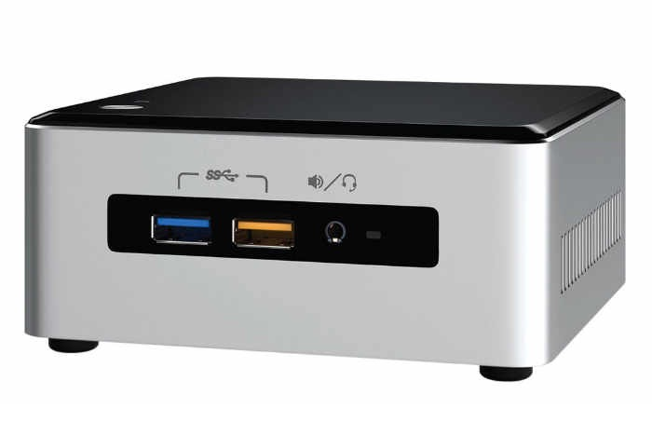
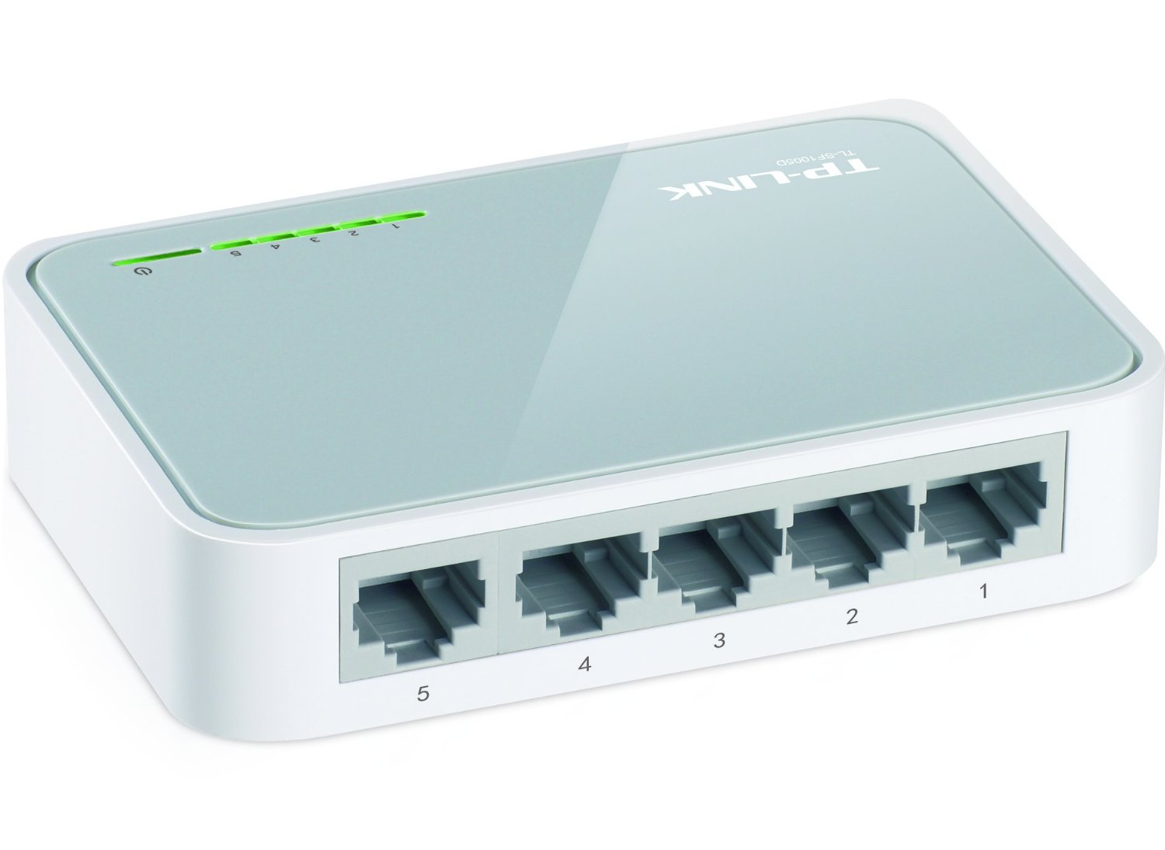
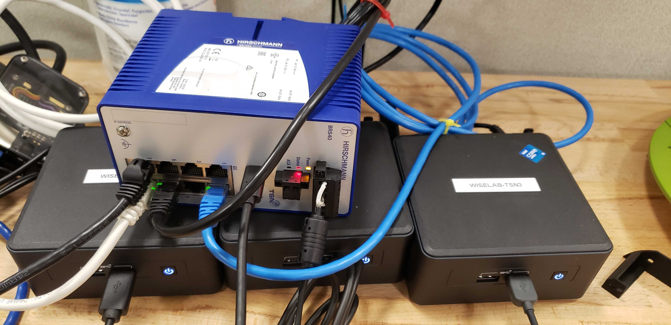
Sample network at CMU
3 Linux endpoints
Stock Ubuntu 20.04 LTS
Intel NUC (11th generation) Mini-PC
Intel i225-LM Ethernet NIC
Advertised with TSN support in hardware and Linux drivers
1 Belden BOBCAT BRS40-8TX
Managed L2 switch
PTP/802.1AS for time sync
TDMA-based traffic shaping/QoS
Distinguish/prioritize based on VLAN priority
Data Source
Data Sink
TSN Switch
Internet / ARENA
Jammer

Slide 4
Progress to Date (dec. ‘21)
Synchronize NIC clocks with gPTP, System clocks with PHC2SYS
Configure VLANs in Linux with default priority above best-efforts traffic
Switch automatically notified of VLAN and the assigned IP’s for each device on VLAN (MVRP & LLDP)
Assert VLAN traffic is prioritized above best-efforts-priority jammer
Else, high latency and packet drop rate
Assert VLAN traffic is time-slotted based on priority, TDMA settings
TDMA is configured with ‘gate control lists’ to assign time slots to priorities, and the settings may be different on different (physical) ports
Switch will not use this unless synchronized with PTP
Bind MQTT broker and client to VLAN interface with priority above jammer

Slide 5
Learnings
Before moving on to configuration and interfaces, a few observations about limitations of TSN and our equipment:
TSN standards operate at the link layer
Interfaces to app-layer are immature, nonexistent, or require specific Linux distro
802.1Qcc defines models for centralized/decentralized network configuration, but no open-source implementations could be found
Stream reservation (802.1Qat) is not supported in hardware or software of Linux nor the switch
A stream is represented as a special MAC address that the talker sends (broadcasts) to
Once the network is configured and an Eth frame leaves the NIC, the only parameter of interest (to the switch for QoS) is VLAN priority
Notes:
On stream reservation, this may be added at some piont in the future. I should think the hardware is capable, but they are lacking the right interface(s). It has to be initiated by the endpoints, and the switches play an active role. To my knowledge, there is no defined frame-format for stream reservation (MSRP, specifically; MMRP and MVRP do have defined formats (and it works in linux and switch))
The last point is to drive home that we actually don’t have THAT much control once it leaves the NIC. Only the priority matters, nothing more. If Qat were implemented, there would be more, but then you’re sending to a specific MAC… unsure how to manage this at the application level if you’re using a single TCP socket.

Slide 6
Linux VLAN Configuration
Setup a VLAN with ID 5 and default priority above best-efforts:
sudo ip link add link enp87s0 name enp87s0.5 type vlan id 5 mvrp on egress-qos-map 0:3 1:0 2:1 3:2 4:4 5:5 6:6 7:7
egress-qos-map maps a traffic class in Linux (priority of the socket; default 0) to VLAN priority
mvrp will send VLAN notification messages to inform switches of this VLAN and IP (see next)
Assign an IP address to virtual interface:
sudo ip addr add 10.0.5.101/24 dev enp87s0.5
Turn on the virtual interface:
sudo ip link set enp87s0.5 up
To use, bind a socket to virtual interface’s IP address
Or connect to another device’s IP on the VLAN
See also:
https://tsn.readthedocs.io
https://github.com/reese-grimsley/tsn_sandbox/blob/main/VLAN_setup.md
Notes:
https://tsn.readthedocs.io/qdiscs.html for setting up queueing disciplines for traffic control (tc utility).
Will set a discipline such that a particular Linux socket priority maps to a traffic class, which maps to 1+ queues. You set a queueing discipline per queue.
CBS assigns a high priority traffic class to a queue, then a set of traffic shaping parameters onto that queue. This makes use of hardware queues.
- TDMA style in linux is software-only by my understanding. Unclear is NIC drivers support this yet. Example appears to just use 1 queue.
- ETF for EDF-style sending. Can make use of a timed-launch mechanism in the NIC(?), assuming i210 (i225 probably has this feature too).

Slide 7
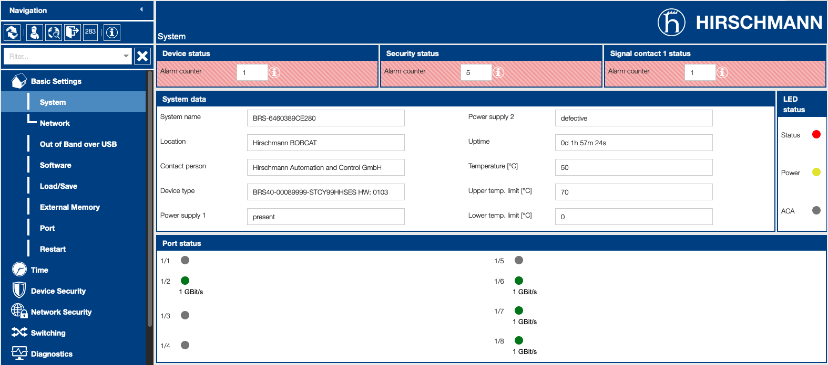
TSN Switch Configuration (1)
We’ll use GUI (initial page after password-change shown below)
CLI is slightly more configurable, but only for a couple of options

Slide 8
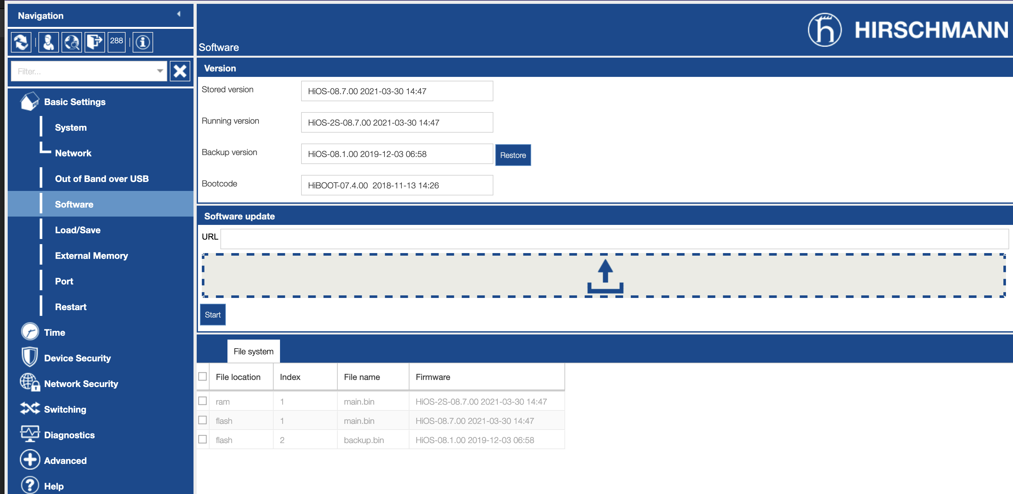
TSN Switch Configuration (2)
Software update interface (drag and drop OS binary)
Must be at least version 8.7 to use TSN functions

Slide 9
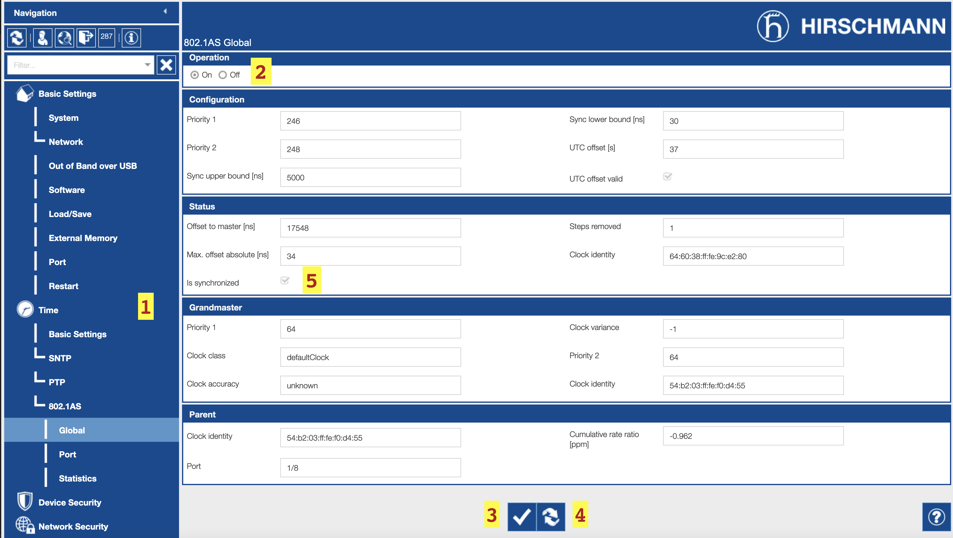
TSN Switch Configuration (3)
Time sync
Menu
Enable/disable
Save config
Load config and stats
Synchronization indicator
Must be checked to use TSN mechanisms!

Slide 10
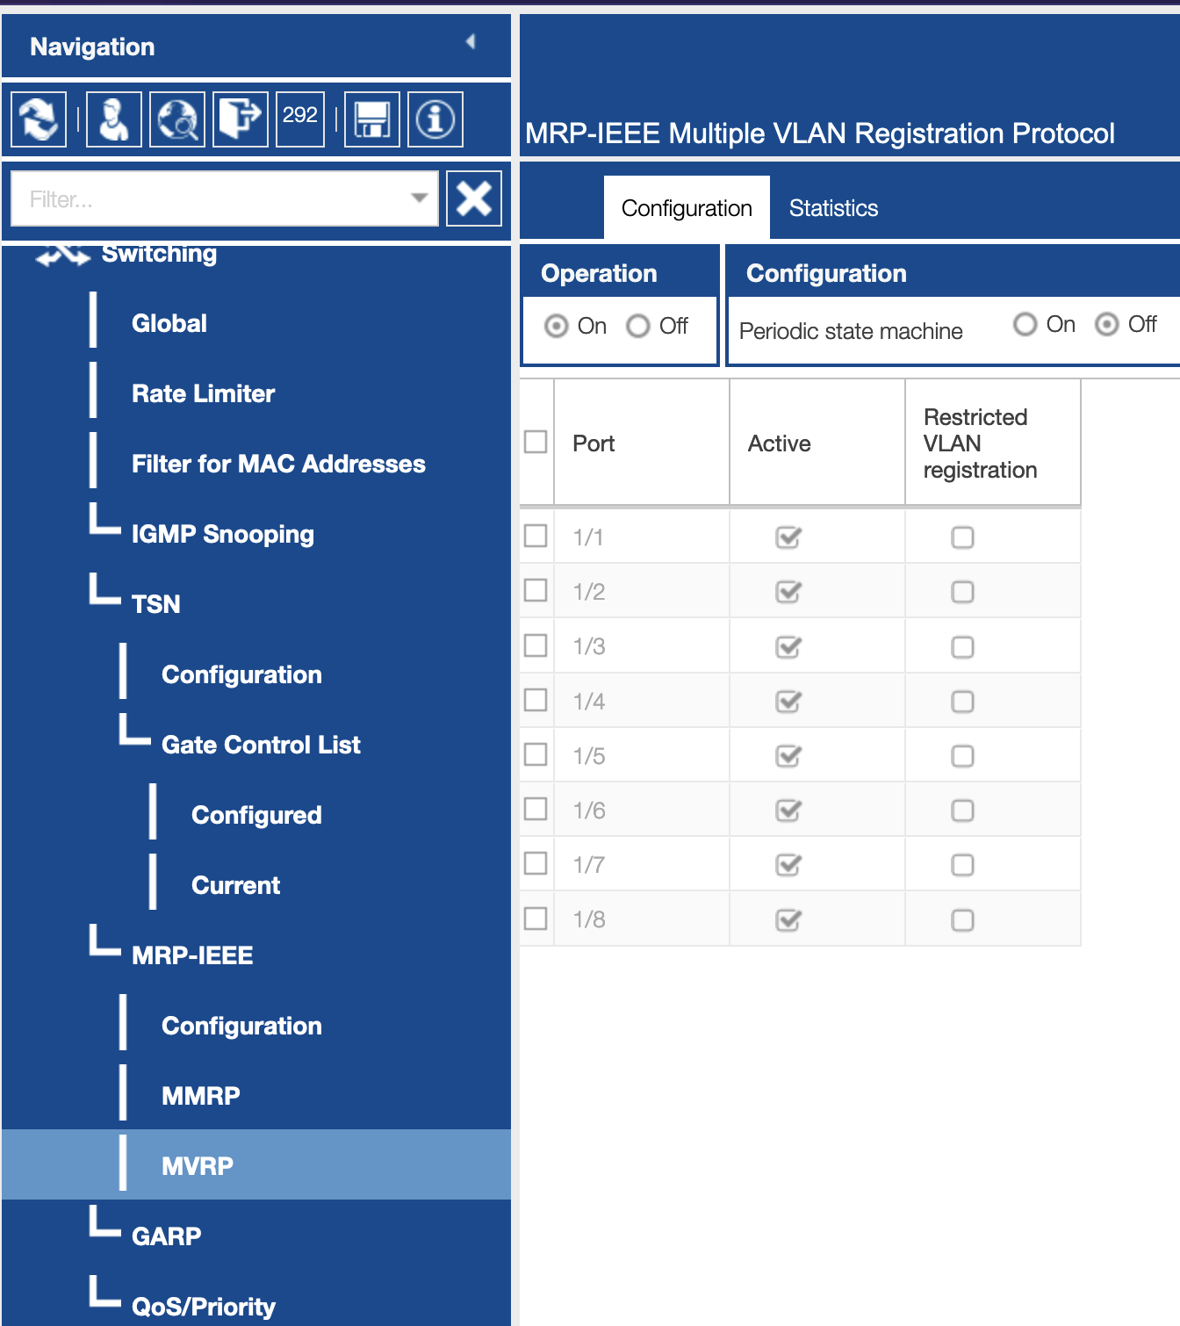
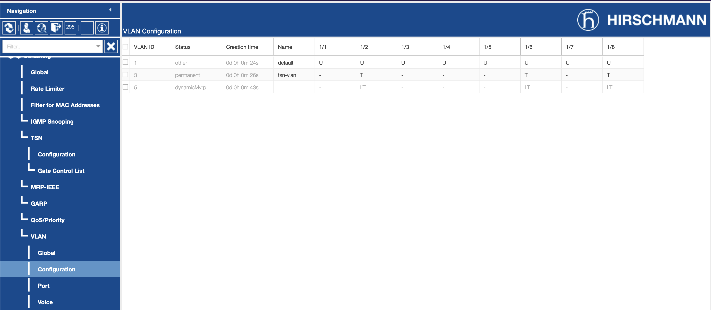
TSN Switch Configuration (4)
2 VLANs created on 3 endpoints (left).
‘T’ means frames are tagged with VLAN header
VLAN 3 manually configured in switch, VLAN 5 learned (LT) using MVRP
VLAN 1 is automatically generated for management
MVRP must be turned on (right)

Slide 11
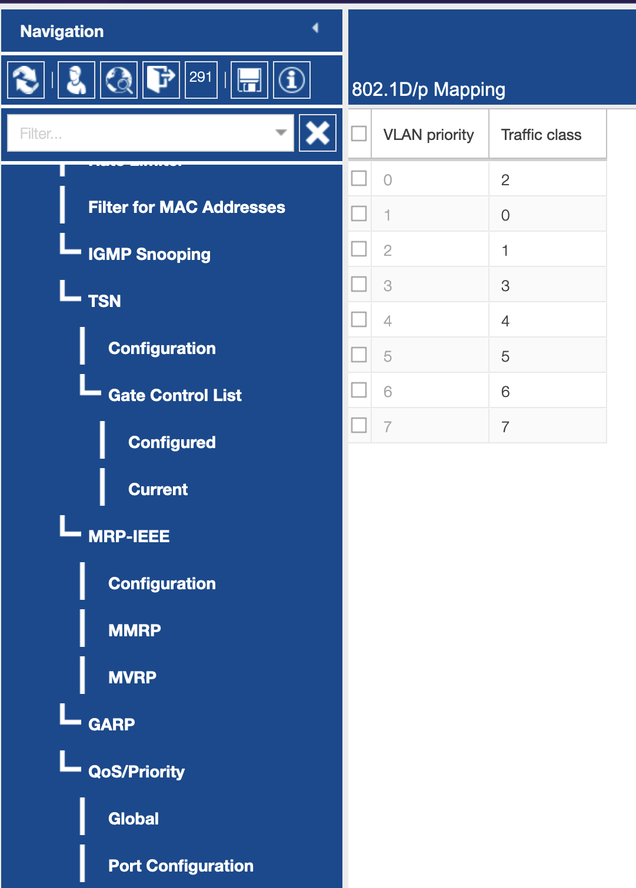
TSN Switch Configuration (5)
(right) mapping of VLAN priority to traffic class
Traffic class is the basis for priority within the switch
Notes:
Traffic class is effectively local to a device. The frame priority is what stays on the frame itself. Frame priority persists after the switch forwards. Traffic class does not.

Slide 12
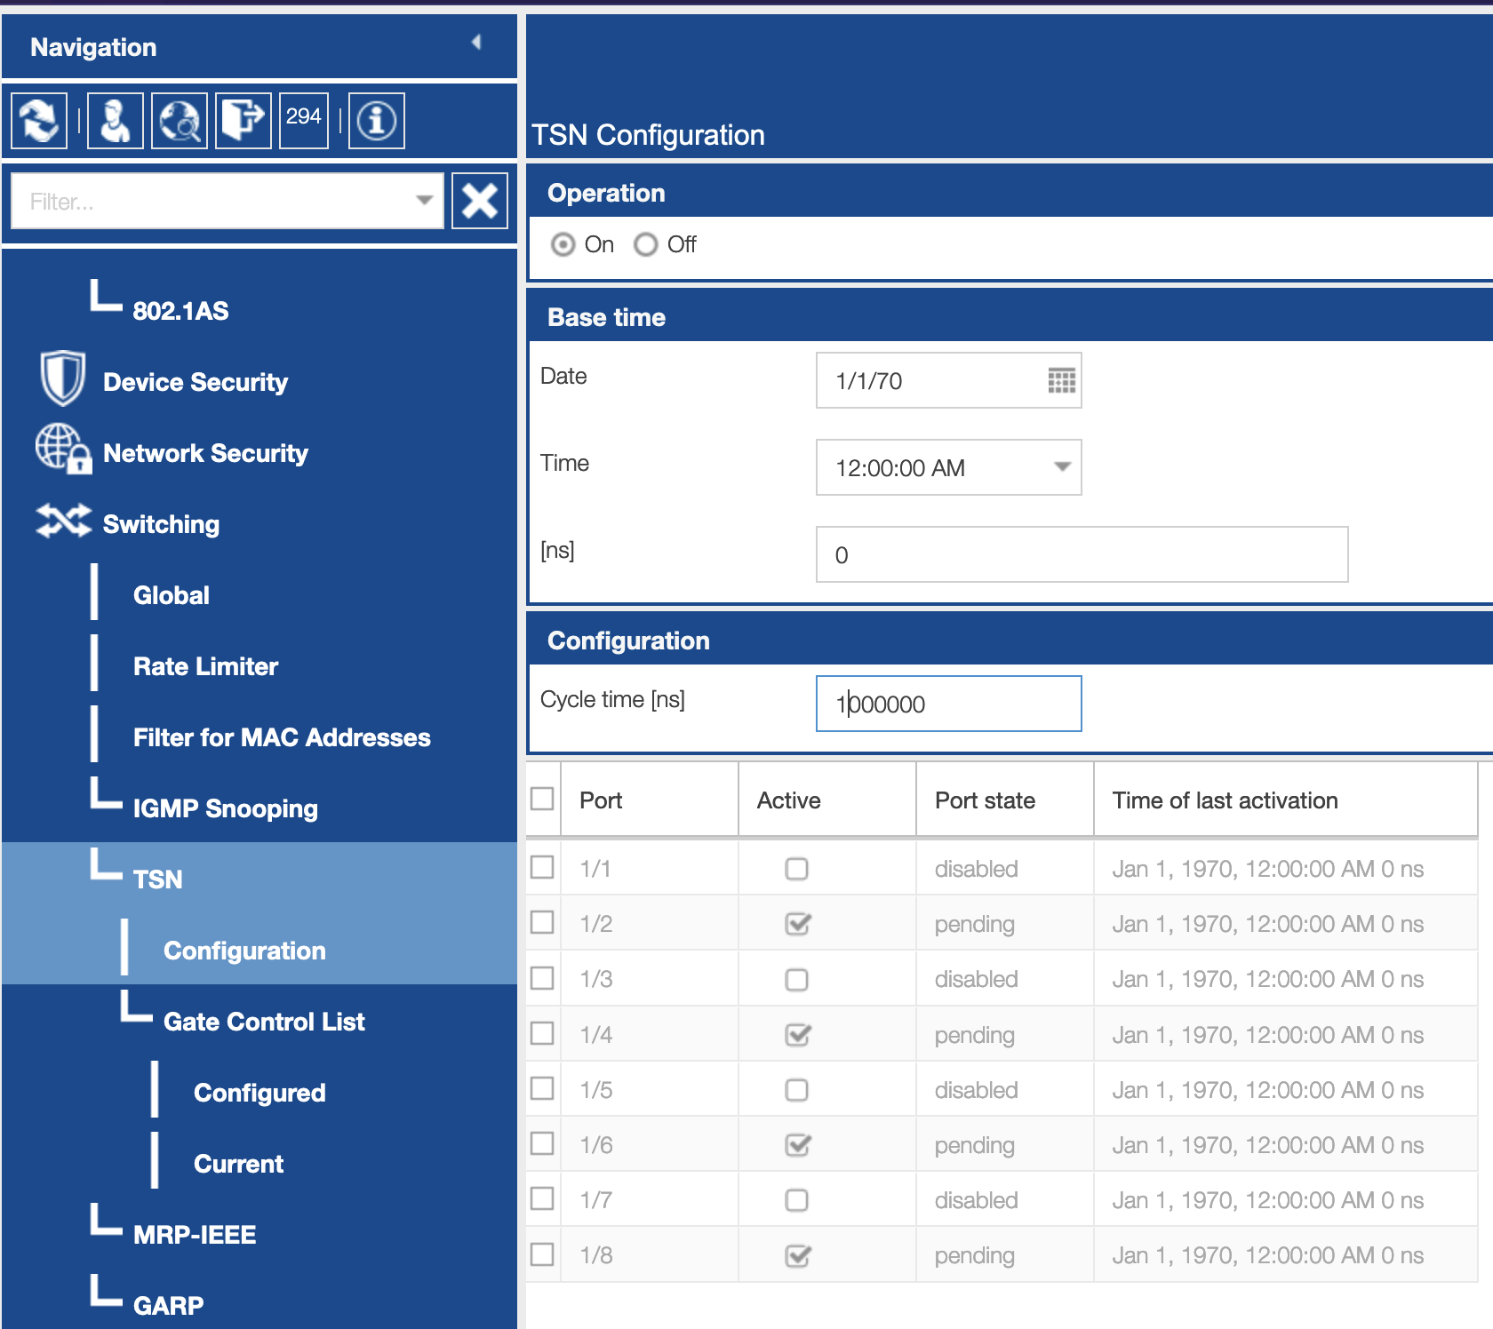
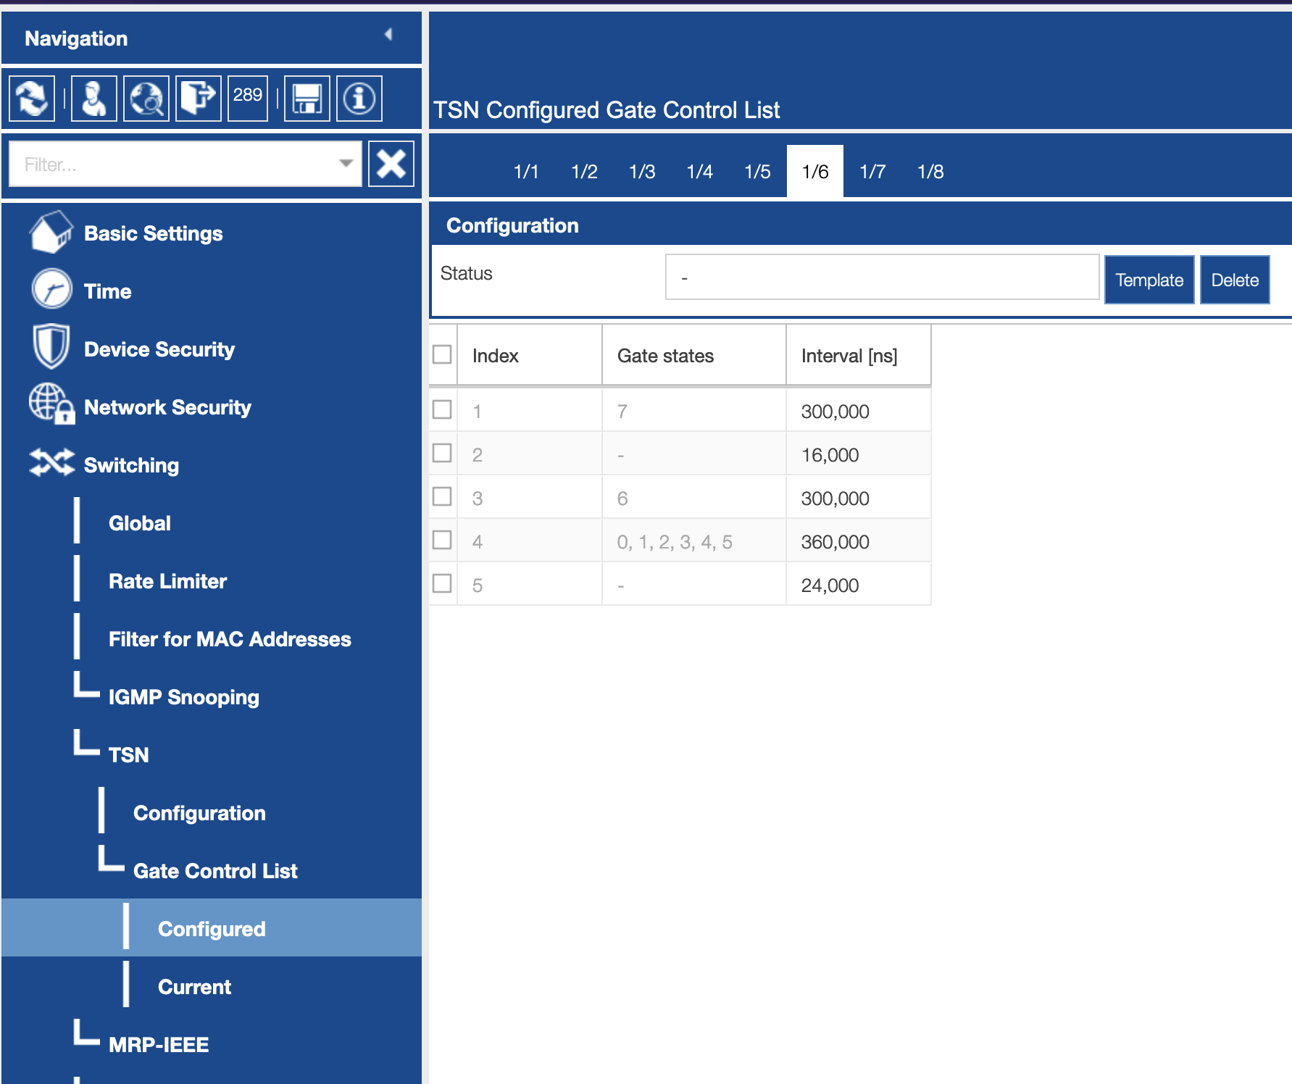
TSN Switch Configuration (5)
TSN Configuration page (left)
TSN TDMA gate control list (right) – gate states are traffic classes
Only templates in the GUI; can create new template with CLI

Slide 13
Questions for A TSN Expert
Do you actively use stream-reservation and enforcement?
If yes, what is the SW or HW interface? Do you require hardware support to propagate this information among nodes? Did you use a reference design or build from scratch?
What is the software stack on the endpoints? Stock Linux?
How do you map QoS requirements from your application to the network?
QoS mechanisms are L2, but we need TCP
What traffic shaping method do you use? CBS, TDMA, EDF, None?
Do you perform a global scheduling analysis on all traffic flows?
What is the composition of traffic like in your application? Latency / throughput requirements, number/density of flows per endpoint, relative priority (e.g. traffic classes)
Configure all switches identically? Individually? Through a central authority ?
Extra focus on this question they us TDMA-based shaping! How does this impact scheduling analysis, if done?
Do you ever change the configuration to optimize or account for changes in flows?

Slide 14
ARENA & TSN Discussion Points
How do users specify their QoS requirements?
Who needs this knowledge? ARTS, Wasm/ARENA runtime, user’s module?
How are these requirements satisfied with the runtime, network switches?
What parameters within the switching network must change at runtime?
e.g., TDMA gate control lists, learned VLANs, ARENA-VLAN priority/bandwidth allocation
What changes with more switches, endpoints? Scalability discussion.
Global scheduling analysis? Per traffic-class scheduling analysis?
Single VLAN for all of ARENA with X% of network time/bandwidth?
Multiple VLANs of different priorities, but all to the same broker? Other alternatives?
Main degree of freedom at runtime is the VLAN priority (0-7), not the VLAN ID
Extra latency as the broker receives, propagates data to subscribers
MQTT stack takes time – will it be substantial relative to network latency? Can we prioritize certain messages in within the broker?
Notes:
1b: Requirements are satisfied by allocating network resoruces in the switches to ARENA, and letting the runtimes prioritize channels/topics per some scheduling/prioritization policy
2: Hopefully none. They would all need to change in the same way, assumedly. Network will be a wreck during reconfig
3: Hopefully nothing, so long as all switches are configured identically. May not make it from one endpoint to another within the same TDMA slot + cycle (wait for next cycle..)
What happens as this scales to a larger deployment with multiple switches

