Slide 1
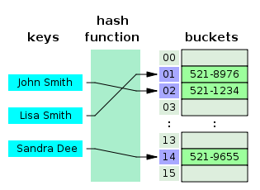
COSC 222 Data Structures
Yves Lucet
CC BY-SA 3.0 https://en.wikipedia.org/wiki/Skip_list#/media/File:Skip_list_add_element-en.gif
"Hash table 3 1 1 0 1 0 0 SP" by Jorge Stolfi - Own work. Licensed under CC BY-SA 3.0 via Commons - https://commons.wikimedia.org/wiki/File:Hash_table_3_1_1_0_1_0_0_SP.svg#/media/File:Hash_table_3_1_1_0_1_0_0_SP.svg

Slide 3
Notes:
1 Readings is to be done after Class 1 and before Class 2

Slide 4
Reminder
Showing your code to another student is considered cheating
Reading the code of a solution online or from another student is cheating
You can discuss general strategies and problem-solving but not implementation details.
Until now assignments have been very prescribed with very little variations, this will change and will make it very obvious who is crossing the line
You cannot claim ignorance; at best if you listed your sources, you can claim good faith (you may still book a meeting with the associate dean).
Plagiarism has way more consequences in code than in English: code contamination can bankrupt a company!

Slide 5
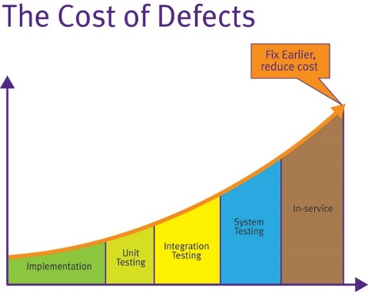
Lab: how do I know it works? Did I get the right answer?
Unit tests are NOT an academic exercise
Did you write unit tests?
Are your tests
Fast i.e. all tests run in 1-5 seconds (10 max)
Isolated i.e. no dependency from file, database, etc.
Repeatable i.e. always return same result
Self-checking aka automated
Timely i.e. tests are fast to write
https://docs.microsoft.com/en-us/dotnet/core/testing/unit-testing-best-practices
https://fullstackmark.com/post/7/learning-unit-testing-in-aspnet-core

Slide 6
Readings
Date | Files
Sep 13 | 1 readings-Java-UnitTesting.txt 1 readings-Java-UnitTesting.txt
Sep 15 | 2 readings-complexity.txt
Sep 20 | 3 readings-Array-List.txt
Sep 27 | 5_6 readings-recursion-stack-queue.txt
Oct 4 | 7 readings-iterator.txt
Oct 11 | 8_9 readings Trees-PQ.txt
Oct 13 | 10 reading hash skiplist.txt
Oct 18 | 11 readings Dijkstra.txt
Oct 20 | 12 reading union-find.txt
Oct 27 | 14 readings search trees.txt
Nov 17 | 15 reading (2,4)-B trees.txt
The readings should be done before the indicated date with questions posted on Ms Teams.
Notes:
12:20pm take 10min to debrief

Slide 7
Reading for Thursday
For Red-Black trees: do not memorize rotations, just be convinced the tree performs as expected
You should be able to
Recognize Binary Search Tree, AVL, Red-Black, 2-3-4 (at https://people.ok.ubc.ca/ylucet/DS/BTree.html use Max. Degree =4) Trees
Given an AVL/2-3-4/Binary Search tree, draw the resulting tree after insert/delete
Know the complexity of each operation

Slide 8
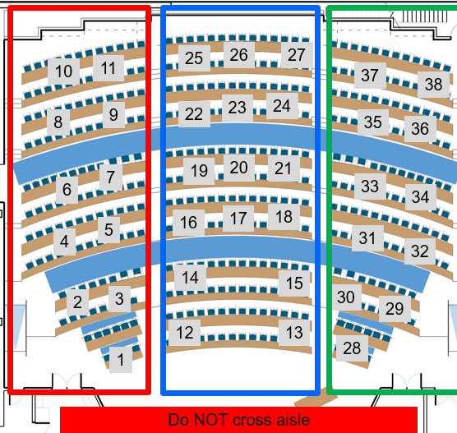
Team build & critic
Do not forget to assign a TIMEKEEPER
[10 marks] Answer the questions on your poster
write clearly
Take picture and post it on Canvas as group assignment tMAT2 – Poster Your pseudo-code must be written on the poster. Submitting poster m minutes late will result in penalty –m²%, e.g., 3min = -9%
[4 marks] Rotate posters on each aisle (left, centre, right); do NOT cross aisle. Critic 4 posters. Make a list of any error, bug, omission; is complexity correct?
The full team has to agree on the justification
Upload your poster to tMAT2 Critics
Be time efficient!
Include the list of team members present today on your poster
DO NOT USE INTERNET except to submit tMAT
11:50am
12:15pm
Notes:
15’ post-mortem
10’ quiz
30’ write poster
16’ read 4 posters
Total = 71’ [only read 3 posters if 3rd poster is after 1:40]

Slide 9
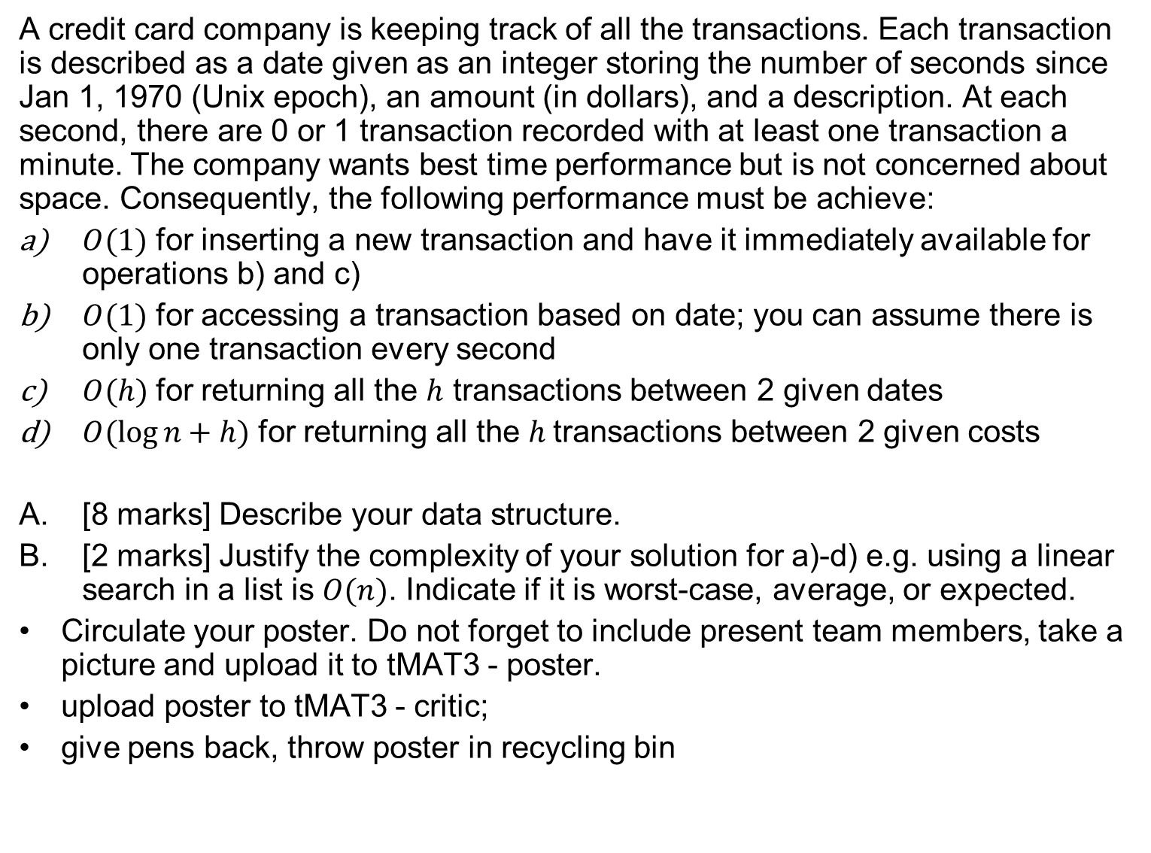
A credit card company is keeping track of all the transactions. Each transaction is described as a date given as an integer storing the number of seconds since Jan 1, 1970 (Unix epoch), an amount (in dollars), and a description. At each second, there are 0 or 1 transaction recorded with at least one transaction a minute. The company wants best time performance but is not concerned about space. Consequently, the following performance must be achieve:
$O(1)$ for inserting a new transaction and have it immediately available for operations b) and c)
$O(1)$ for accessing a transaction based on date; you can assume there is only one transaction every second
$O(h)$ for returning all the $h$ transactions between 2 given dates
$O(\log{n+h)}$ for returning all the $h$transactions between 2 given costs
[8 marks] Describe your data structure.
[2 marks] Justify the complexity of your solution for a)-d) e.g. using a linear search in a list is $O(n)$. Indicate if it is worst-case, average, or expected.
Circulate your poster. Do not forget to include present team members, take a picture and upload it to tMAT3 - poster.
upload poster to tMAT3 - critic;
give pens back, throw poster in recycling bin
11:05-11:50 write poster
11:50 poster MUST be uploaded
11:51-12:15 critic 4 posters
12:16-12:20 upload pict; wrap up

