Slide 1
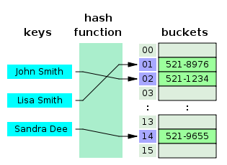
COSC 222 Data Structures
Yves Lucet
CC BY-SA 3.0 https://en.wikipedia.org/wiki/Skip_list#/media/File:Skip_list_add_element-en.gif
"Hash table 3 1 1 0 1 0 0 SP" by Jorge Stolfi - Own work. Licensed under CC BY-SA 3.0 via Commons - https://commons.wikimedia.org/wiki/File:Hash_table_3_1_1_0_1_0_0_SP.svg#/media/File:Hash_table_3_1_1_0_1_0_0_SP.svg
Notes:
11am

Slide 2

Menu
Syllabus
Course plan
Teaching Strategy
Java review
Generics
Testing
Assignments (aka Labs)
Readings
Image courtesy of Gregory Szarkiewicz / FreeDigitalPhotos.net

Slide 3

Interests
PhD Optimization (Applied Mathematics)
Research
New algorithms to compute math operators
Math modeling+optimization:
road design,
ranking students for scholarships
machine learning
Computer Science Education
Optimized learning
Team-based learning
Teaching:
222 Data Structure
520 Advanced Algorithms
(Paid) Opportunities
Research Assistant
Honours
MSc
PhD
and
Teaching Assistant

Slide 4
COSC Curriculum
111
121
210
222
320
310
499
COSC 222 pre-req to
COSC 310, 315, 320, 322, 328, 329, 335, 344, 405, 414
Notes:
210 is an anti-req, i.e., can only get credit for one of COSC 210, or COSC 222

Slide 5
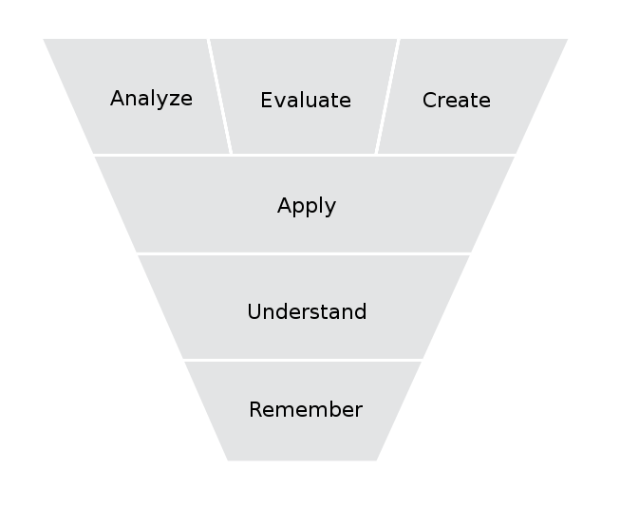
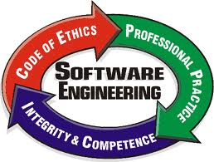
COSC 222 Goals
Efficient use of computer memory
Good programming method:
problem solving
design
testing
programming
In class
At home
Bloom’s Revised Taxonomy
picture from http://csciwww.etsu.edu/gotterbarn/secepp/

Slide 6
Syllabus Available on Canvas
Course description, lectures, lab, office hours
Evaluation
Rules: sickness, cheating
Academic misconduct will NOT be tolerated

Slide 7
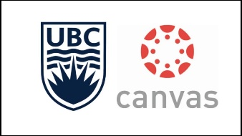






Mandatory
Canvas https://canvas.ubc.ca
inteDashboard, $5 https://www.intedashboard.com/
Ms Teams [link in canvas]
GitHub,
Eclipse…
Internet device in class (phone, tablet, laptop)
Personal computer (laptop) recommended (could use the lab computers)
This Photo by Unknown Author is licensed under CC BY-SA

Slide 8
Team Creation
Test on Canvas:
Avoid-list: students you do not want to work with
Grade in COSC 121
Programming experience not in COSC 111/121/122/123
Joe Doe: Jane Doe, …; 82%; JS: beginner

Slide 9
Do not forget
How about doing it now?
For next class
Fill in setup quiz in Canvas
Click the link to register for Ms Teams
Read the material
Wait for announcement (I need to create teams and upload your data including your email)
Register on inteDashboard before Thursday class
We will have a graded exercise
MANDATORY BY END OF TODAY

Slide 10
Academic Misconduct
Educate:
brainstorming ideas is encouraged
Showing code is cheating… for both
Discourage:
Systematic code similarity software run
Systematically penalized: zero on lab+sent to dean’s office+[letter | zero on course | thrown out of university]
Invigilated evaluations
Reduce cheating benefit:
Drop lowest lab mark
Need to pass the final; cheating reduces your learning, which decreases your chances to pass the final
Report
TA trained to detect cheating

Slide 11
Labs
No lab this week
Labs posted on Canvas by end of week
Expectations/Marking
Code does not compile = mark of ZERO
No unit test = no more than 50%
Coverage testing less than 80% = no more than 70% [Grace period of 1 lab]
Follow specific format to submit your assignment; see your TA. [Marks deducted starting from Lab 2]
Show your assignment in lab: run unit tests/code in front of TA [Talk to your TA]

Slide 12
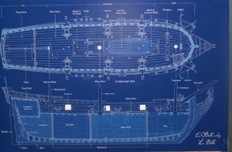
Teaching Strategy: Team-Based Learning
Course split in modules
Each module has learning objectives
Each module is delivered
reading assignment
mini-lecture to clarify readings
iRAT + tRAT
in class team exercises
Lab
out of class iMAT
tMAT
Notes:
picture: public domain https://en.wikipedia.org/wiki/Blueprint#/media/File:LaBelle_Blueprint.jpg

Slide 13
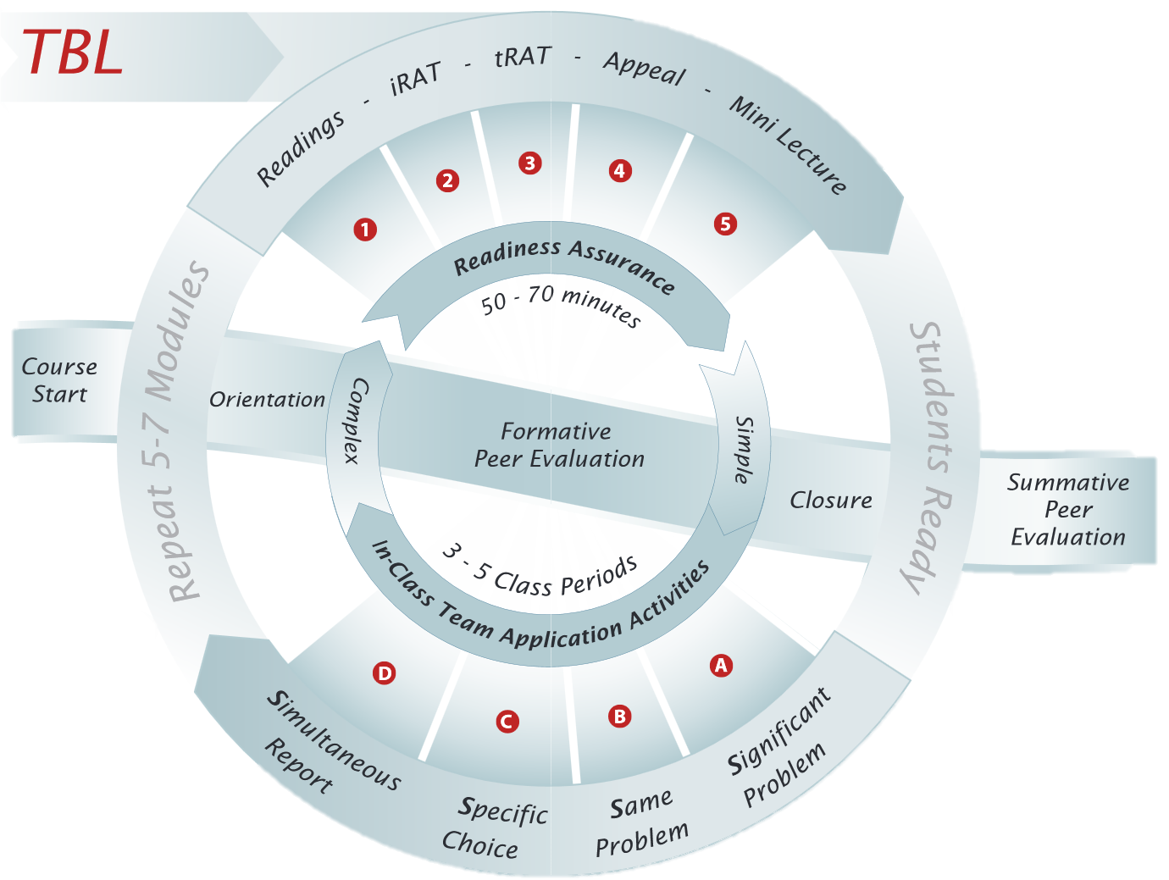

Slide 14
Learning objectives
Data structures:
How they work
Which one to select
Problem solving
Team dynamics
From programmer to software developer
Unit testing
Versioning system

Slide 16
TBL rationale
Studies show that TBL
improve student grades by 14%
Positive student feedback 2 years later
My teaching methodology objective:
maximize student learning within limited time
around 8-10 hrs/wk for COSC 222
3 hrs in class + 1-2 hrs reading/video
2 hrs in labs + 2-3 hrs prelab/postlab
if you need more
you are catching up on concepts from COSC 121
you could be better organized
Notes:
Time is averaged i.e. some weeks spend less others more

Slide 17
Evaluation
Need to pass the final to pass the course
Notes:
Midterm can only boost your grade, i.e., it is a preparation for the final.

Slide 18

What is not on the syllabus
LinkedIn UBCO COSC group
Opportunities: Research experience
NSERC USRA [GPA]
UBCO URA [Project]
Work study program [Professor]
Summer Research Assistant [Professor]
Honours
Graduate studies
https://cmps-people.ok.ubc.ca/ylucet/TopicFair.php

Slide 19
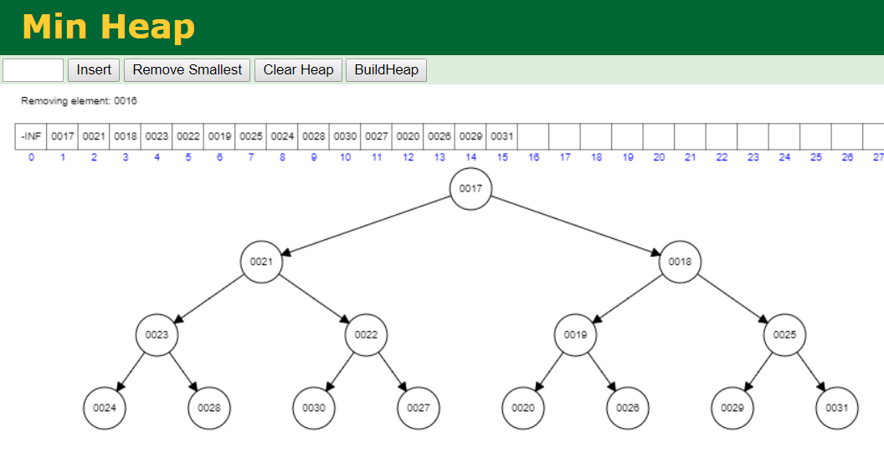
How to know you are doing it right? https://cmps-people.ok.ubc.ca/ylucet/DS/Algorithms.html

Slide 20
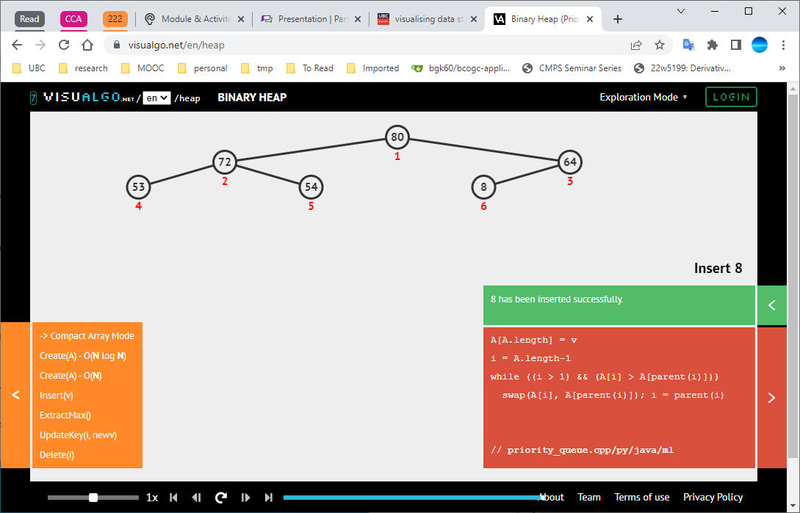
How to know you are doing it right? https://visualgo.net/en

Slide 21
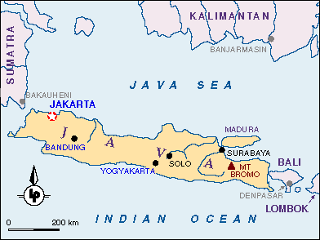
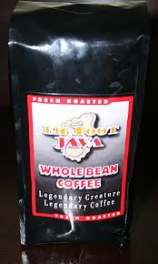

Java
1996: JDK 1.0
1997: JDK 1.1
1998: J2SE 1.2
2000: J2SE 1.3
2002: J2SE 1.4
2004: J2SE 5.0: Generics, autoboxing, foreach, scanner
2006: Java SE 6
2011: Java SE 7: Strings in switch
2014: Java SE 8: closure, embedded JS, Date/Time API
2017: Java SE 9: jShell, removed applets
2018: Java SE 10, SE 11
2019: Java SE 12, 13
2020: Java SE 14, 15
2021: Java SE 16, 17
2022: Java SE 18
http://en.wikipedia.org/wiki/Java_version_history

Slide 22


Questions?
This Photo by Unknown Author is licensed under CC BY
Notes:
11:15am

Slide 23

Java Review: Are you ready?
Yes
No
https://ars.particify.de/p/84771516/feedback
Link in Canvas announcements
Notes:
https://ars.particify.de/edit/84771516

Slide 24
The static keyword in Java means
The variable cannot be modified
The variable can only be modified at runtime
The variable is associated with the class
The variable is associated with the object
Notes:
C

Slide 25
public static void main(String[] args) means
this method can be run by anyone
this method returns nothing
this method is associated with the class
all of the above
Notes:
D

Slide 26
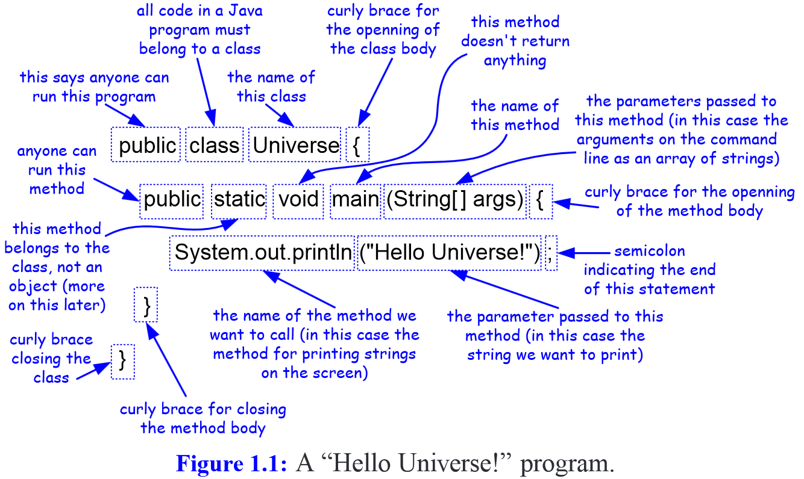
Notes:
Missing figure from textbook
http://higheredbcs.wiley.com/legacy/college/goodrich/0470383267/miss_fig/fig1.1.pdf

Slide 27
The final keyword in Java means
The variable must be assigned an initial value and can never be assigned a new value
The variable is a constant
The variable cannot be inherited
The variable can only be changed by an internal method
Notes:
A

Slide 28
The final keyword in Java means
A final class cannot be subclassed.
A final method cannot be overridden by subclasses.
A final variable can only be assigned once.
Unlike the value of a constant, the value of a final variable is not necessarily known at compile time.

Slide 29
public class Gnome {
public int age; Gnome(int ag){ age = ag;}
Gnome(){ age = 204;}
}
The code defines no constructor
The code defines one constructor
The code defines two constructors
The code defines one method and one default constructor
Notes:
C

Slide 30
What is written on the console by the following code?
public class Gnome {
public int age;
Gnome(){ age = 204;}
}
public class Example {
static void modify(Gnome g){ g.age=123; }
public static void main(String[] args) {
Gnome g = new Gnome();
System.out.println(g.age);
Example.modify(g);
System.out.println(g.age);
}
}
123 204
204 204
123 123
204 123
Notes:
D compiled and run

Slide 31
What is written on the console by the following code?
interface Formula {
double calculate(int a);
default double sqrt(int a) {
return Math.sqrt(a);
}
}
Formula formula = new Formula() {
@Override
public double calculate(int a) {
return sqrt(a * 100);
}
};
System.out.println(formula.calculate(100));
System.out.println(formula.sqrt(16));
Formula.java
100.0 4.0
Compile Error
Runtime Error
No output
CodeTestMain.java
Notes:
A: Default methods for interfaces introduced in JDK 8

Slide 32
Inheritance is the capability of a class to use the properties and methods of another class.
How would you judge this definition?
EXCELLENT (complete answer)
GOOD (partial answer)
MEDIOCRE (totally unrelated)
https://www.easytutorial.in/category/java-programming-inheritance-442
Notes:
B: Inheritance is the capability of a class to use the properties and methods of another class while adding its own functionality.

Slide 33
You need to implement 3 different types of trees. All will have different implementations of the find, insert, and remove methods. How would you design your code?
Create 3 classes.
Create an abstract class and 3 child classes
Create a parent class and 3 child classes
Use cloning to avoid duplicating code
Notes:
C although B is not too bad depending on context

Slide 34
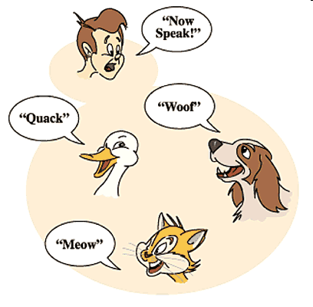
public class AnimalReference {
public static void main(String args[]){
Animal ref;
Cow aCow = new Cow("Bossy");
Dog aDog = new Dog("Rover");
Snake aSnake = new Snake("Ernie");
Animal [ ] a = {aCow, aDog, aSnake};
for (Animal animal : a) {animal.speak();}
}
This code is an example of
Inheritance
Polymorphism
Overriding
Reflection
Notes:
B. Polymorphism

Slide 35
Polymorphism is the capability of an action or method to do different things based on the object that it is acting upon.
How would you judge this definition?
EXCELLENT (complete answer)
GOOD (partial answer)
MEDIOCRE (almost unrelated)
https://beginnersbook.com/2013/03/polymorphism-in-java/
Notes:
A

Slide 36
public abstract class Animal {
private String name;
public Animal(String nm) { name=nm; }
public String getName() { return name; }
public abstract void speak();
}
The code
is good
works but would be better implemented as an interface
generates an exception
is missing { } after speak()
Notes:
A

Slide 37
Abstract classes | Interfaces
Abstract classes are used only when there is a “is-a” type of relationship between the classes. | Interfaces can be implemented by classes that are not related to one another.
You cannot extend more than one abstract class. | You can implement more than one interface
Abstract class can implement some methods too. | Interfaces can not implement methods [JDK 8: Default methods https://www.geeksforgeeks.org/interfaces-in-java/ ]
With abstract classes, you are grabbing away each class’s individuality. | With Interfaces, you are merely extending each class’s functionality.
https://www.geeksforgeeks.org/difference-between-abstract-class-and-interface-in-java/

Slide 38
Java
Review
Other topics
Loops, conditionals, expressions, variables
methods
Classes, interfaces, objects
Packages
Exceptions
Encapsulation
Eclipse
New:
Generics
Streams
Lambda expressions
Notes:
11:50am

Slide 39
Generics

Slide 40
ArrayList Class
To declare a List “object” whose elements will reference String objects:
List<String> myList = new ArrayList<String>();
The initial List is empty and has a default initial capacity of 10 elements
To add strings to the list,
myList.add("Bashful");
myList.add("Awful");
myList.add("Jumpy");
myList.add("Happy");

Slide 41
Generic Collections
The statement
List<String> myList = new ArrayList<String>();
uses a language feature called generic collections or generics
The statement creates a List of String; only references of type String can be stored in the list
String in this statement is called a type parameter
The type parameter sets the data type of all objects stored in a collection

Slide 42
Generic Collections (cont.)
The general declaration for generic collection is The <E> indicates a type parameter
Adding a noncompatible type to a generic collection will generate an error during compile time
However, primitive types will be autoboxed:
ArrayList<Integer> myList = new ArrayList<Integer>();
myList.add(new Integer(3)); // ok
myList.add(3); // also ok! 3 is automatically wrapped
in an Integer object
myList.add(new String("Hello")); // generates a type incompatability error
CollectionClassName<E> variable = new CollectionClassName<E>();

Slide 43
Why Use Generic Collections?
Better type-checking: catch more errors, catch them earlier
Documents intent
Avoids the need to downcast from Object

Slide 44
Generics (cont.)
Diamond operator List<String> myList = new ArrayList<>();
Compile time check: single .class file
Different with C++ templates
Explains why
Not allowed: theData = new E[capacity]
Allowed: theData = (E[]) new Object[capacity];
with warning
Notes:
theData = (E[]) new Object[capacity];
Why can’t I do theData = new E[capacity]; // because E is not known at compile time!

Slide 45
Type erasure
Compiler
Replaces all generic type parameters with bounds or Object
Bytecode only contains ordinary classes, interfaces, and methods
Insert type casts to preserve type safety
Generate bridge methods to preserve polymorphism
No classes are created for parametrized types so generics incur no runtime overhead
https://dev.java/learn/type-erasure/
Notes:
We will not worry about type erasure unnecessarily in this course

Slide 46
Testing
How are you reasonably sure your code does what it is supposed to?
Notes:
Hand survey: Have you done unit testing in Java in 111 or 121?
12pm

Slide 47
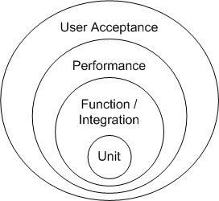
Testing
Unit testing
Coverage Testing
Integration Testing
Acceptance Testing
Mandatory
Free
NA
TA

Slide 48
Testing levels
Unit testing:
test each method independently
Integration testing:
test interfaces between components
System testing
Test completely integrated system
consider scenarios/user stories/use case
Acceptance testing
User acceptance testing
Operational acceptance testing
Contractual and regulatory acceptance testing
Alpha and beta testing

Slide 49
Cost of fixing bugs
Source: Dawson, Maurice & Burrell, Darrell & Rahim, Emad & Brewster, Stephen. (2010). Integrating Software Assurance into the Software Development Life Cycle (SDLC). Journal of Information Systems Technology and Planning. 3. 49-53. https://www.researchgate.net/publication/255965523_Integrating_Software_Assurance_into_the_Software_Development_Life_Cycle_SDLC/download

Slide 50
Cost of fixing bugs
Barry Boehm’s “Equity Keynote Address” March 19, 2007

Slide 51
Solution: test early, test often
1948-1980: debugging
1980s: broader view
1990s: transition to quality assurance
Methodologies
Powerful tools to manage testing process
Test automation tools
Continuous testing
Instead of separating testing from development
Ship software with bugs
Delay release date to fix bugs
DevOps: Development and operations collaborate
Accelerate software delivery
Balance cost, quality, and risk: “Good, fast, cheap: you can only pick two!” https://www.pyragraph.com/2013/05/good-fast-cheap-you-can-only-pick-two/
https://www.ibm.com/topics/software-testing

Slide 52
Unit testing
Write a single method
No more than 1 page screen = 20 lines
Write, run, and record tests
KEEP THE TESTS
Any time code is modified, rerun ALL the test
Regression testing
Rerun all the tests to make sure new code did not trigger previously fixed bugs
Prevent software from regressing to previous state

Slide 53
Common sense
Test often
Run all tests in seconds or split in test groups (<5s, <30s, <1min, > 1min)
Test small pieces of code
Do NOT write 1,000 loc then test
Write 20 lines, test, write next 20, test/rerun all tests, etc.
What would you prefer
10,000 loc with documentation, or
10,000 with 1,000 tests?
Do NOT test for the pleasure of testing
Testing supports coding, it is not a goal in itself
5-8 tests per method is usually enough
Do not aim at 100% code coverage
Start with trivial tests
Sum(0,0), sum(1,-1), sum(10,0), sum(3.2,-1.2)
Tests are reproducible (how can you fix otherwise!)
No random numbers (unless you fix the seed)
Keep it simple!

Slide 54
Unit tests
May show the presence of errors
May show the absence of errors
Are written during the testing phase of software development
Are required to compile any code
Notes:
A
B: UT cannot show the absence of errors
C: there is no testing phase! Software is written iteratively and tested all the time to catch bugs as early as possible
D: I wish
E: I doubt it.

Slide 55
public class MyClass {
public int multiply(int x, int y) {
return x / y;
}
}
import org.junit.Test;
import static org.junit.Assert.assertEquals;
public class MyClassTest {
@Test
public void testMultiply() {
MyClass tester = new MyClass();
assertEquals("Result", 50, tester.multiply(10, 5));
}
}
The test passes
The test fails
Compile error
runtime error
Notes:
B: fails because code using / instead of *

Slide 56

Do not forget
How about doing it now?
For next class
Fill in setup quiz in Canvas
Click the link to register for Ms Teams
Read the material
Wait for announcement (I need to create teams and upload your data including your email)
Register on inteDashboard before Thursday class
We will have a graded exercise
This Photo by Unknown Author is licensed under CC BY-NC-ND
MANDATORY BY END OF TODAY

Slide 57
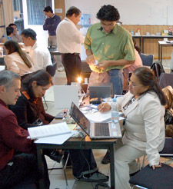
Reading list on Canvas
1 readings-Java-UnitTesting.txt
Review on Java language
New topics:
Generics: Generics 2.5; Nested classes: 2.6
Testing: unit testing handout.pdf file
There will be questions on your understanding before moving on

Slide 58

[T]here are known knowns; there are things we know that we know. There are known unknowns; that is to say there are things that, we now know we don't know. But there are also unknown unknowns – there are things we do not know, we don't know.
United States Secretary of Defense, Donald Rumsfeld, 2002
picture from http://www.soothetube.com/2013/12/29/thats-all-folks/

Slide 60
True or false: This loop iterates over each int value exactly once:
for (int i = Integer.MIN_VALUE;
i <= Integer.MAX_VALUE;
i++)
doSomething(i);
True
False
https://learning.oreilly.com/library/view/java-puzzlers-traps/032133678X/
Notes:
B
This is a Java puzzler from Joshua Bloch, who says, "It doesn't. It's an infinite loop, because every int value is less than or equal to Integer.MAX_VALUE. Once the loop gets to Integer.MAX_VALUE, it wraps around to Integer.MIN_VALUE and starts over again." Bloch characterizes this mistake as an example of unwarranted optimism, a style of thinking that he believes "can be applied to every aspect of the language and its libraries with equally unpleasant results."

Slide 61
static void myMethod( int counter){
if(counter == 0)
return;
else {
System.out.println("hello" + counter);
myMethod(--counter);
System.out.println(""+counter);
return;
}
}
public static void main(String[] args) {myMethod(2);}
hello2 hello1 0 1
hello1 hello2 1 0
hello1 hello2
hello2 hello1
http://danzig.jct.ac.il/java_class/recursion.html
Notes:
A
Taken originally from http://danzig.jct.ac.il/java_class/recursion.html (website down)

