Slide 1
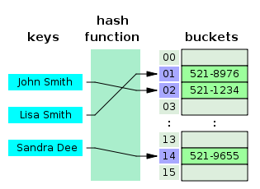
COSC 222 Data Structures
Yves Lucet
CC BY-SA 3.0 https://en.wikipedia.org/wiki/Skip_list#/media/File:Skip_list_add_element-en.gif
"Hash table 3 1 1 0 1 0 0 SP" by Jorge Stolfi - Own work. Licensed under CC BY-SA 3.0 via Commons - https://commons.wikimedia.org/wiki/File:Hash_table_3_1_1_0_1_0_0_SP.svg#/media/File:Hash_table_3_1_1_0_1_0_0_SP.svg

Slide 2
Remember
It is your job to check your grades weekly; any mark you do not understand, should be brought to my attention (or your TA for the lab) asap
You may receive a 0 for a lab for a number of reasons: does not compile, not submitted, not submitted as per the instructions, etc. Check, ask your TA, and follow instructions.
Do NOT wait till Christmas!

Slide 3

TAs feedback
This Photo by Unknown Author is licensed under CC BY-NC
No code in Git repository
See the TA for help in uploading
Check that your code was uploaded by going to the website
Students renaming their GitHub username
If the TA does not have your username, you cannot receive a mark
It is your responsibility to check your marks, and bring any discrepancy (like a zero for a lab your completed) to the TA for the lab, to me for other grades
Students
Asking for zoom meetings with TA
Go to the lab for help
Ask questions on zoom
Come to my office hours
Asking whether the code is right
The TA is there to support you by giving you hints and clarifying what you have not understood.
The TA will not tell you if the code is right in real time, they need to run the code and do other verifications to give you a grade.
Ask precise questions, e.g., why is there a compile error on that line? Could an ArrayList work?
Avoid vague questions that show you haven’t spent enough time thinking about it, e.g., does that work? [run it] Is that enough testing? [do you have 80% coverage?]

Slide 4
Notes:
1 Readings is to be done after Class 1 and before Class 2

Slide 5
InteDashboard Peer evaluation
Deadline 29 Sep 2022, 11:00 pm
Penalty
1 day: 20%;
2 days: 50%;
3+ days: 100%.

Slide 6
RAT
iRAT2 53%(2018: 59%; 2016: 52%; 2015: 53%)
tRAT2 86%(2018: 92%; 2016: 89%; 2015: 93%)
Notes:
Update before class

Slide 7
Appeals: all declined
6: 32, 30, 14, 12
9: 27
Replies were posted in Canvas in your Team Group homepage as an announcement.
11: 36, 38, 17, 9, 4, 34, 29, 12

Slide 8
Module 1: Labs
Unit testing, comparing arrays, sorting
Coverage testing, counting sort
[unit/coverage testing expected from now on]
Streams: Lab 3

Slide 9
Practicing
https://cmps-people.ok.ubc.ca/ylucet/DS/Algorithms.html

Slide 10
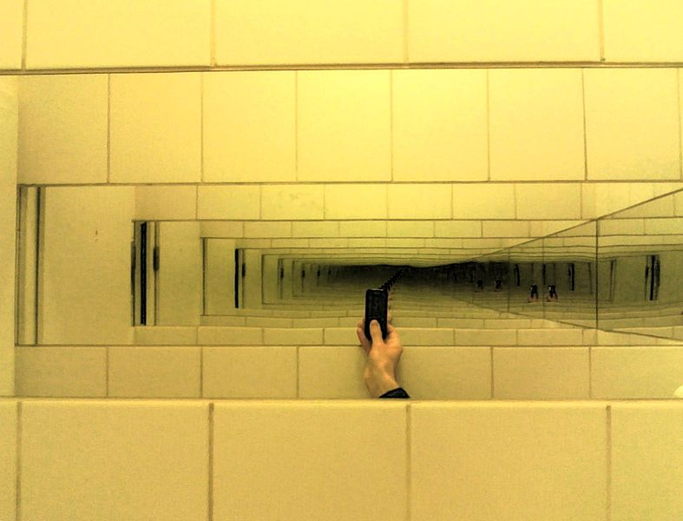
Using Recursion
Elsamuko from Kiel, Germany, CC BY-SA 2.0 via Wikimedia Commons

Slide 11
Defining Arguments for Recursion
Method signature should facilitate recursion.
May need to use additional parameters
For example,
we defined the array reversal method as ReverseArray(A, i, j), not ReverseArray(A)
binarySearch(A, i, j, x), not BinarySearch(A, x)

Slide 12
Steps to Design a Recursive Algorithm
There must be at least one case (the base case), for a small value of n, that can be solved directly
Identify the base case(s) and solve directly
A problem of a given size n can be reduced to one or more smaller versions of the same problem (recursive case(s))
Devise a strategy to reduce the problem to smaller versions of itself while making progress toward the base case
Combine the solutions to the smaller problems to solve the larger problem

Slide 13
Recursive Algorithm for Finding the Length of a String (cont.)
/** Recursive method length
@param str The string
@return The length of the string
*/
public static int length(String str) {
if (str == null || str.equals(""))
return 0;
else
return 1 + length(str.substring(1));
}

Slide 14
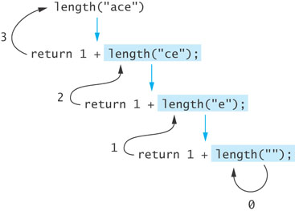
Tracing a Recursive Method
The process of returning from recursive calls and computing the partial results is called unwinding the recursion

Slide 15
Run-Time Stack and Activation Frames
Java maintains a run-time stack on which it saves new information in the form of an activation frame
The activation frame contains storage for
method arguments
local variables (if any)
the return address of the instruction that called the method
Whenever a new method is called (recursive or not), Java pushes a new activation frame onto the run-time stack

Slide 16
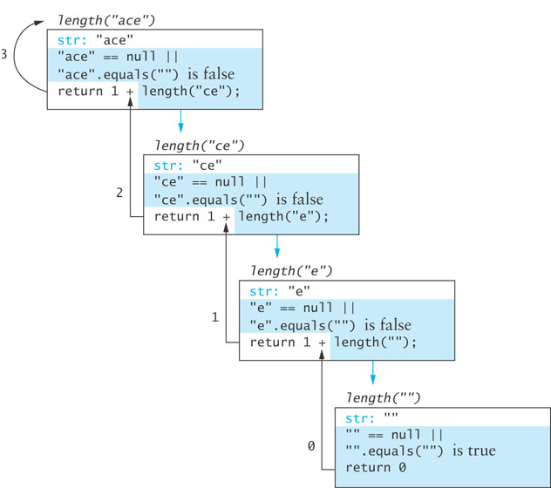
Run-Time Stack and Activation Frames

Slide 17
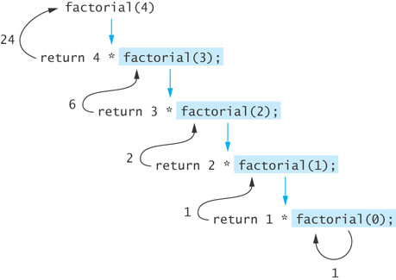
Factorial of n: n! (cont.)
The recursive definition can be expressed by the following algorithm:
if n equals 0
n! is 1
else
n! = n x (n – 1)!
The last step can be implemented as:
return n * factorial(n – 1);

Slide 18
Factorial of n: n! (cont.)
public static int factorial(int n) {
if (n == 0)
return 1;
else
return n * factorial(n – 1);
}

Slide 19
Infinite Recursion and Stack Overflow
If you call method factorial with a negative argument, the recursion will not terminate because n will never equal 0
If a program does not terminate, it will eventually throw the StackOverflowError exception
Make sure your recursive methods are constructed so that a stopping case is always reached
In the factorial method, you could throw an IllegalArgumentException if n is negative

Slide 20
Recursion Versus Iteration
There are similarities between recursion and iteration
In iteration, a loop repetition condition determines whether to repeat the loop body or exit from the loop
In recursion, the condition usually tests for a base case
You can always write an iterative solution to a problem that is solvable by recursion
A recursive algorithm may be simpler than an iterative algorithm and thus easier to write, code, debug, and read

Slide 21
Efficiency of Recursion
Recursive methods often have slower execution times relative to their iterative counterparts
The overhead for loop repetition is smaller than the overhead for a method call and return
If it is easier to conceptualize an algorithm using recursion, then you should code it as a recursive method
The reduction in efficiency usually does not outweigh the advantage of readable code that is easy to debug

Slide 22
Factorial of n: n! (cont.)
The recursive definition can be expressed by the following algorithm:
if n equals 0
n! is 1
else
n! = n x (n – 1)!
The last step can be implemented as:
return n * factorial(n – 1);

Slide 23
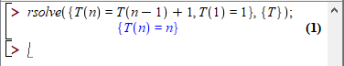
Time Complexity
public static int factorial(int n) {
if (n == 0)
return 1;
else
return n * factorial(n – 1);
}
Write recursive equation T(n)=T(n-1)+1 T(0)=1
Solve recursive equation
Maple
Master’s Theorem
Manually (Mathematical proof usually by induction)

Slide 24
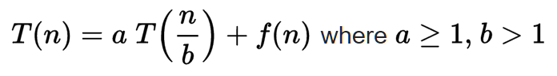
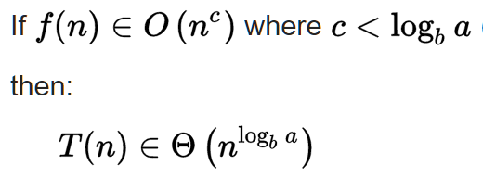
Master’s Theorem

Slide 25
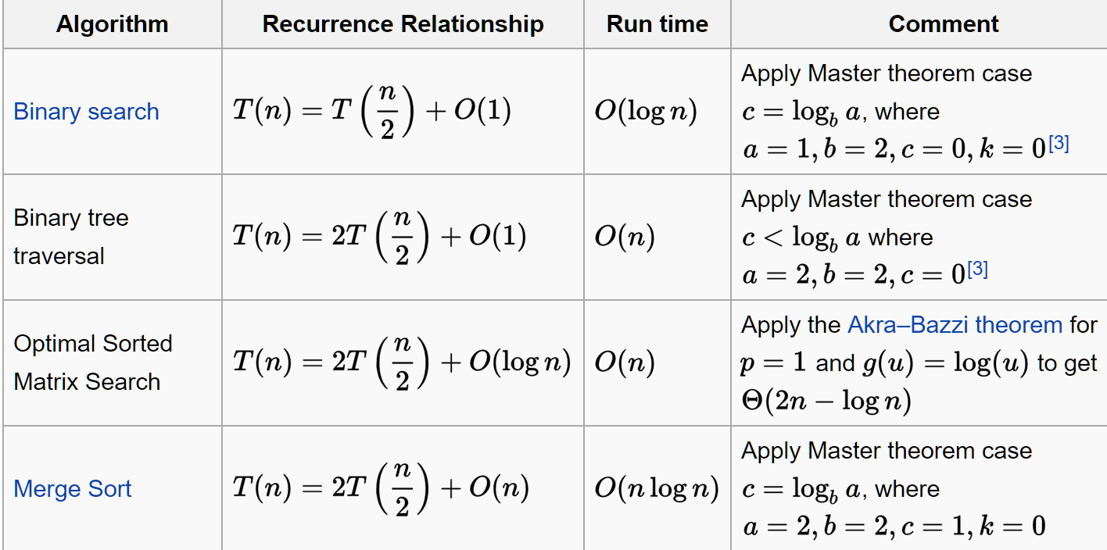

Slide 26
What should you be able to do with recursion?
Now
Read recursive algorithms
Design recursive algorithms
Implement recursive algorithms
Debug recursive algorithms
In the future
Compute the complexity of recursive algorithms, at least in the known cases

Slide 27
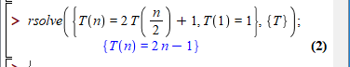
Another Binary Recursive Method
Problem: add all the numbers in an integer array A:
Algorithm BinarySum(A, i, n):
Input: An array A and integers i and n
Output: The sum of the n integers in A starting at index i
if n = 1 then return A[i ]
return BinarySum(A, i, n/ 2) + BinarySum(A, i + n/ 2, n/ 2)
Example trace:
0
,
8
0
,
4
4
,
4
0
,
2
2
,
2
4
,
2
6
,
2
0
,
1
1
,
1
2
,
1
3
,
1
4
,
1
5
,
1
6
,
1
7
,
1

Slide 28
Careful
static int[] A = IntStream.rangeClosed(1, 100).toArray();
Recursive
Iterative
static int sumRecursive() {
return sumRecursiveFromIndexToEnd(0);
}
static int sumRecursiveFromIndexToEnd(int i) {
if (i==A.length - 1) return A[i];
else return A[i] + sumRecursiveFromIndexToEnd(i+1);
}
static int sumIterative() {
int sum = 0;
for (int i=0; i<A.length; i++) {
sum += A[i];
}
return sum;
}
static int sumStream() {
return Arrays.stream(A).sum();
}
Time: O(n)
Space: O(n) in addition to array
Time: O(n)
Space: O(1) in addition to array

Slide 29
Depth-first search
Visit all nodes in a graph
DFS-recursive(G, s):
mark s as visited
for all neighbours w of s in Graph G:
if w is not visited:
DFS-recursive(G, w)
https://www.hackerearth.com/practice/algorithms/graphs/depth-first-search/tutorial/
https://cmps-people.ok.ubc.ca/ylucet/DS/DFS.html

Slide 30
Application exercise

Slide 31
Code & Read Practice
Write a short recursive Java method that rearranges an array of integer values so that all the even values appear before all the odd values.
Write your solution
Write unit tests in another colour
Write the complexity of your algorithm (time/space)
Upload solution on inteDashboard
Comment other teams solutions in inteDashboard

Slide 32
Solution

Slide 33
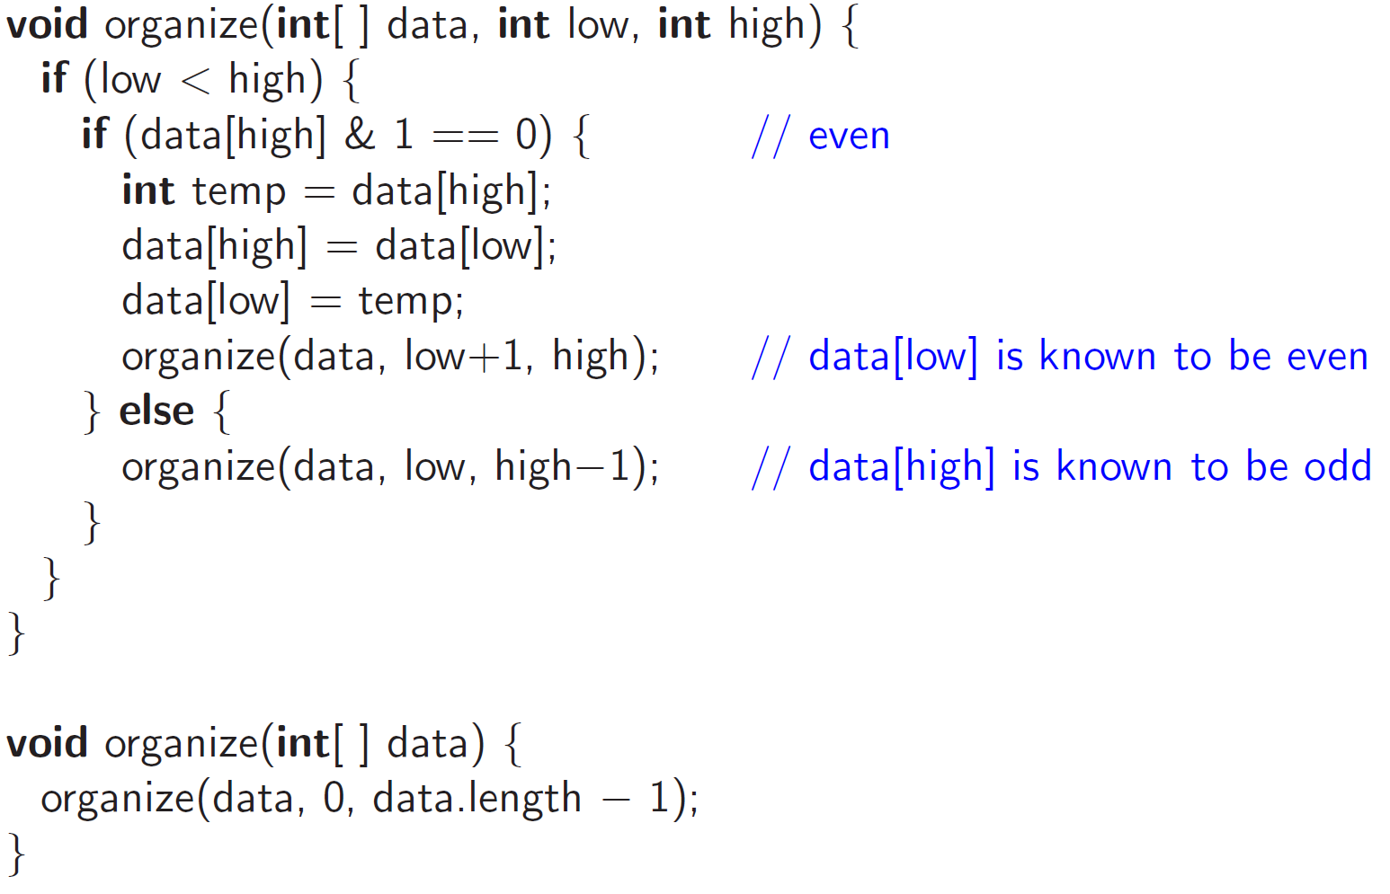
Official solution
Notes:
Complexity: each time function is called on an array of size – 1 so need n calls in total; each call is O(1) consequently: O(n) time. Space is O(n) since call method n times and each call uses O(1) space.

Slide 34
Readings
7 readings-iterator.txt

