Slide 1
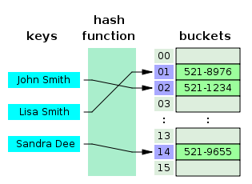
COSC 222 Data Structures
Yves Lucet
CC BY-SA 3.0 https://en.wikipedia.org/wiki/Skip_list#/media/File:Skip_list_add_element-en.gif
"Hash table 3 1 1 0 1 0 0 SP" by Jorge Stolfi - Own work. Licensed under CC BY-SA 3.0 via Commons - https://commons.wikimedia.org/wiki/File:Hash_table_3_1_1_0_1_0_0_SP.svg#/media/File:Hash_table_3_1_1_0_1_0_0_SP.svg

Slide 2


Slide 3
Notes:
1 Readings is to be done after Class 1 and before Class 2

Slide 4
Since last class
Readings
7 readings-iterator.txt

Slide 5
Recall: Code & Read
Write a short recursive Java method that rearranges an array of integer values so that all the even values appear before all the odd values.
Write your solution
Write unit tests in another colour
Write the complexity of your algorithm

Slide 6
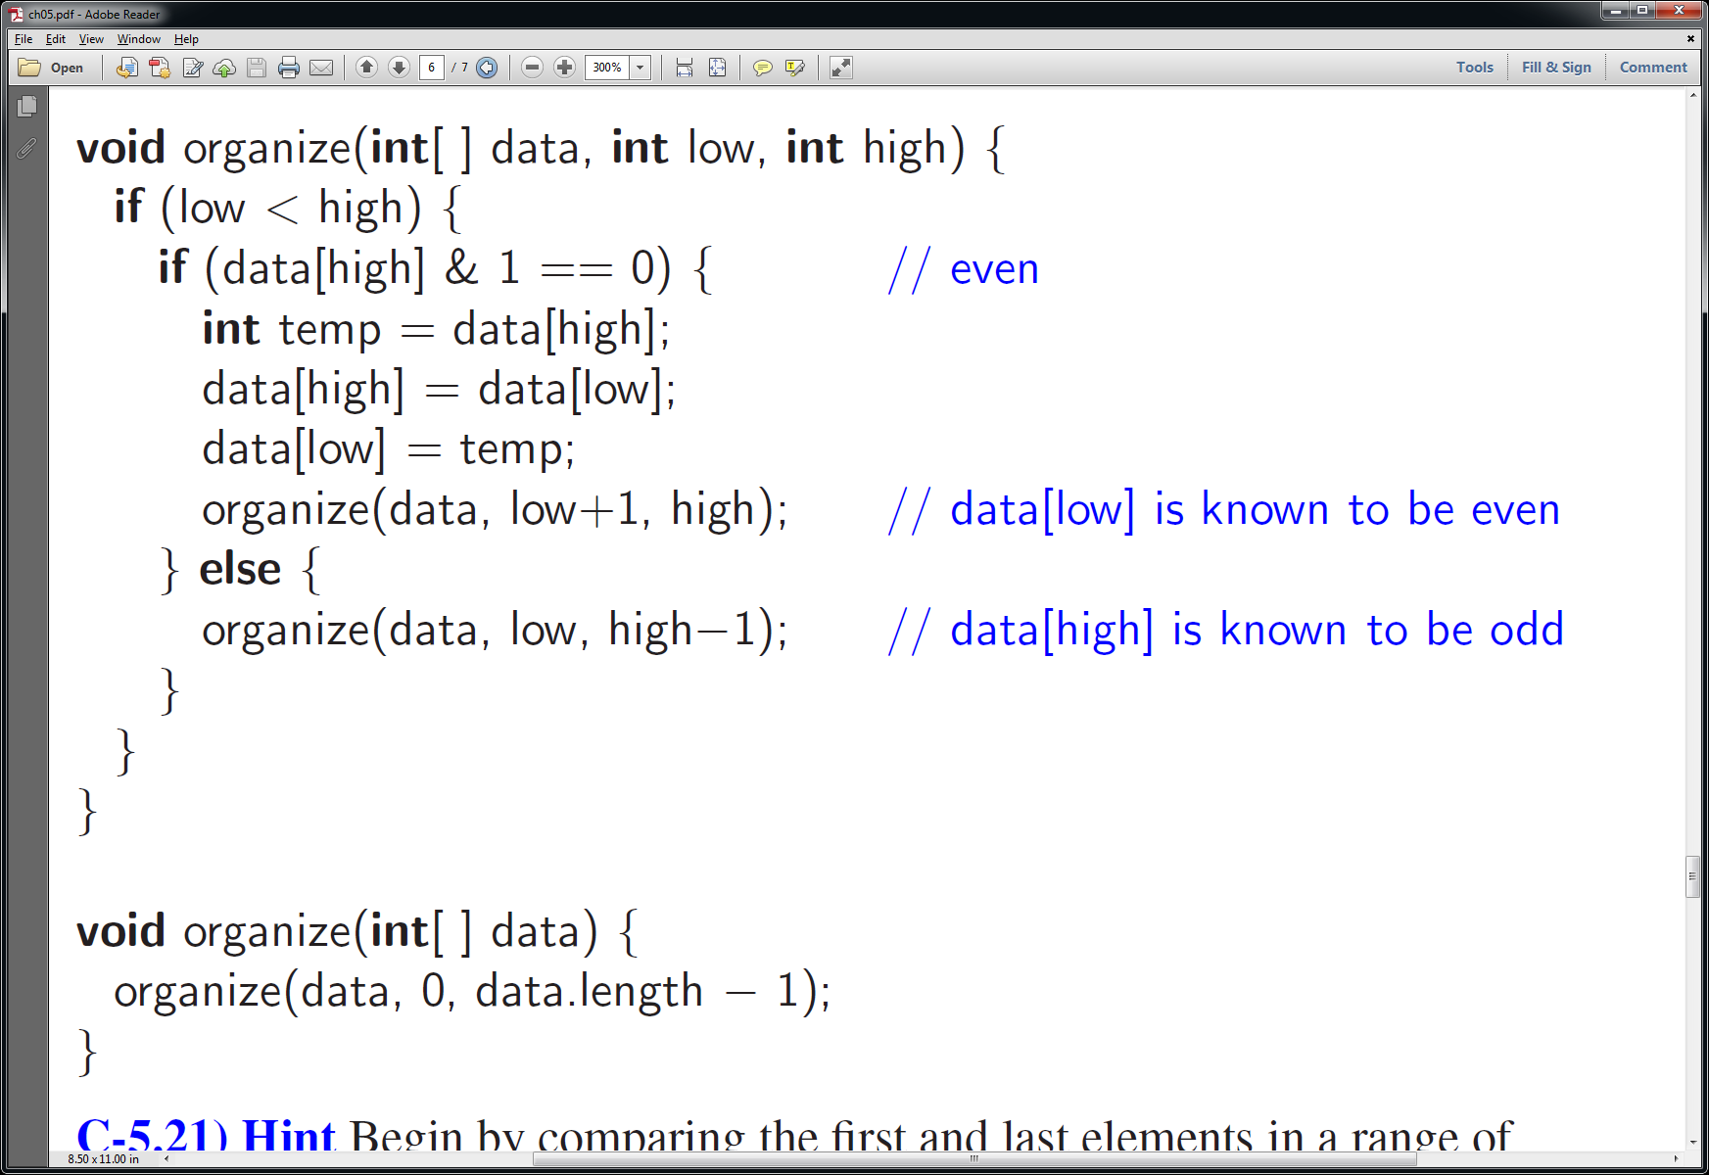
Official solution
Notes:
Complexity: each time function is called on an array of size – 1 so need n calls in total; each call is O(1) consequently: O(n) time. Space is O(n) since call method n times and each call uses O(1) space.

Slide 7
Unit tests
Edge cases: [ ], [0], [1]
All even: [0, 2, 4]
All odd: [1, 3, 5]
Nothing to do: [2, 4, 6, 1, 3, 5]
Reversed: [5, 1, 3, 6, 8, 2]
Alternate: [1, 2, 3, 4, 5, 6]
Unbalanced: [1, 3, 5, 8], [7, 8, 0, 2]

Slide 8
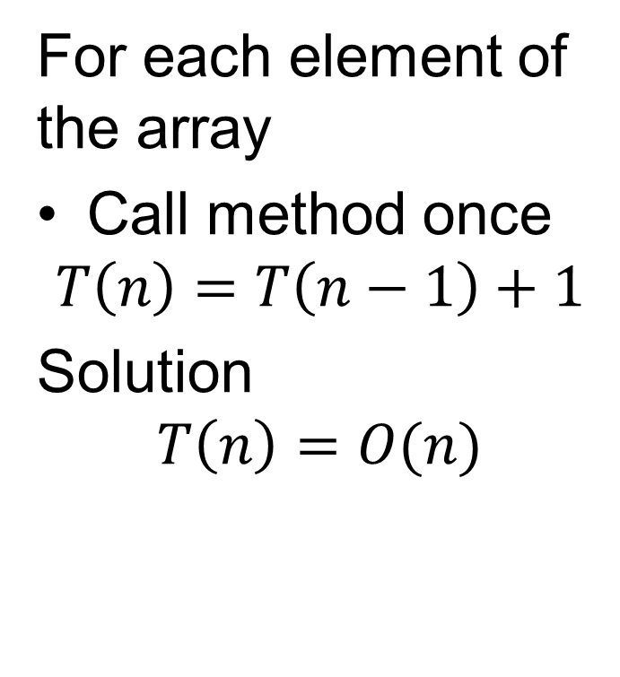
Complexity
For each element of the array
Call method once
$$T\left(n\right)=T\left(n−1\right)+1$$
Solution
$$T\left(n\right)=O(n)$$

Slide 9
Feedback
Timekeeper
Communication
Weak answers
Incomplete answer or nothing uploaded
Confusing answer
No unit test
No complexity (if asked)
No critic
Strong answer
Clear poster
Complete answer: unit test, complexity
Relevant critic of other posters
Organized team with good communication and assertive timekeeper

Slide 10
Complexity Reminder
sequential code O(1)
loop O(n)
Loop inside loop: O(n²)
Recursive function
minimum(int[] A, int i, int j){
if (j-i==1) return A[i]
else return min(A[i], i+1,j)
complexity t_{n} = 1 + t_{n-1}=2+t_{n-2}=…=O(n) more in COSC 221

Slide 11
Keep in mind: you can build your own data structure
int
Student class
List<Student>
List<Student> [] is an array of a list of students
Queue<Student> [] is an array of queues of students
List<Queue<List<Person>>> is a ….
Aggregate structures: List<StudentID>, List<StudentNames>

Slide 12
Team Exercises

Slide 13
15 min only!
No time
No Java code
No details
Only indicate the data structure
And the complexity: time and space
All about
Communication
timekeeper

Slide 14
Exercise
When Bob wants to send Alice a message M on the Internet, he breaks M into n data packets, numbers the packets consecutively, and injects them into the network. When the packets arrive at Alice’s computer, they may be out of order, so Alice must assemble the sequence of n packets in order before she can be sure she has the entire message.
Select the best data structure, and compute the resulting complexity
Notes:
Start at 12:55pm: 1, 15+5 till 1:15pm; 2, 10+5 till 1:30pm; 3, 10+5 till 1:45pm

Slide 15
Solutions
Send n beforehand (or with each packet): O(n) time+space
create an array of size n of packets
put packet i in position i as it comes in
Do not send n
List + counting sort: O(n) time + space
put each packet in a list as it arrives
counting sort to put them in order
Array: average O(n) time + space
create array of estimated size n’
put packet i in position i as it comes in
If i > n’ – 1, create array of size 2 n’ and set n’ = 2n’
binary search tree: O(n) space, O(n log n) time
Hash table: O(n) expected time; O(n) space
Skip list: O(n) expected time; O(n) expected space

Slide 16
Exercise
Given an input string of size n such as “(2*(1-3)+4)*2” how would you check that the parenthesis are balanced?
Select the best data structure, and compute the resulting complexity

Slide 17
Solution
Stack: O(n);
Push on (
Pop on )
Check that stack is empty at the end
Proper order is handled by raising StackEmptyException on pop on an empty stack
2 counters: O(n); Int openCount, closeCount
Scan each character
If s=“(“, openCount++
If s=“)”, closeCount++
If openCount > closeCount, raise improper order exception
Check openCount==closeCount at end
1 counter: O(n)
Scan each character
If s=“(“, count++
If s=“)”, count--
If count <0, raise improper order exception
Check count == 0 at end

Slide 18
Exercise
An airport has 2 runways that handle takeoffs and landings. Priority is given to planes requesting a landing. Simulate 120 min of the airport operations when takeoff or landing takes 15min and a request (either takeoff or landing) comes every 5min.
Select the best data structure, and compute the resulting complexity

Slide 19
Solution
One deque for each runway
Landing addLast
Takeoff addFirst
Dequeue with removeLast
A single deque with round-robin between runways.
Landing addLast
Takeoff addFirst
Dequeue with removeLast
Alternate requests between runways

Slide 20
Next Class
iMAT: Canvas quiz to be completed BEFORE class
tMAT: in class to be uploaded by END of class

