Slide 1
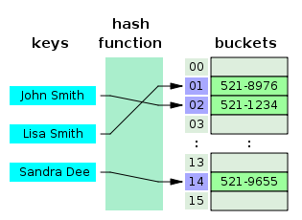
COSC 222 Data Structures
Yves Lucet
CC BY-SA 3.0 https://en.wikipedia.org/wiki/Skip_list#/media/File:Skip_list_add_element-en.gif
"Hash table 3 1 1 0 1 0 0 SP" by Jorge Stolfi - Own work. Licensed under CC BY-SA 3.0 via Commons - https://commons.wikimedia.org/wiki/File:Hash_table_3_1_1_0_1_0_0_SP.svg#/media/File:Hash_table_3_1_1_0_1_0_0_SP.svg

Slide 2
Notes:
1 Readings is to be done after Class 1 and before Class 2

Slide 3
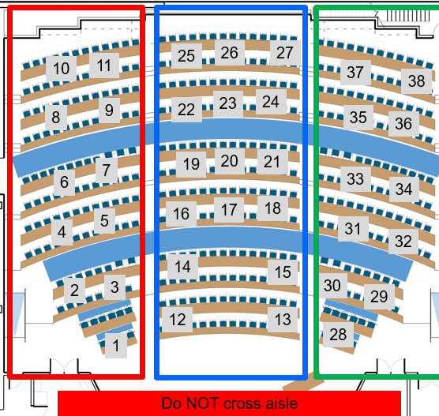
Team build & critic
Do not forget to assign a TIMEKEEPER
[10 marks] Answer the questions on your poster
write clearly
Take picture and post it on Canvas as group assignment tMAT2 – Poster Your pseudo-code must be written on the poster. Submitting poster m minutes late will result in penalty –m²%, e.g., 3min = -9%
[4 marks] Rotate posters on each aisle (left, centre, right); do NOT cross aisle. Critic 4 posters. Make a list of any error, bug, omission; is complexity correct?
The full team has to agree on the justification
Upload your poster to tMAT2 Critics
Be time efficient!
Include the list of team members present today on your poster
DO NOT USE INTERNET except to submit tMAT
11:50am
12:15pm
Notes:
15’ post-mortem
10’ quiz
30’ write poster
16’ read 4 posters
Total = 71’ [only read 3 posters if 3rd poster is after 1:40]

Slide 4
tMAT: build & critic
Breast cancer patients are sorted into 5 stages: 0 (localized) to IV (generalized). Write the pseudo code to schedule treatment
Input: list of n patients with their stage in any order
Output: list of treatments delivered with patient name, stage condition before and after; and at the end of the list: number of deaths, number of cured
Patients are scheduled for treatment according to their cancer stage, with Stage IV going first, then III, etc. Same stage patients are scheduled on first-come first-served. Each time a patient is to be treated, there is a 15% chance he cannot come to the appointment and needs to be rescheduled. After treatment, there is a 40% chance the cancer is reduced to the next lower stage, 10% chance it spreads to the next higher stage, and 50% it is cured. A Stage IV worsens to death and State 0 lessens to cure.
[5 marks] Write a main method (loads data, treat patient, display)+other methods.
[2 marks] Indicate the space complexity, and the time complexity to treat n patients (do not include the time to load the n patients into the system in your complexity calculation; only of treating the n patients).
11:05-11:50 write poster
11:50 poster MUST be uploaded
11:51-12:15 critic 4 posters
12:16-12:20 upload pict; wrap up

Slide 5
Readings
Don’t forget readings
RAT next class

