Slide 1
Brain Drain
Presented By:
016 Akash Chavan
017 Akhil Darge 018 Akhilesh Pathak 019 Akhlesh Gour 020 Akshat Sawerkar

Slide 2

WHAT IS BRAIN DRAIN
Understanding brain drain / human flight
History of brain drain
Root cause of brain drain
Impact on India
How to overcome
Reverse brain drain

Slide 3
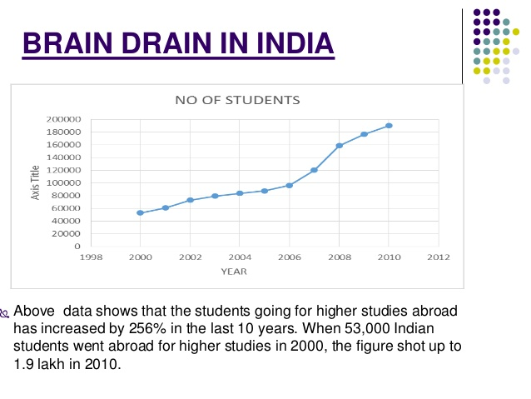
ACCORDING TO NSF REPORT
Migration of 3crore Indians
Estimation of scientist working in NASA
Estimation of doctors working un UK
CEO of the worlds biggest company

Slide 4
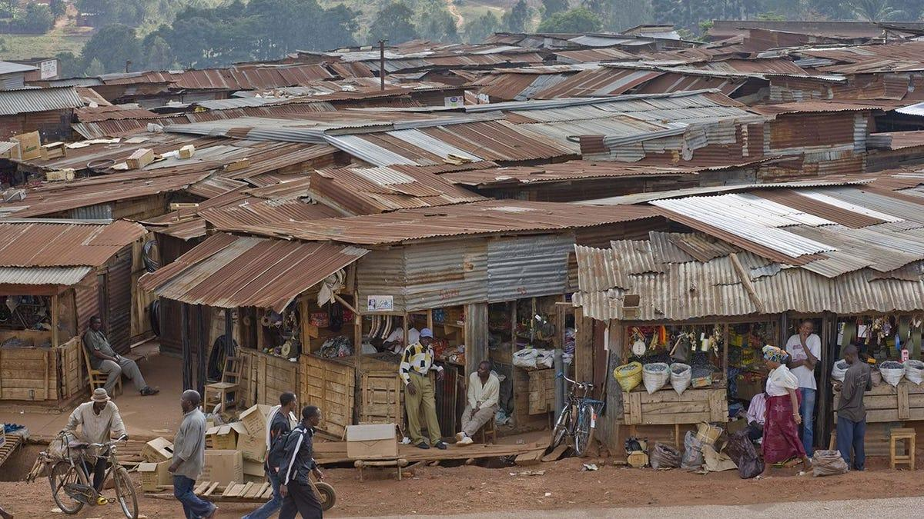
ROOT CAUSE OF INDIA FACING BRAIN DRAIN
Higher Education
Challenging economic conditions and Policies
Value of Talent
Growing population
Unemployment
Lower Wages
Standard of living
Access of advance technology

Slide 5

IMPACT ON INDIA
Economy
Lack of Tax Revenue
30 million people residing outside India
Loss of skilled professional
Lack of Inventions
Lack of Innovations
Loss of Health and Education services
Lack of Recovery Rate

Slide 6

HOW TO OVERCOME BRAIN DRAIN
Rural Development
Education system
Infrastructure
Politics
Work Culture
Reverse Brain Drain

Slide 7

REVERSE BRAIN DRAIN
Definition - Reverse Migration
Returning of skilled and peoples
Reasons
Opportunities
Comfort

Slide 8
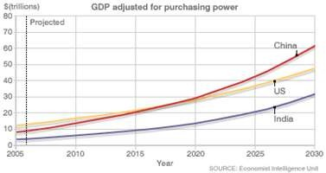
BRAIN- DRAIN REVERSAL
Cause
India, the world’s 5th largest GDP
IT industry grew at a whopping pace of 19-25% in last 10 years
Indian companies now pay global salaries
Second-generation Indians are coming back to the country
Other reasons for returning

Slide 9

GOVERNMENT INITIATIVES
Governments Initiatives
Make in India a much mooted ‘Think in India’
National Skill Development Mission
India’s 12th Five Year Plan (FYP)
Reviving romance for science in India
The SERB Fellowship
PM Scholarship Scheme

Slide 10
ADVANTAGES OF BRAIN DRAIN
They get more opportunities
They get more exposure
They are able to increase there professional skills
Makes them financially develop
Helps to reduces the unemployment
The individual can develop his own nation by applying the skills
Helps to improve the education and infrastructure

Slide 11
DISADVANTAGES
It can lead to a shortage of skilled workers
Loss of tax revenue
Lower in growth of country
The investment in higher education is lost
Loses potential entrepreneurs

Slide 12
CONCLUSION
As we discussed about brain drain, this is one of the leading problem India is facing right now, so we have to work on it and government should take initiatives. So that talented individuals will get chance to manifest.

Slide 13
REFERENCES
https://www.investopedia.com/terms/b/brain_drain.asp
https://www.sundayguardianlive.com/lifestyle/brain-drain-becoming-cause-concern-india
https://lifehacks.io/5-reason-for-indias-brain-drain/

Slide 14
THANK YOU

