Slide 1

Online BookStore Strategic Planning

Slide 2
Initiation
Notes:
Market Overview

Slide 3
Market Overview
The book store in the retailing industry is one unique industry that is active in all parts of the world.
Mostly retail a broad range of books, newspapers and periodicals including trade books, textbooks, magazines, paperbacks and stationeries.
In a recent research that was conducted in America, it was found that approximately 63,000 book publishers
Major players in this industry have multiple retail outlets while smaller companies are independently owned and operate at the local level.
The global e-book market was valued at USD 18.13 billion in 2020, and it is expected to reach USD 23.12 billion by 2026

Slide 4
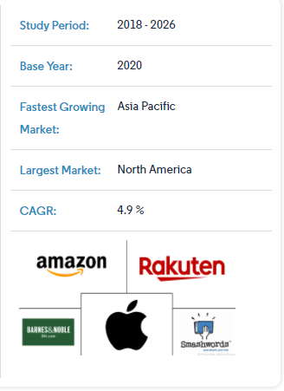
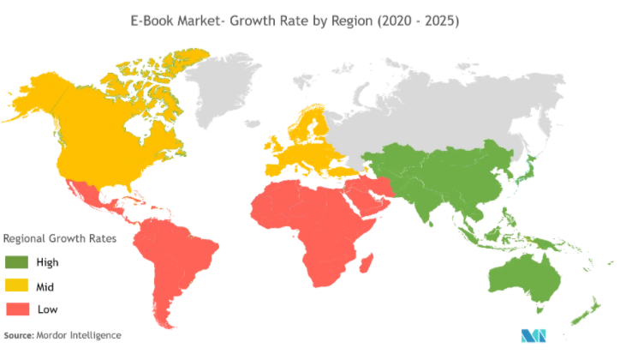
Market Overview
Technical development and sophistication of reading devices that provide a similar experience to that of reading an actual book is the key factor driving the global e-book market.
Besides, libraries and publishers are also increasingly receiving responses for e-books. Hachette Book Group, one of the big publishers, has announced that in 2019 the publishing company generated EUR 2.38 billion, which is a 5% increase since 2018.
Furthermore, the environment protection campaigns from governments across the globe especially for saving trees to reduce the use of paper also increases the demand for e-books.
Libraries across the country have closed most of their services to mitigate the spread of COVID-19. But many are still offering electronic reading materials. Moreover due to decreasing cost of the e-books, librariers are now able to buy more copies of the e-books, which is aiding in the market growth.

Slide 5
Disintermediation
Because the business is running on the internet platform, therefore instead of going through traditional distribution channel, we may now deal with customer directly and the buyer bypass the middleman(whole saler and retail saler).
Help increase profit margin.
The business supply chain:
The supplier.
Manufacturer
Buyer.

Slide 6
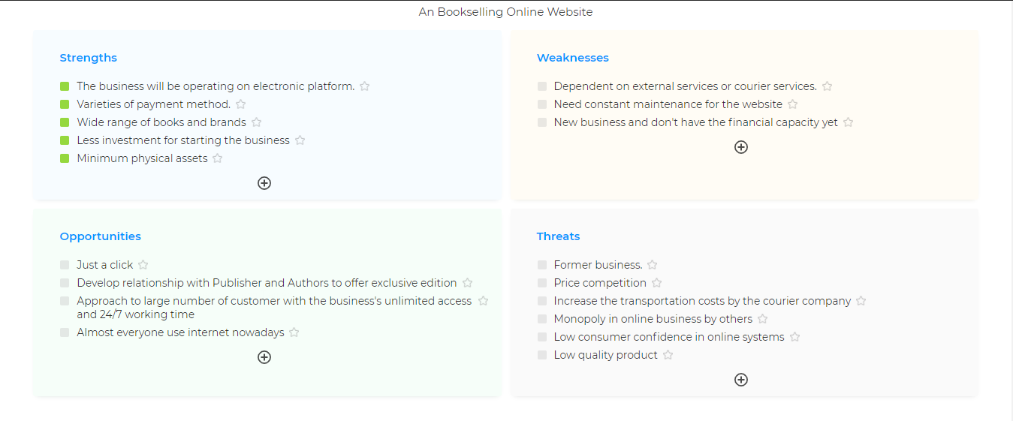
SWOT Analysis

Slide 7
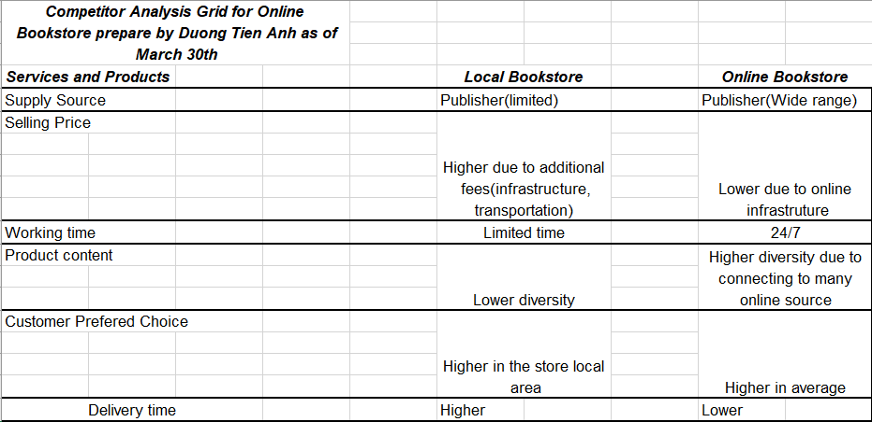
Competitor Analysis Grid

Slide 8
Formulation

Slide 9
Product And Service
Trade books
Religious goods (including books)
Textbooks
Magazines and newspapers
Retailing new books (including e-books)
Retailing newspapers
Retailing magazines and other periodicals
Retailing of stationery and other related merchandise (pens, pencils, erasers, writing pads, notice boards, writing boards, crayons, water colors, plaster of Paris, stick – on, and cardboards et al)

Slide 10
Future Product
Flowers & gifts
Lifestyle & accessories

Slide 11
Mission
Establish a book store business that will make available a wide range of books and stationeries from top brands at affordable prices
Provide shipping policy that means power to order and receive item at a place most convenient to the customer.
Shopping cart hold all the items that customer picks from online store. It retains these till customer place order for them or save them to buy later or simply delete them from the cart.

Slide 12
Targer Market
Schools and Students
Bachelors and Spinsters
Corporate Executives
Business People
About to wed couples
Expectant Mothers
Sports Men and Women
Government officials
Tourists

Slide 13
Marketing Strategy
Conduct a thorough market survey and feasibility studies in order to be able to be able to penetrate the available market.
Hired experts who have good understanding of the book store / retailing industry to help develop marketing strategies
Leverage on the internet(social media,etc) to promote business
Encourage word of mouth marketing from satisfied and loyal customers

Slide 14
Pricing Strategy
Payment by cash
Payment via Point of Sale (POS) Machine
Payment via online bank transfer (online payment portal)
Payment via Mobile money
Payment with check

Slide 15
Cost Plus
Infrastructure
System Developtment
Advertisement
Rent
Operational
Tax
System Modeling
Employee
Maintaining

Slide 16
Implementation

Slide 17
Responsibilities
Documentation And Architecture Design: AnhDT
Backend: TriNM and QuangNV
FrontEnd:TrongND

Slide 18
Phase
Phase 1(1 week): System Design and Documentation
Phase 2(6 weeks):Coding and Testing Main Module
Phase 3(2 weeks): Demo and Review
Phase 4(1 week): Deploy system

Slide 19
SRS Documentation
https://drive.google.com/file/d/13OmyCbqGh6BytHDHlavA2yMclN3uWeF0/view?usp=sharing

