Slide 1
CS 550 Movie Recommendation System
TEAM 6 MEMBERS
Abhilash Kolluri
Manad Desai
Pruthviraj Patil
Notes:
Explain what a recommendation system is and how it has gained relevance to our modern society

Slide 2

Adam : Hey John have you seen the movie Interstellar
John : No, I haven’t seen that movie , how is it ?
Adam : Yeah it’s great , we both love Sci-Fi movies, I am sure you will love it
John : Oh is it? I will definitely watch it now
Adam recommended a movie to John and John is eager to watch it.
Why is this?
Because John and Adam have similar taste in movies.
Can we build a model that can find similar users and recommend them new items?

Slide 3
INTRODUCTION
RECOMMENDATION SYSTEM
In this project we have built a recommendation system
User to User Collaborative Filtering (Cosine , Pearson correlation)
SVD
Neural Collaborative Filtering

Slide 4
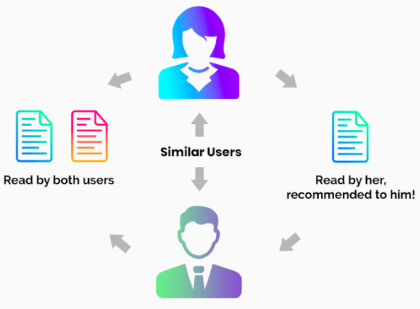
User to User Collaborative Filtering
Advantages:
No domain knowledge required because the embeddings are automatically learned
The model can help users discover new interests
Disadvantages:
User Cold Start Problem: Cannot correctly recommend items to new users
Item Cold Start Problem: Cannot find similarity for a recently added item
Sparsity: The user/rating matrix is sparse which makes it hard to find users with similar tastes

Slide 5
STEPS TO PREDICT RATING
Data preprocessing
Similarity Calculation
Weighted Average
Prediction

Slide 6



DATA PRE-PROCESSING
RECOMMENDATION SYSTEM
We have used Movie Lens Data set (MovieLens 100k ratings dataset) containing 100,000 records and divided it training and testing subsets.
Attributes not required for processing are removed
filter the movies and keep only those with over 50 ratings for the analysis
We normalize the rating by extracting the average rating of each user
The main attributes in our datasets are user_id, movie_id and rating

Slide 7

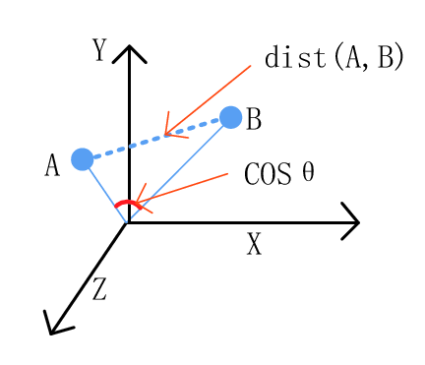
SIMILARITY CALCULATION
Let A and B be two users. Their behaviour can be represented in the form of a n dimensional vector
Here n represents the total number of movies
The values in the vector would be the rating for a particular movie by the user

Slide 8
SIMILARITY CALCULATION
The distance between vector A and B represents the difference in their behaviour
The angle between these two vectors gives us a good estimate of the distance
We use the cosine function to measure the difference between vectors A and B

Slide 9
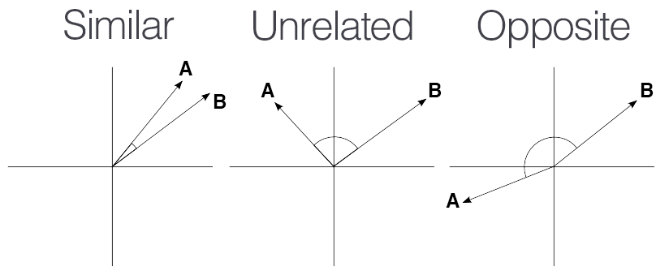
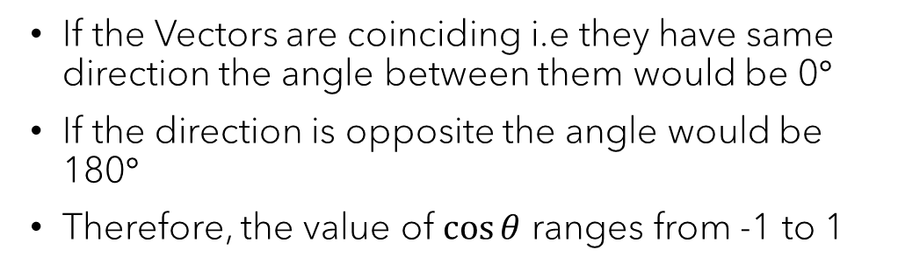
SIMILARITY CALCULATION

Slide 10
WEIGHTED AVERAGE
The cleaned data may still have outliers
A good way to tackle it is by taking the average rating of K most similar users.
K needs to be wisely chosen as a low or a high number may impact the rating.

Slide 11
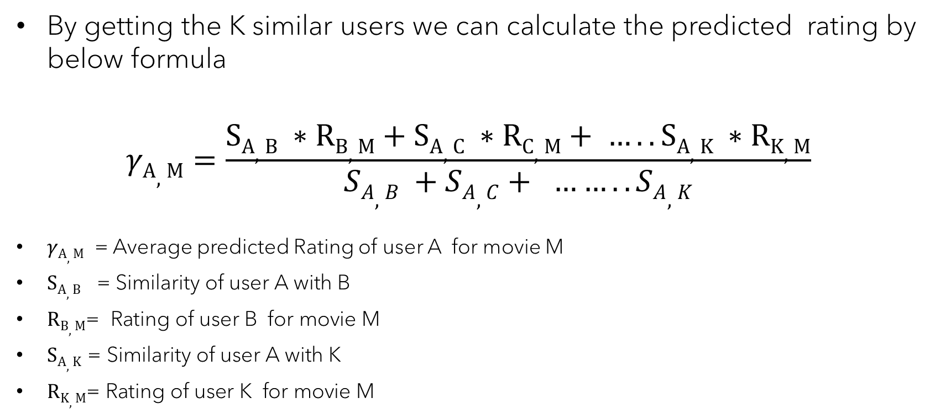

PREDICTION

Slide 12
Results for Collaborative Filtering using user similarity
Cosine Similarity
Precision : 0.1127
Recall : 0.101
F1 : 0.1065
RMSE : 2.12
MAE : 1.98
Pearson Correlation
Precision : 0.1034
Recall : 0.0957
F1 : 0.0995
RMSE : 2.27
MAE : 2.05

Slide 13
Recommendation using SVD
WHY?
Reduces the Dimension, advantageous for larger data set.
Reduce computation and memory footprint.
Removes Noise and conveys important information wrt Data set.
Interpretability : SVD represent meaningful factors that help understand why the recommendations are made.

Slide 14
Results SVD
Precision : 0.1945
Recall : 0.1120
F1 : 0.1421
RMSE : 0.80
MAE : 0.67

Slide 15
Neural Collaborative Filtering
NCF tries to learn interaction between user and item using Multilayer Perceptron.
MLP is better at learning continuous functions and provides non- linearities to learn interaction.
Due to sparsity in the data, Embedding layer is introduced.
Embedding layer produces lower dimensional representation.
Neural CF architecture will map latent vectors to prediction scores.

Slide 16
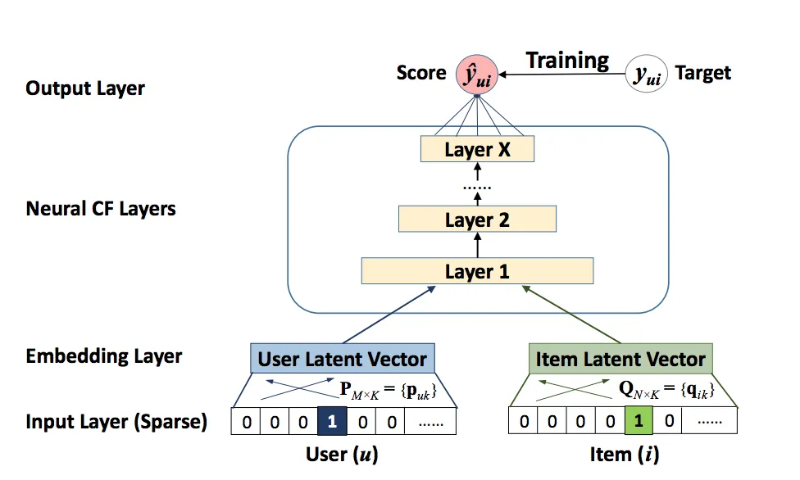
Architecture

Slide 17
Evaluation Criteria
RMSE: 0.52
MAE : 0.49
Precision for top 10 results: 30.38%
Recall for top 10 results: 16.70%
F1 score for top 10 results: 21.55%
Ndcg for top 10 results: 28.38%

Slide 18
Results
Method | MAE | RMSE | Precision | Recall | F-measure | NDCG
Cosine Similarity | 1.98 | 2.12 | 11.27% | 10.1% | 10.65% | 13.33%
Pearson Similarity | 2.05 | 2.27 | 10.34% | 9.57% | 9.95% | 11.78%
SVD | 0.65 | 0.77 | 19.45% | 11.20% | 14.21% | 19.20%
Neural Collaborative Filtering | 0.49 | 0.52 | 30.38% | 16.70% | 21.55% | 28.38%

Slide 19
Future work
Testing item to item collaborative filtering with a different similarity measure(eg - Euclidean Distance)
We can also include implicit feedback as part of our dataset.
Ensemble Learning approach to get better recommendation system.

Slide 20
THANK YOU

