Slide 1


Deterministic policy engine for high-stakes decisions
Gemini drafts, kernel confirms.
Built with
Policy fail only on confirmed breaches. Observations create review tasks.
Enterprise AI · Developer Tools
github.com/Silveroboros-dev/Governance-OS
Thinking Mode · Context Caching · JSON Mode · Gemini-as-Judge

Slide 2




THE PROBLEM
Leaders get paid for decisions, not meetings
High-stakes teams can’t operationalize AI because outputs aren’t deterministic, auditable, or safely escalated.
As bots automate reporting, leaders get paid for defensible decisions under uncertainty. Governance OS turns evidence into assumptions into decisions into an audit trail — in minutes, not meetings.
→
→
→
Evidence
Assumptions
Decisions
Audit Trail
Documents, signals,
source data
Flagged explicitly,
never hidden
Human commitment
with full context
Immutable record,
evidence pack
Minutes, not meetings. Defensible by design.

Slide 3


THE ARCHITECTURE
AI proposes. Kernel verifies. Humans decide.
→
→
→
Document
Gemini 3
Deterministic
Kernel
Human
Decision
PDF / Email / Report
Extraction + Reasoning
Breach / Observation / Conflict
Full context. No nudge.
The Canonicalizer sits between Gemini and the Kernel — a pure function that enforces category semantics, completeness gates, and lookthrough requirements.

Slide 4
GEMINI 3: THINKING MODE
Every extraction is auditable
● ● ● Gemini Thinking Mode -- Treasury Report
Scanning for threshold violations...
Cash CHF 86,400 < covenant CHF 100,000 -> liquidity breach
But: 'unrestricted cash' definition disputed in footnote
-> covenant_breach needs definition_lock before confirming
EUR payables 410k, hedge 150k -> EUR 260k unhedged
-> fx_exposure_breach (clear threshold, no ambiguity)
Payment hold CHF 41,500 = settlement event
-> cannot be a threshold violation by definition
OK 5 signals extracted with full reasoning chain
Thinking Mode exposes a reviewable rationale summary — auditors can verify why each signal was extracted. Designed for audit review in regulated environments (SOX / MiFID-style expectations).

Slide 5
THE CANONICALIZER
Two-thirds false alarm prevention
14
9
5
→
→
Breach candidates
from Gemini
Blocked by
deterministic gates
Confirmed
breaches
✗
Category Gate
Events (settlements, flags) can never be breaches
✗
Lookthrough Gate
Portfolio signals need fund-level data verification
✗
Definition Lock
Disputed metrics blocked until definition confirmed
✗
Authorized Source
Thresholds must come from authorized documents
Measured on curated demo packs (eval suite). Reproducible: make evals — same inputs, same outputs, every time.

Slide 6
HUMAN DECISION SURFACE
One screen. No recommendation. Full context.
Policy Context
Symmetric Options
Decision Commitment
• Triggered policy + version
• No default selected
• Rationale required
• Contributing signals
• No recommendation
• Decided-by attribution
• Evidence with source spans
• Equal visual weight
• Immutable once committed
• Uncertainty highlighted
• Implications shown
• Evidence pack generated
Each decision creates an immutable audit record + evidence pack — which signals triggered it, which policy applied, who decided, and why.

Slide 7

GEMINI 3: COST + SAFETY
Enterprise-ready from day one
Context Caching
Eval-Gated Claims
50–60%
546
cost reduction at scale
CI-gated checks
• 90% less for cached input tokens
• Gemini-as-Judge catches subtle errors
• Auto-invalidation on policy changes
• Regex + semantic validation pipeline
• Graceful fallback if cache unavailable
• CI blocks unsupported claims (eval-gated)
All LLM outputs use native JSON mode with schema validation. Conflict detection surfaces contradictions between sources for human review.

Slide 8
BUILT WITH
Production architecture, not a prototype
Gemini 3
FastAPI + Python
Next.js + React
Flash + Thinking Mode
Context Caching, JSON Mode
Gemini-as-Judge
Deterministic kernel
SQLAlchemy + Alembic
Pydantic validation
Decision surface UI
Tailwind CSS dark theme
Real-time dashboard
PostgreSQL
MCP Server
Google Cloud
JSONB governance data
Immutable audit trail
Content deduplication
Model Context Protocol
Vendor-agnostic AI access
Read/write tool boundary
Cloud Run + Cloud SQL
Firebase App Hosting
Docker containers
MCP Integration: Any AI agent can query the governance kernel via standard protocol. Read tools always available. Write tools gated through approval queue.

Slide 9
RESULTS
Measured. Reproducible. Auditable.
2/3
0
0
50-60%
Unconfirmed
breaches caught
Signals
missed
Unsupported
claims (eval)
Cost reduction
via caching
Verify it yourself
make evals
Run canonicalization suite — proves 2/3 false alarm prevention rate
make demo-video-auto
Watch the full pipeline: extraction → canonicalization → safety
MCP connect
Point any MCP client to the server and query the governance kernel live

Slide 10
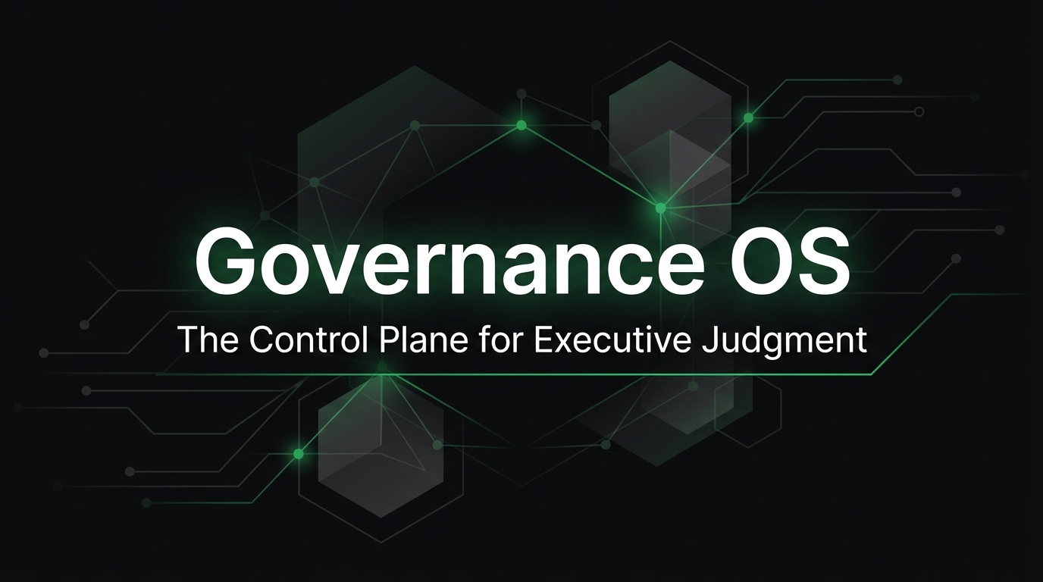
AI that extracts,
but never decides.
Gemini 3 reads documents, shows its reasoning
Deterministic kernel validates with zero randomness
Humans decide with full context
github.com/Silveroboros-dev/Governance-OS
governance-os.web.app

