Slide 1
Connect 4 Revolution
The Connect 4 project
Alexander Adranly

Slide 2

Java implementation (1st prototype)

Slide 3
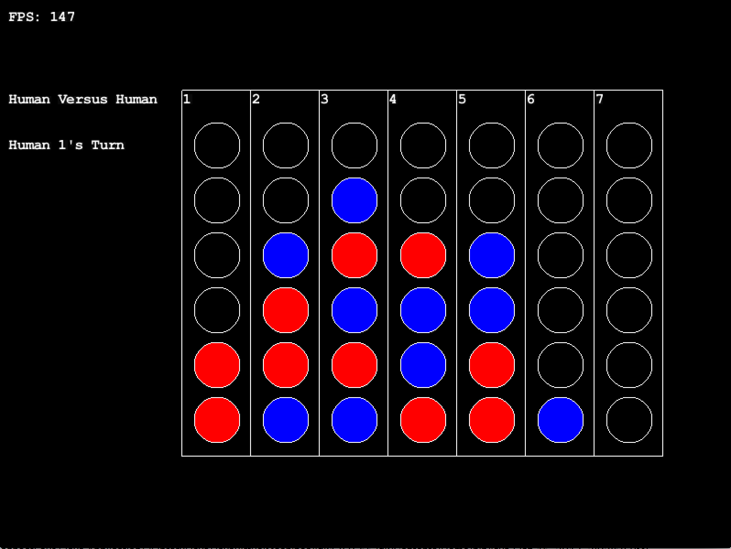
PLAYER VS. PLAYER

Slide 4
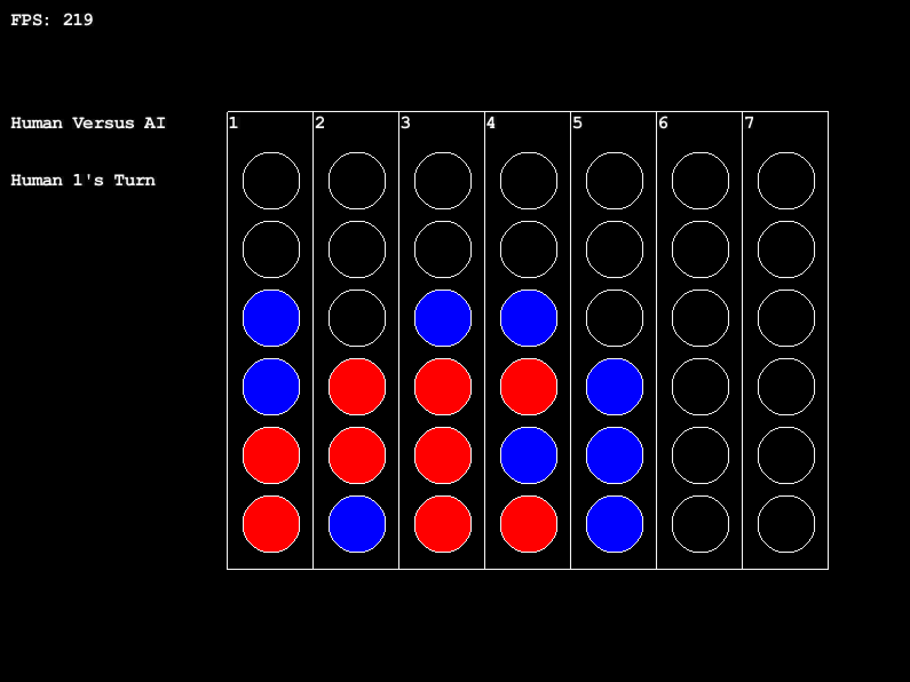
PLAYER VS. AI (REACTIVE AGENT – GLOBAL SCOPE)

Slide 5
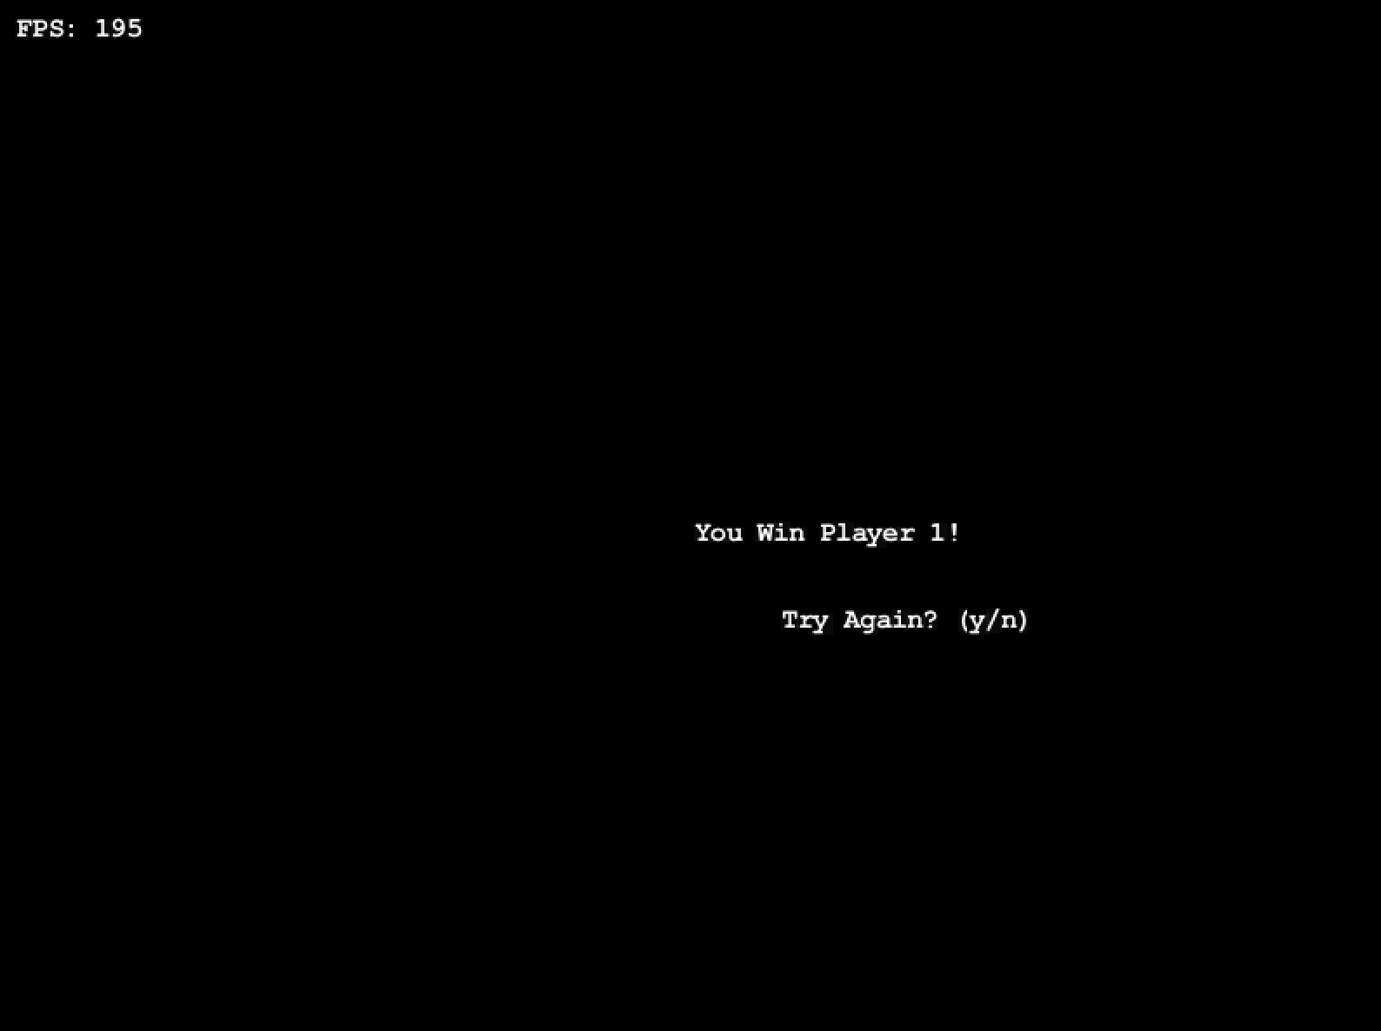
WIN/LOSE/TIE DETECTION

Slide 6
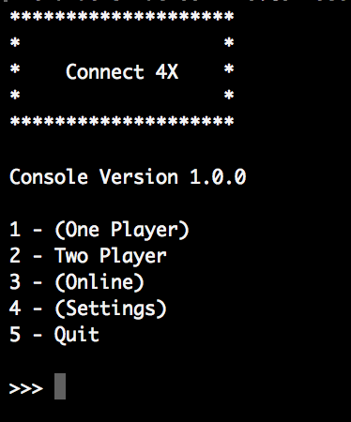
PYTHON REMODELING – WORK IN PROGRESS
What’s New?
New, modular code!
Character selection capabilities
Improved omniscient search algorithms
Improved, state-driven, Game Flow!
What’s In Store For the Future?
3D graphics for gameplay
Game State API that integrates game controller with graphical interface
Improved AI
Transitioning from a purely reactive agent to a hybrid (reactive and planning)
Artificial Intelligence Player Feedback
(Having the AI Player respond strategically and vocally to whatever move was played
Much, much, more!

Slide 7
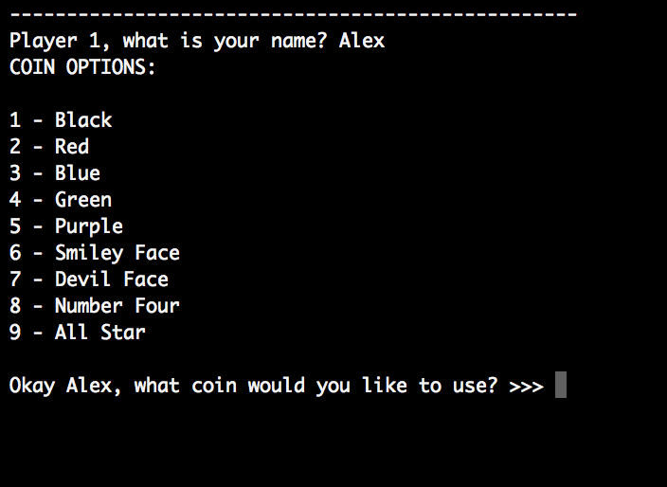
Character select
Character creation is starting to be driven by the user.
Hoping to eventually have a nicer looking character select screen

Slide 8
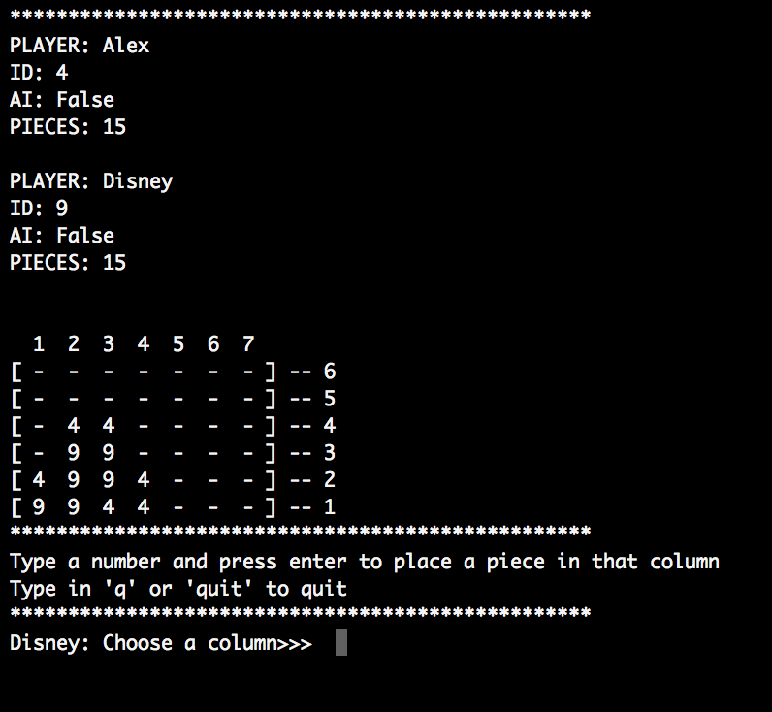
Console Gameplay
clean, easy to see how both players are doing
Console clears after each move so only one board is seen on the screen

Slide 9
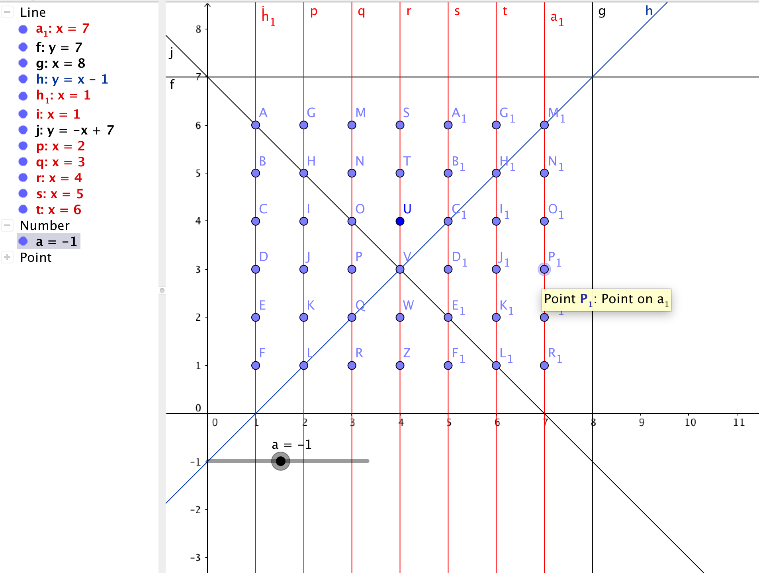
New Omniscient Diagonals Search
Nicknamed: Rising Slash Algorithm
Iteratively scans diagonals for possible solutions
Easier solution to read than previous solution
More flexible feedback for AI analysis

Slide 10
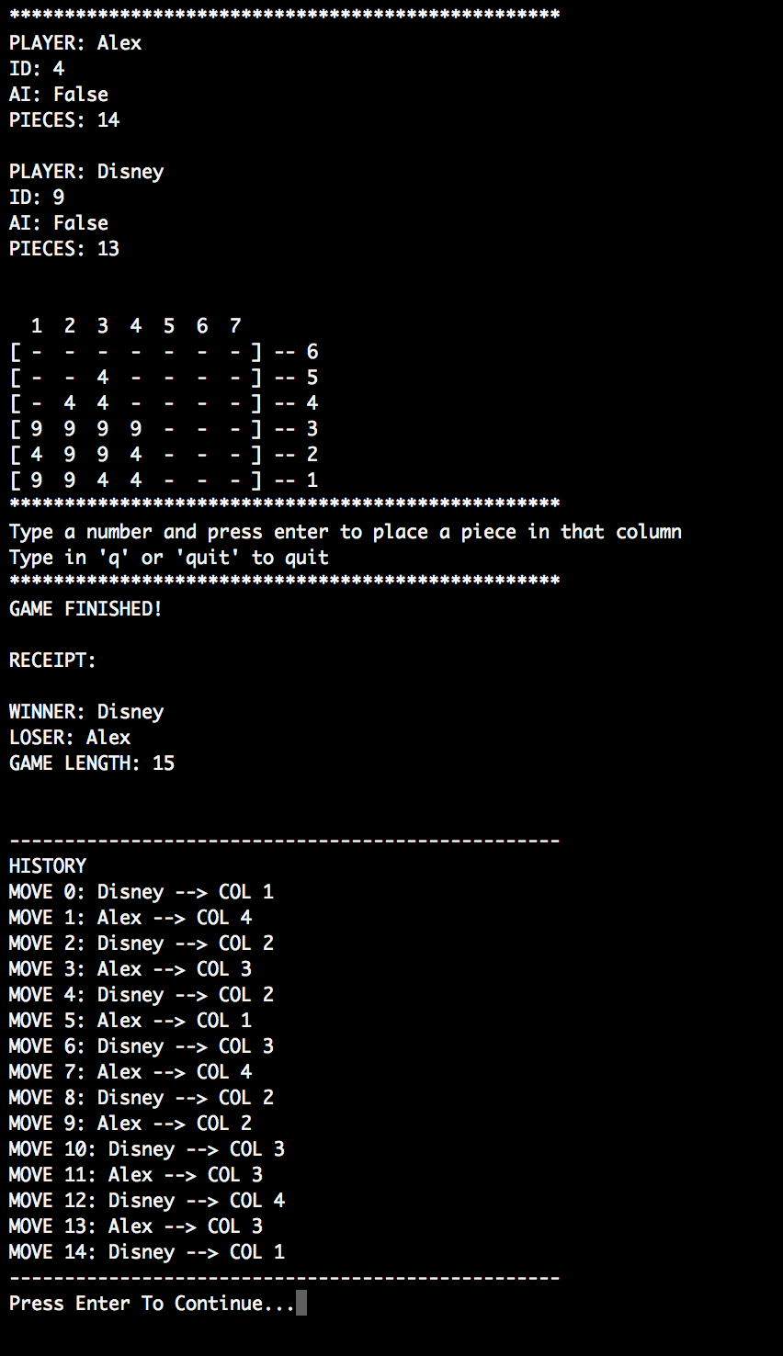
Win/lose/tie detection (game history)
Detects wins, losses, ties and distinctly says who wins, who loses, and who ties at the end of the game
The game instance keeps a history of the entire game
Useful for AI learning algorithms for pattern detection in playstyle
Rematch option for determined or salty players

Slide 11
Thank you!

