Slide 1
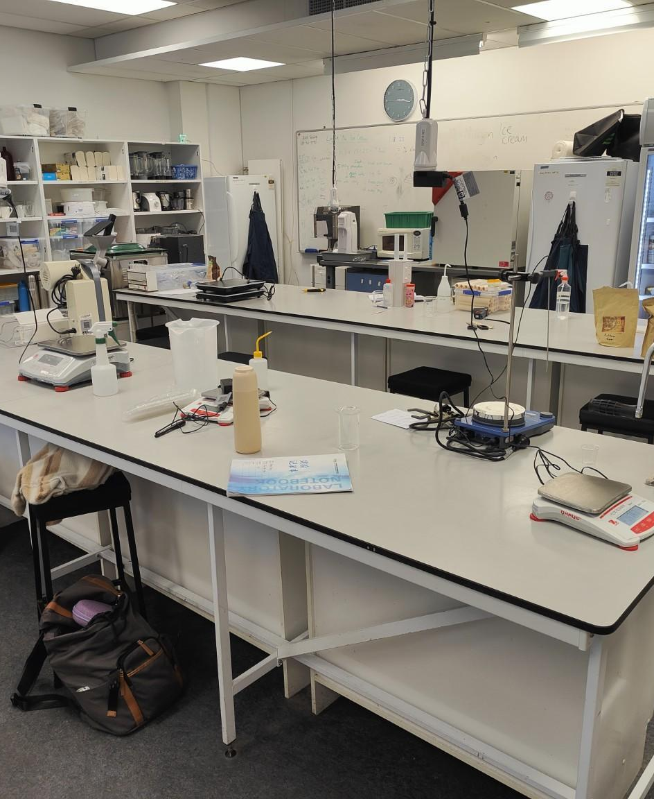



ENGINEERING INTERNSHIP DEFENSE
Protein Enrichment
of an Oat-Based Beverage
Engineering Internship at Auckland University of Technology
Kali Mana
Food Engineering, ESIROI
Auckland, New Zealand
April – August 2026
Notes:
Good morning. My name is Kali Mana, and I completed this engineering internship at Auckland University of Technology from 24 April to 24 August 2026. The internship began with a virtual-reality research project and then moved to food formulation. Today I will focus mainly on the development of a protein-enriched oat-based beverage, from process design and protein incorporation to analytical characterisation and sensory evaluation.
Source: Kali Mana, AUT Internship Report, 2026, cover page and pp. 1–3.

Slide 2
INTRODUCTION
Presentation overview
01
02
03
04
AUT and internship context
From virtual reality to oat beverage development
Protein-enriched oat beverage project
Results, recommendations and professional outcomes
The oat beverage project forms the core of this defense.
Kali Mana, AUT 2026
02
Notes:
I will begin by presenting the host environment and the overall trajectory of the internship. I will then explain why the initial virtual-reality project could not continue under reliable conditions. The main part of the presentation covers the oat beverage process, protein enrichment, Kjeldahl analysis and sensory evaluation. I will finish with the selected development candidate, the limitations of the study and the professional skills I developed.
Source: Kali Mana, AUT Internship Report, 2026, pp. 1–4.

Slide 3

CONTEXT
Internship environment: Auckland University of Technology
AUT
School of Science
Food Science and Microbiology
City Campus, Auckland
Supervised by Dr Nazimah Hamid
Experimental setting
Food processing, rheology, centrifugation, freeze-drying, Kjeldahl analysis and sensory preparation within AUT Food Science facilities.
NEW ZEALAND
Kali Mana, AUT 2026
03
Notes:
The placement took place in Auckland, New Zealand, within AUT’s School of Science. I worked in the Food Science and Microbiology environment at the City Campus under the supervision of Dr Nazimah Hamid. The facilities gave me access to food processing equipment and analytical methods that were new to me. I also had to learn how to organise work around shared laboratory equipment and AUT procedures, which became important when the project changed direction.
Source: Kali Mana, AUT Internship Report, 2026, pp. 1–2.

Slide 4
TRAJECTORY
One internship, two successive projects
24 APRIL
24 AUGUST
Phase 2 · Late June to 24 August
Phase 1 · April to mid-June
Protein-enriched oat beverage
Process trials and formulation screening
Rheology and Kjeldahl analysis
Sensory test and candidate selection
Virtual Reality and Eating Behaviour
Unity familiarisation
Previous project review
Headset testing
Feasibility assessment
PROJECT REDIRECTION
Phase 2 became the main experimental project.
Kali Mana, AUT 2026
04
Notes:
The internship had two distinct phases. From April to mid-June, I prepared the virtual-reality project by reviewing previous work, learning Unity and testing the available headsets. In mid-June, the technical feasibility review showed that the planned protocol could not be implemented reliably. The internship then shifted to an existing oat beverage project. From late June until 24 August, I carried out the main experimental work presented here, including formulation trials, rheology, Kjeldahl analysis and sensory testing.
Source: Kali Mana, AUT Internship Report, 2026, pp. 2–3.

Slide 5

ENGINEERING DECISION
Why the original project changed
Technical constraints
Access delayed by about six weeks
High-resolution headset incompatible with the system
Custom Unity player unavailable
Older headset provided insufficient image quality
ICT troubleshooting could not restore the setup in time
Scientific consequence
Experimental reliability and reproducibility could not be guaranteed. No participants were recruited and no usable VR dataset was produced.
Initial VR study
ENGINEERING DECISION
Redirect the internship toward an experimentally feasible oat beverage project
The change preserved experimental reliability and allowed usable results within the remaining time.
Kali Mana, AUT 2026
05
Notes:
This change was an engineering decision rather than a failure. Access to the VR room was delayed by around one and a half months. When I could finally test the system, the higher-resolution headset was incompatible with the available computer, the previous Unity player was no longer accessible and the older Oculus headset did not provide sufficient image quality. Continuing would have produced a protocol that differed from the intended study and could not guarantee reliable data. We therefore redirected the project before recruiting participants.
Source: Kali Mana, AUT Internship Report, 2026, pp. 2–3.

Slide 6
PROBLEM STATEMENT
Protein enrichment as a formulation challenge
How can the protein content be increased while acceptable sensory properties are maintained?
Formulation risks
Nutritional objective
2.39
Poor dispersion and lumps
Higher viscosity
Powdery or gritty mouthfeel
Bitterness and flavour changes
Increase plant protein using soy, rice and pea powders while keeping the formulations comparable.
g protein / 100 mL
selected base
≈4.85%
The target must balance composition, process feasibility and sensory acceptance.
Kali Mana, AUT 2026
06
Notes:
The new project involved more than adding a calculated mass of protein. Commercial plant protein powders can change dispersion, viscosity, flavour and mouthfeel. The selected oat beverage base later measured 2.39 grams of protein per 100 millilitres. The final enriched samples were estimated at approximately 4.85 percent protein. The engineering challenge was therefore to increase protein while controlling lumps, thickening, bitterness and particle-related sensations. This balance guided every stage of the experimental strategy.
Source: Kali Mana, AUT Internship Report, 2026, pp. 3–4 and 16–18.

Slide 7
PROJECT LOGIC
Experimental strategy
01
02
03
04
05
06
07
08
Oat beverage
production
Preliminary
protein trials
pH and rheology
screening
Kjeldahl
analysis
Protein basis
correction
Final
formulations
Sensory
evaluation
Candidate
selection
Sequential decision logic
Each stage reduced uncertainty before the next formulation decision. Preliminary nominal protein levels were interpreted separately from the corrected final protein estimates.
Kali Mana, AUT 2026
07
Notes:
The work followed a sequential strategy. I first established a workable oat beverage process and explored how the protein powders behaved. pH and rheology screening identified the main formulation constraints. I then used Kjeldahl analysis to replace the approximate one-percent protein assumption with an experimental value for the selected base. Using this corrected basis, I recalculated the final formulations, conducted a sensory evaluation and selected the strongest enriched candidate. This sequence helped separate early screening assumptions from the final interpretation.
Source: Kali Mana, AUT Internship Report, 2026, pp. 4–12.

Slide 8
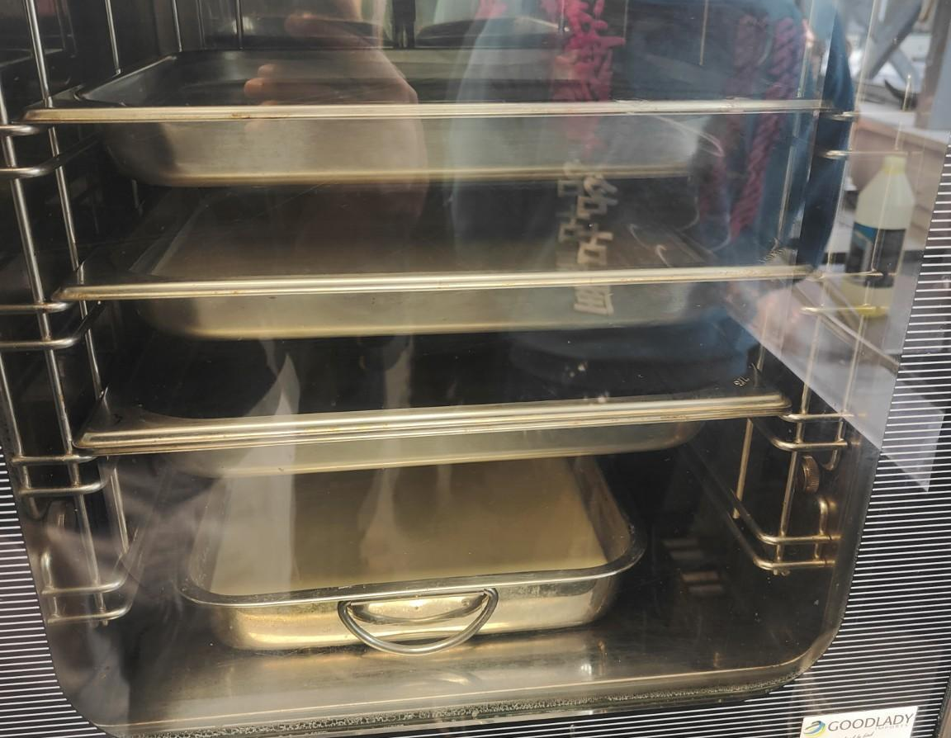
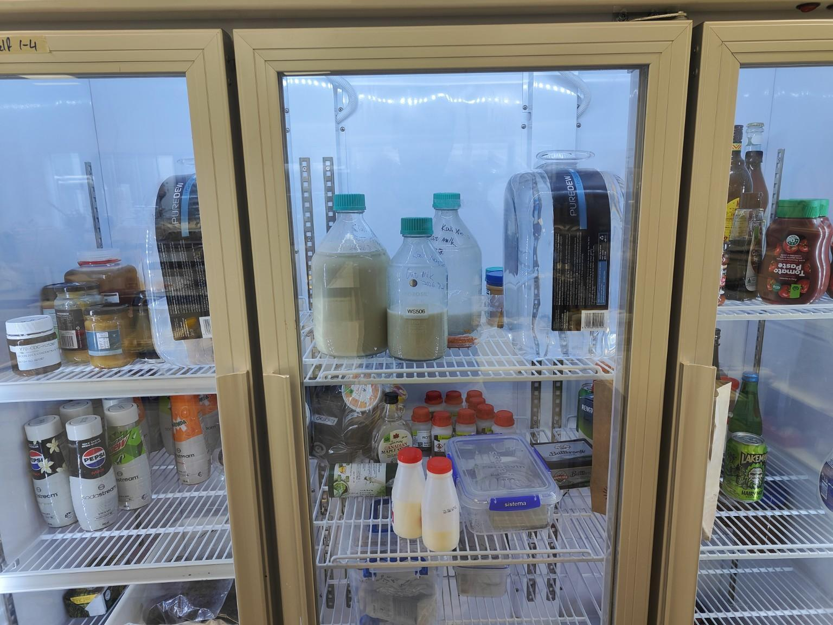
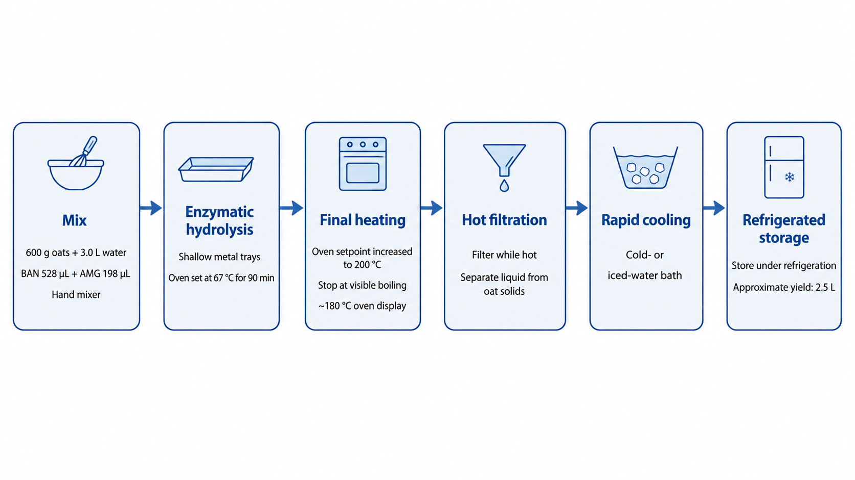
PROCESSING
Oat beverage process
600 g + 3 L
rolled oats + water
BAN 528 µL
AMG 198 µL
Mix
Enzymatic
hydrolysis
Empirical final
heating
Hot
filtration
Rapid
cooling
Functional
formulation
Protein
enrichment
67 °C oven setpoint for 90 min
Final heating: oven set to 200 °C, stopped at visible boiling. Product temperature was not measured.
≈2.5 L filtered beverage recovered
Kali Mana, AUT 2026
08
Notes:
The selected base used 600 grams of oats and 3 litres of water with BAN and AMG enzymes. The trays remained in an oven set to 67 degrees Celsius for 90 minutes to approach the intended hydrolysis conditions. A short empirical final heating step followed, with the oven set to 200 degrees and the process stopped after visible boiling as the display approached 180 degrees. This does not mean the beverage reached 180 degrees. Product temperature was not measured, so this was not a validated pasteurisation schedule.
Source: Kali Mana, AUT Internship Report, 2026, pp. 5–6.

Slide 9
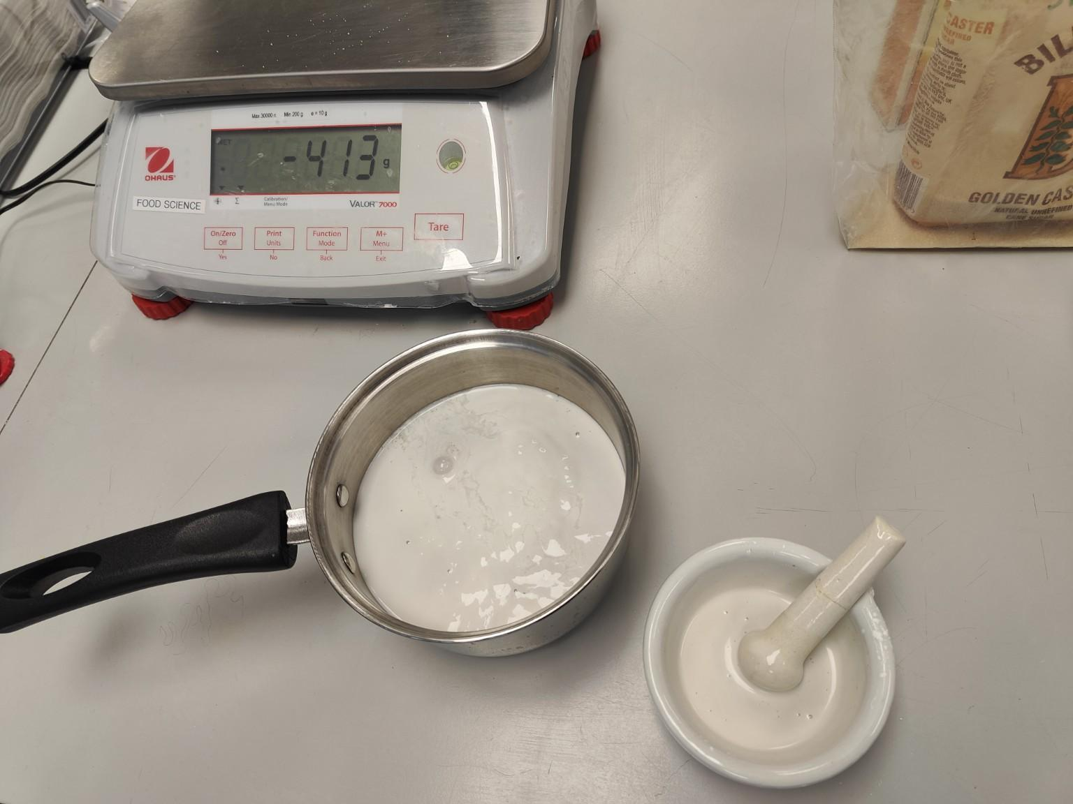
FORMULATION
From selected base to functional beverage
375 g
≈2.5 L
Coconut caramel
50 mL
selected oat-beverage base
Tulsi extract
3.25 g
Xanthan gum
5.00 g
Protein powders were added after the common functional base had been prepared.
Salt
Kali Mana, AUT 2026
09
Notes:
After filtration and cooling, the selected oat beverage became a common functional base. For approximately 2.5 litres, the formulation included coconut caramel, Tulsi extract, xanthan gum and salt. The protein powders were not added during enzymatic hydrolysis. They were incorporated only after the common functional beverage had been prepared. This order meant that the final sensory samples shared the same base and differed mainly in the source and quantity of the protein powders.
Source: Kali Mana, AUT Internship Report, 2026, pp. 6–7.

Slide 10
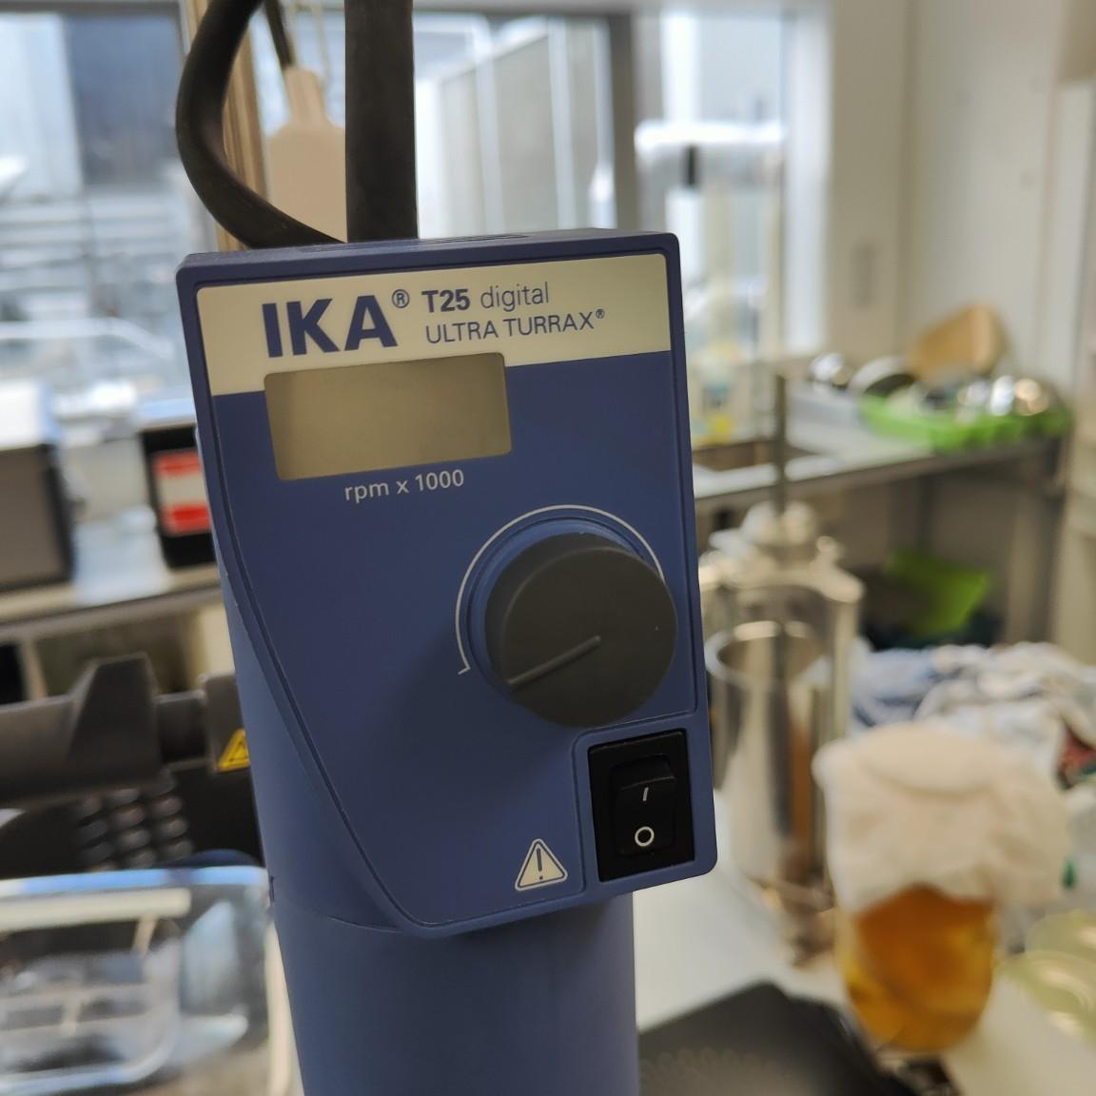
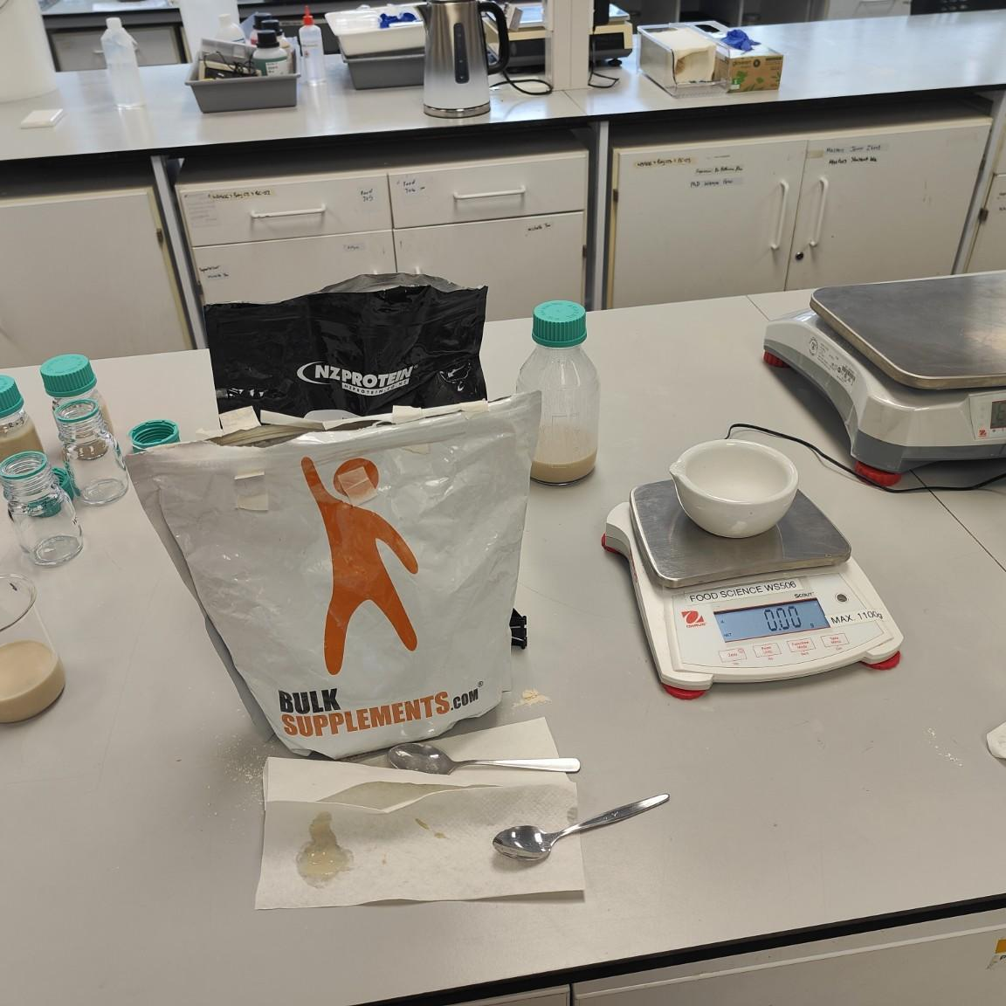
FORMULATION
Protein incorporation: trial and error
SELECTED PRACTICAL METHOD
Mortar + sieve
1 Powder + small
beverage volume
2 Paste
formation
3 Progressive
dispersion
Ultra-Turrax
Sonication
4 Sieve and crush
agglomerates
5 Reincorporate
into full beverage
High shear was useful for small-volume trials, but persistent lumps and powdery sensations remained. The available head was poorly suited to large batches.
Considered and tested during preliminary work. Undesirable flavour changes and persistent agglomerates prevented selection.
The most sophisticated equipment was not the most effective option under the available conditions.
Kali Mana, AUT 2026
10
Notes:
Direct powder addition produced strong agglomeration, so I compared several dispersion approaches. The Ultra-Turrax provided high shear for small volumes but did not remove the powdery sensation or lumps sufficiently, and the small head was not adapted to the full batch size. Sonication also produced undesirable changes and was not retained. The most practical method was to form a concentrated paste in a mortar, add beverage progressively, pass the dispersion through a sieve and crush the remaining agglomerates before reincorporation.
Source: Kali Mana, AUT Internship Report, 2026, pp. 7 and 15.

Slide 11
SCREENING
Preliminary screening changed the formulation strategy
SOY PROTEIN SCREENING
Viscosity
Soy addition increased apparent viscosity from 30.0 to 136.6 mPa·s across the nominal screening range.
Thermal sensitivity
The nominal 4% rice pilot increased from ≈11.6 to 86.1 mPa·s after exploratory heating.
Practical observations
High additions produced lumps, powderiness, bitterness and an excessively thick or yoghurt-like texture.
Decision: compare blends at a lower common enrichment target
Kali Mana, AUT 2026
11
Notes:
The preliminary trials identified the conditions that would not be suitable for the final sensory test. In the soy series, apparent viscosity at around 100 inverse seconds increased from 30.0 millipascal-seconds for the control to 136.6 at the nominal six-percent level. A separate rice pilot became much thicker after heating. Practical observations also showed lumps, powderiness, bitterness and, at high soy additions, a yoghurt-like texture. These results supported the decision to test blends at a lower common enrichment target.
Source: Kali Mana, AUT Internship Report, 2026, pp. 13–15.

Slide 12
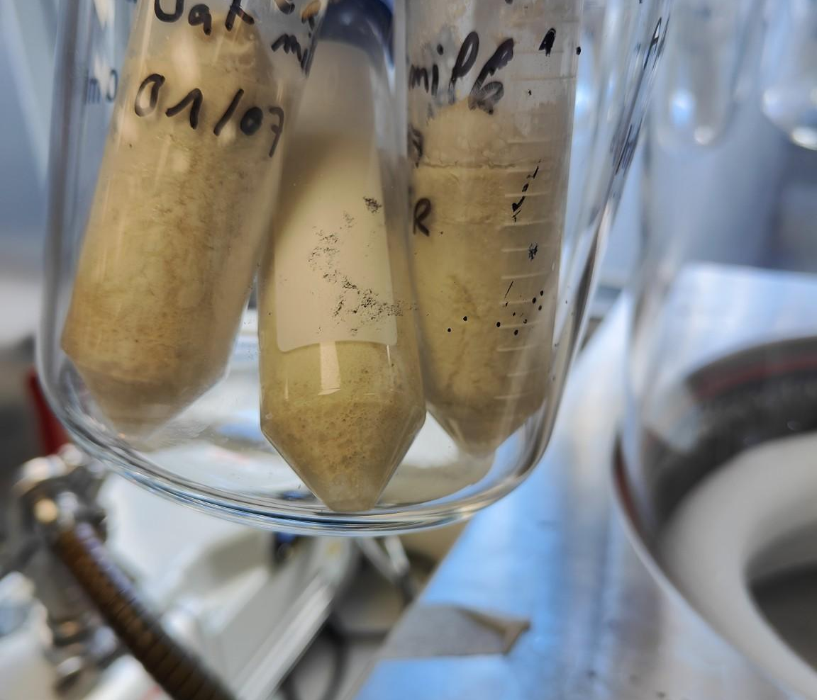
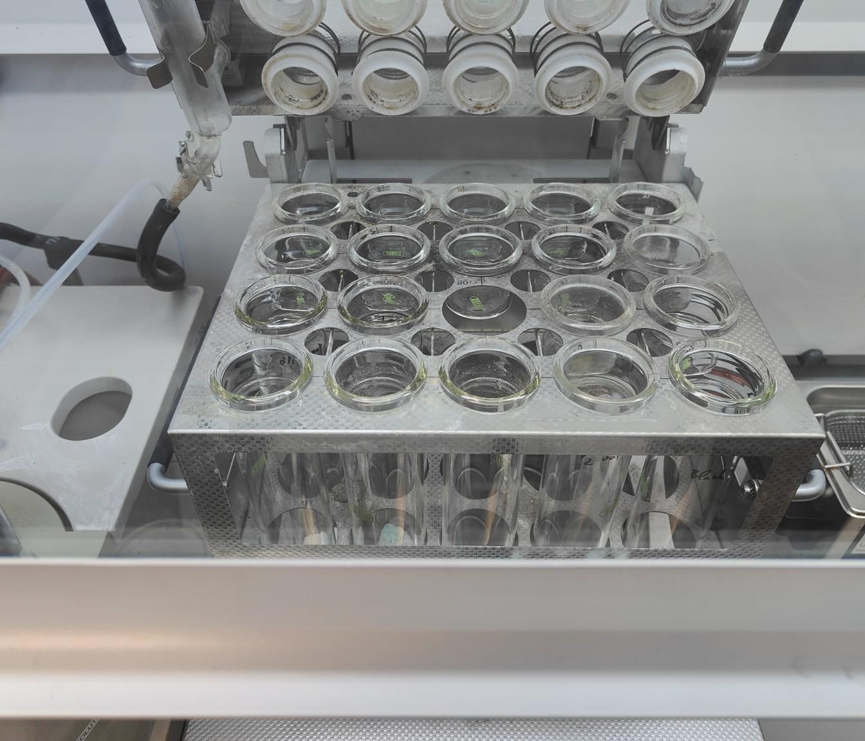
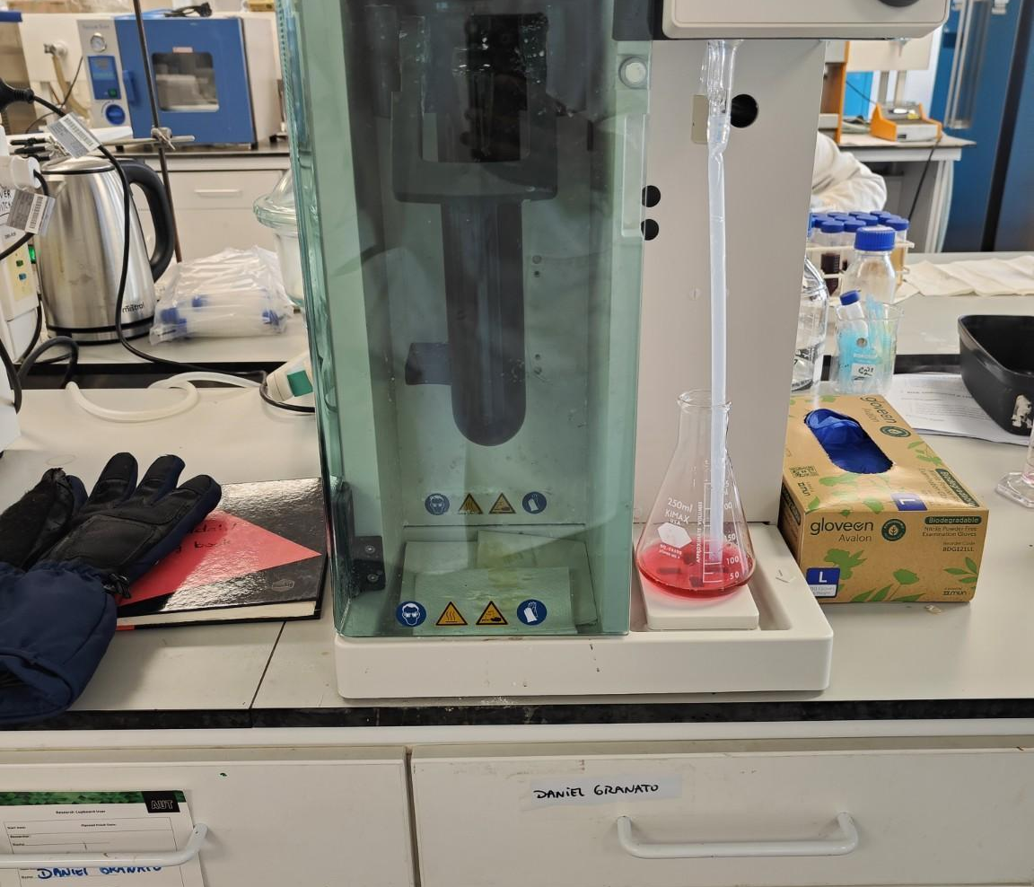
ANALYTICAL CHARACTERISATION
Kjeldahl analysis corrected the protein basis
2.39 ± 0.17
g protein / 100 mL
Selected oat-beverage base
n = 3 analytical replicates
Freeze-dry
Digest
Distil
Titrate
Calculate N
Convert to protein
≈1.000 g dry sample, CuSO₄ + K₂SO₄ + H₂SO₄, 0.100 mol/L HCl, factor 5.83
This measured result replaced the previous 1% working assumption.
Kali Mana, AUT 2026
12
Notes:
The preliminary calculations assumed that the base contained about one percent protein. I performed Kjeldahl analysis to establish an experimental value. Freeze-dried samples were digested, distilled and titrated with 0.100 molar hydrochloric acid. Total nitrogen was converted using the oat-specific factor of 5.83. The selected batch contained 2.39 plus or minus 0.17 grams of protein per 100 millilitres. The three values represent analytical replicates from one homogenised batch, not independent production batches.
Source: Kali Mana, AUT Internship Report, 2026, pp. 9–10 and 16.

Slide 13
FORMULATION DESIGN
Final protein formulations
All enriched samples were designed for a closely matched theoretical protein level.
156
235
320
473
589
667
798
Pea / Rice
50:50
Pea / Soy
50:50
Soy / Rice
50:50
Rice
100%
Soy
100%
Control
Soy / Rice / Pea
40:30:30
4.85%
4.85%
4.85%
4.85%
4.85%
2.39%
4.85%
Calculated estimates based on measured base protein, added powder mass and declared powder protein content.
Soy 90%, rice 80%, pea 80%. Enriched products were not directly reanalysed by Kjeldahl.
Kali Mana, AUT 2026
13
Notes:
The final comparison included six enriched formulations and one control. Each enriched sample was calculated to contain approximately 4.85 percent protein, while the control remained at 2.39 percent. Keeping the estimated protein level similar allowed the sensory comparison to focus mainly on protein source and blend. These enriched values are theoretical estimates. They combine the measured protein in the base, the powder mass and the manufacturer declarations of 90 percent for soy and 80 percent for rice and pea. The enriched beverages were not directly reanalysed by Kjeldahl.
Source: Kali Mana, AUT Internship Report, 2026, pp. 10–11 and 17.

Slide 14
SENSORY EVALUATION
Sensory test design
25
7
10 mL
24 Aug
Randomised order in Qualtrics
participants
coded samples
per sample, served cold
AUT Food Lab
1
2
3
4
5
Receive coded sample
Taste
Rate in Qualtrics
Rinse with water
Next sample
Overall liking, colour, taste, flavour, consistency and mouthfeel
JAR, CATA, purchase intention and final preference
Protein dispersions rested for at least 30 min and were agitated before pouring.
Kali Mana, AUT 2026
14
Notes:
The exploratory sensory test took place on 24 August in the AUT Food Lab with 25 convenience participants. Every participant evaluated all seven coded formulations, served cold in 10-millilitre portions. Qualtrics randomised the sample order for each participant. The questionnaire combined overall liking and other hedonic attributes with just-about-right scales, check-all-that-apply descriptors, purchase intention and final preference. The enriched dispersions rested for at least 30 minutes and were agitated immediately before pouring to limit sedimentation effects.
Source: Kali Mana, AUT Internship Report, 2026, pp. 11–12.

Slide 15
RESULTS
Overall liking identified candidate 798
7.04 / 9
Control 667 · highest mean
6.56 / 9
798 · best enriched mean
40% soy / 30% rice / 30% pea
Overall formulation effect
Friedman χ²(6) = 27.56
p < 0.001
Kendall's W = 0.184
Control vs 798: Holm-adjusted p = 0.104
Kali Mana, AUT 2026
15
Notes:
Overall liking differed across the seven formulations. The Friedman test gave chi-squared 27.56 with p below 0.001, although Kendall’s W of 0.184 indicates a modest effect size. The control achieved the highest mean score at 7.04 out of 9. Candidate 798, containing 40 percent soy, 30 percent rice and 30 percent pea protein, was the best enriched formulation at 6.56. In the planned comparison, no significant difference was detected between the control and 798 after Holm adjustment, with p equal to 0.104. This does not establish equivalence.
Source: Kali Mana, AUT Internship Report, 2026, pp. 17–18.

Slide 16
CANDIDATE SELECTION
Why formulation 798 was selected
Overall liking
Balanced JAR profile
6.56 / 9
Highest mean among enriched formulations
Sweetness 84% · bitterness 60%
Flavour intensity 88%
Creaminess 84% · thickness 80%
798
Selected development
candidate
Planned comparison
No significant difference detected versus control
pHolm = 0.104
Descriptors
40% soy
30% rice
30% pea
Relatively low beany/soy-like perception and the lowest gritty/sandy frequency among enriched samples.
MAIN LIMITATION
Powdery / chalky and gritty / sandy mouthfeel
A promising candidate for development, not a validated commercial product.
Kali Mana, AUT 2026
16
Notes:
Formulation 798 was selected using several criteria rather than overall liking alone. It achieved the highest mean liking among the enriched samples, and the planned comparison with the control did not detect a significant difference. Its JAR profile was relatively balanced for sweetness, flavour intensity, creaminess and thickness. It also showed relatively low beany perception and the lowest gritty frequency among enriched products. However, particle-related mouthfeel remained the main limitation. For that reason, 798 is a development candidate, not a validated final product.
Source: Kali Mana, AUT Internship Report, 2026, p. 18.

Slide 17
NEXT STEPS
Limitations translated into a development roadmap
01
Protein dispersion
02
Thermal validation
Prehydration, addition order, finer sieving, suitable homogenisation and particle-size measurement
Direct product-temperature monitoring with calibrated probes and data logging
03
Composition
04
Repeatability
Direct protein analysis of the final enriched beverage
At least three independent control and 798 batches; yield, pH, rheology, particle size and sedimentation
05
Food safety
06
Sensory confirmation
Microbiological analysis and shelf-life testing; pH alone is insufficient
A larger and more representative consumer panel
Proposed next experiment
Control vs 798, replicated production, thermal monitoring, rheology, particle size, Kjeldahl and sensory confirmation
Kali Mana, AUT 2026
17
Notes:
Each limitation points to a specific next experiment. Protein dispersion should be improved through controlled hydration, a better addition sequence, finer separation and more suitable homogenisation. The thermal process requires direct product-temperature monitoring. The enriched beverage should be analysed directly for protein. Manufacturing repeatability should be tested with at least three independent control and 798 batches. Microbiological and shelf-life work is essential because pH alone cannot demonstrate safety. Finally, a larger consumer panel should confirm whether the sensory pattern remains stable.
Source: Kali Mana, AUT Internship Report, 2026, pp. 19–20.

Slide 18
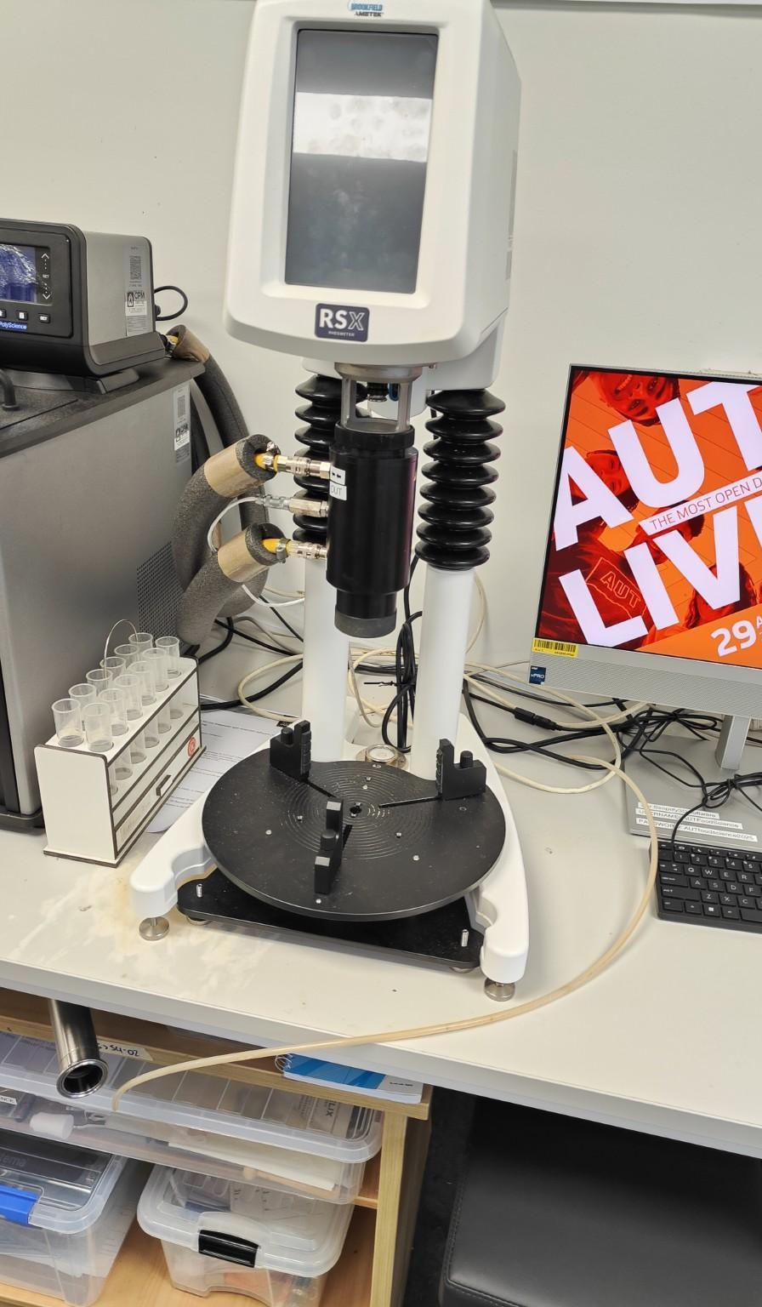
PROFESSIONAL OUTCOMES AND CONCLUSION
Engineering is also knowing when an experimental plan must change.
ADAPTATION
The VR study was redirected when experimental reliability could not be guaranteed.
ANALYTICAL RESULT
Selected base: 2.39 ± 0.17 g protein / 100 mL.
DEVELOPMENT RESULT
Theoretical enriched level ≈4.85%; 798 was the strongest enriched candidate, with powdery and gritty mouthfeel still unresolved.
Thank you
Questions?
Technical
Processing, formulation, rheology, Kjeldahl and sensory preparation
Professional
Working in English, troubleshooting, autonomy, traceability and project redirection
Kali Mana, AUT 2026
18
Notes:
This internship developed both technical and professional skills. I gained practical experience in oat processing, enzyme-assisted production, plant protein formulation, rheology, freeze-drying, Kjeldahl analysis and sensory preparation. I also improved my data traceability, Qualtrics work and interpretation of non-parametric statistics. The main lesson was that engineering includes recognising when a plan can no longer produce reliable evidence and changing direction responsibly. The project established a measured base protein value and identified 798 as the strongest enriched candidate, while clearly defining the dispersion work still required. Thank you for listening. I am ready for your questions.
Source: Kali Mana, AUT Internship Report, 2026, pp. 19–20.

Slide 19
BACKUP
Detailed oat beverage process
Stage | Inputs / conditions | Key control point
Base | 600 g oats + 3.0 L water | Hand mixing; shallow trays
Enzymes | BAN 528 µL + AMG 198 µL | Scaled to batch size
Hydrolysis | Oven set to 67 °C for 90 min | Product temperature not continuously measured
Final heating | Oven set to 200 °C, then stop at visible boiling | Empirical inactivation step, not validated pasteurisation
Recovery | Hot filtration, then cold or iced-water cooling | ≈2.5 L filtered beverage
Functional base | 375 g caramel, 50 mL Tulsi, 3.25 g xanthan and 5.00 g salt | Protein added after this stage
Coconut caramel: 400 g coconut cream + 250 g brown sugar + 5 g corn starch + 0.5 g salt + 2 g vanilla
Appendix
19
Notes:
Backup detail for questions about the selected oat beverage process.
Source: Kali Mana, AUT Internship Report, 2026, pp. 5–7.

Slide 20
BACKUP
Preliminary rheology
SOY: NOMINAL PRELIMINARY LEVELS
RICE: EXPLORATORY HEATING PILOT
Single screening runs. Preliminary nominal percentages used the earlier 1% base-protein assumption.
Appendix
20
Notes:
Backup chart using the exact apparent-viscosity values reported at approximately 100 inverse seconds. Raw curve data were not included in the supplied report.
Source: Kali Mana, AUT Internship Report, 2026, pp. 14–15.

Slide 21
BACKUP
Kjeldahl method
Freeze-drying
≈1.000 g sample
Digestion
Distillation
0.100 mol/L HCl
Calculation
Vcorrected = Vsample − Vblank
Nitrogen (% DM) = Vcorrected × CHCl × 14.007 × 100 / (m × 1000)
Protein (% DM) = Nitrogen (% DM) × 5.83
Protein (g/100 mL) = Protein (% DM) × dry matter (g/100 mL) / 100
Reagents
≈0.5 g CuSO₄, 7 g K₂SO₄, 10 mL concentrated H₂SO₄ and boric-acid indicator solution
Appendix
21
Notes:
Backup equations and analytical workflow used for Kjeldahl protein determination.
Source: Kali Mana, AUT Internship Report, 2026, pp. 9–10.

Slide 22
BACKUP
Kjeldahl calculation example: selected batch replicate 1
01
Measured HCl
13.95 mL
02
Blank correction
13.95 − 0.45 = 13.50 mL
03
Nitrogen in dry matter
1.8909%
04
Protein in dry matter
1.8909 × 5.83 = 11.024%
05
Selected-batch dry matter
14 g / 60 mL = 23.33 g/100 mL
06
Protein in beverage
11.024 × 23.33 / 100 = 2.572 g/100 mL
Replicate result: 2.572 g protein / 100 mL
Appendix
22
Notes:
Backup calculation based on the first analytical replicate from the selected batch. The sample mass was approximately 1.000 g.
Source: Kali Mana, AUT Internship Report, 2026, Appendix A, p. 22.

Slide 23
BACKUP
Complete final formulation table
Code | Protein composition | Soy (g) | Rice (g) | Pea (g) | Total powder (g) | Estimated protein (%)
156 | Pea / Rice 50:50 | — | 6.45 | 6.45 | 12.90 | 4.85
235 | Pea / Soy 50:50 | 6.06 | — | 6.06 | 12.12 | 4.85
320 | Soy / Rice 50:50 | 6.06 | 6.06 | — | 12.12 | 4.85
473 | Rice 100% | — | 12.91 | — | 12.91 | 4.85
589 | Soy 100% | 11.42 | — | — | 11.42 | 4.85
667 | Control | — | — | — | 0.00 | 2.39
798 | Soy / Rice / Pea 40:30:30 | 4.91 | 3.68 | 3.68 | 12.27 | 4.85
The 4.85% values are corrected theoretical estimates, not direct Kjeldahl measurements of the enriched products.
Appendix
23
Notes:
Backup table reproducing the final formulation design from the report.
Source: Kali Mana, AUT Internship Report, 2026, Table 6, p. 11.

Slide 24
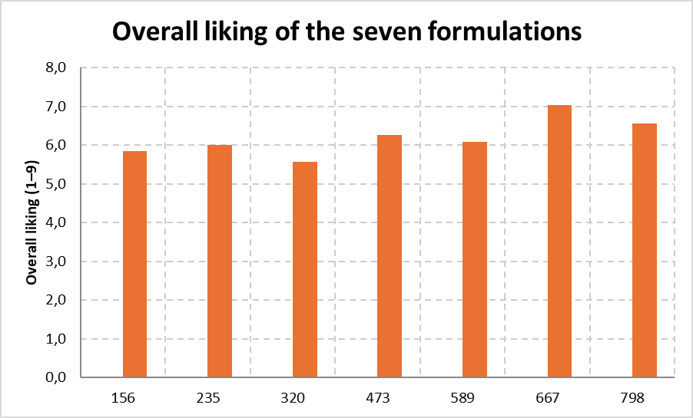
BACKUP
Hedonic results: complete visual and reported values
Code | Formulation | Mean ± SD / 9
156 | Pea / Rice 50:50 | Not stated in report text
235 | Pea / Soy 50:50 | Not stated in report text
320 | Soy / Rice 50:50 | 5.56 ± 1.66
473 | Rice 100% | 6.27 ± 1.81
589 | Soy 100% | 6.09 ± 1.83
667 | Control | 7.04 ± 1.70
798 | Soy / Rice / Pea 40:30:30 | 6.56 ± 1.72
The chart shows all seven means. Exact mean ± SD values for 156 and 235 were not available in the supplied text, so they were not inferred.
Appendix
24
Notes:
Backup hedonic results. The original report chart is retained to show all seven products; the table includes every exact mean and standard deviation stated in the supplied materials.
Source: Kali Mana, AUT Internship Report, 2026, pp. 17–18.

Slide 25
BACKUP
JAR profile of candidate 798
798
The most balanced JAR profile among the enriched formulations
Bitterness showed the lowest central response at 60%.
Appendix
25
Notes:
Backup visual of the exact central JAR percentages reported for candidate 798.
Source: Kali Mana, AUT Internship Report, 2026, p. 18.

Slide 26
BACKUP
CATA descriptors linked to particle-related mouthfeel
Descriptor | Control 667 | Enriched formulations | Interpretation
Powdery / chalky | 24% | 48–60% | Protein enrichment increased powder-related perception
Gritty / sandy | 0% | 20–36% | Absent in control; present across enriched products
Smooth | 60% | 32–48% | Control was more often described as smooth
Beany / soy-like | — | 798 = 24% | Lowest frequency among enriched formulations
Particle-related mouthfeel
Primary formulation issue
798 reduced, but did not eliminate, this limitation.
Appendix
26
Notes:
Backup CATA summary using only frequencies and ranges explicitly reported in the supplied report.
Source: Kali Mana, AUT Internship Report, 2026, p. 18.

Slide 27
BACKUP
Purchase intention and final preference
44%
Control 667
11 of 25 first-choice votes
Positive purchase intention
Control: 56%
Enriched formulations: 16–28%
Preference varied across the enriched formulations.
Appendix
27
Notes:
Backup preference and purchase-intention results using the exact values provided in the report.
Source: Kali Mana, AUT Internship Report, 2026, p. 18 and Appendix C.

Slide 28
BACKUP
Study limitations
Manufacturing
Kjeldahl
One experimental preparation; no independent batch replication
Analytical replicates from one homogenised batch
Sensory panel
Protein estimate
n = 25 convenience participants; limited habitual oat-beverage consumption
Final enriched products were not directly analysed by Kjeldahl
Thermal process
Safety and shelf life
No validated product-temperature profile
No microbiological shelf-life validation
These results guide further development; they do not validate a commercial product or shelf life.
Appendix
28
Notes:
Backup summary of the principal study limitations that constrain interpretation and generalisation.
Source: Kali Mana, AUT Internship Report, 2026, p. 19.

