Slide 1
Gene Prediction Model – Neural Network
Structure：
Three fully connected layer
Regarding the structure of the model: it is divided into an input layer, three fully connected layers and an output layer.

Slide 2
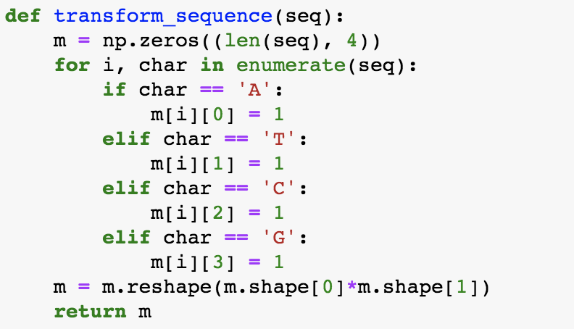
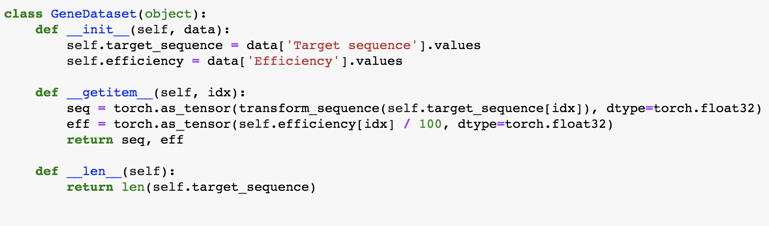
Code and result :
1. Construct Dataset :
Build a gene sequence dataset. The first is sequence encoding. I vectorize the gene sequence into a 4 by 23 vector, and then reshape this vector into a 1x23x4 feature map. I used 1000 samples as the training set and 186 samples as the test set.

Slide 3
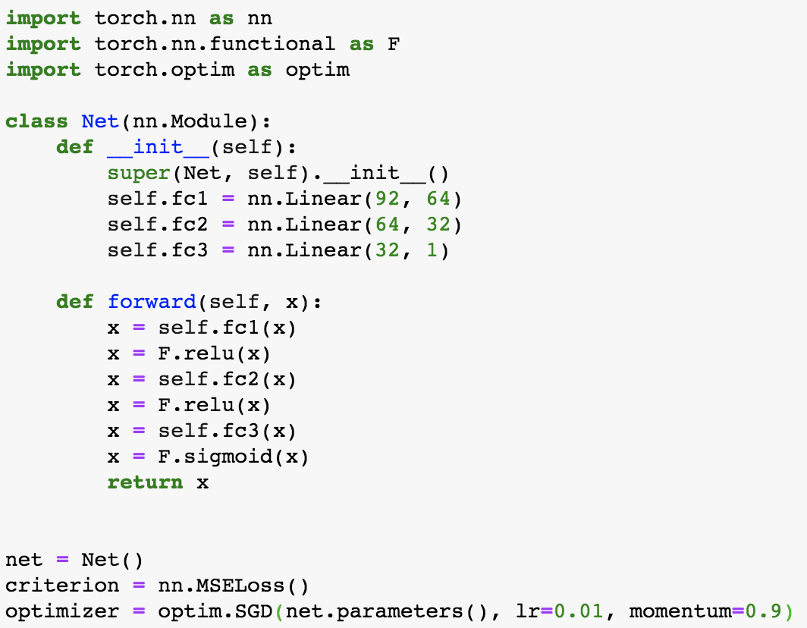
2. Construct Neural Network:
construction and the training of the neural network model :
In the middle are three fully connected layers, which linearly combine the feature dimensions of the previous layer and remap to the new dimensions. However, I have added a rectified linear unit function to each layer here, so that we can not only learn about linear transformations, but also learn non-linear features. The first layer, originally 92-dimensional, is mapped to 64-dimensional. The second layer, which was originally 64 dimensions, maps to 32 dimensions. The third layer is mapped from 32-dimensional to 1-dimensional. During training, I set 500 epochs. On the right is my training result. You can see that when looping to the last epoch, the model's loss dropped to 0.03.

Slide 4
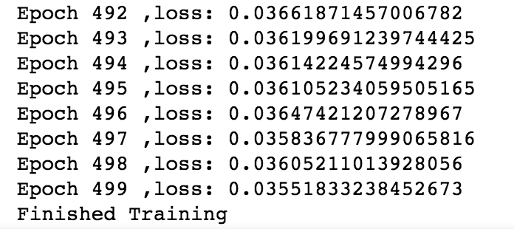
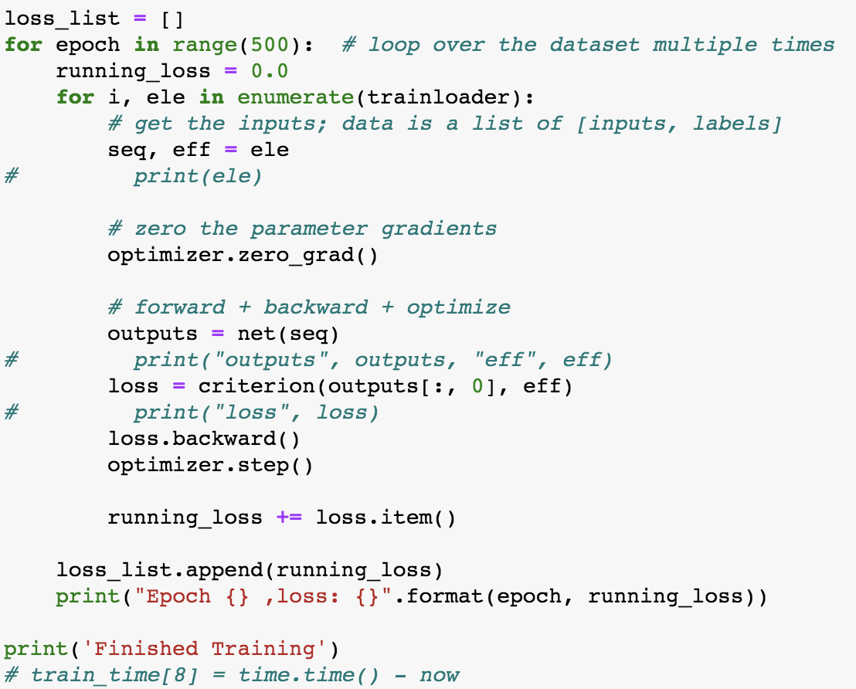
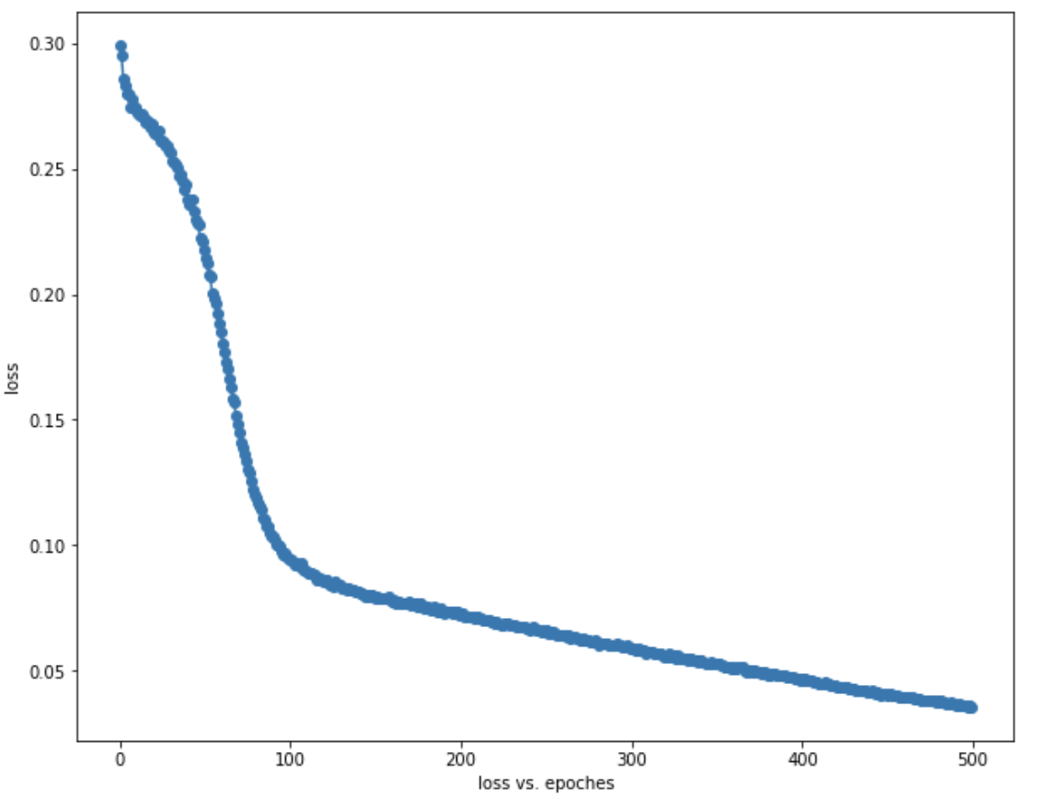
3. Training model:

Slide 5
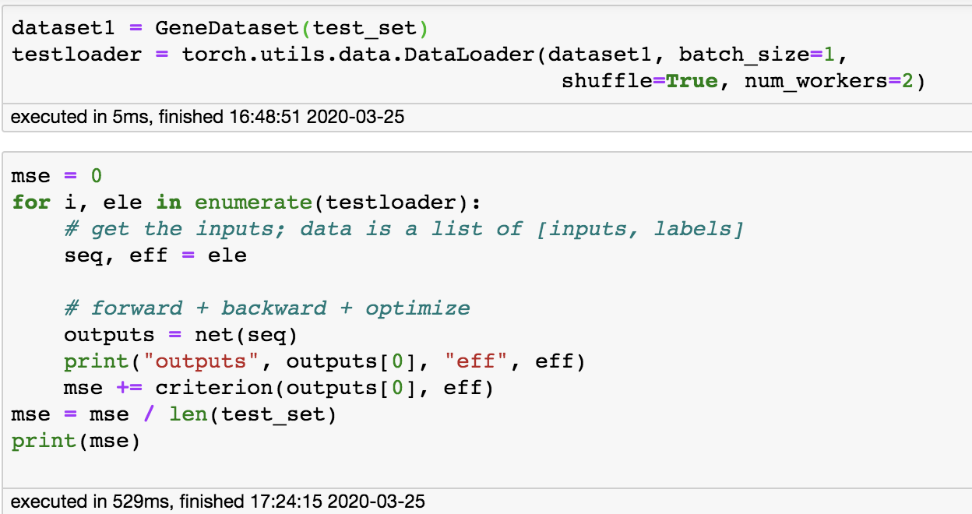
4. Test and result:
MSE | 0.0052
RMSE | 0.072

