Slide 1




Entity Summarization with User Feedback
Qingxia Liu¹, Yue Chen¹, Gong Cheng¹, Evgeny Kharlamov^{2,3}, Junyou Li¹, and Yuzhong Qu¹
¹ National Key Laboratory for Novel Software Technology, Nanjing University, China
² Department of Informatics, University of Oslo, Norway
³ Bosch Center for Artificial Intelligence, Robert Bosch GmbH, Germany

Slide 2
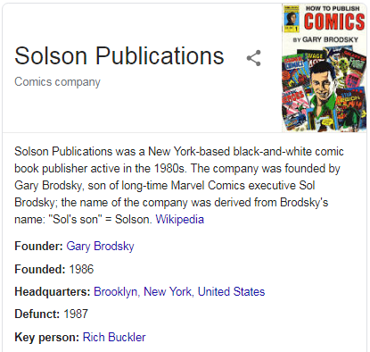
Entity Summarization
RDF Dataset: T
triple t∈T: <subj, pred, obj>
Entity Description: Desc(e)
Desc(e) = {t∈T: subj(t)=e or obj(t)=e}
t∈Desc(e): <e, prop, value>
Entity Summarization: S(e, k)
S⊆Desc(e) , |S|≤k
Organization
Company
Rich Buckler
keyPerson
type
Gary Brosky
type
Brooklyn
headquarters
Solson Publications
founder
industry
founded
“1986”
comics
label
subject
defunct
United States-themed superheroes
“Solson Publications”
“1987”

Slide 3
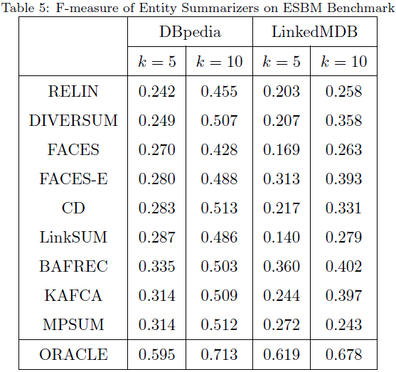
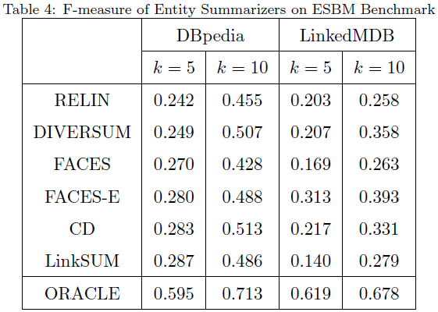
Entity Summarization Methods
Goal
to satisfy users’ information needs
Limitations
have large diff from user-created (F1<0.6)
=> do not meet users’ expectations
summaries are static
=> cannot adjust to users
A lack of mechanisms for improving an entity summary
when its quality could not satisfy users’ information needs.

Slide 4

Adding User in the Loop
Summarizer
Summarizer
User
Our proposal: cooperation between summarizer and user
involve users in the summarization process
ask users for feedback
utilize user’s feedback when computing summaries

Slide 5
Adding User in the Loop
Summarizer
Summarizer
User
Research Challenges
[C1] Cooperative process of 2 agents
How to represent the process?
[C2] Combining results of actions of 2 agents
How to represent interdependence between summary and feedback?
Notes:
Research challenges
To represent the cooperative process using a formal model
To represent the interdependence of the current summary and the user feedback

Slide 6
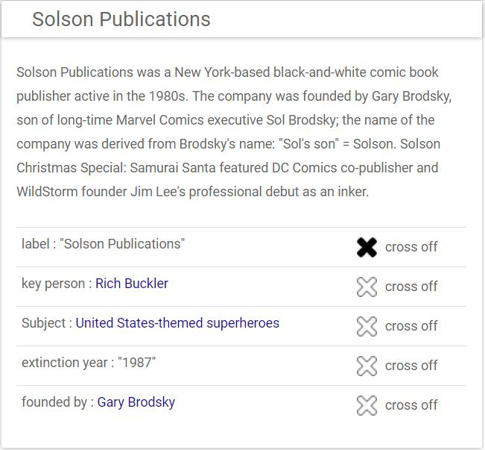
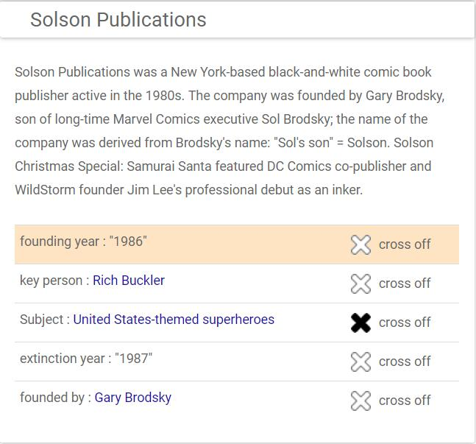
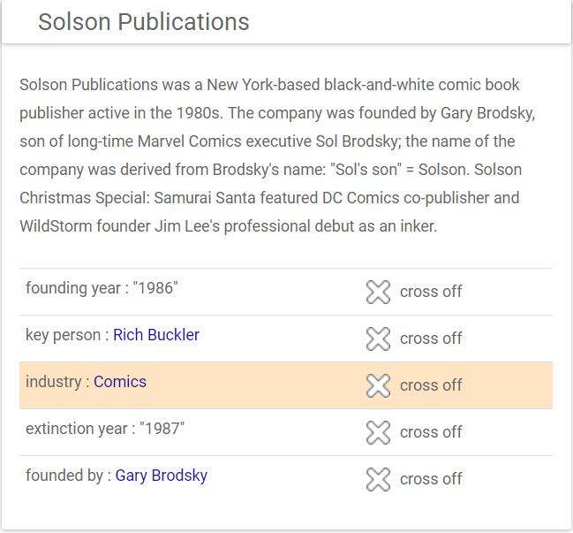
Cross-Replace Scenario
Cooperation Process
Summarizer: presents (current) summary S_{i}
User: crosses off an irrelevant triple as negative feedback f_{i}
Summarizer: replaces it with a new triple r_{i} ,
presents an improved summary S_{i+1}
User: … (repeated)
Solson Publications
replaced by
f₀
r₀
replaced by
f₁
r₁
S₀
S₁
S₂
Notes:
describe the cooperative process

Slide 7

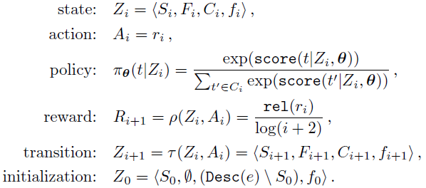




Our Approach: DRESSED
[C1] Representation of the Cross-Replace Scenario
Markov Decision Process (MDP) based modeling
Summarizer = reinforcement learning agent
Setting:
agent: summarizer
environment: Desc(e), user
Feedback
Solson Publications
- Label: “Solson Publications”
- Key person: Rich Bucker
- Subject: United State-themed superheroes
- Extinction year: “1987”
- Founded by: Gary Brodsky
Current Summary
Candidate Facts
Replace
- Industry: Comics
- Name: “Solson Publications”
- Founding year: “1986”
…

Slide 8
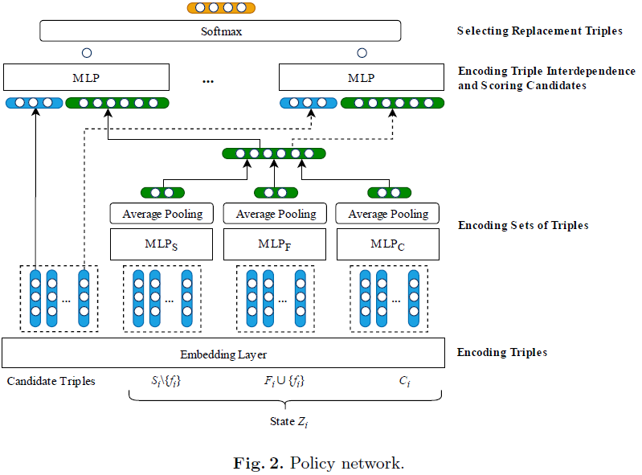

Our Approach: DRESSED
[C2] Representation of Triple Interdependence
Policy Network
Encoding triples
Encoding sets of triples
Encoding triple interdependence
and scoring candidates
Selecting replacement triple

Slide 9


Our Approach: DRESSED
Policy Learning
Learning task: to find a policy that maximize the expected reward
REINFORCE: a standard policy gradient method in reinforcement learning
to maximize the expected reward

Slide 10
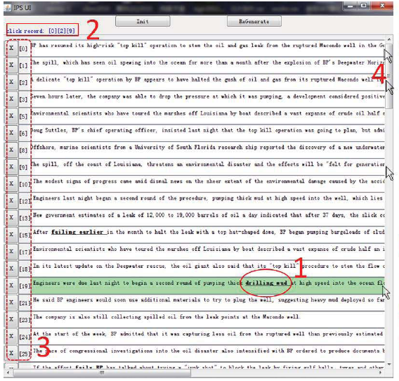
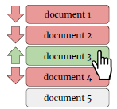
Baselines Adapted for Evaluation
Entity Summarization
(not utilize user feedback)
FACES-E: rank triples and select top-k as summary
Interactive Document Summarization
(Re-compute doc summaries utilizing user feedback)
IPS
positive feedback
Interactive Document Retrieval
(Re-rank retrieved documents based on user feedback)
NRF
negative relevance feedback
query-based
PDGD -L, -N
positive feedback
SOTA online learning to rank
utilize user feedback for model selection
(not as input of the model)
generate
model
query
update
generate
model
update

Slide 11
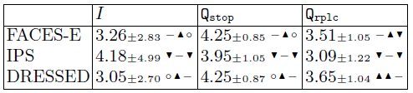
Experiment 1: User Study
Setting
24 participants
train: Entity Summarization Benchmark (ESBM)
test: re-sampled entities from
DBpedia and LinkedMDB
Results
DRESSED: in general best-performing
with FACES-E and DRESSED
users stop quickly: I < 4
obtain reasonably good results: Q_stop > 4
replacement triples selected by DRESSED significantly better than the ones of FACES-E
Metrics:
I = number of iterations
Q_{rplc} = user rating of suggested replacements (1-5)
Q_{stop} = user rating of the final summary after all iterations (1-5)

Slide 12
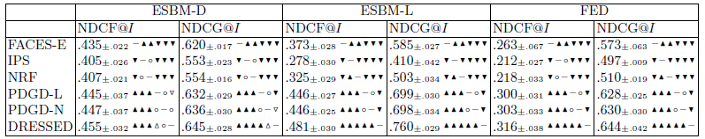
Experiment 2: Offline Evaluation
Benchmarks
ESBM (ESBM-D, ESBM-L), FED
Metrics
NDCF: for summary sequence
Normalized Discounted Cumulative F1
NDCG: for replacement sequence
Normalized Discounted Cumulative Gain
Results
DRESSED outperforms
all baselines
on all datasets
DRESSED significantly outperforms
in most cases

Slide 13
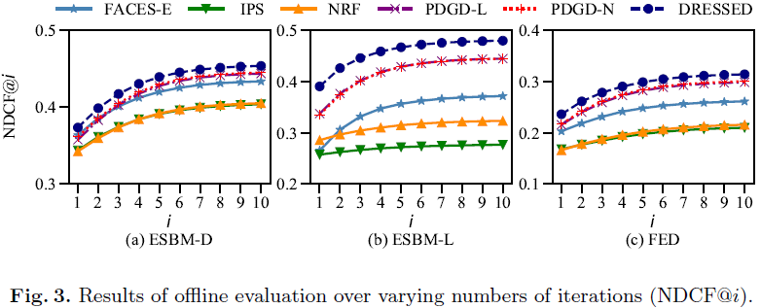
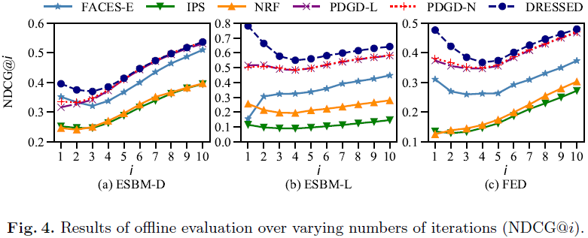
Experiment 2: Offline Evaluation
Iterations
DRESSED is consistently above all the baselines
DRESSED better exploits early feedback to quickly improve computed summaries
Notes:
very high value NDCG@1=0.782 on ESBM-L

Slide 14
Conclusion and Future Work
Our Approach: DRESSED
showed better performance than baselines
has the potential to replace static entity cards
Future Work
cross-replace scenario
can be extended to support other scenarios:
multi-feedback, without replacement, positive feedback
extend the scope of entity summary
deal with paths, more complex structures, RDF sentence

Slide 15
Take-home Message
Contributions
The first research effort to improve entity summarization with user feedback.
A representation of entity summarization with iterative userfeedback.
cross-replace scenario, MDP
A representation of set of triples and their interdependence as a novel DNN.
DRESSED, solve by RL
The first empirical study of entity summarization with user feedback.
based on real users and simulated users
DRESSED
Deep Reinforced Entity Summarization with uSer fEedback
GitHub Repository: nju-websoft/DRESSED

Slide 16
Thank you !
Questions ?

