Slide 1
HACK ARMENIA · DEMO DAY · AUGUST 9, 2026
armenian.cc
Learn the Armenian language people actually speak — the missing step between living in Armenia and belonging to it.
Tigran Andreasyan · Silvi Avayan · Ilya Lysenkov

Slide 2
THE PROBLEM
In Armenia — but not part of it
Newcomers to Armenia, from Russian speakers, Iranians and Indians to returning diaspora, work and rent here for years, yet stay outside the society they live in. The first barrier to integration is language: not the textbook kind, but the one spoken around them every day.
100K+
Russian speakers moved to Armenia since 2022, plus returning diaspora
Ministry of Economy of Armenia, 2022
500K
people watched the first lesson of a YouTube Armenian course; only 40K reached the last
0
big language apps teach Armenian (Duolingo, Babbel, Rosetta Stone, Busuu)
People start learning Armenian, then quit: lessons have to be engaging. And the street language already lives in the most engaging format ever invented, short viral video.

Slide 3
WHAT WE BUILT — LIVE DEMO
Viral TikToks become lessons
armenian.cc turns trending Armenian TikToks into interactive lessons for Russian speakers.
Watch real life
Fresh viral videos from Armenian TikTok: jokes, street interviews, kitchens. The language exactly as people speak it.
Understand every word
Hover a word for its Russian meaning in this exact context, with grammar notes.
Absorb the cultural code
Lessons are whatever Armenia is watching right now: the memes, the humor, what the country cares about this week. Language plus cultural code is what integration is made of.
Սիրում
люблю
եմ
(вспом. «быть»)
քեզ
тебя
armenian.cc

Slide 4
TO BE CLEAR
What we came with, what we built here
Before the hackathon
armenian.cc itself: the frontend, the backend video pipeline, the live site. An ongoing project.
During the 24 hours
Everything that makes it trustworthy: a ground-truth dataset of real Armenian speech, a 33-model speech recognition benchmark, and an evaluation of Armenian translation. The next two slides.

Slide 5
BUILT AT THE HACKATHON · SPEECH RECOGNITION
Can AI hear Armenian? We measured 33 models
TikTok speech is its own world: noisy, informal, nothing like the read speech in existing Armenian datasets. So we built the ground truth ourselves: real TikTok audio, hand-corrected, split into five categories from formal speech to songs. Then we ran 33 ASR models against it.
Model · word error rate | Formal | Single speaker | Multi speaker | Songs | Difficult speech | Overall | Cost / hr
ElevenLabs Scribe v2 (what we ship) | 2.1% | 5.7% | 15.4% | 7.1% | 16.7% | 7.6% | $0.22
Gemini 3 Flash (preview) | 2.1% | 11.3% | 12.8% | 16.1% | 19.4% | 10.4% | $0.12
Gemini 3.6 Flash | 3.2% | 20.8% | 20.5% | 26.8% | 19.4% | 15.8% | $0.17
OpenAI gpt-transcribe | 3.2% | 20.8% | 25.6% | 21.4% | 47.2% | 19.1% | $0.27
OpenAI Whisper-1 | 35.1% | 71.7% | 74.4% | 44.6% | 61.1% | 52.9% | $0.36
…28 more in the repo: github.com/SilviAvayan/Armenian.cc/blob/main/ASR_EVALUATION.md
Cost is per hour of audio (from OpenRouter pricing). We ship the winner: best on real speech, plus the per-word timestamps and recognition confidence our platform needs.

Slide 6
BUILT AT THE HACKATHON · TRANSLATION
Are the word meanings actually right?
A fluent speaker hand-checked the app’s word meanings (gloss): 88% correct in context, 90% of sentences faithful. We benchmarked a dozen translation models in the same way.
Model · translation quality | Gloss (chrF++) | Sentence (chrF++) | Valid | Latency
Gemini 3.1 Flash-Lite (what we ship) | 71.7 | 74.1 | 100% | 1.5s
Gemini 3 Flash (preview) | 69.0 | 73.0 | 99% | 2.9s
Gemini 3.1 Pro | 63.4 | 67.2 | 98% | 14.6s
Gemini 2.5 Flash | 63.2 | 65.2 | 100% | 1.4s
GPT-4.1-mini | 58.7 | 55.4 | 100% | 3.4s
DeepSeek v3.1 | 55.8 | 57.6 | 100% | 10.6s
…Gemini 3.5 / 3.6 Flash, 2.5 Flash-Lite, GPT-4o-mini, DeepSeek v4 — full board in the repo
chrF++ = character match to a human translation (0–100). Flash-Lite wins on quality AND speed; the bigger reasoning tiers match quality but cost 4–10× the latency. And we don’t let AI grade itself — a self-check grader is trusted only after it matches the human (κ 0.66).

Slide 7
LIMITATIONS · FAILURE MODES · SAFETY
We know where it breaks, and what stops it
Speech recognition still gets about 8% of words wrong.
29% of word errors come from mishearing, not translation; the rest are slang, loanwords, and the auxiliary «է/եմ».
Guardrails: videos that fail production checks never publish —
• low confidence in speech recognition
• no speech
• non-Armenian
• prohibited content
Errors we find are corrected by hand.
Who could it harm? A learner memorizing a wrong meaning. The guardrails above exist to make that as rare as possible.

Slide 8
REAL-WORLD FEASIBILITY · REPRODUCIBILITY
Not a demo — running every day on real data
Live and automatic
Deployed at armenian.cc. New trending videos become lessons on a daily schedule, with no humans in the loop.
Cost and latency
One new video: $0.005 in API costs and 1 minute of processing, end to end.
Reproducible
The ground-truth dataset and the whole evaluation live in an open repo and rerun with one command.
Everything we've built during the hackathon: the dataset, the benchmark, and the evaluation code, under the Apache-2.0 license: github.com/SilviAvayan/Armenian.cc

Slide 9
CONCLUSION
Living in Armenia and belonging to it are different things.
armenian.cc removes the first barrier.
Շնորհակալություն

Slide 10
Q&A
armenian.cc · github.com/SilviAvayan/Armenian.cc

Slide 11
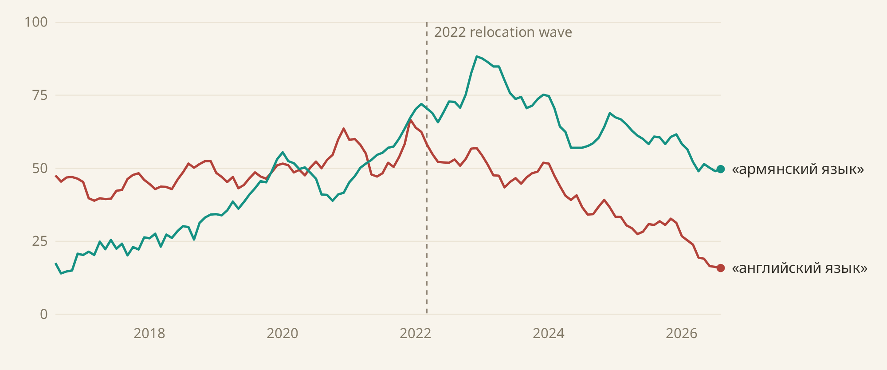
BACKUP · SEARCH DEMAND
Learning Armenian: searches ×5 in a decade
Google Trends: monthly search interest in Armenia, queries in Russian, six-month average. «Армянский язык» has led «английский язык» since mid-2021.
Source: Google Trends, region Armenia, 2016–2026. 100 = peak search interest.

Slide 12
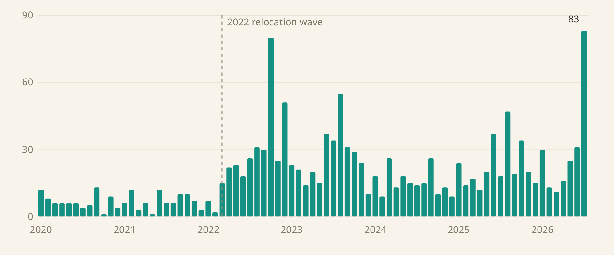
BACKUP · SEARCH DEMAND · YANDEX
Yandex agrees: ×4 after the wave
Yandex Wordstat: monthly queries «изучение армянского языка» from Armenia, 2020–2026. About 7 per month before 2022, about 29 after; July 2026 is the record.
Source: Yandex Wordstat, region Armenia, query «изучение армянского языка», all devices.

Slide 13
BACKUP · FUTURE WORK
What's next
▸ Comprehensible input: order lessons to sit just above each learner's level, with the LLM rating every video's teaching value.
▸ Speaking practice: the learner repeats a phrase and speech recognition checks it. Listening and speaking first, spelling second.
▸ Spaced repetition: tap a word to save it, then review it later with the exact video moment and audio it came from.
▸ A personal feed: videos matched to the learner's interests, from a far wider catalog than the trending page.
▸ A mobile app, so lessons live where TikTok does: on the phone.
▸ New interface languages from the same pipeline: English and Persian glosses, for the Indian and Iranian communities.
▸ Grow the ground-truth dataset and keep the leaderboard running as new models appear.

Slide 14
BACKUP · IMPACT NOTE
Who uses it, and what changes if it works
Who uses it
Newcomers learning spoken Armenian: Russian speakers, Iranians, Indians, returning diaspora. And anyone building Armenian speech technology: the ground-truth dataset and the model leaderboard are open to all.
What changes if it works
Newcomers stop living beside Armenian society and start belonging to it: they understand their neighbors, the memes, the daily conversation. And Armenian speech AI stops being unmeasured, so every future tool for the language starts from a scorecard instead of a guess.

