Slide 1
Evaluating the Performance of Double Deep Q-Network (DDQN) Reinforcement Learning in Heart Disease Prediction: A Study on Algorithmic Ineffectiveness
Presented By
Silvia Sifath

Slide 2
Introduction
Heart disease is a leading cause of death globally, emphasizing the need for effective prediction models.
Traditional methods such as logistic regression, decision trees, and SVM are well-suited for heart disease prediction.
The study aims to explore the Double Deep Q-Network (DDQN) algorithm's potential in predicting heart disease.
DDQN is typically used in sequential decision-making tasks, not classification problems like heart disease prediction.

Slide 3
Research Problem
Reinforcement learning, particularly DDQN, is unconventional for structured tabular data tasks like heart disease prediction.
The study aims to evaluate the effectiveness of DDQN for heart disease prediction and highlight its limitations for this task.

Slide 4
Literature Review
Overview of machine learning in healthcare, specifically heart disease prediction.
Introduction to DDQN and its traditional applications (gaming, robotics).
Comparison between conventional supervised learning and reinforcement learning in healthcare.

Slide 5
Data Preprocessing
Dataset: Cleveland Heart Disease dataset.
Handling missing values by imputation (mean for numerical, mode for categorical).
Feature encoding: Label encoding for categorical variables.
Standardization of numerical features.

Slide 6
Addressing Data Imbalance
The dataset suffers from an imbalanced class distribution (more healthy cases).
SMOTE (Synthetic Minority Over-sampling Technique) was applied to balance the dataset by creating synthetic samples for the minority class.

Slide 7
DDQN Algorithm Implementation
State Representation: Preprocessed feature vector for each patient.
Action Space: Binary classification (0 for no heart disease, 1 for heart disease).
Reward System: +1 for correct classification, -1 for incorrect classification.
Network Architecture: Two neural networks with three layers each, using ReLU activation functions.
Training Parameters: 100 episodes for training, epsilon decay to balance exploration and exploitation.

Slide 8
DDQN Training Process
State: Feature vector for each patient.
Action: Binary classification (Heart Disease or No Heart Disease).
Reward: Correct classification (+1), Incorrect (-1).
Learning Update: Use of target network and experience replay.
Epsilon Decay: Exploration-exploitation balance.

Slide 9
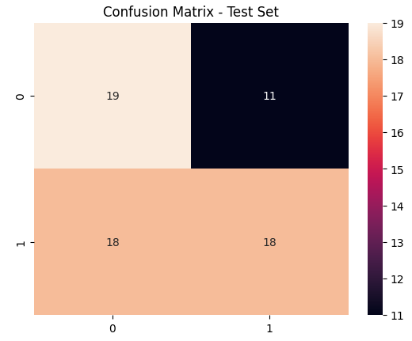
Model Evaluation
Metrics used: Accuracy, Precision, Recall, F1-score.
Fig 1: Confusion Matrix

Slide 10
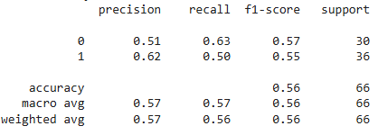
Model Evaluation
Metrics used: Accuracy, Precision, Recall, F1-score.
Fig 1: Confusion Report

Slide 11
Explainability with SHAP
SHAP values used to understand feature importance.
Display SHAP summary plot and explain the importance of the top features influencing heart disease prediction.

Slide 12
Conclusion
DDQN is not suitable for structured tabular data like heart disease prediction.
Traditional machine learning algorithms (e.g., Logistic Regression, SVM) outperform DDQN in terms of accuracy and efficiency.
Future Work: Investigate hybrid models that combine reinforcement learning and supervised learning.

Slide 13
References
Abidin, A. S., & Zulkefli, M. R. (2020). Machine learning in heart disease prediction. Journal of Healthcare Engineering, 2020, 1-15.
Sadiq, M. M., et al. (2020). Heart disease prediction using machine learning algorithms. Journal of Biomedical Science and Engineering, 13, 83-95.
Zhang, L., et al. (2020). A study on the challenges and improvements of deep reinforcement learning in healthcare applications. Artificial Intelligence in Medicine, 104, 101-113.

