Slide 1
Force-Driven Minimum Latency Resource-Constrained Scheduling (ML-RCS)
Silvia Bonenti and Please Lukau
ECE/CS 565: Physical Design Automation
Fall 2025

Slide 2







Outline
1
Introduction
2
Where we left off
3
Requested Adjustments
4
New Features
5
Results
6
Results Analysis
7
Conclusion

Slide 3
Introduction: High-Level Synthesis and Scheduling
High-Level Synthesis (HLS) converts algorithmic descriptions into RTL hardware. Scheduling decides when each operation in a Data Flow Graph (DFG) executes. Performance depends on:
Latency – total execution time.
Resource usage – number of functional units (FUs).
The ML-RCS problem generalizes the classical MR-LCS formulation.

Slide 4
The Need for Dual Forces
Scheduling in HLS must balance two competing goals:
1
2
Resource usage: keep FU utilization ≤ a_{k} per cycle.
Latency optimization: minimize overall completion time.
Classical Force-Directed Scheduling (FDS) considers only resource forces to spread operations over time.
This scheduling algorithm for ML-RCS introduces an additional latency force to prioritize operations on the critical path.
Combined, these two forces guide the scheduler to produce feasible yet fast schedules.
Key Idea
Resource force prevents overuse of functional units, while latency force reduces critical-path delay. Their interaction defines a balanced scheduling priority.

Slide 5
Iterative List Scheduling Framework
This scheduling algorithm extends list scheduling into an iterative refinement loop. Each iteration includes three core phases:
1
2
3
Priority Computation — derive urgency from mobility and congestion.
List-Based Scheduling — assign operations respecting FU limits.
Latency Update — compare L_{final} and L_{target}.
The process repeats until latency converges or the iteration limit is reached.
Essence
Priority → Schedule → Update → Repeat ensures progressively improved latency-aware scheduling.

Slide 6
Algorithm Forces
The algorithm defines two interacting forces for each operation:
1
2
Latency Force (S) — measures timing urgency (low mobility ⇒ high priority).
Resource Force (C) — measures congestion impact (high usage ⇒ penalized).
Both forces combine into a unified priority:
F (u) = S_{norm}(u) · ( C_{norm}(u) + ε )
Lower F (u) means higher scheduling urgency.
Summary
The dual-force interaction balances delay minimization and resource feasibility within a single priority metric.

Slide 7
Summary
      Proposed a suboptimal Iterative List Scheduling algorithm for the ML-RCS problem.
      Combines Force-Directed Scheduling (FDS) concepts with a dual-force priority model:
Latency force — urgency from scheduling mobility.
Resource force — probabilistic, non-myopic FU congestion.
Iterative refinement of L_{target} balances delay and resource use.
Proven properties:
1
Produces valid, resource-feasible schedules. Guaranteed termination.
Respects the critical-path lower bound. Optimal when resources are unconstrained.
2
3
4
Complexity:
T_{Total} = O(K (L_{max}N log N + E )), Space = O(N + E + L_{max})

Slide 8
Where we left off: Algorithm Limitations
Suboptimal by Design (Greedy Heuristic):
Scheduling is NP-complete; we aim for a good solution, not a guaranteed optimal one.
Our algorithm is a greedy List Scheduler: it makes the best greedy choice (based on our heuristic mixing local urgency and global cost) and never backtracks to fix strategic mistakes.
Heuristic Limitations (e.g., False Ties):
The priority formula (F = S · C ) is an estimate, not a perfect model of cost.
It can create false ties (like a vs. d in Example. 2), forcing an arbitrary (e.g., alphabetical) tie-break.

Slide 9
Requested Adjustments
Non-Myopic Congestion Cost
  Modified the Congestion Cost $C(u)$ calculation to use the average expected usage $q^{avg}$
  instead of the peak usage $q^{max}$ over the critical path $P(u)$.
      Why? Average gives a better estimate of the expected resource usage with respect to the
        worst case given by taking the maximum.
  The new Congestion Cost $C(u)$ formula is the following:
$$C(u)=\frac{1}{|P(u)|}\underset{v∈P(u)}{∑}\frac{q_{type(v)}^{avg}}{a_{type(v)}}$$

Slide 10
Requested Adjustments
Probability Distribution
The calculation of the probabilistic FU usage $q_{k}(m)$ was corrected to accurately model
operations with $\text{Latency}(u)>1$.
      Why? While an operation has a uniform probability of starting in any cycle within its mobility
      window $[\text{ASAP},\text{ALAP}]$, its actual occupation time of the resource lasts for L cycles.
Impact: When we sum these individual probabilities, the effective resource utilization profile
$q_{k}(m)$ becomes non-uniform and peaked in the middle of the operation's time range,
accurately reflecting the higher expected congestion in those central cycles. This provides a
realistic basis for the Congestion Cost $C(u)$.

Slide 11
Requested Adjustments
Relaxed Latency Initialization
  The outer loop now starts from a relaxed upper bound
  ($L_{target}←\text{LatencyParameter}×L_{standard-LS}$ , where $\text{LatencyParameter}=1.5$
  and iteratively decrements the target latency by ($L_{target}←L_{current-run}-1$) to find
  the minimum feasible solution. If no solution is found, $L_{target}$ is multiplied again by
  $\text{LatencyParameter}$, and the loop is run again, until a valid solution is found.
        Why? Using an upper bound that can only be decreased, prevents oscillating
        behaviors and allows for a controlled convergence path

Slide 12
Requested Adjustments
Relaxed Latency Initialization: Pseudo Code of Control Structure
  Calculate Upper_Bound_Latency using LS and multiply by LatencyParameter
  Calculate Lower_Bound_Latency using ASAP
  Repeat
  Success $←$ false
  Target_Latency $←$ Upper_Bound_Latency
  Repeat
  Run LS with current Target_Latency
  If valid_schedule is found:
  Save current result as Best
  Success $←$ true
  Target_Latency $←$ Current_Run_Latency - 1
  Until no valid_schedule or Target_Latency $≤$ Lower_Bound_Latency
  If no valid_schedule found:
  Lower_Bound_Latency $←$ Upper_Bound_Latency + 1
  Upper_Bound_Latency $←$ Upper_Bound_Latency $×$ Latency_Parameter
  Until Success is true

Slide 13
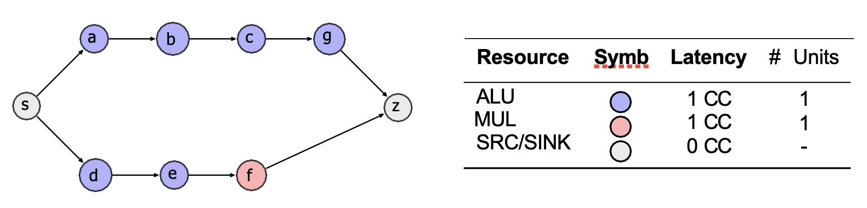
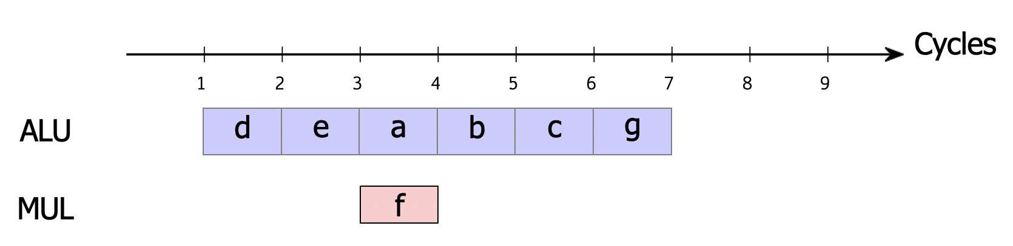
Effect: Example 1
Result
The new changes still succeed to identify d as the higher priority task with respect to a. This choice allows the MUL operation f to be scheduled in parallel ("hidden"), resulting in an optimal latency of 6.

Slide 14
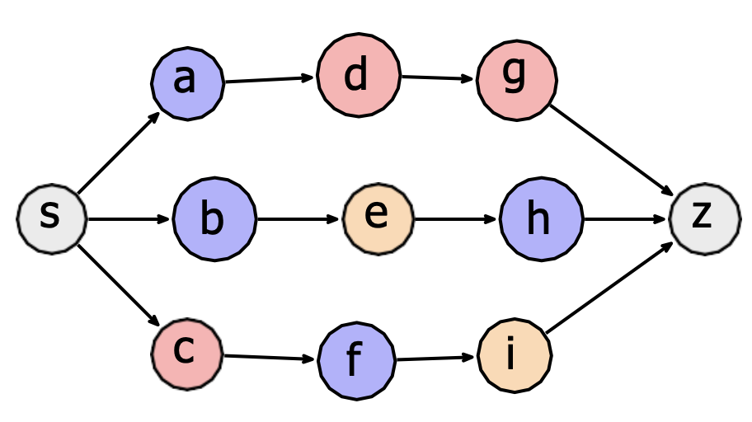
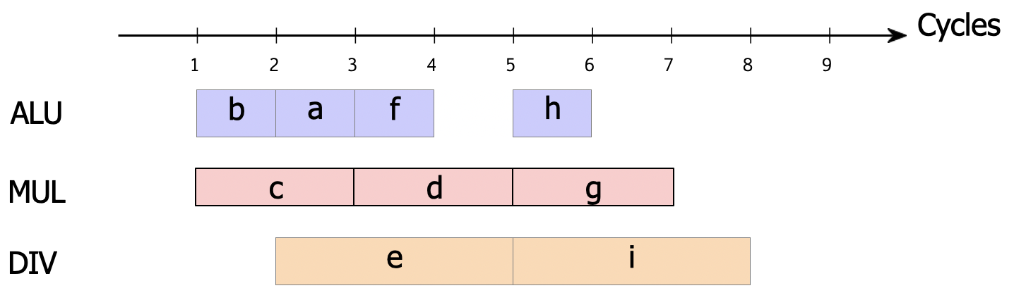
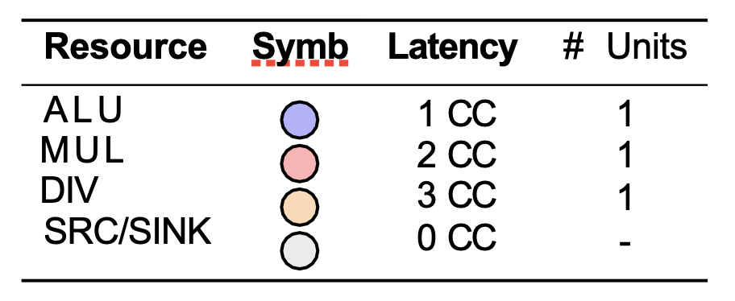
Effect: Example 2
Result
The new changes succeed also to identify b as the higher priority task with respect to a. This choice allows the DIV operations to be executed as soon as possible, resulting in an optimal latency of 7.

Slide 15
New Features
Two new features are presented:
Silvia’s Idea
Please’s Idea

Slide 16
New Features: Silvia’s idea - Motivation: The false tie problem
Context: In the original ML-RCS scheduler, the priority function
$F(u)=S(u)×(C(u)+ε)$ defines the main scheduling force.
Problem: When two nodes have similar $F(u)$, the scheduler breaks ties
arbitrarily (e.g., by node ID).
This leads to unstable or suboptimal schedules, since some nodes are
structurally harder to fit than others.
Goal: Introduce a tie-breaking which makes more consistent scheduling
decisions, thanks to structural awareness and path rigidity awareness.
Essence

Slide 17
New Features: Silvia’s idea - Motivation for a Rigidity Metric
The standard ML-RCS force function accounts for temporal urgency and
resource congestion, but it ignores the structural rigidity of the DFG.
$F(u)=S(u)×(C(u)+ε)$ defines the main scheduling force.
In fact, Two nodes with similar $F(u)$ values can differ significantly:
One may lead to a long, sequential downstream chain that is difficult to
place later.
Another may lead to short or parallel branches that are easier to
accommodate.
Essence
To capture this structural aspect, a rigidity metric called stiffness is
introduced, quantifying how rigid or inflexible the paths following a node are,
based on the squared latency of its successors.

Slide 18
New Features: Silvia’s idea - Mathematical Definition of Stiffness
$Π(u)$ = all the paths starting from a child of $u$ and ending at sink, each
containing operations $v$ with latency $\text{latency}(v)$
  $$P(u)=\max_{p∈Π(u)}\underset{v∈p}{∑}[\text{latency}(v)]^{2}$$
In this way, the squared term penalizes long-latency operations more
strongly, while the maximum selects the most rigid successor path.
Interpretation: if $P(u)$ is higher, it means that the path is more rigid and less
flexible, so it should be scheduled earlier
Normalization: $P_{norm}(u)$ is obtained by normalizing $P(u)$ to have a value
between 0 and 1, and then performing ( 1 - normalized version ) in order to
get higher priority (lower value) for higher stiffness
Essence

Slide 19
New Features: Silvia’s idea - Implementation
calculate_stiffness_term(available_ops)
For each node in available_ops
  If node has no children, stiffness $←$ 0
Else find max stiffness across children.
Return 1 - normalized(stiffness) // List
get_stiffness(node)
Essence
If already computed for this node, return it
Else
  Compute latency squared for this node
  If node has no children, return it
  Else recursively find max across its children

Slide 20
New Features: Silvia’s idea - Integration into the Force Function
Rather than using stiffness only as a tie-breaker, it is directly embedded into
the main force: $F(u)=S(u)×(C(u)+ε)×P(u)$
$S(u)$: temporal urgency (slack)
$C(u)$: resource congestion
$P(u)$: normalized stiffness term
Effect: Nodes with more rigid successors slightly decrease their total force,
causing them to be scheduled earlier.
Essence

Slide 21
New Features: Silvia’s idea - Descendant-Based Tie-Breaker (Priority 3)
When two nodes still have still equal $F(u)$ and thus the tie-breaking is
arbitrary, we apply an additional criterion based on unlock potential:
$P_{2}=−N$,
Where $N=N_{desc}(u)=|\{v∈V|u\text{is}\text{an}\text{anchestor}\text{of}\text{v}\}|$
In other words, it is the number of immediate children.
Effect: Having more children gives a higher potential to unlock parallelism.
The negative sign ensures that the scheduler, which sorts ascending,
assigns higher priority to nodes with more descendants.
Essence

Slide 22
New Features: Silvia’s idea - Final sorting hierarchy
Level 1: $F(u)$ - Original force enhanced with rigidity awareness. It is minimized.
Level 2: $P_{2}$ - Prefer nodes that unlock more successors.
Level 3: Node ID - Stable ordering in case of full tie.
Essence
Effect: This hierarchy resolves ties consistently while incorporating structural
information and parallelism potential.

Slide 23
New Features: Silvia’s idea - Outcome
Eliminates random tie behavior.
Captures rigidity of successor paths via stiffness.
Promotes parallelism using descendant-based tie-breaking.
Keeps complexity low through memoization and local computations.
Essence
Essence

Slide 24
New Features: Please’s idea
The standard ML-RCS priority uses:
$$P\left(u\right)=S\left(u\right)×C\left(u\right)$$
But in practice, different DFGs behave differently:
Some DFGs are deep → slack values matter a lot
Some are wide → congestion matters more
Some have both effects at different stages
So using the same fixed weighting for slack and congestion is sub-optimal.
Goal of my idea
Create a flexible priority formula that adapts to different DFG structures by adjusting the influence of slack and congestion.
Essence

Slide 25

New Features: Please’s idea - Proposed Modification
Where:
α (alpha) controls how strongly slack influences priority
β (beta) controls how strongly congestion influences priority
Exponents allow us to magnify or compress the effect of slack or congestion.
Essence

Slide 26
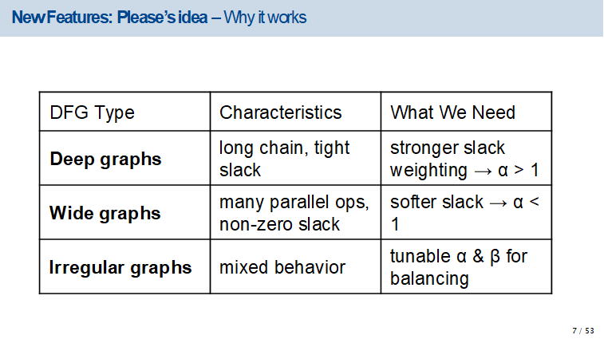
New Features: Please’s idea
The standard ML-RCS priority uses:
$$P\left(u\right)=S\left(u\right)×C\left(u\right)$$
But in practice, different DFGs behave differently:
Some DFGs are deep → slack values matter a lot
Some are wide → congestion matters more
Some have both effects at different stages
So using the same fixed weighting for slack and congestion is sub-optimal.
Goal of my idea
Create a flexible priority formula that adapts to different DFG structures by adjusting the influence of slack and congestion.
Essence
7 / 53

Slide 27
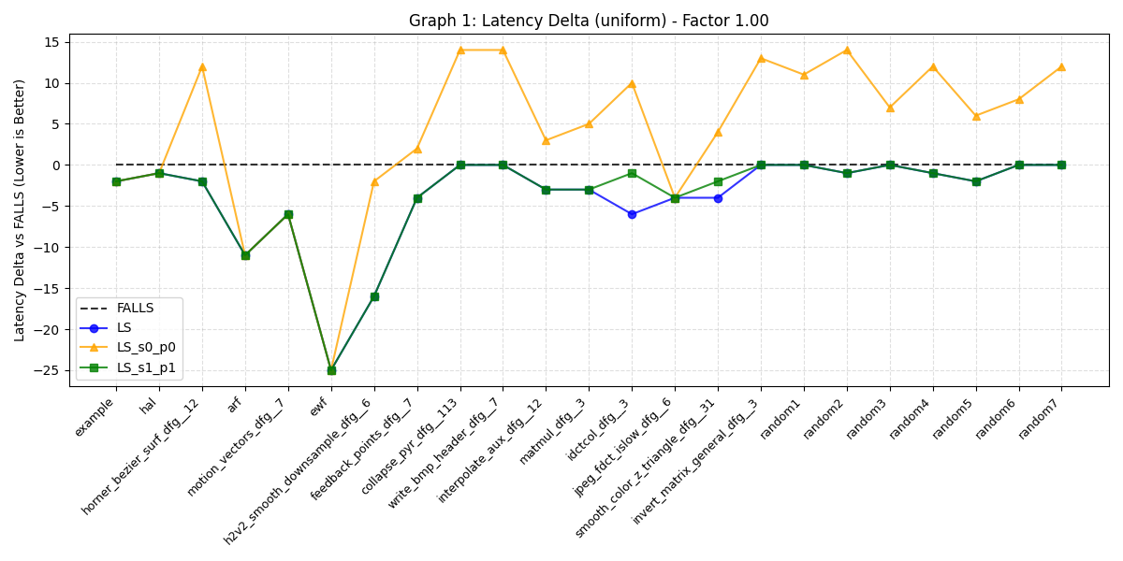
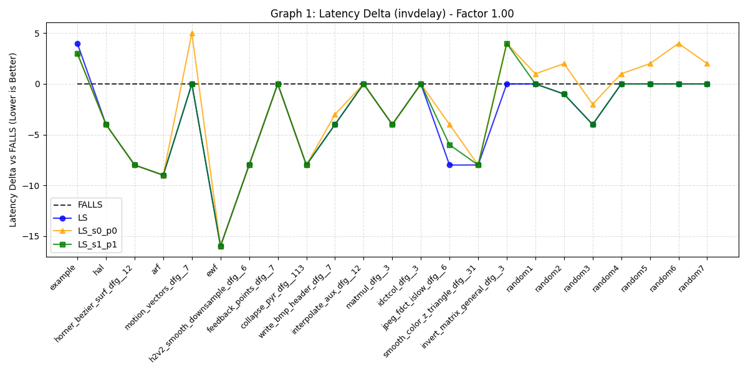
Results: Latency improvement vs DFGs (LS-std, LS-enhanced, FALLS, FDS)
Uniform
InvDelay
Essence

Slide 28
Results Analysis: Latency Improvement - Benchmark comparison
Standard LS dominance: the results clearly show that the standard LS algorithm, with
Slack-based priority, achieves better results in almost any DFG in the benchmark.
Silvia’s Feature Success: despite achieving sometimes worse latency than standard
LS, the new feature significantly improves the Midterm solution, achieving equal or
better latency in all benchmark’s DFGs.
Superiority over FALLS: Both Standard LS and the Final’s version consistently
outperform the FALLS algorithm: for these constrained benchmarks, greedy heuristics
are more effective than complex methods like FALLS.
Essence
Essence

Slide 29
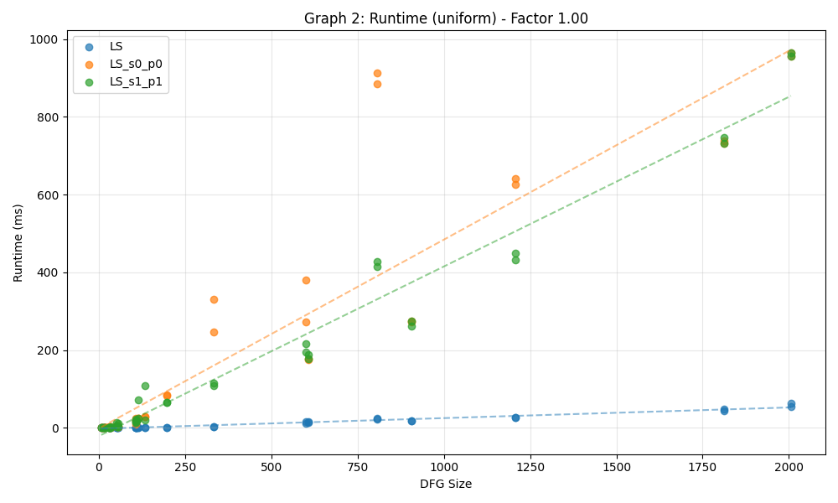
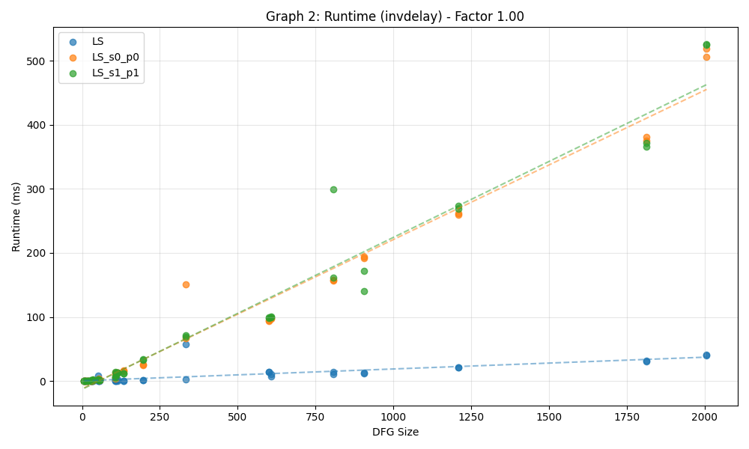
Results: Runtime vs DFGs size (LS-std, LS-enhanced, LS-enhanced-feat, FDS)
Uniform
InvDelay
Essence

Slide 30
Results Analysis: Runtime Analysis & Scalability
Linear Scaling: All three variants demonstrate linear runtime behavior relative to the
  number of operations.
Minimal Overhead: The curves for LS_s1_p1 (Final) and LS_s0_p0 (Midterm are
nearly indistinguishable, while the one for LS is slightly lower.
Observation: The implementation of Silvia's Stiffness metric and the Force calculations
add negligible computational cost.
Essence
Essence

Slide 31
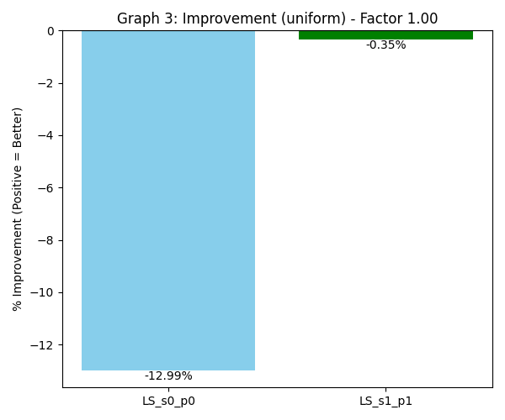
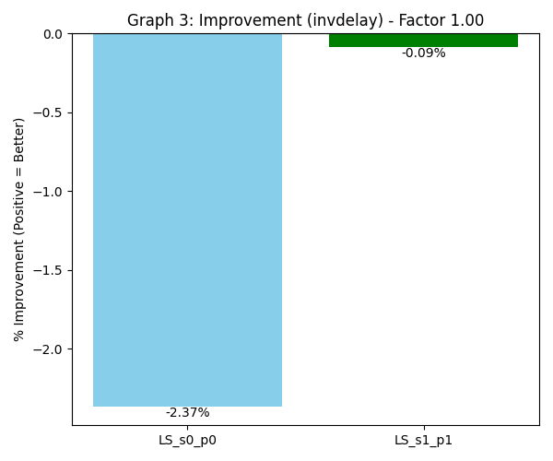
Results: % Improvement of LS-enhanced and LS-enhanced-feat wrt LS-std
Uniform
InvDelay
Essence

Slide 32
Results Analysis: LS-enhanced-feat and LS-enhanced wrt LS
The Noise of Force-Directed Scheduling (Midterm): In the Uniform benchmark,
using Forces without structural awareness introduced significant decision noise.
The scheduler broke ties arbitrarily, leading to a massive 12.99% performance drop
compared to simple Slack Priority.
The Stabilizing Role of Stiffness (Final): Adding the Stiffness metric successfully
filtered out this noise. By identifying the true structural bottlenecks, it forced the
scheduler to make smarter decisions, recovering almost all the lost performance
(from -12.99% to -0.35%).
Conclusion: While Standard LS remains the most robust heuristic, Silvia’s Stiffness
metric is essential for making Force-Directed approaches viable. It transforms
an unstable algorithm (Midterm) into a robust one that is comparable to standard LS.
Essence
Essence

Slide 33
Results Analysis: LS-enhanced-feat and LS-enhanced wrt LS
Even though the results achieved adding the Stiffness metric are far superior to
the ones without it, the results are still slightly worse than the ones obtained with
the standard LS.
Being the resource constraints very loose, an interesting analysis is to try to
make these constraints more tight, to see whether in this case the enhanced LS
can outperform the standard LS.
  The analysis is performed by scaling the available resources from 1.0 (standard case)
  to 0.10, with a step of 1.0.
Essence
Essence

Slide 34
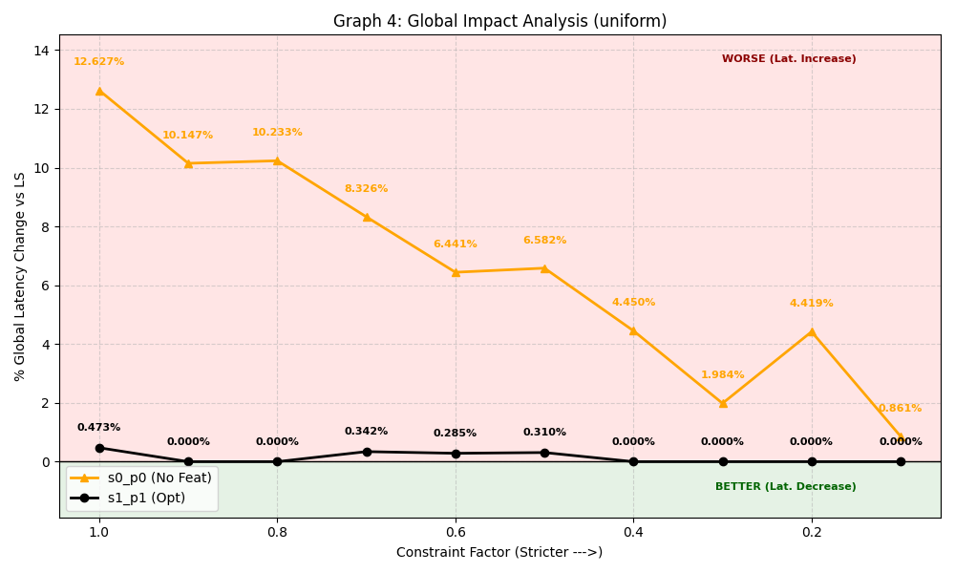
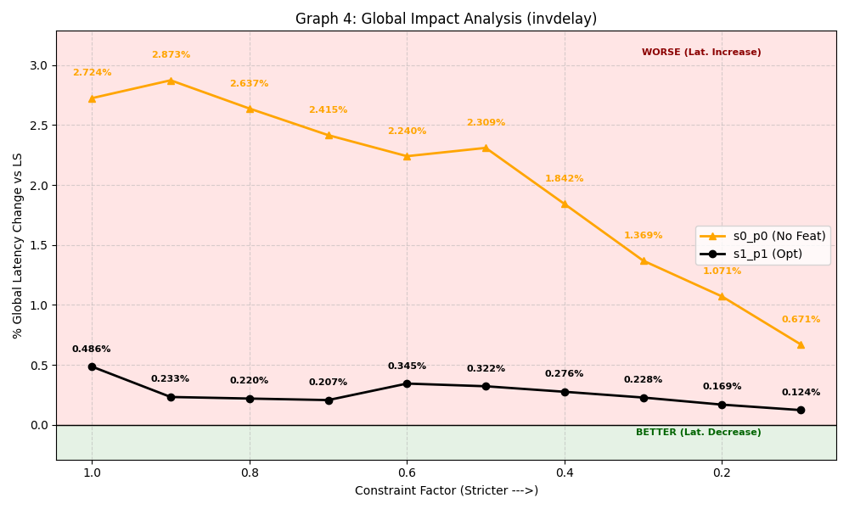
Results: % Improvement of LS-enhanced wrt LS scaling the resource constraints
Uniform
InvDelay
Essence

Slide 35
Results Analyis: LS-enhanced wrt LS scaling the resource constraints
Uniform Benchmark (Final version)
Observation: As resources decrease, the performance gap often vanishes
completely.
Analysis: Under extreme pressure, the new Stifness metric aligns with the optimal
greedy choice, eliminating its own decision noise as options narrow.
Loose Constraints (1.0): Small penalty (- 0.47%).
High Stress (0.4 - 0.1): The gap hits 0%: LS final matches LS standard perfectly.
Essence
Essence

Slide 36
Results Analyis: LS-enhanced wrt LS scaling the resource constraints
InvDelay Benchmark (Final version)
Observation: The performance gap shrinks consistently as the problem becomes
harder.
Analysis: Tighter constraints reduce the margin for error. Instead of degrading, the
final LS version adapts, proving that its logic holds becomes more reliable in
corner conditions.
Loose Constraints (1.0): Gap is - 0.49%
High Stress (0.4 - 0.1): Gap narrows to - 0.12%
Essence
Essence

Slide 37
Results Analyis: LS-enhanced wrt LS scaling the resource constraints
Midterm version
Observation: The performance gap consistently shrinks in both Uniform and
InvDelay benchmarks.
Analysis: Tighter constraints reduce the margin for error also for the version without
the Stiffness metric. Even though results get better as the pressure increases,
this version still gives worse performance with respect to the Final one.
Loose Constraints (1.0): Gap is - 12.67% (Uniform) and - 2.74% (invDelay)
High Stress (0.4 - 0.1): Gap narrows to - 0.86% (Uniform) and - 0.67% (invDelay)
Essence
Essence

Slide 38
Conclusion
The Noise of Force-Directed Scheduling (Midterm): In the Uniform benchmark,
using FDS without structural awareness introduced significant decision noise.
The scheduler broke ties arbitrarily, leading to a massive 12.99% performance drop
compared to simple Slack Priority.
The Stabilizing Role of Stiffness (Final): Adding the Stiffness metric successfully
filtered out this noise. By identifying true bottlenecks, it forced the scheduler to make
smarter decisions, recovering almost all the performance loss (from - 12.99% to
0.35%).
Final Conclusion: While the standard List Scheduling remains a robust heuristic,
Silvia’s Stiffness metric is essential for making Force-Directed approaches viable.
It transforms an unstable algorithm into a competitive one.
Essence
Essence

