Slide 1
Force-Driven Minimum Latency Resource-Constrained Scheduling (ML-RCS)
Silvia Bonenti and Please Lukau
ECE/CS 565: Physical Design Automation
Fall 2025

Slide 2







Outline
1
Introduction
2
Where we left off
3
Requested Adjustments
4
New Features
5
Results
6
Results Analysis
7
Conclusion

Slide 3
Introduction: High-Level Synthesis and Scheduling
High-Level Synthesis (HLS) converts algorithmic descriptions into RTL hardware. Scheduling decides when each operation in a Data Flow Graph (DFG) executes. Performance depends on:
Latency – total execution time.
Resource usage – number of functional units (FUs).
The ML-RCS problem generalizes the classical MR-LCS formulation.

Slide 4
The Need for Dual Forces
Scheduling in HLS must balance two competing goals:
1
2
Resource usage: keep FU utilization ≤ a_{k} per cycle.
Latency optimization: minimize overall completion time.
Classical Force-Directed Scheduling (FDS) considers only resource forces to spread operations over time.
This scheduling algorithm for ML-RCS introduces an additional latency force to prioritize operations on the critical path.
Combined, these two forces guide the scheduler to produce feasible yet fast schedules.
Key Idea
Resource force prevents overuse of functional units, while latency force reduces critical-path delay. Their interaction defines a balanced scheduling priority.

Slide 5
Iterative List Scheduling Framework
This scheduling algorithm extends list scheduling into an iterative refinement loop. Each iteration includes three core phases:
1
2
3
Priority Computation — derive urgency from mobility and congestion.
List-Based Scheduling — assign operations respecting FU limits.
Latency Update — compare L_{final} and L_{target}.
The process repeats until latency converges or the iteration limit is reached.
Essence
Priority → Schedule → Update → Repeat ensures progressively improved latency-aware scheduling.
7 / 53

Slide 6
Algorithm Forces
The algorithm defines two interacting forces for each operation:
1
2
Latency Force (S) — measures timing urgency (low mobility ⇒ high priority).
Resource Force (C) — measures congestion impact (high usage ⇒ penalized).
Both forces combine into a unified priority:
F (u) = S_{norm}(u) · ( C_{norm}(u) + ε )
Lower F (u) means higher scheduling urgency.
Summary
The dual-force interaction balances delay minimization and resource feasibility within a single priority metric.

Slide 7
Summary
      Proposed a suboptimal Iterative List Scheduling algorithm for the ML-RCS problem.
      Combines Force-Directed Scheduling (FDS) concepts with a dual-force priority model:
Latency force — urgency from scheduling mobility.
Resource force — probabilistic, non-myopic FU congestion.
Iterative refinement of L_{target} balances delay and resource use.
Proven properties:
1
Produces valid, resource-feasible schedules. Guaranteed termination.
Respects the critical-path lower bound. Optimal when resources are unconstrained.
2
3
4
Complexity:
T_{Total} = O(K (L_{max}N log N + E )), Space = O(N + E + L_{max})

Slide 8
Where we left off: Algorithm Limitations
Suboptimal by Design (Greedy Heuristic):
Scheduling is NP-complete; we aim for a good solution, not a guaranteed optimal one.
Our algorithm is a greedy List Scheduler: it makes the best greedy choice (based on our heuristic mixing local urgency and global cost) and never backtracks to fix strategic mistakes.
Heuristic Limitations (e.g., False Ties):
The priority formula (F = S · C ) is an estimate, not a perfect model of cost.
It can create false ties (like a vs. d in Example. 2), forcing an arbitrary (e.g., alphabetical) tie-break.

Slide 9
Requested Adjustments
Non-Myopic Congestion Cost
  Modified the Congestion Cost $C(u)$ calculation to use the average expected usage $q^{avg}$
  instead of the peak usage $q^{max}$ over the critical path $P(u)$.
      Why? Average gives a better estimate of the expected resource usage with respect to the
        worst case given by taking the maximum.
  The new Congestion Cost $C(u)$ formula is the following:
$$C(u)=\frac{1}{|P(u)|}\underset{v∈P(u)}{∑}\frac{q_{type(v)}^{avg}}{a_{type(v)}}$$

Slide 10
Requested Adjustments
Probability Distribution
The calculation of the probabilistic FU usage $q_{k}(m)$ was corrected to accurately model
operations with $\text{Latency}(u)>1$.
      Why? While an operation has a uniform probability of starting in any cycle within its mobility
      window $[\text{ASAP},\text{ALAP}]$, its actual occupation time of the resource lasts for L cycles.
Impact: When we sum these individual probabilities, the effective resource utilization profile
$q_{k}(m)$ becomes non-uniform and peaked in the middle of the operation's time range,
accurately reflecting the higher expected congestion in those central cycles. This provides a
realistic basis for the Congestion Cost $C(u)$.

Slide 11
Requested Adjustments
Relaxed Latency Initialization
  The outer loop now starts from a relaxed upper bound ($L_{target}←∑$Latency)
  and iteratively decrements the target latency by ($L_{target}←∑L_{final}-1$) to find
  the minimum feasible solution.
        Why? Using an upper bound that can only be decreased prevents oscillating
        behaviors and allows for a controlled convergence path

Slide 12
Requested Adjustments
Dynamic Priority Calculation
  The priority function $F(u)$ is no longer pre-calculated statically for all operations at the
  beginning of the List Scheduling phase.
  Why? Based on actual resource availability and the specific set of competing operations in
  the current cycle. Provides a more accurate estimate of current urgency and conflict cost.

Slide 13
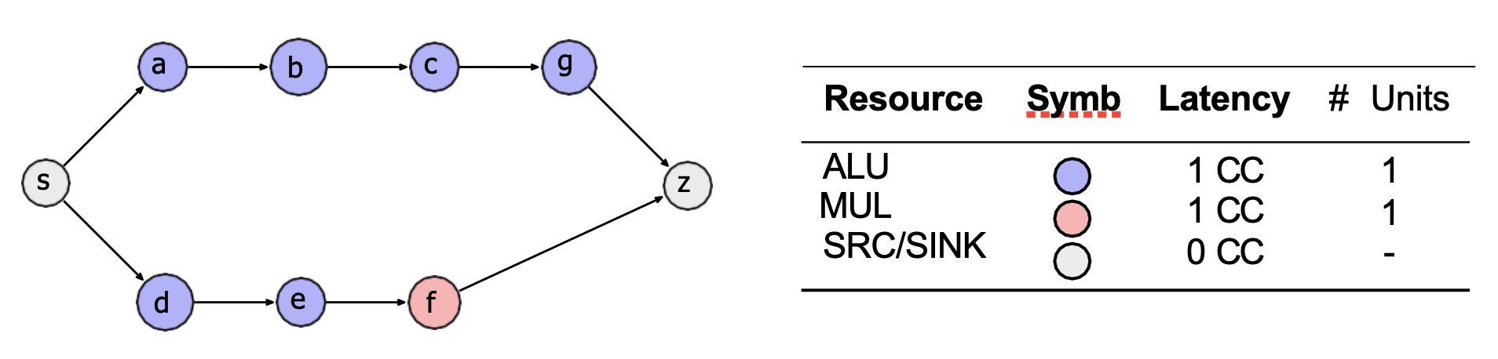
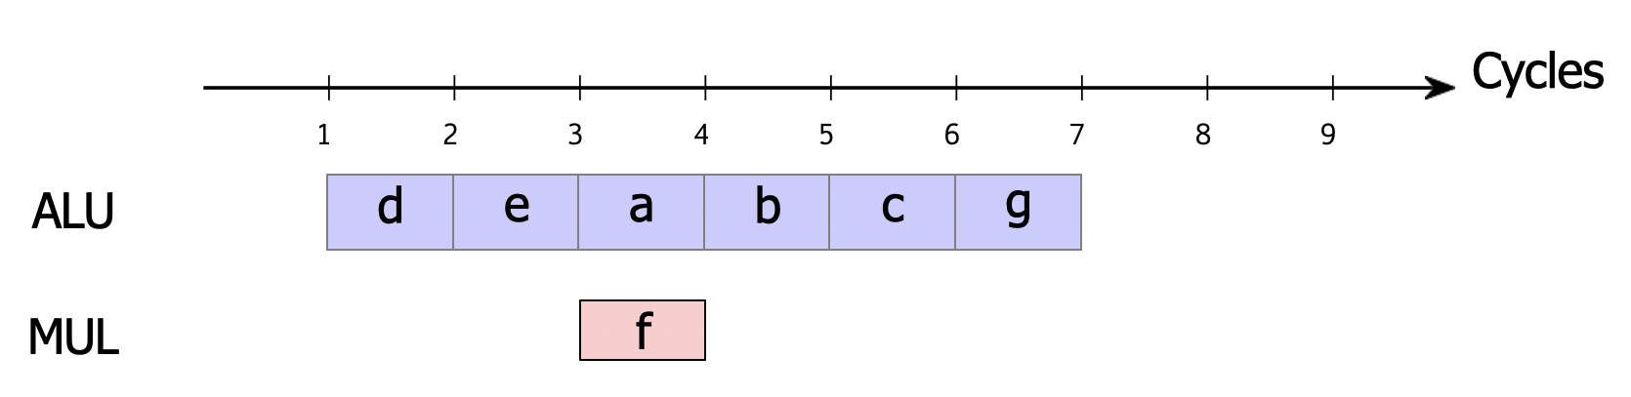
Effect: Example 1
Result
The new changes still succeed to identify d as the higher priority task with respect to a. This choice allows the MUL operation f to be scheduled in parallel ("hidden"), resulting in an optimal latency of 6.

Slide 14
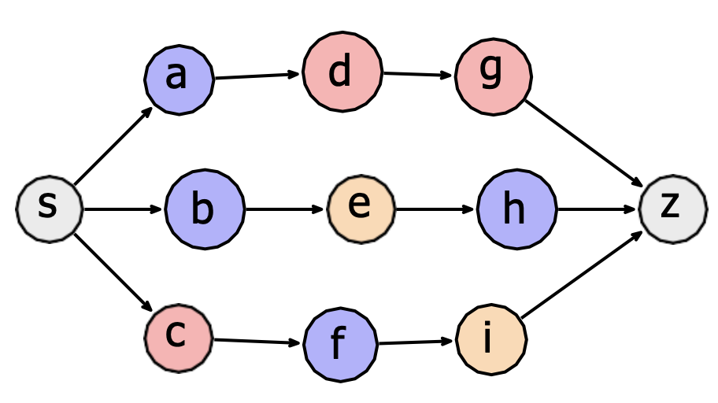
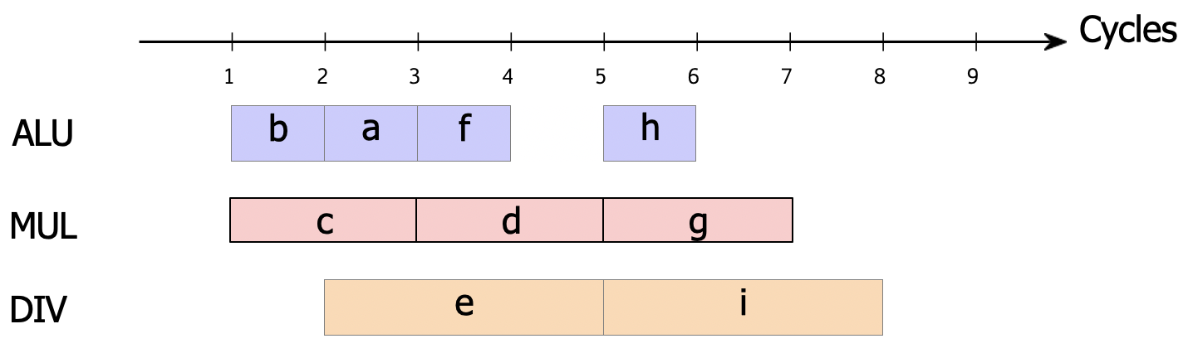
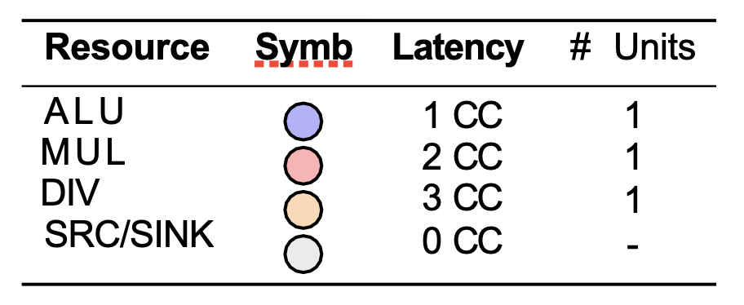
Effect: Example 2
Result
The new changes succeed also to identify b as the higher priority task with respect to a. This choice allows the DIV operations to be executed as soon as possible, resulting in an optimal latency of 7.

Slide 15
New Features
Two new features are presented:
Silvia’s Idea
Please’s Idea
7 / 53

Slide 16
New Features: Silvia’s idea - Motivation: The false tie problem
Context: In the original ML-RCS scheduler, the priority function
$F(u)=S(u)×(C(u)+ϵ)$ defines the main scheduling force.
Problem: When two nodes have similar $F(u)$, the scheduler breaks ties
arbitrarily (e.g., by node ID).
This leads to unstable or suboptimal schedules, since some nodes are
structurally harder to fit than others.
Goal: Introduce a tie-breaking which makes more consistent scheduling
decisions, thanks to structural awareness and path rigidity awareness.
Essence
7 / 53

Slide 17
New Features: Silvia’s idea - Motivation for a Rigidity Metric
The standard ML-RCS force function accounts for temporal urgency and
resource congestion, but it ignores the structural rigidity of the DFG.
$F(u)=S(u)×(C(u)+ϵ)$ defines the main scheduling force.
In fact, Two nodes with similar $F(u)$ values can differ significantly:
One may lead to a long, sequential downstream chain that is difficult to
place later.
Another may lead to short or parallel branches that are easier to
accommodate.
Essence
To capture this structural aspect, a rigidity metric called stiffness is
introduced, quantifying how rigid or inflexible the paths following a node are,
based on the squared latency of its successors.
7 / 53

Slide 18
New Features: Silvia’s idea - Mathematical Definition of Stiffness
$Π(u)$ = all the paths starting from a child of $u$ and ending at sink, each
containing operations $v$ with latency $\text{latency}(v)$
  $$P(u)=\max_{p∈Π(u)}\underset{v∈p}{∑}[\text{latency}(v)]^{2}$$
In this way, the squared term penalizes long-latency operations more
strongly, while the maximum selects the most rigid successor path.
Interpretation: if $P(u)$ is higher, it means that the path is more rigid and less
flexible, so it should be scheduled earlier
Normalization: $P_{norm}(u)$ is obtained by normalizing $P(u)$ to have a value
between 0 and 1, and then performing ( 1 - normalized version ) in order to
get higher priority (lower value) for higher stiffness
Essence
7 / 53

Slide 19
New Features: Silvia’s idea - Implementation
calculate_stiffness_term(available_ops)
For each node in available_ops
  If node has no children, stiffness $←$ 0
Else find max stiffness across children.
Return 1 - normalized(stiffness) // List
get_stiffness(node)
Essence
If already computed for this node, return it
Else
  Compute latency squared for this node
  If node has no children, return it
  Else recursively find max across its children
7 / 53

Slide 20
New Features: Silvia’s idea - Integration into the Force Function
Rather than using stiffness only as a tie-breaker, it is directly embedded into
the main force: $F(u)=S(u)×(C(u)+ϵ)×P(u)$
$S(u)$: temporal urgency (slack)
$C(u)$: resource congestion
$P(u)$: normalized stiffness term
Effect: Nodes with more rigid successors slightly decrease their total force,
causing them to be scheduled earlier.
Essence
7 / 53

Slide 21
New Features: Silvia’s idea - Descendant-Based Tie-Breaker (Priority 3)
When two nodes still have still equal $F(u)$ and thus the tie-breaking is
arbitrary, we apply an additional criterion based on unlock potential:
$P_{2}=-N$,
Where $N=N_{desc}(u)=|\{v∈V|u\text{is an anchestor of v}\}|$
In other words, it is the number of immediate children.
Effect: Having more children gives a higher potential to unlock parallelism.
The negative sign ensures that the scheduler, which sorts ascending,
assigns higher priority to nodes with more descendants.
Essence
7 / 53

Slide 22
New Features: Silvia’s idea - Final sorting hierarchy
Level 1: $F(u)$ - Original force enhanced with rigidity awareness. It is minimized.
Level 2: $P_{2}$ - Prefer nodes that unlock more successors.
Level 3: Node ID - Stable ordering in case of full tie.
Essence
Effect: This hierarchy resolves ties consistently while incorporating structural
information and parallelism potential.
7 / 53

Slide 23
New Features: Silvia’s idea - Outcome
Eliminates random tie behavior.
Captures rigidity of successor paths via stiffness.
Promotes parallelism using descendant-based tie-breaking.
Keeps complexity low through memoization and local computations.
Essence
Essence
7 / 53

Slide 24
New Features: Please’s idea
To improve responsiveness to real scheduling conditions, I introduced dynamic priority computation:
Priorities are recomputed at every cycle, not just once at the beginning
Both latency force and congestion force now incorporate current events:
  Number of active operations
  Resource usage at this cycle
  Changes in mobility windows as nodes are scheduled
This yields a priority model that reflects real-time scheduling pressure.
Essence
7 / 53

Slide 25
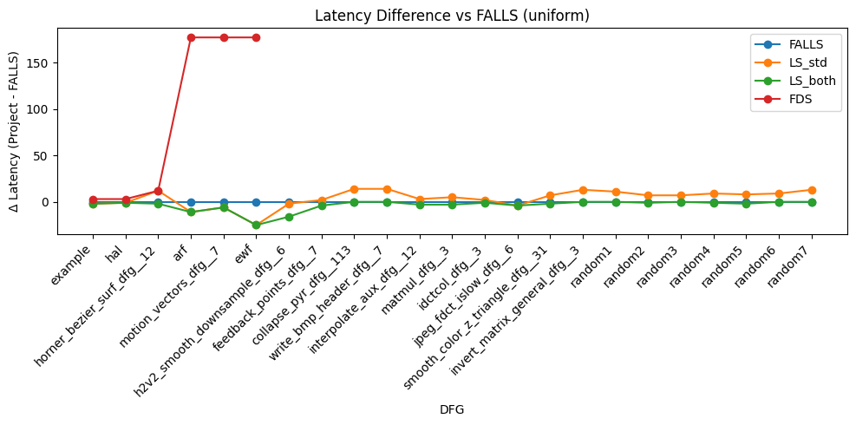
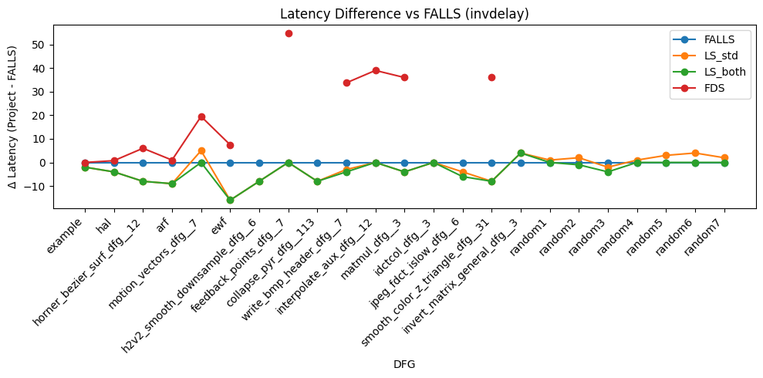
Results: Latency improvement vs DFGs (LS-std, LS-enhanced, FALLS, FDS)
Uniform
InvDelay
Essence
7 / 53

Slide 26
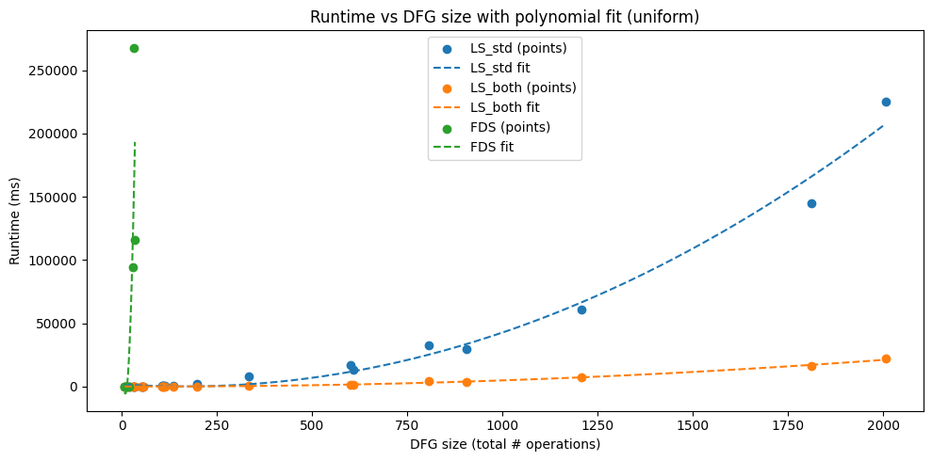
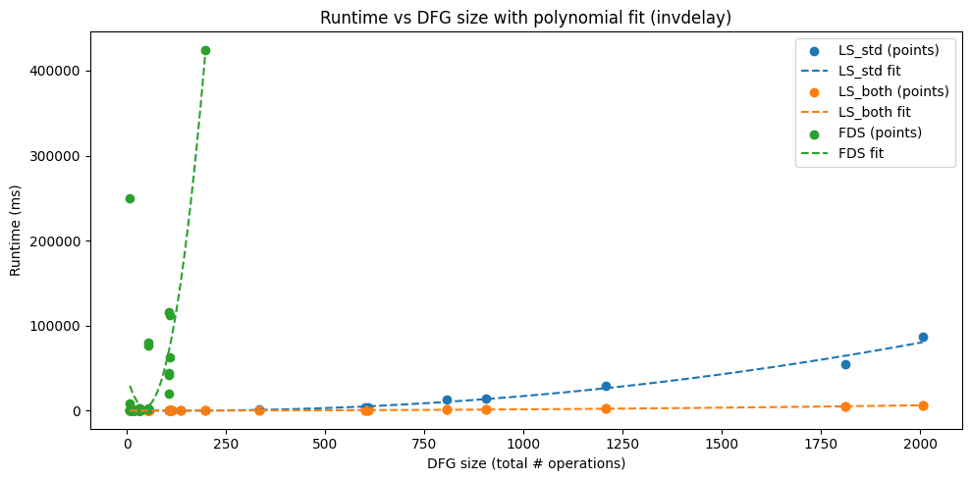
Results: Runtime vs DFGs size (LS-std, LS-enhanced, FDS)
Uniform
InvDelay
Essence
7 / 53

Slide 27
Results Analysis
From the graphs before, it can be observed that the new approach is successful
Runtime experiments confirm that the enhanced scheduler maintains similar asymptotic
complexity but performs fewer mis-scheduling iterations, resulting in faster convergence
for large DFGs.
Time improvement in the final version is consistent, giving better results than both LS
and FALLS (even though with 1.5 factor)
Essence
Essence
7 / 53

Slide 28
Conclusion
From the results discussed before, it is clear that the new approach consistently
outperforms baseline LS and FDS on realistic benchmarks.
Runtime behavior aligns with theoretical predictions and demonstrates strong scalability.
Essence
Essence
7 / 53

