Slide 1
Development of a clustering method based on the Mondrian process

Slide 2

CLUSTERING
UNSUPERVISED LEARNING
organize unlabeled data into classes in order to:
maximize intra-class similarity
minimize inter-class similarity
$$≠$$
SUPERVISED LEARNING
(CLASSIFICATION)
Algorithm procedure: training and testing
training data are labeled
SIMILARITY
Clustering Algorithm
Based on the concept of distance
Characteristic of the specific clustering algorithm
Partitioning approach
Hierarchical approach:
- Agglomerative or Bottom-Up
- Divisive or Top-Down

Slide 3
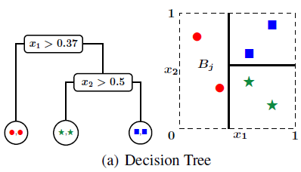

DECISION TREE:
Hierarchical, axis-aligned, binary partition of the dataset X
Nodes: subsets of X
Edges: test on features that splits the father node into two children
Hierarchical:
Root node: whole set of data X
Ensemble of leaf nodes: final partition of X
Binary:
Each non-leaf node has only two children
Each non-root node has only one father
Axis-aligned:
Each splitting propose a test on a single feature
used in hierarchical clustering (both top-down and bottom-up approach)

Slide 4

MONDRIAN PROCESS M(Φ,t0, λ)
temporal recursive stochastic process that randomly partitions the underlying product space in a hierarchical way, through axis-aligned cuts
Φ = [a1; b1]$× ∙∙∙ ×$[aD; bD]$⊂ ℝ ^{D}$ axis-aligned box
t0 = 0 birth time
λ lifetime
Mondrian(Φ,t0, λ)
T $\sim$ Exp(LD(Φ)) time of the cut with LD(Φ) = Σd$≤D$ (bd-ad) the linear dimension of the box
d $\sim$ Discrete(p1,…,pD), where pd $∝$(bd - ad) dimension of the cut
x $\sim$ $𝒰$([ad,bd]) location of the cut
M$^{< }$(Φ$^{< }$, t0+T, λ) and M$^{>}\text{(}\text{Φ} ^{>}\text{, }\text{t}\text{0}\text{+}\text{T}\text{,} \text{λ}\text{)}$: independent Mondrian processes (for each new subspace, steps 1, 2 and 3 are repeated)
The whole process stops when the birth time of the last cut is $>$ λ

Slide 5

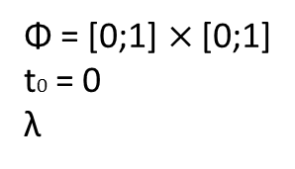

EXAMPLE OF MONDRIAN PROCESS IN 2D
Φ = [0;1]$×$[0;1]
t0 = 0
λ
1
M(Φ,0,λ)
T $=$ 0.23 time of the cut
d $=x$ dimension of the cut
x $=0.67$location of the cut
y
Φ
0
x
1

Slide 6

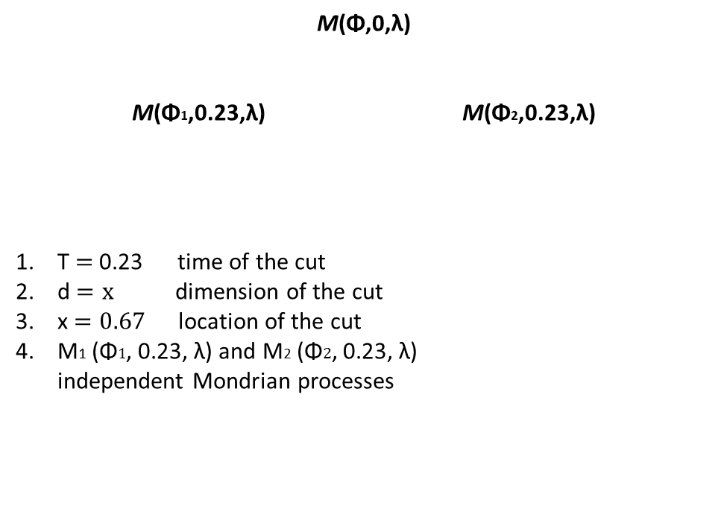
EXAMPLE OF MONDRIAN PROCESS IN 2D
Φ = [0;1]$×$[0;1]
t0 = 0
λ
1
M(Φ,0,λ)
M(Φ1,0.23,λ) M(Φ2,0.23,λ)
T $=$ 0.23 time of the cut
d $=x$ dimension of the cut
x $=0.67$location of the cut
M1 (Φ$1$, 0.23, λ) and M2 (Φ$2\text{, }\text{0.23}\text{,} \text{λ}\text{)}$ independent Mondrian processes
0.23
Φ1
Φ2
0
1

Slide 7
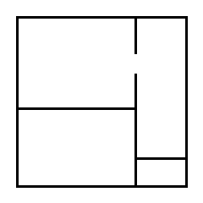
EXAMPLE OF MONDRIAN PROCESS IN 2D
Φ = [0;1]$×$[0;1]
t0 = 0
λ
1
M(Φ,0,λ)
M(Φ1,0.23,λ) M(Φ2,0.23,λ)
M(Φ3,0.80,λ) M(Φ4,0.80,λ) M(Φ5,0.46,λ) M(Φ6,0.46,λ)
Φ3
0.23
Φ5
0.80
Φ4
0.46
Φ6
0
1

Slide 8
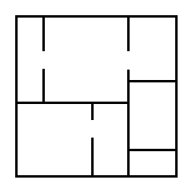




EXAMPLE OF MONDRIAN PROCESS IN 2D
Φ = [0;1]$×$[0;1]
t0 = 0
λ
1
M(Φ,0,λ)
M(Φ1,0.23,λ) M(Φ2,0.23,λ)
M(Φ3,0.80,λ) M(Φ4,0.80,λ) M(Φ5,0.46,λ) M(Φ6,0.46,λ)
M(Φ7,1.27,λ) M(Φ8,1.27,λ) M(Φ9,0.88,λ) M(Φ10,0.88,λ)
1.43
Φ3
Φ9
0.23
0.88
0.80
Φ10
1.27
Φ7
Φ8
0.46
Φ6
0
1

Slide 9
THE MONDRIAN PROCESS IN MACHINE LEARNING
Used in SUPERVISED LEARNING - CLASSIFICATION and REGRESSION
Classification algorithm: Partitioning phase + Labeling phase
PROS and CONS of MONDRIAN FORESTS
Exploit adaptation of Mondrian process: divide data into subsets
Assign label distribution to each subset of data
Can be trained incrementally in an efficient manner
significantly outperform existing online random forests in terms of training time and number of training instances required to achieve a particular test accuracy
achieve competitive test accuracy to batch random forests trained on the same fraction of the data.
unable to handle lots of irrelevant features (since splits are chosen independent of the labels)
Computationally expensive for high dimensional data

Slide 10
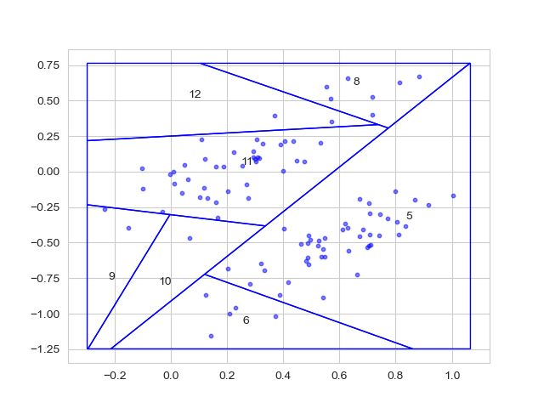
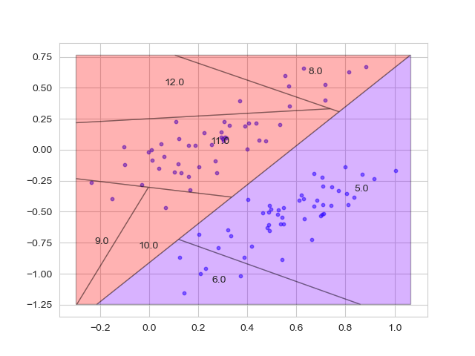
CLUSTERING ALGORITHM BASED ON THE MONDRIAN PROCESS
THESIS WORK
Partitioning phase:
adapt the Mondrian process to UNSUPERVISED CLASSIFICATION:
splitting criterion must depend on data
choice of the distance metric
cuts not forced to be orthogonal to the coordinate axis
Labeling phase:
Subsets belonging to the same cluster are merged:
choice of the merging criterion (related to the same distance metric
of the partitioning phase)
Automatic determination of the number of clusters
Algorithm must work on a generic number of dimensions

Slide 11
REFERENCES:
D. M. Roy and Y. W. Teh. The Mondrian process. In Adv. Neural Information Proc. Systems (NIPS), volume 21, pages 1377{1384, 2009.
B. Lakshminarayanan, D. M. Roy, and Y. W. Teh. Mondrian forests: Efficient online random forests. In Adv. Neural Information Proc. Systems (NIPS), 2014.
Matej Balog and YeeWhye Teh. The Mondrian Process forMachine Learning. 2015. arXiv: 1507.05181 [stat.ML].
Lakshminarayanan, B. (2016). Decision trees and forests: a probabilistic perspective.
Saxena, A.K., Prasad, M., Gupta, A., Bharill, N., Patel, O.P., Tiwari, A., Er, M.J., Ding, W., & Lin, C. (2017). A review of clustering techniques and developments. Neurocomputing, 267, 664-681.
Castin, L., & Frénay, B. (2018). Clustering with decision trees: Divisive and agglomerative approach. In ESANN 2018 - Proceedings, European Symposium on Artificial Neural Networks, Computational Intelligence and Machine Learning (pp. 455-460). (ESANN 2018 - Proceedings, European Symposium on Artificial Neural Networks, Computational Intelligence and Machine Learning). i6doc.com publication.

Slide 12
