Slide 1
CLEAR ACTION WHEN
EVERY MINUTE MATTERS.
An action-oriented AI health triage agent for urgent decisions, safe escalation and coordinated care.
AWS HACKATHON • MVP
Pitch deck • 2026
Notes:
[Sources]
- Internal product repository and project brief

Slide 2

THE PROBLEM
02
Urgent symptoms create an action gap
People do not need another search result. They need to know what to do next, how quickly, and who should be involved.
UNCERTAINTY
DELAY
FRAGMENTATION
Symptoms are hard to interpret under stress.
The right level of care is often unclear.
Patients, providers and emergency teams lack a shared summary.
01
02
03
The result: avoidable anxiety, unnecessary demand and dangerous delay.
HEALTH RESPONSE AGENT
Notes:
[Sources]
- Internal product repository and project brief

Slide 3
THE SOLUTION
03
One conversation. Three clear paths.
The agent gathers structured symptoms, screens for red flags and converts uncertainty into a safe next action.
1
ACT NOW
Emergency guidance and immediate escalation.
2
WITHIN 24 HOURS
Prompt clinical review with a structured summary.
3
SELF-CARE + MONITOR
Practical advice, warning signs and follow-up.
HEALTH RESPONSE AGENT
Notes:
[Sources]
- Internal product repository and project brief

Slide 4
PATIENT EXPERIENCE
04
Designed for action under pressure
A short, multilingual interaction produces guidance for the patient and a reusable clinical handoff.
01
02
03
04
05
DESCRIBE
SCREEN
CLASSIFY
ACT
FOLLOW UP
Voice or text in plain language
Structured questions and red flags
Explainable urgency level
Guidance, consent and escalation
Monitor symptoms and next steps
Safety principle: the agent supports decisions. It does not diagnose or replace clinical judgement.
HEALTH RESPONSE AGENT
Notes:
[Sources]
- Internal product repository and project brief

Slide 5
SAFETY BY DESIGN
05
Trust is a product requirement
Every recommendation must be bounded, explainable, auditable and easy to override.
CLINICAL SAFETY
GOVERNANCE
Red-flag screening before advice
Structured event and decision logs
Conservative escalation when information is incomplete
Source-aware guidance and clear limitations
Explicit consent before contacting providers
Privacy-first data minimisation
No diagnosis or false certainty
Human review and configurable clinical policy
HEALTH RESPONSE AGENT
Notes:
[Sources]
- Internal product repository and project brief

Slide 6
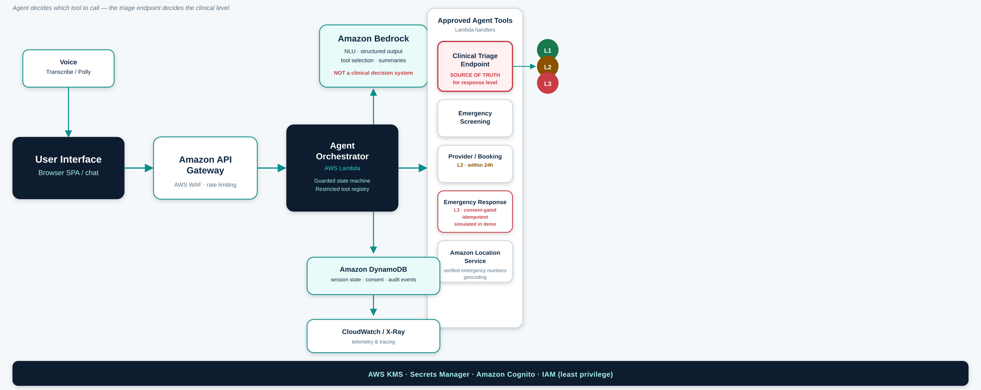
TECHNOLOGY
06
A modular architecture built for AWS
The MVP separates conversation, triage policy, integrations and auditability so each layer can evolve safely.
HEALTH RESPONSE AGENT
Notes:
[Sources]
- Internal product repository; AWS services shown as target deployment architecture

Slide 7
HOSPITALS AND CARE PROVIDERS
07
A digital front door for coordinated care
Hospitals can configure pathways, receive structured summaries and reserve human capacity for the patients who need it most.
BEFORE ARRIVAL
AT HANDOFF
AFTER CARE
Capture symptoms, red flags, timing, medication and consent.
Send a concise summary to the appropriate team or booking pathway.
Deliver instructions, monitor warning signs and support follow-up.
VALUE TO PROVIDERS
Faster routing • Better-prepared consultations • Consistent escalation • Auditable patient journeys
HEALTH RESPONSE AGENT
Notes:
[Sources]
- Internal product repository and project brief

Slide 8
GOVERNMENT AND PUBLIC HEALTH
08
A configurable public-health response layer
Governments can provide consistent guidance at scale while maintaining local policy, language and emergency routing.
PUBLIC ACCESS
1
Local emergency numbers and pathways
24/7 multilingual guidance through web, app, voice or public service channels.
2
National clinical guidance and alerts
3
Population-level demand signals
A single trusted entry point for residents, visitors and vulnerable populations.
4
Privacy, audit and policy controls
HEALTH RESPONSE AGENT
Notes:
[Sources]
- Internal product repository and project brief

Slide 9
BUSINESS MODEL
09
Enterprise SaaS with usage-based expansion
Start with one care pathway, prove operational value, then expand across sites, languages and service lines.
PLATFORM
USAGE
SERVICES
Annual licence
Per interaction
Implementation
Configuration, governance, dashboards and support.
Volume-based pricing for triage sessions, voice and integrations.
Clinical pathway design, integration, localisation and training.
Illustrative commercial model
Pilot fee → Annual contract → Multi-site expansion
HEALTH RESPONSE AGENT
Notes:
[Sources]
- Commercial structure is an illustrative proposal for validation

Slide 10
GO-TO-MARKET
10
Land with a focused pilot. Expand through evidence.
The fastest route is a bounded deployment with a measurable pathway and a committed clinical owner.
01
02
03
DESIGN PARTNER
VALIDATED PILOT
SCALE
One hospital, insurer or public-health entity
One pathway, agreed safety policy and integration
More sites, languages and care pathways
4–8 weeks
8–12 weeks
Annual
Target buyers: hospitals • emergency networks • insurers • ministries of health • large employers
HEALTH RESPONSE AGENT
Notes:
[Sources]
- Pilot timing is illustrative and subject to integration and clinical governance scope

Slide 11
ROADMAP
11
From guidance to coordinated response
The MVP proves safe triage. The next phases connect the right people and automate approved workflows.
PHASE 1 • NOW
PHASE 2
PHASE 3
GUIDE
CONNECT
COORDINATE
Action-oriented triage, emergency screening, self-care and structured summaries.
Appointments, provider handoff, consented notifications and follow-up workflows.
Integrated emergency response, clinician console, population insights and partner ecosystem.
Each phase remains human-controlled, consent-based and policy-configurable.
HEALTH RESPONSE AGENT
Notes:
[Sources]
- Internal product repository and project brief

Slide 12
THE NEXT STEP
Prove safer decisions
in one real care pathway.
We are looking for a design partner to validate the workflow, clinical governance and integration model.
01
02
03
CLINICAL OWNER
PILOT PATHWAY
TECHNICAL ACCESS
Health Response Agent
Clear action when every minute matters.
Notes:
[Sources]
- Internal product repository and project brief

