Slide 1

Análise do artigo “Relationship of Soil Moisture and Reflected GPS Signal Strength”
Privette III et al. , 2016
Sílvia Mourão FC57541
Mestrado em Engenharia Geoespacial
Geodesia Espacial 2021-2022
Professor Virgílio Mendes

Slide 2
Article
Privette III, C. V., Khalilian, A., Bridges, W., Katzberg, S., Torres, O., Han, Y. J., Maja, J. M., Qiao, X. (2016). “Relationship of Soil Moisture and Reflected GPS Signal Strength.” Advances in Remote Sensing, Vol. 5, No. 1, pp. 18–27.

Slide 3
Index
Introduction and State of the Art
Area of Study
Methodology
Results
Conclusion

Slide 4
Introduction and State of the Art
Objective: Determine the relationship between reflected GPS signal and soil moisture content
Application in precision agriculture – variable rate irrigation

Slide 5
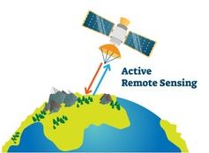
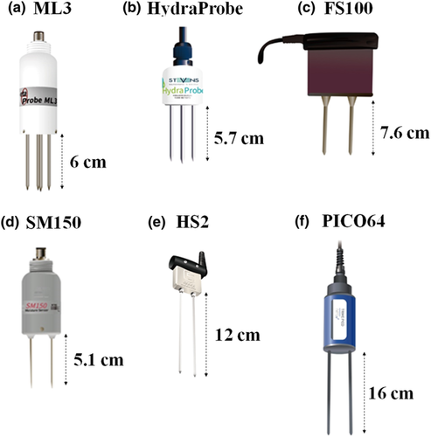
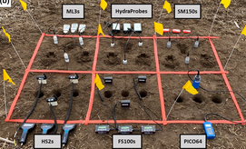
Introduction and State of the Art
Main methods used currently are probes and microwave remote sensing

Slide 6
Introduction and State of the Art
Problems with these methods:
High number of probes required for adequate characterization of a field
Low availability of satellite images
Not adequate for real time measurements

Slide 7




Introduction and State of the Art
Different approach: use of Delay Maping Receiver to record reflected GPS signal

Slide 8
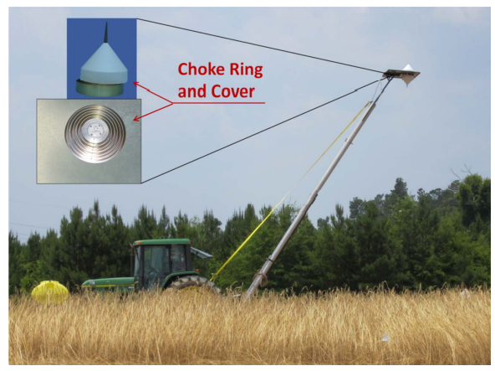
Introduction and State of the Art

Slide 9
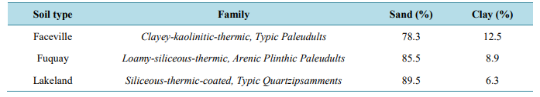
Area of Study
Agricultural field in South Carolina
2.5 ha area
Three different types of soil with different compositions

Slide 10
Methodology
Original Area
Divided in three regions based on soil texture
Region
Divided in seven zones for seven different treatments
Zone
Divided into three blocks for three different soil moisture contents

Slide 11
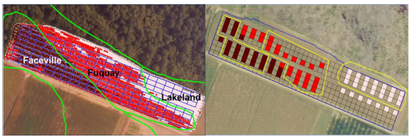
Methodology
Seven types of treatment:
1-3 Rye plantation with 3 different densities
4 Naked soil not compacted
5-7 Naked soil with 3 different levels of compaction

Slide 12
Methodology
For each parcel
DMR measure of its centre
Probe measure of soil moisture
Data processing
Calculation of reflectivity
Development of several linear regression models to find best adjustment

Slide 13
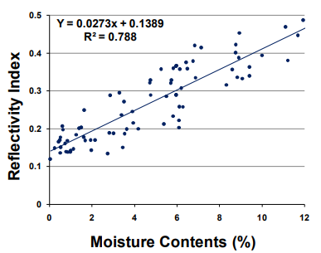
Results
Relationship between soil moisture content and reflectivity – R² =0.788

Slide 14
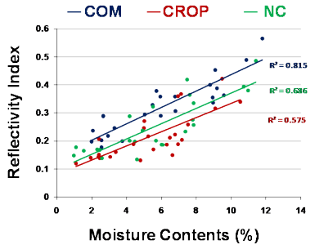
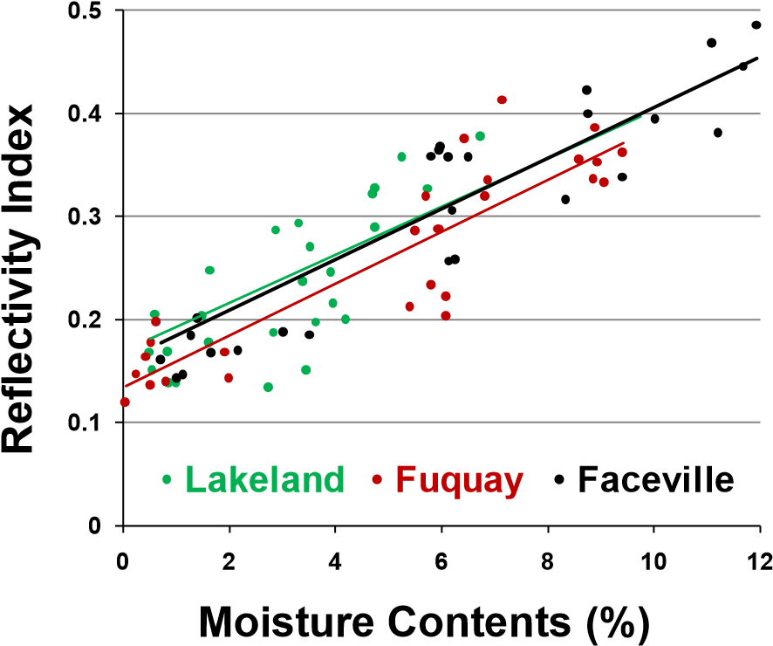
Results
Breakdown by type of treatment and type of soil does not have a significant impact on the model

Slide 15
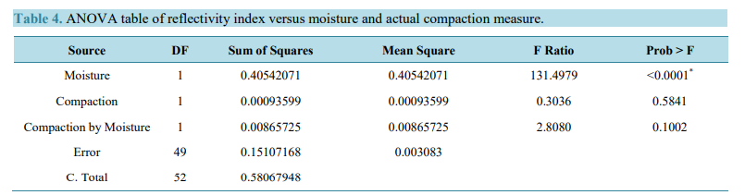
Results
Further models were constructed for the influence of biomass and compaction.
No significant influence was discovered.

Slide 16
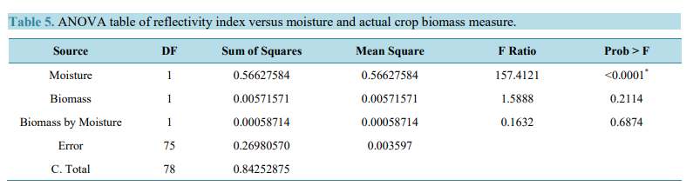
Results
Further models were constructed for the influence of biomass and compaction.
No significant influence was discovered.

Slide 17
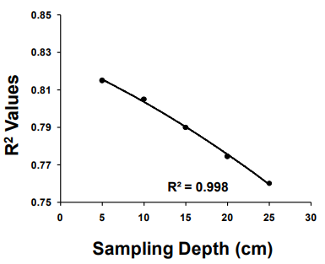
Results
A model was created to evaluate the how the relationship between reflected GPS signal and soil moisture changed with depth of soil sample

Slide 18
Conclusion
A significant relationship was found between reflectivity index and soil moisture
RI increases 0.02 per percent of soil moisture content
Other factors investigated in the study do not influence this result significantly
This technology has potential to estimate soil moisture for precision agriculture

