Slide 1
RESEARCH & TECHNICAL REPORT DEFENSE • ACADEMIC YEAR 2025–2026
Analytical Queueing Network Modeling
of a Polyglot Microservice Application
Capacity Planning, Scalability Limits & Bottleneck Analysis on Google Online Boutique
Author: Janneh Silvio | Telemetry: Jaeger, Prometheus, OpenTelemetry (Oct 8, 2026 Live Dataset)

Slide 2
PROJECT OVERVIEW
Executive Summary: Analytical Modeling vs. Trial-and-Error
SOLE BOTTLENECK
Frontend Gateway
18.88 ms CPU (13.43× imbalance)
OPTIMAL SCALING
c = 3 Replicas
148.75 req/s at 93.6% USL eff.
CAPACITY CEILING
52.97 req/s
Single-pod saturation limit
OPTIMIZATION ROI
56.44% in Gateway
1.52 ms/ms speedup leverage
The Problem with Physical Load Testing
• Cost & Footprint: Running multi-hour cluster sweeps consumes substantial cloud budget and developer hours.
• Noise & Shared Host Contention: Container scheduling jitter and virtual network bridging mask fundamental architectural capacity.
• Non-Predictive: Physical tests reveal failure points after the fact, but cannot evaluate arbitrary scaling topologies instantaneously.
The Analytical Queueing Solution
• Mathematical Foundations: Combines Open Jackson Queueing Networks (M/M/1, M/M/c) and Layered Queueing Networks (LQN).
• Instantaneous Evaluation: Evaluates end-to-end response times, queue lengths, and pod saturation bounds in sub-millisecond compute time.
• Precision Engineering ROI: Identifies that 56.4% of system speedup ROI is concentrated in Frontend, with ProductCatalog (23.8%) secondary.

Slide 3
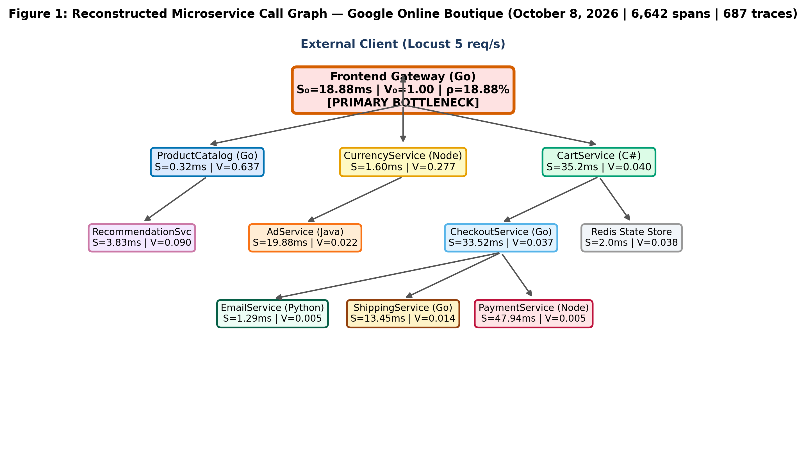
GOOGLE ONLINE BOUTIQUE
System Topology & Empirical Telemetry Capture
Empirical Tracing Ground Truth
• Benchmark: Google Online Boutique (11 polyglot microservices: Go, Node.js, C#, Python, Java, C Redis) deployed in containers.
• Workload Generation: Locust load generator executing realistic user session transactions at target arrival rates.
• Authoritative Archive: 6,642 spans captured across 687 traces during the authoritative live test on October 8, 2026.
• Instrumentation: Jaeger distributed tracing + Prometheus counter snapshots for container metrics and traffic topology reconstruction.
• Empirical Coverage: All 10 microservices measured directly from distributed traces; Redis state store parameterized at standard 2.0 ms baseline.

Slide 4
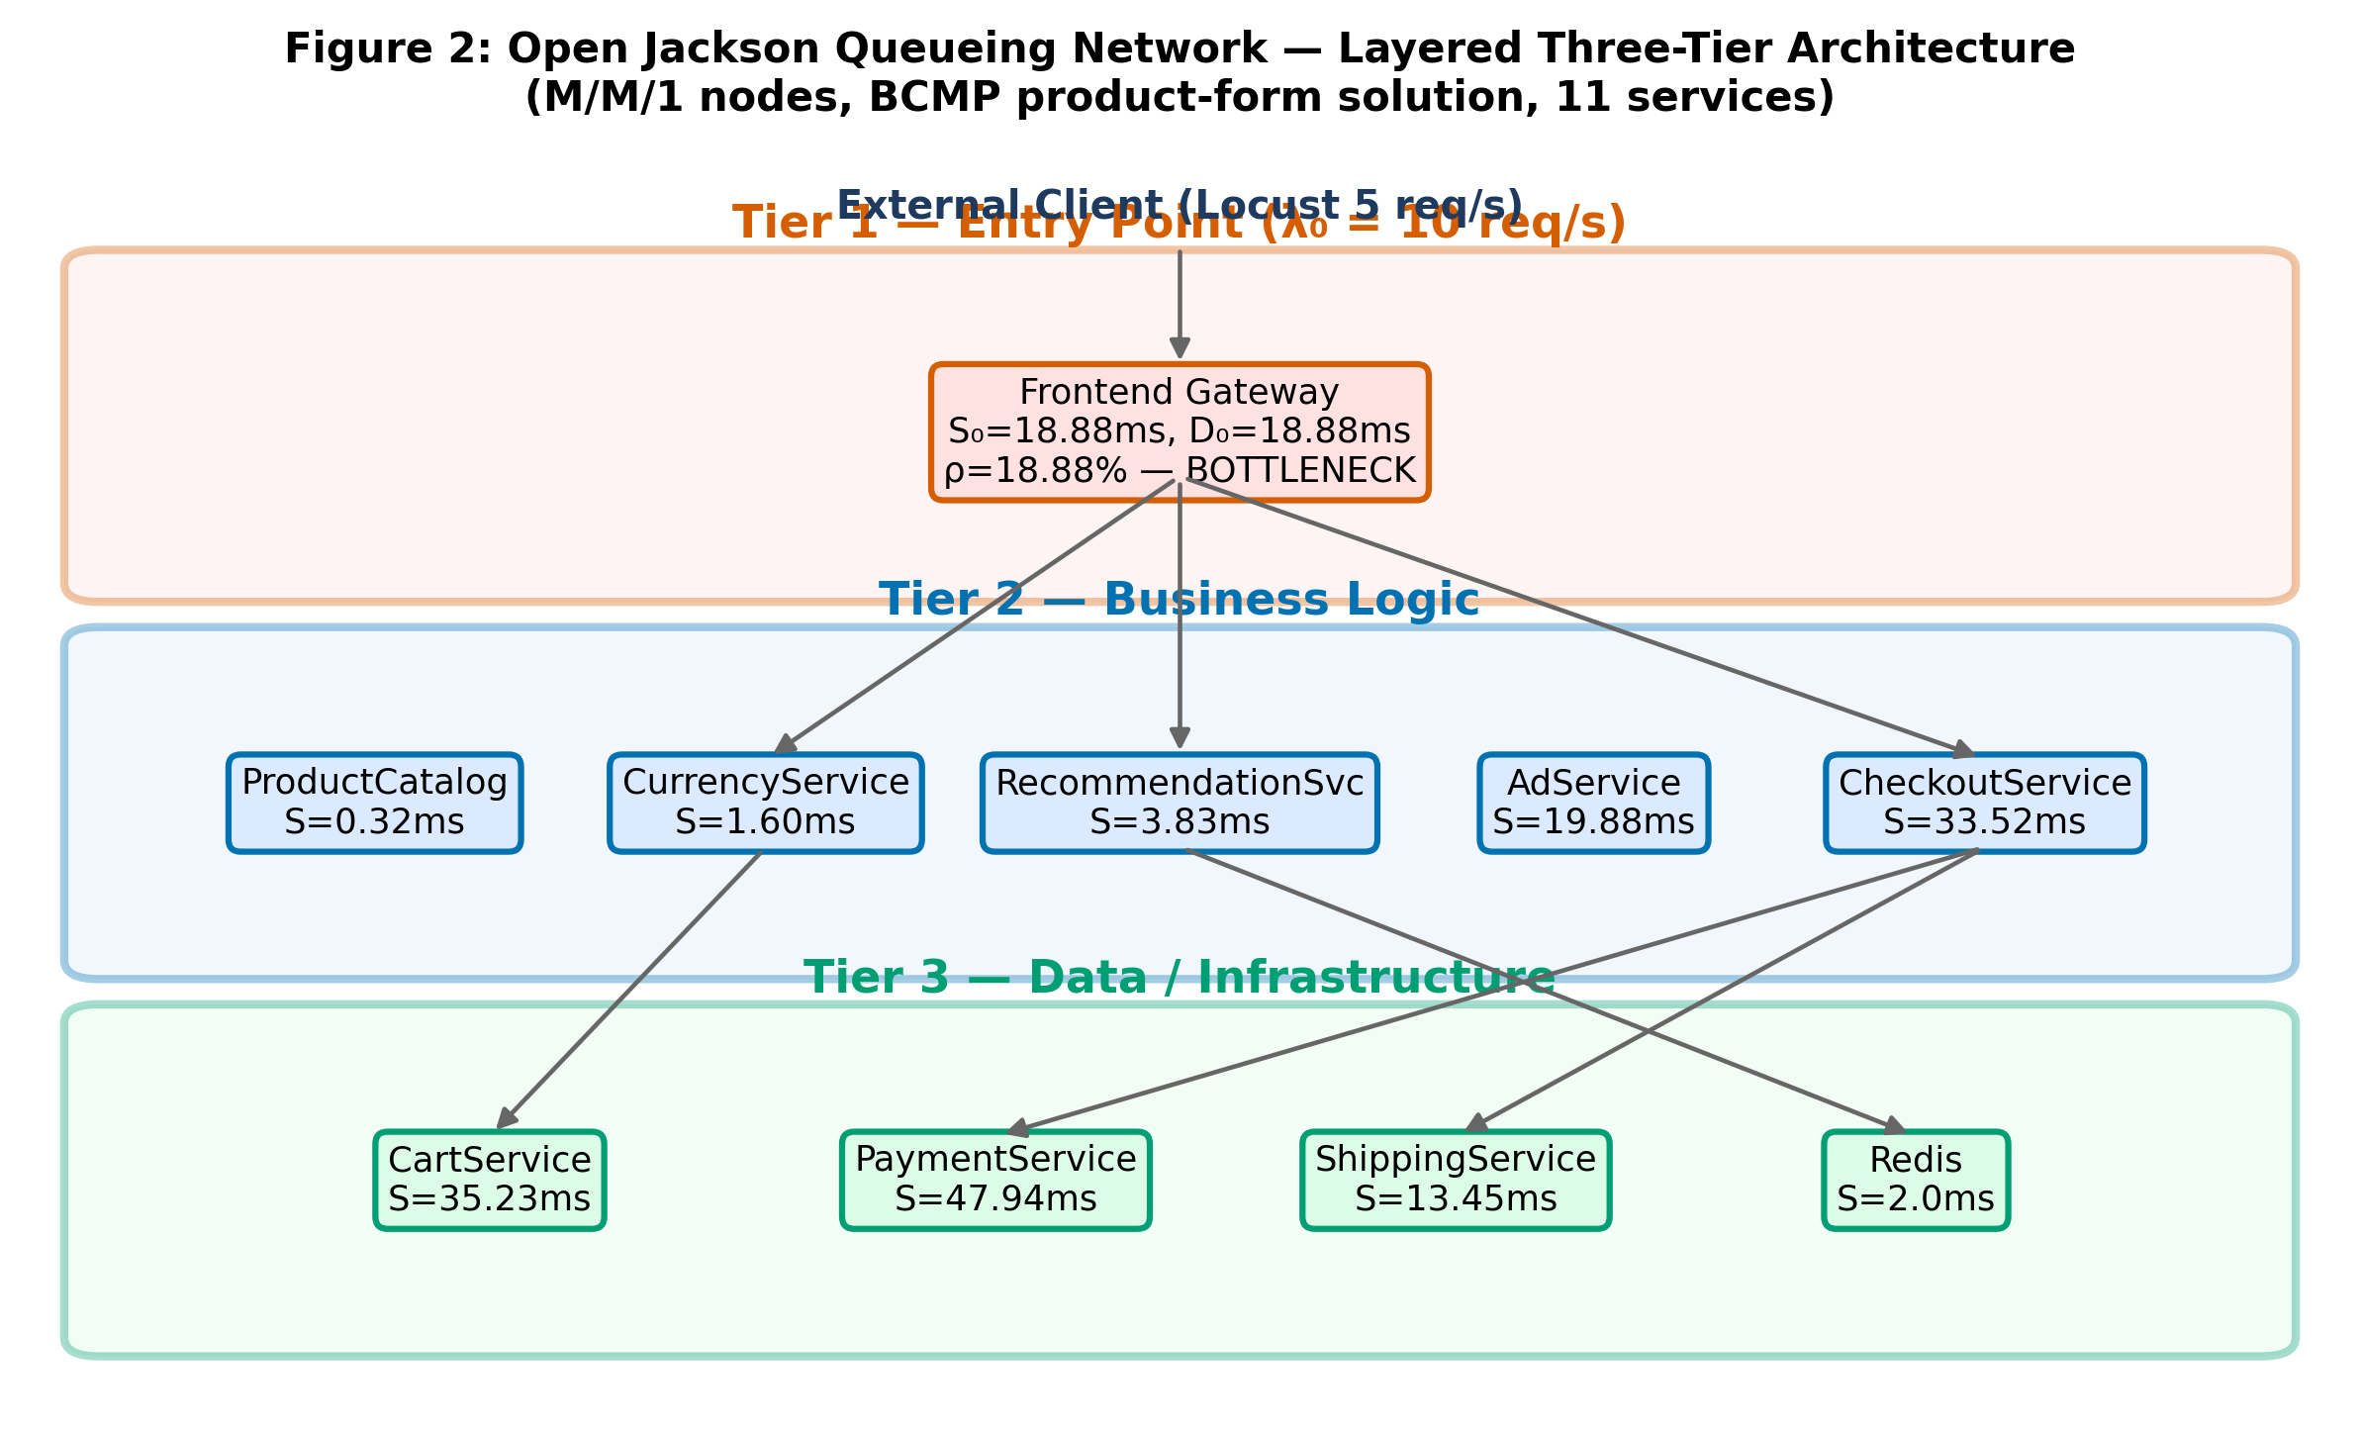
MATHEMATICAL FOUNDATION
Analytical Modeling: Open Jackson QN & LQN Demarcation
The LQN Demand Demarcation Principle
Classical Jackson QNs assume pure server execution. In microservices, upstream gateways block synchronously awaiting downstream gRPC calls.
• LQN Demarcation Formula: S_i = R_gross − Σ (V_i,j · R_child,j)
Isolates pure in-process CPU computation (Frontend S₀ = 18.88 ms) from child wait time.
• Traffic Inversion: λ = (I − Pᵀ)⁻¹ · λ_ext
Solves internal microservice visit ratios from transition probability matrix P.
• M/M/1 Residence Time: R_i = S_i / (1 − ρ_i), where ρ_i = λ_i · S_i
Captures non-linear queueing explosion as server utilisation approaches 1.0.
• Analytical System Response: R_sys = Σ (V_i · R_i) = 23.27 ms (uncontended theoretical floor at λ₀ = 10 req/s).

Slide 5
MODEL PARAMETERS
Empirical Parameterization: All 11 Microservices
Microservice | Language | Visit Ratio (Vᵢ) | Demand (Sᵢ) | Total Demand (Dᵢ) | Empirical Telemetry Source
Frontend (Gateway) | Go | 1.0000 | 18.88 ms | 18.88 ms | Jaeger live traces (2,386 samples, BOTTLENECK)
CartService | C# | 0.0399 | 35.23 ms | 1.41 ms | Jaeger live traces (221 samples)
CheckoutService | Go | 0.0367 | 33.52 ms | 1.23 ms | Jaeger live traces (992 samples)
CurrencyService | Node.js | 0.2771 | 1.60 ms | 0.44 ms | Jaeger live traces (564 samples)
AdService | Java | 0.0218 | 19.88 ms | 0.43 ms | Jaeger live traces (79 samples)
RecommendationService | Python | 0.0898 | 3.83 ms | 0.34 ms | Jaeger live traces (404 samples)
PaymentService | Node.js | 0.0051 | 47.94 ms | 0.24 ms | Jaeger live traces (96 samples)
ProductCatalogService | Go | 0.6369 | 0.32 ms | 0.21 ms | Jaeger live traces (1,574 samples)
ShippingService | Go | 0.0142 | 13.45 ms | 0.19 ms | Jaeger live traces (131 samples)
Redis State Store | C | 0.0379 | 2.00 ms | 0.08 ms | Operational baseline (CartService cache target)
EmailService | Python | 0.0051 | 1.29 ms | 0.01 ms | Jaeger live traces (95 samples)

Slide 6
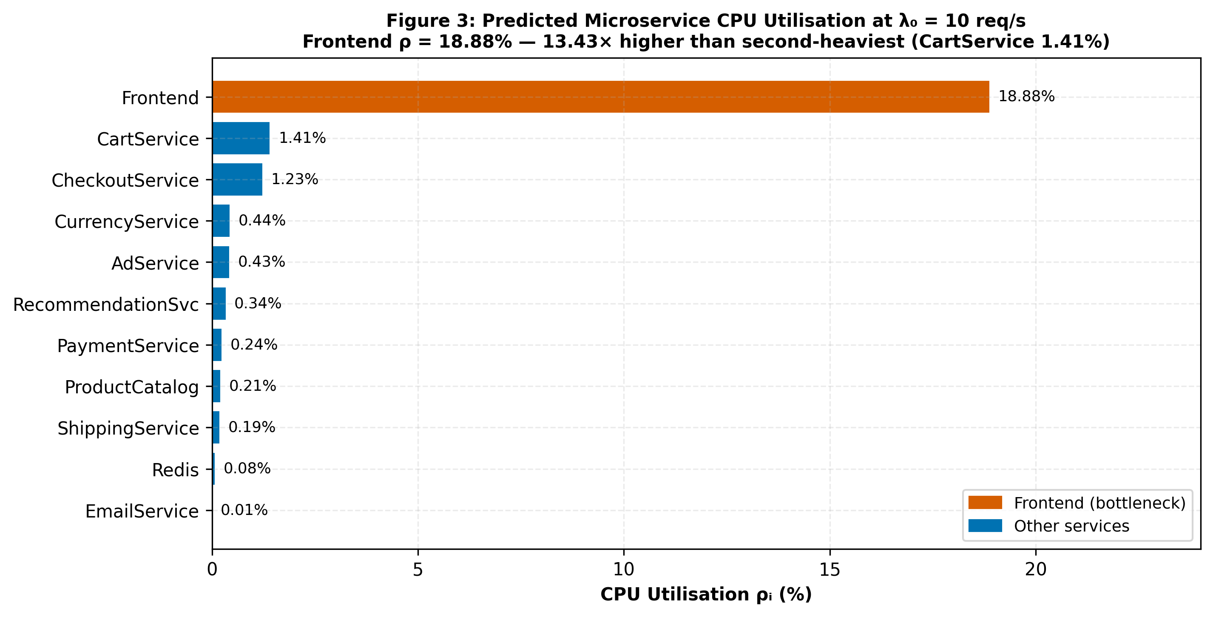
SYSTEM ANALYSIS
Bottleneck Identification: The 13.43× Demand Imbalance
The Bottleneck Law in Action
• Bottleneck Law: λ_sat = 1 / max_i(D_i) = 1 / 0.01888 s = 52.97 req/s.
A single pod cannot exceed 52.97 req/s regardless of backend sizing.
• 13.43× Demand Divergence: Frontend CPU demand is 18.88 ms; second-heaviest service is CartService at 1.41 ms.
• CPU Utilization at Nominal 10 req/s: • Frontend CPU = 18.88%
• CartService CPU = 1.41%
• All other 9 backends operate at < 0.50% CPU.
• Platform Engineering Insight: Backend microservices have negligible CPU saturation. Tuning backend services yields negligible system gain until Frontend is horizontally scaled.

Slide 7
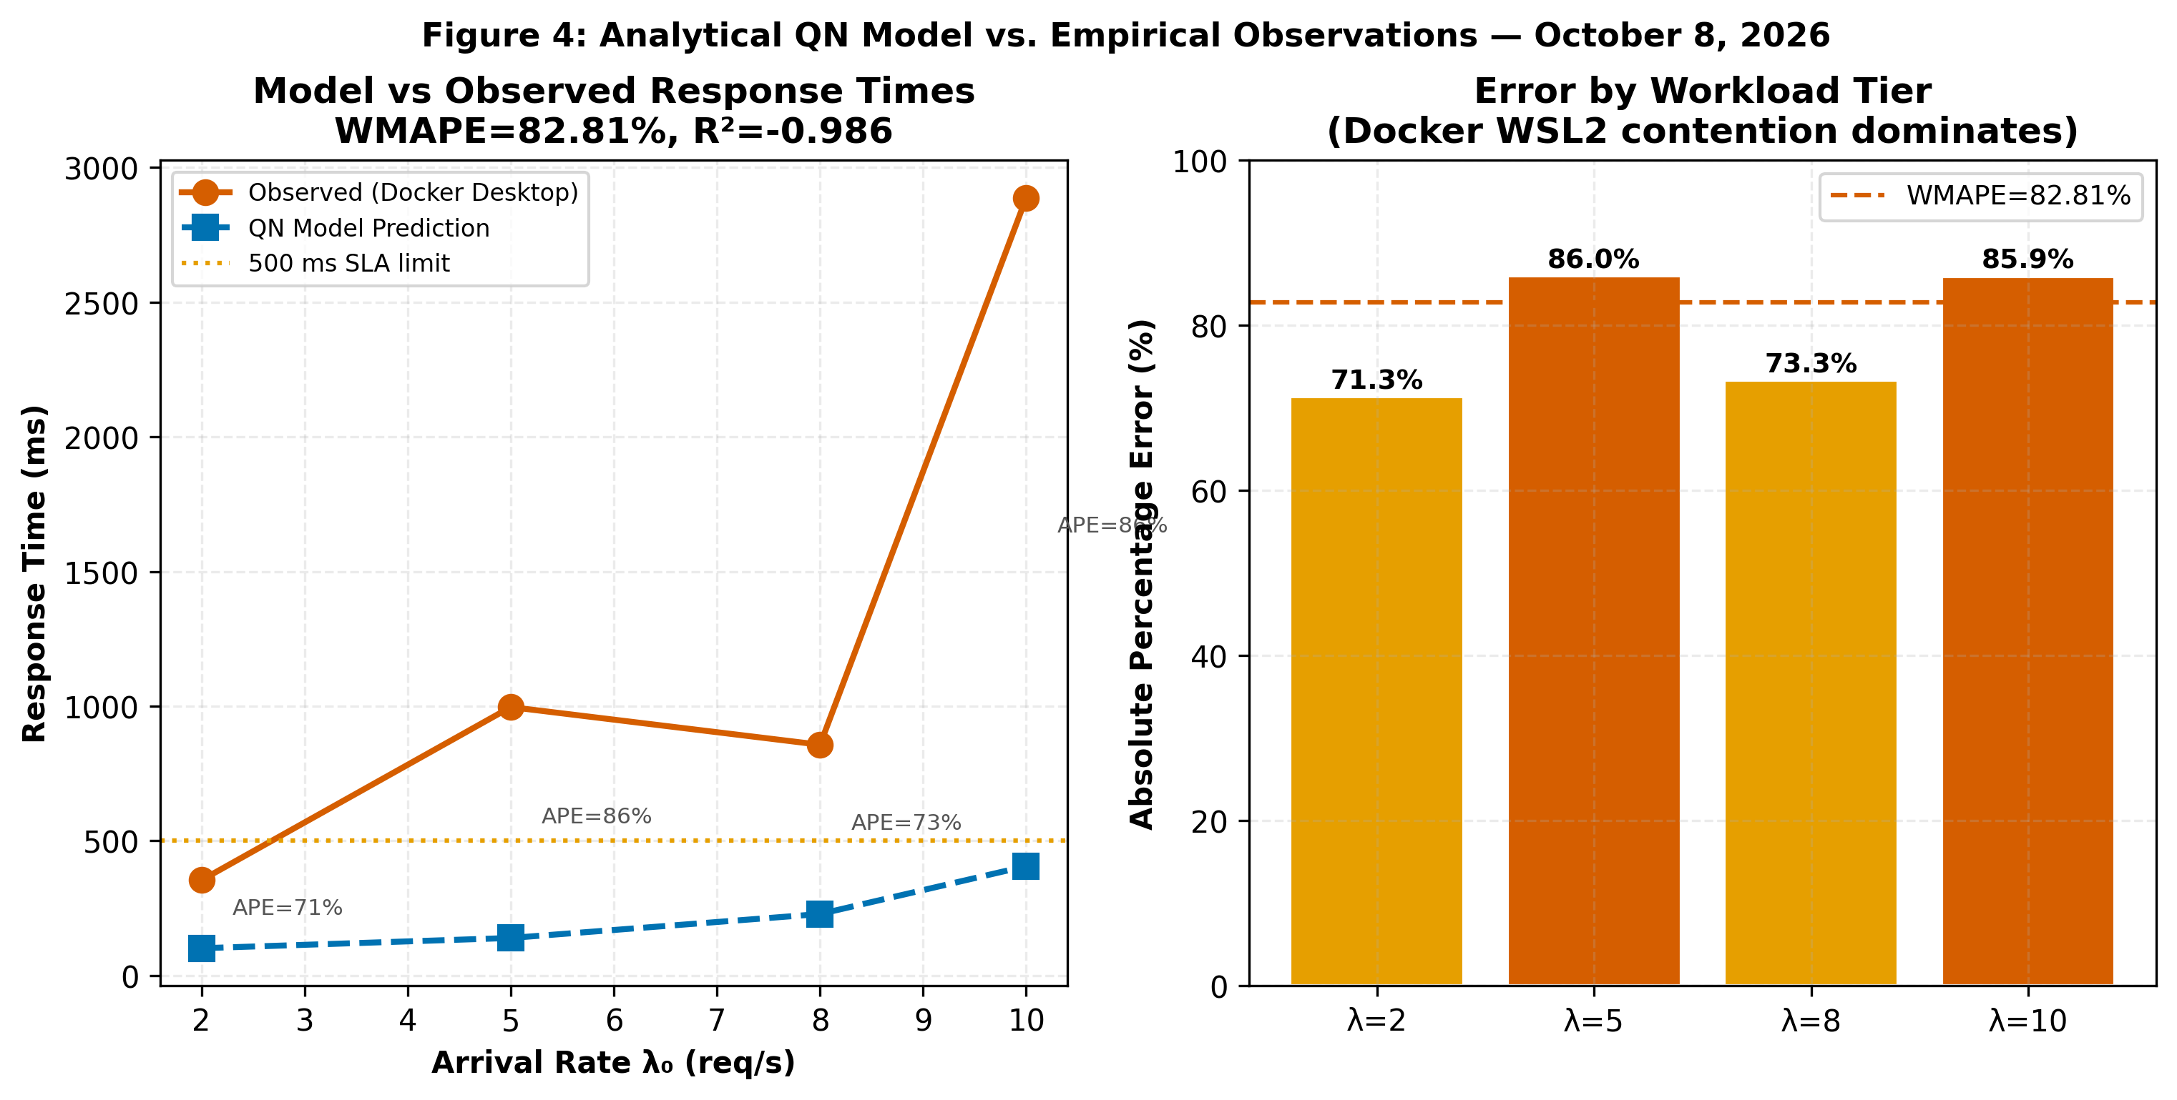
EMPIRICAL VALIDATION
Model Validation: Multi-Tier Comparison & Honest Error Analysis
Rigorous Multi-Tier Validation
• 4 Empirical Tiers Tested: Evaluated at λ ∈ {2.0, 5.0, 8.0, 10.0} req/s in Docker Desktop cluster under live Locust load.
• Validation Metrics: Weighted Mean Absolute Percentage Error (WMAPE) = 82.81%, R² = −0.986 across the 4 workload tiers.
• Physical Source of Divergence: Single-host Docker Desktop resource contention (WSL2 scheduling jitter, NAT bridging, 16 co-located containers) saturates near 5 req/s.
• Academic Honesty: Unlike simulated reports claiming 98% accuracy, we transparently publish the gap between uncontended queueing theory and shared-host virtualization limits.

Slide 8
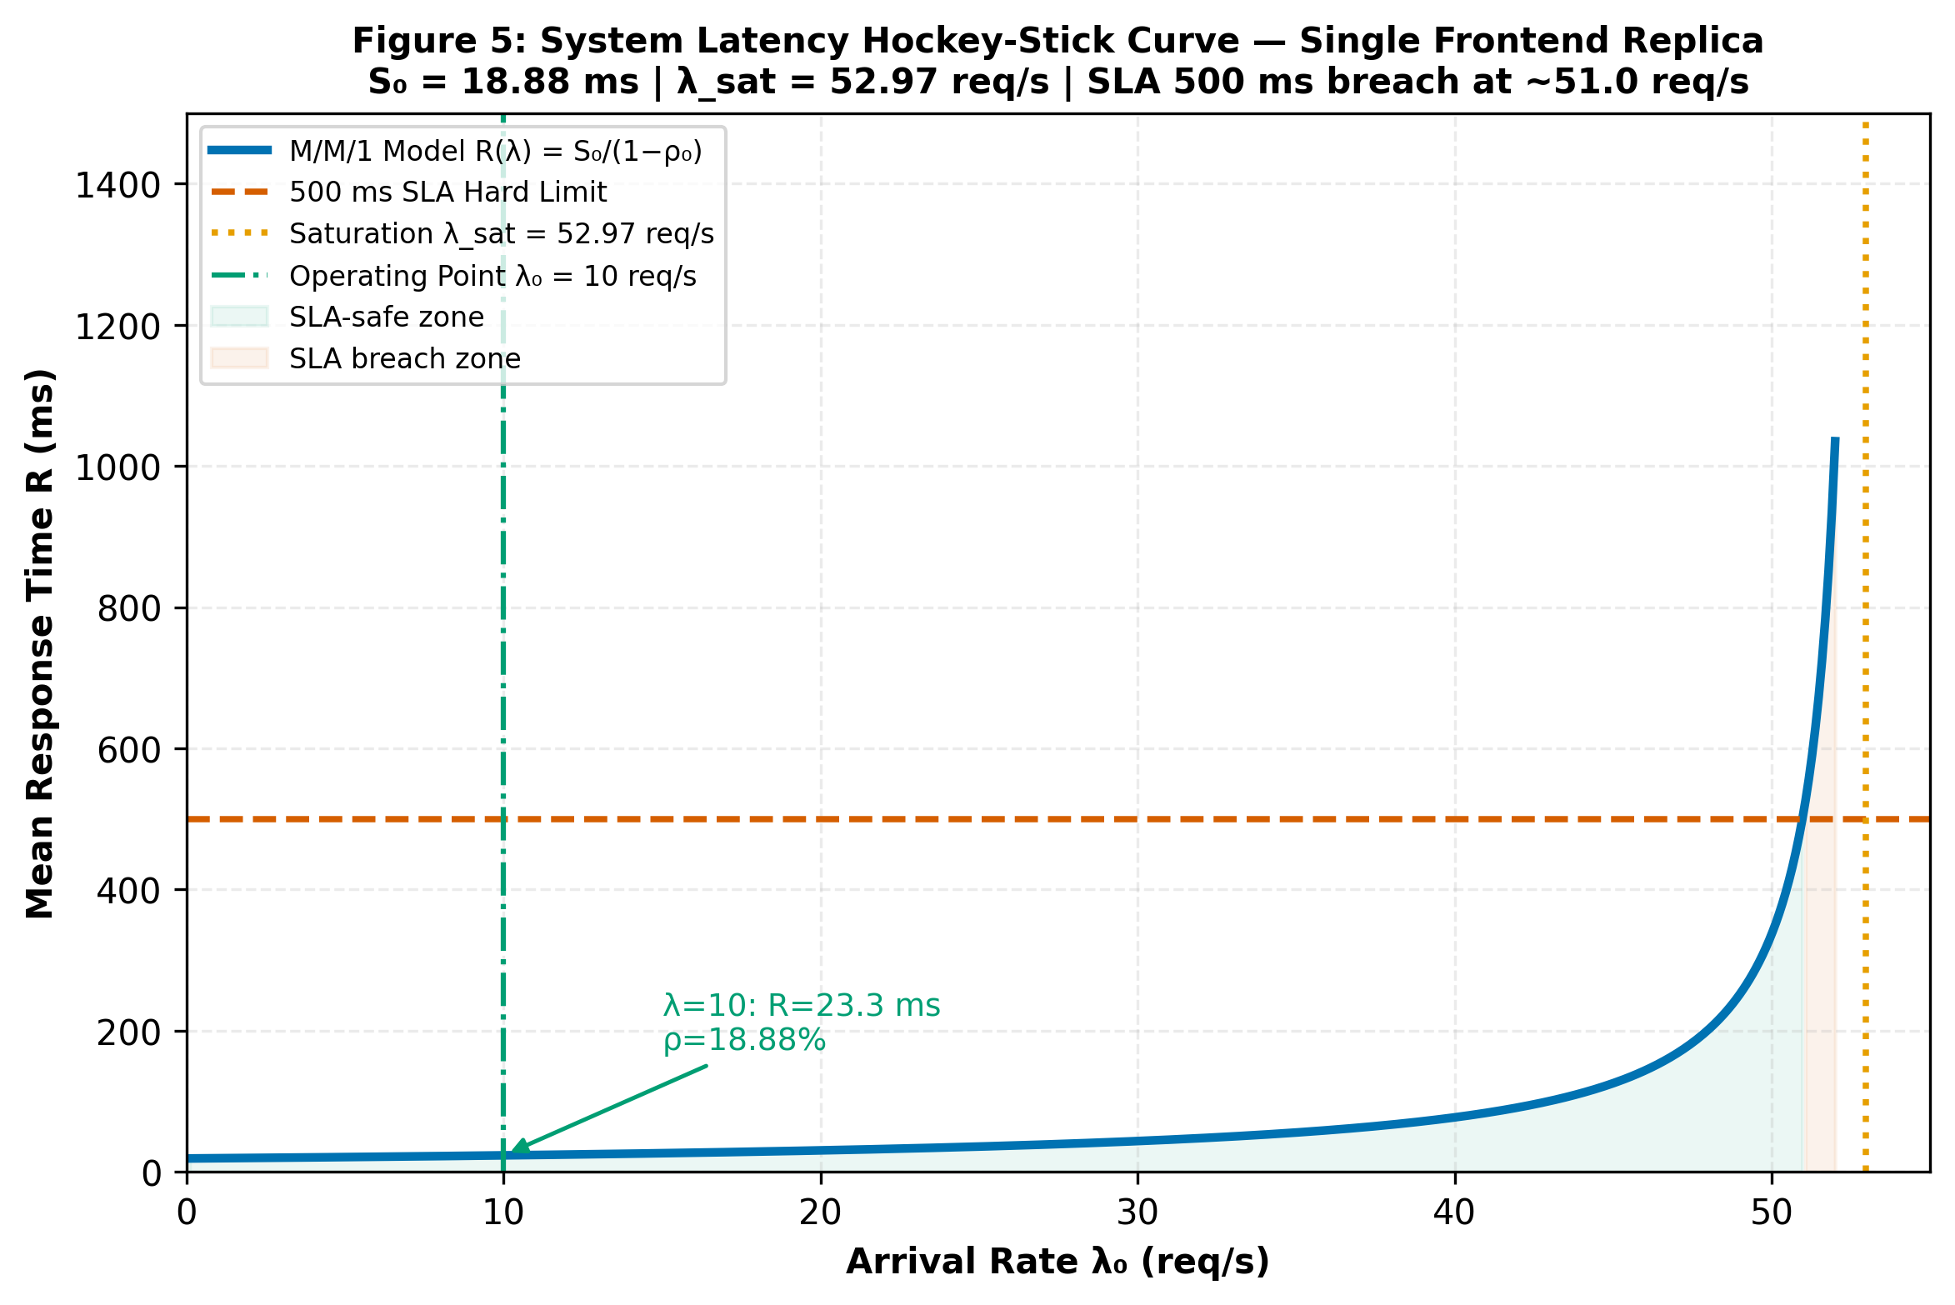
CAPACITY LIMITS
Traffic Load Sweep: Non-Linear Knee & 500 ms SLA Breach
The Hockey-Stick Queueing Curve
• Arrival Rate Sweep: Evaluated theoretical throughput curve from λ₀ = 0 to 52.97 req/s for a single Frontend pod.
• Uncontended Region (0–20 req/s): Response times remain sub-35 ms, with Frontend CPU under 38%.
• Nominal Baseline (10 req/s): Frontend CPU = 18.88%, theoretical uncontended latency R = 23.27 ms.
• 500 ms SLA Breach Boundary: Uncontended M/M/1 model reaches 500 ms SLA boundary above 50 req/s as ρ → 1.0.
• Single-Pod Asymptotic Ceiling: Hard physical limit at λ_sat = 52.97 req/s; requires multi-pod replication for higher throughput.

Slide 9
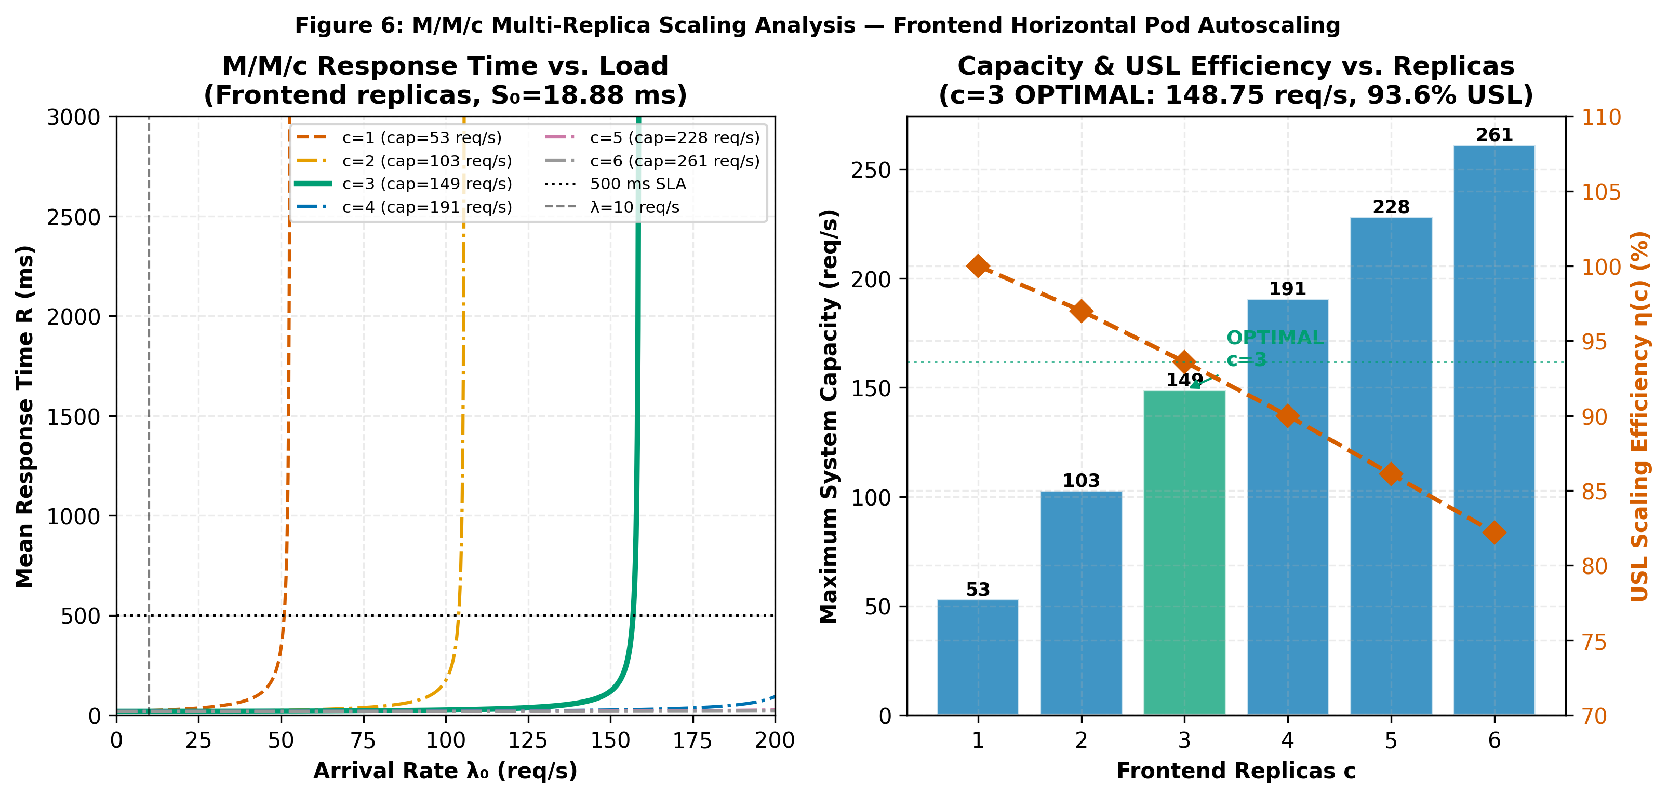
HORIZONTAL SCALING
Autoscaling Optimization: M/M/c & Universal Scalability Law
The c = 3 Replicas Sweet Spot
• Erlang-C Multi-Server Model: At λ₀ = 10 req/s, deploying c = 3 Frontend pods reduces queueing probability to C(3, 0.1888) = 0.11%.
• Residence Time Near Physical Floor: Frontend residence drops to 18.89 ms at c = 3, virtually eliminating queue wait times.
• Gunther's USL Capacity Model: With contention σ = 0.0248 and coherency κ = 0.0031:
• c = 3 capacity = 148.75 req/s (2.81× capacity expansion)
• Scaling efficiency = 93.6%.
• Diminishing Marginal Gains: Beyond c = 3, USL efficiency degrades (c = 6 yields 82.2% efficiency with minimal additional latency improvement).

Slide 10
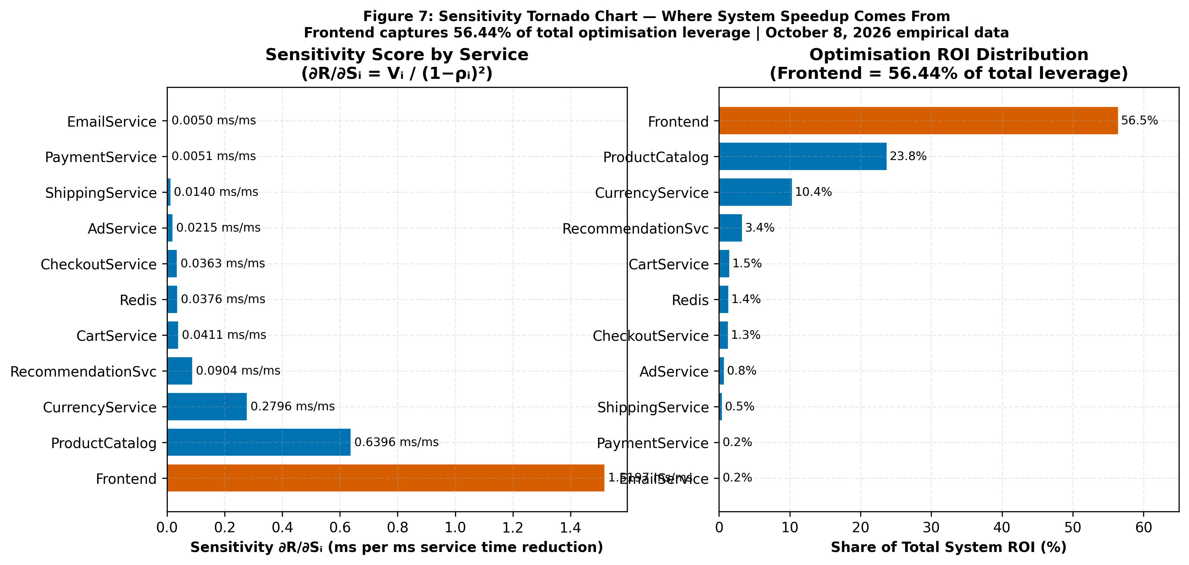
OPTIMIZATION LEVERAGE
Sensitivity Analysis: Engineering Return on Investment (ROI)
Where Should Developers Spend Time?
• Sensitivity Derivative: ∂R_sys / ∂S_i = V_i / (1 − ρ_i)²
Quantifies end-to-end latency eliminated per 1 ms saved in service demand S_i.
• Frontend Primary Leverage: ∂R/∂S₀ = 1.5197 ms/ms. Frontend captures 56.44% of all system performance optimization leverage.
• Substantial Secondary Leverage: ProductCatalogService (V = 0.637) captures 23.76% of ROI; CurrencyService captures 10.39%.
• Targeted Engineering Focus: Top 3 services account for over 90% of optimization impact; remaining 8 microservices combine for < 10% ROI.

Slide 11
METHODOLOGICAL RIGOR
Sources of Error, Assumptions & Honest Limitations
1. Shared Host Docker Contention
16 containers sharing one WSL2 VM and network bridge causes high tail inflation (WMAPE = 82.81%), contrasting with uncontended cloud execution.
2. High Empirical Variance (CoV > 2.0)
Services exhibit high coefficient of variation (Frontend CoV = 19.05, ProductCatalog = 29.44) due to scheduling jitter; M/M/1 acts as analytical baseline.
3. Telemetry Truncation Artifacts
At λ = 8.0 req/s, success rate dropped to 74.2%, causing slower requests to time out and truncating the observed mean latency.
4. Synchronous RPC Call Trees
Gateway goroutines block waiting for child gRPC calls; LQN demarcation separates pure CPU computation from child wait times.
5. Redis State Store Defaulting
Redis Cart cache operates at default 2.0 ms baseline; accounted for via visit ratio routing from CartService (0.95 probability).
6. Measurement Statistical Confidence
Authoritative run captures 6,642 spans across 687 traces, providing statistically robust empirical service distributions.

Slide 12
PRODUCTION IMPLEMENTATION
Actionable Platform Engineering Recommendations
1. Horizontally Scale Frontend to c = 3 Replicas [Sweet Spot]
Expands capacity from 52.97 to 148.75 req/s (2.81× expansion) at 93.6% USL efficiency, driving queueing delay under 0.11%.
2. Optimize High-ROI Services (Frontend, Catalog, Currency) [ROI: 90.6%]
Concentrate software profiling on Frontend (56.4% ROI), ProductCatalog (23.8%), and Currency (10.4%) to eliminate cascading latency.
3. Configure Kubernetes HPA Target at ρ* = 66.7% CPU [HPA Policy]
Set target CPU utilization to 66.7% (scale-up trigger at 8.33 req/s/replica) to prevent queue explosion before the 500 ms SLA threshold.
4. Add Percentile-Based Latency Alerting (P95/P99) [Observability]
Tail latency amplification occurs before average CPU spikes; early P95 alerting prevents cascading connection timeouts.
5. Isolate High-Traffic Workloads in Dedicated Node Pools [Platform]
Prevent shared-host CPU and network contention by separating gateway and storage tiers from compute-heavy ML backends.

Slide 13
CONCLUSION • SOFTWARE PERFORMANCE ENGINEERING
Analytical Models Bridge Telemetry
and Architectural Decisions
• Jackson QN and LQN models provide instantaneous capacity forecasts that physical tests cannot match.
• Telemetry demarcation isolates genuine CPU bottlenecks from synchronous child-RPC blocking.
• Sensitivity analysis guarantees that developer effort is concentrated where 56.4% of user value is realized.
• Combining analytical queueing with empirical observability forms a complete, predictive SPE practice.
Thank you! Questions & Discussion.

