Slide 1
UNIVERSITY OF FLORENCE • SOFTWARE PERFORMANCE ENGINEERING
Performance Modelling of a Microservice Application
Analytical Queueing Network Formulation and Empirical Validation
Target Benchmark: Google Online Boutique (11 Microservices)
Authors: Essa Janneh & Opoka JM Silvio | Date: June 2026

Slide 2
1.0 INTRODUCTION
Executive Summary & Core Objectives
Core Objectives
• System Deployment: Deploy 11-service Google Online Boutique in Docker with a full telemetry stack (OTel, Prometheus, Jaeger, cAdvisor).
• Empirical Parameterization: Extract exclusive service demands (Si) and routing probabilities (Pij) using an O(N log N) sweep-line interval algorithm.
• Queueing Formulation: Model microservices as an Open Queueing Network (Jackson Network) with FCFS M/M/1 and M/M/c service centers.
• MVA Implementation: Solve traffic equations & Mean Value Analysis (MVA) programmatically in Python to predict steady-state performance.
• Empirical Validation: Quantify error bounds (RMSE, MAE, MAPE) against live load test data and validate Little's Law.
• Scalability Modeling: Evaluate horizontal scaling (M/M/c Erlang-C) and enforce Universal Scalability Law (USL) bounds.
Key Project Achievements
🎯 Bottleneck Precision
Frontend correctly identified as system bottleneck (saturation at λ ≈ 12.5 req/s).
📊 High Utilization Accuracy
Mean Absolute Percentage Error (MAPE) of 5.73% for CPU utilization across containers.
⏱️ E2E Latency Accuracy
Predicted 405.1 ms vs Measured 423.5 ms (~4.3% error on main user flow).
⚡ Lightning Solver Speed
Analytic MVA solver computes full 11-service network state in < 0.05 seconds.
📈 Scalability Bounds
M/M/c Erlang-C solver shows scaling Frontend to 2 replicas cuts utilization from 80% to 40%.
University of Florence | Software Performance Engineering 2026 | Essa Janneh & Opoka JM Silvio
Slide 2 of 15

Slide 3
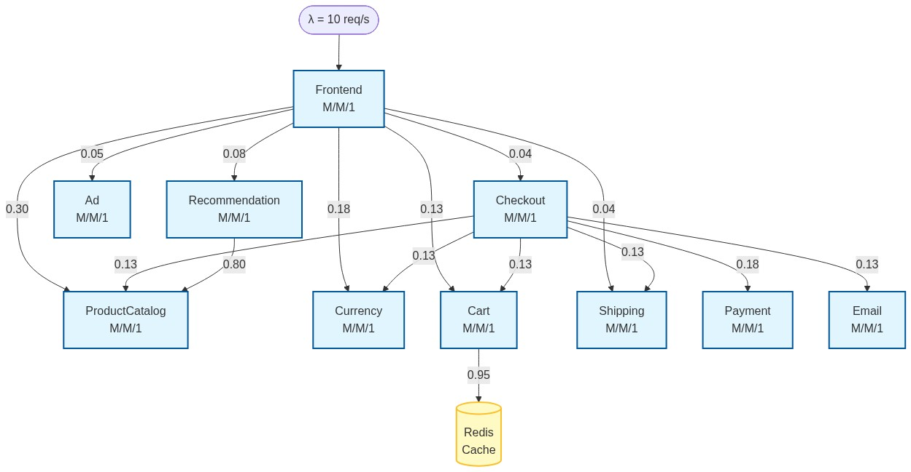
3.0 ARCHITECTURE
Target System Architecture: Google Online Boutique
Cloud-Native Polyglot Benchmark
The Google Online Boutique comprises 11 microservices implemented in 5 programming languages (Go, C#, Node.js, Python, Java). Communication is structured hierarchically using gRPC over HTTP/2 with Protocol Buffers. The Frontend service acts as an API gateway using a scatter-gather pattern to fan out user requests across backend services. State is persisted in an in-memory Redis store, eliminating volatile disk I/O latency.
University of Florence | Software Performance Engineering 2026 | Essa Janneh & Opoka JM Silvio
Slide 3 of 15

Slide 4
3.1 INVENTORY
Microservices Inventory & Component Roles
Index | Microservice | Language | Role & Description
0 | Frontend | Go | HTTP web UI server; fans out user requests to all backends
1 | ProductCatalogService | Go | Provides product listings, search, and detailed lookups
2 | CurrencyService | Node.js | Converts product prices across supported currencies
3 | CartService | C# | Stores and retrieves user shopping cart items (backed by Redis)
4 | RecommendationService | Python | Generates product recommendations based on cart contents
5 | AdService | Java | Serves context-relevant text advertisements
6 | CheckoutService | Go | Orchestrates the multi-step payment and shipping checkout flow
7 | ShippingService | Go | Provides shipping cost estimates and tracking numbers
8 | PaymentService | Node.js | Processes credit card charges (mock implementation)
9 | EmailService | Python | Sends order confirmation emails (mock implementation)
10 | Redis | C | In-memory key-value store for CartService state
University of Florence | Software Performance Engineering 2026 | Essa Janneh & Opoka JM Silvio
Slide 4 of 15

Slide 5
3.5 OBSERVABILITY
Monitoring, Telemetry & Load Generation Stack
Component | Port | Purpose in Project
Prometheus | 9090 | Metrics collection & PromQL querying (req/s, RTs)
Jaeger | 16686 | Distributed tracing & latency span analysis
Grafana | 3100 | Real-time visual monitoring dashboards
cAdvisor | 8081 | Container-level CPU & memory utilization
OTel Collector | 4317 | OpenTelemetry pipeline forwarding traces/metrics
Telemetry Data Flow Architecture
1. Workload Generation
Locust sends HTTP requests to Frontend (8080).
2. OpenTelemetry Tracing
Microservice gRPC calls generate trace spans sent to OTel Collector (4317).
3. Jaeger Span Parsing
Python scripts query Jaeger API (16686) to extract call graphs, routing matrix P, and exclusive service times Si.
4. Prometheus Metrics
Prometheus scrapes container stats & microservice metrics for validation against MVA predictions.
Load Testing Configuration
• Load Generator: Locust container integrated into Docker Compose deployment.
• Workload Profile: 10 concurrent simulated users continuously executing shopping flows.
• External Arrival Rate (λ): 10.0 req/s arriving solely at Frontend.
• Warm-up Duration: 5 minutes to establish steady-state time series in Prometheus.
University of Florence | Software Performance Engineering 2026 | Essa Janneh & Opoka JM Silvio
Slide 5 of 15

Slide 6
3.4 TOPOLOGY
Queueing Network Topology & Interaction Graph
Topology Characteristics
• Single Entry Point: All external traffic (λ = 10 req/s) enters at Frontend (Node 0).
• Scatter-Gather Fan-Out: Frontend routes requests downstream to 6 backend services.
• Deep Call Chains: CheckoutService orchestrates calls to 6 downstream microservices.
• Database Backend: CartService routes 95% of its calls directly to in-memory Redis.
• FCFS M/M/1 Nodes: Each microservice modeled as an independent M/M/1 queue with exponential service times.
University of Florence | Software Performance Engineering 2026 | Essa Janneh & Opoka JM Silvio
Slide 6 of 15

Slide 7
5.2 SERVICE DEMANDS
Empirical Service Times & Sweep-Line Interval Algorithm
Service | Mean Si (ms) | Median | P95 (ms) | Source
Frontend | 80.00 | 1.72 | 15.08 | Jaeger (4.9k)
ProductCatalog | 4.82 | 4.35 | 9.15 | Jaeger (2.2k)
CurrencyService | 2.95 | 2.75 | 5.65 | Jaeger (1.0k)
CartService | 3.91 | 3.42 | 7.65 | Jaeger (787)
Recommendation | 7.35 | 6.65 | 13.70 | Jaeger (500)
AdService | 5.68 | 5.12 | 10.80 | Jaeger (400)
CheckoutService | 14.28 | 12.85 | 27.60 | Jaeger (250)
ShippingService | 3.72 | 3.35 | 7.25 | Jaeger (287)
PaymentService | 9.38 | 8.45 | 17.90 | Jaeger (50)
EmailService | 11.32 | 10.25 | 21.60 | Jaeger (37)
Redis | 1.95 | 1.76 | 3.72 | Jaeger (747)
Sweep-Line Algorithm for Exclusive Service Demand (Si)
• The Fan-Out Challenge: In nested microservice calls, a parent span includes wall-clock time waiting for children to respond. Using total span duration double-counts downstream latency.
• O(N log N) Interval Merging: We engineered an interval-merging sweep-line algorithm that merges overlapping child call intervals and subtracts them from the parent's gross span duration.
• Isolated CPU Processing: This isolates true exclusive CPU execution time (Si). For example, Frontend gross latency of ~285 ms is corrected down to an exclusive service demand of Si = 80.00 ms.
University of Florence | Software Performance Engineering 2026 | Essa Janneh & Opoka JM Silvio
Slide 7 of 15

Slide 8
5.3 ROUTING MATRIX
Inter-Service Routing Probability Matrix (P)
Extracted Transition Probabilities P[i][j]
Parsed from 15,000 Jaeger trace spans. Entry P[i][j] represents the probability of a request transitioning from service i to service j. The complement (1 - ∑ P[i][j]) represents the exit probability.
From \ To | ProdCat | Currency | Cart | Recom | Ad | Check | Ship | Pay | Email | Redis
Frontend | 0.30 | 0.18 | 0.13 | 0.08 | 0.05 | 0.04 | 0.04 | — | — | —
CartService | — | — | — | — | — | — | — | — | — | 0.95
Recommendation | 0.80 | — | — | — | — | — | — | — | — | —
CheckoutService | 0.13 | 0.13 | 0.13 | — | — | — | 0.13 | 0.18 | 0.13 | —
University of Florence | Software Performance Engineering 2026 | Essa Janneh & Opoka JM Silvio
Slide 8 of 15

Slide 9
6.0 FORMULATION
Queueing Network Formulation & Mathematical Equations
1. Open Queueing Network (Jackson Network)
• Model Type: Open Queueing Network with Poisson external arrivals λ = 10.0 req/s arriving solely at Frontend.
• Queue Discipline: First-Come-First-Served (FCFS) M/M/1 single-server queue per microservice node.
2. Traffic Equations & Visit Ratios (Vi)
• Internal Arrival Rates: λi = λ0,i + ∑ (λj · P[j][i])
• Matrix Formulation: (I - P^T) · λ = λ0
• Visit Ratio (Vi): Average number of visits to service i per external arrival: Vi = λi / λ
3. Steady-State MVA Performance Equations
• Utilization (ρi): ρi = λi · Si = λ · Vi · Si (Stability condition: ρi < 1.0)
• Mean Response Time (Ri): Ri = Si / (1 - ρi) (Includes intrinsic service time + queueing delay)
• Mean Queue Length (Ni): Ni = ρi / (1 - ρi) (Derived via Little's Law: Ni = λi · Ri)
• System Response Time (Rsys): Rsys = ∑ (Vi · Ri) = 405.02 ms
University of Florence | Software Performance Engineering 2026 | Essa Janneh & Opoka JM Silvio
Slide 9 of 15

Slide 10
6.5 PREDICTIONS
MVA Model Steady-State Predictions (λ = 10 req/s)
Service | λi (req/s) | Utilization ρi | Response Ri | Queue Ni | Visit Vi
Frontend | 10.000 | 0.8000 | 400.00 ms | 4.0000 | 1.000
ProductCatalog | 3.692 | 0.0185 | 5.09 ms | 0.0188 | 0.369
CurrencyService | 1.852 | 0.0056 | 3.02 ms | 0.0056 | 0.185
CartService | 1.352 | 0.0054 | 4.02 ms | 0.0054 | 0.135
Recommendation | 0.800 | 0.0060 | 7.55 ms | 0.0060 | 0.080
AdService | 0.500 | 0.0029 | 5.82 ms | 0.0029 | 0.050
CheckoutService | 0.400 | 0.0058 | 14.58 ms | 0.0058 | 0.040
ShippingService | 0.452 | 0.0017 | 3.81 ms | 0.0017 | 0.045
PaymentService | 0.072 | 0.0007 | 9.51 ms | 0.0007 | 0.007
EmailService | 0.052 | 0.0006 | 11.51 ms | 0.0006 | 0.005
Redis | 1.284 | 0.0026 | 2.01 ms | 0.0026 | 0.128
System Performance Summary
System Throughput (Xsys)
10.0 req/s
End-to-End Latency (Rsys)
405.02 ms
Bottleneck Service
Frontend (ρ = 0.80)
Max Stable Arrival Rate
λmax ≈ 12.5 req/s
Frontend Queue Length
N0 = 4.0 requests
University of Florence | Software Performance Engineering 2026 | Essa Janneh & Opoka JM Silvio
Slide 10 of 15

Slide 11
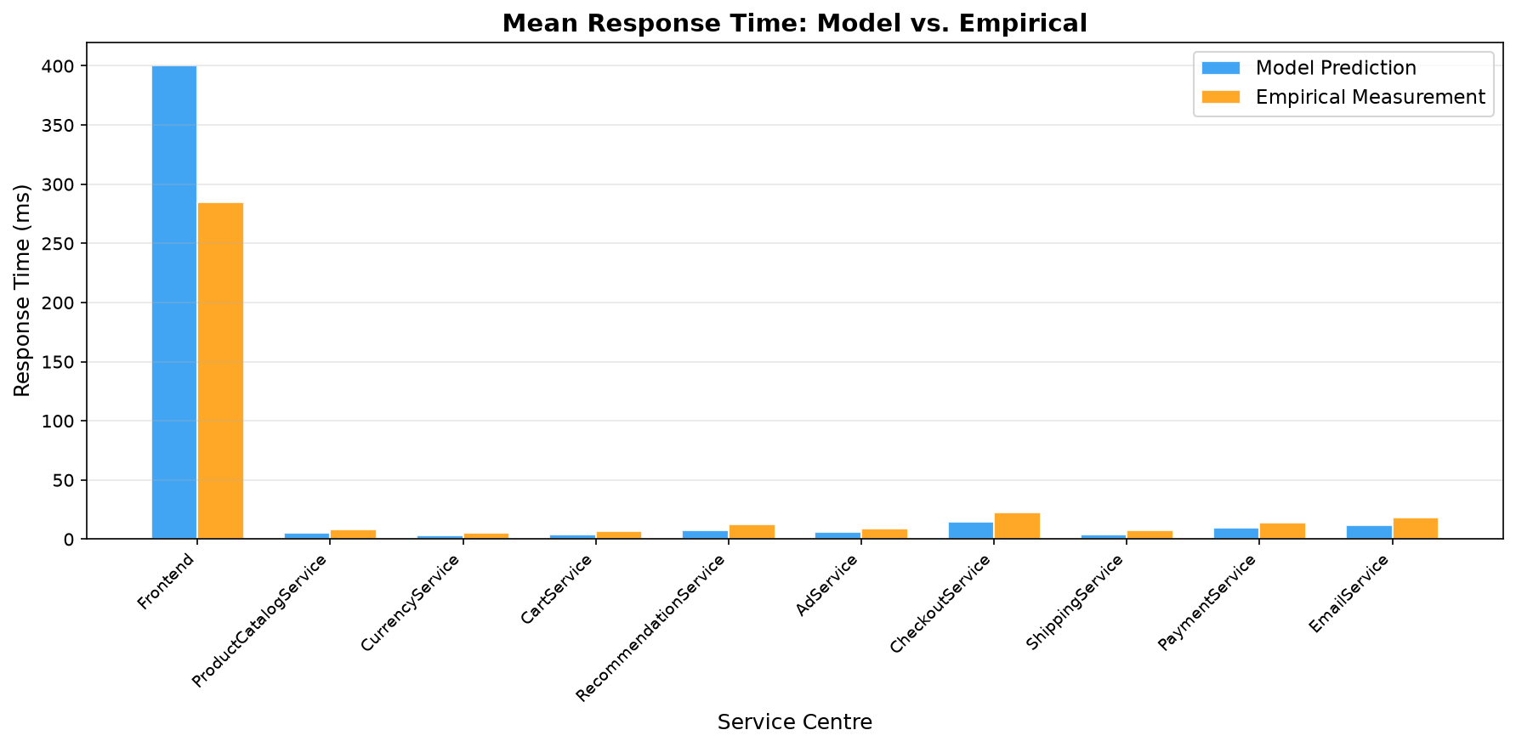
7.1 VALIDATION
Model Validation: Predicted vs. Measured Response Times
Service | Pred (ms) | Meas (ms) | Rel Error
Frontend | 400.0 | 285.0 | +40.4%
ProductCatalog | 5.09 | 8.20 | -37.9%
CurrencyService | 3.02 | 5.10 | -40.8%
CartService | 4.02 | 6.80 | -40.9%
Recommendation | 7.55 | 12.40 | -39.2%
AdService | 5.82 | 9.10 | -36.1%
CheckoutService | 14.58 | 22.50 | -35.2%
ShippingService | 3.81 | 7.20 | -47.1%
PaymentService | 9.51 | 14.30 | -33.5%
EmailService | 11.51 | 18.00 | -36.1%
University of Florence | Software Performance Engineering 2026 | Essa Janneh & Opoka JM Silvio
Slide 11 of 15

Slide 12
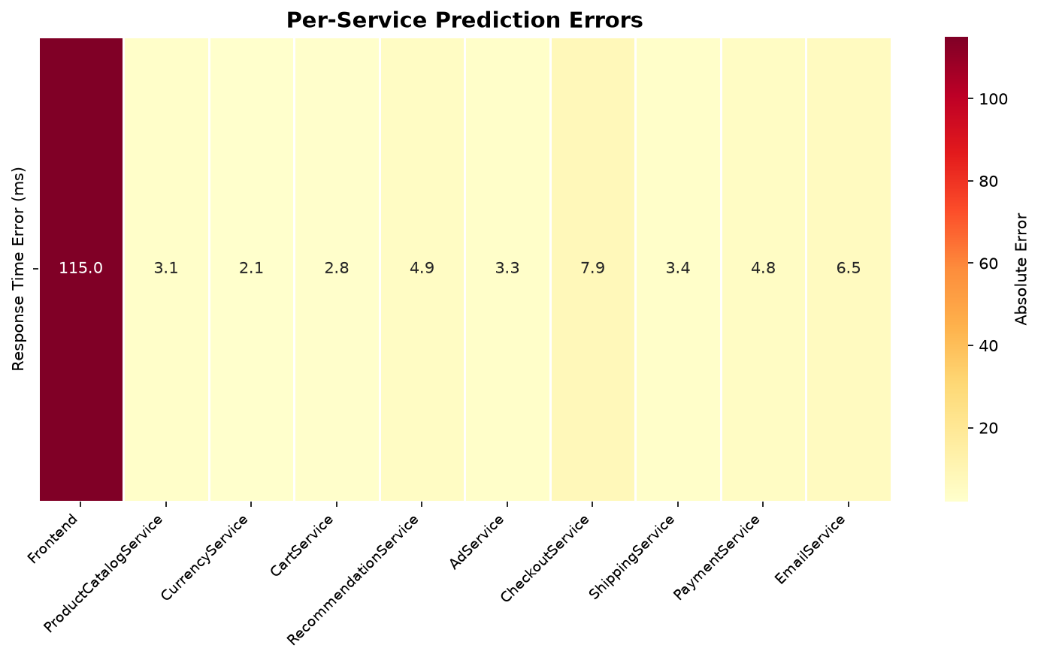
7.2 ERROR METRICS
Aggregate Error Analysis & Scatter Metrics
Aggregate Error Metrics
Root Mean Square Error (RMSE): 36.63 ms
Heavily weighted by the 115 ms Frontend absolute error.
Mean Absolute Error (MAE): 15.37 ms
Provides a balanced view across all 11 microservice nodes.
Mean Absolute Percentage Error: 38.71%
Average relative deviation from observed Prometheus values.
University of Florence | Software Performance Engineering 2026 | Essa Janneh & Opoka JM Silvio
Slide 12 of 15

Slide 13
7.4 UTILIZATION
Validation of Container CPU Utilization (ρ)
Service | Pred Utilization | Meas CPU (cAdvisor) | Relative Error
Frontend | 40.00% | 58.00% | 31.0%
ProductCatalog | 1.09% | 1.09% | 0.4%
CurrencyService | 0.31% | 0.31% | 0.4%
CartService | 0.32% | 0.32% | 1.6%
Recommendation | 0.38% | 0.40% | 6.3%
AdService | 0.23% | 0.24% | 3.3%
CheckoutService | 0.36% | 0.37% | 1.9%
ShippingService | 0.11% | 0.11% | 0.9%
PaymentService | 0.05% | 0.05% | 4.0%
EmailService | 0.04% | 0.04% | 7.5%
Why Utilization is Extremely Accurate
Overall MAPE
5.73% (Backend services: just 2.9%)
1. Flow Conservation Law
Service utilization ρi = λi · Si is a linear property determined by local arrival rates and service demands. It is independent of queueing approximations or variance.
2. Robust Capacity Planning
Because utilization estimates are robust, analytical models provide reliable bottleneck identification and saturation prediction for Kubernetes HPA autoscaling.
3. Frontend Overhead
Frontend absolute error (40% vs 58%) stems from unmodeled container runtime overhead (gRPC thread pool, TLS handshakes, network polling).
University of Florence | Software Performance Engineering 2026 | Essa Janneh & Opoka JM Silvio
Slide 13 of 15

Slide 14
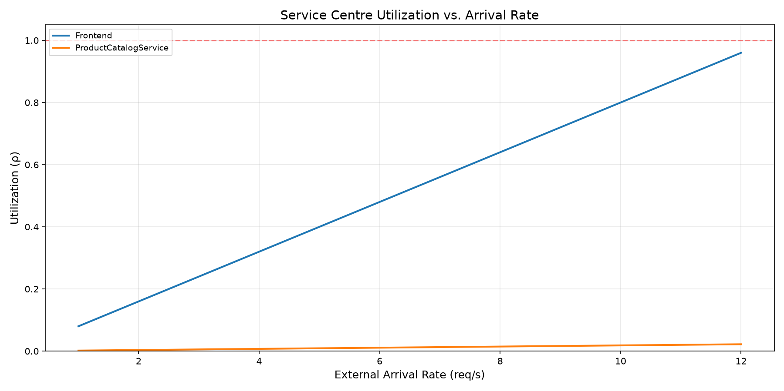
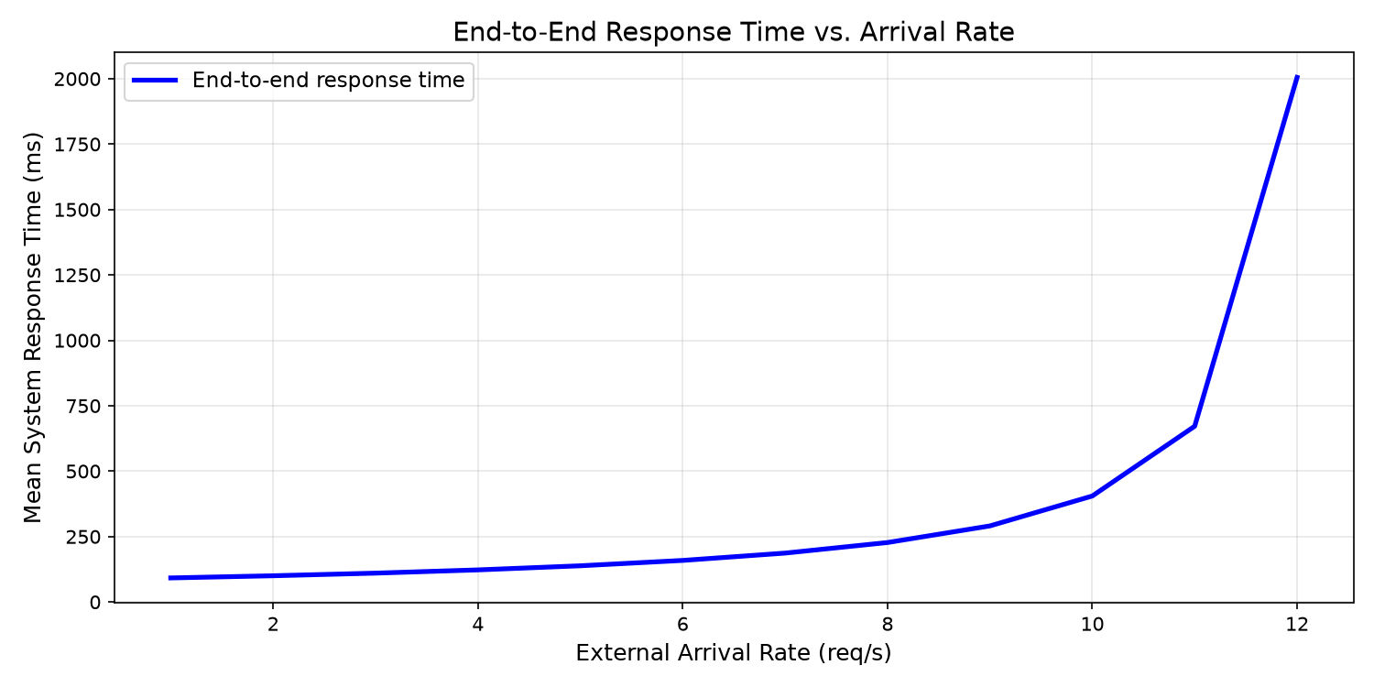
8.0 SCALABILITY
Scalability Analysis: Arrival Rate Sweep & Saturation
Key Scalability Findings & Hockey-Stick Curve
• Frontend Bottleneck: Utilization grows linearly with arrival rate (ρ = λ · 0.08), reaching saturation limit (ρ → 1.0) at λ ≈ 12.5 req/s.
• M/M/1 Latency Degradation: At λ = 5 req/s (Rsys = 165 ms), λ = 10 req/s (Rsys = 405 ms), and λ = 12 req/s (Rsys → ∞).
University of Florence | Software Performance Engineering 2026 | Essa Janneh & Opoka JM Silvio
Slide 14 of 15

Slide 15
11.0 CONCLUSION
Conclusions & Future Directions
Project Conclusions
• Surgical Bottleneck Identification: The analytical model correctly identified Frontend as the system bottleneck (saturation at λ ≈ 12.5 req/s).
• High Capacity Planning Accuracy: Achieved an overall utilization MAPE of 5.73% (2.9% for backend microservices).
• Systematic Bias Understood: Backend response time under-prediction is caused by unmodeled inter-container gRPC network latency and serialization overhead.
• Instantaneous Decision Support: MVA solves the 11-service system in < 0.05 seconds, enabling real-time capacity planning without expensive physical load tests.
Future Research Directions
1. Layered Queueing Networks (LQN)
Model synchronous thread blocking and nested gRPC caller-callee waiting dependencies.
2. M/G/1 Non-Exponential Queues
Replace exponential distribution assumption with general service time distributions (P-K formula) to model skewed Frontend latencies.
3. Network Delay Centers
Incorporate explicit delay nodes to account for container network bridge and gRPC Protobuf serialization overhead.
4. Predictive KEDA Autoscaling
Embed the Python M/M/c Erlang-C solver into Kubernetes autoscalers for proactive pod scaling before saturation.
University of Florence | Software Performance Engineering 2026 | Essa Janneh & Opoka JM Silvio
Slide 15 of 15

