Slide 1
Smart Kitchen
Students: Alexa Cristian & Manzur Silviu
Course: Microprocessor Systems
Assistant Teacher: Groza Claudiu

Slide 2
Content
1.Problem statement
2.System architecture
3.Hardware & System design
4.Results
5.Conclusion and future work

Slide 3
Problem statement
The problem statement of Smart Kitchen is to centralize and automate the essential functions of kitchens.
Using this application, customers will have an easier life.

Slide 4
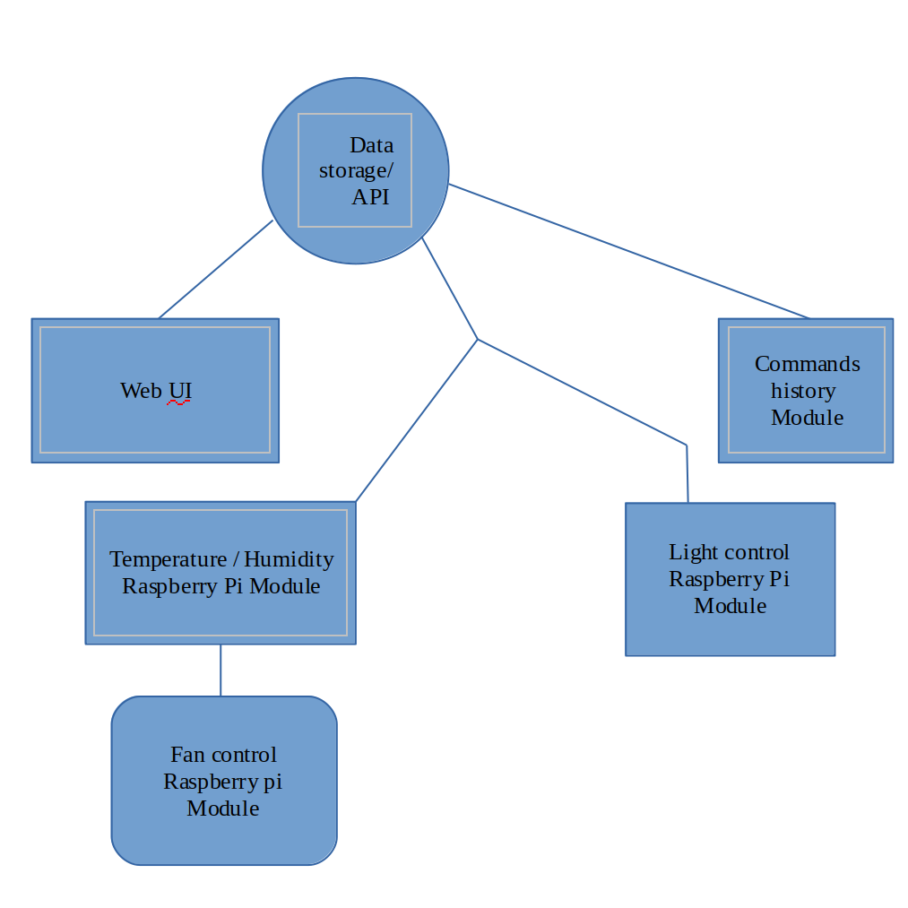
System Architecture

Slide 5
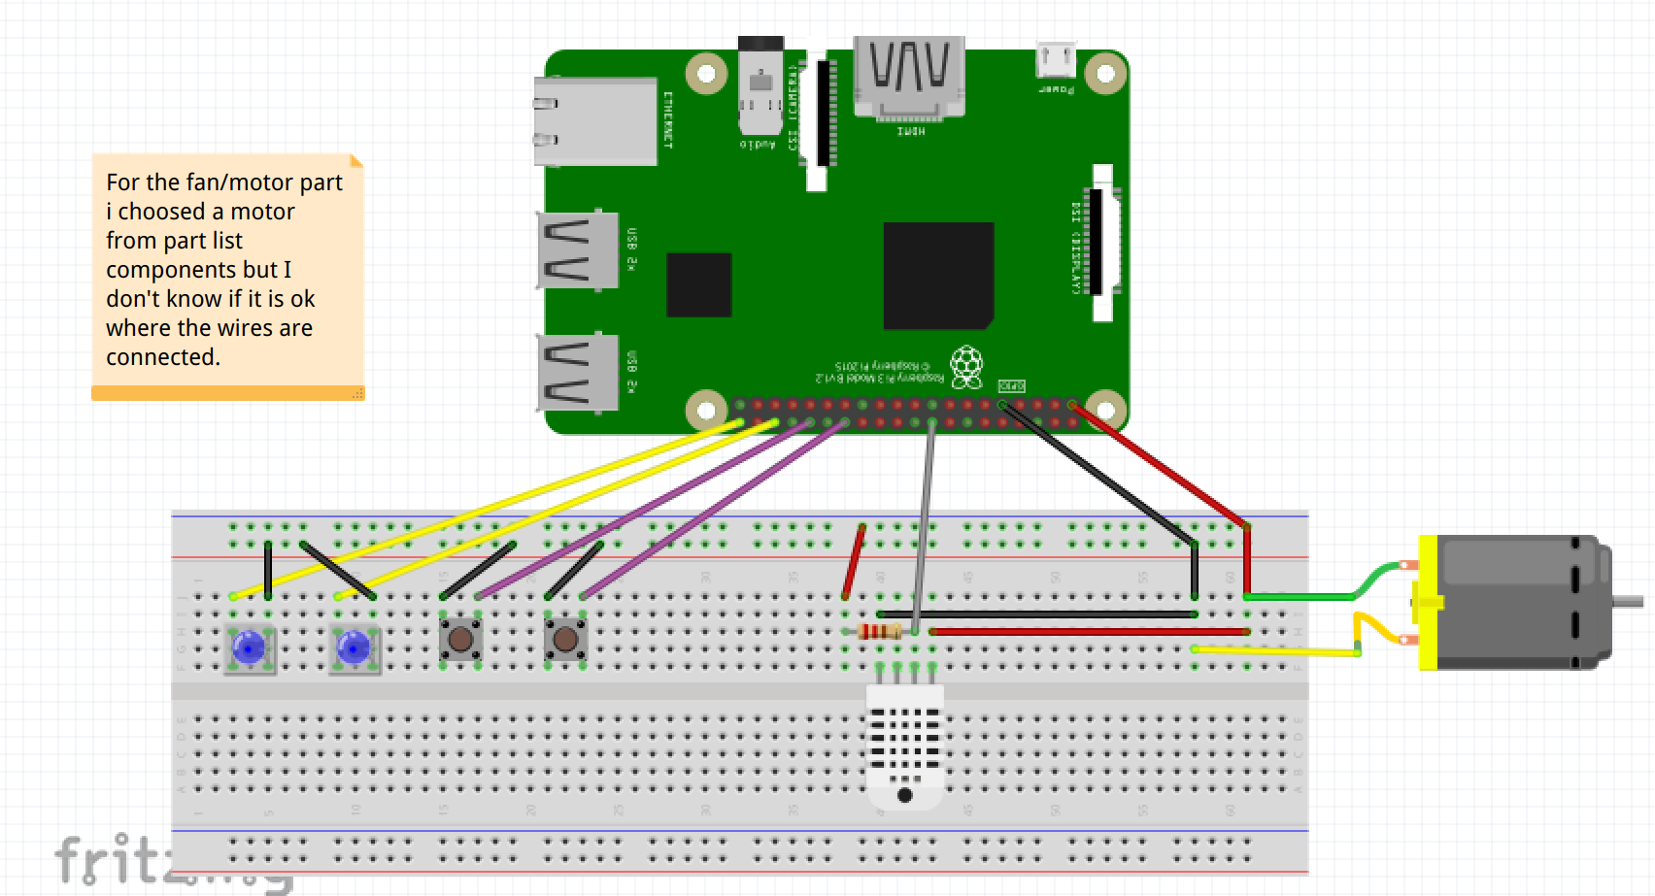
Hardware Design

Slide 6
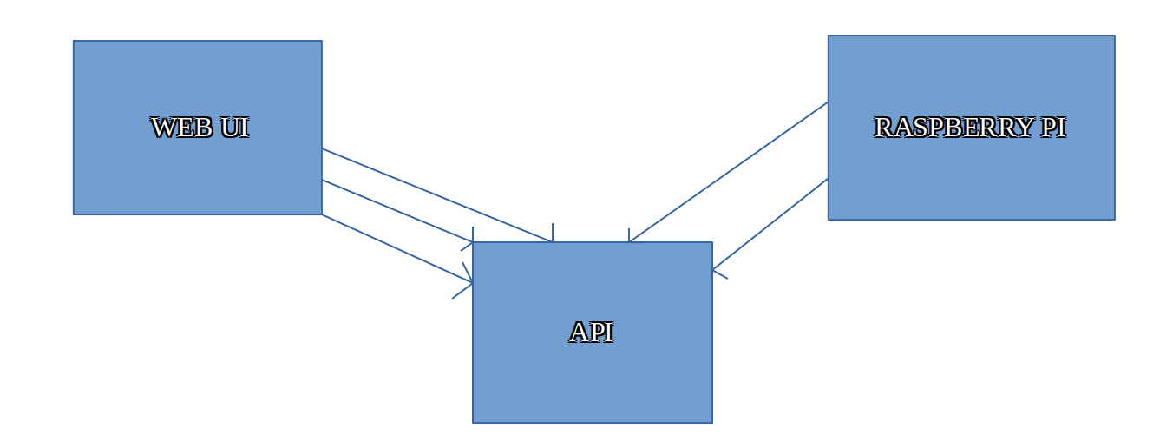
Software Design

Slide 7
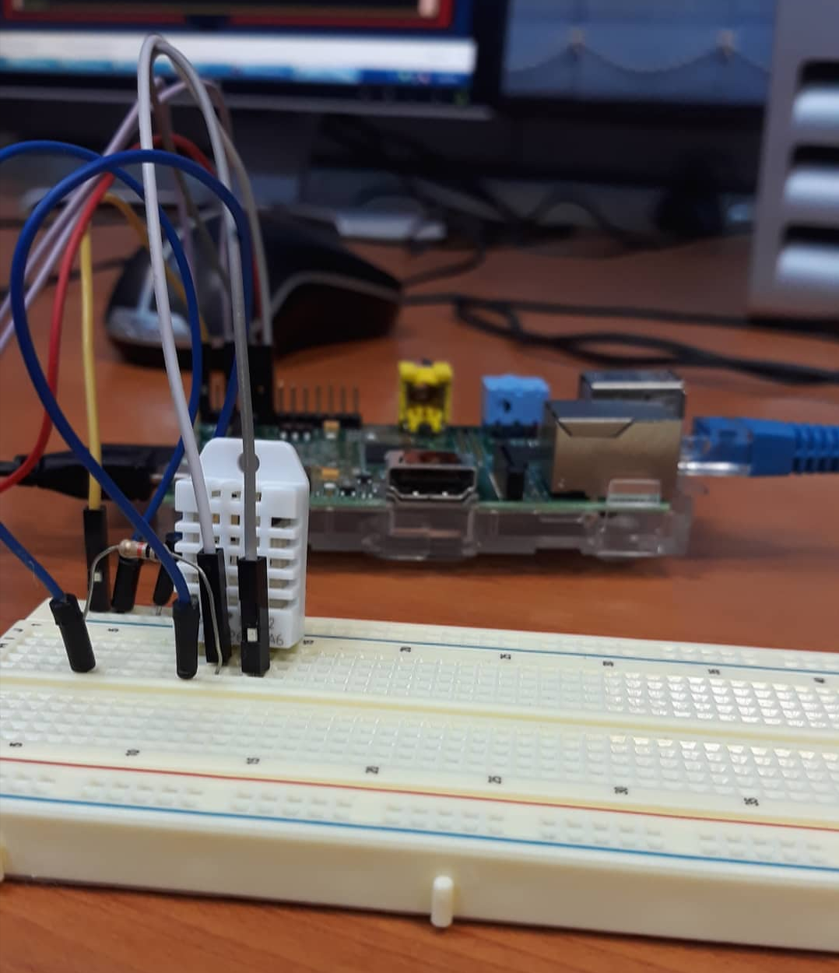
Results

Slide 8
Conclusion and future work
Future work:
Android Version
Improve Temperature and Humidity measurements
Option to store results

